Slide 1
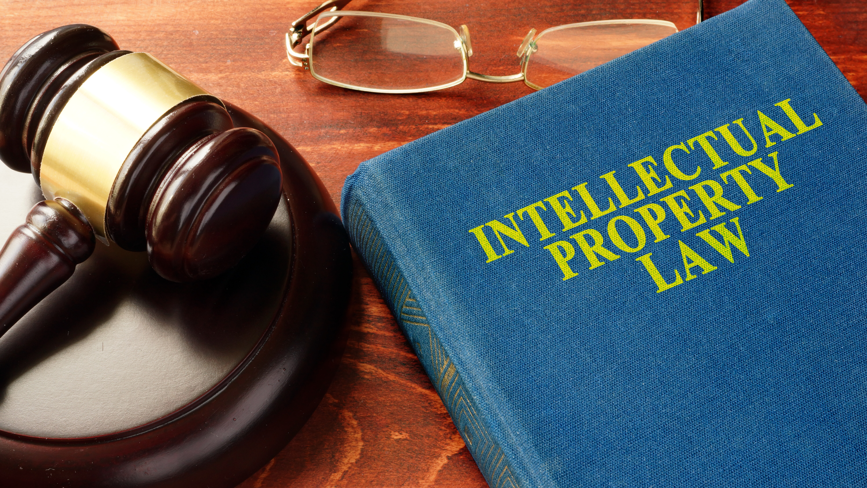
INTELLECTUAL PROPERTY RIGHTS IN HEALTH CARE
Pharmaceutical Law and Legislation

Slide 2

The concept of intellectual property in healthcare
The notion of “intellectual property” arose in the second half of the 20th centuryin connection with the signing the Convention establishing the World Intellectual Property Organization (WIPO) in 1967 in Stockholm.
According to the WIPO constitutive documents intellectual property includes rights related to the following objects:
literary, artistic and scientific works;
• performing activities of actors, sound recording, radio and television programs;
• inventions in all areas of the human activity;
• industrial designs;
• trademarks, service marks, trade names and commercial designations;
• other rights related to the intellectual activity in the production, scientific, literary and artistic fields.
Later, exclusive rights related to geographical indications, new plant varieties and animal breeds, integrated circuits, radio signals, databases, domain names were included in the scope of the WIPO activities

Slide 3
The concept of intellectual property in healthcare
Intellectual property means a temporary exclusive right fixed by the law, as well as personal non-property rights of authors to the result of the intellectual activity or means of individualization
The public relations the concerning the ownership, use and disposal of the results of the intellectual and creative activity regulated by the law is determined by the institution of the intellectual property law
The institute of intellectual property covers the objects of industrial property and the objects of copyright, related rights (intangible objects)

Slide 4
The concept of intellectual property in healthcare
Objects of the industrial property:
•inventions, industrial designs, trademarks;
•their legal protection is provided by patents.
Objects of Objects of copyright:
•literary, musical, artistic and scientific works;
•the protection of these objects provides the rights of their authors to allow or prohibit any attempts to use the works within a definite period of time

Slide 5
The right of intellectual property
TWO COMPONENTS:
•the personal non-property right of the author to the object created by him/her (the result of the intellectual activity),
•the property right to this result
Property right
ownership
right to use
right of disposal
Non-property right
authorship
right to the inviolability of the work
right to publish a work

Slide 6
The right of intellectual property
The personal non-property right belongs only to the author who created the object, and cannot be transferred to another person.
•they are unlimited and do not inherit;
•but heirs can protect these rights, and these powers of heirs are not limited by time limits
The property rightsinclude the right to own, use and disposal of the object of the intellectual property rights

Slide 7
The right of intellectual property
The personal non-property rights of intellectual property include:
•the right of authorship (to be recognized as the author of the object of the intellectual property rights);
•the right to a name (the right to use or authorize the use of the work under the author’s real name, pseudonym or without a name, i.e. anonymously);
•the right to inviolability of the work (the right to protect the work, including its name, from any change, reduction, addition and distortion);
•the right to publish an object of the intellectual property right (the right to publish or permit the publication of a work in any form, including the right to withdraw);
•other personal non-property intellectual property rights established by the law
The rights belong to the creator of the intellectual property object
In the cases provided by the law the rights may be transferred to other persons
The rights are valid for an indefinite period unless otherwise provided by the law

Slide 8
The right of intellectual property
Property rights of intellectual property are:
•the right to use the object of intellectual property rights;
•the exclusive right to authorize the use of the object of the intellectual property rights to other persons;
•the exclusive right to prevent the misuse of the object of the intellectual property rights, in particular to prohibit this use;
•other property rights of intellectual property established by the law
The essence of exclusive property rights to intellectual property lies in the monopoly on the potential profit
Concerning intellectual property the right to use means the right of its owner to receive a definite income from its use in economic circulation

Slide 9
The right of intellectual property
Disposal of the exclusive rightcan be in the following forms:
•alienation of the exclusive rightis a transfer full and complete from one person to another (the previous right holder completely loses the legal opportunity to use the object of intellectual property);
•the granting the right to use on the basis of a license agreement(the owner retains the exclusive right, and the licensee receives the right to use a limited amount, which is prescribed by the license agreement)
Property rights of intellectual property are valid within the periods established by the Civil Code of Ukraine, other laws or the contract

Slide 10
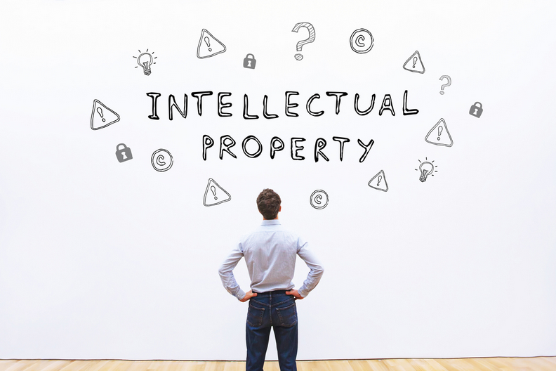
Objects of the intellectual property law
Objects of copyright
The
invention
Commercial
designations
Useful
models
Industrial
designs

Slide 11

Objects of the intellectual property law
Objects of copyright
among the objects of copyright that are actively used in the sphere of management should be noted:
•reports on the pharmaceutical development of medicines, the preclinical and clinical study of drugs;
•development of analytical normative documentation, projects of the instructions for medical use, etc.

Slide 12
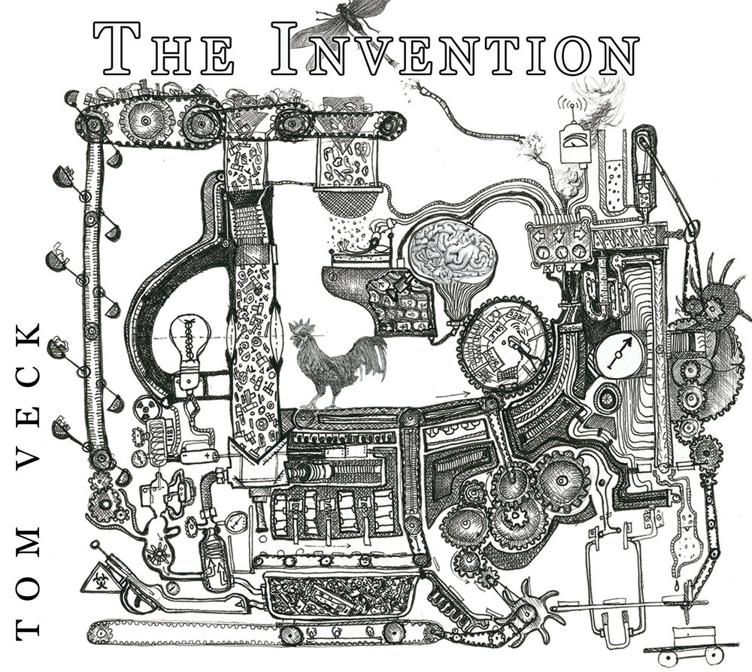
Objects of the intellectual property law
The invention is a technological (technical) solution in the form of an image, a product, or in the form of applying the previously known product, a method for a new purpose
•a new substance (compound) or a group of new chemical compounds united by a common structural formula;
•pharmaceutical composition (or drug composition);
•a method for producing a new biologically active chemical (compound) (a group of new chemical compounds) or a pharmaceutical composition;
•a method of treatment (or diagnosis) using a new chemical compound or composition based on it;
•the use of the known substances, in which the pharmacological activity was first detected or the known drugs for a new medical purpose

Slide 13
Objects of the intellectual property law
According to the current legislation, the conditions of patentability of the invention include:
•novelty,
•a definite inventive level,
•industrial applicability
Compliance with the following conditions is determined by the qualification expert examination, which is conducted by Ukrpatent (Ukrainian patent organization)

Slide 14

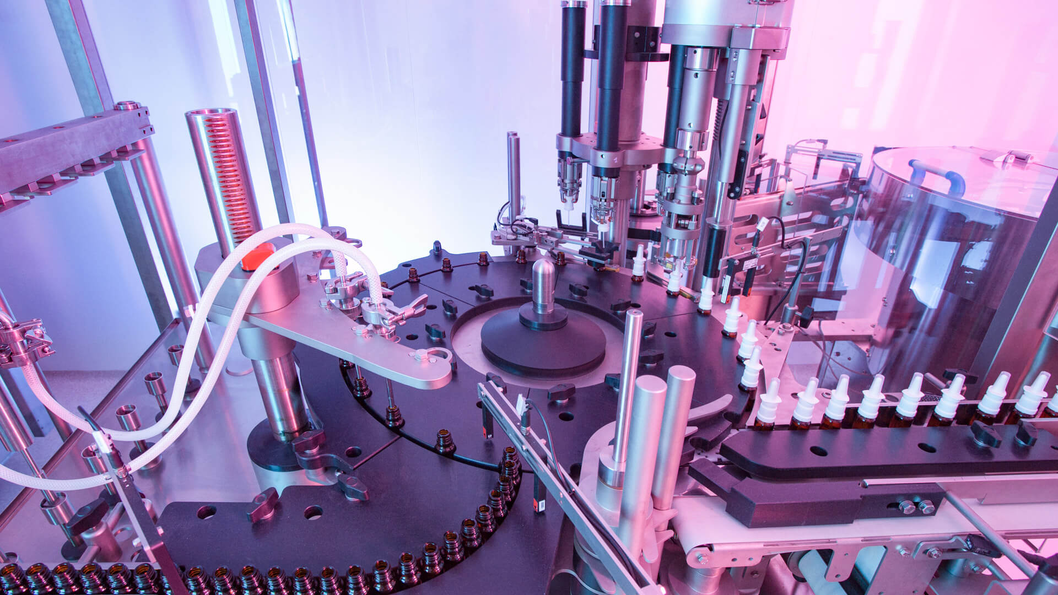
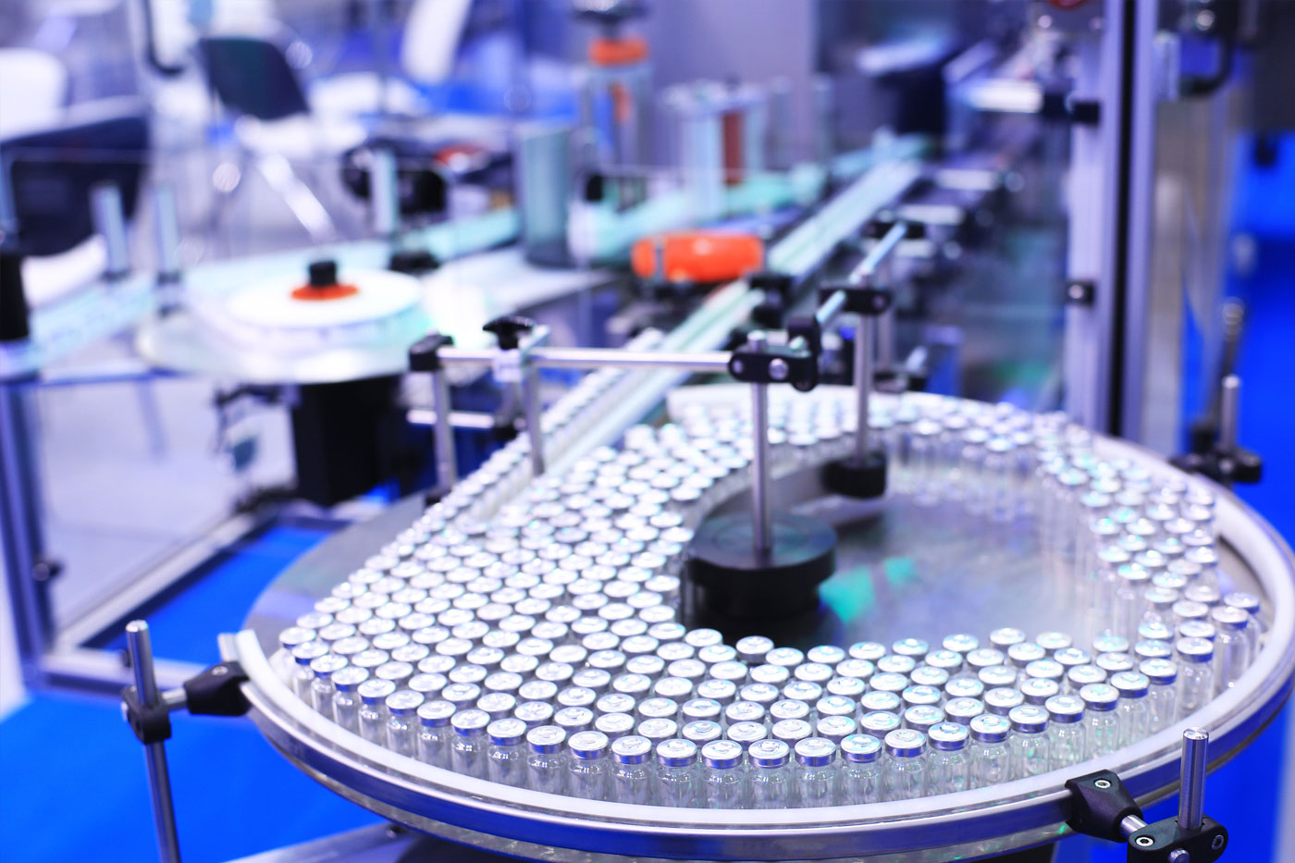
Objects of the intellectual property law
Useful models
unlike the invention, the inventive step is not required for the utility model; this means that any device, even quite obvious for a specialist, can nevertheless be recognized as a useful model, but, nevertheless, not described anywhere and not applied in practice, i.e., possessing world novelty
equipment for manufacturing medicines

Slide 15
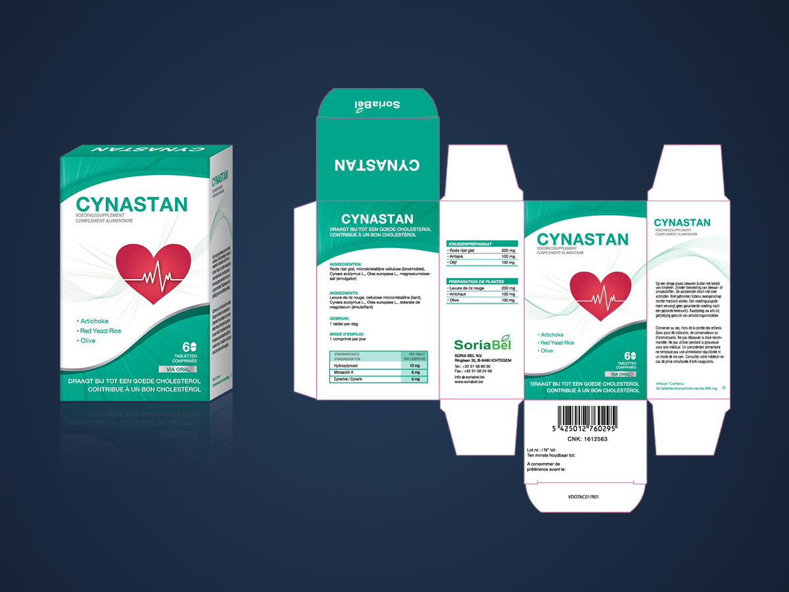
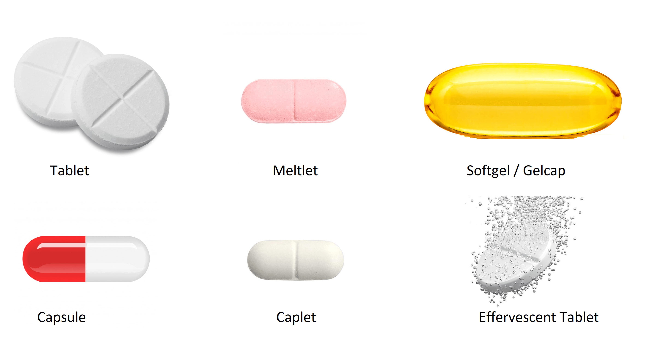
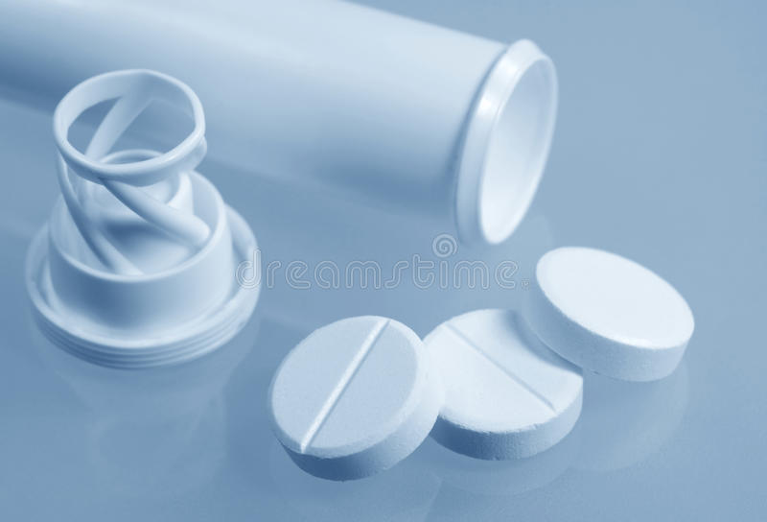
Objects of the intellectual property law
Industrial designs
are the artistic and design solution of a product of
industrial production, which determines its appearance
the object of the industrial sample is the appearance of the medicines (tablet form, packaging, etc.)

Slide 16
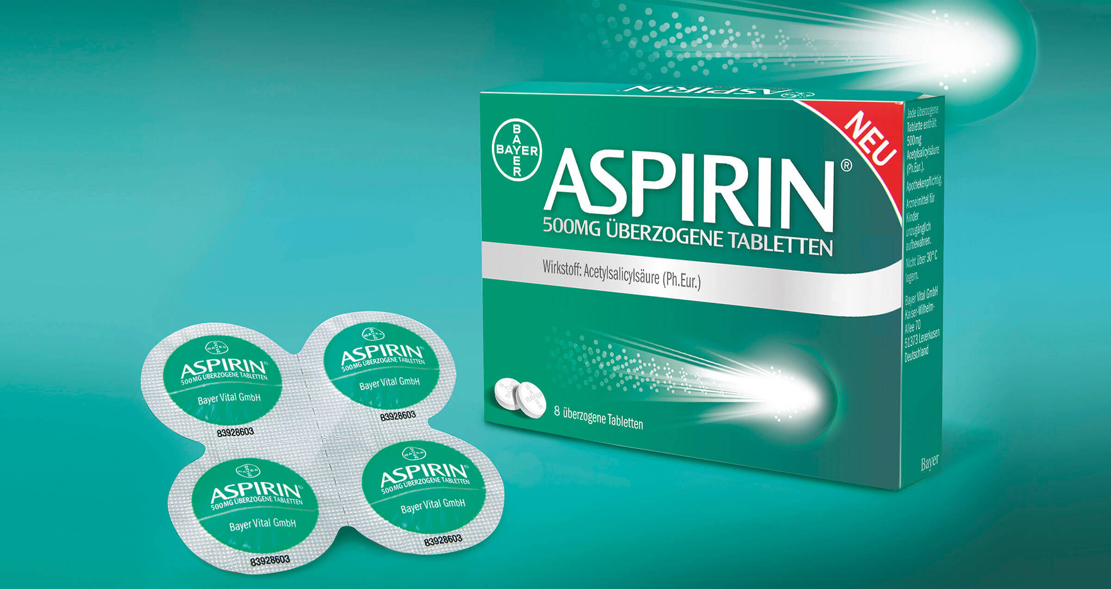
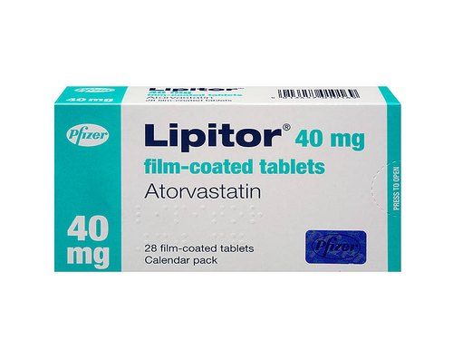
Objects of the intellectual property law
Commercial designations include:
the brand name of the manufacturer and its logotype
•the right of intellectual property to a company name is valid from the moment of the first use of this name and is protected without its obligatory registration;
•legal protection is granted to a commercial name if it does not mislead consumers about its current activities;
•information on the commercial name may be recorded in the registers, the procedure for keeping the register is established by the law;
the trade name of a medicinal product
•trade names allow consumers to distinguish medicines from one manufacturer from similar medicines of another;
•in accordance with the Law of Ukraine “On protection of the rights to marks for goods and services” dated December 15, 1993 No. 3689-XII they can be registered as signs for goods and services;
•the main task of the trademark is identification (medicinal product, its manufacturer, distributor);
•the owner of the trademark receives the exclusive right to use it. Exclusivity of this right is that third persons can use this sign only with the consent of the owner and under his/her control over the quality of the goods produced.

Slide 17
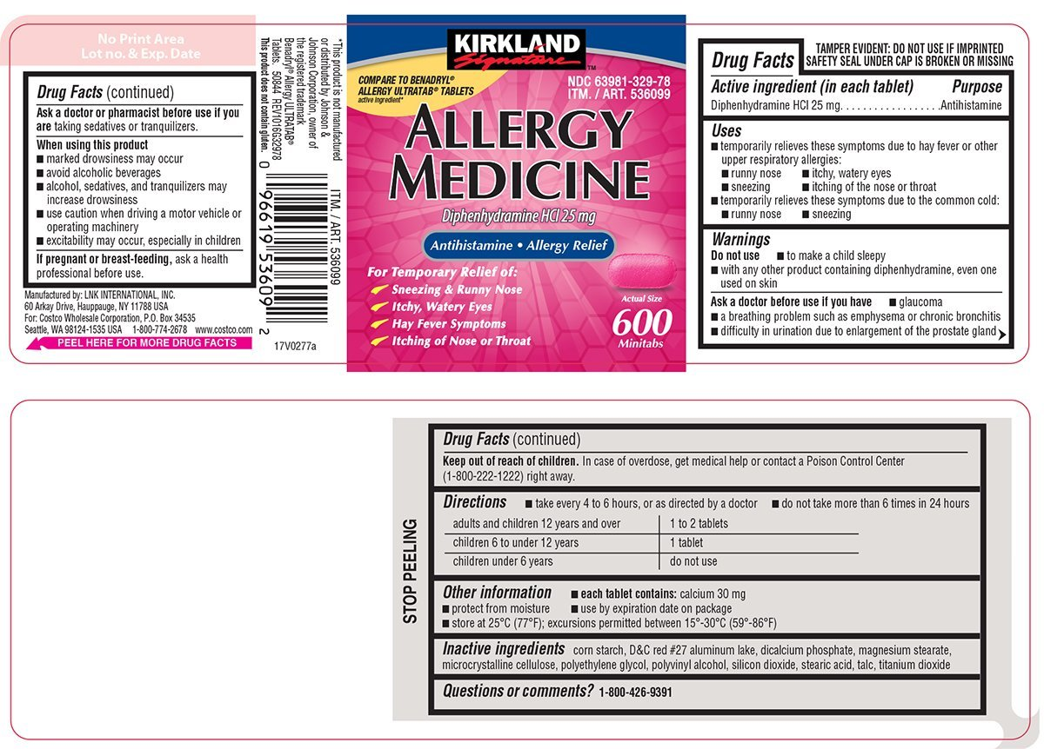
Objects of the intellectual property law
(commercial designations)

Slide 18
Objects of the intellectual property law
(commercial designations)

Slide 19
Legal mechanisms for protection of the intellectual property rights
The protection of rights is a set of measures aimed at the restoration and recognition of rights in the event of their violation, including the activities of the state bodies on the restoration and recognition of rights envisaged by the law, as well as removal of obstacles preventing the implementation of the rights and legitimate interests of their subjects
There are two main forms of protection -non-jurisdictional and jurisdictional:
•Non-jurisdictional form of protectioncovers the actions of citizens and organizations for protection of the intellectual property rights and legally protected interests that they carry out independently, without addressing for the assistance from the state and other competent authorities;
•the methods of self-defense can be chosen by the person himself/herself or established by an agreement or acts of the civil legislation, for example, an important way to ensure the protection of rights are negotiations between the subject of the intellectual property rights and the person who violates these rights during which one can convince the offender to stop the violation of rights and conclude an agreement on the lawful use of the intellectual property object.
•Jurisdictional form of protection is the activity of state authorized bodies for protection of violated or contested subjective rights;
•a person whose rights and legitimate interests are violated by unlawful actions apply for protection to competent state bodies, for example, to a court or the law enforcement bodies authorizedto take the necessary measures to restore the violated right and suppress an offense

Slide 20
Legal mechanisms for protection of the intellectual property rights
The international system for protection of the intellectual property rights is a complex mechanism implemented in accordance with multilateral international treaties, bilateral international treaties on the principle of reciprocity
Among the existing multilateral treaties in the field of copyright, it is possible to differentiate:
•treaties that are international in nature,
•treaties that are of a regional nature

Slide 21
Legal mechanisms for protection of the intellectual property rights
Treaties that are international in nature:
•Berne Convention for Protection of Literary and Artistic Works of 1886;
•World (Geneva) Copyright Convention, 1952;
•The WIPO Copyright Treaty of 1996;
•-Agreement on Trade-Related Aspects of Intellectual Property Rights of 1994 (TRIPS Agreement)
Treaties that are of a regional nature:
•Inter-American conventions (the Convention concluded in Montevideo in 1889, the Washington Convention of 1946);
•-Arab Copyright Convention of 1981;
•-EU directives

Slide 22
Legal mechanisms for protection of the intellectual property rights
Article 16 of the Civil Code of Ukraine established the methods of civil
protection used in violation of the intellectual property rights:
•recognition of the rights;
•recognition of the transaction as invalid;
•termination that violates the law;
•restoration of the situation that existed before the violation;
•compulsory performance of duties in kind;
•the changing of the legal relationship;
•termination of the legal relationship;
•compensation for the damages and other means of compensation for property damage;
•compensation for moral (non-property) damage;
•recognition of the decision, actions or inactivity of the state authority or the local government and their officials to be illegal

Slide 23
Conclusions
1.Intellectual property means a temporary exclusive right fixed by the law, as well as personal non-property rights of authors to the result of the intellectual activity or means of individualization.
2.The right of intellectual property has two components: the personal non-property right of the author to the object created by him/her (the result of the intellectual activity) and the property right to this result.
3.Based on the requirements for the creation, production and sale of medicines, as well as considering the scope of their application, in the pharmaceutical industry, one can distinguish the following objects of intellectual property: objects of copyright (development of analytical normative documentation, projects of the instructions for medical use, etc., should be noted); the invention(a new substance (compound), pharmaceutical composition (or drug composition), a method for producing a new biologically active chemical (compound) or a pharmaceutical composition, a method of treatment (or diagnosis) using a new chemical compound or composition based on it, the use of the known substances, in which the pharmacological activity was first detected or the known drugs for a new medical purpose); useful models(equipment for manufacturing drugs); industrial designs(tablet form, packaging, etc.); commercial designations(the brand name of the manufacturer and its logotype, the trade name of a medicinal product).
4.There are two main forms of protection -non-jurisdictional and jurisdictional.

Slide 24


