Slide 1
ODESSA NATIONAL MEDICAL UNIVERSITY
Department of Organization and Economics of Pharmacy
PERMISSION SYSTEM
IN THE FIELD
OF THE ECONOMIC
ACTIVITY

Slide 2

List of recommended literature
1. Pharmaceutical Law and Legislation : the textbook for applicants for higher education / A. A. Kotvitskaya, I. V. Kubarieva, A. V. Volkova, A. V. Cherkashyna, I. V. Zhirova, A. A. Surikov, I. A. Surikova. - Kharkiv : NUPh : Golden Pages, 2019. - 204 p.
2. Gordon E Appelbe, Joy Wingfield Dale and Appelbe’s Pharmacy Law and Ethics / - 9 edition. - London, Pharmaceutical Press, 2009 - 553 p. - ISBN 9780853698272
3. William E. Fassett Washington Pharmacy Law: A User’s Guide 2011 Edition. - 2011 - 446 p. -http://sop.washinqton.edu/imaqes/stories/pharmacv/public/ Pharm_544/11_Fassett_Washington_Pharmacy_Law_Users_Guide _2011.pdf
4. The Pharmacy Law. Excerpts from the Business and Professions Code. Board of Pharmacy Regulations. -http://www.pharmacv.ca.qov/laws_reqs/lawbook.pdf.
5. Law of Ukraine "On Medicines" №123\96-SS. - 4.04.1996. -http://www.pharma-cnter.kiev.ua/site/file_uploads/en/new_doc/law_en.doc
6. National Drug Policy. - 2003. -http://apps.who.int/medicinedocs/documents/s16450e/s16450e.pdf
3

Slide 3

PERMISSION SYSTEM IN THE FIELD OF THE ECONOMIC
ACTIVITY

Slide 4

a totality of relationships well-regulated by the legislation between regulatory authorities, administrators and business entities in connection with the issuance of authorization documents, as well as reissuance and withdrawal of authorization documents
THE PERMISSION SYSTEM
The basic principles of the state policy
in the field of economic activity
protection of rights, legal interests of society,
life of citizens ,protection of the environment and
providing of the state safety;
a permission, conclusion, decision, approval, certificate, other document, including in the electronic form, that must be issued by a regulatory authority to the business entity in the case of granting the rights in course of certain types of the economic activity
development of competition;
transparency of issuance procedure of authorization documents;
observance of the right equality for the business entities when issuing authorization documents;
responsibility of public officials of the regulatory authorities, administrators and business entities for the violation of requirements of the legislation on issues of issuing authorization documents;
a decrease of the level of the government control of the economic activity;
establishment of the uniform requirement to the order of issuance of authorization documents.

Slide 5
The functions of the permit system
Information
function
obtaining timely information concerning the activities of entities
Control
function
checking of the compliance with the rules set
Management
function
r
\
making decisions on the types and forms
Regulation
function
\
establishment of the definite rules of the state for economic entities through the laws and regulations

Slide 6
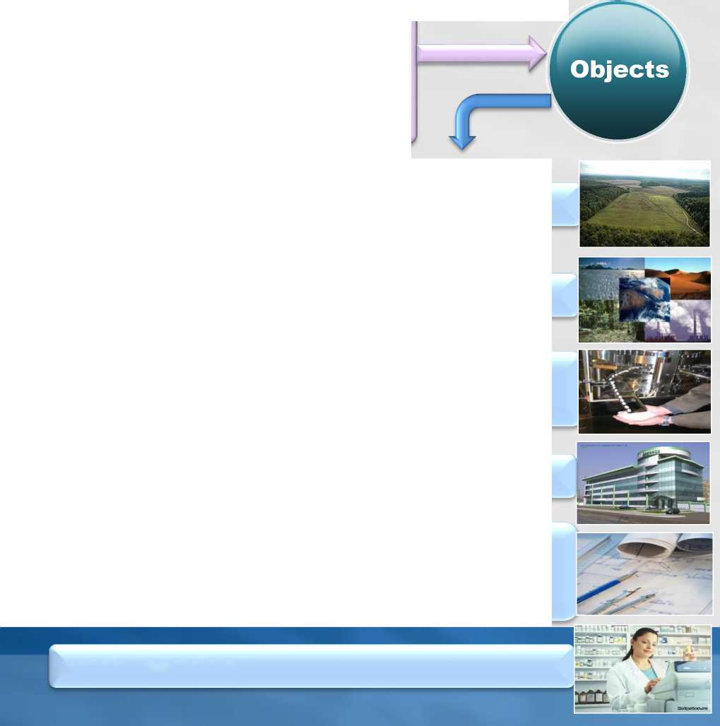

Elements of the permit system
Permission procedure is a totality of actions performed by administrators and regulatory authorities during registration and submission of authorization documents
Public
administrators
the soil land
Subjects
natural resources
Entities
Permission
agencies
facilities, equipment, mechanisms commissioned
Executive
authorities
construction, building, premises
documentation (design, land management, town-planning documentation)
Local government bodies
work, service
7

Slide 7

GENERAL PRINCIPLES OF STATE POLICY IN LICENSING

Slide 8

Principles and licensing functions
CONTROL - control of conditions to provide a certain level of pharmaceutical care
uniform state licensing system
territoriality
ACCOUNTING -implementation of unified accounting of all entities that are licensed
the principle of the rule of law
equalities of rights of the business entities
INFORMATION - keeping registration and storage | business entity that applied for registration
openness of the licensing process
the basic mechanisms of the government control for the activity of the legal and natural persons directed to the concordance of interests of business entities and society as a whole
priority of protecting the rights and lawful interests, life and human health, the environment, protecting the limited resources of the state and state security
STATISTIC - analysis of the dynamics of the market
PROTECTION - to ensure the protection of rights and interests as subjects and patients
LICENSING of the economic activity IN THE PHARMACEUTICAL SECTOR is the basis for solution the task of providing available and qualitative pharmaceutical aid

Slide 9

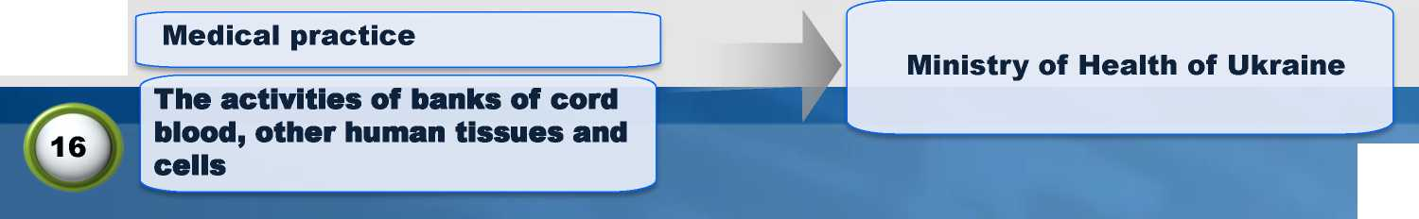
Types of activities subject to licensing
Types of the economic activity subjected to licensing
A LICENSE is a document issued by licensing authority for the right to implement a definite type of the economic activity by an economic entity
License Authority - executive power by the Cabinet of Ministers of Ukraine, State or authorized by law a collegial body
The Law of Ukraine "On licensing
of types of the economic activity"
■ Production of medicines
■ Compounding of medicines
■ Wholesale and retail sale of medicines
■ Import of medicines
10
State Service of Ukraine on Medicines and Drug Control
■ Cultivation of the plants included in the List of Narcotic Drugs, Psychotropic Substances and Precursors ■Development, production, compounding, storage, transportation, purchase, sale (dispensing), import, export, use, disposal of narcotic drugs, psychotropic substances and precursors included in the corresponding list
22
15
10

Slide 10

Licensing activities related to the production of medicines, wholesale and retail sale of medicines

Slide 11
The documents for obtaining a license
The aim of licensing
and standards
of the pharmaceutical activity
\
protection public health by ensuring that medicines and medical products meet definite standards of quality assurance and are manufactured in conditions that are clean and free of contaminants
The documents for obtaining a license
for the production (manufacturing):
- A copy of the dossier of the production site
For wholesale and retail:
1. Statement installed form (Application form)
2. Supporting documents
3. List of submitted documents
- Information on the availability of the necessary material and technical base and the qualification level of employees (the prescribed form and content for each individual type of the activity subjected to licensing)
To import:
- A copy of the importer's dossier file

Slide 12

Requirements retail medicines under
licensing conditions
1. Having all the necessary facilities, equipment and facilities for proper storage and trafficking of medicines
2. The presence of the required number of employees who meet eligibility requirements
3. The presence of the necessary conditions for accessibility of persons with disabilities to pharmacy
4. Compliance with manufacturer-defined general and specific storage conditions of medicines
5. Availability of Qualified Person
6. Compliance to ensure medicines quality control and availability urgent action plan for withdrawal from medicines sales
7. Pharmacy and its structural divisions shall be provided with legal acts concerning pharmaceutical activities

Slide 13


Licensing of online pharmacies
Since 1st of July 2015, all online pharmacies or retailers legally operating in the EU have to display the common logo adopted by the European Commission through the Falsified Medicines Directive. The common logo shows the flag of a specific EU Member State and text. By clicking on it, the logo helps verify the safety of the website by redirecting to a list of online pharmacies legally operating in that country. You can find more information on how it works here .
BUYING MEDICINES ONLINE
rr
THINK YOU KNOW WHAT YOU ARE GETTING?
https://ec.europa.eu/health/human-use/eu-logo_en
Click to verify if this website is operating legally ft
False medicine can kill. Use the logo. Stay safe.

Slide 14
Control questions
1. What is the permission system in the field of the economic activity?
2. What are general principles of state policy in licensing?
3. What are types of activities subject to licensing?
4. Define requirements retail medicines under
licensing conditions

Slide 15

Thank you for attention!

