Slide 1
ODESSA NATIONAL MEDICAL UNIVERSITY
Department of Organization and Economics of Pharmacy
PHARMACEUTICAL LAW AND PHARMACEUTICAL LEGISLATION. NORMATIVE AND LEGAL REGULATION OF PHARMACEUTICAL ACTIVITY.

Slide 2
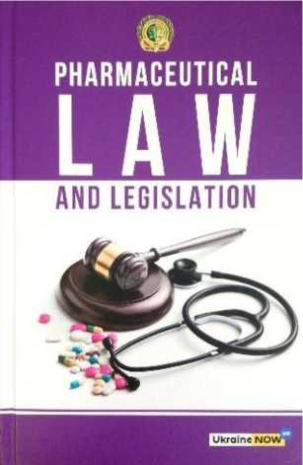
List of recommended literature
1. Pharmaceutical Law and Legislation : the textbook for applicants for higher education / A. A. Kotvitska, I. V. Kubarieva, A. V. Volkova, A. V. Cherkashyna, I. V.
Zhirova, A. A. Surikov, I. A. Surikova. - Kharkiv : NUPh : Golden Pages, 2019. - 204 p.
2. Gordon E Appelbe, Joy Wingfield Dale and Appelbe’s Pharmacy Law and Ethics / - 9 edition. - London, Pharmaceutical Press, 2009 - 553 p. - ISBN 9780853698272
3. William E. Fassett Washington Pharmacy Law: A User’s Guide 2011 Edition. - 2011 - 446 p. -
http://sop.washinqton.edu/imaqes/stories/pharmacv/public/ Pharm_544/1 1_Fassett_Washington_Pharmacy_Law_Users_Guide _2011.pdf
4. The Pharmacy Law. Excerpts from the Business and Professions Code. Board of Pharmacy Regulations. -http://www.pharmacv.ca.qov/laws_reqs/lawbook.pdf.
5. Law of Ukraine "On Medicines" №123\96-SS. - 4.04.1996. -http://www.pharma-center.kiev.ua/site/file_uploads/en/new_doc/law_en.doc
6. National Drug Policy. - 2003. -http://apps.who.int/medicinedocs/ documents/s16450e
3

Slide 3
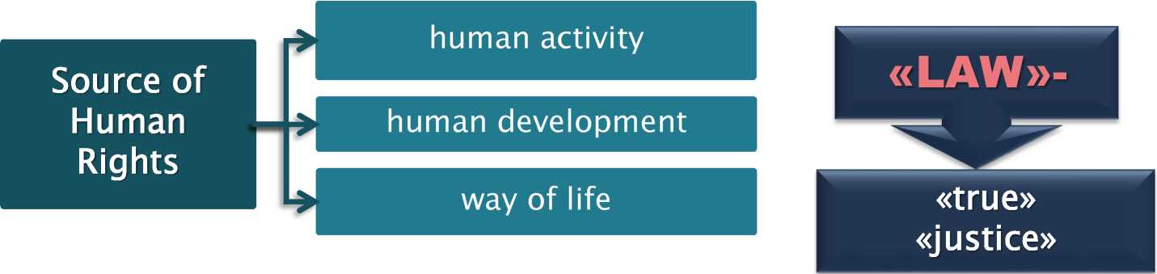
The general concept of the term «LAW»
overall social law
juridical law
the norm is a habit ("norm-custom“)
"moral norm"
Right to require the exercise of corporate
rights "legal norm"
overall social law
comes directly from social life and is independent of the state
THE LAW
a system of compulsory rules of behavior (norms) set, sanctioned and protected by the state, they express the nation-wide and individual interests of the population of the country and act as the state regulator of public relations
juridical law
consequence of state activity

Slide 4
Occurrence of the law
individual control Orderly behavior of a particular person in a particular case | social regulation The direction of human behavior and society through social norms and to maintain order in society | regulatory control Orderly behavior by the general rules applicable to all such cases
Feauters
Unwritten rules
Voluntary compliance
enforcing
authority elders genus
protection was achieved with custom "taboo" - a mandatory ban
«Norm-custom» -rules of conduct in a primeval society:
Genus
Community
tribe
Occurrence and development of the law
regulation
economic activity
morality
religious and ritual activities
relationships of family members

Slide 5
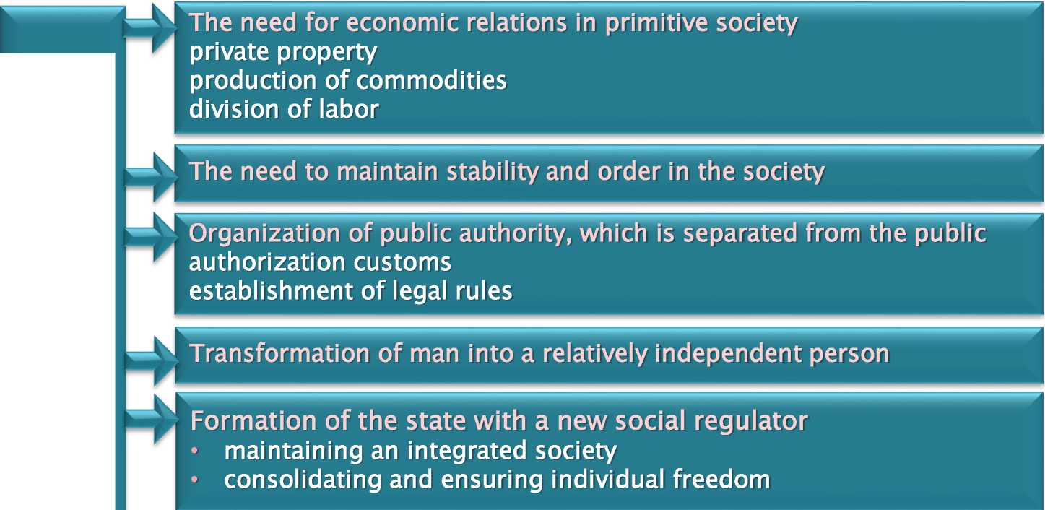

The main causes of the State and Law
The main causes of the State and Law
The tasks facing the developed primitive communal society is not possible with the «Norm-custom»
Formation of a
legal right

Slide 6

Constitutional state - the origins and formation
Legal state XIX c.
Social State XX c.
SOURCES
Position of the ancient authors of the legal state
on the rule of law as a combination of force and law (Aristotle, Solon);
of the difference between right and wrong forms of government (Socrates, Plato);
of the difference between natural and positive law, and their ratio (Aristotle, Democritus);
human equality on natural law (Roman law);
of law as a measure of fairness, regulatory norms of communication (sophists, Cicero, and others);
of the state as the legal union of people (Cicero); spheres of public and private law, the legal entity or entities (the Ro lawyers)
SOCIAL STATE - political organization of the society in which the right associates and subordinates state power. The fundamental rights of the individual and social security are the content of freedom, based on the laws that are promulgated and amended in the prescribed manner.

Slide 7
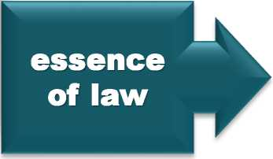



Right - its definition and characteristics
LAW - system of rules, the
principles established and defined by the state as a regulator of social relations that:
._
• formalizes the degree of freedom, justice, equality, population
• ensure compliance with the legal means
Regulator of public relations, which is expressed in the unity and general social group interests through government consolidation degree of freedom, equality and justice
Value -
normative
aspect
law is a measure of justice (legitimate order)
law aims at regulating social relations
Branch off law - is a component of the right, separated by a set of rules of law that govern certain qualitatively similar public relations

Slide 8
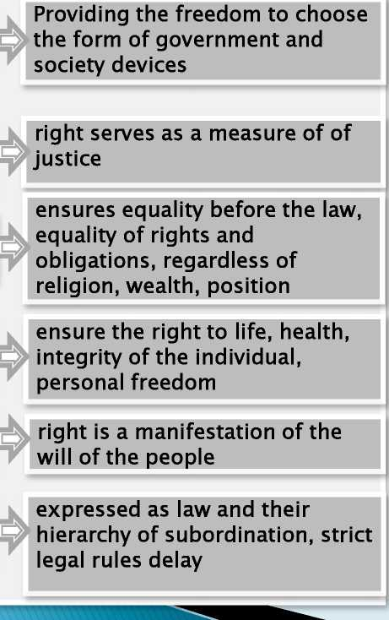
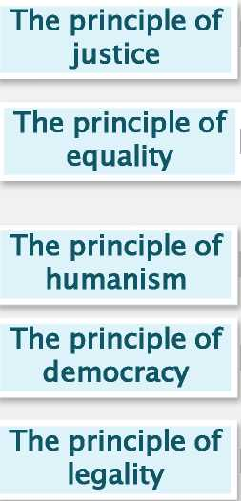

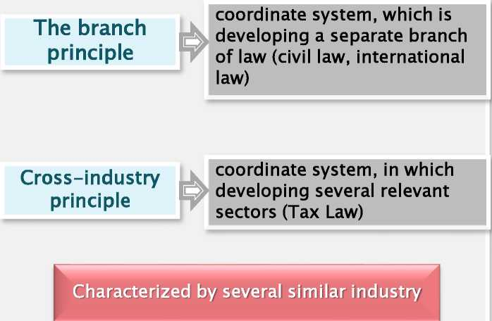
General principles of law
Principles Of law - mandatory requirements are put forward to the participants of public relations to the harmonious union of individual
group, the public interest.
overall social Specifically - social
principles Q (legal) principles Q
The principle of freedom
The general principles |  | coordinate system, in which developing national legal system and the vector that
 |  | defines the direction of
11

Slide 9



Functions law - main areas of legal influence on social relations
with a view to streamlining.
Information
informing citizens about ways of regulating social relations, rights and obligations
Regulatory
Legal
Information
ordering of social relationships
orientation
orientation of citizens to the legal provisions and regulations
_J
Security
Legal
behavior
providing legal protection and state bans on illegal activities, the use of legal sanctions
educational
general legal impact on the spiritual sphere of human development of respect for the law
legal
training
12

Slide 10

THE LAW SYSTEM AND THE LEGISLATION SYSTEM
THE LAW SYSTEM
THE LEGISLATION SYSTEM
a set of ordered and mutually
a coherent set of regulatory
• the conditionality of the objective development of public relations;
• the primacy of the rule of the law as an element of the law system;
• the presence of norms, institutions, sub-sectors and branches of the law in the structure of the law system;
• a set of rules of the law, which are regulated in a definite way and creating the system.
• the external form of existence of the main part of the law system;
• the way of providing the legal (formal) value to the norms of the law formed in the society;
• the completeness of rules of the law through the primary elements - the regulatory requirements contained in the articles of the law;
• the presence of a two-level structure -vertical (hierarchical, subordinate) and horizontal (equivalent).
13

Slide 11
Formation of law in the world
The type of the legal system is a set of the basic legal features belonging to a definite group of legal systems.
Roman-German
(continental)
Anglo-Saxon (common law)
Mixed (convergent) (Scandinavian and Latin American types)
Custom + solution tribal of assembly —> formation of judicial precedent (the decision of individual cases and the subsequent development of models of general rules) —> harbingers case law
Occurrence the rule of law established by acts of the king, the prince —► formation law enacted law
legal
systems
• France
• Spain
• Austria
• Germany
• Ukraine
* England
• USA
• Canada
* Australia
Traditional religious
15

Slide 12
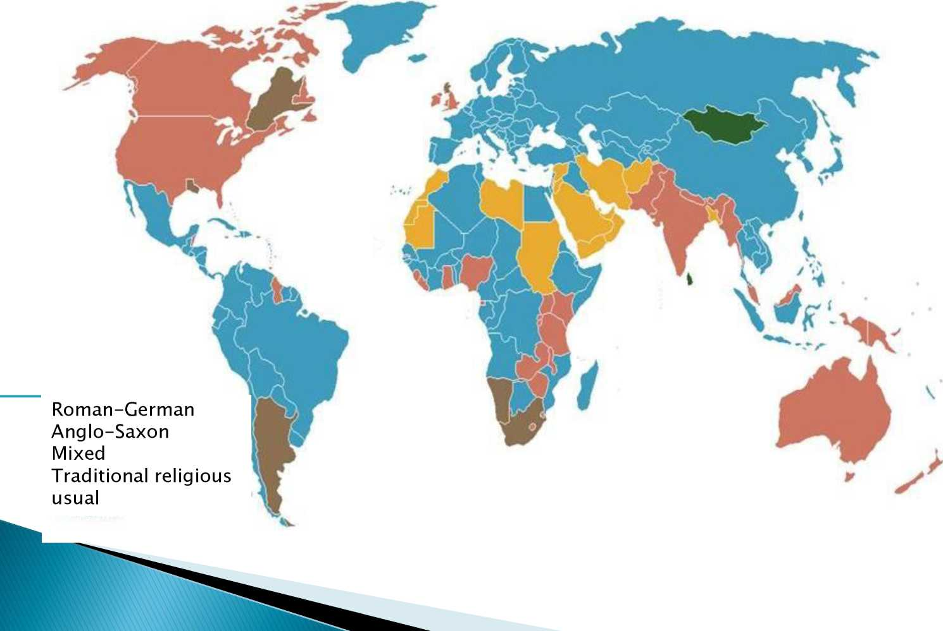
MAP OF THE LEGAL SYSTEMS
16

Slide 13

Types of legal acts
A NORMATIVE LEGAL ACT
an official act document adopted by authorized normative subjects in a definite form and order, which establishes (changes, cancels, adds) legal norms for the regulation of public relations, its main functions are the function of the legal source of the law and the function of the form of the law
Law — legal act legislative body of the state or of the people who accepted and changed in a special manner regulates major public relations and has supreme legal force with respect to all other legal acts.
Sub-normative legal acts - acts that have an auxiliary character, determine the rights and duties of those
specific subjects addressed to a specific case.
> Decrees
> Resolution
> Instructions
> Orders
> Disposal
> Decision

Slide 14
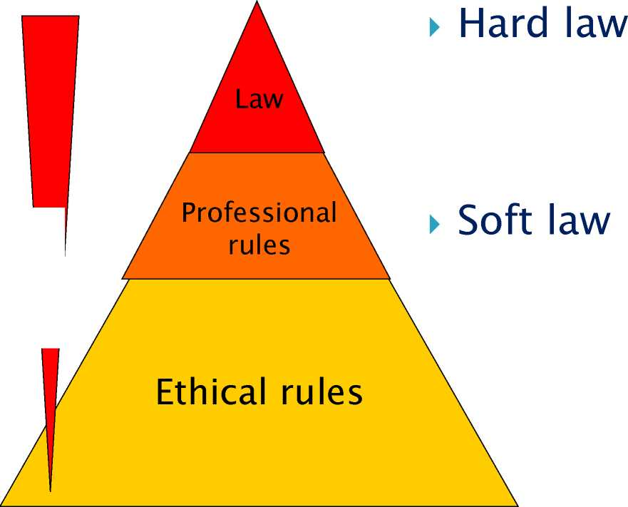
Hierarchy of the rules...
► Constitution
► Acts of Parliament
► Governmental Decree
► Minister’s Decree (Municipality Decree)
► ministerial guidelines
► methodological letters of National Boards/Institutes
► scientific literature
HIERARCHI
19

Slide 15
Hierarchy levels | Legal act | State registration | Publication | The period of entry into power
Higher level | The Constitution of Ukraine | Publication in the Uniform State official printed Register of Legal sources in Acts 15 days after adoption |  | In 10 days after the publication if otherwise is not specified by the legal act
Level 1 | Codes of Ukraine; The laws of Ukraine; other legal acts of the Verkhovna Rada (Parliament) Decrees of the President
Level II | Resolution of the Government (CMU) |  |  | After publication
Level III | Orders of the Ministries and agencies | Ministry of Justice of Ukraine | Published in specialized publications | In 10 days after registration
Level IV | Legal act of the local executive authorities | Department of Justice in regions and districts | Mass media of the local authorities
20

Slide 16

Community
law
National
law
Community law-makers: the EU Parliament and the EU Council (as a rule, together)
taken from Community directives
if no Community law:
Member States are empowered to issue national law
the EU Commission (if supported by the 2/3 of the Member States in the Standing Committee)
Types of Community law:
• Regulation issued in all Member States’ languages, coming at once into force • Directive every Member State must place it into its legislation (+2-3 years)
22

Slide 17
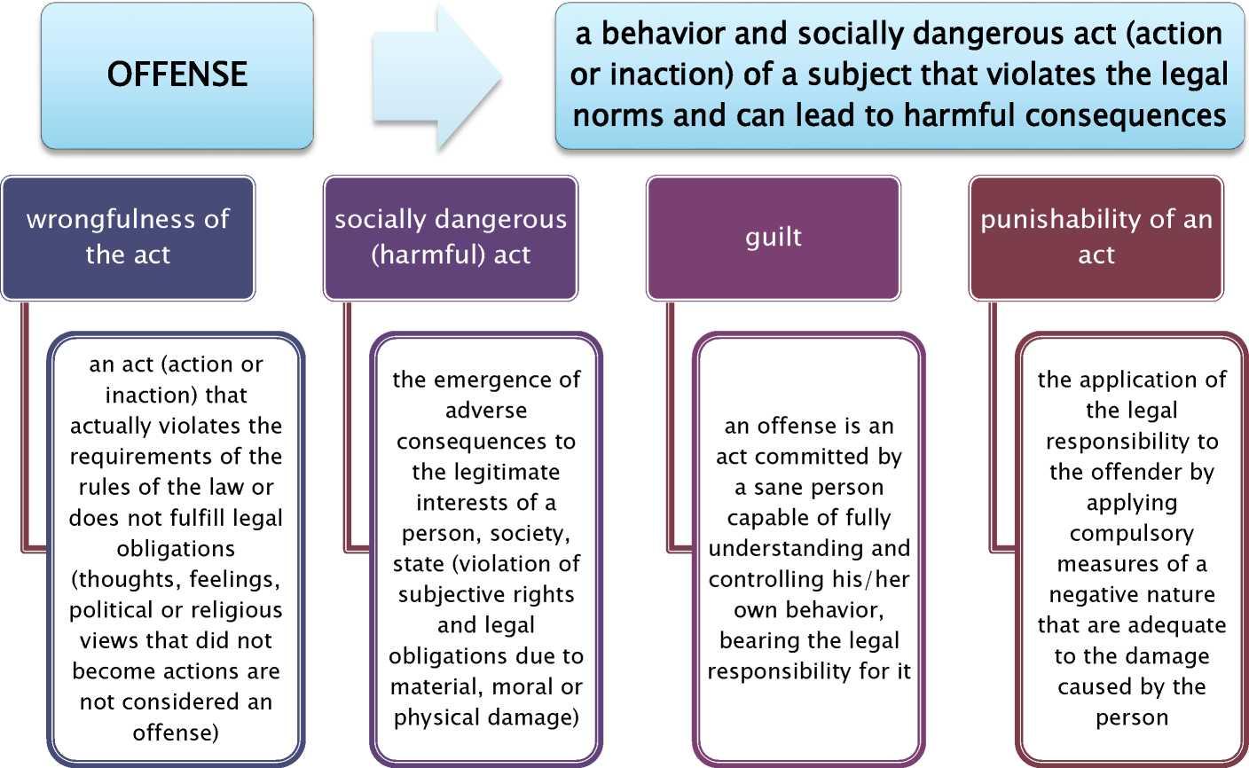

CRIME is a socially dangerous, unlawful, guilty and punishable act that inflicts or can cause a significant harm to particular public relations according to the criminal law
24

