Slide 1
REGULATORY AND LEGAL SUPPORT FOR
TURNOVER OF VARIOUS NOMENCLATURE AND
LEGAL AND CLASSIFICATION-LEGAL DRUG
GROUPS
Pharmaceutical Law and Legislation

Slide 2
The definition of classification legal group (CLG) of drugs
group that indicates the safety profile of the
effect of drugs on the patient’s body
Toxic substances
Potent drugs
Narcotic drugs
Analogs of narcotic
drugs and psychotropic substances, as well as drugs of the general list
Psychotropic
substances
Precursors

Slide 3
90% of the amount consumed narcotic substances in the United States took a non-medical use;
annual volume of consumption of opiates in China amounted to more than 3 000 tones in morphine equivalent.
the First International Opium Conference -the first international drug control treaty
The Hague, 23 January 1912
International Opium Convention
China, France, Germany, Italy, Japan, the Netherlands, Persia (Iran), Portugal, Russia, Siam (Thailand), the UK and the British oversees territories (including British India)

Slide 4
Normative and legal regulation in the fight against narcotics at the international level
Year of adoption | Name of the document
1961 | Single Convention on Narcotic Drugs (As amended by the 1972 Protocol amending the Single Convention on Narcotic Drugs, 1961)
1971 | Convention on Psychotropic Substances (Including Final Act and Resolutions, as agreed by the 1971 United Nations Conference for the Adoption of a Protocol on Psychotropic Substances, and the Schedules annexed to the Convention)
1988 | United Nations Convention against Illicit Traffic in Narcotic Drugs and Psychotropic Substances
Agreement on cooperation between states in this area

Slide 5
Major problems associated with the control of the turnover of CLG of drugs
the problem of unequal access to controlled substances at the international level
insufficient effectiveness of current international conventions on drug control
Their solution requires actions at the international, regional, national and local levels!
ACHIEVEMENT
Three international conventions on drug control have joined almost all countries
International system for the control of precursor chemicals that were used in the illicit manufacture of drugs was created
At the international level the leakage of narcotic drugs and psychotropic substances was stopped almost completely

Slide 6
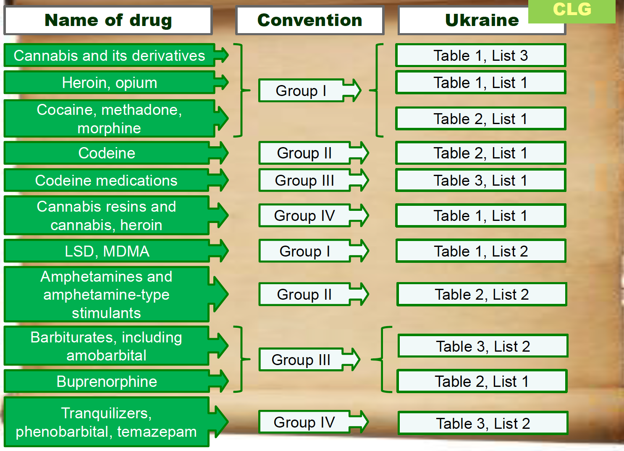
The comparative analysis of approaches to the classification of controlled groups of drugs in international practice and Ukraine

Slide 7
Classification of narcotic drugs, psychotropic substances and precursors
(Government Decree № 770 from 6.05.2000)
Group name, characteristic |  | Measures to limit turnover
I Especially dangerous substances
Narcotic drugs (list1) psychotropic substances (list2) |  | FORBIDDEN: •Activity on the cultivation of plants •Any other activity that is related with drugs’ turnover LIMITED: •Use for industrial purposes •Availability of license COMPULSORY: •Number determined by the size of quotas of government
Plants containing narcotic drugs and psychotropic substances (list3)
Allowed to use in:
Expert activities
Operational and investigative activities
Scientific and educational activities

Slide 8
Restriction of turnover of narcotic drugs, psychotropic substances and precursors
Group name, characteristic |  | Measures to limit turnover
II Drugs which turnover of is limited
narcoticdrugs(list1) psychotropic substances(list2) |  | PERMITTED: •Use in medical practice on prescription •Use in veterinary medicine •Use expert and operational and investigative activities •Use in scientific and educational purposes LIMITED: •Availability of license is necessarily FORBIDDEN: •Use for other purposes
precursors (lists1,2) |  | PERMITTED: •Purchase and use within industrial purposes, including in medical practice LIMITED: •Availability of license is necessarily FORBIDDEN: •Wholesale implementation by retailers

Slide 9
Restriction of turnover of narcotic drugs, psychotropic substances and precursors
Group name, characteristic |  | Measures to limit turnover
III Drugs which turnover is limited and for which the exclusion of definite control measures is permitted
narcotic drugs (list 1) psychotropic substances (list 2) |  | PERMITTED: •Use in medical practice on prescription •Use in veterinary medicine •Use expert and operational and investigative activities •Use in scientific and educational purposes LIMITED: •Availability of license is necessarily FORBIDDEN: •Use for other purposes •as part of combined drugs •in small doses

Slide 10
The main activities related to turnover in narcotic drugs, psychotropic substances and precursors
cultivation of plants
Development
Manufacture
Preparation
Storage
transportation
Purchaise
sales (dispensing)
importation into the territory of Ukraine
export from the territory of Ukraine
Use
disposal
Types of activities related to narcotic drugs, psychotropic substances and precursors circulation in the territory of Ukraine are
subject to licensing
by the State Service of Ukraine on medicines and Drugs Control

Slide 11
DOCUMENTS for obtaining a license to one or more type of activities, that related to narcotic drugs, psychotropic substances and precursors turnover
Application
notarized copies of statutory documents
information on conformity its material and technical base, the availability normative legal documents, information on the qualifications of employees, who have or will have access to controlled drugs directly (certified by signature of the applicant)
notarized copy of the certificate of specialist that confirms professional competence of head for the implementation of the licensed activity
certificate of state or municipal hospital about the absence of psychiatric disorders, that associated with the abuse of alcohol, narcotics or psychotropic substances in workers, who will have access to controlled drugs
Certificate of Ministry of Internal Affairs of Ukraine on the absence unremoved criminal record of employees, who have or will have access to controlled drugs
Permission of Ministry of Internal Affairs of Ukraine on using the objects and premises for activity, that related narcotic drugs, psychotropic substances and precursors turnover
Conclusion of state sanitary-epidemiological service, that the available premises are comply with the requirements of sanitary norms and rules

Slide 12
Dispensing of narcotic drugs, psychotropic substances and precursors from pharmacies to patients
A PRESCRIPTION
special prescription form No. 3 (f-3)
prescription form No. 1 (f-1)
approved by the Order of the Ministry of Health of Ukraine of August 7, 2015 No. 494
approved by the Order of the Ministry of Health of Ukraine of July 19, 2005 No. 360

Slide 13
Procurement and sale of narcotic drugs, psychotropic substances and precursors
Purchase and sale | Terms | Notes
The purchase and sale in quantities that exceed the maximum permissible limits (wholesale trade) | Exclusively between entities that have the license for activities, that related to narcotic drugs, psychotropic substances and precursors turnover | Substances producer – drugs producer; drugs producer – pharmacy warehouse; pharmacy warehouse – pharmacy; pharmacy warehouse – hospital; Pharmacy – hospital.
Retail sale | The pharmacies of all forms of ownership (legal entities) at presence of licenses for this activity
Purchase of physical person | For medical indications by prescription | The pharmacy with an associated license

Slide 14
Import, export and transit through Ukraine narcotic drugs, psychotropic substances and precursors, including preparations containing them in quantities that exceed the maximum permissible
Is carried out on basis of permission issued by the SSDC
Through checkpoints across the customs border of Ukraine, which list is approved by the Government decree N 1950 from 25.12.2002, as amended on 03.06.2009

