Slide 1
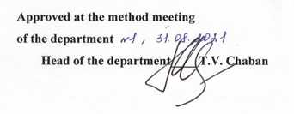
ODESSA NATIONAL MEDICAL UNIVERSITY
DEPARTMENT OF INFECTIONES DISEASES
LECTURE OUTLINES
A discipline «Infectious diseases»
Lecture № 1 «INTRODUCTORY
LECTURE.»
Year 4
Faculty international
Specialty 221 «Dentistry»

Slide 2

INTRODUCTORY
LECTURE

Slide 3
More than 30 before unknown pathogenic pryonov, viruses, chlamidies and bacteria were opened from 80th of the last century.
Exciters of infectious diseases, opened for the last 25 years
Etiologic factor | Disease
HIV-1, HIV-2 | AIDS, HIV-infection
Virus of hepatitis С | Hepatitis С
Borrelia burgdorferi | Borreliosis (Laime disease)
The Guanaryto virus | Venezuelan hemorrhagic fever
The Sabia virus | Brazilian hemorrhagic fever
Pryons | The Kroyttsfel'dta-Yakoba disease, kuru, Gerstmana-Strausslera-Sheykera syndrome, fatal domestic insomnia, the Al'persa disease,
Virus of heavy sharp respirator syndrome (SARS) | Heavy sharp respirator syndrome
Ehrlichia senettsu | Erlykhyosis senetsu
Virus grippe A (H7N1) | Grippe A (Hong Kong), bird

Slide 4
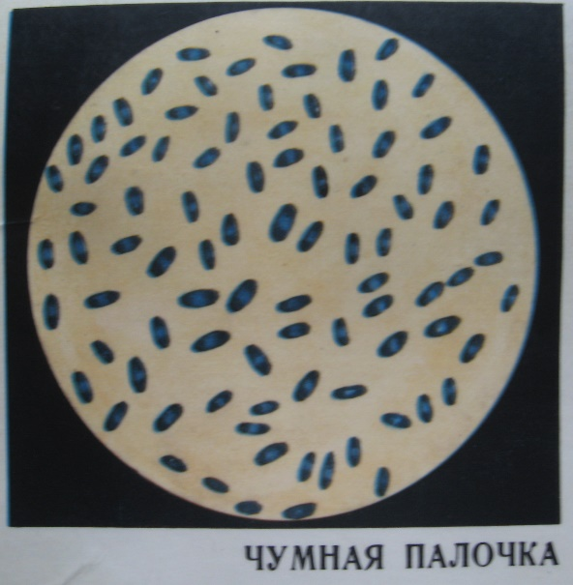
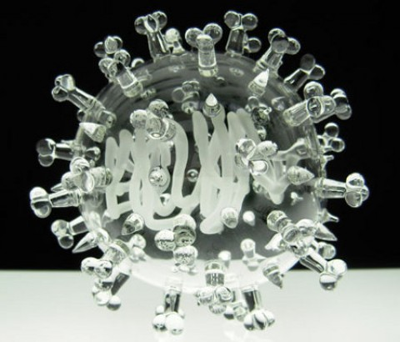
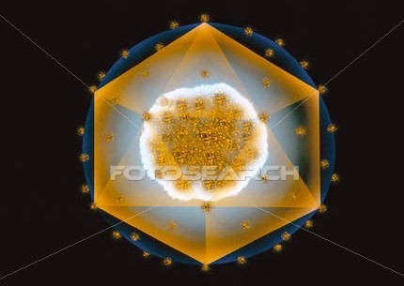
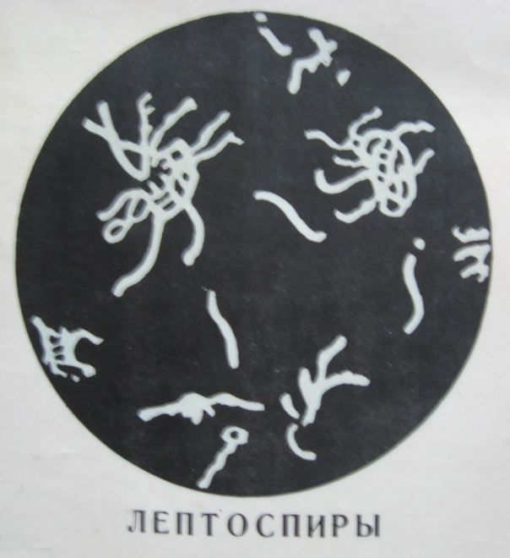
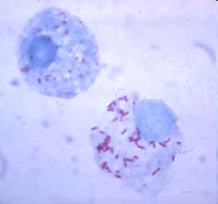

Slide 5
Infection - (Latin “infectio”, pollution) means penetration of the microorganism into another organism or condition of the pollution of the organism by another organism (viruses, bacteriae, protozoa and other)
Infectious process is the complex of the reactions, directing to providing of homeostasis and equilibrium with an environment. Infection process is a result of the penetration and reproduction of pathogenic microorganisms into the macroorganism.
Infectious disease is the extreme stage of infectious process, when violation of homeostasis develops as a result of predominance of pathological reactions above compensatory reactions.

Slide 6
Features of infectious diseases
presence in the organism of alive agent;
a man becomes the source of infection, can infect other people; the degree of contagiousness is determined by properties of agent, its localization and period of the disease;
many infectious diseases are characterized by massive character (outbreaks, epidemic, pandemic);
the typical feature of infectious diseases is cyclic course: presence of definite periods of the disease;
formation of immunity after infectious disease.

Slide 7
Periods in the flow of infectious diseases:
  incubation (from the infection till the first clinical manifestations);
  initial (first days of the disease, first clinical manifestations);
  climax period (the most marked clinical symptoms related with the features of the agent);
  period of the decrease of the clinical manifestations due to activation of the protective reactions of organism and effect of medical measures;
  convalescence (or chronization, residual phenomens)

Slide 8
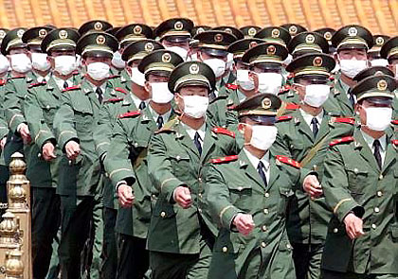
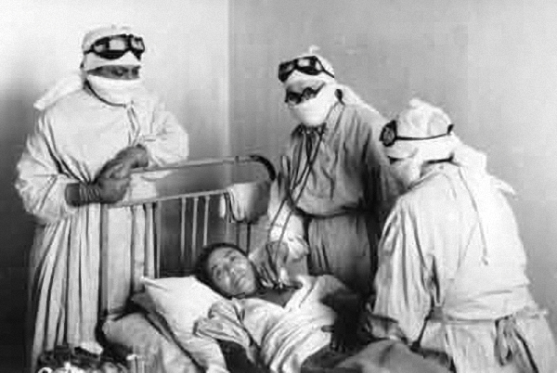
Epidemic process is infection of population by the agents of infections (invasions), naturally presented in the alive organisms or on the objects of environment and penetrating in the infected organisms due to realization of the mechanisms of the transmission.
The result of this process is development of the infectious states.

Slide 9
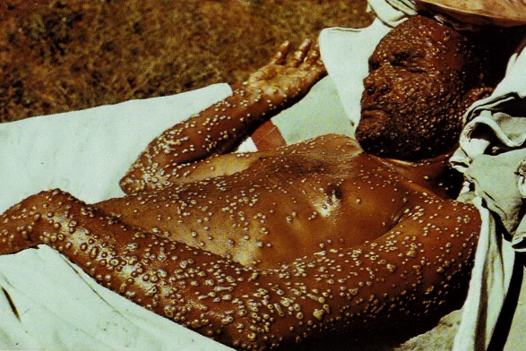
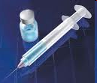

An epidemic process develops only in cooperation
of three direct motive forces:
the source of infection;
the mechanism of the transmission of the agent;
the susceptibility of the population.

Slide 10

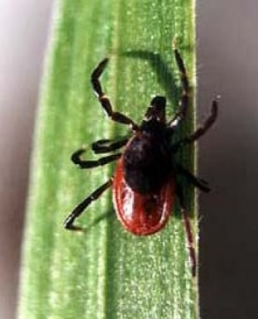



Mechanisms of transmission of the infection
fecal -oral
air-drop
transmissive
contact
vertical
parenteral
sexual
multiply
(combination of the some routes of the transmission is possible)

Slide 11
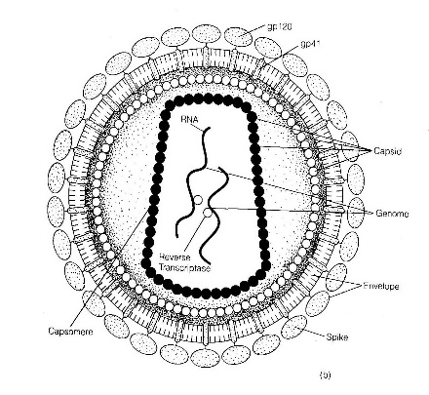
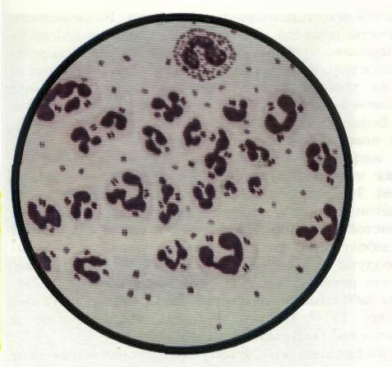
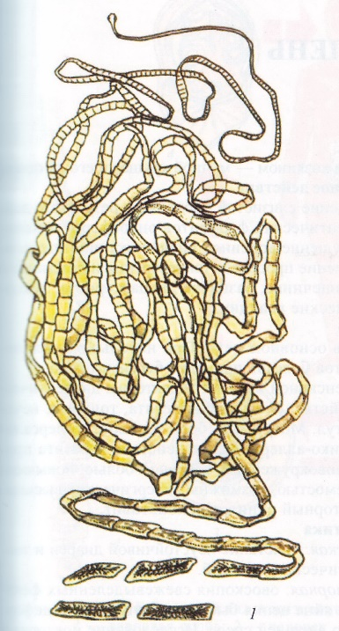
International classification of infectious diseases in accordance with the specific of the agent
viral infections
bacterial infections
mycoplasmoses
chlamidioses
rickettsioses
spirochetoses
mycosis
protozoal infections
helminthiases

Slide 12
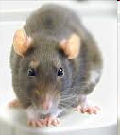

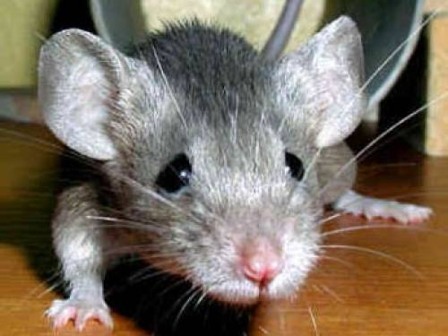

Classification of infectious diseases
(on ecological principle)
antroponozic (the source of infection is a man)
zoonotic (the source of infection is an animal)
sapronotic (the source of infection is an environment)

Slide 13
Classification of infectious diseases
(on the mechanism of transmission)
Groups of infections | Primary localization of the agent | Mechanism of transmission
intestinal | digestive tract | fecal-oral
respiratory tracts | respiratory tract | air-drop
blood | blood | transmissive
dermal integuments | dermal integuments | contact

Slide 14
Infectious process develops due to influence of the 3 basic multicomponent factors:
macroorganism
microorganism
environment

Slide 15
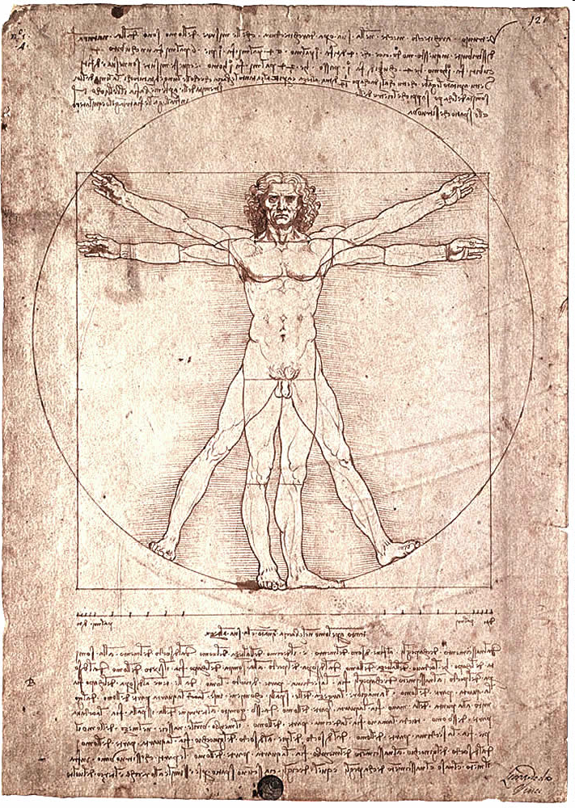
FACTORS OF MACROORGANISM
sex
age
genetic features
presence of concomitant diseases and their character
immune status
nonspecific factors of defense
psychical and emotional status

Slide 16

FACTORS OF MICROORGANISM
Pathogenicity is an ability to cause the disease (pathogenic, conditional-pathogenic, nonpathogenic microorganisms.
Virulence is the degree of pathogenicity at the certain method of the infection.
Toxigence is an ability to form the matters with toxic action on all the organism and (or) on the separate organs and systems.
Invasion is an ability penetrate to the organism, in the protective barriers, to spread and multiplay oneself in it.

Slide 17



FACTORS OF ENVIRONMENT
temperature
humidity
chemical and radiation contamination
uncontrolled reception of antibiotics
feed with the deficit of necessary vitamins and microelements

Slide 18
Forms of infectious diseases
Manifested forms (with clinical manifestations) | Subclinical (asymtomatic) forms
On duration of the course: acute (to 3 months) - typical - atypical - abortive - fulminant - obliterated protracted (to 6 months) chronic (more than 6 months) - remission - relapses - aggravation of process
On severity of the course of the disease: mild moderately severe severe very severe

Slide 19
Chronic forms
Intensification of disease is strengthening of displays clinically of the yet completed illness.
Remission is the temporal weakening or disappearance of clinical displays of disease.
Relapse is the return of displays of illness, arising up after the period of disappearance of clinical symptoms (remission), is investigation of activating of endogenous infection.
Reinfection is a new infection of reconvalescence by that pathological agent, that results again in development of infectious process is investigation of exogenous infection.

Slide 20
Infectious process can be a result:
Monoinfection is the infection by one type of exciter.
Koinfection is infection by two (and more) different exciters.
Superinfection is stratification on a grass-snake is the present infectious process of additional infection with other etiologic factor.
Reinfectioon is a new infection of reconvalescence by that pathological agent, that results again in development of infectious process is investigation of exogenous infection.
Persystention is the protracted saving of exciter in the organism of animal or man

Slide 21
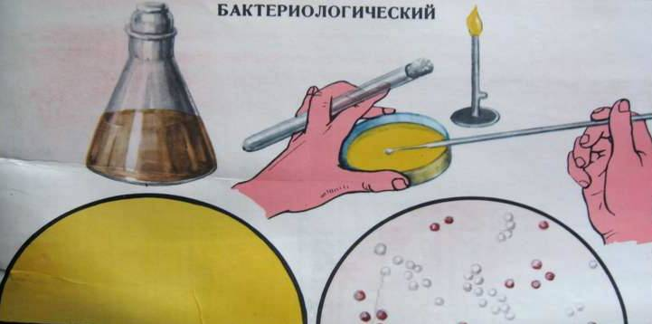
BACTERIOLOGICAL METHOD

Slide 22
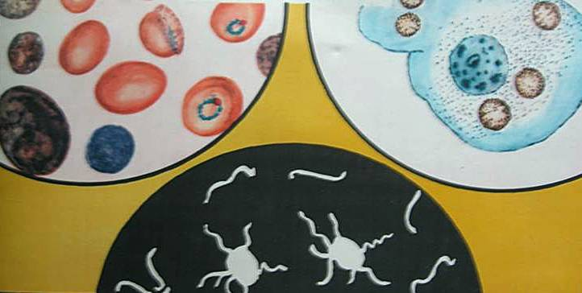
BACTERIOSCOPY

Slide 23
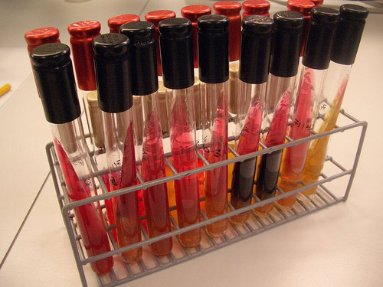
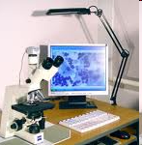
SEROLOGICAL METHOD

Slide 24


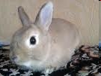

BIOLOGICAL METHOD

Slide 25
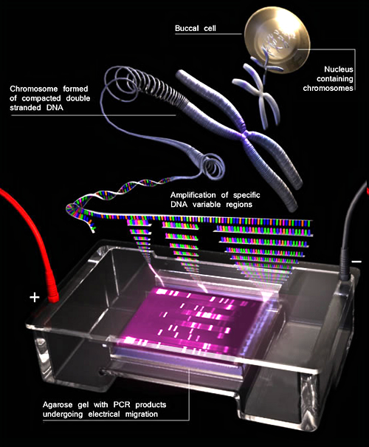
Polymerase chain reaction

Slide 26
PRINCIPLES OF THE TREATMENT OF INFECTIOUS DISEASES
There are 3 directions of the therapy of infectious diseases:
  Etiotropic therapy
  Pathogenetic therapy
  Sympthomatic therapy

Slide 27
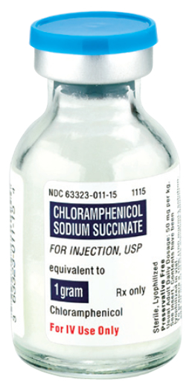
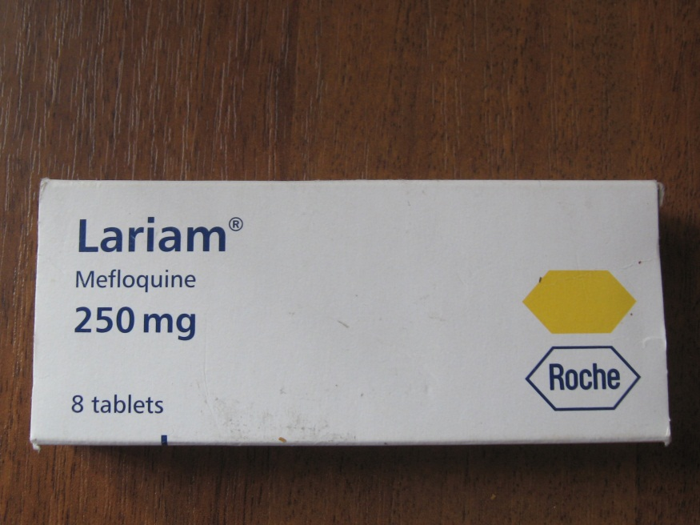
PRINCIPLES OF THE TREATMENT OF INFECTIOUS DISEASES
Etiotropic therapy acts to causative agent of the infectious disease and include next remedies:

Slide 28
ETIOTROPIC THERAPY
Etiotropic
remedies
Nonspecific
Specific:
Immune serums;
- immuglobulins;
- bacteriofags
Chemiopreparates:
antibacterial;
antiviral;
antiprotozoal;
antihelminthiases.
Natural
biological products:
interferons;
Bactrial products:
lactobacteria;
colibacteria;

Slide 29
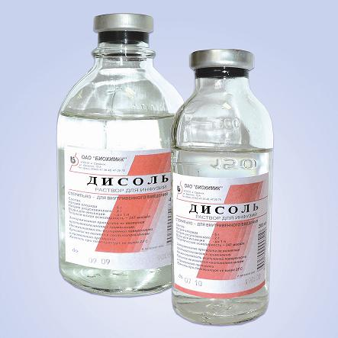
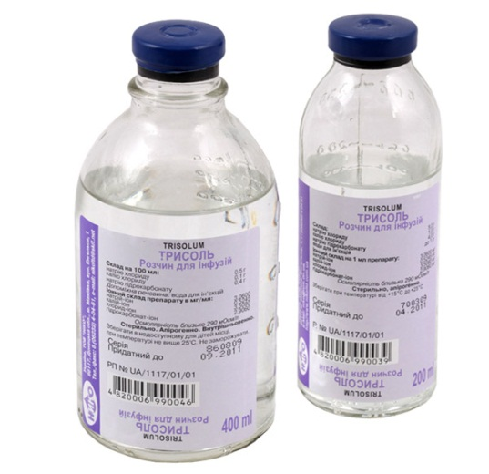
PATHOGENETIC THERAPY
Pathogenetic therapy acts to main links of pathogenesis of the infectious disease and include next direction:
Desintoxicative
Rehydration
Dehydration
Substitution

Slide 30
REMEDIES FOR SPECIFIC PREVENTION OF INFECTIOUS DISEASES
VACCINES
ANATOXINES
SERUMS
IMMUNOGLOBULINES
BACTERIFAGS

Slide 31
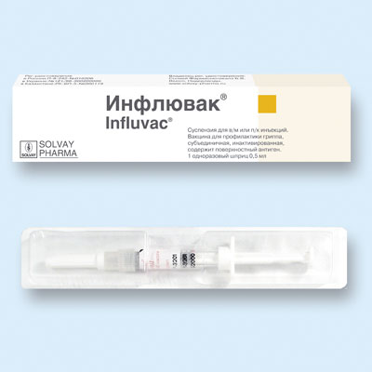
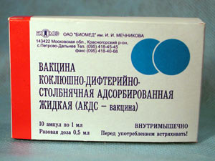
V A C C I N E S
ALIVE (attenuated causative agent, which retained their immunogenic and antigenic properties)
  Tuberculosis vaccine (BCG)
KILLED (INACTIVATED)
  solid-virions (pertussis)
  chemical (meningococcal vaccine)
RECOMBINANT (created by methods of genetic engineering)
  hepatitis В, influenza

Slide 32
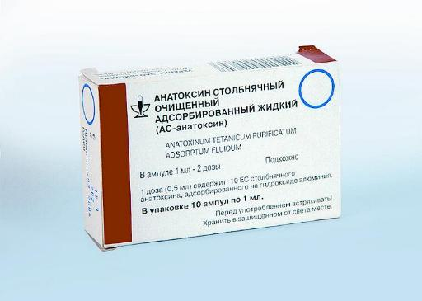
A N A T O X I N E S
This is attenuated toxin of causative agent, which has not pathogenic properties, but retained their immunogenic and antigenic properties)
antitetanic
antidiphtheric

Slide 33
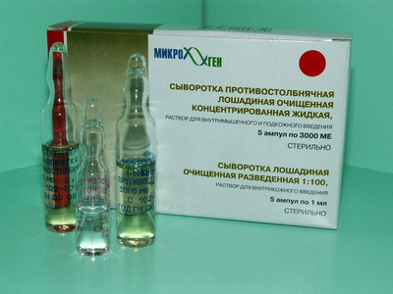
S E R U M S
Serums obtained by hyperimmunization of animals. It is heterogeneous (alien) to the human. There are rules for injections of immune serums
antidiphtheric
antitetanic
antibotulinic
antigangrenous

Slide 34
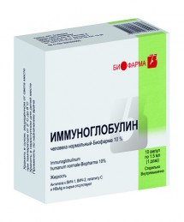
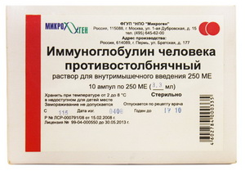
I M M U N O G L O B U L I N E S
Immunoglobulines obtained from donor’s blood. It is homologous to the human.
  For prevention of tick encephalites
  Human antitetanes

Slide 35
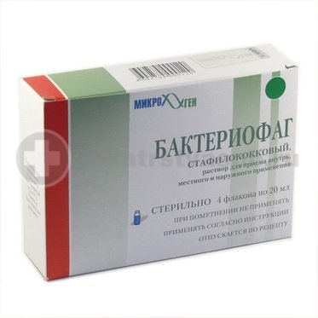
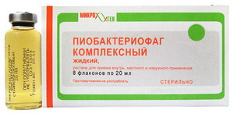
B A C T E R I O F A G E S
Bacteriophages are viruses of bacteria, which penetrate in the bacterial cell, multiply in it, causing lysis and death of bacterial cell.
There are 2 types:
  monovalent (dysentery, salmonellosis)
  polyvalent (pyobacteriofags, intestinal bacterifags)

Slide 36
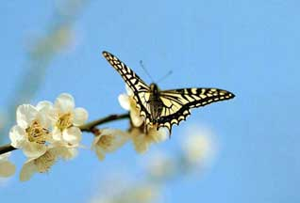
THAHKS FOR YOUR ATTENTION!

