Slide 1
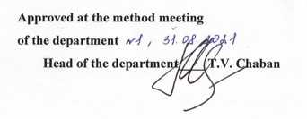
ODESSA NATIONAL MEDICAL UNIVERSITY
DEPARTMENT OF INFECTIONES DISEASES
LECTURE OUTLINES
A discipline «Infectious diseases»
Lecture № 2 «GENERAL CHARACTERISTICS OF AIR-DROP INFECTIONS.»
Year 4
Faculty international
Specialty 221 «Dentistry»

Slide 2
ODESSA NATIONAL MEDICAL UNIVERSITY
DEPARTMENT OF INFECTIOUS DISEASES
GENERAL CHARACTERISTICS OF AIR-DROP INFECTIONS
For the 4th year students
of stomatological faculty

Slide 3
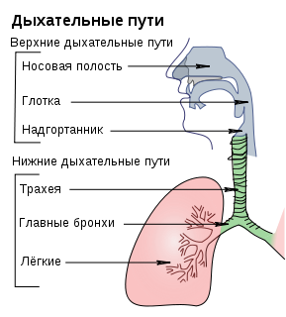
ACUTE
RESOIRATORY INFECTIONS
This is a group of infectious diseases in which target-organ is respiratory tract
The main clinical symptoms of these diseases are : nessee, cough, headache, weakness

Slide 4
Acute respiratory diseases are the most part (50-70%) from all infectious diseases.
Ehiotropic factors :
viruses (60-80%)
bacterias
chlamidias
mycoplasmas
Helminths
fungi
Mechanism of transmissin:
Air - drop
Contact

Slide 5
Main features
These pathogens are ubiquitous (infection without borders);
The high infectivity.
Almost universal susceptibility of people. With flu is causing massive illnesses caused epidemics, pandemics, involving numerous fatalities and enormous economic damage.
Viral infections are often accompanied by bacterial complications.
Viral respiratory infections contribute to the formation of chronic, including allergy (asthma), respiratory disease and other organ systems (heart, kidneys, nervous system)
Many respiratory viruses (adenoviruses, herpesviruses, etc.) are able to persist in human organism.

Slide 6
INFLUENZA
Influenza is an anthroponosic acute respiratory viral disease with air-drop mechanism of the transmission.
It is characterized by acute onset, principal damage of the upper respiratory tract.

Slide 7
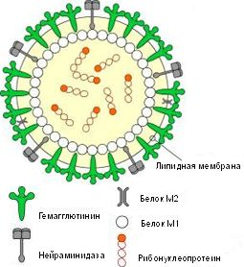
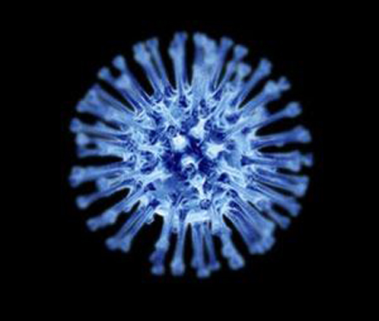
ETIOLOGY

Slide 8
ETIOLOGY
The influenza pathogen belongs to RNA- viruses the family Orthomyxoviruses.
It is not very steady in environment.
There are 2 types of the surface antigens above envelope of virus (aggression's factors):
Hemagglutinin (H) – polypeptide, hemolyses of erythrocytes – 19 types;
Neurominidase (N) – glucoproteid, determines fermentative activity – 9 types;
135 variants of combination hemagglutinin and neurominidase

Slide 9
ETIOLOGY
There are some types of influenza virus pathogenic for different animals, for examples, pig, cow, goat.
And there are some types of influenza virus pathogenic for animal and for human.
Very high changebility is characterized by influenza virus.
Drift is a partial change of genome of influenza virus.
Shift is a full change of genome of influenza virus.

Slide 10
There are some epidemic and pandemic of influenza during ХХ century
 | Year | Subtype | Stem
Epidemic | 1972–1973 | H₃N₂ | A/England/72
 | 1976 | H₃N₂ | А/Victoria/75
 | 1977 | H₃N₂ | А/Техas/77
Pandemic | 1918 | H₁N₁ | Spanish type
 | 1957 | H₂N₂ | Asiatic type
 | 1968 | H₃N₂ | Hon Kong
 | 1977 | H₁N₁ | USSR
 | 2009 | H₁N₁ | California

Slide 11
EPIDEMIOLOGY
Mechanism of the transmission — air-drop
Route of the transmission
    Aerosol
    Dusty
    Contact
Natural susceptibility is high in all old group.
Geographical Distribution – in all countries.
Immunity in influenza is not prolonged 1-3 years, but during all human life immune memory cells saved.

Slide 12
PATHOGENESIS
Penetration of virus in the epithelial cells
Replication of virus in the cell
Destruction of the cells infected by virus
  → Catarrhal syndrome
Virusemia, toxinemia
  → Fever and intoxication
  →, allergy
  → Damage of the vessels → hemorrhagic syndrome
Immunodepression → Secondary flora → complications

Slide 13
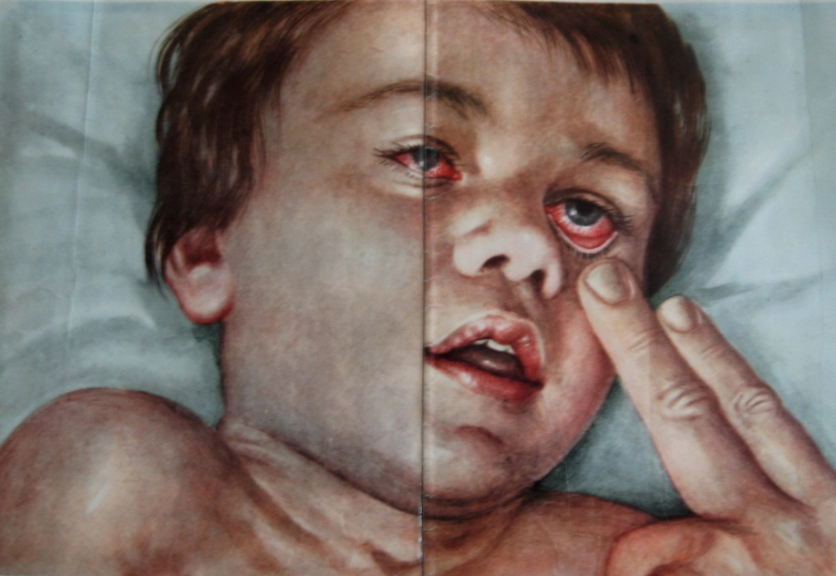
PATHOGENESIS
SYNDROMES
Catharal
Intoxicative
Hemorrhagic

Slide 14
CLINICAL MANIFESTATIONS
The onset of the disease is acute.
The incubation period is short (from some hours to some days).
The temperature is high (to 41 degree Celcius). Temperature during to 5-7 days and than decreased to normal. If the temperature prolonged more than 7 days, we can think about complications of influenza.
There are chill, weakness, myalgia, headache (especially in frontal area).
The skin is pale. Face may be some edematous. Usually rash is absent but rarely hemorrhagic rash may present.
The scleras are injected. Conjunctivitis may develop.

Slide 15
CLINICAL MANIFESTATIONS
There is catharal syndrome: dry cough, pain in the thorax, difficult nasal respiration (but slight discharge from the nose).
There is powerful hyperemia of stomathopharinx, graininess back of stomatopharinx and point hemorrhagic rash on mucous membrane of stomatopharinx.
Degree of intoxication and damage of respiratory tract are criterion of severity of the patients.
There is not lymphadenopathy.

Slide 16
CLINICAL MANIFESTATIONS
Disorders of cardiovascular system connected with a toxic action of influenza virus
There are tachycardia, decreased of arterial pressure
The heart sound are muffed, heart borders are widened, slight systolyc murmur and sometimes extrasystoles appear.
On ECR we can see results of toxic and dystrophic disoders.
Dilatation of cappillares, turbid background, artherial aneurysms are seen on capillaroscopy

Slide 17
CLINICAL MANIFESTATIONS
There are functional disorders of vegetative nervous system such as sweating, change of pulse rate, weakness and may be severe disorders, for examples, meningitis, meningoencephalitis, neuritis.
There are functional disorders of digestive system: bad appetite, heaviness in epigastrium, dry in mouth.

Slide 18
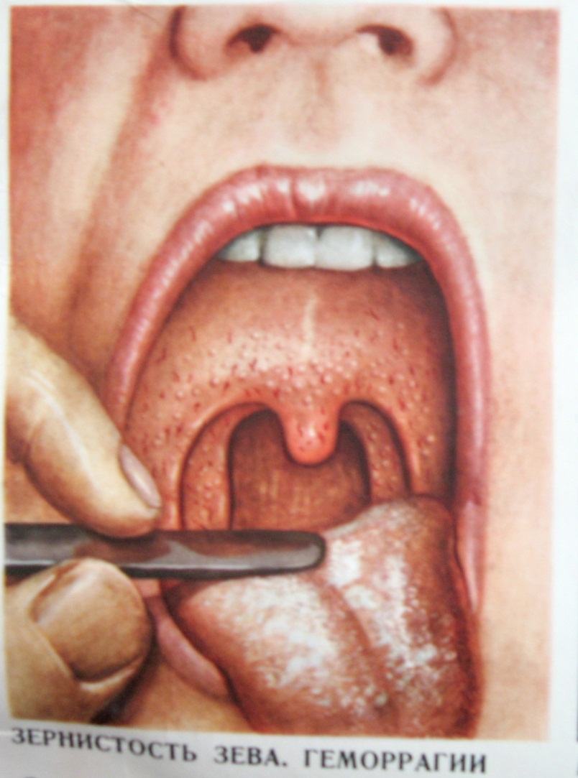
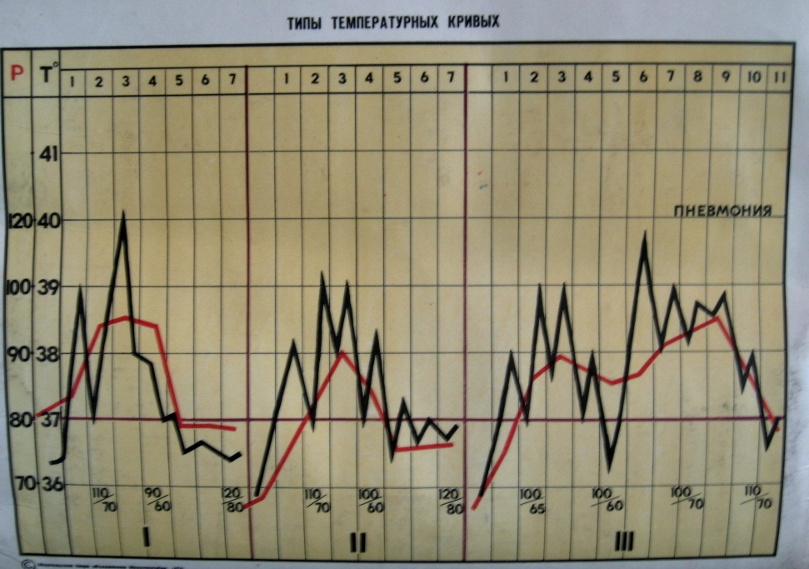
CLINICAL MANIFESTATIONS

Slide 19
COMPLICATIONS
EARLY
Lung’s edema
Brain’s edema
Acute heart insufficiency
Meningitis
Arahnoiditis
Infectious-toxic shock
LATELY
pneumonia
Sinusitis
Otitis
Glomerulonephritis
Insult and infarcts
Acute attacks of chronic diseases

Slide 20
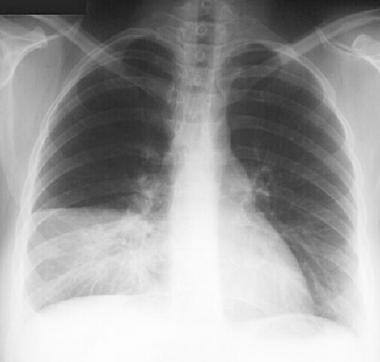
PNEUMONIA

Slide 21
LABORATORY DIAGNOSTICS
GENERAL CLINICAL METHODS
SPECIFIC METHODS
  virusological
  Serological
    Methods of double serums
    polymerase chain reaction
INSTRUMENTAL METHODS

Slide 22
TREATMENT
I. Ethiotropic therapy
А) antiviral remedies
  Blockators of М2-canals of virus grippe A (amantadine, remantadine);
  Inhibitors of function neuraminidase of virus grippe А and В (oseltamivire, zanamivire);
Б) Interferon’s preparations (IFN)
  Human leycocytaric IFN
  Recombinant IFN
В) Inductors of endogenic IFN
  (amixin IC, arbidol)

Slide 23
TREATMENT
II. Pathogenetic therapy
  desintoxicative
  Antigistamin’s
  Polyvitamines
  Febrifuge (not aspirin!!)
III Symptomatic therapy
  Expectorate and anticough remedies
  Nasal drops

Slide 24
Antibiotics prescribe in next cases:
Severe course of the disease (especially with brain’s damage)
Grippe in little children
Pregnant women;
Elderly patients;
Patients with chronic diseases
There are recommended macrolides, cephalosporines ІІІ и IV edition, ftorhonolones ( II edition and upper), protective penicillines.

Slide 25
NONSPECIFIC PREVENTION
Hardening
Polyvitamines
Seasonal immunocoregic therapy (natural adaptogens, interferon’s remedies, inductors of interferons)
Emergency prevention (antiviral remedies interferon’s remedies)

Slide 26
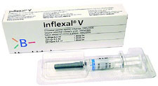
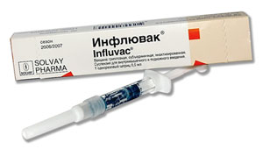
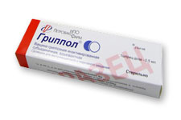
SPECIFIC PREVENTION (VACCINATION)
I SOLIDVIRIONS (contains solid viruses)
II SPLITING VACCINES (contains all viral proteins)
  vaxigrippe (France);
  fluarix (Belgium),
III SUBUNITS (contains only surface virus antigens).
  influvac (Nederland)
  grippol (Russia).

Slide 27
PARAINFLUENZA
Parainfluenza — anthroponosic acute viral disease with damage of the upper part respiratory tract and moderately severe syndrome of intoxication.
The course of the disease is prolonged
There are laryngitis and tracheitis in climax period of the disease.
The false croup is a more frequently and specific complication at this disease
Remedies of specific therapy and prevention is not created

Slide 28
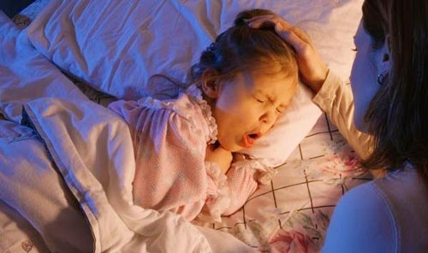
PARAINFLUENZA
FALSE CROUPE IN A CHILD WITH PARAINFLUENZA

Slide 29
ADENOVIRAL INFECTION
Adenoviral infection — anthroponosic viral disease with damage of the respiratory tract and lymphoid tissue.
Etiology agent – DNA contained virus. Adenoviruses (all serotypes) are steady in environment

Slide 30
ADENOVIRAL INFECTION
Clinical forms:
      Acute respiratory disease;
      Pneumonia;
      Pharingoconjuinctival fever.
      Epidemic keratoconjunctivitis.
      Hemorrhagic cystitis.
      Gastroenteritis.
      Damage of the nervous system
There are not remedy of specific therapy
Vaccine for prevention of adenoviral infection is created

Slide 31
RESPIRATORY SINCYTIAL INFECTION
Respiratory-syncytial infection — anthroponosic acute viral disease with damage of the low part respiratory tract and moderately severe syndrome of intoxication
Children ill more frequently as adult
Bronchitis with bronchoobstruction, tracheobronhitis are typical for this infection
The course of the disease is prolonged (10-30 days).
Respiratory-syncytial infection is a reason of suddenly death syndrome and asthmatic sindrome in children
There are not remedies of specific treatment and prevention.

Slide 32
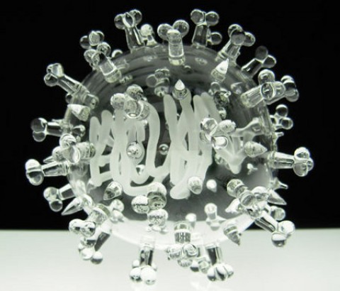
CORONAVIRAL INFECTION
Coronaviral infection — anthroponosic acute viral disease with damage of the respiratory tract or \ and gastrointestinal tract.

Slide 33
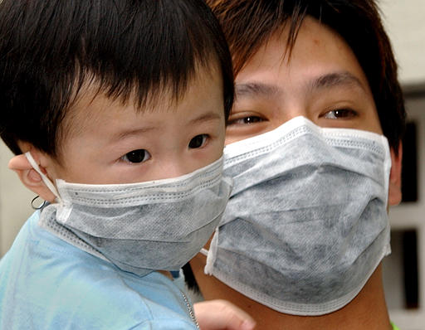
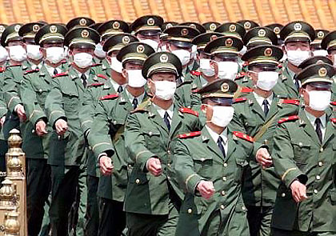
"Severe Acute Respiratory Syndrome" (SARS).

Slide 34
ENTEROVIRAL INFECTION
Enteroviral infection — acute disease with polymorphic clinical manifestations.
Etiology agent — RNA – contained viruses рода Enterovirus family Picornaviridae.
64 enteroviruses pathogenic for human
23 types viruses Coxaci А
6 types Coxaci В
31 types viruses ECHO
and 4 enteroviruses types 68-71.

Slide 35
ENTEROVIRAL INFECTION
Reservoirs and sourse of infection – sick human or carriers
Mechanism of transmission — fecal-oral, air-drop;
Natural susceptibility – high.
Geographical Distribution – in all countries.
Immunity – typospecific

Slide 36
ENTEROVIRAL INFECTION
Atypical forms:
Inanapparant form;
little disease (summer grippe);
Respiratory form;
Encephalitic form;
Encephalomyocarditis of newborn
Epidemic hemorrhagic conjunctivits
nephritis;
pancreatitis;
Mixed infection
Typical forms:
Herpetic angina;
Epidemic myalgia;
Serous meningitis;
Exanthema

Slide 37
MENINGOCOCCAL INFECTION
is an acute infectious disease of the human, caused by Neisseria Meningitigis.
The disease is characterized by damage of mucous membrane of nasopharynx (nasopharingitis), generalization of the process in the form of specific septicemia (meningococcemia) and inflammation of the soft cerebral membranes (meningitis).

Slide 38
ETIOLOGY
The etiologic agent is Neisseria meningitidis.
There are 13 serotypes of Neisseria meningitidis.
The main serotypes are
A, B, C, D, W135, X, Y and Z.
Gram-negative aerobic diplococcus.
It has not spores and flagellums.
Meningococc is very sensitive to all disinfectant remedies and factors of environment
The main toxic sunstance is endotoxin.
It growing on the medium which contains native protein (blood, blood serum, milk, yolk)
Neisseria meningitidis has a high resistant to sulfonamides and a high sensitivity to penicilline

Slide 39
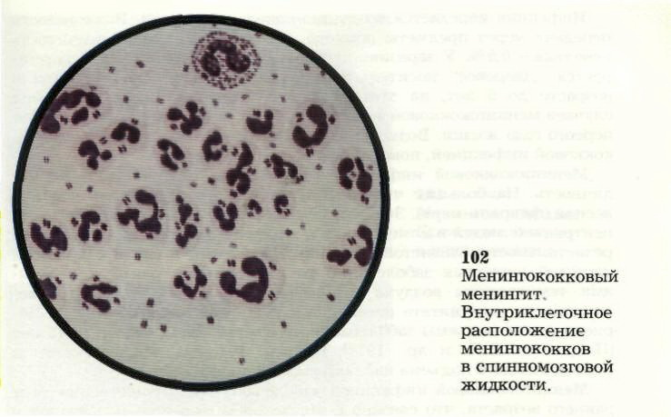
Neisseria meningitidis
A coffee-grain like diplococcus

Slide 40
EPIDEMIOLOGY
Meningococcal infection is typical anthroponosis.
The source of infection is
  sick man
  healthy carriers of N. meningitidis.
  The most dangerous source of the infection is patient with meningococcal nasopharingitis or carrie because he don’t know about him disease and may excrete N. meningitidis in environment during prolonged time
The mechanism of the transmission is air-drop. Close contact with source pf infection is necessary to realization of transmission’s mechanism

Slide 41
EPIDEMIOLOGY
At the last years the morbidity by meningococcal infection is low in the countries of Europe and America.
There is high morbidity in the countries of equatorial Africa (so-called meningitic band).
Susceptibility of meningococcal infection is more high among children
The larger part of carriers is reveled among adults.
There are outbreaks of meningococcal infection among military men.

Slide 42
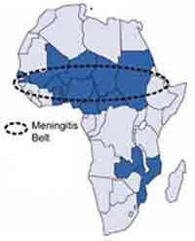
Urgency

Slide 43
CLASSIFICATION OF CLINICAL FORMS
Primary localized forms:
Meningococcal carrier;
Nasopharyngitis;
Pneumonia.
Generalized forms:
Meningococcemia: typical above acute meningococcal sepsis; chronic;
Meningitis; meningoencephalitis;
Mixed forms (meningococcemia + meningitis, meningoencephalitis).
Rare forms (endocarditis, arthritis, iridocyclitis).

Slide 44
International classification of the disease divided next forms of the meningococcal infection
A 39.0 Meningococcal meningitis
A 39.1 Wotherhaus - Fridrihsen syndrome
A 39.2 Acute meningococcemia
A 39.3 Chronic meningococcemia
A 39.4 Unknown origin meningococcemia
A 39.5 Meningococcal heart disease
152.0 carditis
139.0 endocarditis
141.0 myocarditis
132.0 perycarditis
A 39.8 Other meningococcal diseases
  Artritis
  Conjunctivitis
  Encephalytis
  Retrobulbar neuritis
  Postmeningococcal artritis

Slide 45
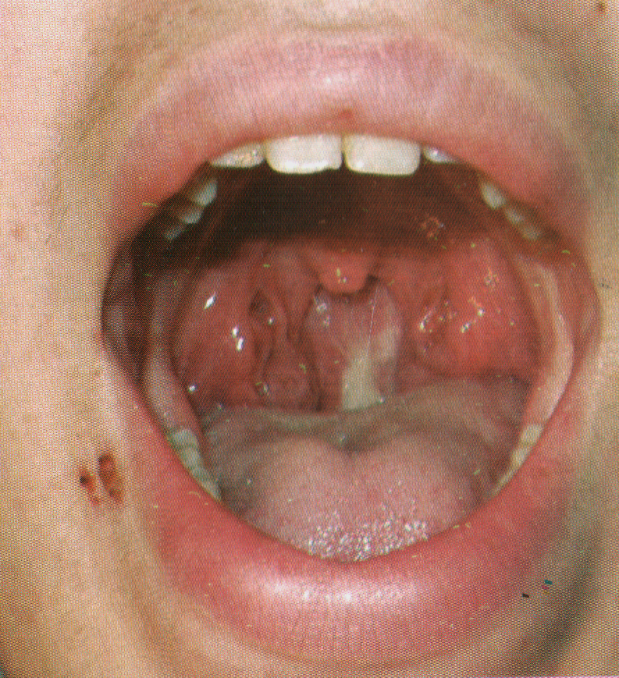
CLINICAL MANIFESTATIONS
Meningococcal nasopharingitis:
subfebril temperature°
mild intoxication
sore throat
dry cough
blocked nose
hyperthermia and edema of the mucous membrane of the nose

Slide 46
CLINICAL MANIFESTATIONS
Meningococcemia
The onset of the is an disease acute
chill, temperature is 39-41°С
severe intoxication
hemorrhagic rash on 5-15-24 hours from onset of the disease
The elements of the rash have incorrect (“star-like”) form, dense, coming out over the level of the skin
The rash at first is localized on back surface of thigh and on buttocks

Slide 47
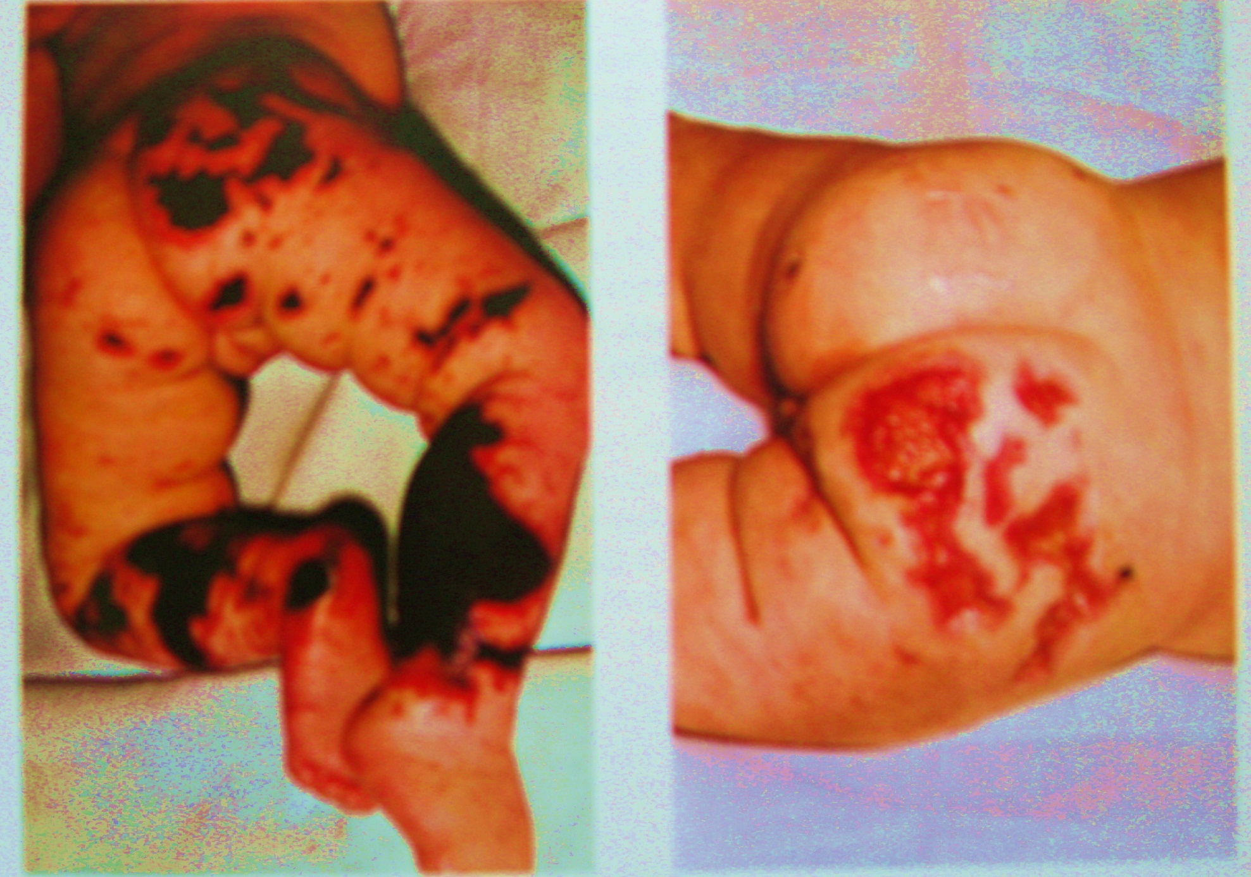

Slide 48
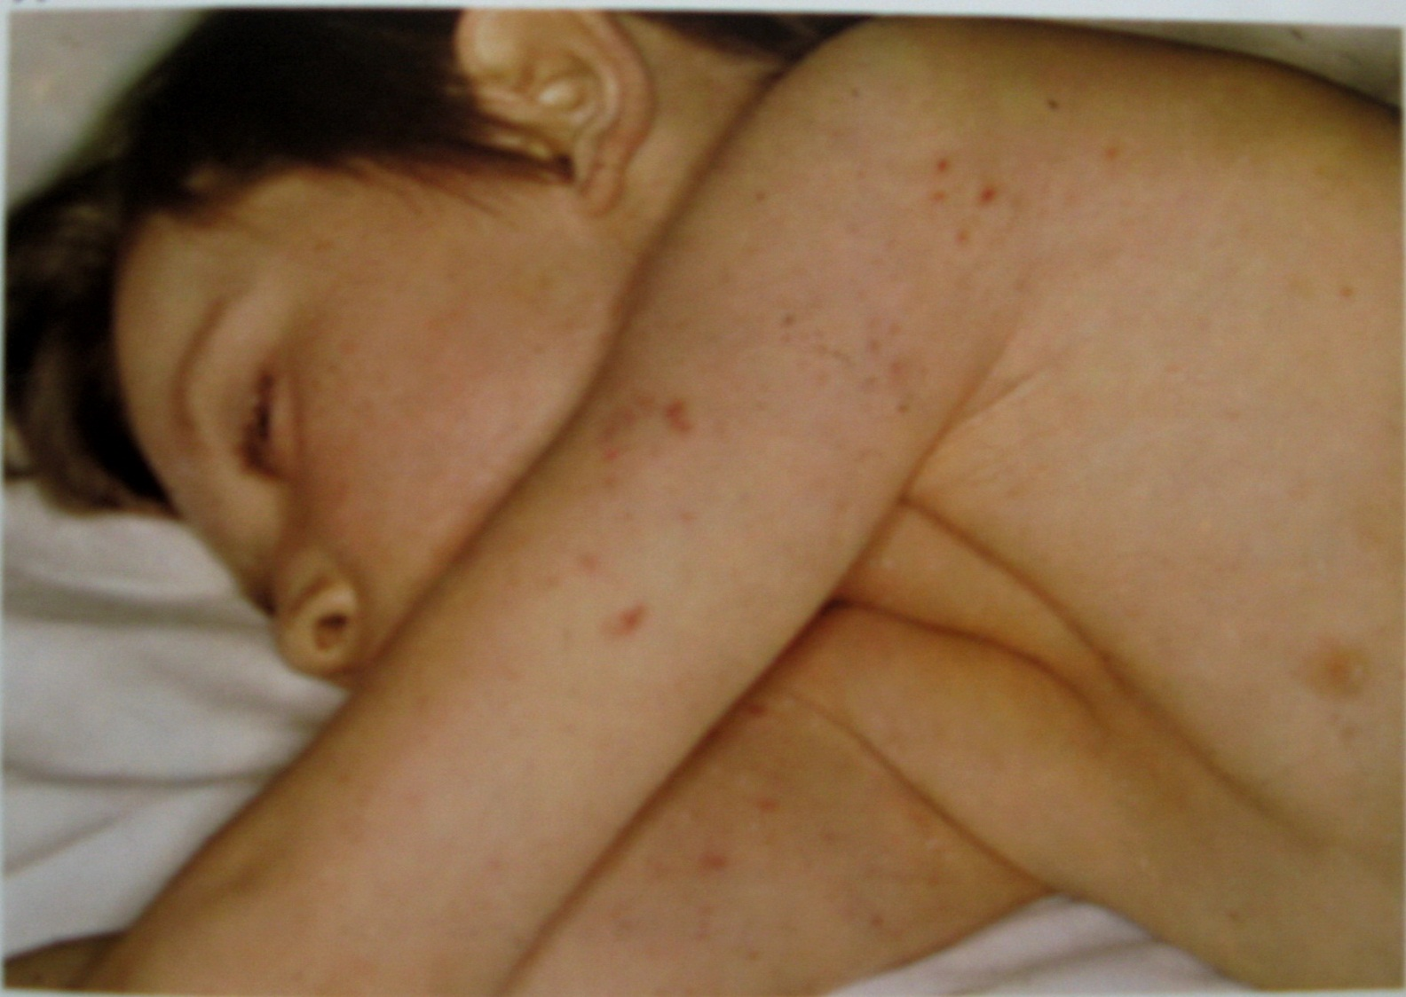

Slide 49
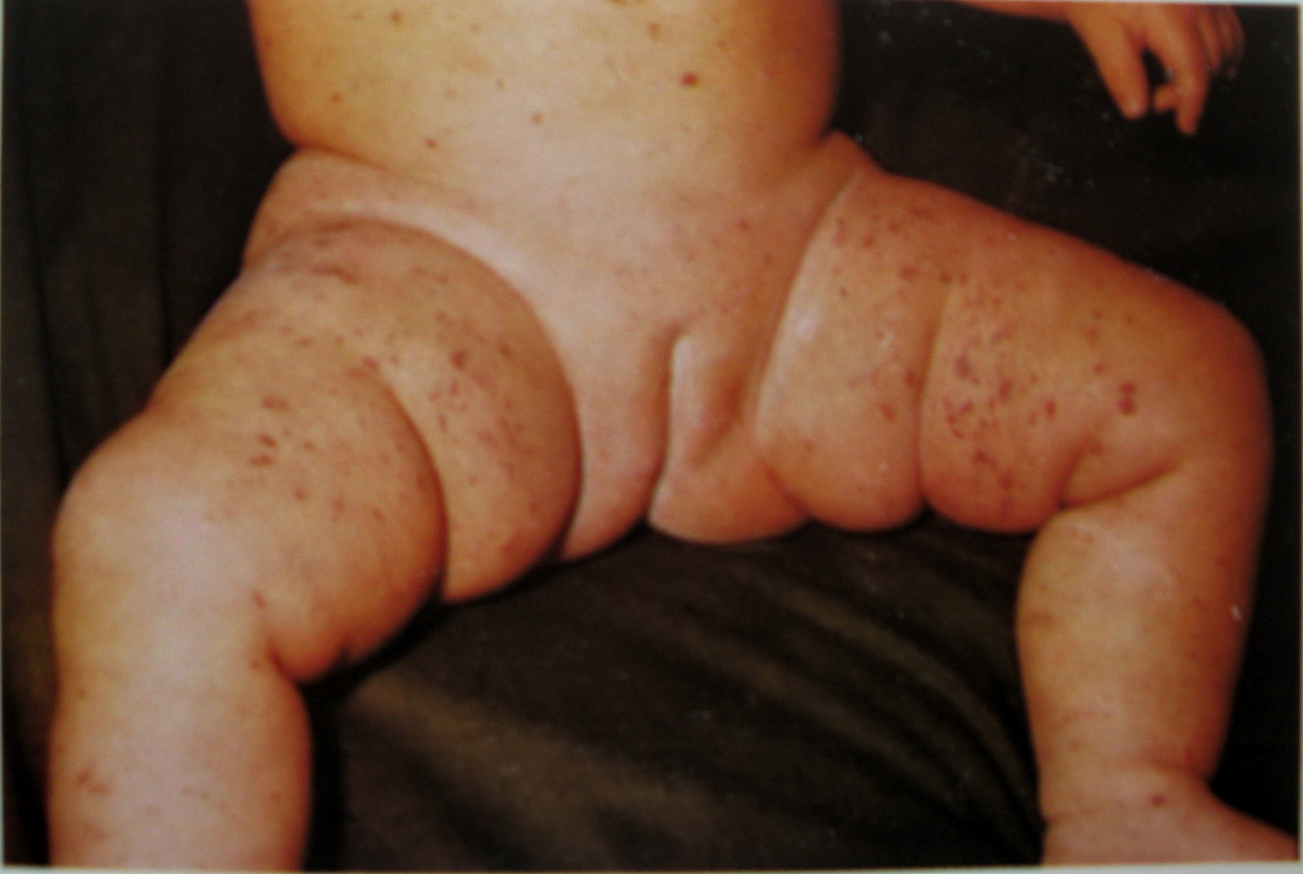

Slide 50
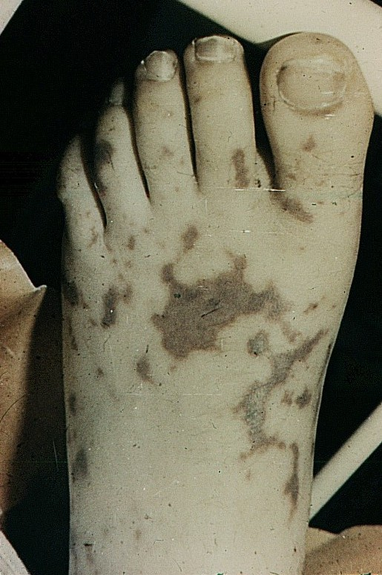
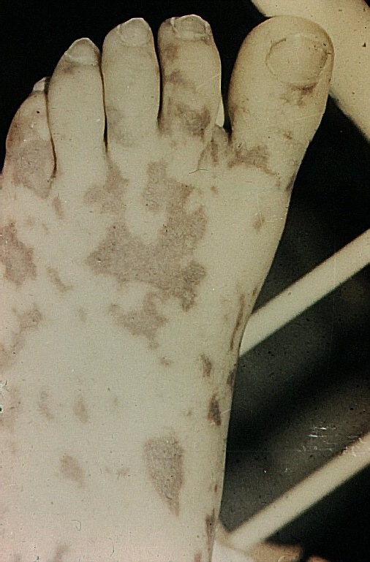

Slide 51
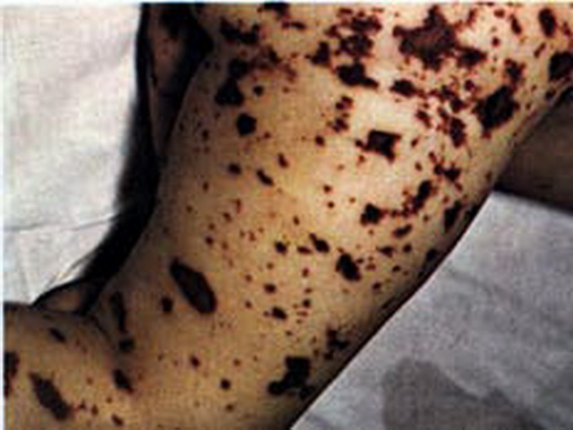

Slide 52
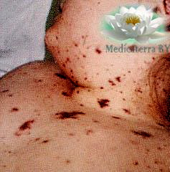

Slide 53
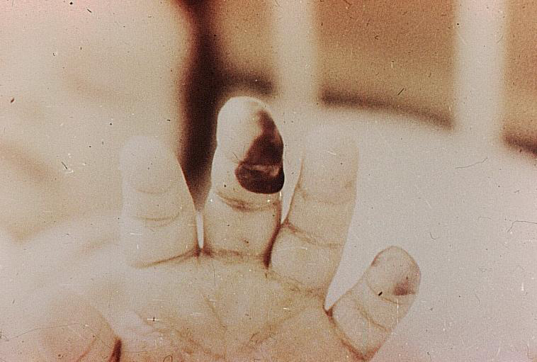

Slide 54
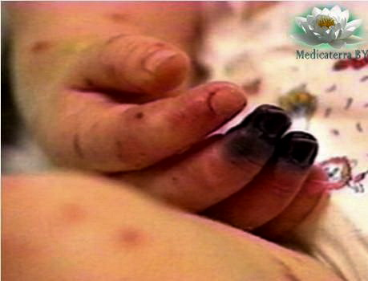

Slide 55
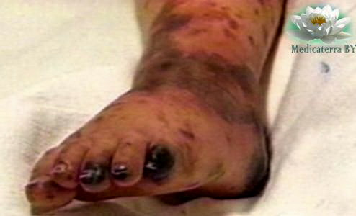

Slide 56
MENINGITIS
is inflammation in of the soft cerebral membranes
ENCEPHALITIS
is inflammation in of the brain
MENINGISMUS
is irritation in of the soft cerebral membranes in result of intoxicaton

Slide 57
CLINICAL MANIFESTATIONS
Meningitis
onset is acute
high temperature
strong headache
vomiting without nausea
positive meningeal signs (rigidity of occipital muscles, Kernig’s symptom, Brudzinsky’s symptom (upper, middle and lower)
cramps

Slide 58
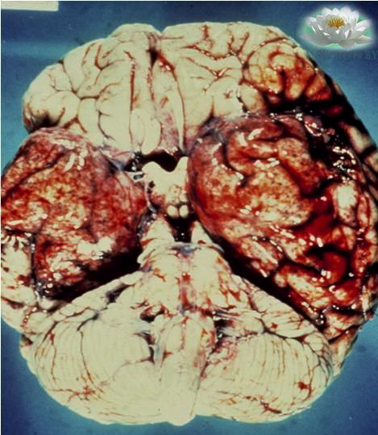
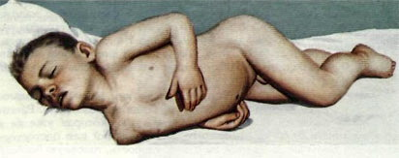
meningitis

Slide 59
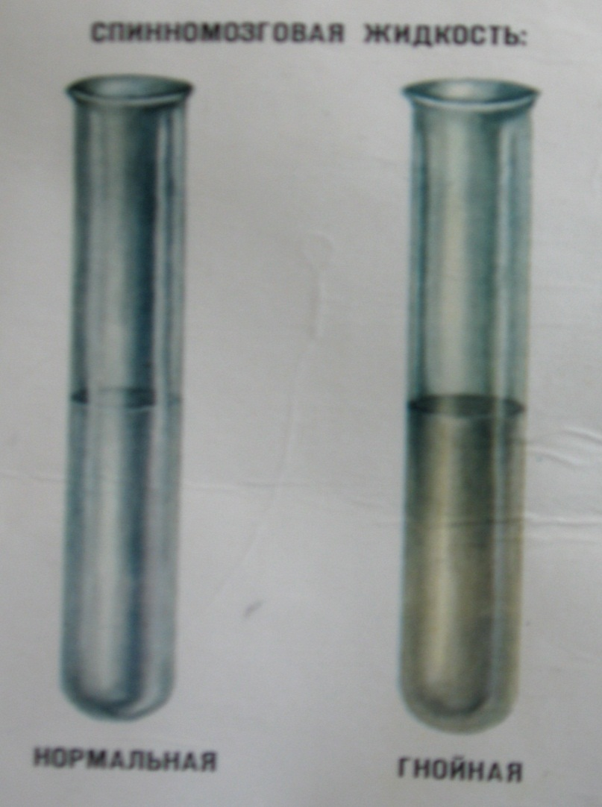
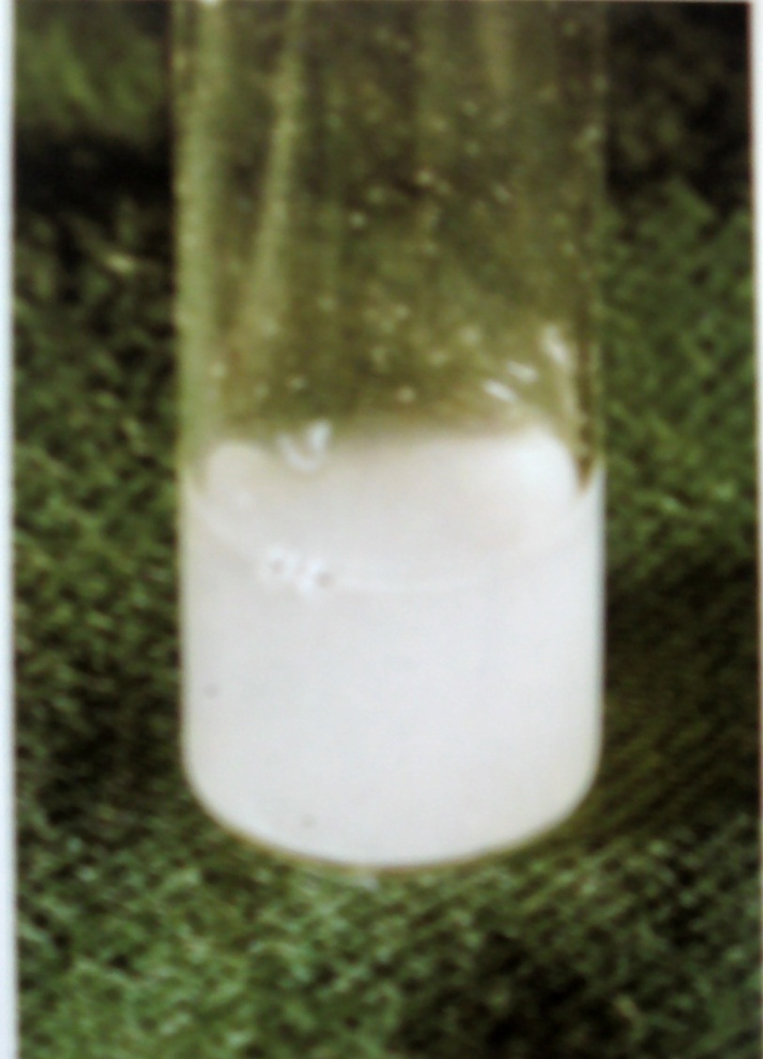
Cerebrospinal fluid

Slide 60
The most important changes in the damages of the central nervous system of the different etiology
Sings | Normal cerebrospinal fluid | Meningismus | Serous viral meningitis | Serous tuberculous menigites | Purulent (bacterial) meningites
Color Tolerance | Transparent | Transparent | Transparent | Transparent | Turbid
Pressure | 1,3-1,8 kP | ↑ | ↑ | ↑ | ↑
Cytosis | Single leukocytes | Single leukocytes | 300-400 leukocytes | 50-500 leukocytes | 1000 and more
Protein | 0,16-0,33 g/l | 0,16-0,45 g/l | 0,33-1,0 g/l | 1-9 g/l | 0,66-16,0 g/l
Sugar | 2,22-3,33 mmol/l | normal | normal | ↓↓ | ↓

Slide 61
Classification of meningitis
Primary | Secondary
Purulent
meningococcal | pneumococcal staphylococcal streptococcal
Serous
Armstrong’s disease tuberculosis' polyomielitis tick encephalitis | Influenza and ARVI children’s air-drop infection leptospirosis syphilis orhithosis

Slide 62
COMPLICATIONS
Infectious-toxic shock
acute renal insufficiency
DIC-syndrome
Acute extrarenal insufficiency
(Waterhouse-Friedrichen syndrome
Lund’s edema
Infarction of myocardium
Brain’s edema
Inculcation of Medulla oblongata to Foramen magnum
Cerebral hypotension

Slide 63
COMPLICATIONS
ependimatitis (ventriculitis)
gangrene
ancylosis of joints
myocardiosclerosis
blindness
deafness
hydrocephalia
epilepsy

Slide 64
LABORATORY DIAGNOSTICS
BLOOD COUNT
leukocytosis (till 20-60 10³ / mkl)
neutrophilosis with increase of young forms
BACTERIOLOGICAL METHODS
Investigation of mucous from proximal portions of upper respiratory tract, blood (in meningococcemia), cerebrospinal fluid (lumbar puncture)
Serological reaction
Consultation of ophthalmologist, neurologist
Instrumental methods (tomogram of brain)

Slide 65
TREATMENT
Ethiotropic therapy
Benzyl penicillin is used in dosage of 200,000-300,000 IU/kg/day on meningitis
Chloramphenicol is used in dose 50-100 mg/kg 3-4 times a day on meningococcemia
Pathogenetic therapy
desintoxication
dehydration
substitute therapy

Slide 66
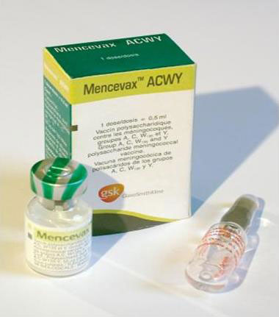
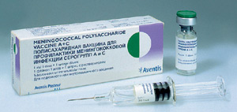
SPECIFIC PROPHYLAXIS
VACCINE on serotypes (4 serotypes)
A, C, W135, Y

Slide 67
Diphtheria is an acute infections disease caused by Leffler bacilli, transmitted mainly in an air-drop way and characterized by the symptoms of general intoxication, local inflammation of the mucous membranes mainly with the formation of fibrinogenous fur and typical complications on the part of the nervous system, cardiovascular system and excretory system.

Slide 68
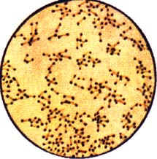
ETIOLOGY
Corynebacterium diphtheriae
3 types:
    C. gravis
    C. intermedius
    C. mitis
C. diphtheriae is a Gramm-positive bacillus.
C. diphtheriae has not spores, capsula and flagellums.

Slide 69
ETIOLOGY
C. diphtheriae has specific appearance. It like on dumbbell or pins package. These features we can use on bacterioscopy in diagnostics on diphtheria.
It growing on the medium which contains bovine serum – Leffler’s medium
C. diphtheriae is steady in environment.
Diphtheritic exotoxin is a main factor of pathogenicity. There are many (over 30) another factors of pathogenicity.
There are toxigenic and not toxigenic strain of C. diphtheriae.

Slide 70
EPIDEMIOLOGY
Diphtheria is typical anthroponosis.
The source of infection is
  sick man
  healthy carriers
The mechanism of the transmission is air-drop.
The routes of transmission are aerosol and contact.

Slide 71
CLASSIFICATION (WHO, 1986)
А. According to location of primary affect:
tonsillar;
nasopharyngeal;
anterior nasal diphtheria;
laryngeal;
other location.

Slide 72
CLASSIFICATION (WHO, 1986)
B. According to severity of the disease:
light;
mild severe;
severe
hypertoxic;
haemorrhagic.

Slide 73
CLASSIFICATION (WHO, 1986)
C. According to the character of local lesions:
catarrhal;
insular;
Membranous
D. According to process extending :
local;
diffuse;
combined.

Slide 74
PATHOGENESIS
Introduction in the place of infection entry
Propagation with the development of diphtheritic inflammation or croupous inflammation
Formation of toxins
  Stimulation of local protective factors - The termination of the toxins formation – Recovering
  Distribution throught the blood - Lesions of inner organs - Development of complications

Slide 75
CLINICAL MANIFESTATIONS
TYPICAL FORM OF TONSILLAR DIPHTHERIA
Acute onset
Mild severe pain in throat
Moderate edema and hyperemia of the mucous membrane of stomatopharynx
Degree of intoxication not correlates with character of pathological process (degree of intoxication expressed more than extending of pathological process)
The films of tonsills are dense, grey, removed with dificulty, under they – bleeding surface.
There are edema of subcutaneous adipose tissue neck
The regional lymphatic nodes are not enlarged.

Slide 76
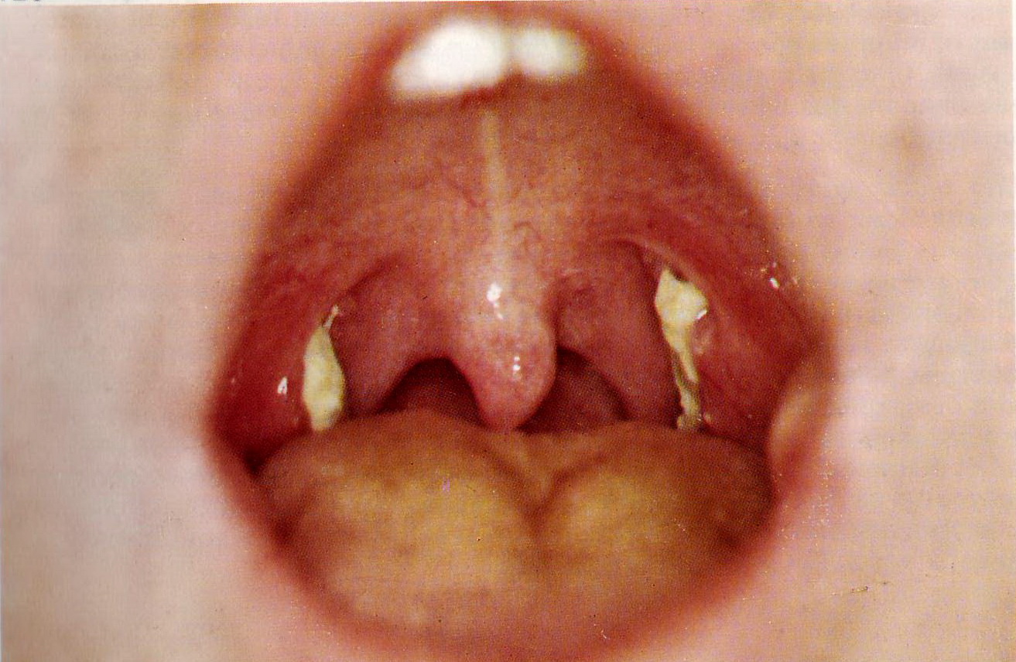
Local form of diphtheria

Slide 77
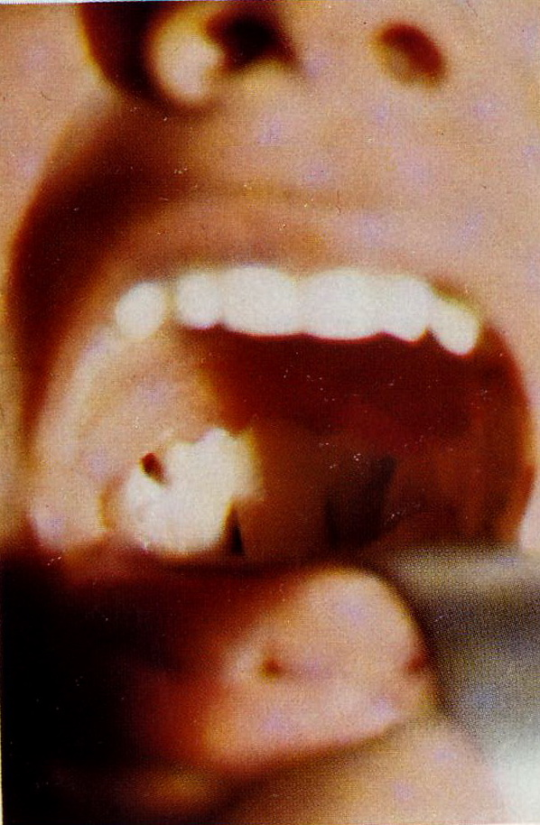
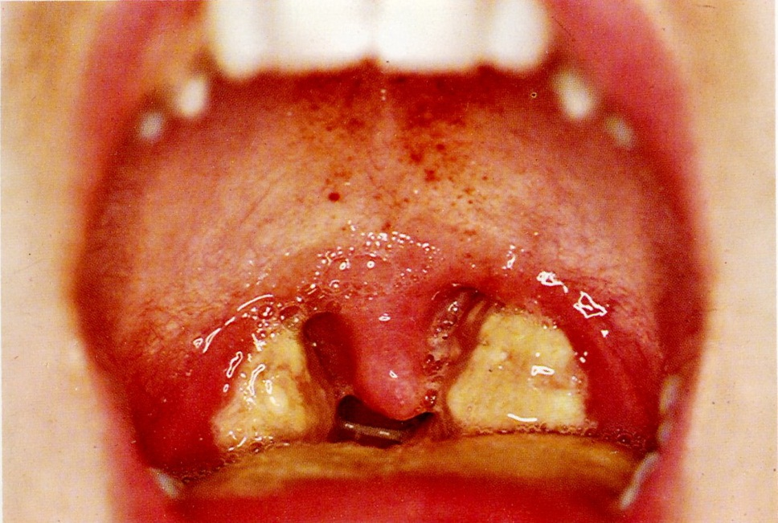
Diffuse form of diphtheria

Slide 78
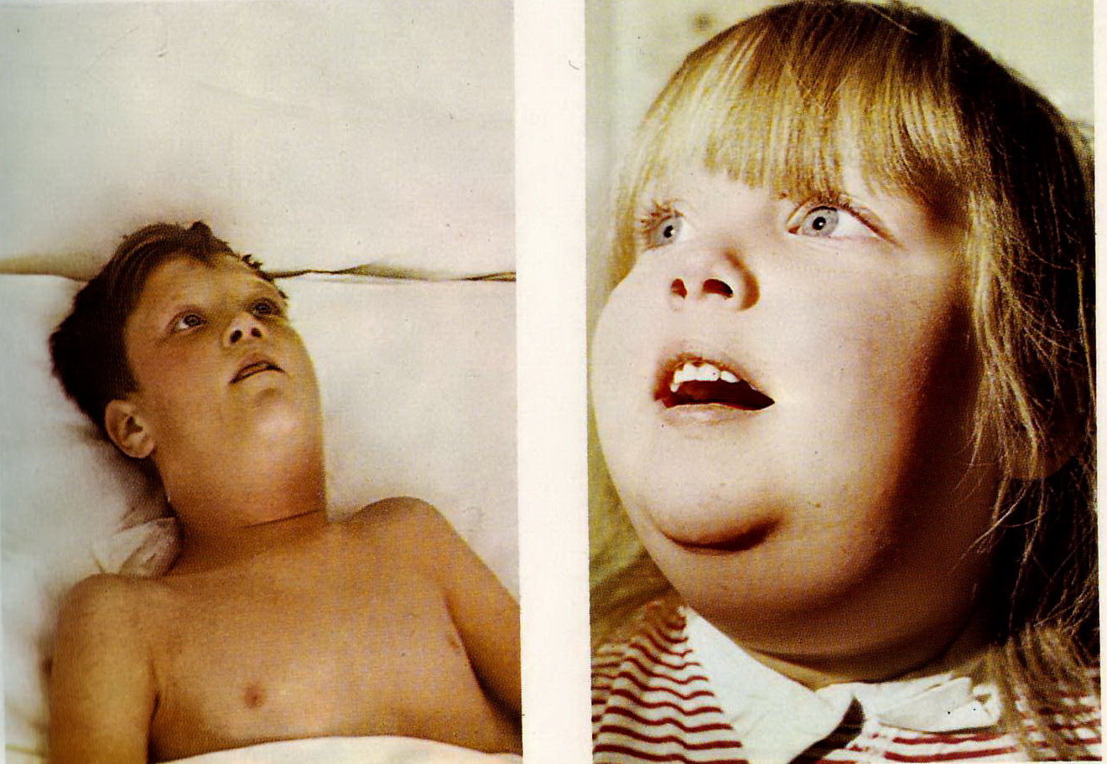
Edema of the neck in diphtheria

Slide 79
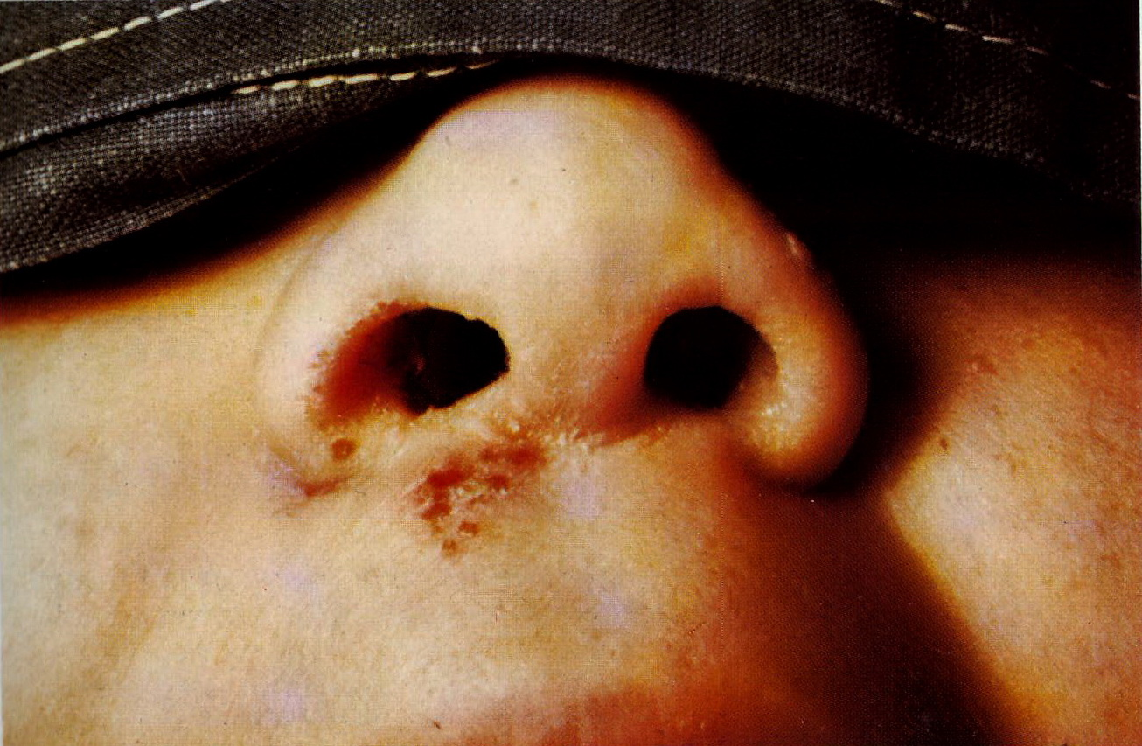
Nasopharyngeal diptheria

Slide 80
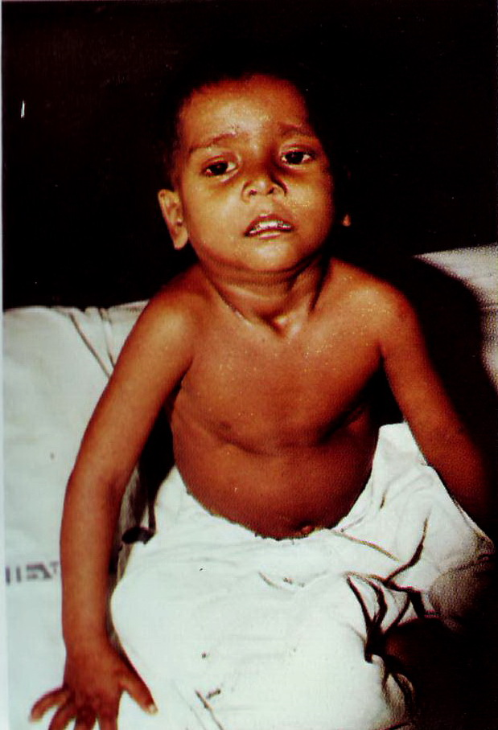
Laryngeal diphtheria

Slide 81
COMPLICATIONS
  Infectious – toxic shock
  Myocarditis
  Damage of the neurvos system
  Damage of kidneys
  Hepatitis in diphtheria
  Nonspecific complications: abscession, otitis, pneumonia and other

Slide 82
DIAGNOSTICS
Bacterioscopy of mucus from the tonsils
Bacteriological analysis of mucus from the tonsils and nose on C.diphteriae
Serum diagnostic to find out specific antibodies in dynamics

Slide 83
ETIOTROPIC THERAPY
SEVERITY OF COURSE | DOSE OF SERUM (IN THOUSAND IU
MILD | 30-40
MILD SEVERE | 50-80
SEVERE | 90-120
VERY SEVERE | 120-150
ANTIBIOTICS
Erythromycin
Penicillin
Ampicillin

Slide 84
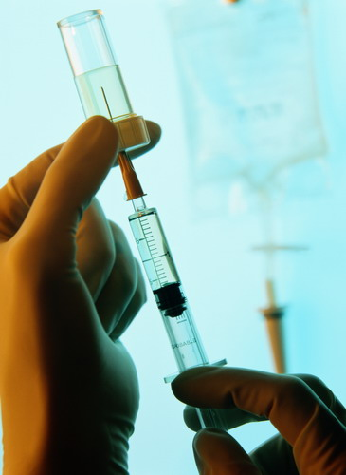
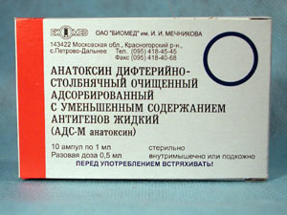
PREVENTION

Slide 85
DIFFERENTIAL DIAGNOSTICS OF THE DISEASES WITH SYNDROME ANGINAE

Slide 86
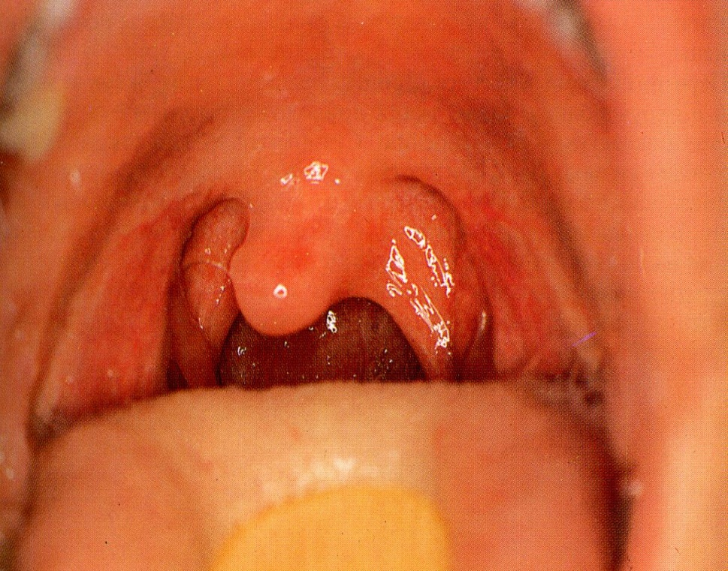
CATHARAL BACTERIAL ANGINA
Light hyperemia of the mucous membrane of stomatopharynx
Mild edema of tonsils
There are not films on the tonsils
Regional lymphatic nodes are enlarged

Slide 87
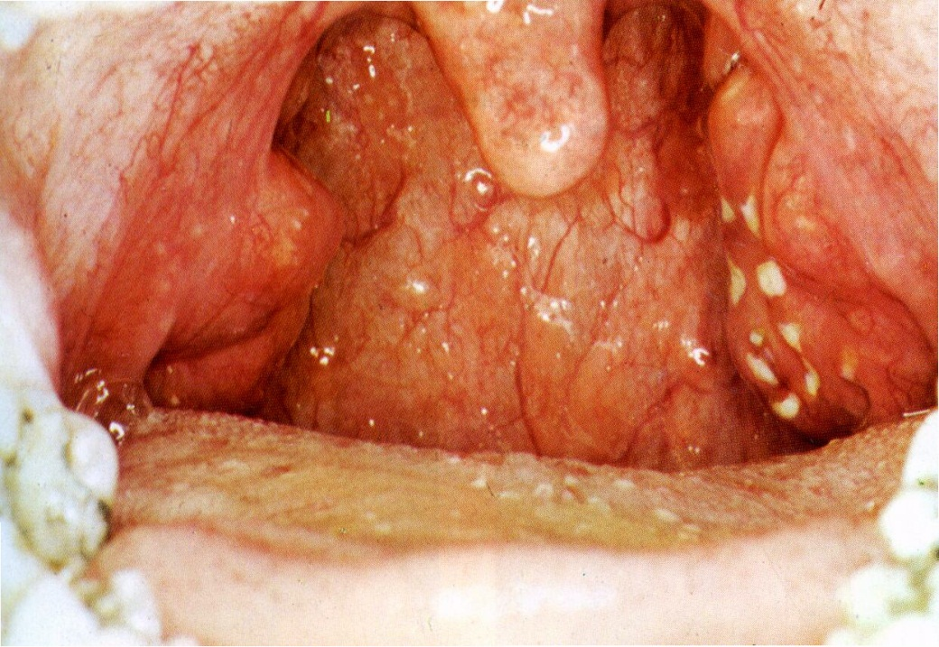
FOLLICULAR BACTERIAL ANGINA
Hyperemia of the mucous membrane of stomatopharynx
Mild edema of tonsils
There are the point-like films on the tonsils
Regional lymphatic nodes are enlarged
Fever

Slide 88
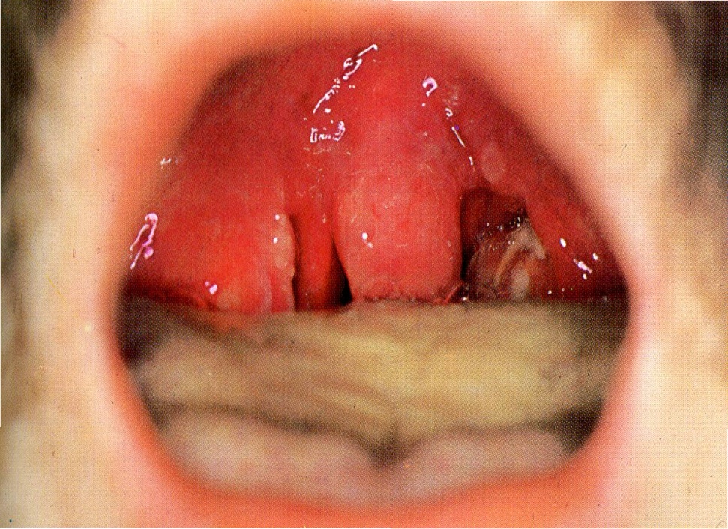
LACUNAR BACTERIAL ANGINA
Light hyperemia of the mucous membrane of stomatopharynx
Mild edema of tonsils
There are the diffuse films on the tonsils Regional lymphatic nodes are enlarged

Slide 89
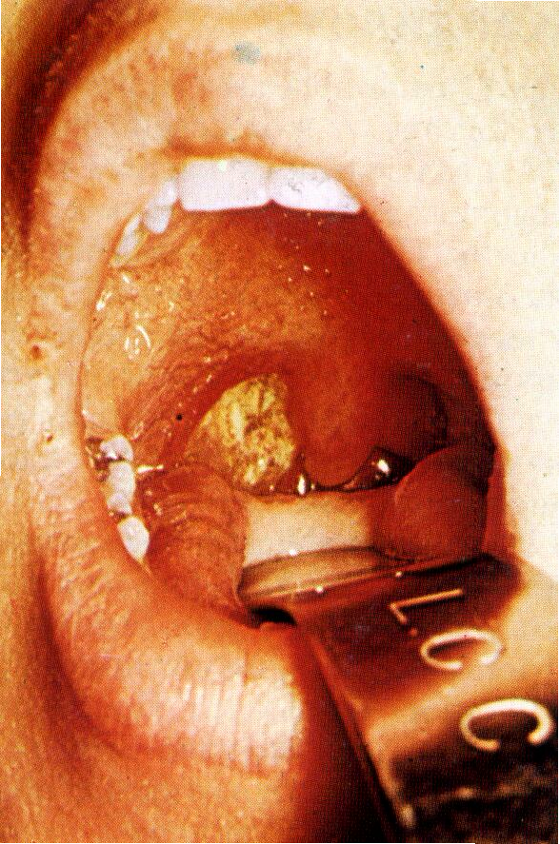
ANGINA OF Simanovsky-Plaute-Vensan
Causative agent is symbiosis of Fusobacterim and Spirocheta
One-side process
There are crater-like ulcer on tonsil
The bad smell from the mouse
There are not severe changes of condition of the patient

Slide 90
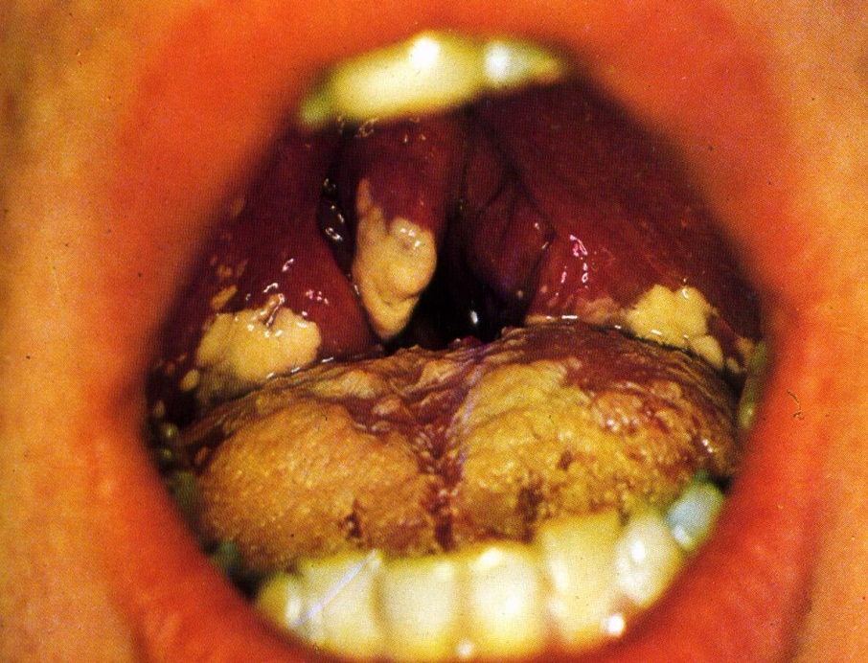
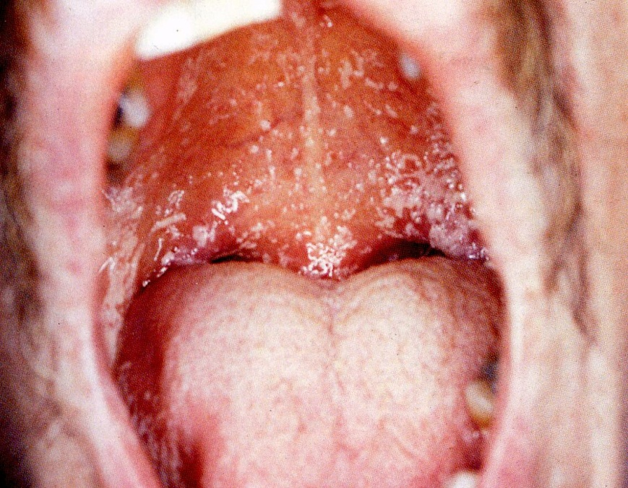
CANDIDIASYS OF STOMATHOPHARYNX
There are diffuse films on the mucous membrane of stomatopharynx, soft palate
The films are white or yellow, removed not difficulty. There is not bleeding surface under films.

Slide 91
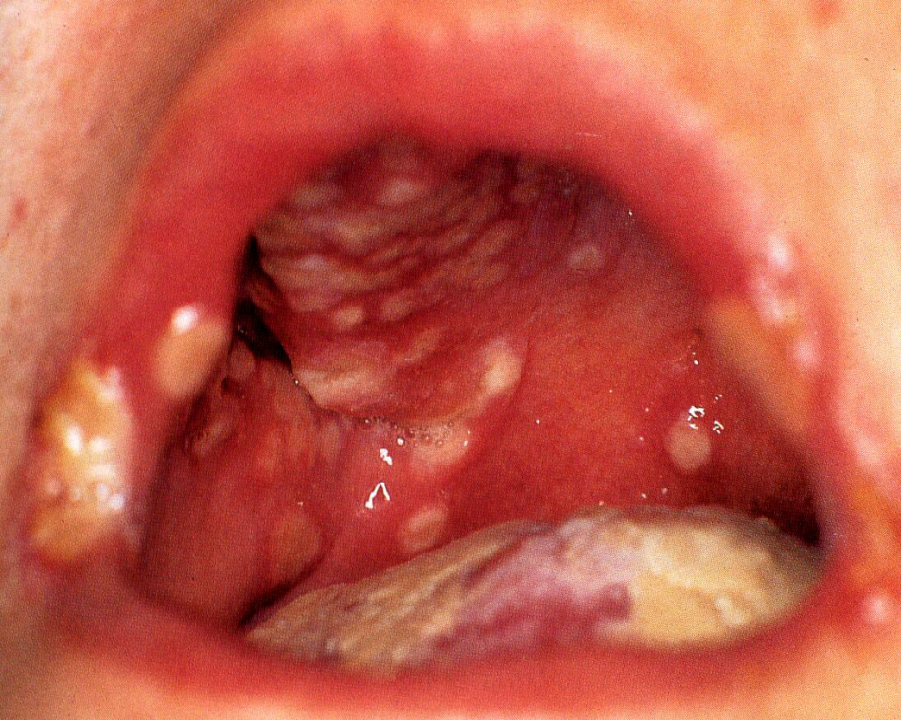
H E R P E T I C S T O M A T I T I S
Light hyperemia of the mucous membrane of stomatopharynx
Mild edema of tonsils
Отек и воспаление десен
The tongue is coated
There are vesicular rash on mucous membrane of stomatopharynx
Эрозии

Slide 92

INFECTIOUS MONONUCLEOSIS
Generalized lymphadenopathy
Prolonged fever
Hepato- and splenimegaly
Syndrome of tonsillitis
Exanthema
Jaundice
Changes in blood count (increase the level of atypical mononuclears more than 10%

Slide 93

MEASLES

Slide 94

RUBELLA

Slide 95

SMALL POX

Slide 96

T H A N K S FOR YOUR
A T T E N T I O N !

