Slide 1
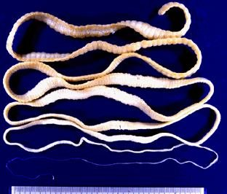
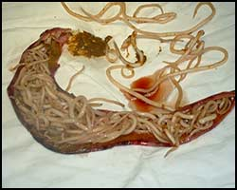
THE LECTURE:
«MEDICAL HELMINTHOLOGY. FLAT AND ROUND WORMS AS HUMAN PARASITES»

Slide 2
Helminthes are parasitic flat and round worms.
Biohelminthes develop by changing hosts. Definite host is an organism where mature sexual form of helminth is located.
Intermediate host is an organism where larvae of helminth live.
Geohelminthes develop without intermediate hosts, in environment, more often – in soil(”geo” – soil, earth).

Slide 3
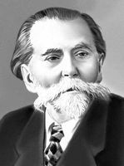
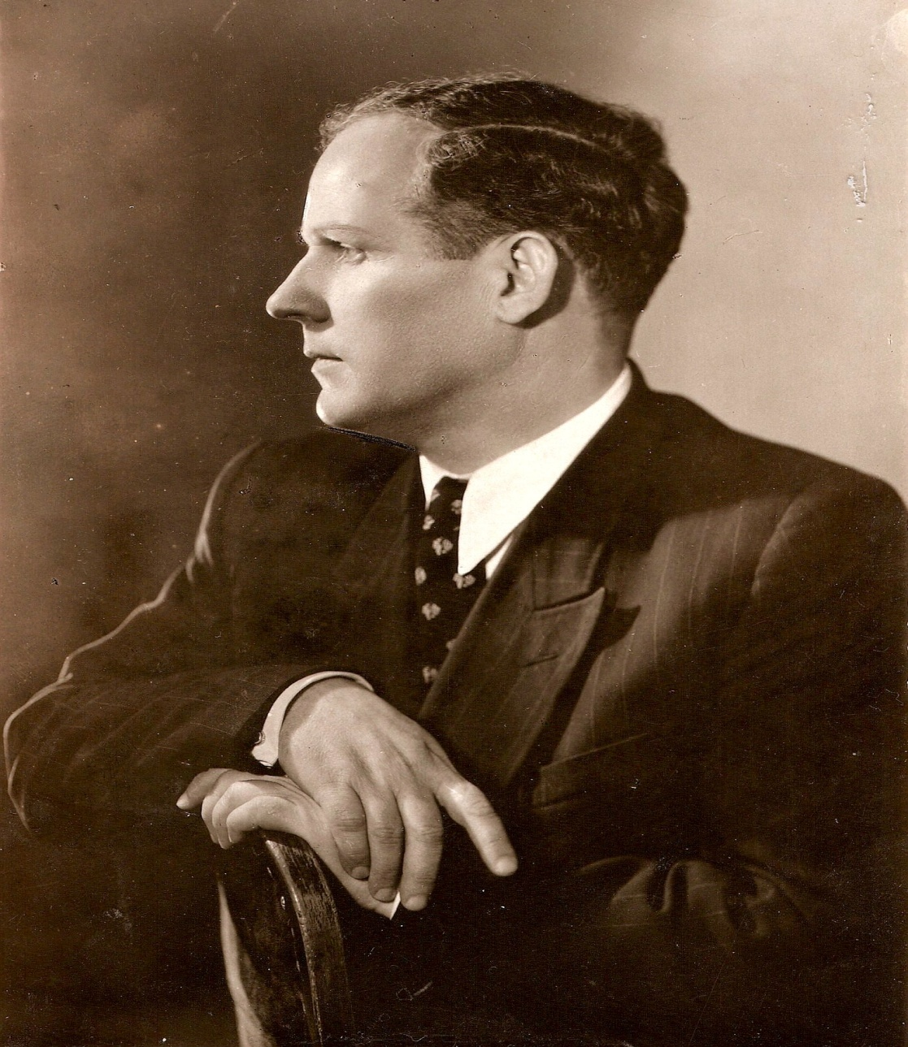
Outstanding helminthologists
К. І. Scryabin and О. P. Markevich

Slide 4
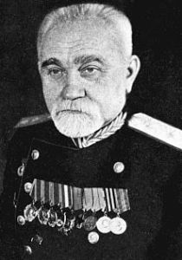
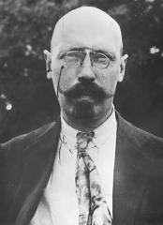
Outstanding helminthologists
E. N. Pavlovsky and V. О. Dogel

Slide 5
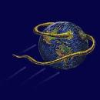
Epidemiology of helminthiases
Every third citizen of Europe is infected by helminthes, there are 2 species of helminthes are found in every citizen of Africa , 1 species of helminth can be found in every citizen of Asia and Latin America
(!)

Slide 6

Every year in the world
1,2 bln. people are infected with ascaridose, ancyclostomidoses are found in 900 mln. people, trichinellose – in 800 mln. people, trichocephaliase – in 700 mln. people. Helminthiases in Ukraine are
1300 per 100 000 a year.

Slide 7
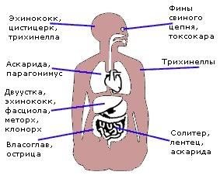
Location of helminthes

Slide 8
Ways of helminthiases transmission
. Eating of row animal products infected with larvae of helminthes.
fecal-oral. Ingestion of helminthes eggs with fruits and vegetables, unboiled water, dirty hands or mechanical vectors (house flies, red cochroaches).
percutaneous. Invasion of helminthes through skin from soil or water.
transmissive. Through bites of bloodsucking insects (mosquitoes, flies, etc.).

Slide 9
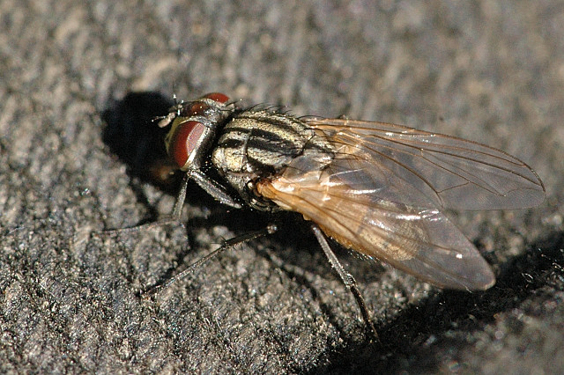
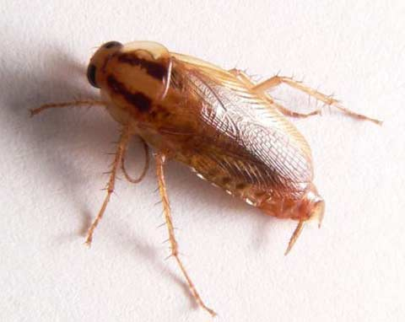
Mechanical vectors of helminthes eggs
(house fly, red cockroache)

Slide 10
Patogenic effect of helminthes
Mechanical. Damage of tissues by organs of fixation, ileus (intestinal obstruction), rupture of intestine by adult worms or larva migrans.
Toxic. Disorders of appetite, head ache, nausea, vomiting,diarrhea.
Allergic reactions. oedema, skin rush, changes of CBC – complete blood count (Eosinophylia, anemia).
Symptom of “food withdrawal”. Decreasing of body weight, exhaustion.
Supression of immunity .
Neoplasm stimulation (cancer of liver, pancreas, urinary bladder).

Slide 11
Natural-focal helmintiases
characters:
Agents circulate in nature independently from humans.
Natural reservoirs are wild animals.
Spread at some special territory (area).
components:
agent.
Natural reservoirs.
Complex of natural climate conditions.

Slide 12
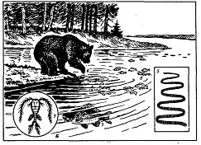
Diphyllobothriase – natural-focal helminthiase

Slide 13
Phylum Flat Worms
(Plathelminthes)
1. Triploblastic.
2. Integumentary-muscular suc.
3. Absence of body cavity. Parenchyme.
4. Bilateral symmetry.
5. Body shape is flatterened dorso-ventrally.
6. Systems of organs (digestive, excretory, nervous
and reproductive).
7. Hermaphrodites (but shistosomas).
8. Biohelminthes.
2 classes have medical importance:
Flukes (Trematoda) – agents of trematodoses.
Tape worms(Cestoda) – agents of cestodoses.

Slide 14
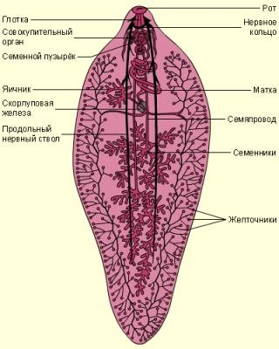
Trematoda, systems of organs

Slide 15
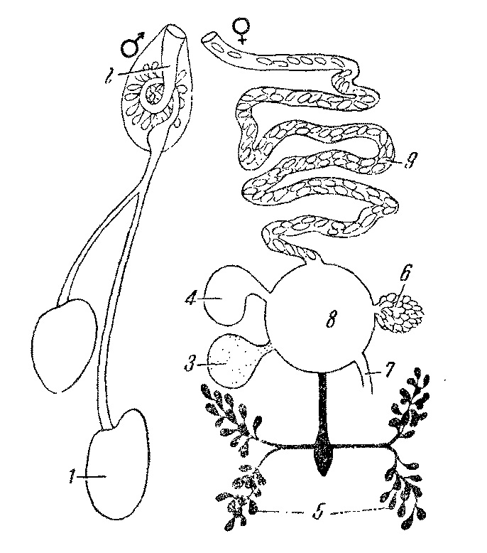
Reproductive system of trematodes

Slide 16
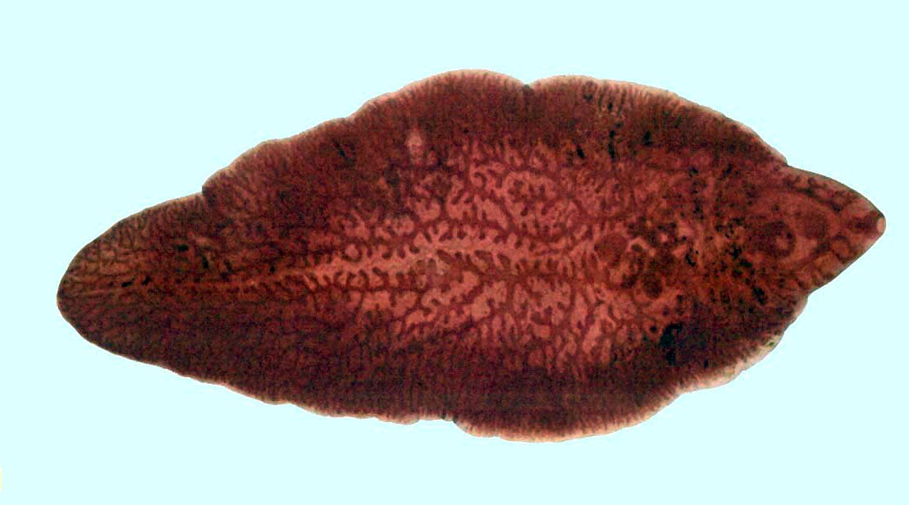
Marita of Fasciola (3-5 cm)

Slide 17
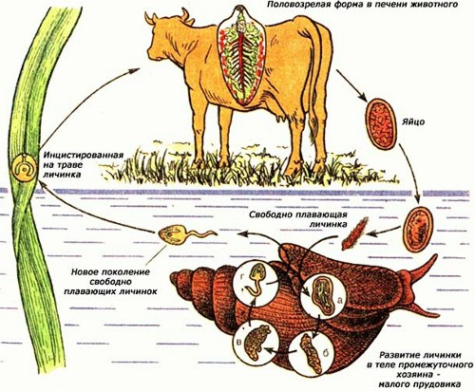
Liver fluke
(Fasciola hepatica)

Slide 18
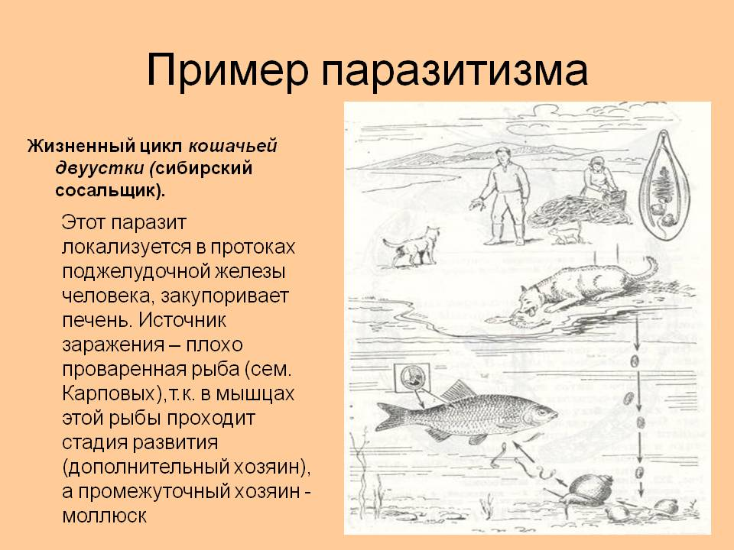
cat (Siberian) fluke
(Opisthorchis felineus)

Slide 19
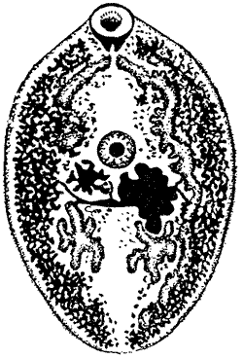
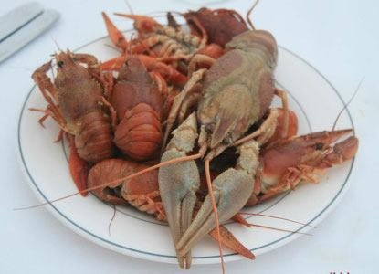
Lung fluke
(Paragonimus ringeri)

Slide 20
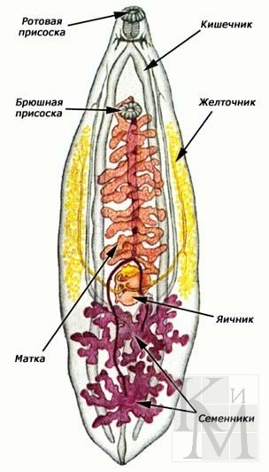
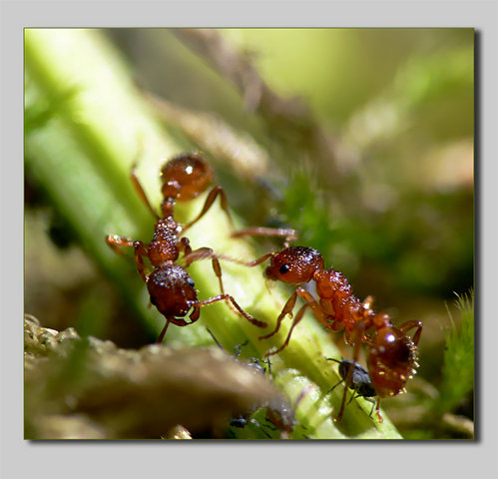
Lancet fluke
(Dicrocoelium lanceatum)

Slide 21
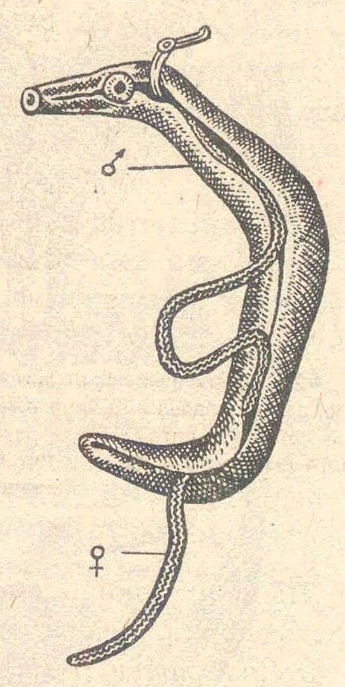
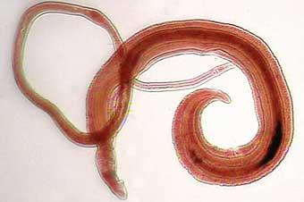
Blood fluke
Schistosoma haematobium

Slide 22
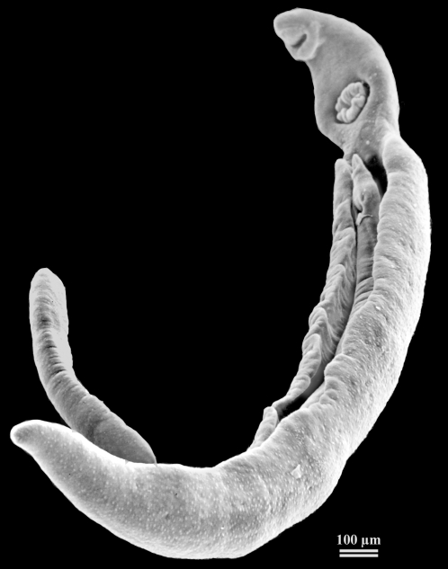
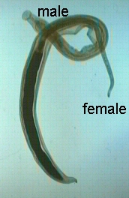
Blood flukes
Sch. mansoni et Sch. japonicum

Slide 23
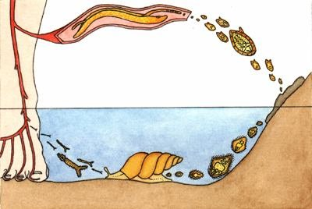
Life cycle of shistosomas

Slide 24
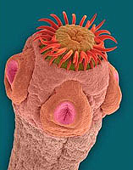
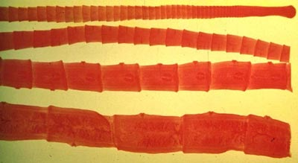
Scolex and proglottide of cestodes

Slide 25

Oncosphere of tape worms

Slide 26
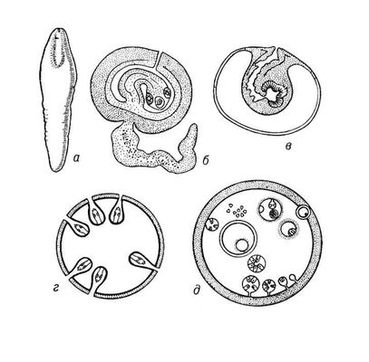
types of cestodes larvae

Slide 27
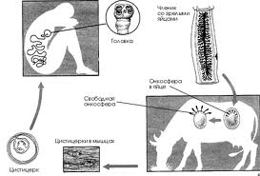
Beef (unarmed) tape worm
(Taeniarynchus saginatus)

Slide 28
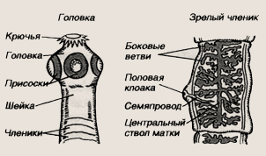
Pork (armed) tape worm
(Taenia solium)

Slide 29
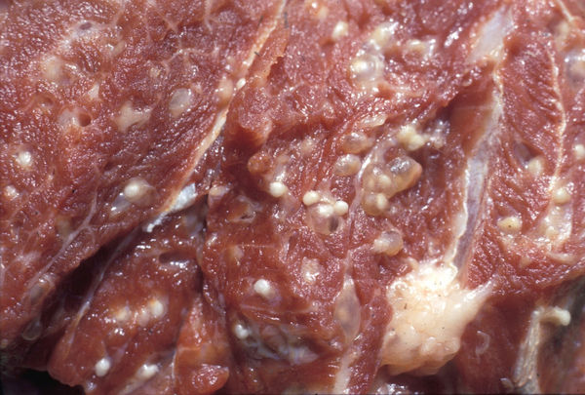
Cysticercs in pork

Slide 30
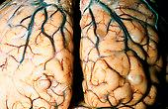
Cysticercosis of brain

Slide 31
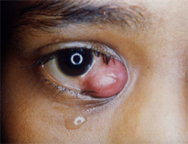
Ocular cysticercosis

Slide 32
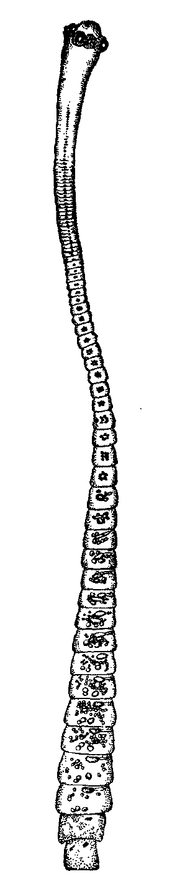
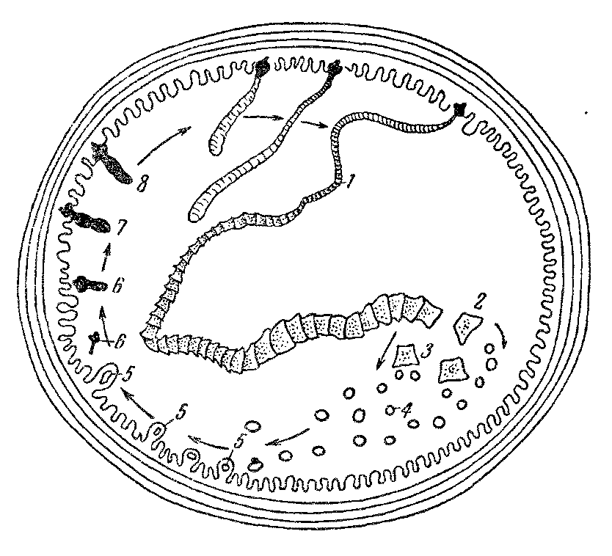
Dwarf tape worm
(Hymenolepis nana)

Slide 33
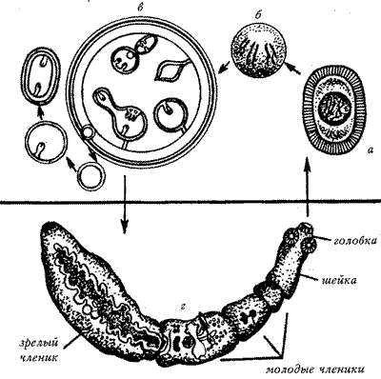
echinococcus
(Echinococcus granulosus)

Slide 34
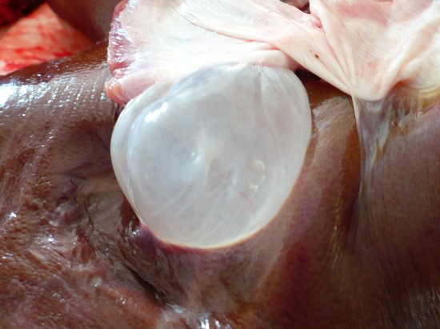
Hydatid cyst (expansive growth)

Slide 35
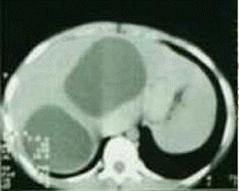
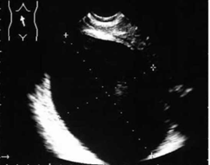
Diagnosis of hydatid disease (echinococcose)

Slide 36
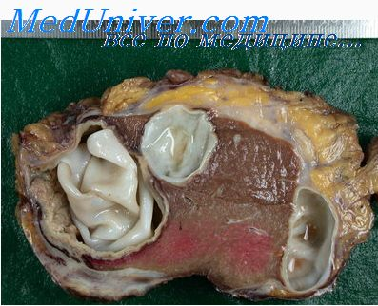
Hydatid cysts in liver

Slide 37
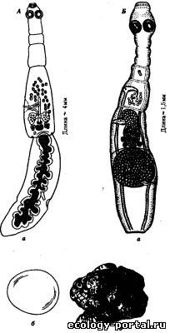
Echinococcus and alveococcus

Slide 38
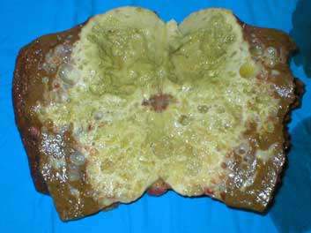
Alveococcus cyst(invasive growth)

Slide 39
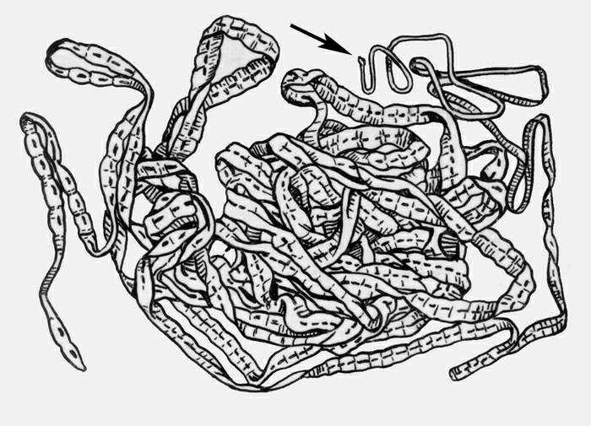
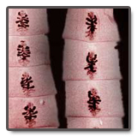
Broad fish tape worm
(Diphyllobotrium latum)

Slide 40
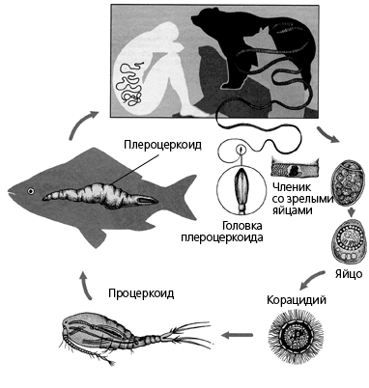
Life cycle of broad tape worm

Slide 41
PHYLUM ROUND WORMS
(Nemathelminthes)
1.Triploblastic.
2. Integumentary- muscular suc.
3. Primary body cavity(pseudocoelom).
4. Bilatery symmetry.
5. Body is not segmented, elongated.
6. Systems of organs(digestive, excretory, nervous and
reproductive).
7. Роздільностатеві. Sexual dimorphism.
8. Lateral part of intestine with anus.
9. Constant number of cells. Auxentic growth.
10. There are biohelminthes and geohelminthes.
11. Some of them are ovoviviperous (trichina worm, filariae).
Medical important are round worms (Nematoda) as agents of nematodoses.

Slide 42
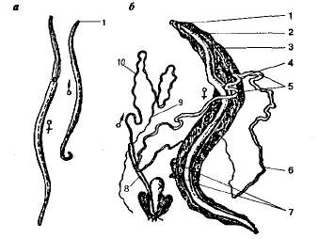
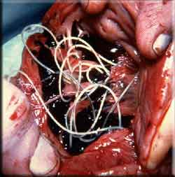
HUMAN ASCARIS
(Ascaris lumbricoides)

Slide 43
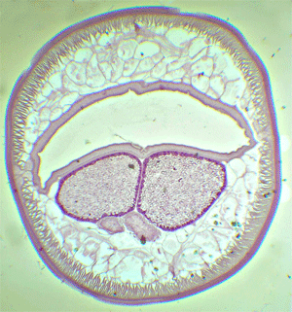
Ascaris female transversal cutting

Slide 44
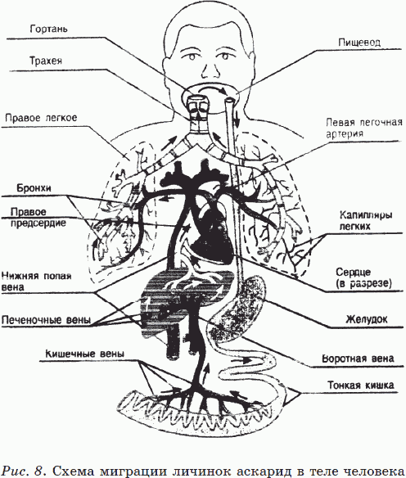
Ascaris larvae migration

Slide 45
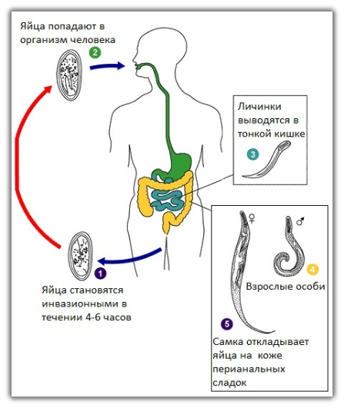

PIN WORM
(Enterobius vermicularis)

Slide 46


WHIP WORM
(Trichocephalus trichiurus)

Slide 47


HOOK WORM
(Ancylostoma duodenale)

Slide 48

NECATOR , American (L.- killer) (Necator americanus)

Slide 49


TRICHINA WORM
(Trichinella spiralis)

Slide 50


GUINEA WORM
(Dracunculus medinensis)

Slide 51

Professor L. M. Isayev made devastation of Guinea worm in Uzbekistan

Slide 52


Filaria Bancrofti
(Wuchereria bancrofti)

Slide 53


Filaria LOA-LOA(Loa loa)

Slide 54


Filaria Oncocerc
(Onchocerca volvulus)

Slide 55

Morphology of helminthes eggs
Nematoda Cestoda Trematoda

Slide 56

Microslide of whip worm eggs

Slide 57
PREVENTION OF HELMINTHIASES
Individual. Wash hands, fruits and vegetables. Boil water. Cook properly animal products.
Social. Make social sanitary education. Make diagnose and treat patients. Veterinary control of markets and supermarkets. Observe sanitary state of water pipes and sewerage. Kill mechanical vectors of helminthes eggs (flies, cochroaches).

Slide 58


STOP HELMINTHIASES!

Slide 59

BE HEALTHY!

