Slide 1
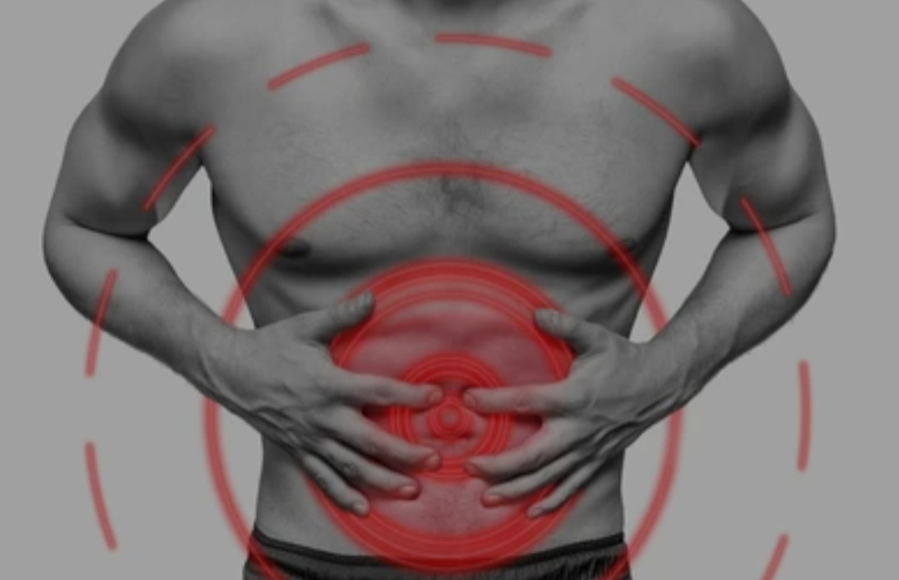
Acute Abdomen
Odesa National Medical University
Department of family medicine and polyclinic therapy
Prepared by: assistant Bazhora Ya. I.

Slide 2
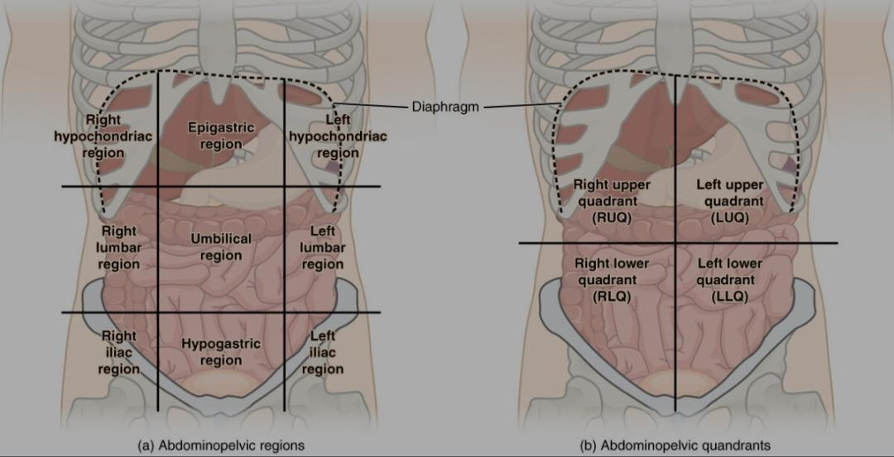
Acute abdomen, which is in many cases a surgical emergency, is the sudden onset of abdominal pain that may be caused by inflammatio, infection, perforation, ischemia, or obstruction. The location of the pain, its characteristics, and associated symptoms (e.g., jaundice) are important tools that help narrow the differential diagnosis. Patients will typically have severe tenderness with associated rigidity and rebound tenderness

Slide 3
Causes of Acute Abdomen
Intestinal
    Acute appendicitis, mesenteric adenitis, mekel’s diverticulitis, perforated peptic ulcer, gastroenteritis, diverticulitis, intestinal obstruction, strangulated hernia
Hepatobiliary
    Biliary colic, cholecystitis, cholangitis, pancreatitis, hepatitis
Vascular
    Ruptured AAA, acute mesenteric ischaemia, ischaemic colitis
Urological
    Renal colic, UTI, testicular torsion, acute urinary retention
Gynaecological
    Ectopic pregnancy, ovarian cyst pathology (rupture/haemorrhage into cyst/torsion), salpingitis, endometriosis, mittelschmerz (mid-cycle pain)
Medical (can mimic an acute abdomen)
    Pneumonia, MI, DKA, sickle cell crisis, porphyria

Slide 4
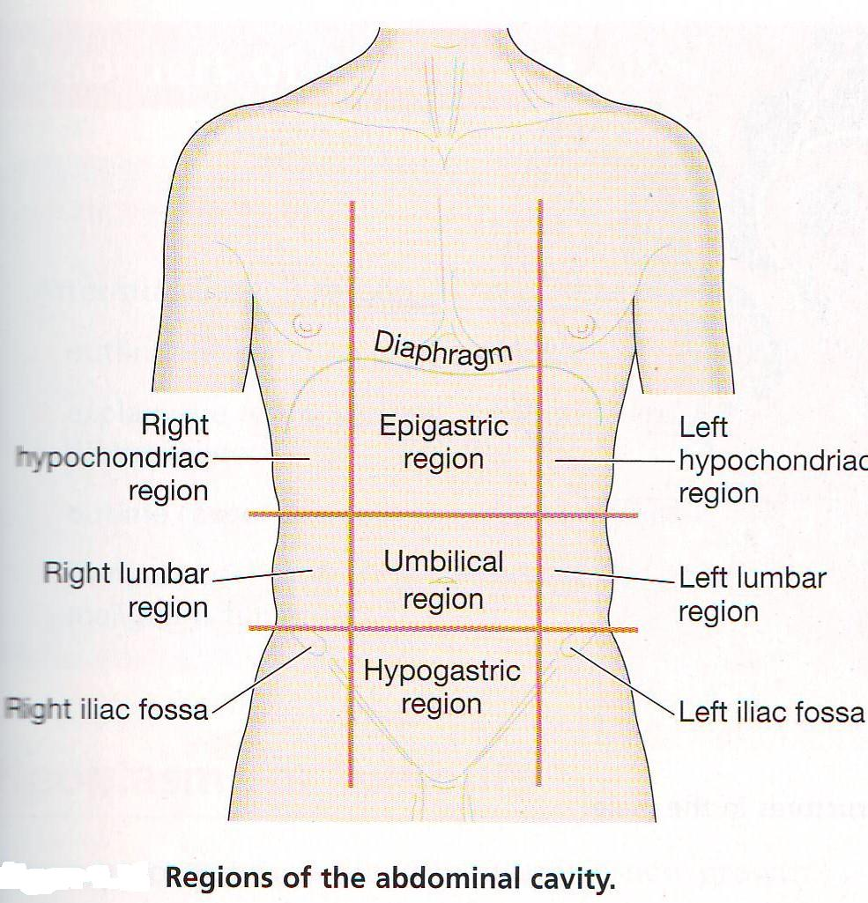
Acute Abdomen: The Examination
Liver (hepatitis)
Gall bladder (gallstones)
Stomach (peptic ulcer, gastritis)
Transverse colon (cancer)
Pancreas (pancreatitis)
Heart (MI)
Liver (hepatitis)
Gall bladder (gallstones)
Stomach (peptic ulcer, gastritis)
Hepatic flexure colon (cancer)
Lung (pneumonia)
Spleen (rupture)
Pancreas (pancreatitis)
Stomach (peptic ulcer)
Splenic flexure colon (cancer)
Lung (pneumonia)
Ascending colon (cancer,)
Kidney (stone, hydronephrosis, UTI)
Descending colon (cancer)
Kidney (stone, hydronephrosis, UTI)
Appendix (Appendicitis)
Caecum (tumour, volvulus, closed loop obstruction)
Terminal ileum (crohns, mekels)
Ovaries/fallopian tube (ectopic, cyst, PID)
Ureter (renal colic)
Sigmoid colon (diverticulitis, colitis, cancer)
Ovaries/fallopian tube (ectopic, cyst, PID)
Ureter (renal colic)
Small bowel (obstruction/ischaemia)
Aorta (leaking AAA)
Uterus (fibroid, cancer)
Bladder (UTI, stone)
Sigmoid colon (diverticulitis)

Slide 5
Intestinal
PU: H.pylori, NSAIDs, steroids, >55, M, alcohol, bloating, epigastric/retrosternal pain, worse with food, GI bleed
Gastric Ca: Wt loss, smoking, blood grp A, GI bleed, epigastric pain, virchow’s node, acanthosis nigricans
Hiatus hernia: F, obese, >55, GORD, epigastric, N+V high
DU: epigastric pain, improves with food, worse at night
Chrohns: transmural = air in abdomen, apthous ulcers, anal fissures, smoking, terminal ileum, younger, PR bleed
UC: non-smoker, PSC, large bowel, PR bleed, lead pipe, nodosum
IBS: Distension, bloating, generalised pain, improves with defacation, >45, F, stress, change in habit, diarrhoea
Coeliac: steatorrhoea, diarrhoea, dermatitis herpetiformis, anaemia

Slide 6
Intestinal (Large Bowel)
Appendicitis: RIF pain, Mc Burney’s point tenderness, peritonitic
Diverticulitis: LIF pain, PR bleed, Elderly, common
Colorectal Ca: Fe deficient anaemia, Wt loss, altered bowel habit, PR bleed, fatigue, mass palpable, obstructed
Large bowel obstruction: Distension, colicky pain, absolute constipation, N+V (faeculent), tinkling BS
Small bowel obstruction: early billious vomiting, late obstruction,chrohns
Perforation: shock, rigid abdomen, severe tenderness, pyrexia, air under diaphragm, Rigler’s sign

Slide 7
Hepatobilliary
Biliary Colic: constant, writhing, RUQ pain radiating to back, worsens with fatty meals
Cholecystitis: female, obese, >40, pregnant, RUQ pain radiating to shoulder blade, amylase, Murphy’s sign
Acute Pancreatitis: gallstones, alcohol, grey turners/cullens sign, RUQ pain radiating to back, improved by leaning forward, amylase
Cholangitis: Fever ~40, Jaundice, RUQ pain, rigors, female, obese, gallstones
Cirrhosis: Jaundice, splenomegaly, telangectasia, spider naevi, high JVP, duputren’s contractures, clubbing, palmer erythema, gynaecomastia, ascites, liver flap, xanthelasma, high INR, low Albumin

Slide 8
Vascular
AAA: severe central pain, back pain, collapse, expansile abdominal mass, >50, smoker, HTN, marfan’s, renal failure/colic, M
Dissection: tearing retrosternal pain radiating to back, high BP, reduced leg pulses, renal involvement
Mesenteric ischaemia: severe colicy generalised pain, reduced bowel sounds, air in intestinal walls, AF, elderly, angina
MI: central, crushing pain, N+V, unstable, elderly, exertional, pale, SOB

Slide 9
GU
UTI: female, common, suprapubic tenderness, positive dip, retention, prolapse, DM
Urinary Retention: UTI, post-op, spinal injury, elderly, stones, severe constant suprapubic pain, well localised, resonant to percussion
Renal colic: sudden very severe loin to groin pain, tachycardic, pyrexia, sweating, writhing
Testicular Torsion: Severe sudden lower abdo pain with unilateral groin tenderness and swelling, young

Slide 10
OBG
Ectopic: young, amennorrhoea, collapse, shock, severe sudden lower abdo pain radiating to shoulder, PV bleed
PID: fertile, previous surgery, previous STI, purulent discharge, pyrexia
Endometriosis: 35-40, nulliparous, cyclical pelvic pain, assoc PR bleed, dysmennorhoea, deep dyspareunia
Fibroids: afro-carribean, nulliparous, mennorhagia, miscarriages, palpable mass, pressure/cyclical pain
Ovarian Cyst torsion: sudden severe RUQ/LUQ pain, vomiting, shock, pyrexia – intermittent if incomplete
Ovarian Ca: 60-70, wt loss, PV bleed, abdo distension

Slide 11
Medical
Gastroenteritis: high diarrhoea, dehydration, fatigue, high pyrexia, elderly, travel hx, Abx use
Pneumonia: SOB, cough, elderly, diabetic, COPD, sharp upper abdo pain, worse with inspiration, creps, CXR
DKA: young, thin, kussmaul’s respiration, dehydration, generalised abdo pain, N+V, high BM, low pH
Sickle cell crisis: afro-carribean, auto-recessive, dehydration, pleuritic, splenic pain, jaundice, gallstones
Porphyria: hereditary, generalised neuropathic abdominal pain, anaemia, response to certain drugs, muscle weakness

Slide 12
Acute Abdomen: The History
Abdominal pain – features will point you towards diagnosis
SOCRATES
    Site and duration
    Onset – sudden vs gradual
    Character – colicky, sharp, dull, burning
    Radiation – e.g. Into back or shoulder
    (Associated symptoms – discussed later)
    Timing – constant, coming and going
    Exacerbating and alleviating factors
    Severity
    2 other useful questions about the pain:
        Have you had a similar pain previously?
        What do you think could be causing the pain?

Slide 13
Acute Abdomen: The History
Associated symptoms
    GI: bowels last opened, bowel habit (diarrhoea/constipation), PR bleeding/melaena, dyspeptic symptoms, vomiting
    Urine: dysuria, heamaturia, urgency/frequency
    Gynaecological: normal cycle, LMP, IMB, dysmenorrhoea/menorrhagia, PV discharge
    Others: fever, appetite, weight loss, distention
Any previous abdominal investigations and findings
Other components of history
    PMH e.g. Could patient be having a flare up/complication of a known condition e.g. Known diverticular disease, previous peptic ulcers, known gallstones
    DH e.g. Steroids and peptic ulcer disease/acute pancreatitis
    SH e.g. Alcoholics and acute pancreatitis

Slide 14
Acute Abdomen: The Examination
Inspection: scars/asymmetry/distention
Palpation:
  Point of maximal tenderness
  Features of peritonitis (localised vs generalised)
      Guarding
      Percussion tenderness
      Rebound tenderness
  Mass
  Specific signs (Rosvig’s sign, murphy’s sign, cullen’s sign, grey-turner’s sign)
Percussion: shifting dullness/tympanic
Auscultation: bowel sounds
      Absent
      Normal
      Hyperactive
      tinkling
The above will point you to potential diagnosis

Slide 15
RIF Pain: APPENDICITIS
Appendix/ abscess
Pelvic inflammation/ period pain
Pancreas
Ectopic/ endometriosis
Neoplasm
Diverticulitis
Intussusseption
Chrohn’s/ Cyst
IBD
Torsion
IBS
Stones

Slide 16
LIF Pain: SUPERCLOTS
Sigmoid diverticuli, volvulous
Ureteric colic
Pelvic inflammation/ period pain
Ectopic/ endometriosis
Rectal Haematoma
Colon cancer
Left lower pneumonia
Ovarian cyst
Torsion
Stones

Slide 17
Acute Abdomen: Investigations
Simple Investigations:
    Bloods tests (FBC, U&E, LFT, amylase, clotting, CRP, G&S/ Xmatch, ABG)
    BM
    Urine dipstick
    Pregnancy test (all women of child bearing age with lower abdominal pain)
    AXR/E-CXR
    ECG
More complex investigations:
    USS
    Contrast studies
    Endoscopy (OGD/colonoscopy/ERCP)
    CT
    MRI

Slide 18
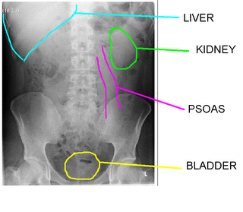
AXR
Demographics/ Type of XR
Black: dilated loops / Air
Small = central, valvulae conniventes
Large = Peripheral, Haustrae
White: Calcification
Renal stones/ Gallstones
Foreign Bodies
Bone
Grey: soft tissue
Liver, spleen, pancreas, gall bladder, ovary, uterus
Enlargement, calcification
Abdominal wall muscles, hernias
Stool
Re-review and summarise

Slide 19
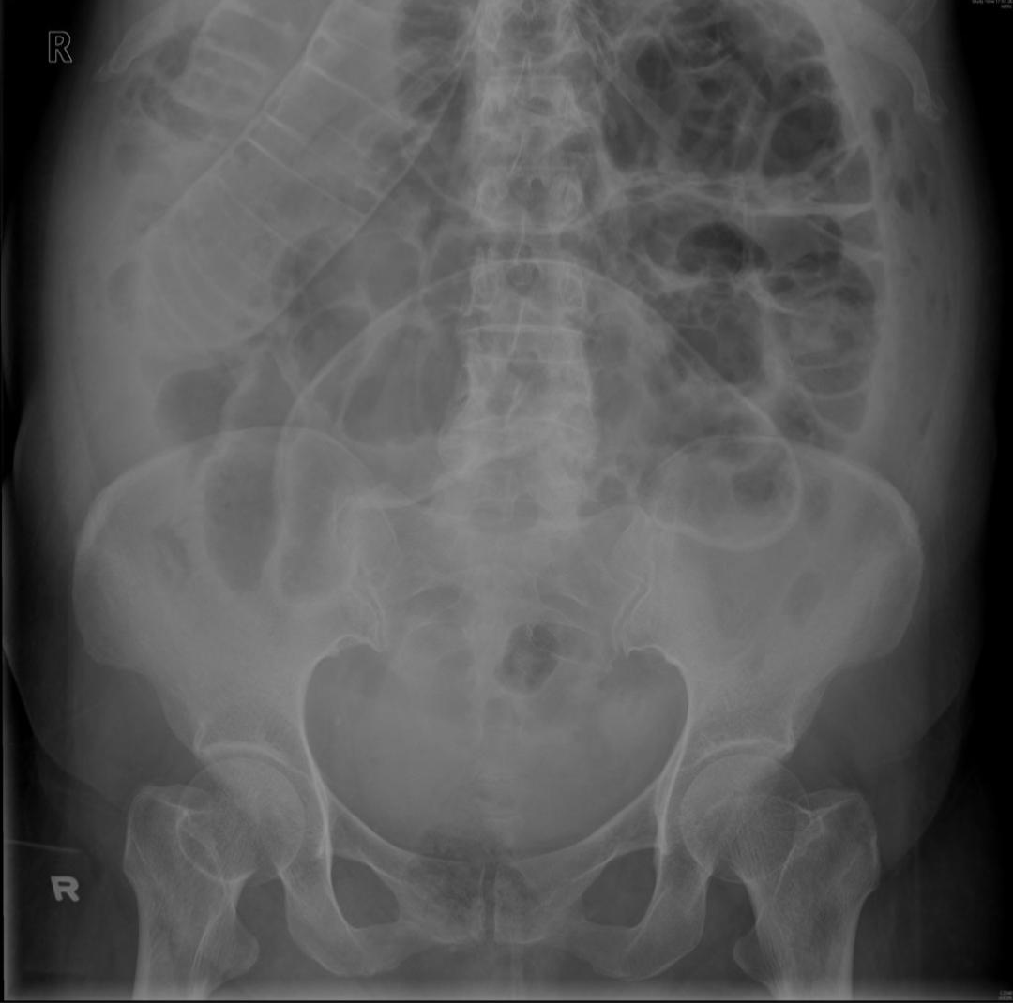
Air in Abdomen
Post-op/ Post-ERCP
Perforation
Cholangitis
Abscess
Gallstone Ileus

Slide 20
Acute Abdomen: Indication for theatre
Urgent surgery should not be delayed for time consuming tests when an indication for surgery is clear
The following three categories of general surgical problems will require emergency surgery
    Generalised peritonitis on examination (regardless of cause – except acute pancreatitis, hence all patients get amylase)
    Perforation (air under diaphragm on E-CXR)
    Irreducible and tender hernia (risk of strangulation)

Slide 21
Management - Conservative
Lifestyle:
Weight loss,
smoking cessation
alcohol reduction
exercise
modified diet (low fat/ high fibre)
MDT: Physio/ OT/ Nutrition Team/ Dietician/ Specialist Nurses, other specialties

Slide 22
Management - Medical
A - Secure airway
B – Oxygen 15L
C - Fluid Balance: large bore, IVF, catheter, bloods, Xmatch
C - Blood Transfusion
D - Analgesia
E – IV Antibiotics
E –Thromboprophylaxis?
Anti-emetics/ NG aspiration
Supportive nutrition/ NBM
Re-assess
Therapeutic procedures: ERCP

Slide 23
Management - Surgical
Emergency Laparotomy or Watch+Wait?
Monitor Pain
Serial CTs
Unstable?
E.g.:
Appendicectomy
Cholecystectomy
Defunctioning Ileostomy
Abscess drainage/ Necrosectomy

Slide 24
Thank you

