Slide 1
Acute respiratory diseases in the practice of a family doctor.
Characteristics of the patient, diagnosis, treatment.
Odesa National Medical University
Department of family medicine and polyclinic therapy
Prepared by: associate professor Chernetska H. V.

Slide 2
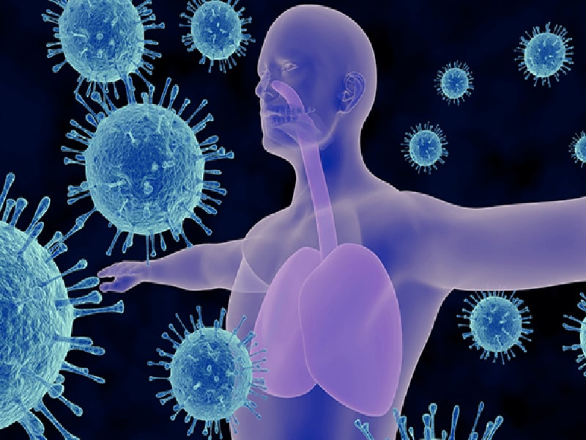
DEFINITION
Acute respiratory diseases (ARI) - a group of diseases caused by a wide range of infectious agents and combined with common features of epidemiology and pathogenesis of respiratory tract, the development of the respiratory syndrome, and general intoxication of varying severity.
Acute respiratory infection (ARI) is defined as an acute infectious disease of the upper or lower respiratory tract, accompanied by the development of respiratory syndrome and general intoxication of varying severity. Upper respiratory tract infections include acute rhinosinusitis, acute otitis, pharyngitis/tonsillitis, and laryngitis. Lower respiratory tract infections include tracheitis, acute bronchitis, bronchiolitis, and pneumonia.

Slide 3
EPIDEMIOLOGY
Each year, children have around 6 to 8 ARI, and adults have 2 to 4 ARI. Adults who are in contact with children get more colds than adults who are not in contact with children. There are no major sex or ethnicity differences in incidence. Most infections occur in the winter period.
Transmission mechanisms include the contact pathway through the hands and surrounding objects that have been exposed to the virus, or from one person to another by airborne droplets spread through coughing or sneezing. Studies show that the virus is most often transmitted by shaking hands.

Slide 4

ETIOLOGY
In the etiological structure of ARI, the largest share belongs to viruses, which mainly belong to 9 different groups of viruses - influenza, parainfluenza, adeno-, RS- (respiratory syncytial), picorna-, corona- reo-, entero- and herpesviruses.
ARI in adults is most often caused by the following bacterial microorganisms:
mainly opportunistic coccal microflora (acute pharyngitis, bronchitis). Meningococcal infection, diphtheria are singled out as especially dangerous and highly contagious;
legionella
mycoplasmas

Slide 5

PATHOGENESIS
Stages of the pathogenesis of ARI
Damage of the sensitive epithelium. For some ARI, there is some "selectivity" of upper respiratory tract involvement associated with the receptor-ligand relationship, which allows the etiology of ARI to be clinically suspected.
Reproduction of viruses in the epithelium of the upper respiratory tract and its damage.
Generalization of the process, viremia, vascular wall lesions with the development of secondary processes.
Formation of the systemic cellular immune response, stimulation of serological protection.
Elimination of the infectious process, development of serological protection, reparative recovery processes.

Slide 6
An important consequence of the study of the pathogenesis of ARI is that recovery from them occurs by activating cellular defenses, antibodies appear late, already in the period of early convalescence, are important mainly for the prevention of re-infection.
In the pathogenesis of bacterial infection (mycoplasmosis, chlamydia, rickettsiosis) is of great importance cellular immunity, certain shortcomings of which often lead to the persistence of these pathogens, especially in children. ARI caused by opportunistic pathogenic microflora, primarily coccal, have mainly signs of a cyclic infectious process that is capable of self-elimination.

Slide 7
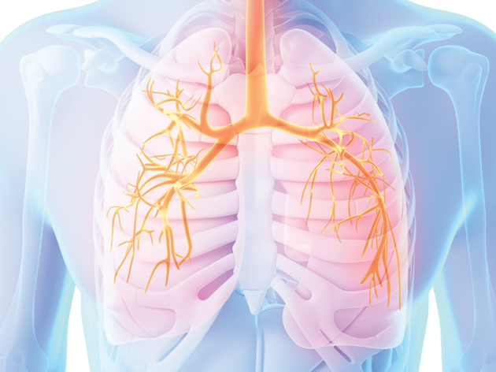
CLASSIFICATION
International Classification of Primary Care, Second Edition (ICPC-2):
R74 Upper respiratory infection acute
R75 Sinusitis acute / chronic
R76 Tonsillitis acute
R77 Laryngitis / tracheitis acute

Slide 8
International Classification of Diseases (ICD-10):
Codes
J00 Acute nasopharyngitis [common cold]
J02 Acute pharyngitis
J02.9 Acute pharyngitis, unspecified
J03 Acute tonsillitis
J03.9 Acute tonsillitis, unspecified
J04 Acute laryngitis and tracheitis
J04.0 Acute laryngitis
J04.1 Acute tracheitis
J04.2 Acute laryngotracheitis
J06 Acute upper respiratory infections of multiple and unspecified sites
J06.0 Acute laryngopharyngitis
J06.8 Other acute upper respiratory tract infections with multiple localizations
J06.9 Acute upper respiratory infection, unspecified

Slide 9
HISTORY
Common symptoms include any or all of the following:
• Runny/blocked nose
• Sneezing
• Sore throat
• Cough
• Headache
• Malaise
• Fever

Slide 10
An alternative or underlying diagnosis should be considered if:
• A sore throat is the main symptom (streptococcal pharyngitis or tonsillitis should be considered, especially if the patient is younger than 15 years of age). Use of the McIsaac score can be useful to differentiate from streptococcal infection.
• Rhinitis has been present for more than 14 days (e.g., allergic rhinitis)
• The illness started suddenly with fever, chills, and severe muscle aches (e.g., influenza or pneumonia)
Symptoms include:
• Pleuritic pain, large amounts of sputum, or blood in the sputum (e.g., pleurisy or pneumonia)
• Otalgia (e.g., otitis media)
• Facial pain (sinusitis)
• Features of meningism are present (altered consciousness, photophobia, hypotonia, neck stiffness, seizures, and tachycardia).

Slide 11
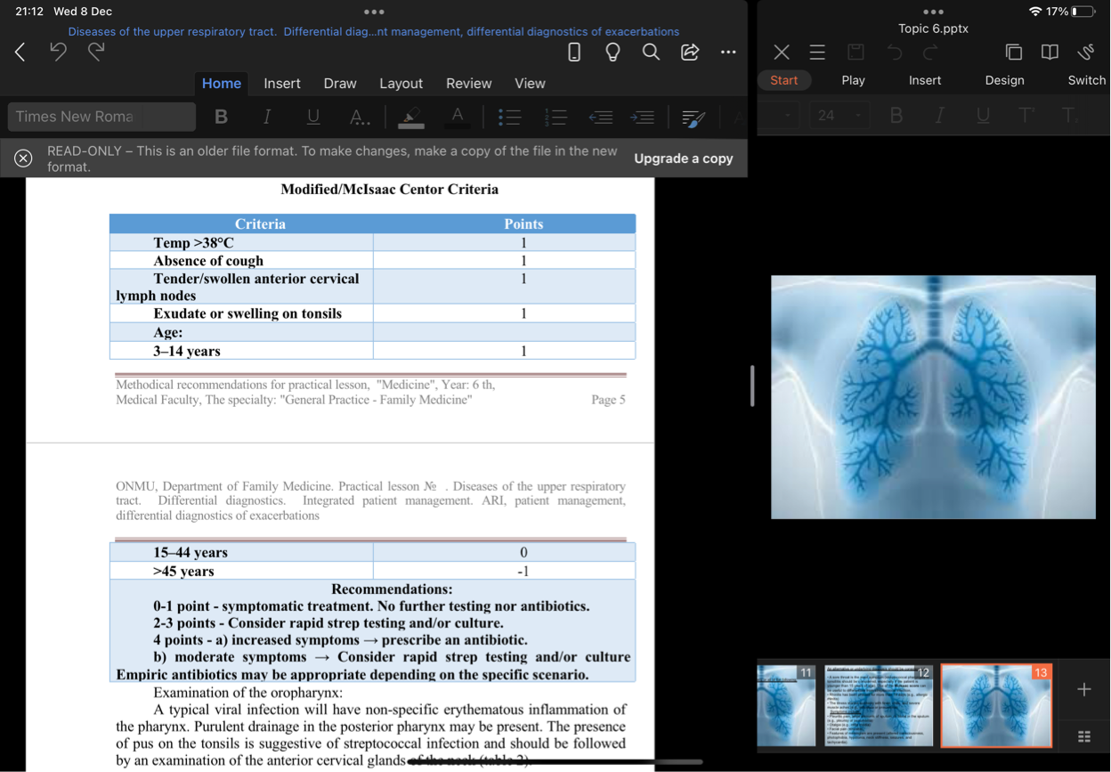

Slide 12
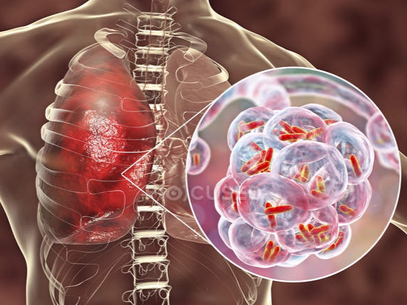
PHYYSICALEXAMINATION
Temperature:
In adults, an elevated temperature is unusual, but this is common in children. A temperature greater than 38°C increases the likelihood of the diagnosis being influenza. Pulse and blood pressure should be measured to rule out septic shock from a bacterial cause (e.g., meningococcal septicaemia) in people who look moderately ill.
Examination of the oropharynx:
A typical viral infection will have non-specific erythematous inflammation of the pharynx. Purulent drainage in the posterior pharynx may be present. The presence of pus on the tonsils is suggestive of streptococcal infection and should be followed by an examination of the anterior cervical glands of the neck

Slide 13
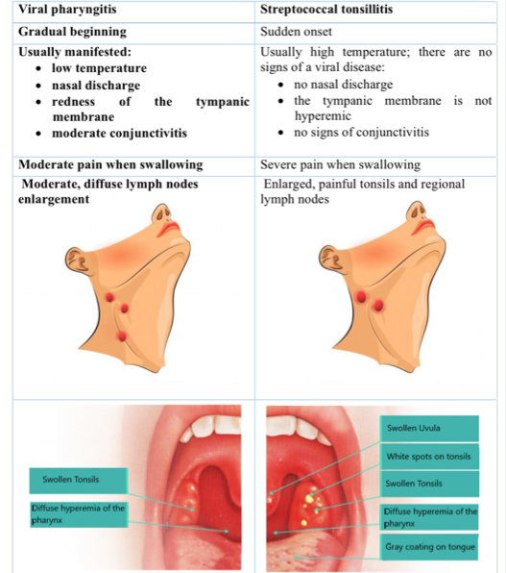
Differential diagnosis of viral pharyngitis and streptococcal tonsillitis

Slide 14
Nostrils:
Erythema and oedema may be present. Purulent drainage in both nares is common.
Neck stiffness:
Should be assessed as may indicate meningism. In infants, a bulging fontanelle and a characteristic high-pitched cry may occur. A positive Kernig's or Brudzinski's sign indicates meningeal inflammation and is suggestive of meningitis. This is present in a minority of patients.
If the patient has lower respiratory signs, other diagnoses should be considered, such as an acute exacerbation of asthma or COPD or pneumonia. In children, bronchiolitis and croup should be considered.

Slide 15
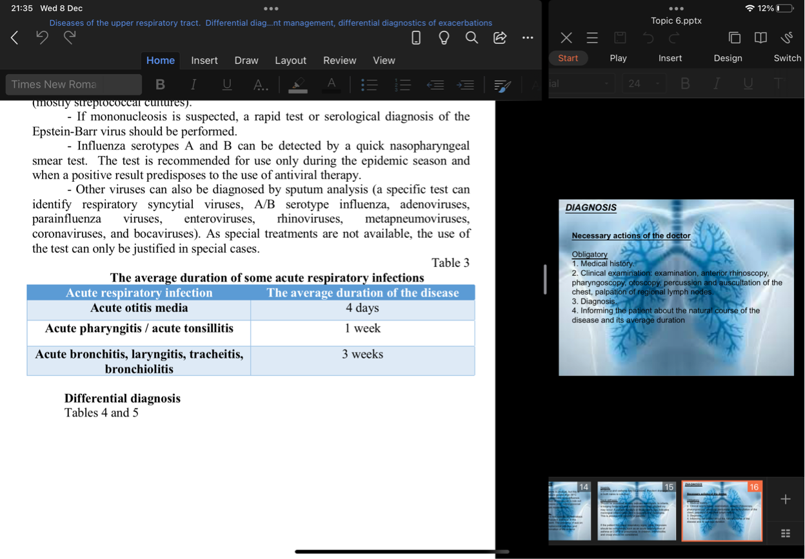
DIAGNOSIS
Necessary actions of the doctor
Obligatory
1. Medical history.
2. Clinical examination: examination, anterior rhinoscopy, pharyngoscopy, otoscopy, percussion and auscultation of the chest, palpation of regional lymph nodes.
3. Diagnosis.
4. Informing the patient about the natural course of the disease and its average duration

Slide 16
Desirable
Laboratory tests: CBC, throat swab and sputum culture; viral testing on influenza.

Slide 17
International protocols state that laboratory tests are usually not required to diagnose ARI. They can be used for the differential diagnosis between viral and bacterial infections or if there is a reason to look for a specific pathogen. The use of a C-reactive protein test in primary care in patients with acute respiratory symptoms may reduce the need for antibiotics, but does not affect treatment outcomes, according to patient estimates.

Slide 18
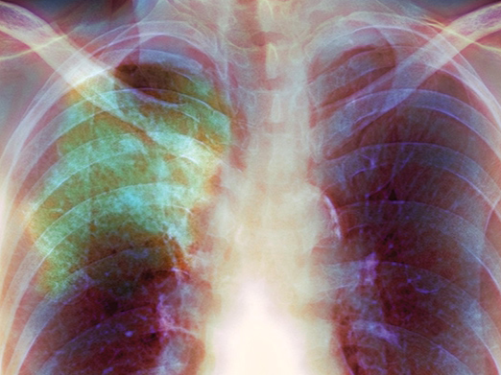
General blood test with platelet count. Lymphocytopenia is common in acute infections. Many viruses can reduce the formation of neutrophils. Sometimes neutropenia can persist for several weeks after a viral infection has subsided. Bacterial infections usually cause neutrophilia and do not inhibit hematopoiesis in the bone marrow.
If you suspect tonsillitis, take a swab from the throat on the microflora (mostly streptococcal cultures).
If mononucleosis is suspected, a rapid test or serological diagnosis of the Epstein-Barr virus should be performed.

Slide 19
Influenza serotypes A and B can be detected by a quick nasopharyngeal smear test. The test is recommended for use only during the epidemic season and when a positive result predisposes to the use of antiviral therapy.
Other viruses can also be diagnosed by sputum analysis (a specific test can identify respiratory syncytial viruses, A/B serotype influenza, adenoviruses, parainfluenza viruses, enteroviruses, rhinoviruses, metapneumoviruses, coronaviruses, and bocaviruses). As special treatments are not available, the use of the test can only be justified in special cases.

Slide 20
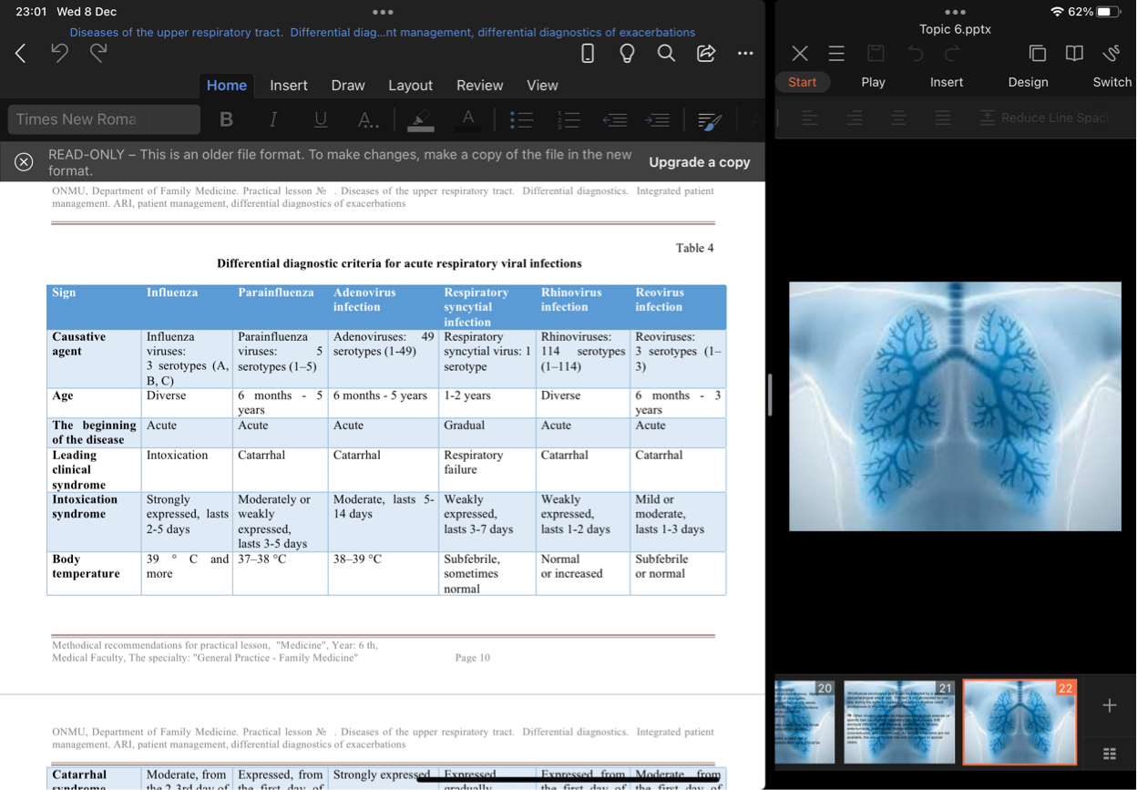

Slide 21
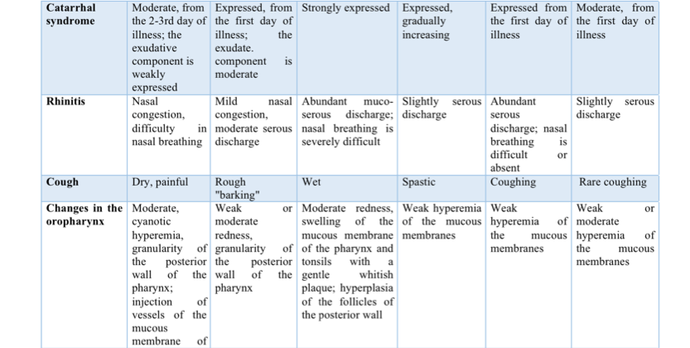
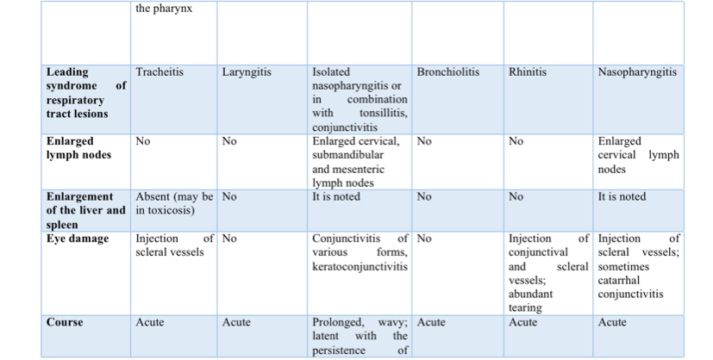
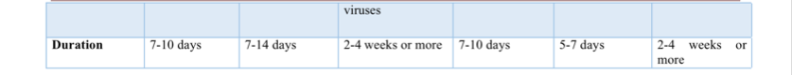

Slide 22
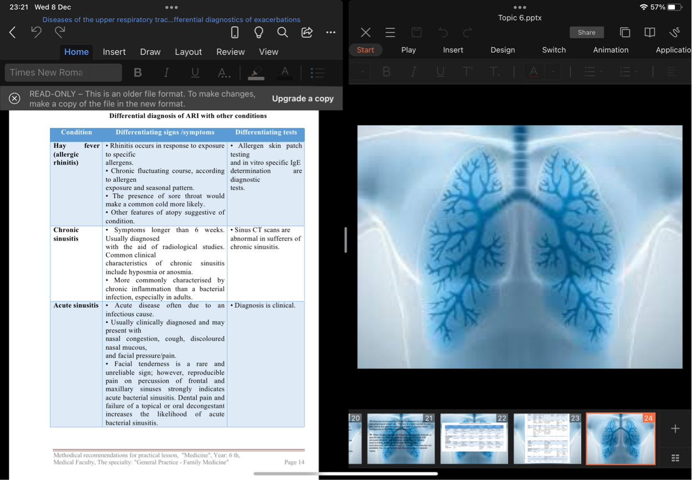

Slide 23
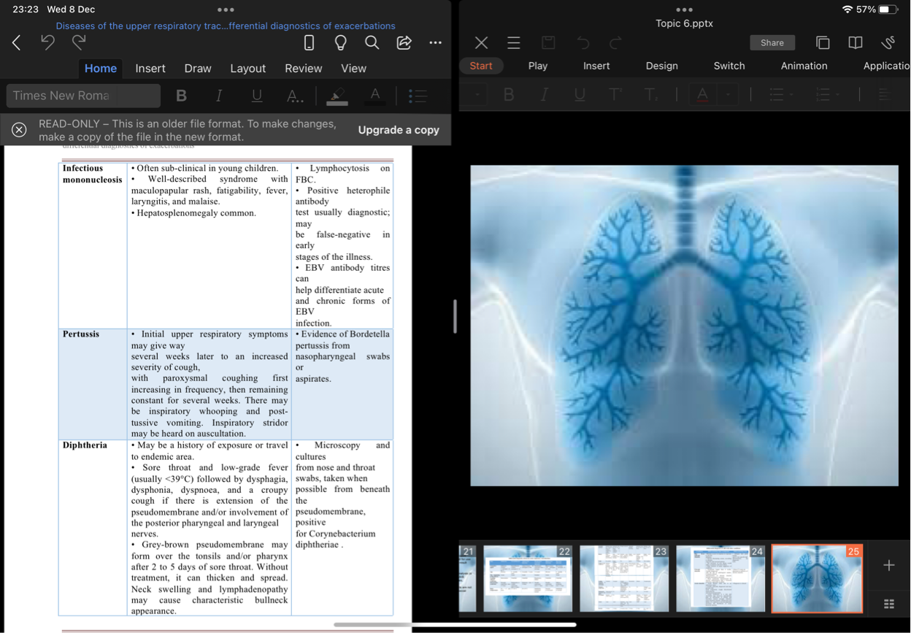

Slide 24
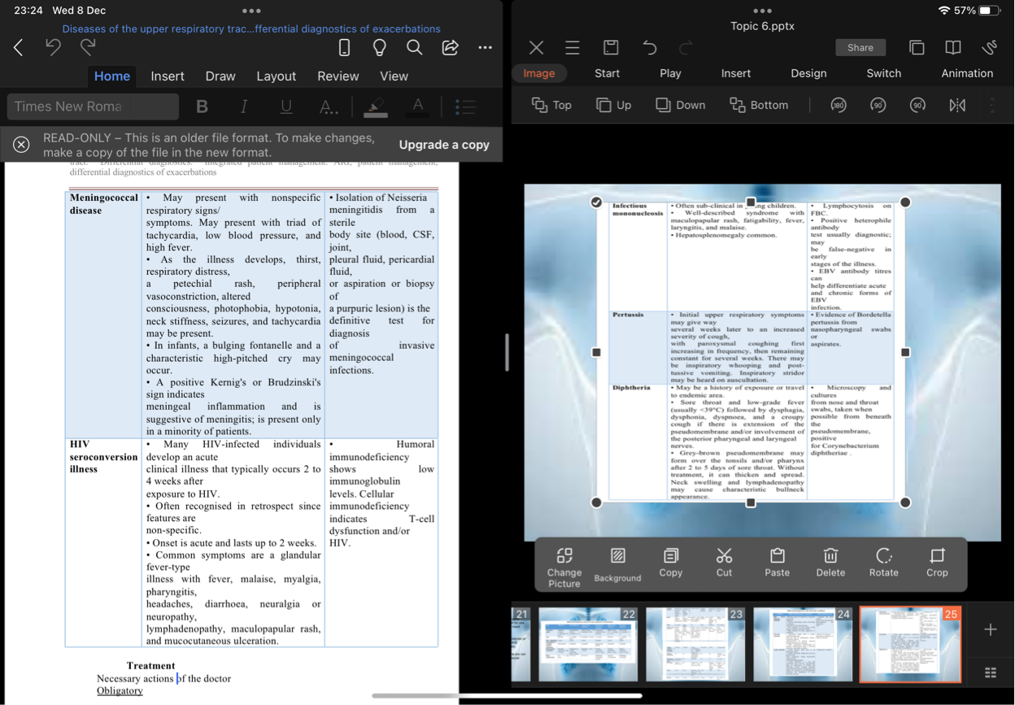

Slide 25
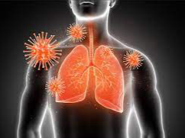
TREATMENT
Necessary actions of the doctor
Obligatory
1. Make a comprehensive and informed decision about the patient's treatment.
2. Inform the patient about the natural course of the disease, about possible variants of the disease in the case of treatment, about possible side effects on the drugs to be prescribed.
3. Inform the patient about the chosen antibiotic therapy strategy and, if necessary, prescribe antibiotics.
4. Prescribe symptomatic treatment.
5. In case of circulation of the influenza virus in the community - act by the medical and technological document regulating the actions of the doctor in case of influenza.

Slide 26
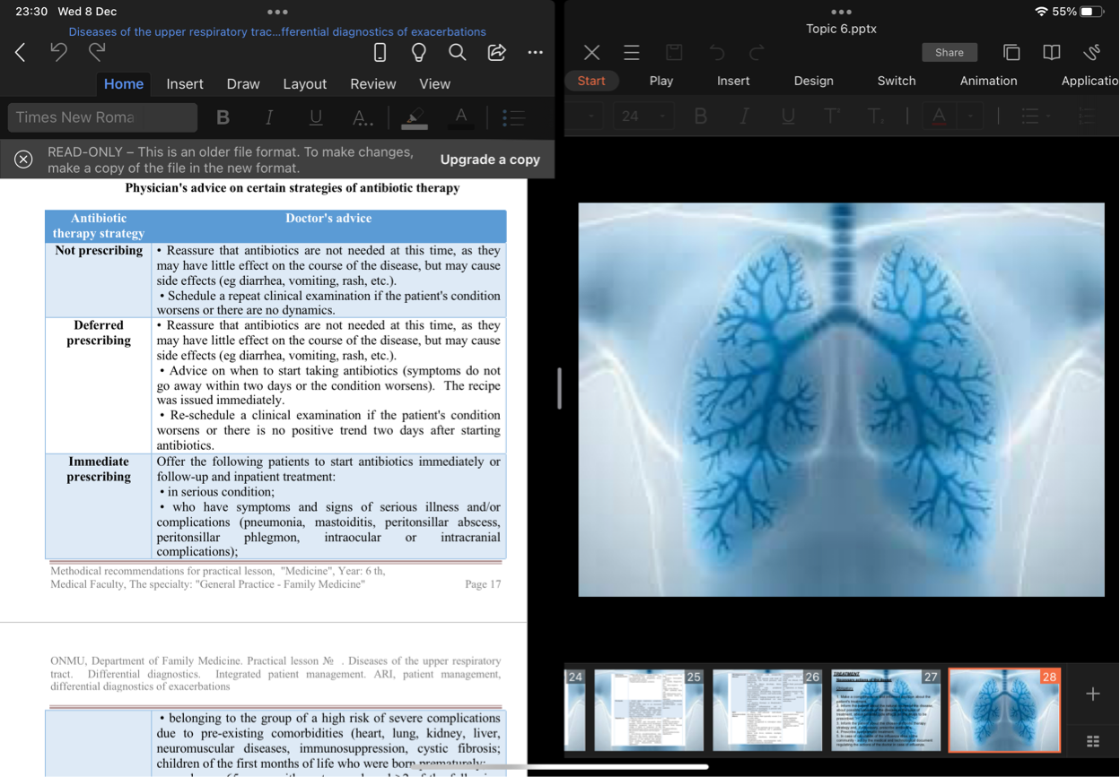
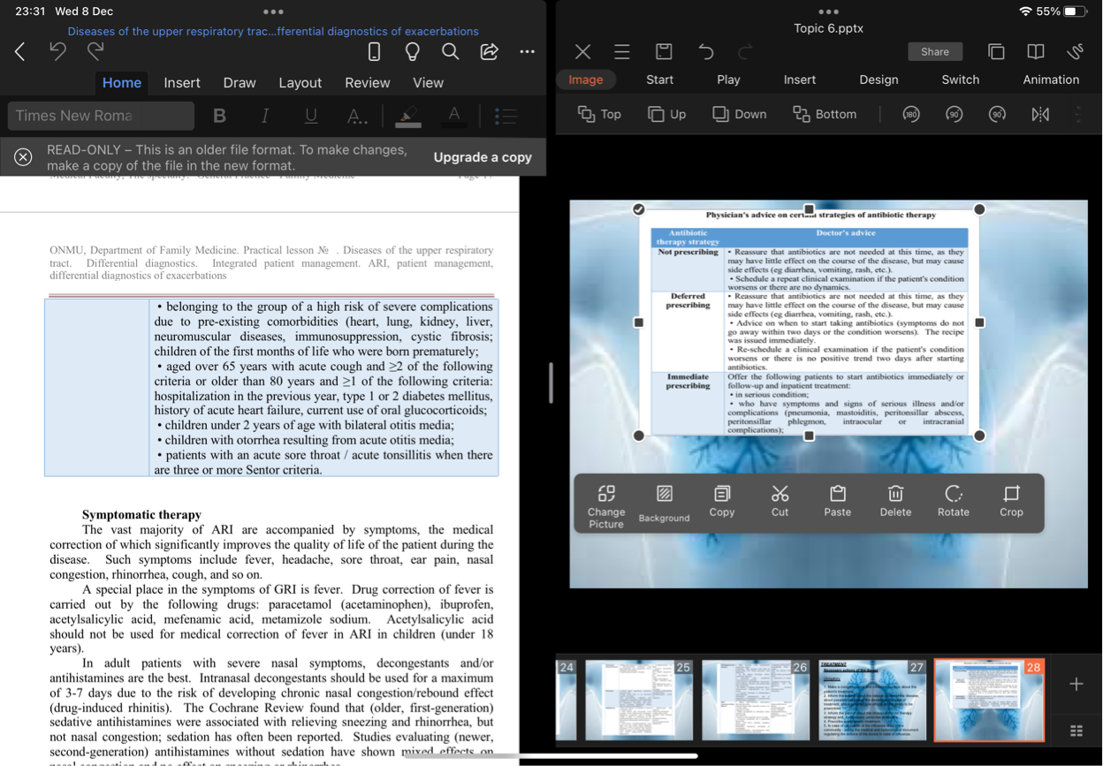

Slide 27
Desirable
Leave the patient a contact phone number where he or she can call the physician and resolve any issues that may arise during treatment.
Assign the patient a re-examination three days after treatment.

Slide 28
Symptomatic therapy
The vast majority of ARI are accompanied by symptoms, the medical correction of which significantly improves the quality of life of the patient during the disease. Such symptoms include fever, headache, sore throat, ear pain, nasal congestion, rhinorrhea, cough, and so on.
A special place in the symptoms of ARI is fever. Drug correction of fever is carried out by the following drugs: paracetamol (acetaminophen), ibuprofen, acetylsalicylic acid, mefenamic acid, metamizole sodium. Acetylsalicylic acid should not be used for medical correction of fever in ARI in children (under 18 years).

Slide 29
In adult patients with severe nasal symptoms, decongestants and/or antihistamines are the best. Intranasal decongestants should be used for a maximum of 3-7 days due to the risk of developing chronic nasal congestion/rebound effect (drug-induced rhinitis). The Cochrane Review found that (older, first-generation) sedative antihistamines were associated with relieving sneezing and rhinorrhea, but not nasal congestion; sedation has often been reported. Studies evaluating (newer, second-generation) antihistamines without sedation have shown mixed effects on nasal congestion and no effect on sneezing or rhinorrhea.

Slide 30
In children, data on these treatments are more limited. There is no evidence that decongestants alleviate nasal symptoms in children, but they are known to cause side effects (eg, drowsiness, gastrointestinal upset, more serious harm, such as convulsions and high heart rate, and death). Therefore, decongestants are not recommended for children under 6 years, and in children 6-12 years it is recommended to use them with caution. There is low-quality evidence that saline in the form of drops or spray may be effective and safe in young children. They reduce the severity of nasal congestion in older children and are likely to reduce the severity of rhinorrhea.

Slide 31
There is no evidence to support or disprove the use of over-the-counter cough medicines, expectorants, or mucolytics to reduce the incidence of cough in adults or children, especially in young children.

Slide 32
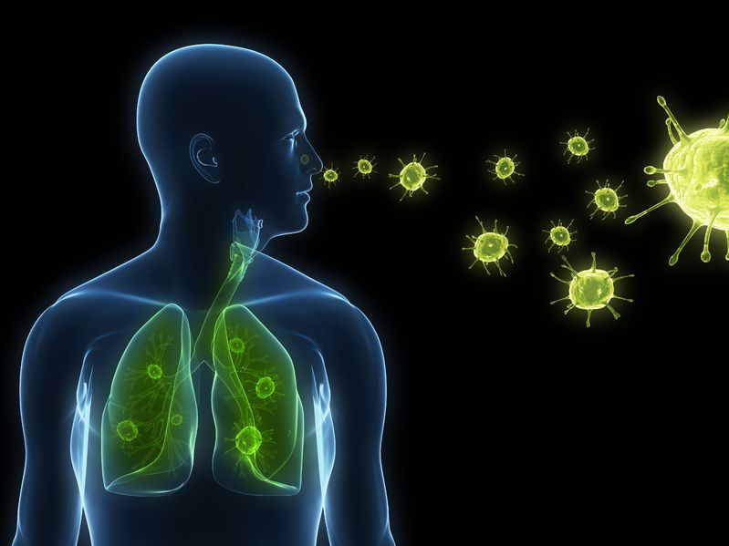
INDICATIONS FOR HOSPITALIZATION
1. Respiration rate > 30 / min.
2. Heart rate > 130 / min.
3. Systolic blood pressure <90 mm Hg, or diastolic blood pressure <60 mm Hg (if this is not the norm for this patient).
4. Oxygen saturation <92%, or central cyanosis (if the person has no history of chronic hypoxia).
5. Peak volumetric expiratory rate <33% of normal.
6. Altered state of consciousness.
7. Respiratory failure ≥II t. (see relevant medical and technological documents).
8. Body temperature ≥38.5 ° C and can be corrected by drugs.
9. Patient aged ≥65 years.
10. Social indications (living in closed institutions; inability to self-care as a result of illness).

Slide 33
PROGNOSIS
Most people recover within 2 weeks. Cough is the most common persistent symptom, lasting from 15.3 to 28.6 days. It is important to advise patients of this to reduce their expectations of a quick improvement and pre-empt a visit seeking additional treatment (e.g., antibiotics).

Slide 34
PREVENTION
Spreading to other people can be limited by physical activity, including washing hands, covering the mouth and nose when sneezing or coughing, effectively disposing of napkins containing nasal secretions, and refusing to attend work or school.
Vaccination is the most effective way to prevent the flu. Vaccination does not guarantee 100% protection against the virus, but significantly reduces the risk of contracting or suffering from severe influenza.

Slide 35
Thank you

