Slide 1
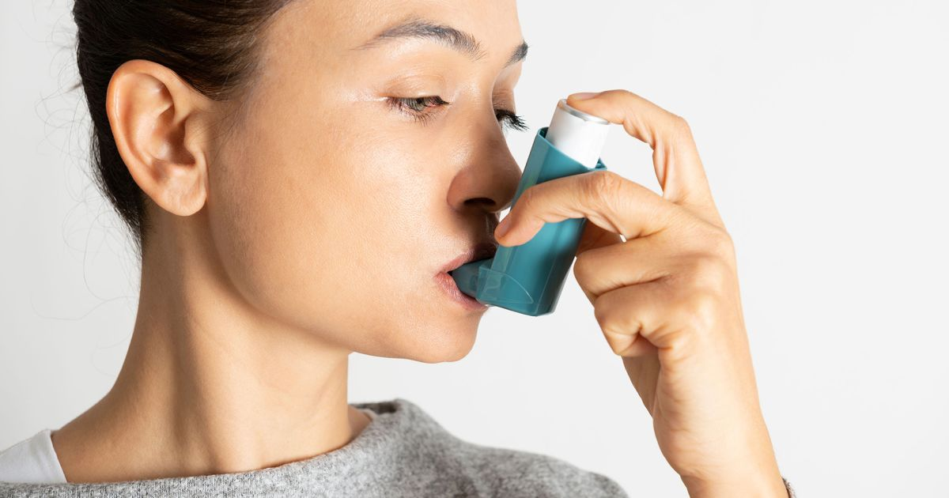
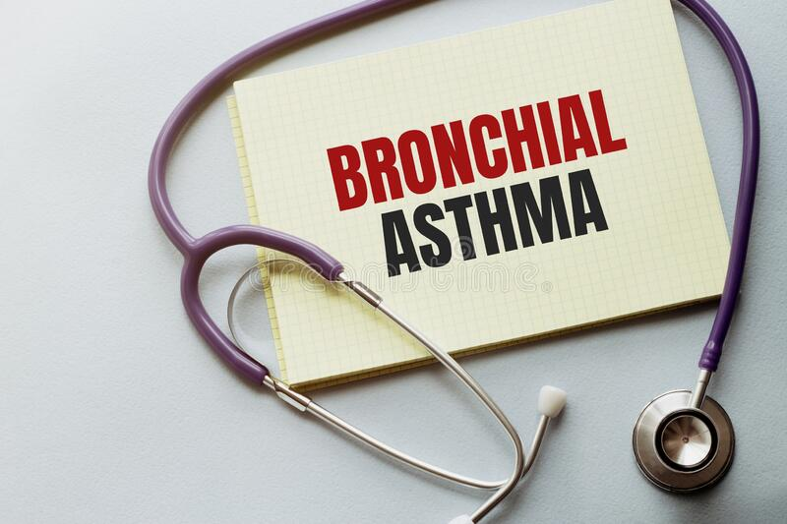
BRONCHIAL ASTHMA
Odesa National Medical University
Department of family medicine and polyclinic therapy
Prepared by:
associate professor Tsyunchyk Yu. H.

Slide 2
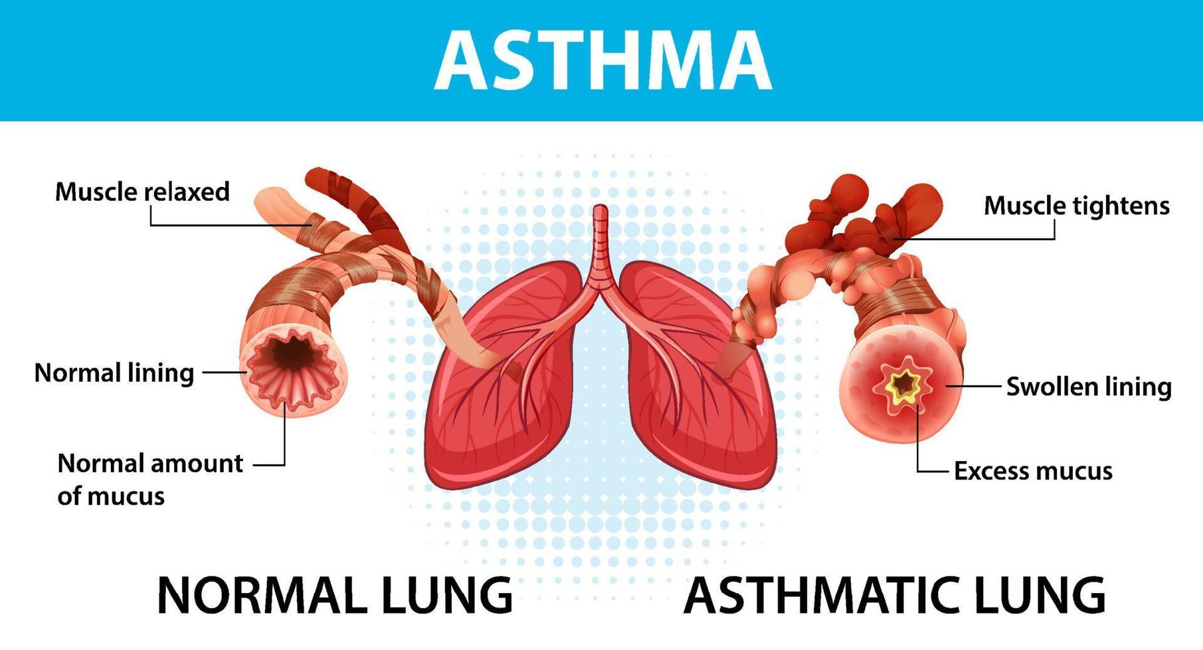
Asthma is a chronic inflammatory disease of the airways that causes airway hyper responsiveness, mucosal edema, and mucus production. This inflammation ultimately leads to recurrent episodes of asthma symptoms: cough, chest tightness, wheezing, and dyspnea
Definition of Bronchial asthma : Bronchial asthma is a chronic , inflammatory disease of the airways, characterized by airflow obstruction, bronchial hyperactivity, and a mucous production.

Slide 3
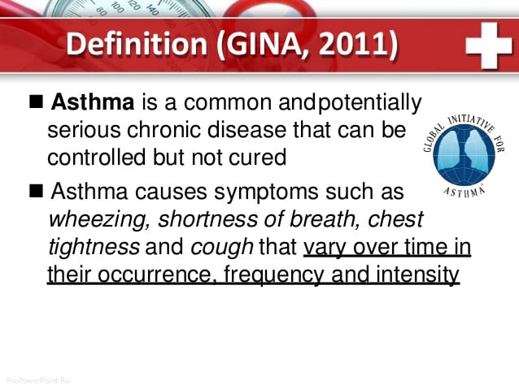

Slide 4
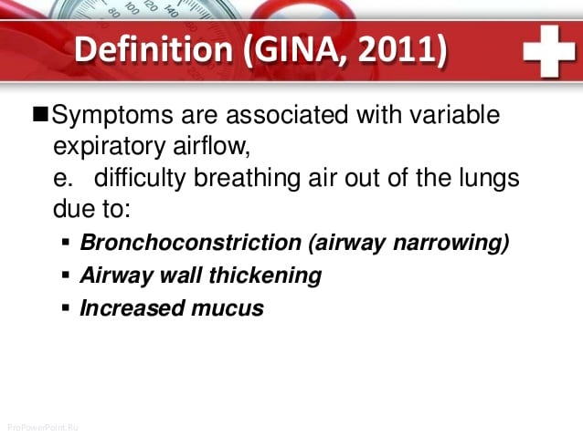

Slide 5
TRIGGERS OF BRONCHIAL ASTHMA
Allergens
Exercise ( Exercise induced asthma) EIA
Respiratory Infections
Nose and Sinus problems
Drugs and Food Additives
GERD ( Gastro esophageal disorder)
Emotional Stress

Slide 6
ETIOLOGY
Genes
Atopy
Bronchial hyper responsiveness

Slide 7
ATOPY
Atopy is a predisposition toward developing certain allergic hypersensitivity reactions by excessive production of allergen- specific antibodies (Ig E).
It is genetic origin.
Atopy is the cause of eczema(atop dermatitis), allergic rhinitis (hay fever), asthma, allergic conjunctivitis, eosinophilic esophagitis, anaphylaxis.

Slide 8
BRONCHIAL HYPERRESPONSIVENESS
Bronchial hyper responsiveness (or other combinations with airway or hyperreactivity) is a state characterised by easily triggered bronchospasm.
Bronchial hyper responsiveness can be assessed with a bronchial challenge test (post bronchodilator test).

Slide 9
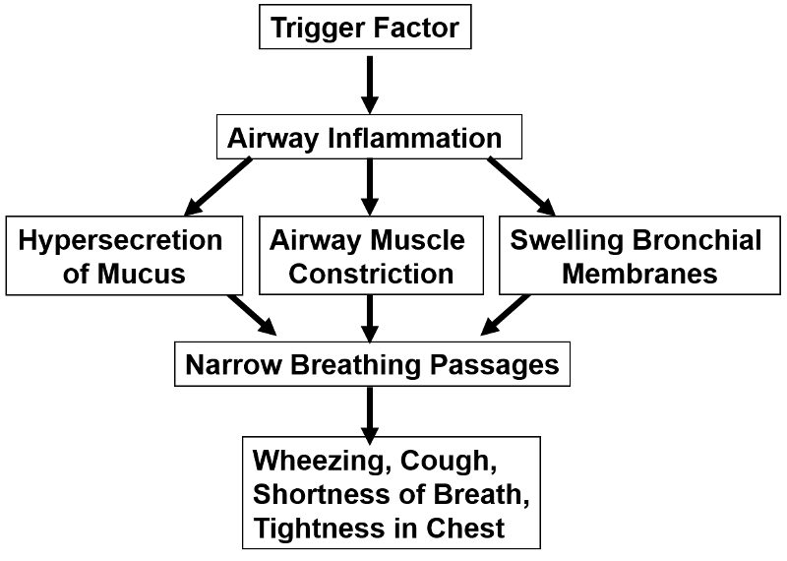
PATHOPHYSIOLOGY OF ASTHMA

Slide 10
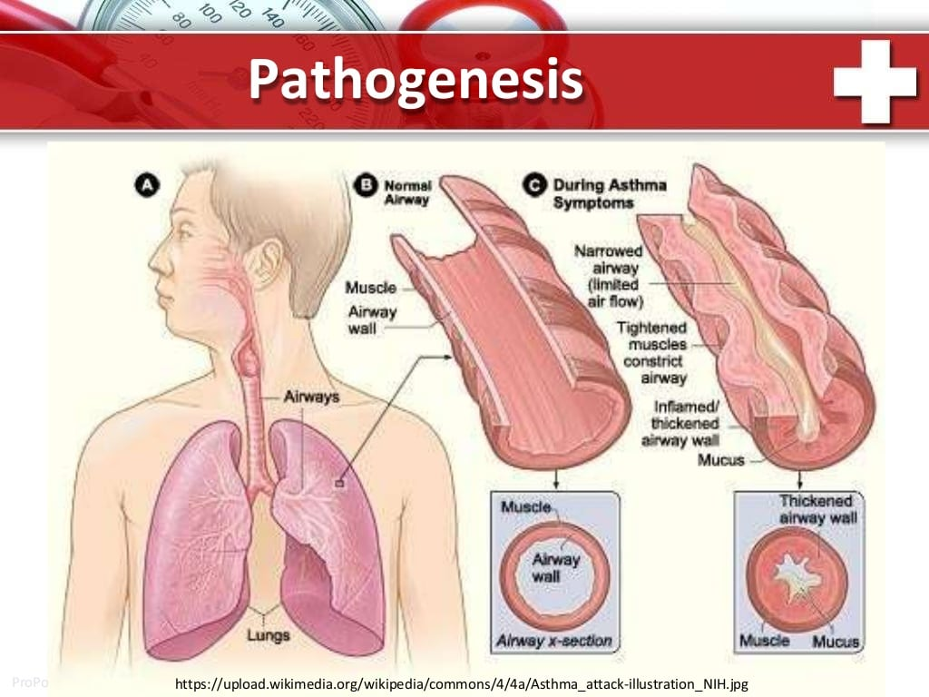

Slide 11
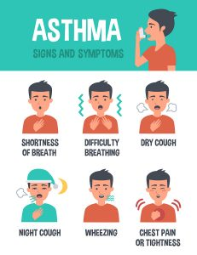
CLINICAL MANIFESTATIONS
The three most common symptoms of asthma are Cough ( esp. at night), Dyspnea, and Wheezing.
In some instances, cough may be the only symptom. Asthma attacks often occur at night or early in the morning, possibly due to circadian variations that influence airway receptor thresholds.

Slide 12
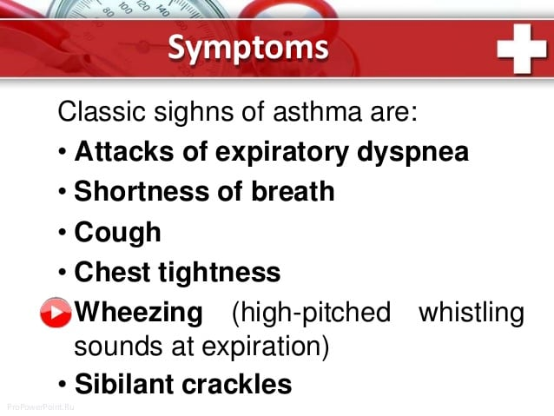

Slide 13
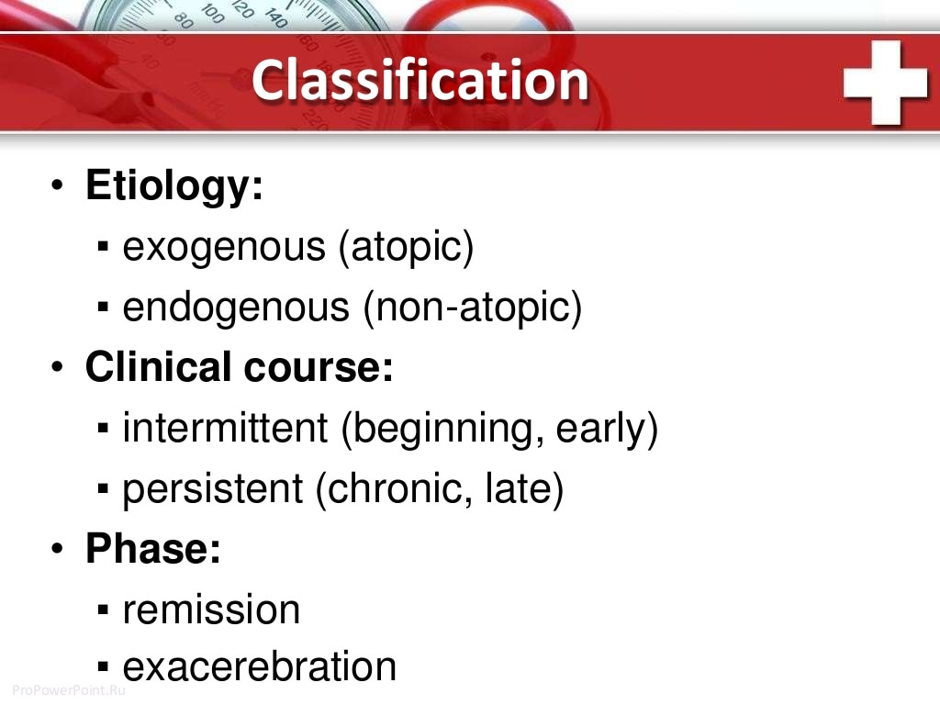

Slide 14
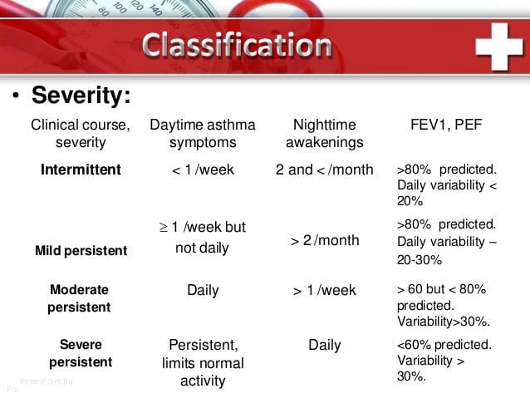

Slide 15
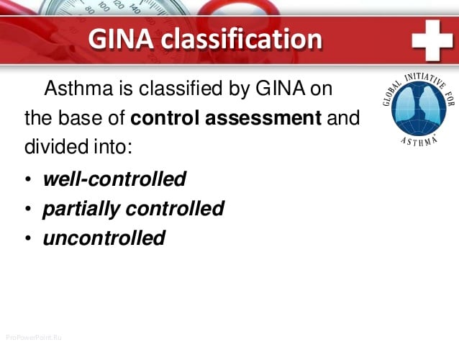

Slide 16
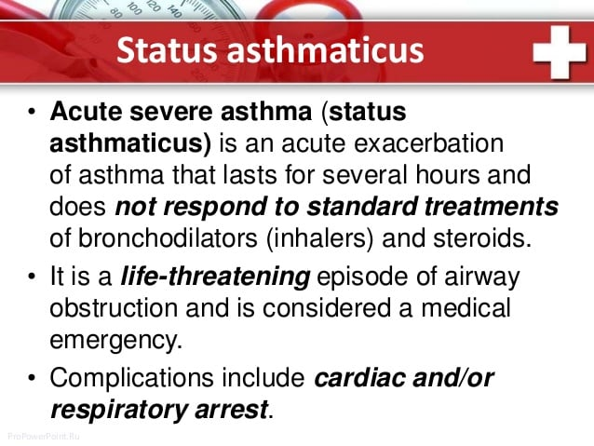

Slide 17
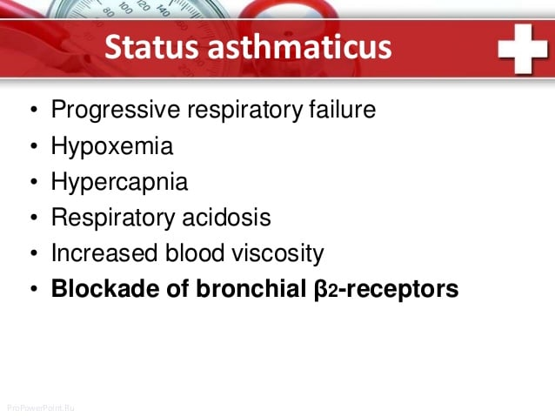

Slide 18
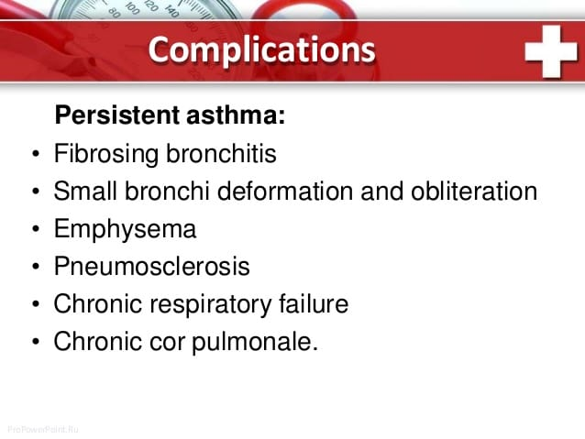

Slide 19
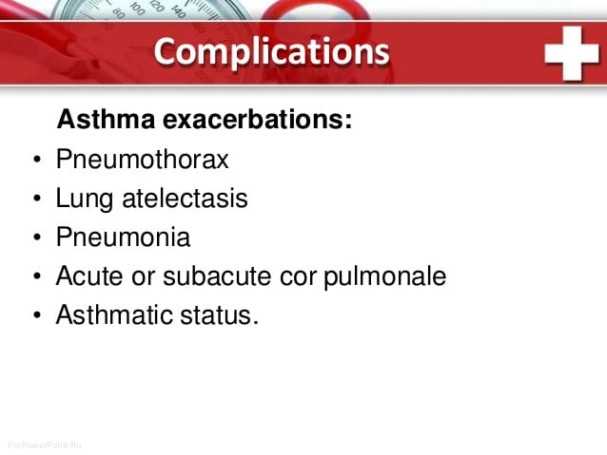

Slide 20
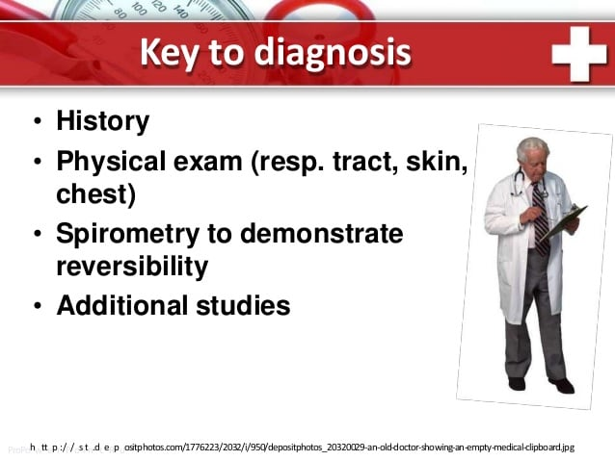

Slide 21
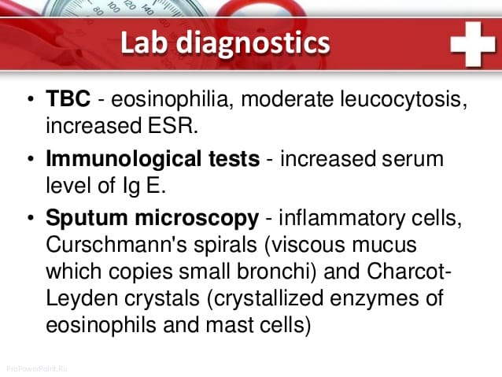

Slide 22
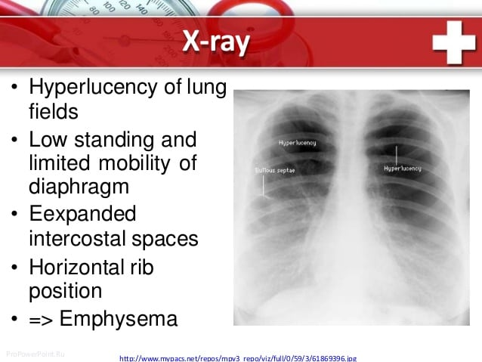

Slide 23
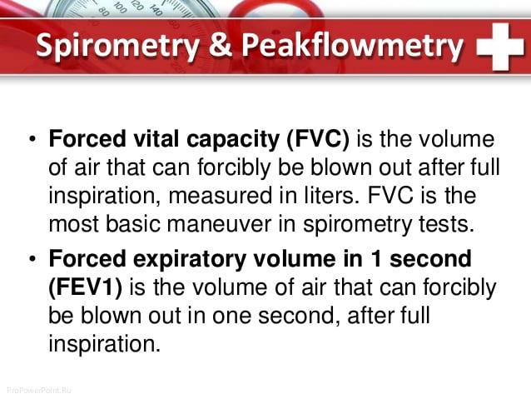

Slide 24
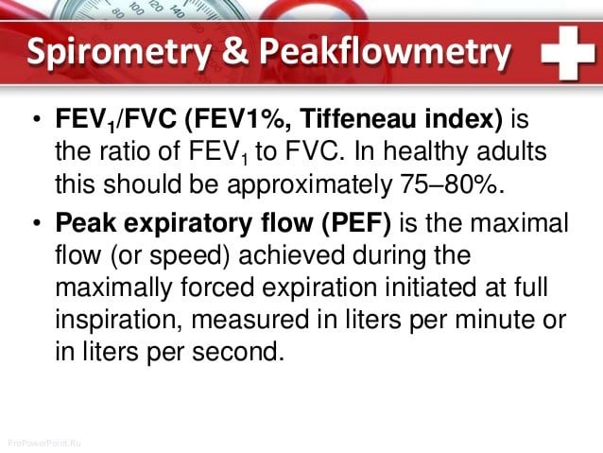

Slide 25
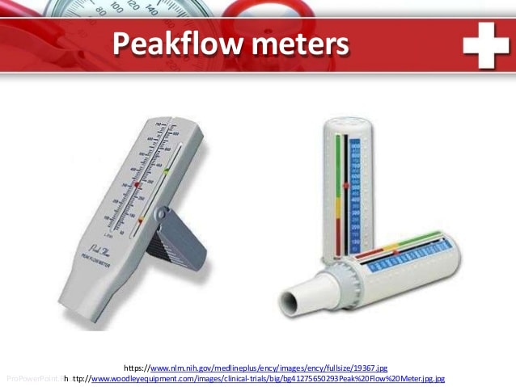

Slide 26
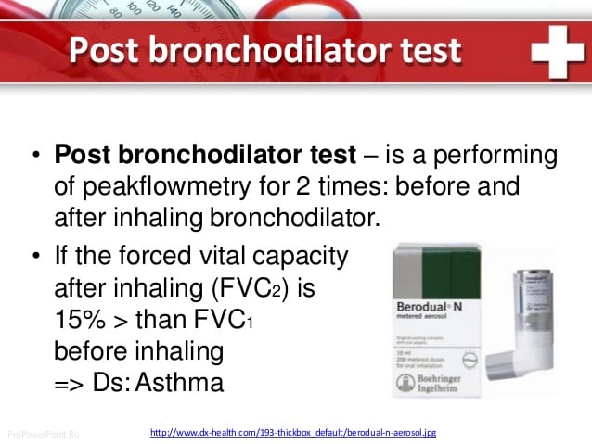

Slide 27
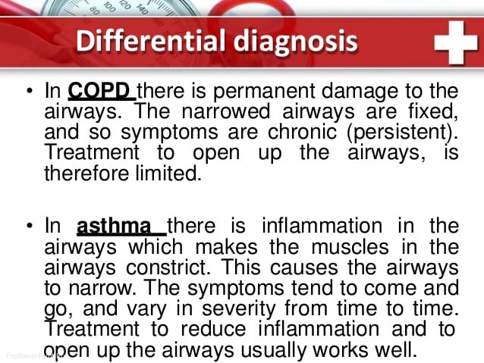

Slide 28
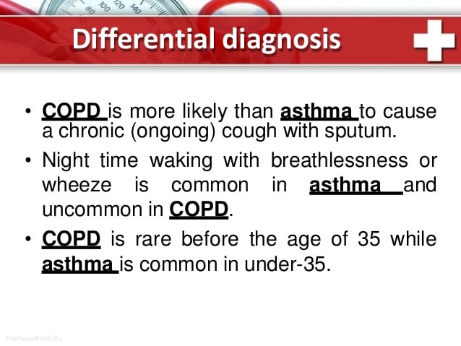

Slide 29
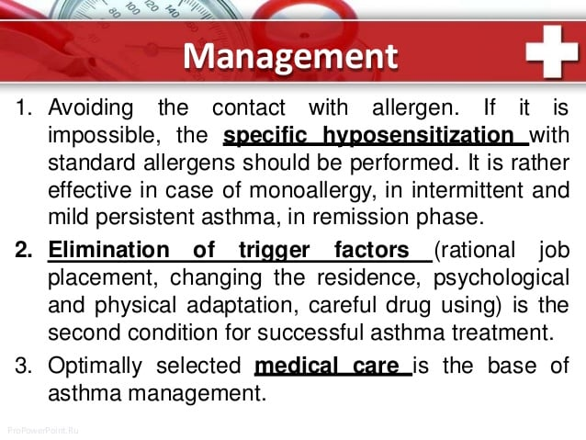

Slide 30
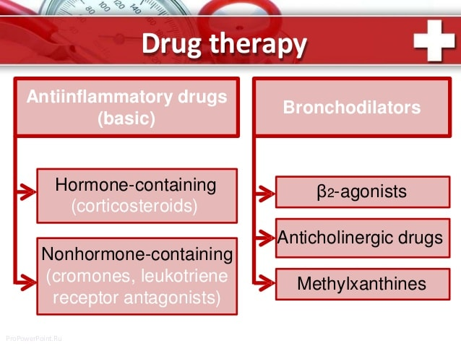

Slide 31
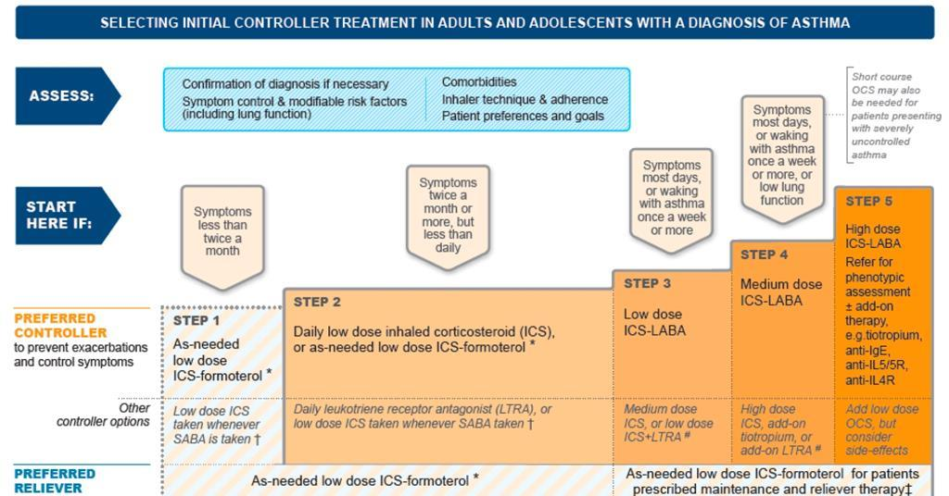

Slide 32
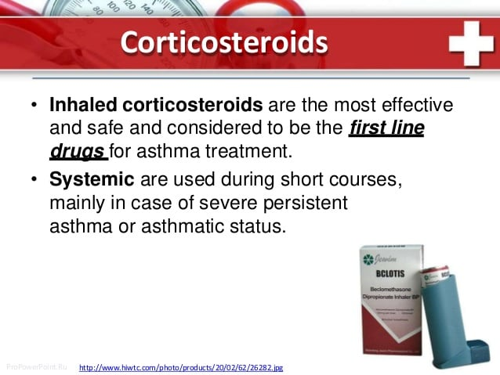

Slide 33
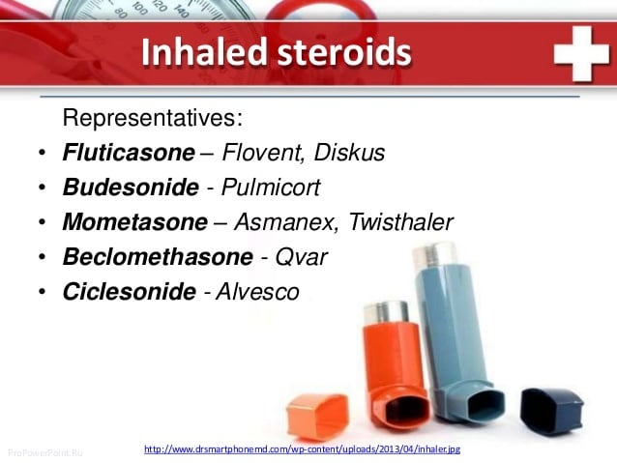

Slide 34
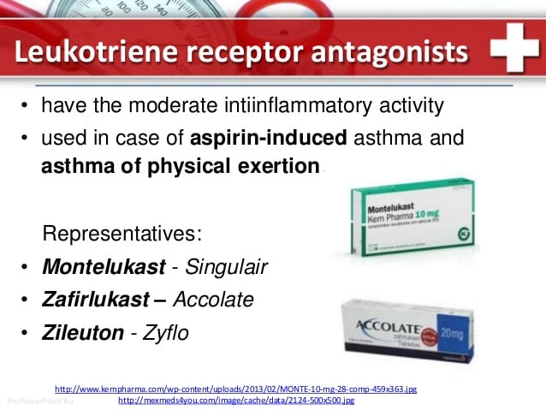

Slide 35
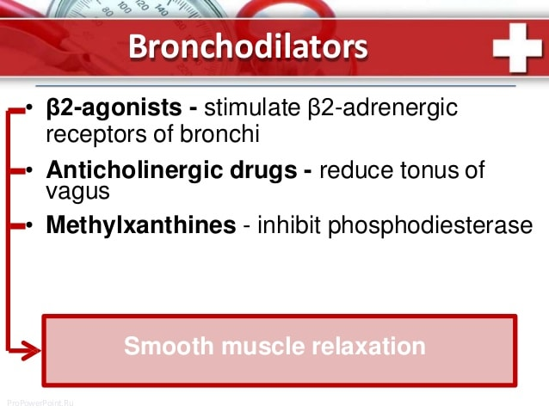

Slide 36
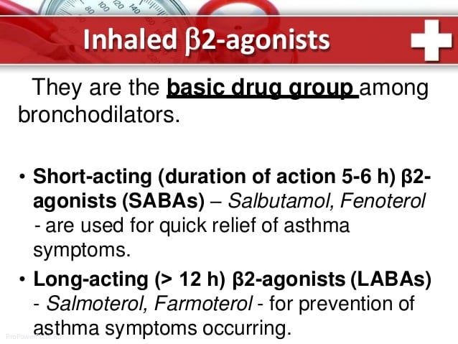

Slide 37
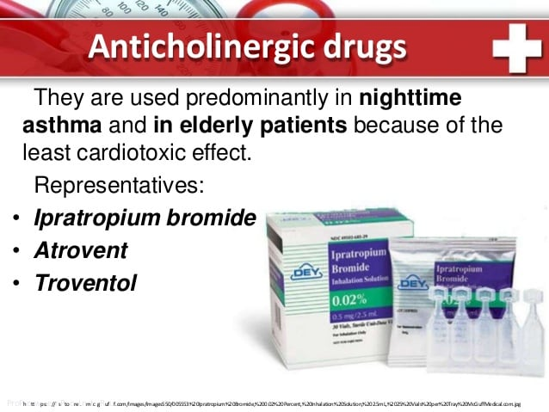

Slide 38
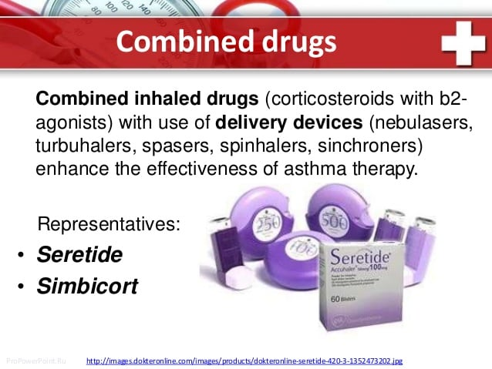

Slide 39
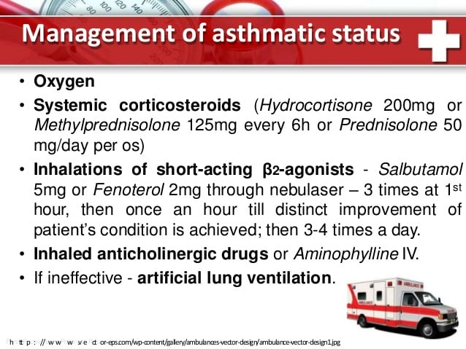

Slide 40
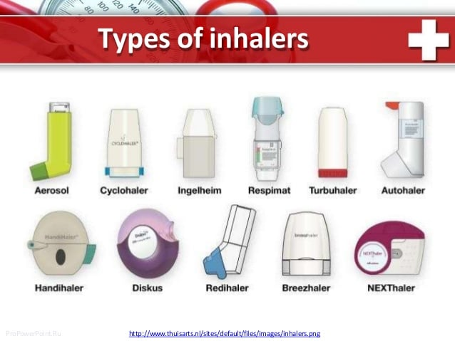

Slide 41
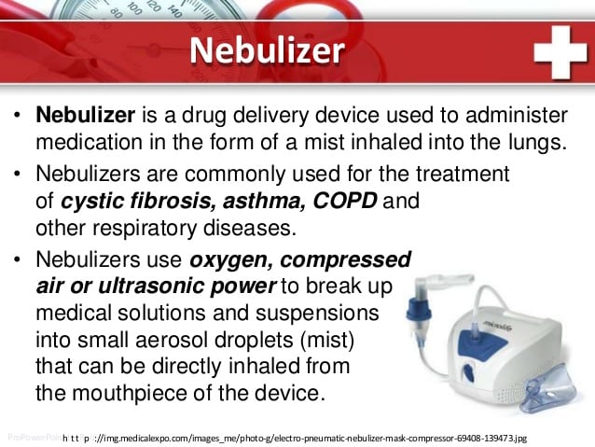

Slide 42


