Slide 1
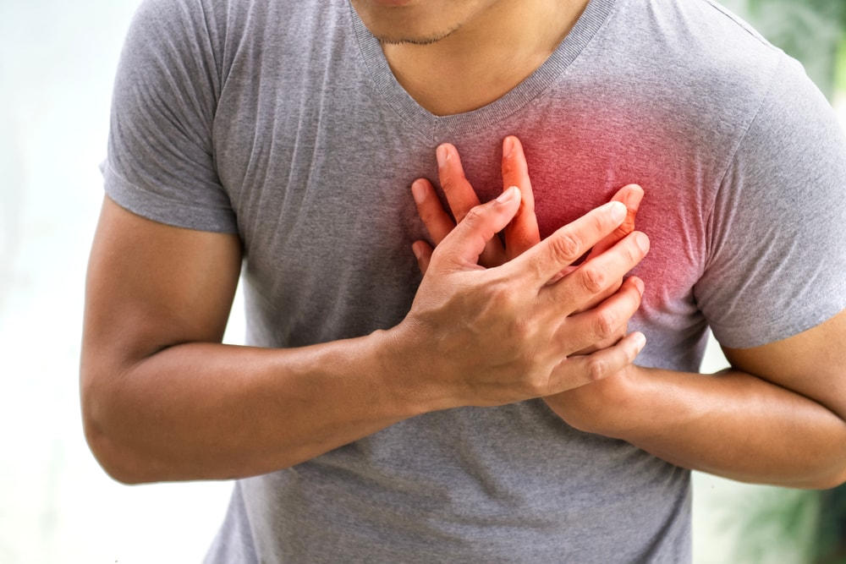
Chest Pain
Odesa National Medical University
Department of family medicine and polyclinic therapy
Prepared by:
assistant Amirova H. Yu.

Slide 2
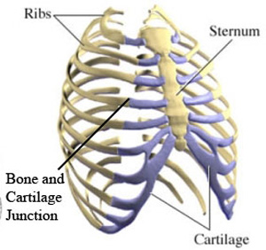
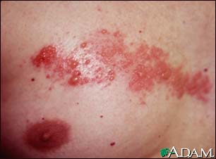
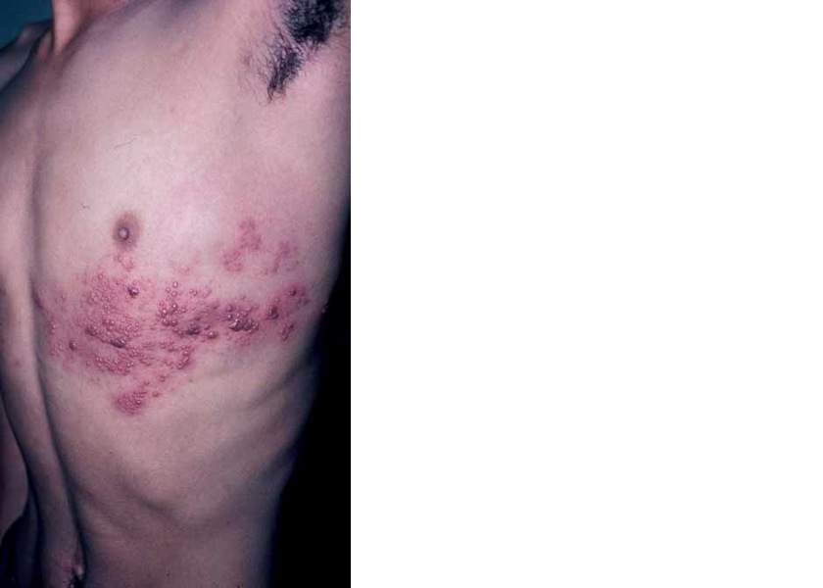
Causes of Chest Pain
Oesophageal
Oesophagitis
Oesophageal spasm
Musculoskeletal
Muscle injury, spasm
Costochondral joint inflammation
Skin
Herpes Zoster (Shingles)

Slide 3
Emergency Medicine
6 deadly causes of chest pain
Acute coronary syndromes
Aortic dissection
Pulmonary Embolus ** most commonly presents with dyspnea
Pericardial Tamponade / Myo- & Pericarditis
Oesophageal Rupture
Tension Pneumothorax
(6 things on a list is too many, but…)

Slide 4
….but luckily some diagnoses predictable for clinicians…
Myo/pericarditis – a diagnostic ECG
Oesophageal rupture – a classic historyHx
Tension pneumothorax – a classic examination
Pleuritic pain has a differential diagnosis that generally does not include cardiac ischaemia
Leaving three ‘problems’:
  Acute Coronary Syndromes, Aortic dissection Pulmonary Embolus

Slide 5
Assessment
Pre- and post test probability
Pre test probability influenced by factors such as:
History of previous coronary disease
Angina, AMI, coronary angiogram or angioplasty, coronary surgery
History of cardiac risk factors
Smoking, Hypertension, High Cholesterol, Diabetes Mellitus
Diagnostic approach to Acute Coronary Syndromes is often a ‘risk assessment’ rather than a ‘diagnosis’

Slide 6
History of the complaint
By far the most predictive assessment
Do it well, saves time!
Know the classic story for the complaints but beware of the pitfalls
If you can make a confident diagnosis DON’T do tests “JUST IN CASE”

Slide 7
History – typical descriptions
Pleuritic Pain = Pain worse on inspiration
  Sharp, stabbing
  Localised
  Worse on inspiration, coughing
  May be worse on sitting up or leaning forward
  Not related to exertion
Oesophageal pain
  Usually “Burning” but may be dull ache
  Worse after meals
  Worse on lying down
  Relieved by antacid
  Oesophageal spasm may be relieved by GTN

Slide 8
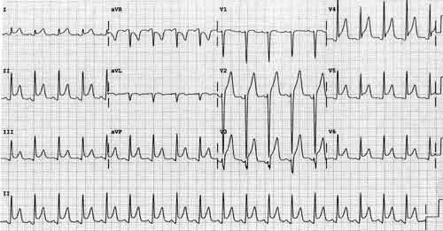
History & ECG: pericarditis
  Due to pericardial inflammation: pericarditis
  Central or Left side
  Sharp, stabbing
  Worse on movement, on breathing, lying flat
  Relief sitting forward

Slide 9
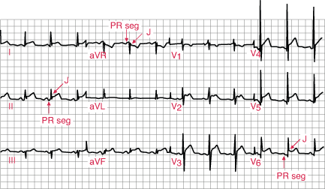
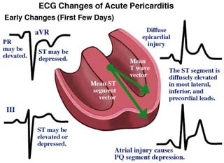

Slide 10
History typical of
Myocardial ischaemia
  “Angina Pectoris” = Pain in the chest
  Central chest pressure, tightness, squeezing
  Intensity increases over a few minutes
  Radiation to shoulders, arms, neck, jaw
  Worse with exertion
  May be relieved by rest
  May be relieved by Glyceryl Tri Nitrate (GTN)
  Associated sweating, nausea, dyspnoea
Often not described as a “pain” but as
  Pressure
  Discomfort
  Ache
  Tightness
May be mistaken by patient (and doctor) for indigestion

Slide 11
History pitfalls
Response to analgesia type does not make a diagnosis
  cardiac pain can get better with antacid
  Oesophageal pain improves with GTN
“Atypical” pain
  Is common
  Does not exclude ischaemia
  May be more common in women, renal failure
Some patients have no pain
  “Silent” ischaemia or infarction
  More common in diabetics due to neuropathy

Slide 12
ACS – history pitfalls
Painless AMI common with age, women and diabetics
  Prev stroke or heart failure also risks
By age 85 MAJORITY of AMI painless
Anginal ‘equivalents’ include:
  Dyspnoea (commonest)
  With age: syncope, weakness, confusion
  Elderly women also: cold sweats & dizziness

Slide 13
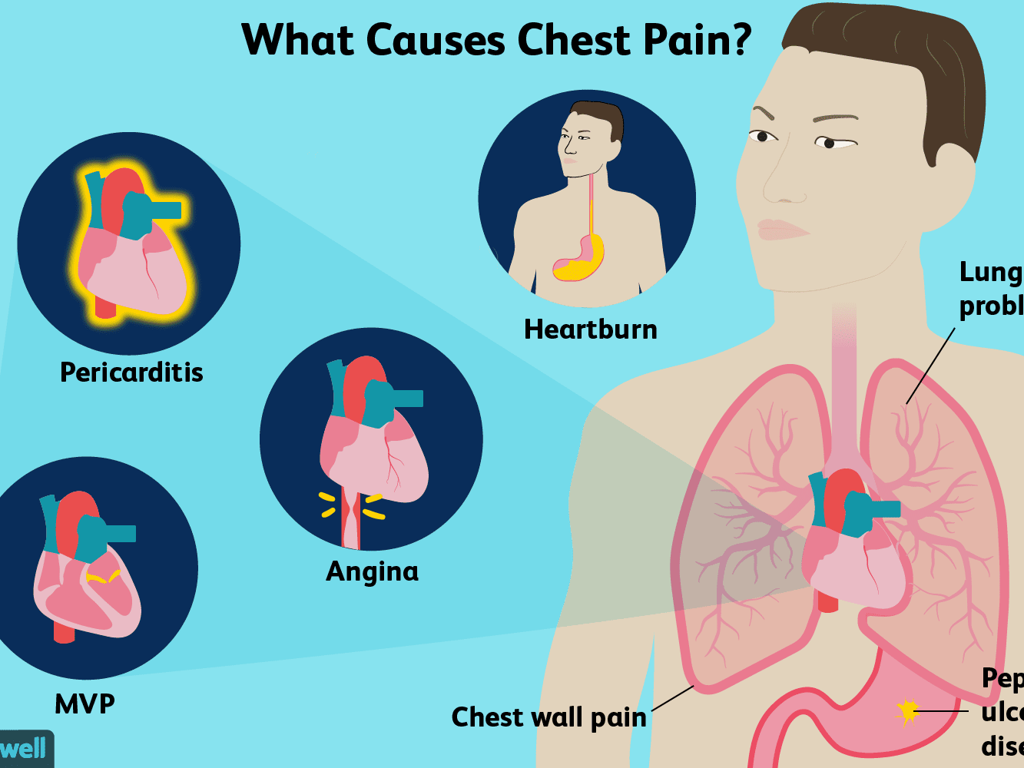
Which features of pain make myocardial ischaemia more or less likely?
More likely
  Radiates to shoulders
  Worse on exercise
  Associated dyspnoea
Less likely
  Stabbing, sharp
  Pleuritic
  Worse on changing position
  Very localised
  Reproduced by palpation or movement
  Very brief (seconds)
  Very prolonged (constant for days)
  Radiates to the legs
  No past history of AMI or angina

Slide 14
Response to analgesia
The “GI cocktail” has only been studied poorly, mostly other drugs get given around the same time
Not safe to make a discharge decision based on the response

Slide 15
Chest wall tender & AMI
7% of AMI or unstable angina have partially or fully reproducible pain
Important to note if the pain produced is the same one
Be suspicious if there is no proceeding history of injury

Slide 16
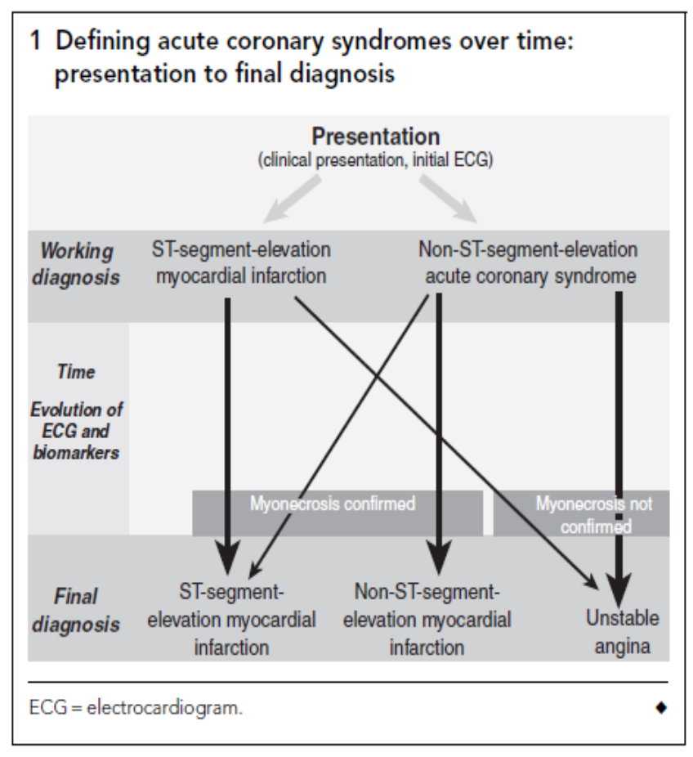
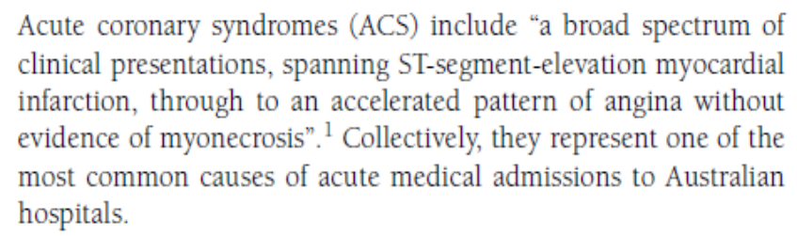
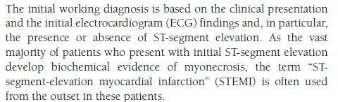
Acute coronary syndromes
https://www.mja.com.au/sites/default/files/issues/191_06_210909/bri10275_fm.pdf

Slide 17
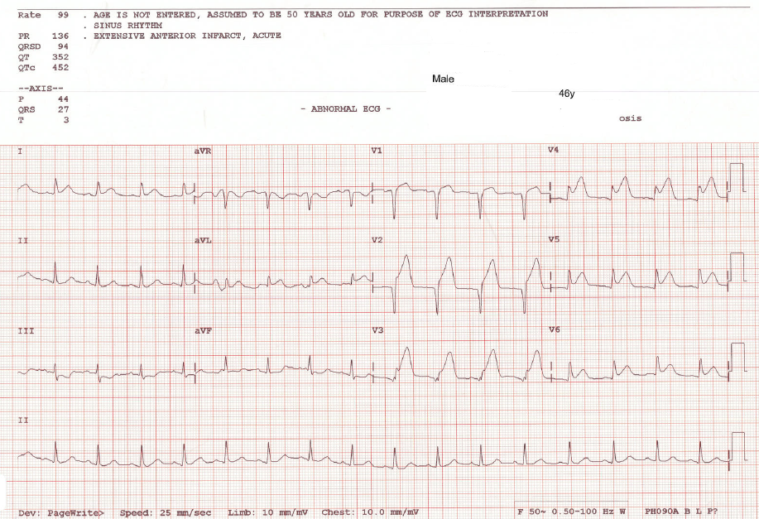
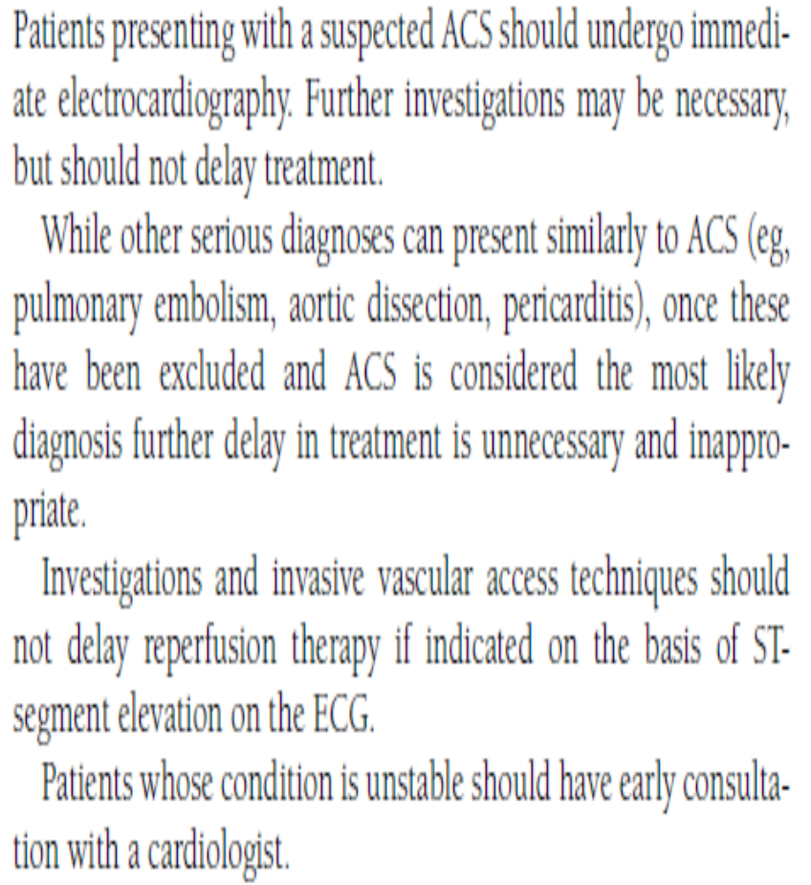
ECG interpret in <5mins.

Slide 18
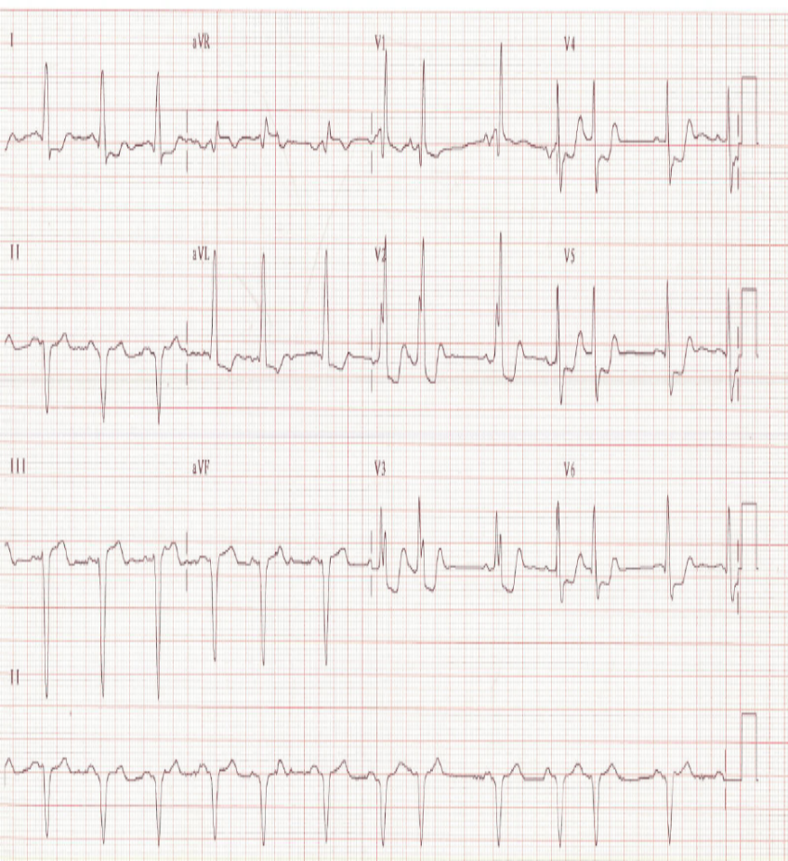
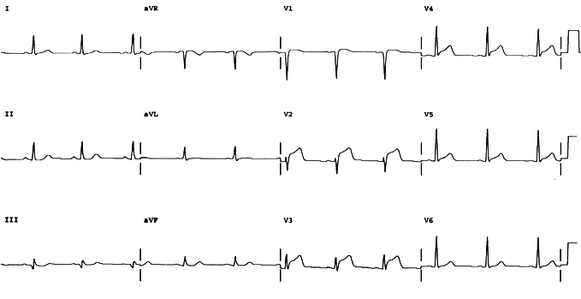

Slide 19
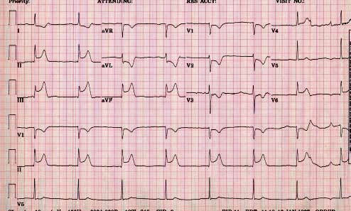
ECG – your opinion?

Slide 20
Basic investigations
ECG, CXR and bloods
  In Emergency Department an ECG in most if not all patients.
More useful as ‘rule in’ than ‘rule out’
  ECG in AMI 50% sensitivity, 90% specificity
  ECG not useful in PE or aortic dissection

Slide 21
Acute Coronary Syndrome
Difference between risk Ax & diagnosis
Blood tests are not diagnostic tests (unless positive)
Ruling out AMI in a stable patient with a non-diagnostic ECG is the difficulty

Slide 22
prognosis v diagnosis #1
The same coronary lesion in one patient might be tolerated or a disaster
Increased rate of complications with:
  LV dysfunction
  DM
  HTN / LVH
  Probably renal failure

Slide 23
Assessing risk
Risk factors don’t help in the ED
ECG and biomarkers do
Many systems, none perfect, and following the guideline of your hospital including getting expert help is sensible and medico-legally correct
ED role: determine disposition immed RX
  Risk Ax of complications = discharge

Slide 24
ECG as rule out AMI test
Not known how useful a normal ECG is:
  AMI rate ?<1%, up to 7%
It is known that an abnormal non-diagnostic ECG = risk for missed AMI
Probably with passing time a normal ECG begins to decrease likelihood of at risk ACS but this has not been shown

Slide 25
Blood markers - troponin
Troponin I or T rise within 3-6H and then remain elevated for about one week
Serial testing, at least 6H after symptom onset improves sensitivity
In ACS an increased troponin is a marker for increased risk of AMI and death
Does NOT diagnose cardiac ischaemia

Slide 26
myoglobin
One study showed excellent rule out figures for 90 minute testing of troponin and myoglobin levels

Slide 27
Rx in ACS
Aspirin should be given immediately
  alternative clopidogrel if truly contraindicated
Rapid decisions on reperfusion
  Based on ECG only
All other decisions less time dependent
  Can involve further consultation
  Need risk / benefit analysis

Slide 28
Adjunctive Rx in ACS
Further antiplatelet options:
  Heparin (LMW v unfractionated)
  clopidogrel
  Glycoprotein IIb/IIIa inhibitors
Symptomatic / pain control
  GTN / morphine
Secondary prevention
  BBlockade / statins

Slide 29
Thrombolysis (fibrinolysis)
50% flow return rate where indicated
But 15% re-occlude (and do badly)
1% patients have a major bleed
  Usually intra-cranial haemorrhage
Using LMW heparin as opposed to UFH:
  Some evidence more benefit

Slide 30
PCI v thrombolysis
Guideline varies with:
  time from symptom onset
  Time to get to catheter lab (balloon inflation)
  Lesser factors inc localisation of AMI and relative risk / benefit thrombolysis
All other things being equal esp in anterior AMI PCI better option

Slide 31
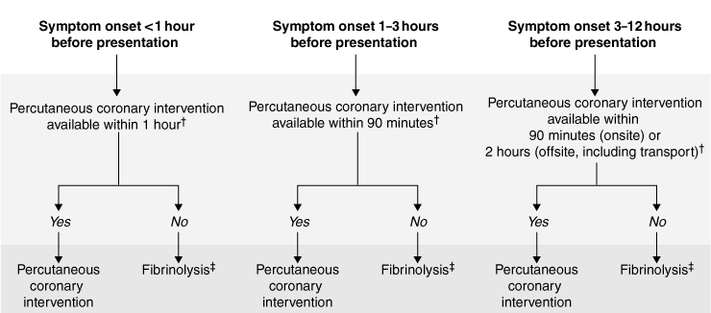
Guideline for PCI v ‘lysis

Slide 32
CABG’s
Routine after STEMI
  Considered if poor LVF
  ‘appropriate’ anatomy
    Means LAD or severe vessel disease
Emergency
  Considered in cardiogenic shock
  Failed reperfusion and persistent pain
All above is level B recommendation

Slide 33
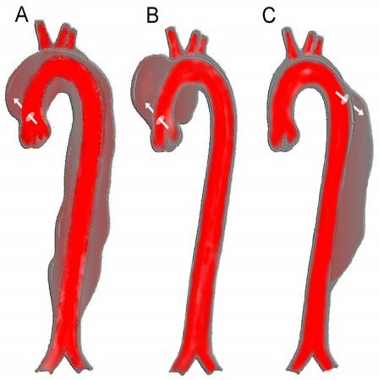
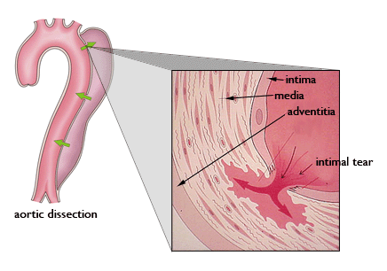
AORTIC DISSECTION
Challenging diagnosis, lethal if missed (75% in 2/52), prob.s if Rx as ACS
Classic Hx:
  Sudden onset ripping / tearing PIC, radiates to back (interscapular, migratory) & Hx HTN
  Not sensitive enough
Best approach is risk factor assessment
Be aware of atypical presentations

Slide 34
Risk factors for Aortic Dissection
HTN
Aortic valve
  Bicuspid, previous surgery
Abnormal Aorta – mainly congenital
  Coarctation / Marfan’s / Ehlers-Danlos
  Arteritis (Giant cell)
Aortic ‘stresses’
  PREGNANCY, COCAINE, TRAUMA

Slide 35
Atypical presentations AD
Atypical history
  Non-classical pain, chest or back only, severe & sharp pain, abdo pain
Syncope
Acute stroke (& peripheral neuro)
    Others just get too weird & make you paranoid
      Eg. Pulsatile stenoclavicular joint!!

Slide 36
AD - imaging
Widened mediastinum (62%) and abnormal aortic contour (50%) most sensitive CXR findings
Normal CXR may decrease the likelihood but if examination, Hx and RF’s raise suspicion needs further imaging

Slide 37
Oesophageal rupture
Ruptures due to developing a tear due to raised intra-luminal pressure
Classical triad is forceful emesis, chest pain and subcutaneous emphysema
Prefer to sit up and may have chest signs
CXR usually abnormal on left side

Slide 38
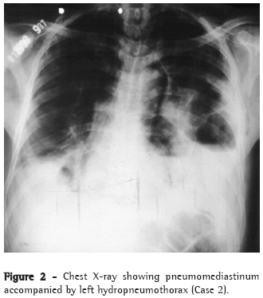
Oesophageal rupture - problems
Definitive diagnosis usu on CT, can do oesophagogram (can be false negatives)
Vomiting can be absent in 21%
Can occur in kids, can be right sided
Patients are UNWELL, only needs pursuing in atypical case if SICK

Slide 39
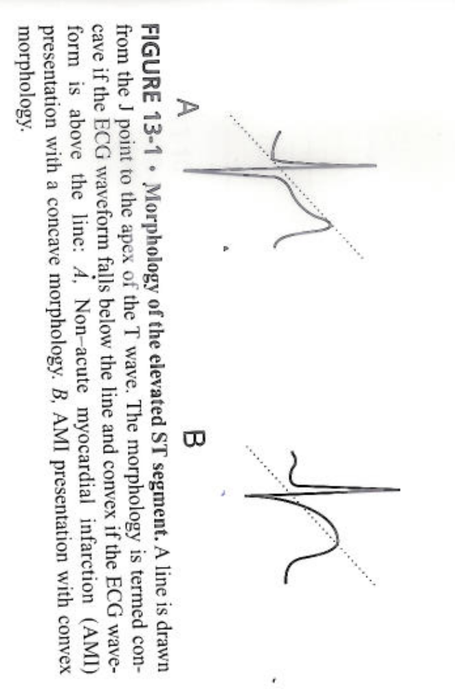
Myo and pericarditis

Slide 40
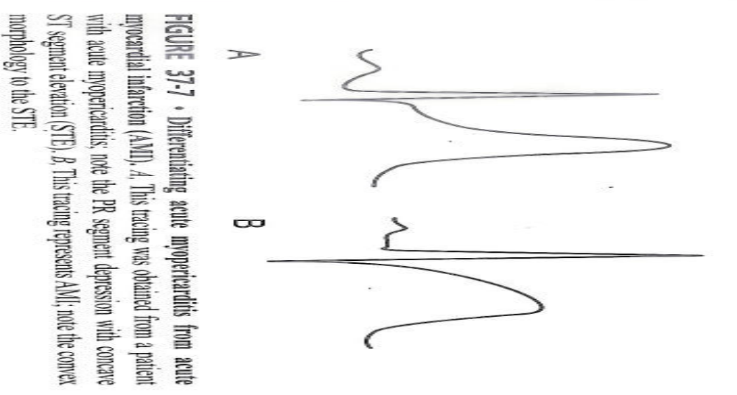

Slide 41
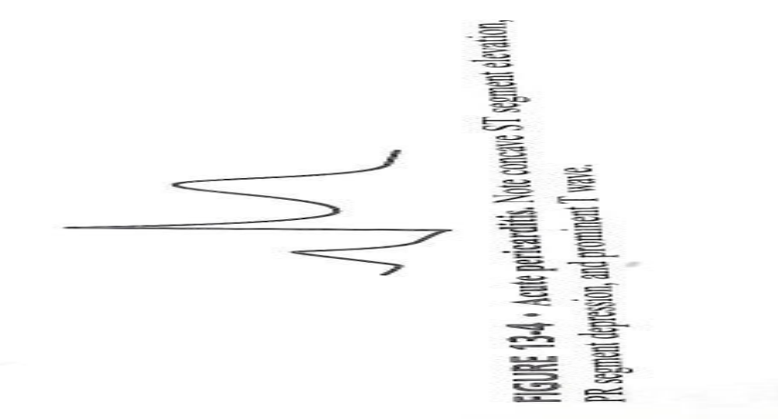

Slide 42
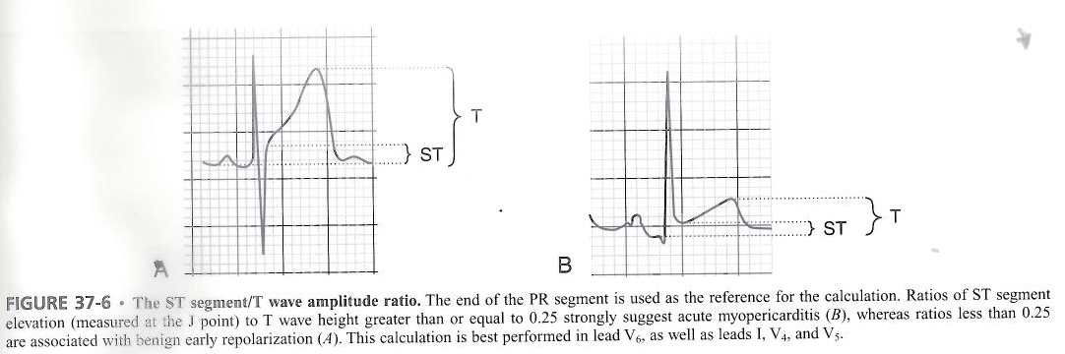

Slide 43
Pulmonary Embolism
Classic triad about 20%:
  Pleuritic PIC, dyspnoea & haemoptysis
Typically some combination of:
  SOB, PIC, tachypnoea, tachycardia
Dypnoea commonest (about 80%)
Pleuritic pain not sensitive or specific
      44% with, 30% without in one study
  Needs infarction
      more likely in existing lung disease, implies smaller clot?

Slide 44
PE investigations
No test is ideal
Can have normal tests & be very unlucky
Classic diagnosis for combining pre- and post-test clinical probability

Slide 45
PE – more worrying facts
Mortality hasn’t changed
Rate of asymptomatic PE not known
Not known what the actual incidence is
Most diagnosed at autopsy in US
10% deaths after diagnosis, 90% before
Up to a third of PE’s asymptomatic?

Slide 46
PE - ECG
ECG has many reported associations
  All from study of pt. s AFTER diagnosis
S1Q3T3 about 12% of PE & normal pt.s
Sinus tachy not that common
  Range is 8-69% in 6 studies
Commonest is anterior T wave inversion
  68% pt.s with confirmed PE
ECG doesn’t ‘rule in’ or ‘rule out’

Slide 47
PE – Well’s criteria
3 points for:
  PE ‘most likely diagnosis’
  Signs and symptoms suggesting DVT
1.5 points for:
  PR>100, past Hx (PE/DVT), immobilisation
1 point for:
  Haemoptysis or malignancy
<2 low (10%), 2-6 i/med (25%), >6 high (50%)

Slide 48
D-dimer
Only use is in a low risk patient
A negative test makes PE very unlikely
A slightly positive test IS a positive test

Slide 49


