Slide 1
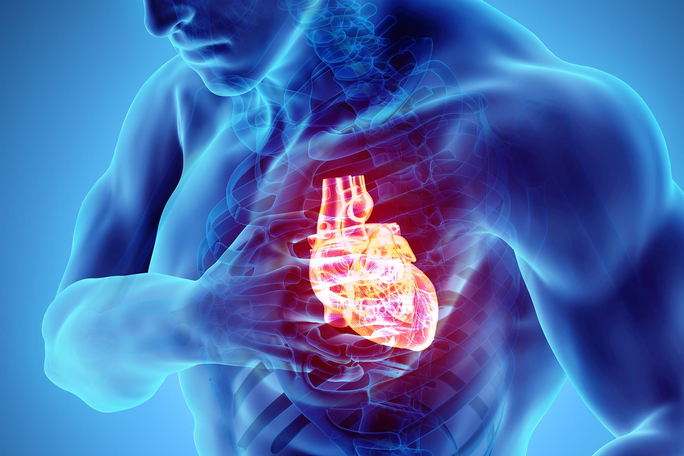

SUDDEN CARDIAC DEATH
Odesa National Medical University
Department of family medicine and polyclinic therapy
Prepared by: assistant Amirova H. Yu.

Slide 2
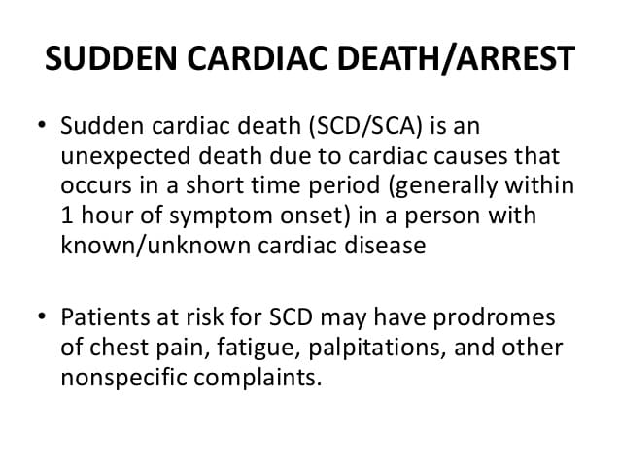

Slide 3
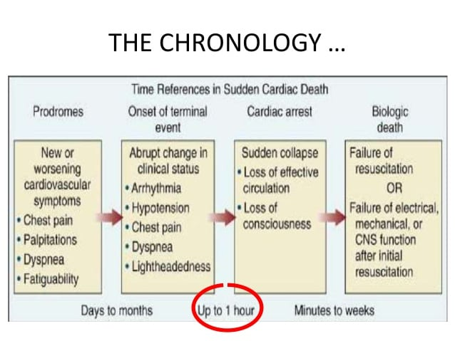

Slide 4
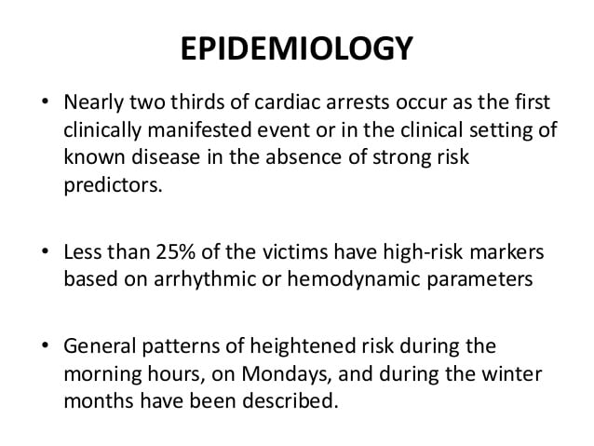

Slide 5
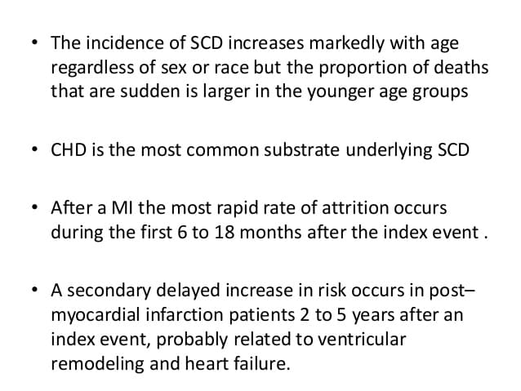

Slide 6
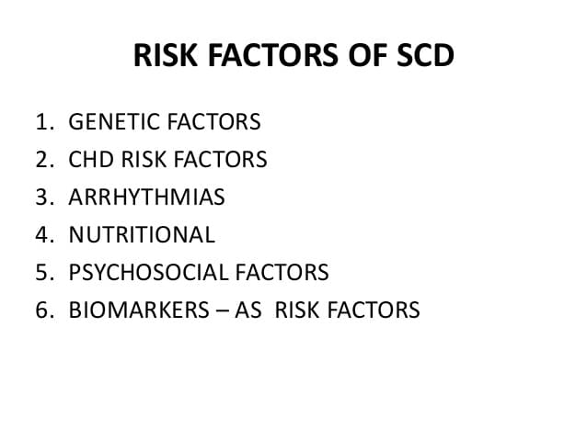

Slide 7
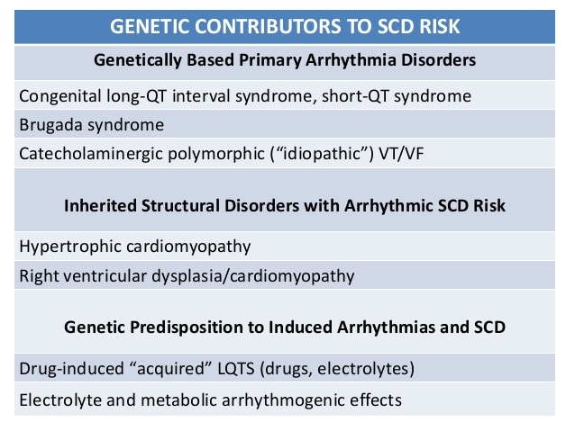

Slide 8
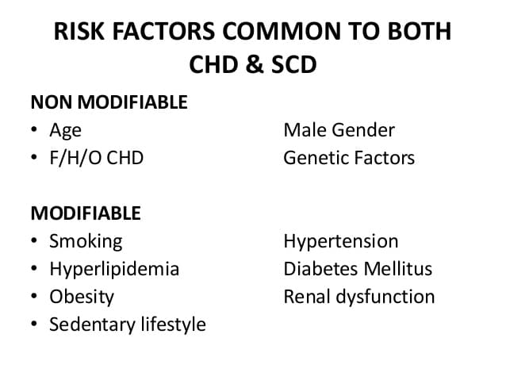

Slide 9
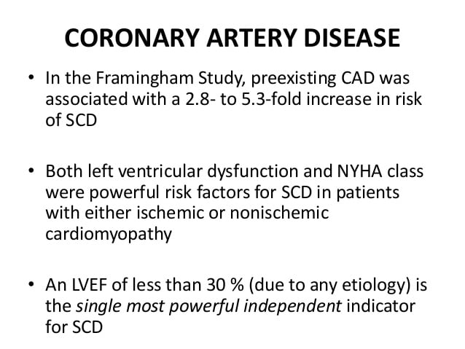

Slide 10
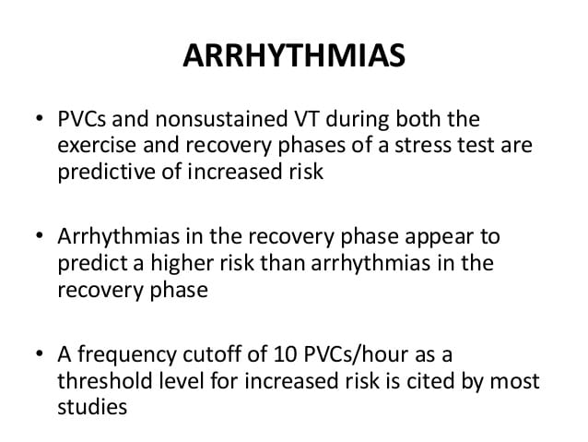

Slide 11
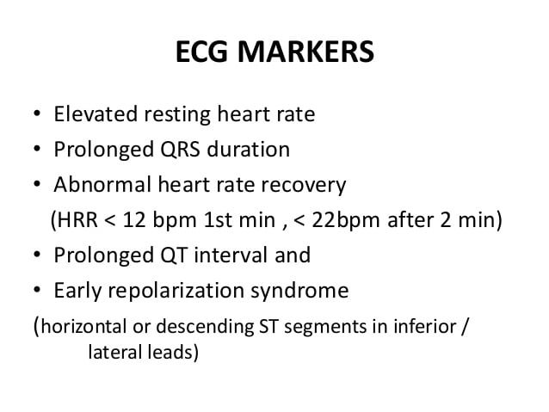

Slide 12
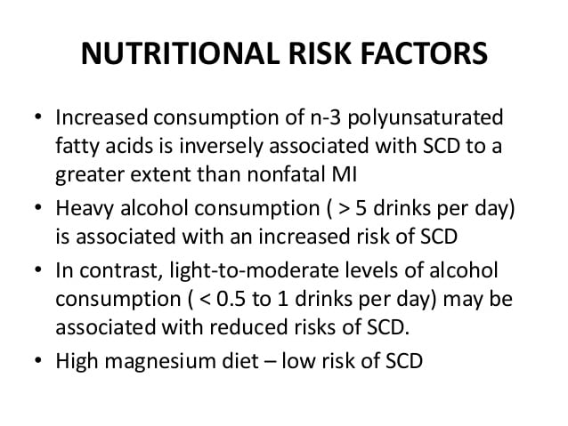

Slide 13
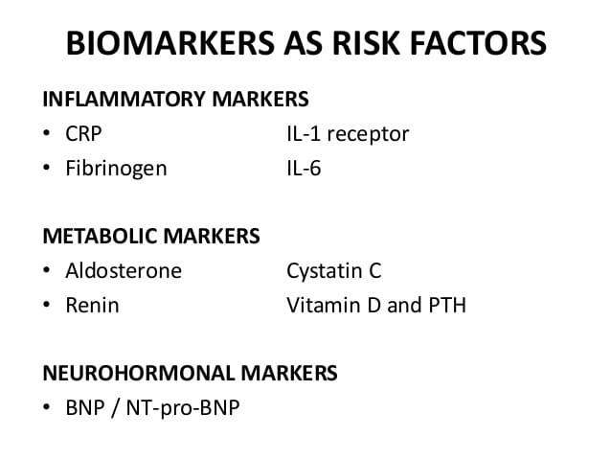

Slide 14
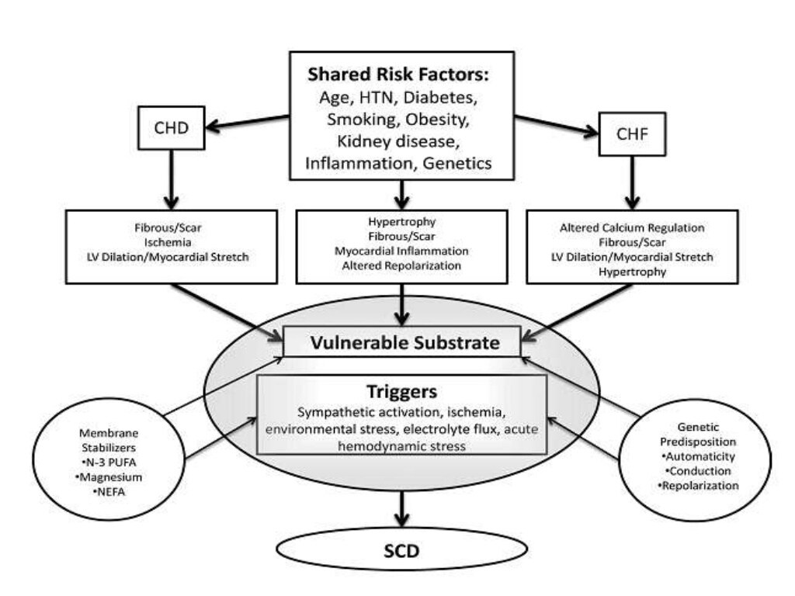

Slide 15
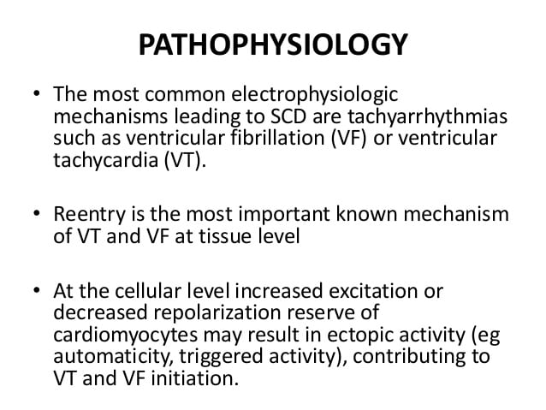

Slide 16
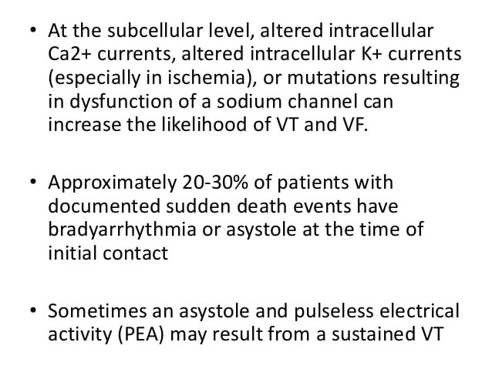

Slide 17
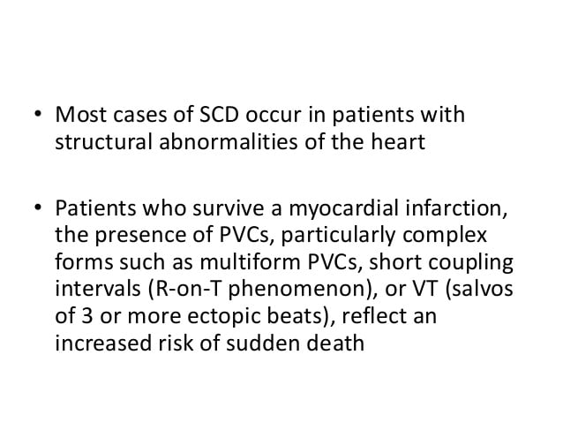

Slide 18
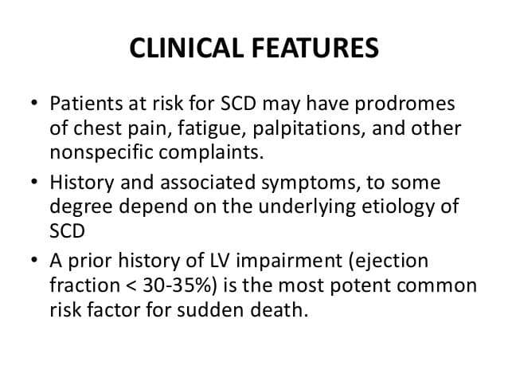

Slide 19
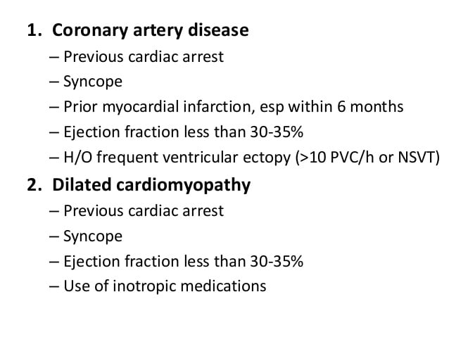

Slide 20
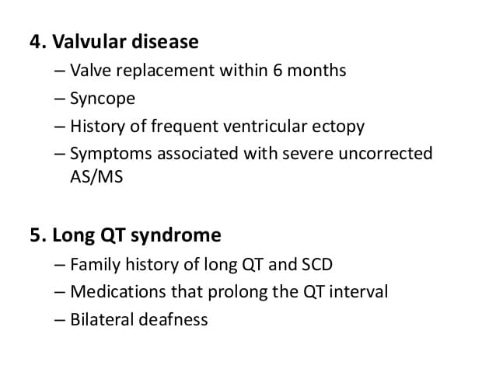

Slide 21
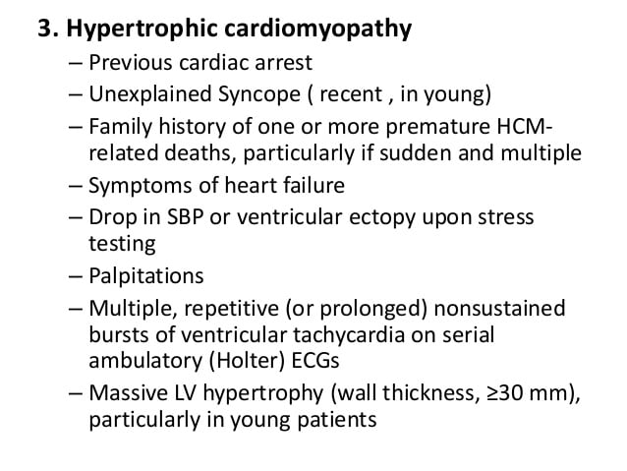

Slide 22
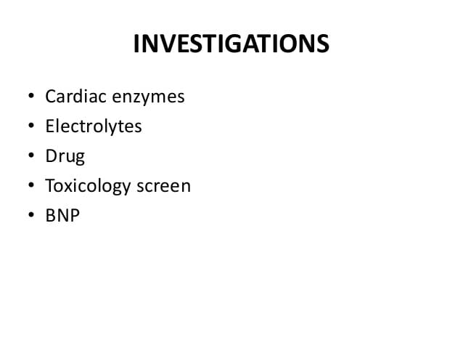

Slide 23
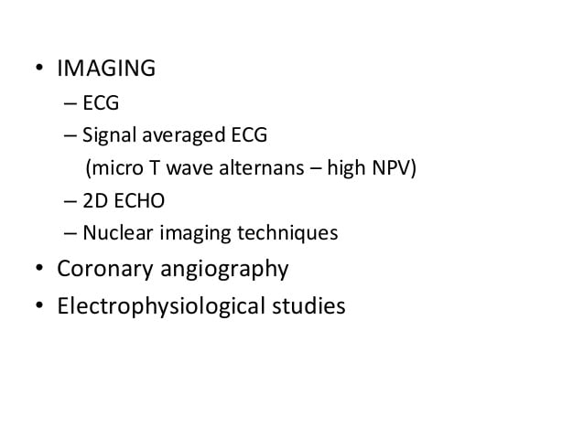

Slide 24
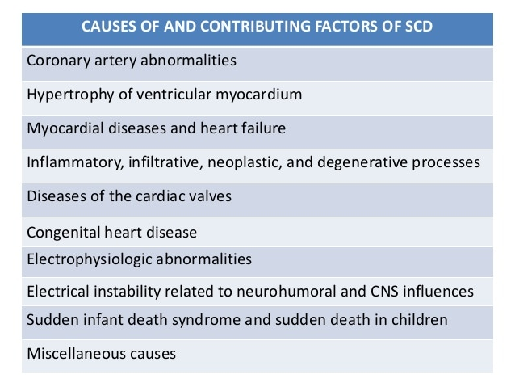

Slide 25
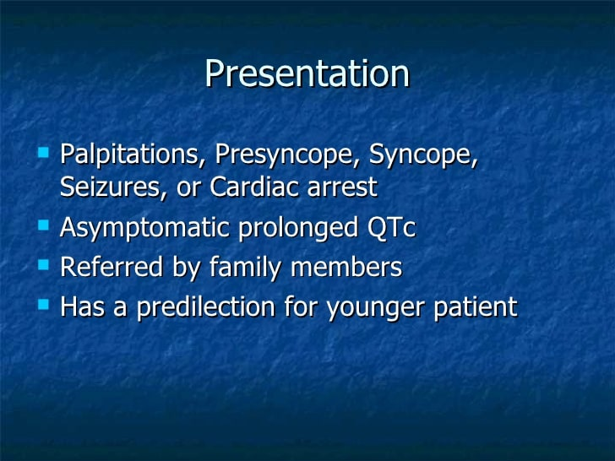
LONG QT SYNDROME

Slide 26
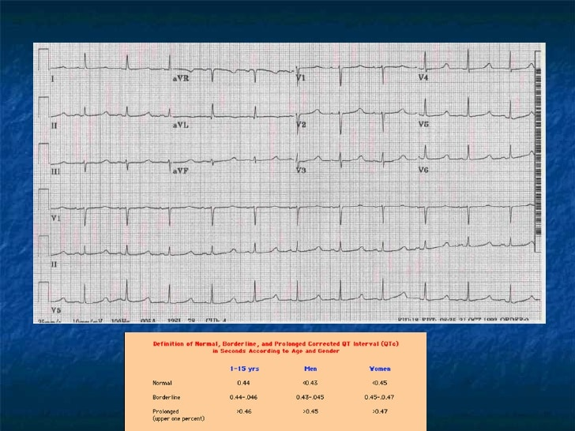

Slide 27
BRUGADA SYNDROME
Brugada syndrome is a rare, but potentially life-threatening heart rhythm disorder that is sometimes inherited.
People with Brugada syndrome have an increased risk of having irregular heart rhythms beginning in the lower chambers of the heart (ventricles).

Slide 28
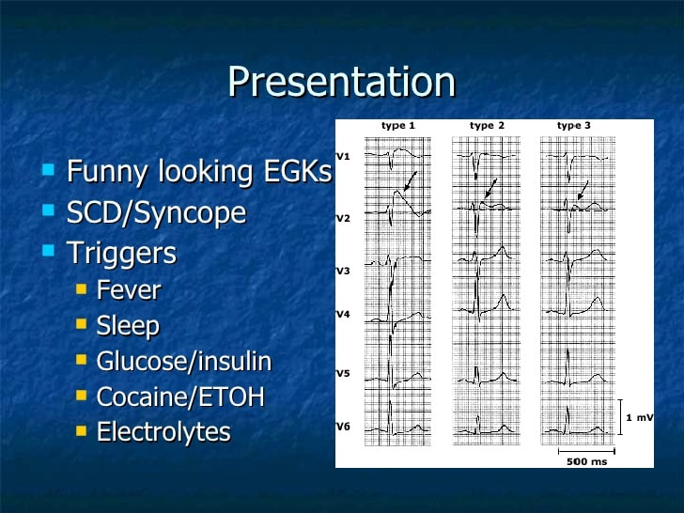

Slide 29
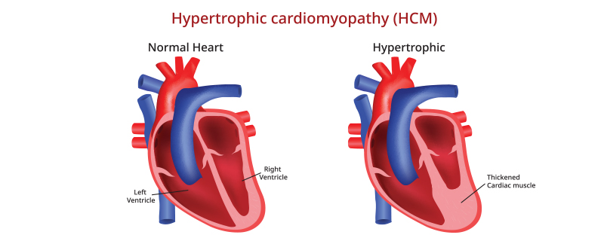
HYPERTROPHIC CARDIOMYOPATHY
Hypertrophic cardiomyopathy (HCM) is a disease in which the heart muscle becomes abnormally thick (hypertrophied). The thickened heart muscle can make it harder for the heart to pump blood.

Slide 30
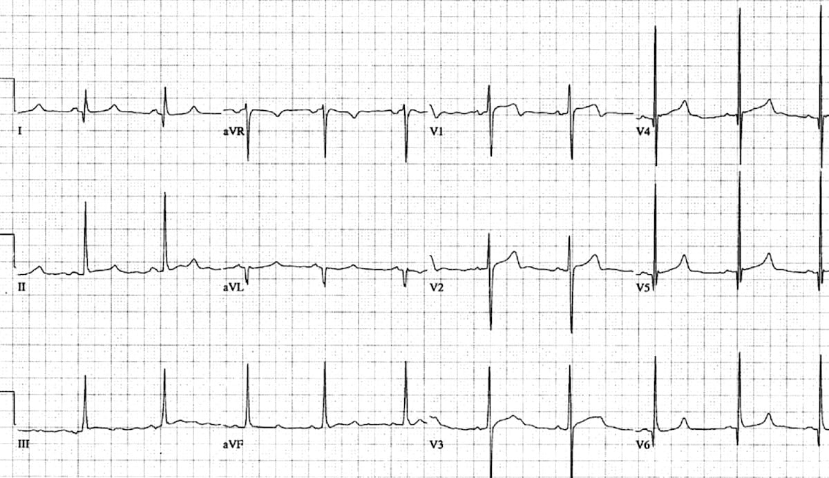
HYPERTROPHIC CARDIOMYOPATHY

Slide 31
VENTRICULAR ARRHYTHMIAS
Ventricular arrhythmias are abnormal heart rhythms that make the lower chambers of your heart twitch instead of pump. This can limit or stop your heart from supplying blood to your body

Slide 32
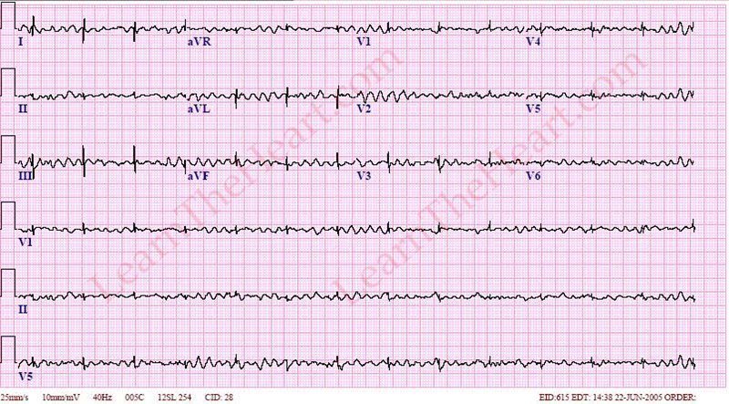

Slide 33
ARRHYTHMOGENIC RIGHT VENTRICULAR DYSPLASIA (ARVD)
Arrhythmogenic right ventricular dysplasia / cardiomyopathy (ARVD/C) is a rare familial disorder that may cause ventricular tachycardia and sudden cardiac death in young, apparently healthy individuals
The clinical hallmark of the disease is ventricular arrhythmias, arising predominantly from the right ventricle.

Slide 34
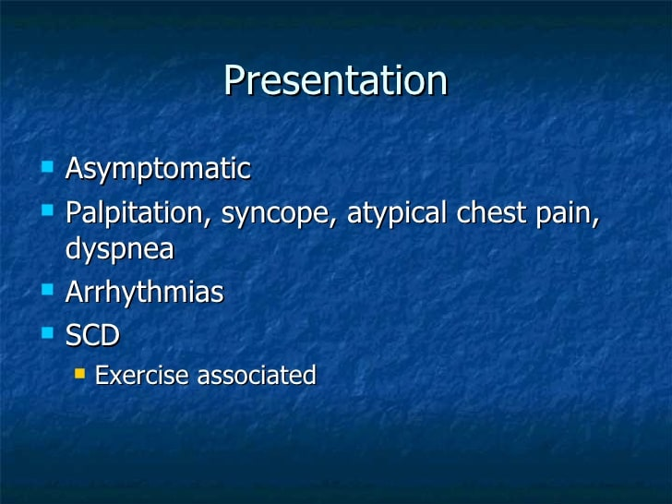

Slide 35


