Slide 1

ODESSA NATIONAL MEDICAL UNIVERSITY
Department of Radiation Diagnostics, Therapy, Radiation medecine and Oncology
Lecture #3. Breast cancer

Slide 2
Discussed issues:
Epidemiology of breast cancer.
History. Ancient evidence of breast tumors.
Anatomy of the mammary gland: blood supply and lymphatic drainage.
Benign and precancerous diseases of the mammary gland.
Primary prevention of breast cancer.
Risk factors for the development of breast cancer.
Diagnostic methods.
The role of self-examination for early detection of tumors.
Clinical picture. Symptoms, forms of breast cancer.
General principles of treatment (surgery, radiation, chemotherapy and hormone therapy, targeted therapy).
Prognosis factors. Survival
Summary of the lecture, general conclusions.

Slide 3










«Happiness is a good health and bad memory».
Ingrid Bergman.

Slide 4
Breast Cancer Statistics
Breast cancer is the most common cancer among women, excluding skin cancers
Breast Cancer is the 2nd leading cause of cancer-related deaths in women, after lung cancer
Notes:
4
Slide 5
Breast cancer is the most common cancer among women (excluding non-melanoma skin cancers). While death rates have decreased in the 1990’s perhaps due to earlier detection and improved treatment, breast cancer is still the second leading cause of cancer related death in women, after lung cancer.
References:
American Cancer Society Website: Breast Cancer Resource Center: What is it?
American Cancer Society Website: Breast Cancer Fast Facts.

Slide 5
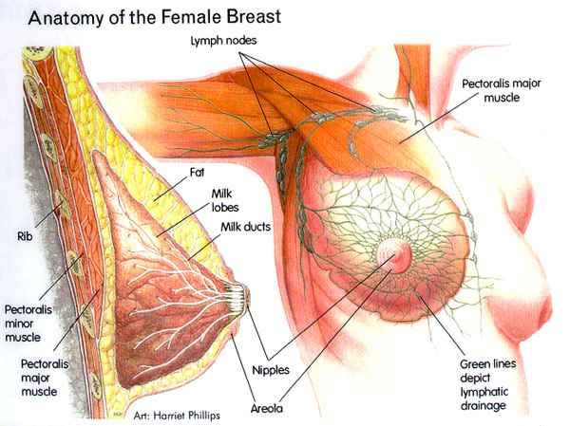
Breast Exam: Anatomy
Variety of sizes and shapes
Composed of fatty, fibrous and glandular tissue
Lymph nodes are important

Slide 6
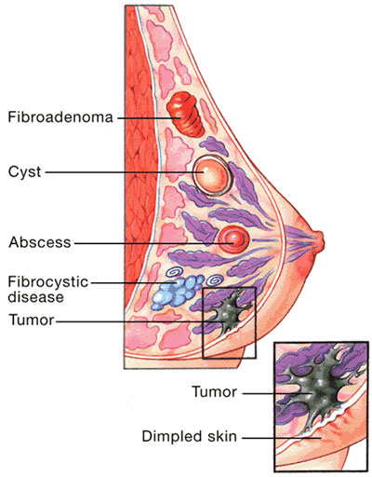
Breast tumours
Malignant
Benignant
Infection
Due to trauma or metabolic discharge
Epithelial (papilloma, adenoma);
Mixed (fibroadenoma, lipoma).
Displazy, mastopathy.

Slide 7
Cancerous @ Noncancerous
Malignant Tumor (Cancer) | Benign Tumor
Invades, compresses, destroys normal tissue | 80% of breast lumps
Cells may break away to form new tumors | Do not invade or spread
Life-threatening | Not life-threatening

Slide 8
Types of Breast Cancer
Invasive Cancers
Noninvasive Cancers
(in situ)
Breast cancer
has spread
from
the ducts or lobes
into the
fatty tissue
of the breast
Breast cancer
is confined
to the ducts or lobes &
has not spread into
fatty tissue
of the breast

Slide 9
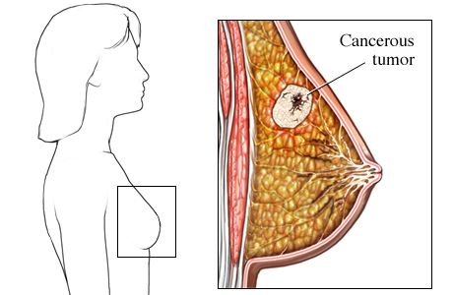
What is breast cancer?
Breast cancer is where cancerous (malignant) cells are found in the breast tissue.
There are several types of breast cancer.
Ductal cancer (effects the ducts and also is the most common type)
Lobular (which begins in the lobes of the breast and often is found in both breasts)

Slide 10

Monthly Self Exams
Its important to remember that monthly self exams are also a good tool for early detection.
Here is a web site that has the complete monthly self-exam program

Slide 11
Breast Self-Exam (BSE)
WHEN TO DO BSE?
Still Menstruate (have your period)
  Best time is two or three days after your period ends
No Longer Menstruate
  Pick the same day every month

Slide 12

Breast Self-Exam
Use pads of your fingers to touch every part of your breast
Feel gently for any
lumps or changes under the skin
In the Shower

Slide 13

Breast Self-Exam
Place arms at sides & clasp behind your head Look for:
  unusual discharge
  dimpling
  changes in skin texture
  changes in shape
Squeeze both nipples & look for discharge
Before a Mirror

Slide 14



Breast Self-Exam
LYING DOWN
Lie flat on your back
Move fingers
in an up & down pattern
Rest your arm on a firm surface

Slide 15
Abnormal Breast Changes
Lump in the breast
Changes in breast size of shape
Notify
Your
Doctor
Nipple discharged or tenderness
Changes in the skin of the breast

Slide 16
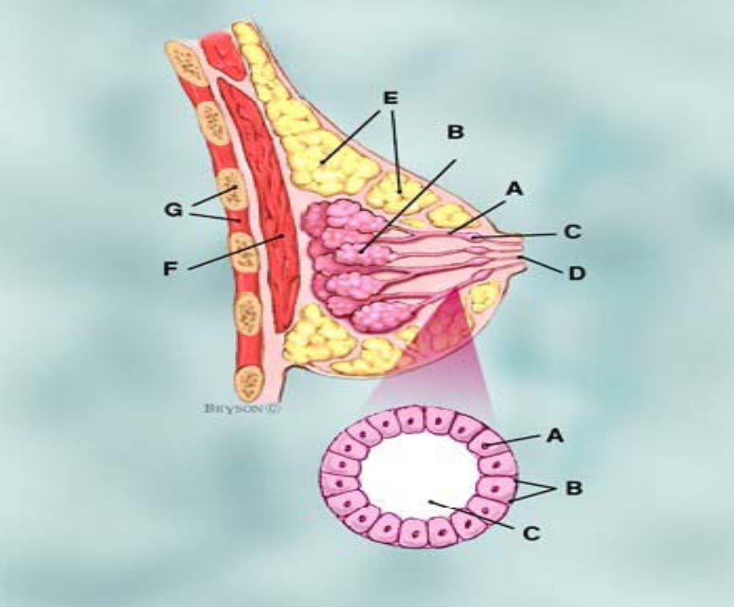
Normal Breast

Slide 17
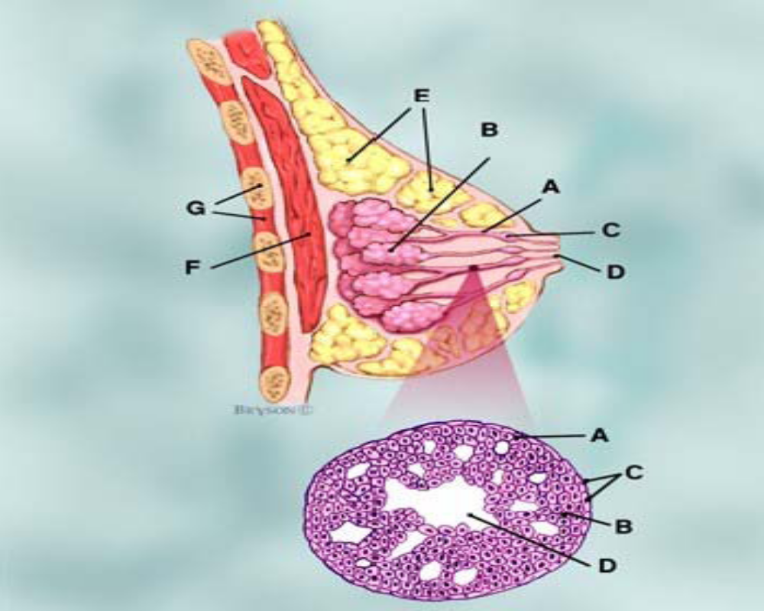
DCIS (Ductal Carcinoma in Situ)

Slide 18
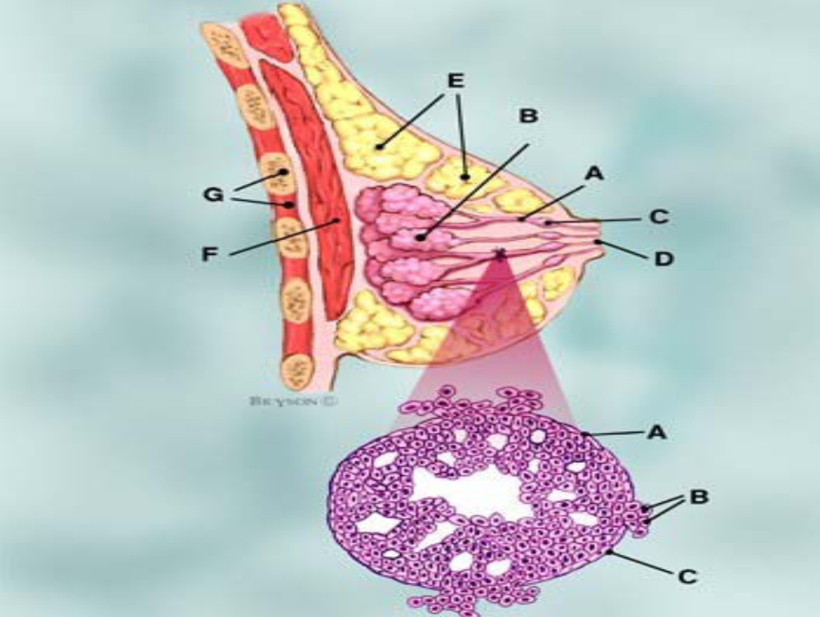
Invasive Cancer

Slide 19
Breast Cancer (BC) Statistics
About 1 in 8 women in the U.S. (12%) will develop invasive BC over the course of her lifetime.
In 2010, an estimated 207,090 new cases of invasive BC were expected to be diagnosed in women in the U.S., along with 54,010 new cases of non-invasive (in situ) breast cancer.
For women in the U.S., BC death rates are higher than those for any other cancer, besides lung cancer.
Besides skin cancer, BC is the most commonly diagnosed cancer among U.S. women. More than 1 in 4 cancers in women (about 28%) are breast cancer.
Compared to African American women, white women are slightly more likely to develop breast cancer, but less likely to die of it. Women of other ethnic backgrounds — Asian, Hispanic, and Native American — have a lower risk of developing and dying from BC than white women and African American women.

Slide 20
Breast Cancer (BC) Statistics
A woman’s risk of BC approximately doubles if she has a first-degree relative (mother, sister, daughter) who has been diagnosed with BC. About 20-30% of women diagnosed with breast cancer have a family history of breast cancer.
About 5-10% of BC can be linked to gene mutations (abnormal changes) inherited from one’s mother or father. Mutations of the BRCA1 and BRCA2 genes are the most common. Women with these mutations have up to an 80% risk of developing BC during their lifetime, and they are more likely to be diagnosed at a younger age (before menopause). An increased ovarian cancer risk is also associated with these genetic mutations.
About 70-80% of BC occur in women who have no family history of BC. These occur due to genetic abnormalities that happen as a result of the aging process and life in general, rather than inherited mutations.

Slide 21
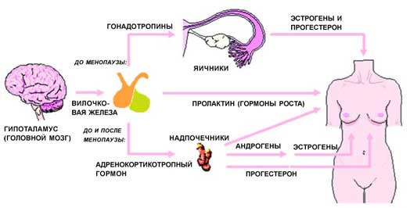
estrogens,
progesterone
gonadothropines
Before
menopause
ovarian
thymus
prolactin
hypothalamus
Before and after
menopause
adrenals
androgens
estrogens
adrenocorticotropic
hormone
progesterone

Slide 22
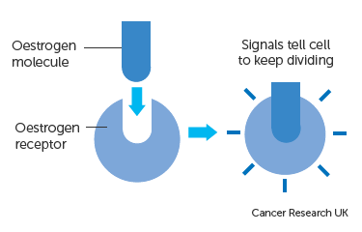
Hormone therapy

Slide 23
Non-proliferative lesions (those not associated with any overgrowth of breast tissue) do not seem to affect breast cancer risk, or if they do at all it is to a very small extent. They include: fibrosis, cysts, mild hyperplasia, adenosis (non-sclerosing), simple fibroadenoma, phyllodes tumor (benign), a single papilloma, fat necrosis, mastitis, duct ectasia, benign tumors (lipoma, hamartoma, hemangioma, neurofibroma).
Proliferative lesions without atypia (those with excessive growth of cells in the ducts or lobules of the breast tissue) seem to raise a woman’s risk of breast cancer slightly (1 Ѕ to 2 times normal). They include: usual ductal hyperplasia (without atypia), complex fibroadenoma, sclerosing adenosis, several papillomas or papillomatosis, radial scar.
Proliferative lesions with atypia (those with excessive growth of cells in the ducts or lobules of the breast tissue and the cells no longer appear normal) have a stronger effect on breast cancer risk, raising it 4 to 5 times higher than normal. They include: atypical ductal hyperplasia (ADH), atypical lobular hyperplasia (ALH)

Slide 24
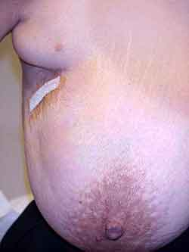
Accessory Breast Tissue
Should always be examined as carefully as the other breast tissue.
Accessory lobules of a mammary gland can be a source of inflammation, and tumors, having a high risk of malignization.
Accessory lobules are ought to be operated.

Slide 25
Physical Findings Suspicious for Malignancy
Venous patterns
Skin edema
Nipple inversion
Retraction
Scaling or ulceration of the nipple
Inflammation

Slide 26
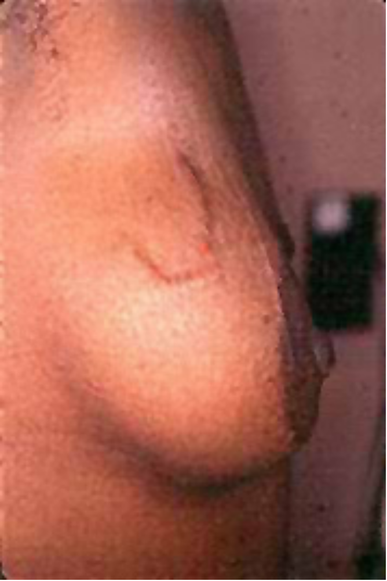
Venous Patterns
Increased prominence or engorgement of blood vessels in an asymmetric patterns
Suggestive of angiogenesis of tumor

Slide 27
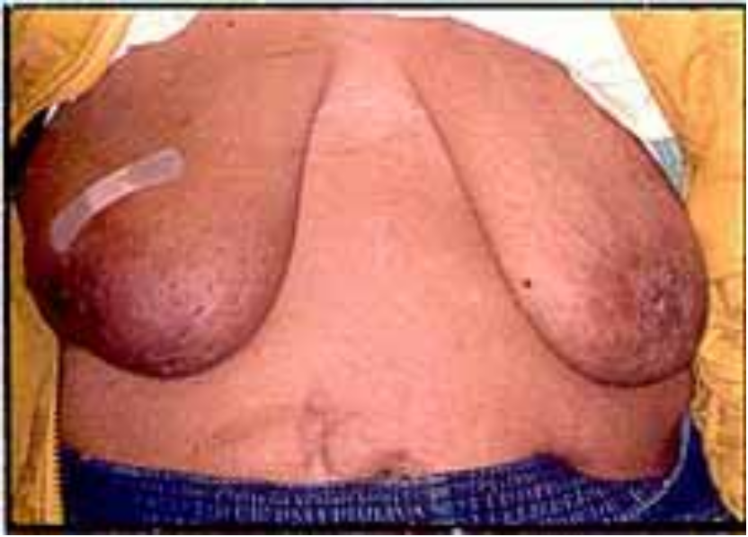
Skin Edema
Produced by lymphatic blockade by tumor, lymph node removal
Appears as thickened skin with enlarged pores
aka “peau d’orange”

Slide 28
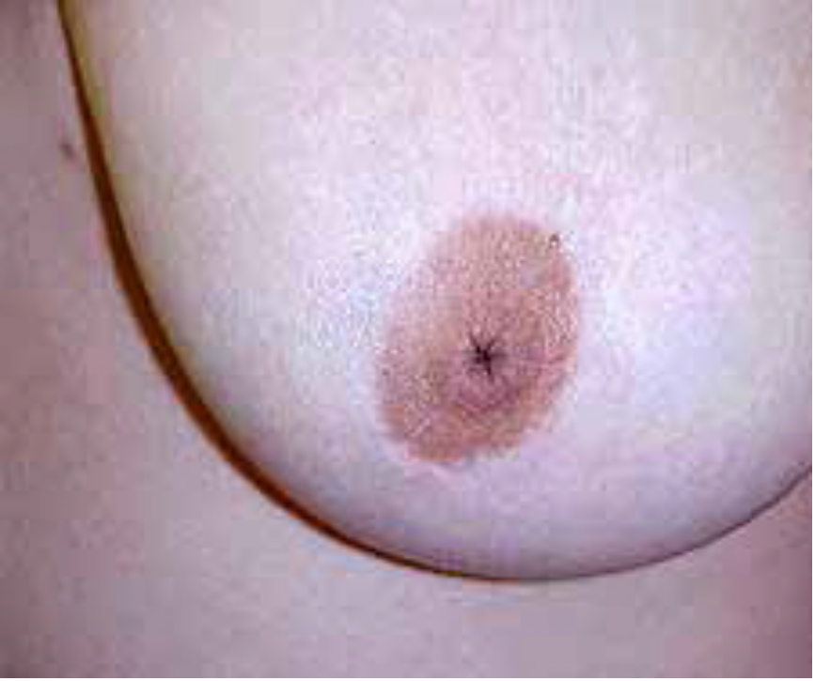
Nipple Inversion
Can be a normal variant
Unilateral or bilateral
Be suspicious for cancer in recently developed cases

Slide 29
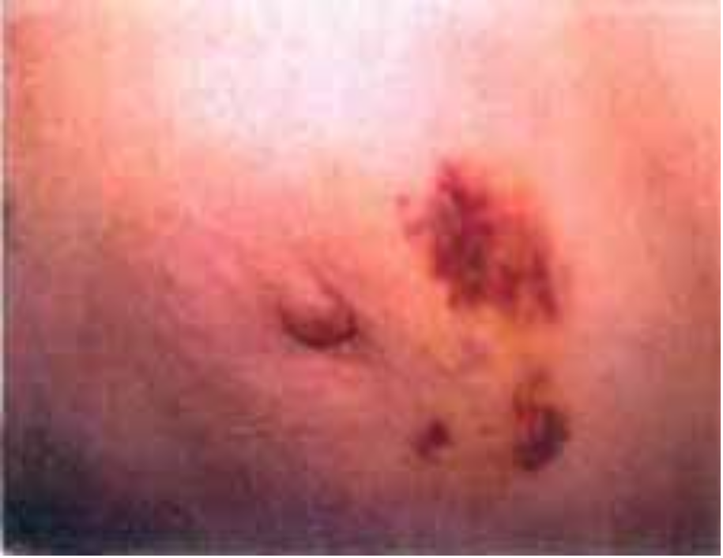
Retraction
Can be caused by fibrosis formation in breast cancer
Fibrosis may produce retraction signs:
  Dimpling of skin
  Alteration in breast contour
  Flattening or deviation of nipple

Slide 30
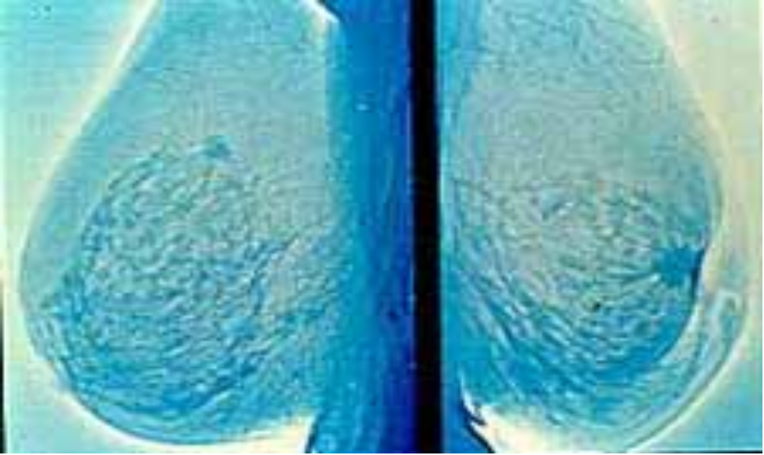
Retraction As Seen on Mammogram

Slide 31
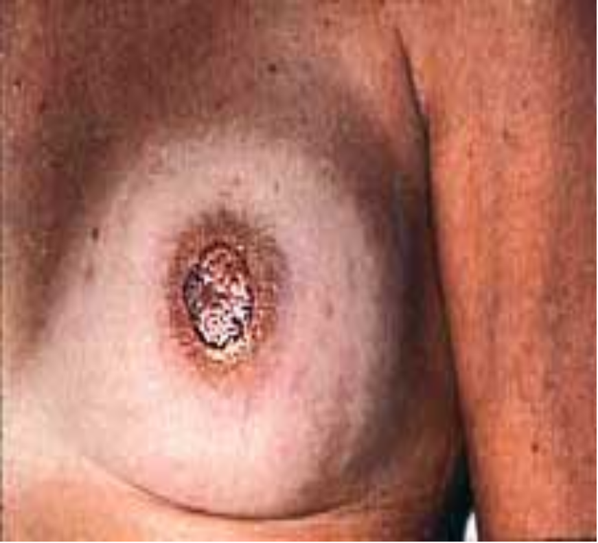
Scaling or Ulceration
Seen in nipple and/or areola
“Paget’s disease”

Slide 32
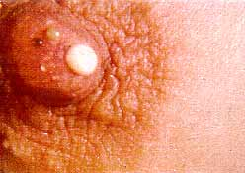
Nipple Discharge
Spontaneous
Unilateral
One Duct
Green
White or Milky
Clear, Serous, Bloody or Serosanguinous
Referral not normally necessary, especially if bilateral or multiple ducts

Slide 33
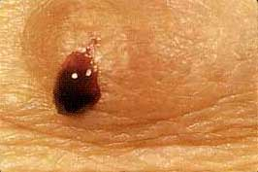
Nipple Discharge
Bloody discharge
Could be a sign of benign intraductal papilloma
Should always be a referral to a breast specialist

Slide 34
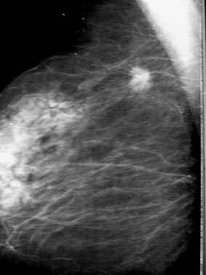
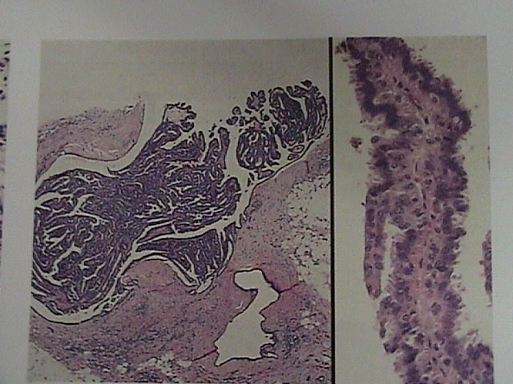
Intraductal Papilloma
Bleeding breast (Mintz disease)
Most common cause of bloody nipple discharge
papilla have central fibrovascular core covered by myoepithelial and epithelial cell layers
inclined to malignancy
subject to urgent surgical treatment

Slide 35
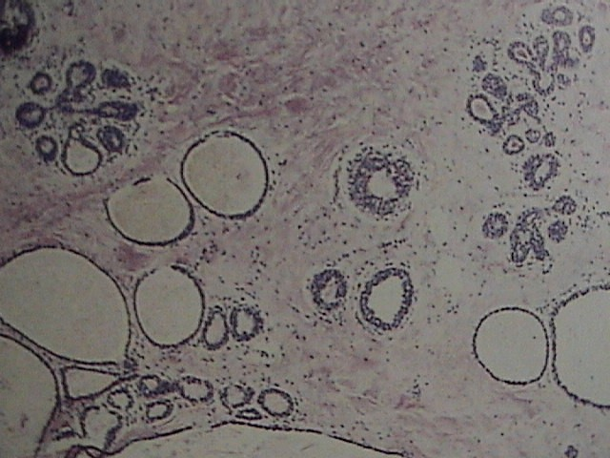
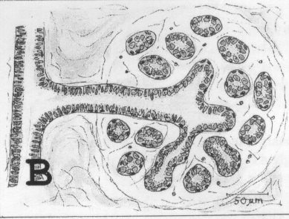
Cysts
Derived from terminal duct lobular unit
endothelial lined
no risk of cancer

Slide 36
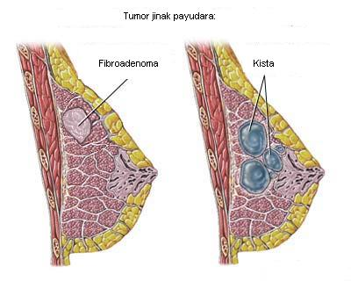

Slide 37
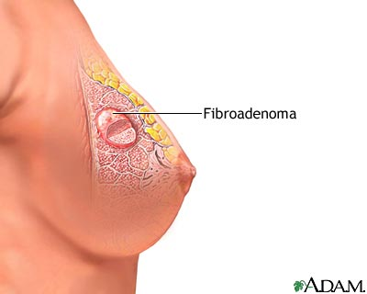
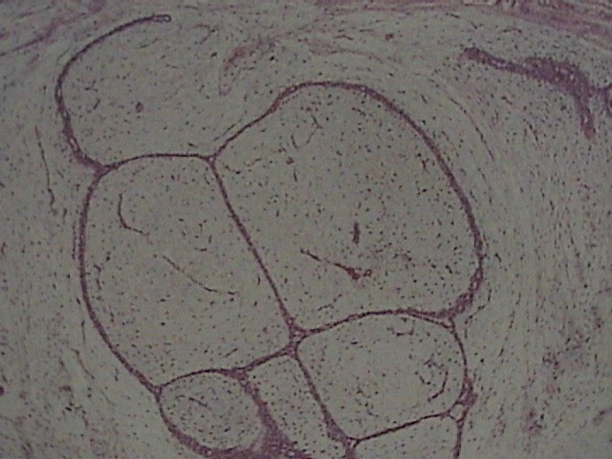
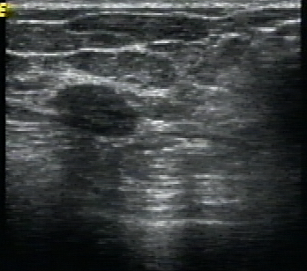
Fibroadenoma
occur in younger women
well limited rounded or polysheric elastic tumor consistency
is located in extraareola zone in the upper parts of the mammary gland

Slide 38
Risk factors
Age > 60 years
Early menarche (< 12 years)
Late menopause (> 55 years)
Oral contraception use
Hormone replacement therapy
Personal history of breast cancer
Family history of breast cancer
Benign proliferate lesions

Slide 39
Do We Know What Causes Breast Cancer?
Some genes (parts of DNA) contain instructions for controlling when our cells grow, divide, and die. Certain genes that promote cell division are called oncogenes. Others that slow down cell division, or cause cells to die at the right time, are called tumor suppressor genes. It is known that cancers can be caused by DNA mutations (changes) that "turn on" oncogenes or "turn off" tumor suppressor genes.

Slide 40
Risk Factors for Breast Cancer?
Risk Factors You Cannot Change
Gender: Simply being a woman is the main risk factor for developing breast cancer. Although women have many more breast cells than men, the main reason they develop more breast cancer is because their breast cells are constantly exposed to the growth-promoting effects of the female hormones estrogen and progesterone, thus making breast cancer much more common in women than men. Men can develop breast cancer, but this disease is about 100 times more common among women than men.
Aging: Your risk of developing breast cancer increases as you get older. About 17% of invasive breast cancer diagnoses are among women in their 40s, while about 78% of women with invasive breast cancer are age 50 or older when they are diagnosed.

Slide 41
Risk Factors You Cannot Change
Genetic risk factors: Recent studies have shown that about 5% to 10% of breast cancer cases are hereditary as a result of gene changes (called mutations). The most common mutations are those of the BRCA1 and BRCA2 genes. Normally, these genes help to prevent cancer by making proteins that keep cells from growing abnormally. However, if you have inherited either mutated gene from a parent, you are at increased risk for breast cancer.

Slide 42
Family history of breast cancer:
You have 2 or more relatives with breast or ovarian cancer.
Breast cancer occurs before age 50 in a relative (mother, sister, grandmother or aunt) on either side of the family. The risk is higher if your mother or sister has a history of breast cancer.
You have relatives with both breast and ovarian cancer.
You have 1 or more relatives with two cancers (breast and ovarian, or 2 different breast cancers).
You have a male relative (or relatives) with breast cancer.
You have a family history of breast or ovarian cancer and Ashkenazi Jewish heritage.
Having 1 first-degree relative (mother, sister, or daughter) with breast cancer approximately doubles a woman's risk. Having 2, first-degree relatives increases her risk 5-fold. Although the exact risk is not known, women with a family history of breast cancer in a father or brother also have an increased risk of breast cancer. Altogether, about 20% to 30% of women with breast cancer have a family member with this disease.

Slide 43
Factors With Uncertain, Controversial, or Unproven Effect
Antiperspirants: This was a preliminary finding, and more research is needed to determine what effect, if any, parabens may have on breast cancer risk.
Induced abortion: Also, there is no evidence of a direct relationship between breast cancer and spontaneous abortion (miscarriage) in most of the studies that have been published.
Breast implants: Several studies have found that breast implants do not increase breast cancer risk although silicone breast implants can cause scar tissue to form in the breast.
Environmental pollution: A great deal of research has been reported and more is being done to understand environmental influences on breast cancer risk.
Tobacco smoke: Though active smoking has been suggested to increase the risk of breast cancer in some studies, the issue remains controversial.

Slide 44
Risk Factors You Can Change
Breast-feeding and pregnancy: Some studies suggest that breast-feeding may slightly lower breast cancer risk, especially if breast-feeding is continued for 1.5 to 2 years. Other studies found no impact on breast cancer risk.
Alcohol: Use of alcohol is clearly linked to an increased risk of developing breast cancer. The risk increases with the amount of alcohol consumed. Compared with nondrinkers, women who consume 1 alcoholic drink a day have a very small increase in risk. Those who have 2 to 5 drinks daily have about 1Ѕ times the risk of women who drink no alcohol.
Obesity and high-fat diets: Obesity (being overweight) has been found to be a breast cancer risk in all studies, especially for women after menopause.

Slide 45
Lifestyle-Related Factors
Not having children: Women who have had no children or who had their first child after age 30 have a slightly higher BC risk. Having multiple pregnancies and becoming pregnant at an early age reduces BC risk.
Oral contraceptive use: Women now using oral contraceptives have a slightly greater risk of BC cancer than women who have never used them. Women who stopped using oral contraceptives more than 10 years ago do not appear to have any increased BC risk.
Postmenopausal hormone therapy (also known as hormone replacement therapy, or HRT): It has become clear that long-term use (several years or more) of postmenopausal hormone therapy (PHT), particularly estrogen and progesterone combined, increases your risk of BC. Long-term PHT use may also increase your chances of dying of BC.

Slide 46
Risk Factors You Cannot Change
Previous chest radiation: Women who as children or young adults had radiation therapy to the chest area as treatment for another cancer (such as Hodgkin disease or non-Hodgkin lymphoma) are at significantly increased risk for breast cancer. Some reports found the risk to be 12 times normal risk.
Menstrual periods: Women who started menstruating at an early age (before age 12) or who went through menopause at a late age (after age 55) have a slightly higher risk of breast cancer.
Abnormal breast biopsy: Some types of benign breast conditions are more closely linked to breast cancer risk than others.

Slide 47
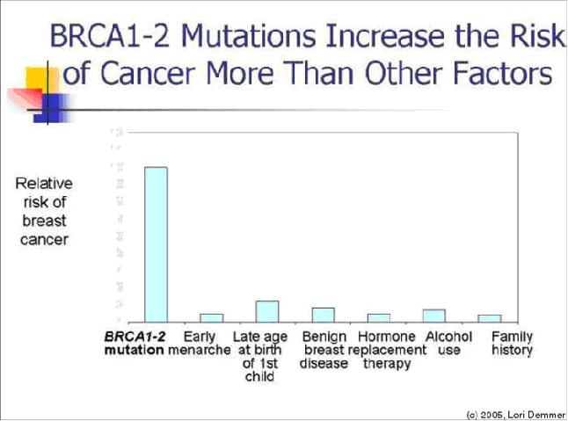

Slide 48
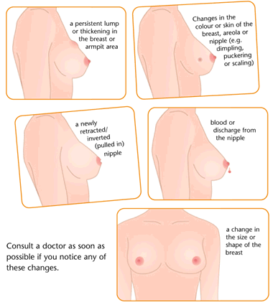

Slide 49
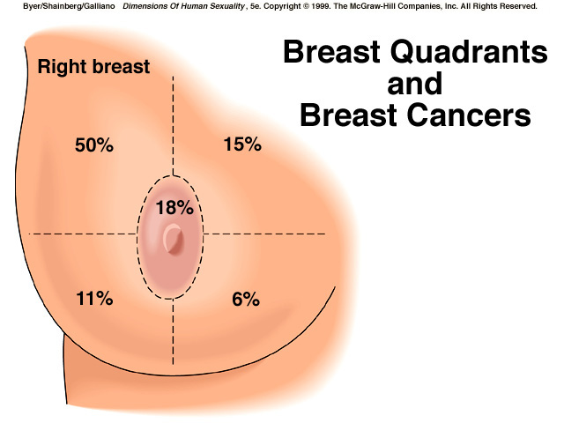

Slide 50
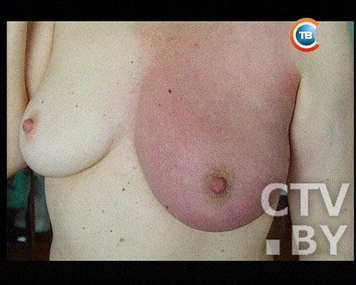
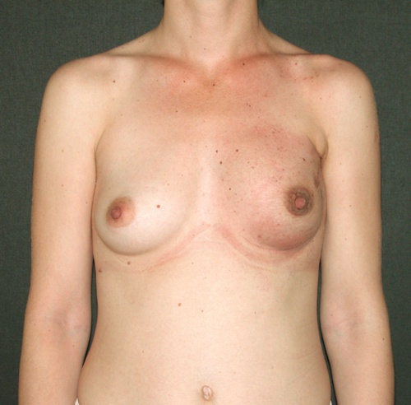
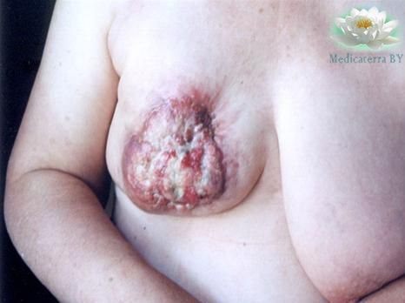
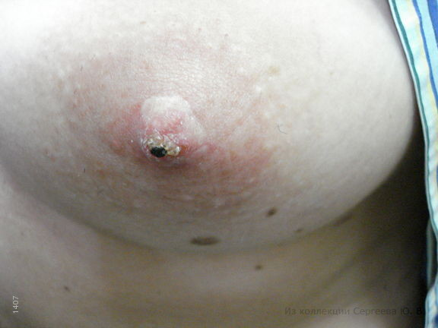
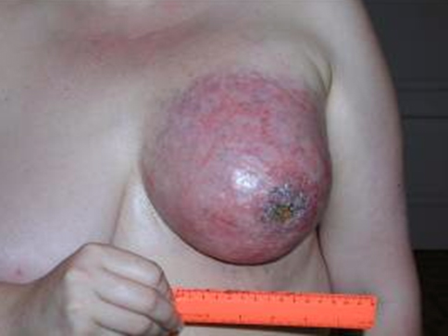

Clinical forms of Breast cancer
Nodular
Diffuse
Infiltrative
Edema
As Mastitis
As erysipelas
Shell-form
3. Atypical form

Slide 51
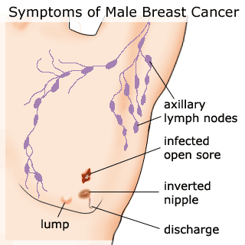
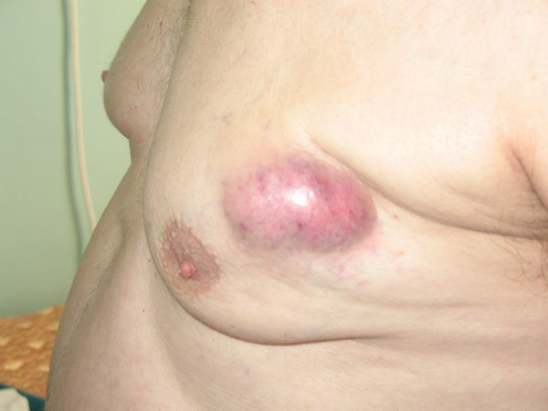

Slide 52
Biopsy Techniques
Fine Needle Aspiration
  Cytology vs. Histology
  Significant insufficient sampling
  Unable to differentiate in-situ from invasive

Slide 53
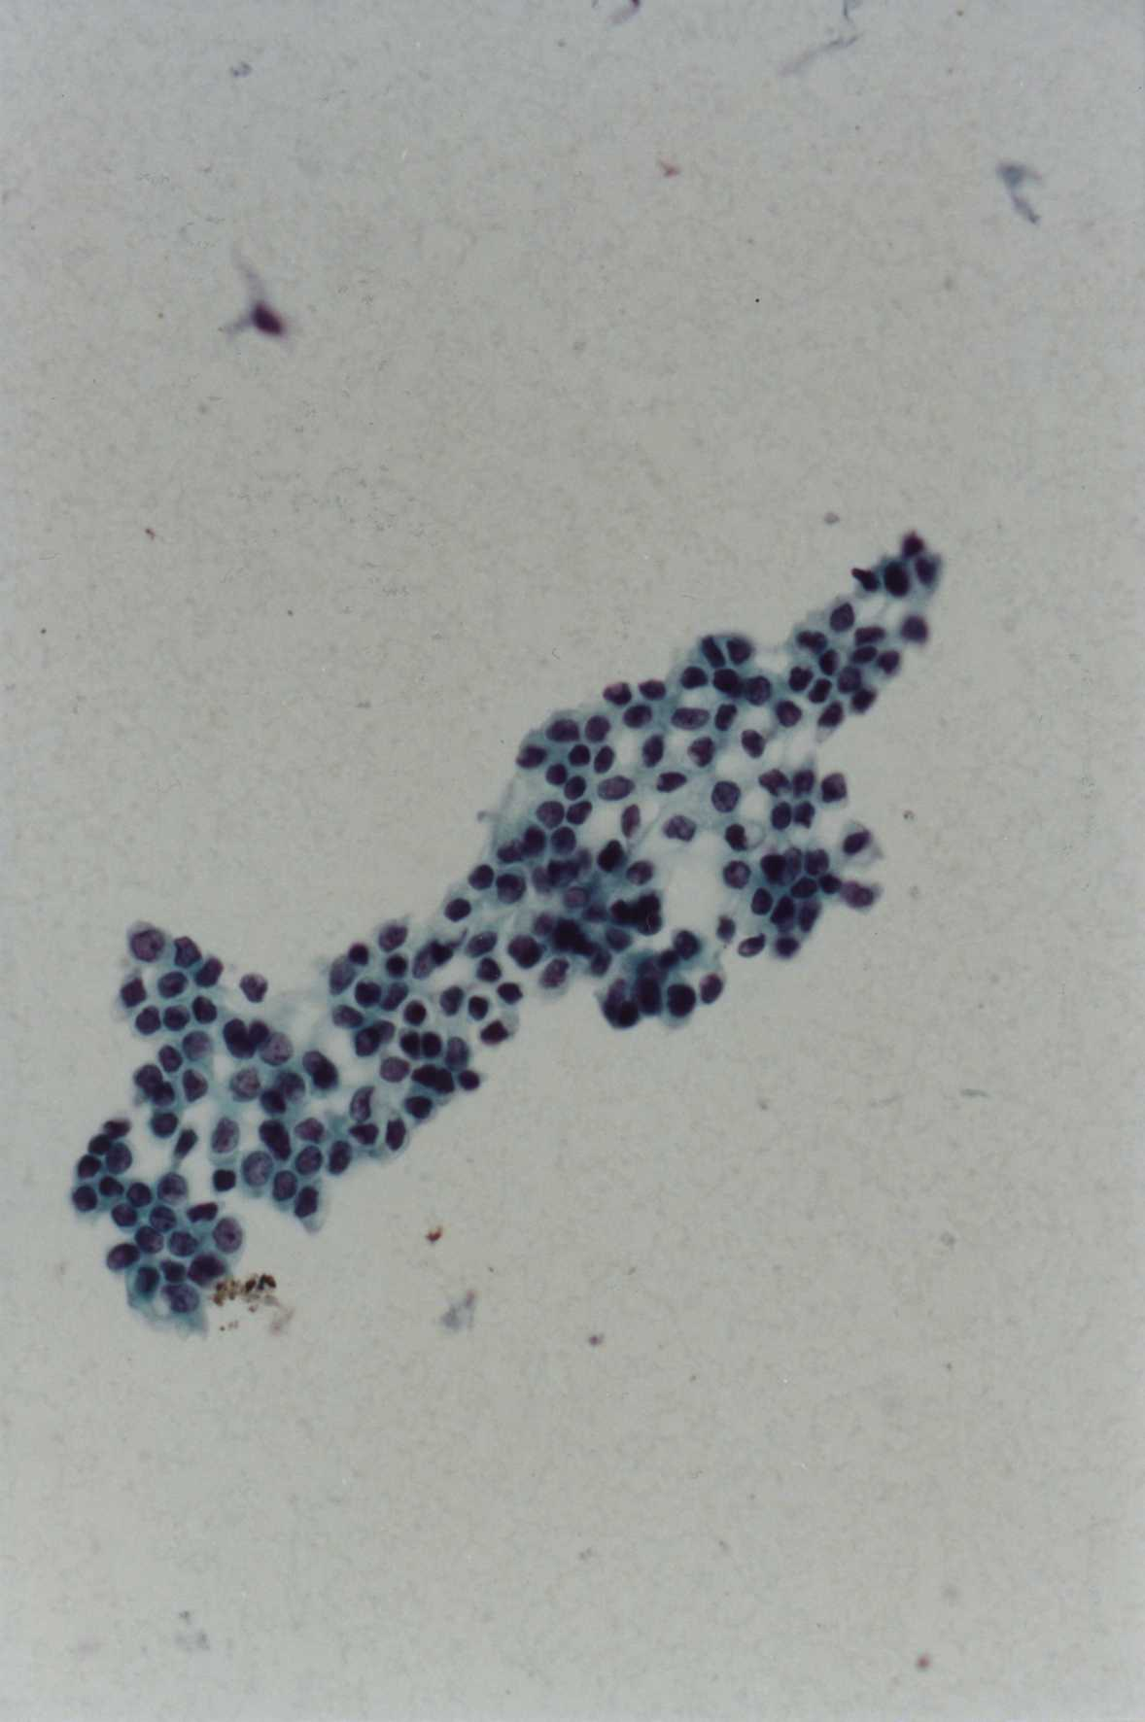
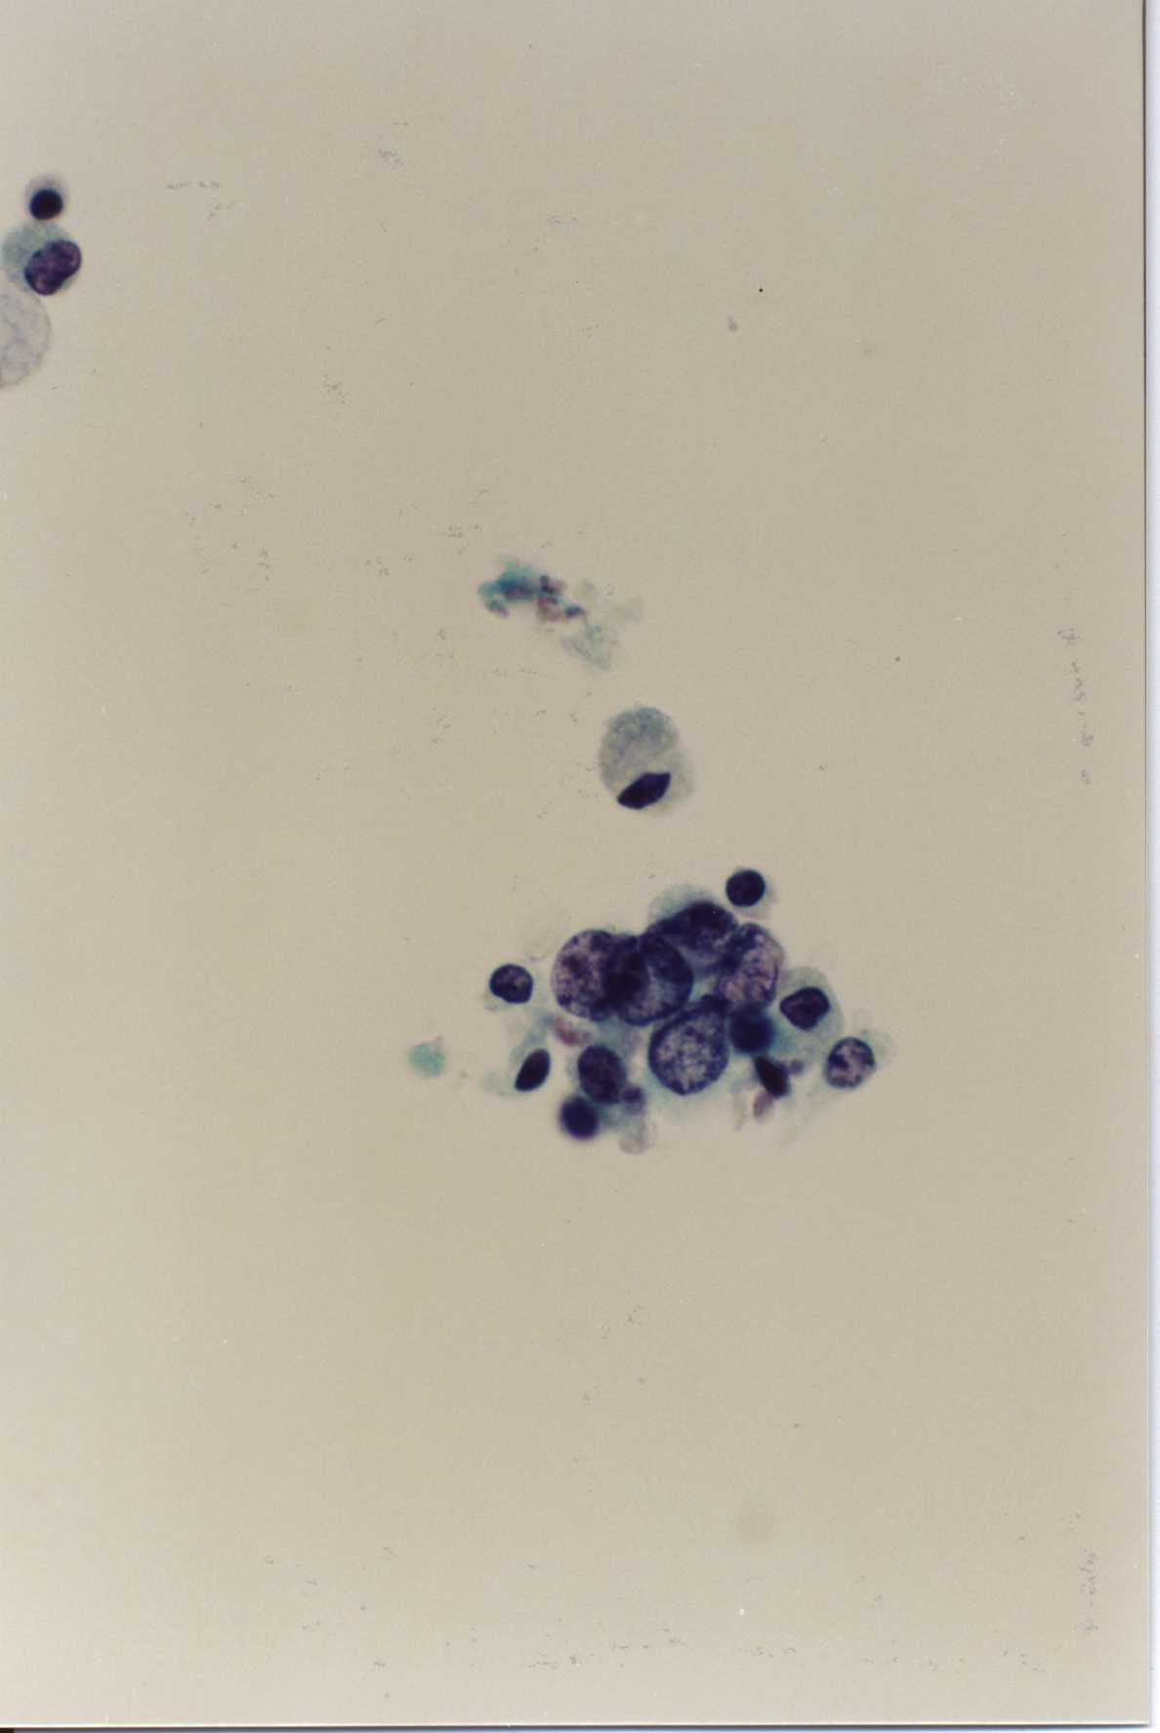
Examples of Ductal Cells Under a Microscope
BENIGN
MALIGNANT

Slide 54
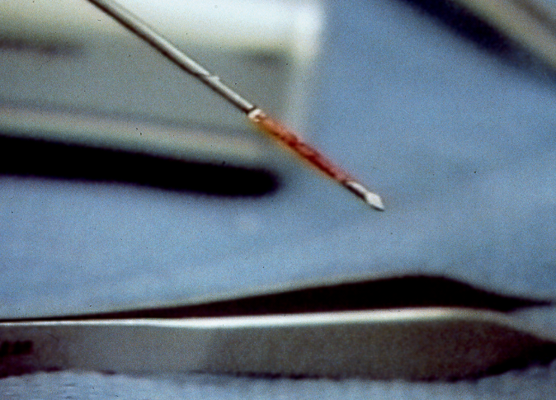
Tru-Cut
Histology
More definitive compared to FNA
Small fragmented samples
Multiple insertions/re-insertion's

Slide 55
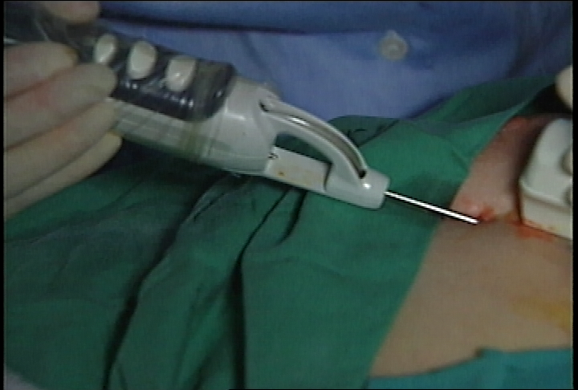
Vacuum-Assisted Mammotome
Histology
Large, contiguous tissue samples
Single insertion
Can mark biopsy site
2-3 mm skin incision – sutureless

Slide 56
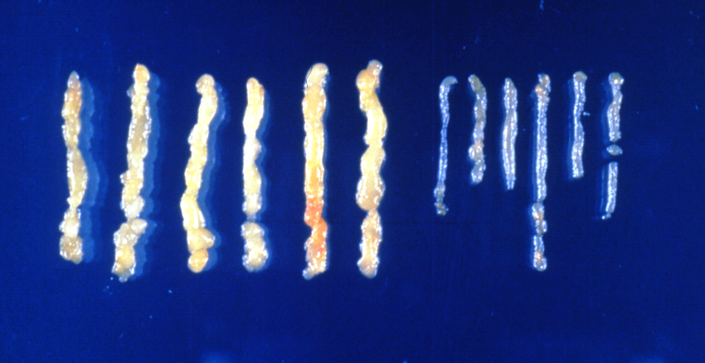
Core biopsy samples

Slide 57
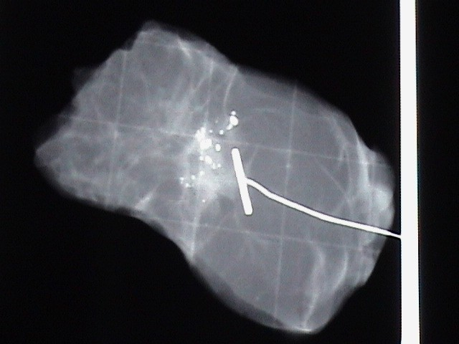
Screening Mammogram
Can identify abnormal mass or calcification
Biopsy under mammogram guidance
Stereotactic biopsy or excisional biopsy guided by wire placement

Slide 58
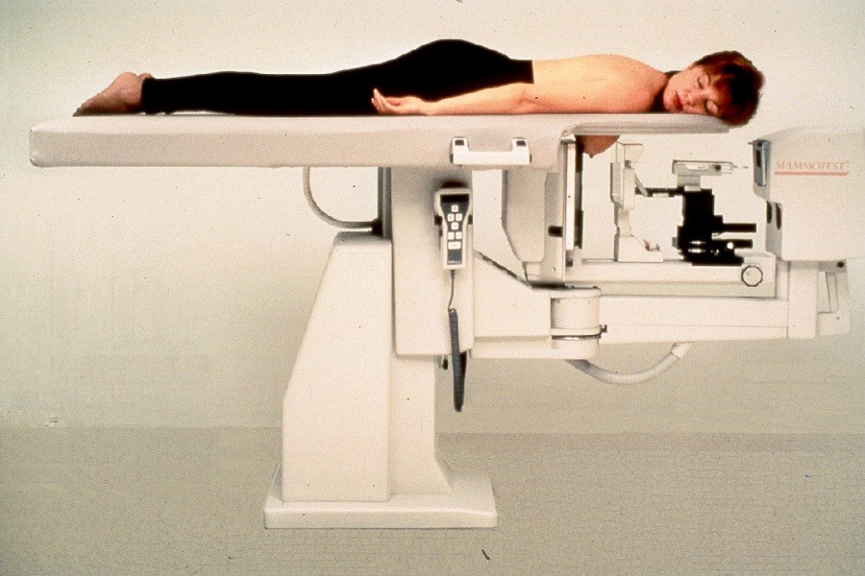
Stereotactic Breast Biopsy

Slide 59
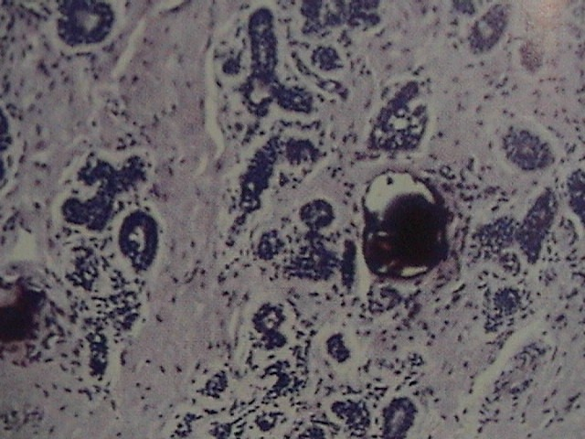
Calcifications

Slide 60
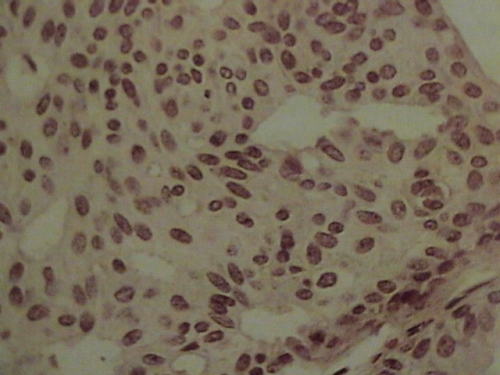
Intraductal Hyperplasia
No atypia
proliferation of epithelial cells
varied size,shape
elongated secondary spaces
low risk cancer

Slide 61
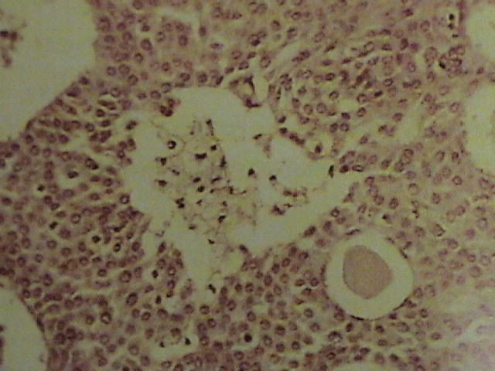
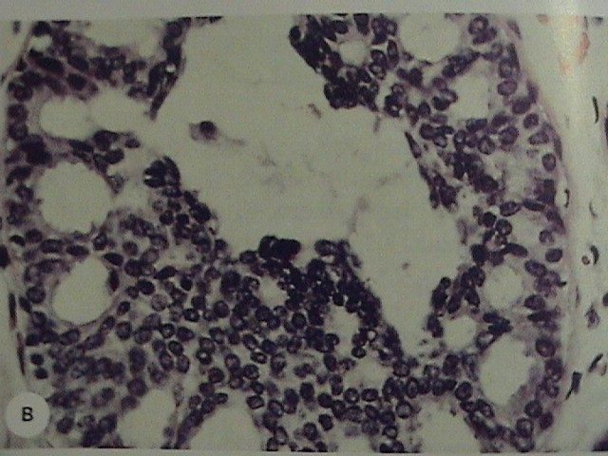
Atypical Ductal Hyperplasia
Uniform cells with monotonous nuclei
lacks some features of DCIS -near periphery maintain orientation
three to five-fold increase risk of breast cancer

Slide 62
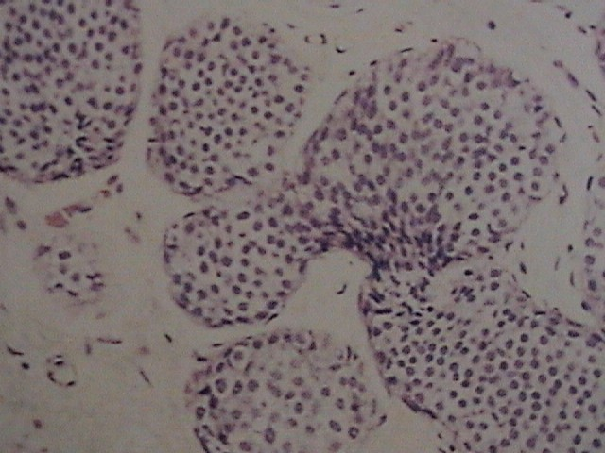
Lobular Carcinoma in Situ (LCIS)
Acini of lobules filled with uniform tumor cells
Multicentric and bilateral
1% per year risk of invasive cancer in either breast

Slide 63
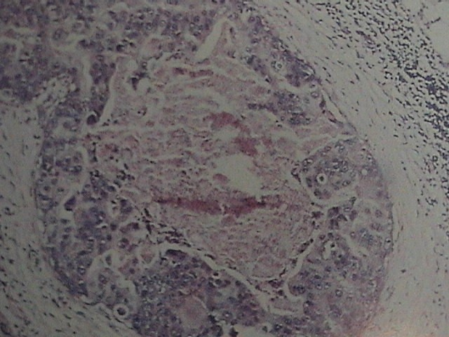
Ductal Carcinoma in Situ (DCIS)
Comedo type - central necrosis
Other types:
  cribiform
  micropapillary
  papillary
  solid

Slide 64
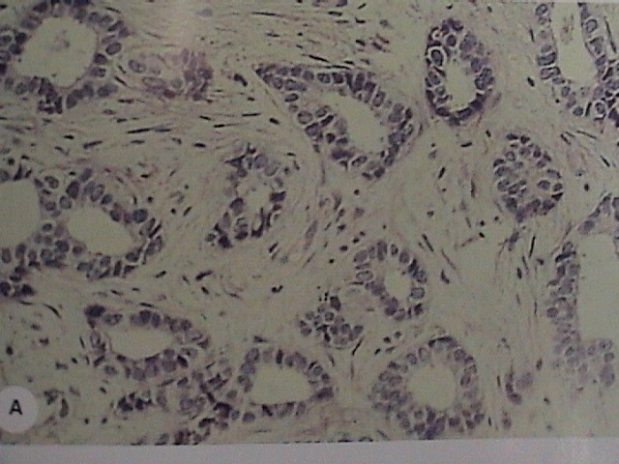
Infiltrating Ductal Cancer
most common type
well (gr I) to poorly (gr III) differentiated
Gr I tumor cells grow in glandular patterns
prognostic factors:
  ER,PR, HER-2neu,p53
  S-phase, ploidy
  angiogenesis

Slide 65
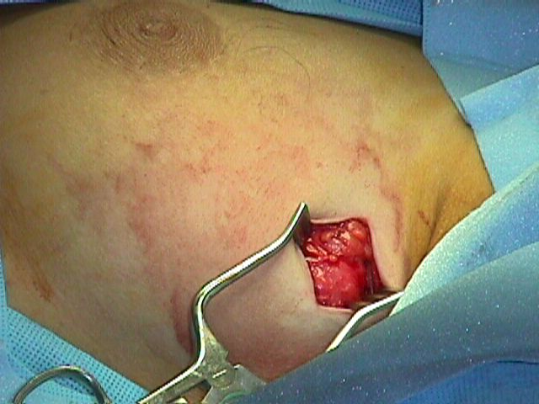
Open Surgical Excision
Performed in the OR
  large skin incision
  Local or General Anesthesia

Slide 66
History of Treatment
1890’s - Halstead - Radical Mastectomy
1948 - Dyson and Patey - Modified Radical Mastectomy
1948 - McWhirter - Simple Mastectomy and radiation therapy
1990’s - Lumpectomy/Axillary node dissection and radiation therapy

Slide 67

Radical Mastectomy
Remove breast, axillary contents, pectoralis muscles
lymphedema of left arm

Slide 68

Axillary Node Dissection
Level I - lower axilla around tail of breast
Level II - nodes up to the axillary vein
Level III - nodes above axillary vein and under pectoralis

Slide 69

Modified Radical Mastectomy
Excision of nipple and areola
breast and axillary nodes
leave pectoralis muscles

Slide 70

Modified Radical Mastectomy
Axilla dissected en bloc with the breast

Slide 71

Modified Radical Mastectomy
Long Thoracic Nerve
  Winged Scapula
Thoracodorsal Nerve
Intercostal brachial
  Numbness of the upper inner arm

Slide 72




Slide 73

Lymphatics
Routes of lymphatic flow
Used to devise less invasive techniques

Slide 74

Sentinel Node Biopsy
Technetium sulfur colloid
Isosulfan blue
injected at tumor
draining lymph node identified

Slide 75

Sentinel Node Biopsy
Node identified using gamma probe or by tracing blue lymphatic
excise “hot” and/or blue nodes and any palpable nodes

Slide 76

Sentinel Node Biopsy
Node sent to pathology
if no tumor, may avoid axillary dissection
false negative rate is 1-2%

Slide 77

Skin-sparing Mastectomy
Still excise nipple and areola

Slide 78

Skin-sparing Mastectomy
Leaves adequate skin for immediate reconstruction

Slide 79

Reconstruction
tissue expander (R) placed initially - inflated with saline
subpectoral placement
silicone implant

Slide 80

Mammograms
Getting a mammogram is an effective way to detect breast cancer in its early stages.
It is recommended by the AMERICAN CANCER SOCIETY that all women over 40 get a yearly mammogram.
Its also recommended that women over 20 should get a mammogram every 2-5 years depending on your risk.

Slide 81





Mammograms

Slide 82

Thermograph
Thermograph is one of the newest ways to detect breast cancer.
Thermograph is a thermal image of the breast tissue.
It can also detect cancer before the traditional mammogram can.

Slide 83


Slide 84


Slide 85


Slide 86


Slide 87


Slide 88
Treatment
One of the most widely used treatments is radiation therapy.
Radiation therapy is targeted directly to the specific area and the side effects are limited to the area being treated.
Radiation works by killing all the cells in the effected area.
There are two types of radiation, one is administered externally and one internally.
External radiation is delivered over a 5-7 weeks and 5 times a week. It is delivered by an liner acceptor. And is the most common of the two.
Internal radiation is where radioactive material is delivered directly into the site where the tumor was.
This is usually done at the end of traditional radiation to give it an extra “boost” at the end of treatment.

Slide 89
Radiation top 10
Radiation kills the cancer cells left after surgery.
Radiation therapy doesn't make you radio active.
Radiation is painless when it’s delivered, but it will become more painful over time.
Treatments will be given up to 5-7 weeks, 5 days a week.
Treatments only take ½ hour so you can keep your routine.
Your hair won’t fall out unless you are also taking chemotherapy.
Your skin in the area may become red and easily irritated.
You may feel tired even after its over.
Radiation after surgery reduces the chances of the cancer reoccurring.

Slide 90
Chemotherapy
Chemotherapy effects the whole body even if the cancer has not spread.
Chemotherapy is often administered prior to surgery to reduce the size of the tumor to leave clear margins.
Chemotherapy also reduces your leukocytes (white blood cells that is also our immune system), making you more susceptible to every day bugs.
The side effects include nausea and, losing all your hair.
Its administered through and IV or its also available in pill, and liquid form.
As always its your choice and should not be taken lightly.

Slide 91
Herceptin
Herceptin introduces the cancer to your immune system, taking a more proactive approach to the cancer by attacking the cancer like any other foreign invader in your body.
Herceptin is only effective in certain types of cancer.
Herceptin side effects include, fever, chills, muscle aches, and nausea.
In rare cases (5%) heart trauma occurs which can lead to strokes, and even congestive heart failure.

Slide 92


Slide 93


Slide 94
Tamoxifen
Tamoxifen has been used widely over the past 20 years as an effective tool to help eliminate the cancer.
Many cancers love the estrogen, which is already in our body.
Tamoxifen, also known as an anti-estrogen, works by blocking the estrogen receptors in the cancer preventing it from getting the estrogen it feeds on shrinking or eliminating the cancer completely.
It has also been given to high risk patients to reduce the likelihood that they will get cancer.
Possible side effects include nausea, vomiting, blurred vision and even swelling in your lips.

Slide 95
Adjuvant therapy
Adjuvant Therapy
􀂄 Radiation Therapy (local)
􀂄 Chemotherapy (systemic)
􀂄 Hormonal agents (systemic)
􀂄 Each therapy adds to reduction of recurrent disease.
􀂄 Therapy is individualized, discussion with health care provider.
Chemotherapy Drugs
􀂄 Adriamycin, Epirubicin
􀂄 Cytoxan
􀂄 Methotrexate, 5-fluorouracil
􀂄 Taxol, Taxotere
􀂄 Navelbine
􀂄 Intravenous
􀂄 Nausea, hair loss, low blood counts, cardiac toxicity, bladder toxicity, nerve damage
􀂄 Given for adjuvant or recurrent disease.

Slide 96





Pay attention

