Slide 1
LECTURE №2
The main principles of the theory of strong electrolytes. The law of active masses and its application to various types of ionic equilibria in analytical chemistry. Application of the law of active masses to equilibria in heterogeneous systems and its significance in analytical chemistry.
Odessa National Medical University
Faculty of Pharmacy
Department of Pharmaceutical Chemistry
Одеса 2022

Slide 2
LeCTURE plan:
Theory of strong electrolytes
The law of active masses
Нeterogeneous systems
The solubility product (SP)

Slide 3
Theory of strong electrolytes.
All substances are divided into electrolytes and non-electrolytes according to their ability to conduct electricity.
substances
Electrolytes able to conduct electric current
non-electrolytes
unable to conduct electricity

Slide 4
the main provisions of Arrhenius' theory of electrolytic dissociation.
The dissolution of the electrolyte is accompanied by its breakdown into positively and negatively charged ions, which undergo solvation (or hydration, if the solvent is water). The solvated ions are in a state of disordered thermal motion and move in different directions in the solution.
When an electric current is passed through a solution or melt of an electrolyte, ions acquire a directional movement: positively charged ions move to the cathode (that's why they got the name cation), and negatively charged ones - to the anode, which is why they are called anions.
Electrolytic ionization is a reversible process, i.e. simultaneously with the breakdown of molecules into ions, the reverse process occurs - the combination of ions into molecules - the so-called association.
Electrical conductivity and some other general properties of electrolyte solutions are proportional to the total concentration of molecules and ions.
Quantitative characteristics of the dissociation process are the degree and constant of dissociation.

Slide 5
Quantitative characteristics of the dissociation process
The degree of dissociation is the ratio of the concentration of the electrolyte disintegrated into ions to its total concentration in the solution:
α = C_{dis}/C_{total}
where C_{dis} and C_{total} are, respectively, the molar concentration of that part of the electrolyte that has broken down into ions, and its total concentration, mol/l.
Depending on the ability of the electrolyte to dissociate and, as a result, on the degree of dissociation in dilute solutions, all electrolytes are divided into separate groups: strong, medium and weak.

Slide 6
Classification of electrolytes depending on the degree of dissociation
Strong electrolytes | Medium strength electrolytes | Weak electrolytes
α > 30% | 3% ≤ α ≤ 30% | α < 3%
Medium soluble salts: NaCl, K₂SO₄, Ba(NO₃)₂ Alkali and alkaline earth metal hydroxides: LiOH – CsOH, Ca(OH)₂ – Ba(OH)₂,; Strong mineral acids : H₂SO₄, HNO₃, HClO₄, HCl, HBr, HI |  | Organic acids : HCOOH, CH₃COOH, C₂H₅COOH Mineral acids : HNO₂, HClO, H₂CO₃, H₂SiO₃, H₃BO₃, H₂S Low-activity metal hydroxides: Cu(OH)₂ , Fe(OH)₃ , Al(OH)₃ , Cr (OH)₃ , Ammonium hydroxide: NH₄OH

Slide 7
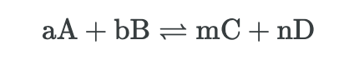
The law of active masses and its application to various types of ionic equilibria in analytical chemistry.
The law of active masses: the rate of chemical reaction is directly proportional to the active masses. Active masses are the concentrations of substances that participate in reactions.
Reversible chemical reactions is a reaction in which the conversion of reactants to products and the conversion of products to reactants occur simultaneously.
If we denote the concentrations of substances A and B by [A] and [B], then the rate of a forward chemical reaction according to the law of active masses can be written in the form of an equation:
V = k [A]ª[B]^{b},
де k – the rate constant of a chemical reaction, which shows the fate of the starting substances reacting per unit of time.

Slide 8
The law of active masses
V = k [A]ª[B]^{b},
As you can see, in the given version, the concentration is included in the rate equation in a degree equal to the numerical coefficient of the chemical reaction equation. Thus, the given equations are a mathematical expression of the law of active masses.
If we denote the concentrations of substances C and D by [C] and [D], then the rate of a reverse chemical reaction according to the law of active masses can be written in the form of an equation:
V = k [C]^{m}[D]^{n},

Slide 9
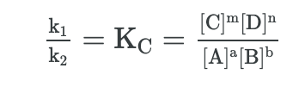
The law of active masses
Forward and reverse reaction rates are equal in equilibrium:
k₁ [A]ª[B]^{b}= k₂ [C]^{m}[D]^{n}
By transforming this equation, it is possible to write down the equation of the equilibrium constant for any chemical reaction that occurs in solutions or in a gaseous medium:

Slide 10
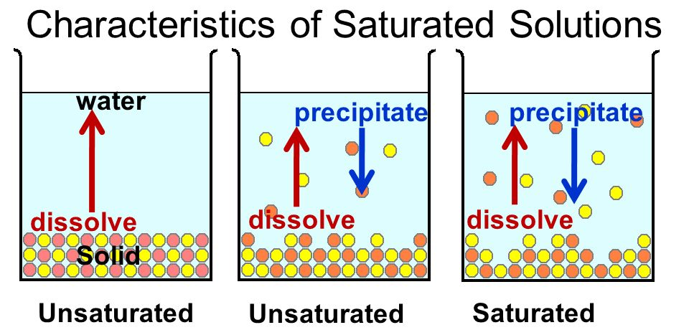
heterogeneous systems
In analytical chemistry, heterogeneous systems - "precipitate - saturated solution" - are of great importance. It should be remembered that completely insoluble substances do not exist, therefore, if a precipitate has formed in the solution, then the liquid above the solution is a saturated solution of this poorly soluble electrolyte.
A solution that is in dynamic equilibrium with the corresponding solid phase is called saturated.

Slide 11
heterogeneous systems
In a saturated salt solution, some solid is always present as a precipitate. Between the A⁺ and B⁻ ions of a sparingly soluble strong electrolyte AB and its precipitate at a constant temperature, a state of heterogeneous ionic equilibrium is established:
А⁺ + В⁻ ↔ АВ↓
Applying the law of mass action to heterogeneous systems precipitate - saturated solution, the equilibrium in them can be characterized by an equilibrium constant, called in this case the solubility product (SP)
SP = [A⁺]∙[B⁻] = const

Slide 12
the solubility product (SP)
The solubility product of a sparingly soluble strong electrolyte is the product of the equilibrium molar concentrations of the cations and anions of this electrolyte in a saturated aqueous solution.
SP = [A⁺]∙[B⁻] = const
For an electrolyte with a more complex composition AaBb, the solubility product is expressed as follows:
А_{а}В_{b} ↔аА^{b+} + bB^{a-}
SP = [А^{b+}]ª∙[ B^{a-}]^{b}

Slide 13
the solubility product (SP)
For silver chloride: AgCl↓ ↔ Ag⁺ + Cl⁻;
SP = [Ag⁺]∙[Cl⁻] = 1.8∙10⁻¹⁰ (reference data)
2. For calcium orthophosphate: Ca₃(PO₄)₂↓ ↔ 3Ca²⁺ + 2PO₄³⁻;
SP = [Ca²⁺]³∙[PO₄³⁻]₂= 1.0∙10⁻²⁵ (reference data)

Slide 14
the solubility product (SP)
If the electrolyte concentration in the solution is higher than the SP value, then an excess amount of the substance precipitates. Therefore, the condition for precipitation for electrolyte AB will be the ratio:
C_{A+}∙C_{B-}> SP (precipitates)
If the precipitation condition is not met, i.e.
C_{A+}∙C_{B-} < SP
then a precipitate of a sparingly soluble substance is not formed.

Slide 15
the solubility product (SP) and solubility
Since SP characterizes the solubility of a substance, knowing its value, one can determine the concentration of ions of a given electrolyte in its saturated solution, i.e. its solubility (S) in mol/dm³.There is a relationship between the solubility product and solubility s (mol/dm³) of a sparingly soluble electrolyte. For electrolyte AB, it has the following mathematical expression:
АВ↓ ↔ А⁺ + В⁻;
SP = [A⁺]∙[B⁻]
[A⁺] = [B⁻] = S
SР = [A⁺]∙[B⁻]= S² or S = √ПР

Slide 16
Effect of homonymous ions on solubility
A change in the concentration of one of the electrolyte ions affects the solubility of the substance. If the concentration of one of its ions is artificially increased in a saturated electrolyte solution, then, in accordance with the constancy of the value of SP, the concentration of another type of ions should decrease, which means that the solubility of the electrolyte decreases and part of it precipitates from the solution.Example. If in a saturated solution of calcium sulfate
CaSO₄↓ ↔ Ca²⁺ + SO₄²⁻;
SP = [Ca²⁺]∙[SO₄²⁻]
some well-soluble sulfate (K₂SO₄, Na₂SO₄) is added, then the concentration of sulfate ions SO₄²⁻ increases, and, consequently, the concentration of Ca²⁺ ions should decrease due to precipitation of CaSO₄. Therefore, the solubility of CaSO₄ decreases.

Slide 17
Effect of homonymous ions on solubility
If another salt is introduced into a saturated solution of CaSO₄, which does not change the concentration of Ca²⁺ and SO₄²⁻ ions (KCl, NaNO₃), then the solubility of CaSO₄ will not change.
Summarizing the above, it can be argued thatthe introduction of ions of the same name (cations or anions) reduces the solubility of a poorly soluble strong electrolyte.

