Slide 1
LECTURE №5
COOrdination compounds in analytical chemistry. Factors influencing complexation. Quantitative characteristics of the stability of COOrdination compounds.
The use of COOrdination compounds to find, separate and mask ions.
Odessa National Medical University
Faculty of Pharmacy
Department of Pharmaceutical Chemistry
Одеса 2022

Slide 2
LeCTURE plan:
Main concept of redox reaction
Balancing redox equations: ion-electron method
Redox potential
The Nernst’s equation

Slide 3
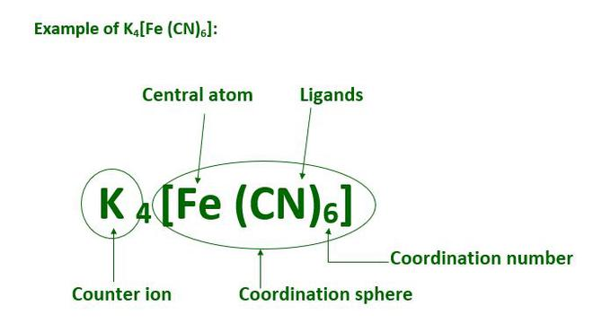
Main concept of COOrdination compound
Coordination compounds are molecules that poses one or multiple metal centers that is bound to ligands (atoms, ions, or molecules that donate electrons to the metal)

Slide 4
Main concept of COOrdination compound
Many coordination compounds contain a metallic element as the central atom and are therefore referred to as metal complexes. These types of coordination complex generally consist of a transition element as the central atom. It can be noted that the central atom in these complexes is called the coordination centre.
The atoms, molecules, or ions that are bound to the coordination centre or the central atom/ion are referred to as ligands. These ligands can either be a simple ion or molecule (such as Cl– or NH3) or in the form of relatively large molecules, such as ethane-1,2-diamine (NH2-CH2-CH2-NH2).
The coordination number of the central atom in the coordination compound refers to the total number of sigma bonds through which the ligands are bound to the coordination centre.
The coordination centre, the ligands attached to the coordination centre, and the net charge of the chemical compound as a whole, form the coordination sphere when written together. This coordination sphere is usually accompanied by a counter ion (the ionizable groups that attach to charged coordination complexes).

Slide 5
Types of Coordination Compound
Cationic complexes: In this co-ordination sphere is a cation. Example: [Co(NH₃)₆]Cl₃
Anionic complexes: In this co-ordination sphere is anion. Example: K₄[Fe(CN)₆]
Neutral Complexes: In this co-ordination sphere is neither cation or anion. Example: [Ni(CO)₄]
Homoleptic complex: The complex consist of a similar type of ligands. Example: K₄[Fe(CN)₆]
Heteroleptic complexes: These consists of different types of ligands. Example: [Co(NH₃)₅Cl]SO₄
Mononuclear complexes: In this co-ordination sphere has single transition metal ion. Example: K₄[Fe(CN)₆]
Polynuclear complexes: More than one transition metal ion is present K₂[Re₂Cl₈]

Slide 6
Rules For Naming Coordination Compound
1. The ligands are always written before the central metal ion in the naming of complex coordination complexes. When the coordination centre is bound to more than one ligand, the names of the ligands are written in an alphabetical order which is not affected by the numerical prefixes that must be applied to the ligands.
2. When there are many monodentate ligands present in the coordination compound, the prefixes that give insight into the number of ligands are of the type: di-, tri-, tetra-, and so on. When there are many polydentate ligands attached to the central metal ion, the prefixes are of the form bis-, tris-, and so on.
3. The names of the anions present in a coordination compound must end with the letter ‘o’, which generally replaces the letter ‘e’. Therefore, the sulfate anion must be written as ‘sulfato’ and the chloride anion must be written as ‘chlorido’. The following neutral ligands are assigned specific names in coordination compounds: NH3 (ammine), H2O (aqua or aquo), CO (carbonyl), NO (nitrosyl).

Slide 7
Rules For Naming Coordination Compound
4. After the ligands are named, the name of the central metal atom is written. If the complex has an anionic charge associated with it, the suffix ‘-ate’ is applied. When writing the name of the central metallic atom in an anionic complex, priority is given to the Latin name of the metal if it exists (with the exception of mercury).
5. The oxidation state of the central metal atom/ion must be specified with the help of roman numerals that are enclosed in a set of parentheses.
6. If the coordination compound is accompanied by a counter ion, the cationic entity must be written before the anionic entity.
!!! The order of listing of ligands depending on the charge: anions, neutral molecules, cations

Slide 8
Rules For Naming Coordination Compound
For neutral ligands, their names are not changed, except the following few:
H₂O: aqua
NH₃: ammine (not two m's, amine is for organic compounds)
CO: carbonyl
NO: nitrosyl
Normal names that will not change
C₅H₅N, pyradine
NH₂CH₂CH₂NH₂, ethylenediamine (en)
C₅H₄N-C₅H₄N, dipyridyl
P(C₆H₅)₃, triphenylphosphine
NH₂CH₂CH₂NHCH₂CH₂NH₂, diethylenetriamine
The last "e" in names of negative ions are changed to "o" in names of complexes.
Cl⁻, chloride -> chloro
OH⁻, hydroxide -> hydroxo
CN⁻, cyanide -> cyano
NH₂⁻, amide -> amido
CO₃²⁻, carbonate -> carbonato
-ONO₂⁻, nitrate -> nitrato (when bonded through O)
-NO₃⁻, nitrate -> nitro (when bonded through N)
S²⁻, sulfide -> sulfido
SCN⁻, thiocyanate -> thiocyanato-S
NCS⁻, thiocyanate -> thiocyanato-N
-(CH₂-N(CH₂COO-)₂)₂,
ethylenediaminetetraacetato (EDTA)

Slide 9
Rules For Naming Coordination Compound
Some examples of the nomenclature of coordination compounds:
K₄[Fe(CN)₆]: Potassium hexacyanoferrate (II)
[Ni(CN)₄] ²⁻: Tetracyanonickelate (II) ion.
[Zn(OH)₄] ²⁻: Tetrahydroxozincate (II) ion.
[Ni(CO)₄]: Tetracarbonyl Nickel (O).
[Co(NH₃)₅Cl]Cl₂, Chloropentaamminecobalt(III) chloride
[Cr(H₂O)₄Cl₂]Cl, Dichlorotetraaquochromium(III) chloride
K[PtCl₃NH₃], Potassium trichloroammineplatinate(II)

Slide 10

Stability of Complexes
A complex is formed in several steps. Each step is reversible and the equilibrium constant is known as stepwise formation constant. Let us consider the formation of complex ML₄
The overall formation constant or stability constant, β = K₁ × K₂ × K₃ × K₄ and 1/β = instability constant

Slide 11
Formation Constant
In general, chemical equilibrium is reached when the forward reaction rate is equal to the reverse reaction rate and can be described using an equilibrium constant, K. Complex ion equilibria are no exception to this and have their own unique equilibrium constant. This formation constant, K_{f}, describes the formation of a complex ion from its central ion and attached ligands. This constant may be called a stability constant or association constant; the units depend on the specific reaction it is describing.
Consider how complex compounds dissociate in steps
K₄[Fe(CN)₆] ↔ 4K⁺ + [Fe(CN)₆]⁴⁻
[Fe(CN)₆]⁴⁻ ↔ Fe²⁺ + 6CN⁻

Slide 12
Formation Constant
At its most basic level, Kf can be explained as the following, where M is a metal ion, L is a ligand, and x and y are coefficients:

Slide 13
Formation Constant
The larger the K_{f} value of a complex ion, the more stable it is. Due to how large formation constants often are it is not uncommon to see them listed as logarithms in the form logK_{f}. You may also see them in the form of a dissociation constant, K_{d} (which should not be confused with pK_{a}). This is merely the inverse value of the formation constant and as such describes the instability of a complex ion. It may help to think of Kf and Kd as stability and instability constants, respectively.

