Slide 1
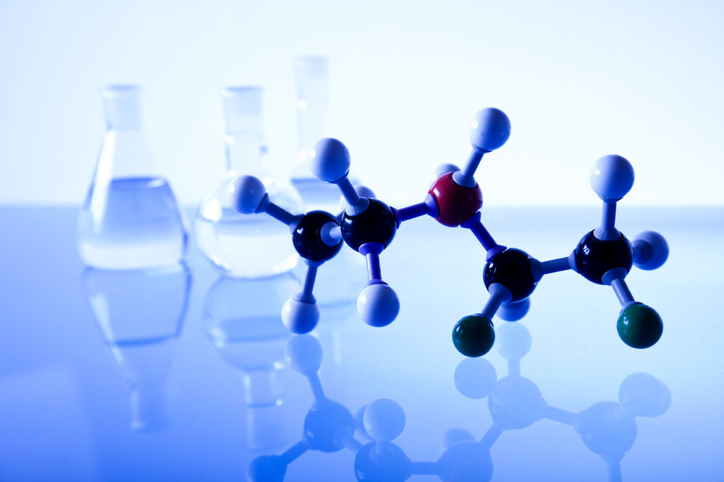
Lecture 2
Isomerism. Mutual influence of atoms in the molecules of organic compounds

Slide 2
Isomerism is
the phenomenon of the existence of chemicals that have the same quantitative and qualitative composition, but have different physical and chemical properties.
Isomers are substances that have the same composition (the number of atoms of each type), but a different mutual arrangement of atoms - a different structure.

Slide 3
There are two types of isomerism - structural and spatial.
positions of multiple bond
carbon skeleton
Interclass
Positions of substituents (functional groups)
structural isomerism
Isomerism
geometrical
spatial isomerism
optical

Slide 4
Structural isomerism
Structural isomers - compounds with the same composition, but a different order of binding atoms, i.e. with different chemical structures. The molecular formula of the structural isomers is the same, but the structural is different.

Slide 5
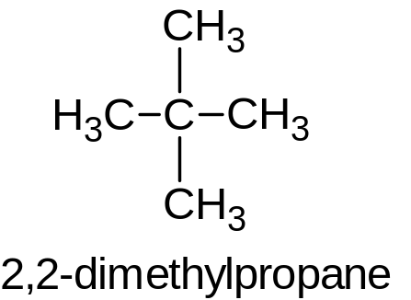
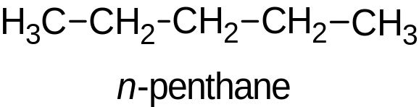
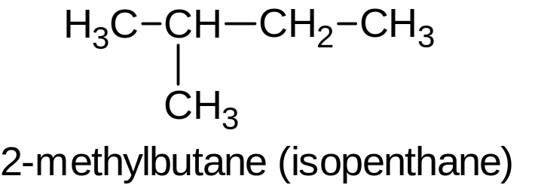
Structural isomerism
Isomerism of the carbon skeleton: substances differ in the structure of the carbon chain, which can be linear or branched.
С₅Н₁₂

Slide 6
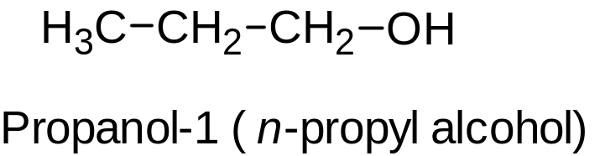
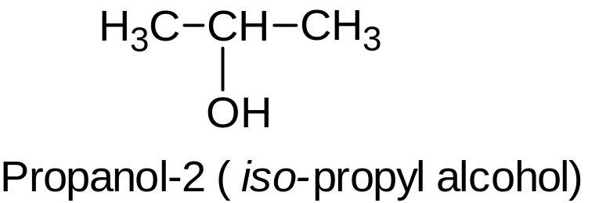
Structural isomerism
2. Isomerism of the position is due to the different position of the multiple bond, functional group or substituent with the same carbon skeleton of the molecules.
2.1. Isomerism of the position of the functional group. For example, there are two isomeric saturated alcohols with the general formula C₃H₈O: propanol-1 (n-propyl alcohol), propanol-2 (isopropyl alcohol):

Slide 7
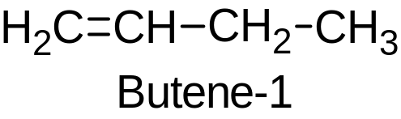
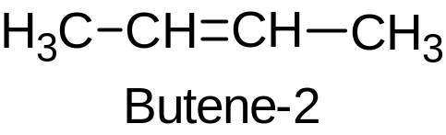
Structural isomerism
2.2. Isomerism of the position of a multiple bond can be caused by the different position of the multiple (double or triple) bond in unsaturated compounds. For example, in butene-1 and butene-2:

Slide 8
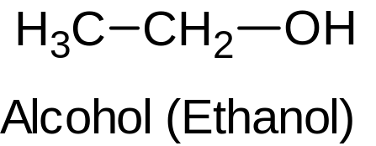
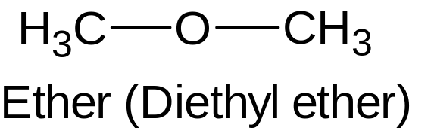
Structural isomerism
2.3. Interclass isomerism is another type of structural isomerism, when substances from different classes of substances have the same general formula.
For example, the formula C₂H₆O corresponds to: alcohol (ethanol) and simple ether (dimethyl ether):

Slide 9
Spatial isomerism
Spatial isomers are substances with the same composition and chemical structure, but with a different spatial arrangement of atoms in a molecule. Types of spatial isomerism - geometric (cis-trans) and optical isomerism.

Slide 10
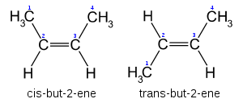
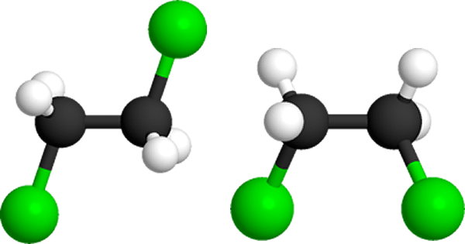
Spatial isomerism
1. Geometric isomerism (or cis-trans-isomerism).
Geometric isomerism is characteristic of compounds in which the position of substituents relative to the plane of the double bond or ring is different. For example, for alkenes and cycloalkanes.
The double bond does not have free rotation around its axis.
Therefore, substituents at carbon atoms in a double bond can be located either on one side of the double bond plane (cis isomer), or on opposite sides of the double bond plane (trans isomer). At the same time, it is impossible to obtain a trans-isomer from a cis-isomer by any rotation, and vice versa.
For example, butene-2 exists as both cis and trans isomers.

Slide 11
Geometric isomerism
cis-trans isomerism is characteristic of compounds in which each carbon atom in the C=C double bond (or in the cycle) has two different substituents
for compounds of the form СH₂=СHR and СR₂=СHR', cis-trans isomerism is not typical.

Slide 12
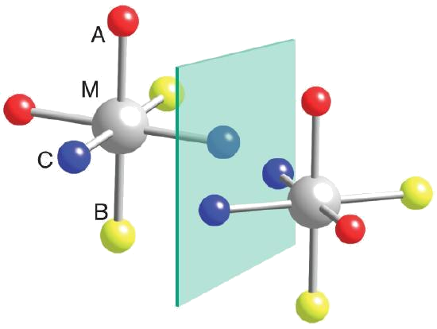
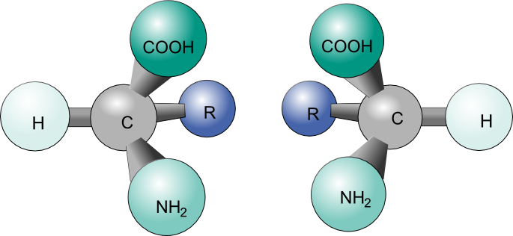
Spatial isomerism
2. Optical isomerism
Optical isomers are spatial isomers whose molecules are related to each other as an object and an incompatible mirror image.
Optical isomerism is characteristic of molecules of substances that have an asymmetric carbon atom.
An asymmetric (chiral) carbon atom is a carbon atom bonded to four different substituents.
Such molecules have optical activity - the ability to rotate the plane of polarization of light when a polarized beam passes through a solution of a substance.

Slide 13
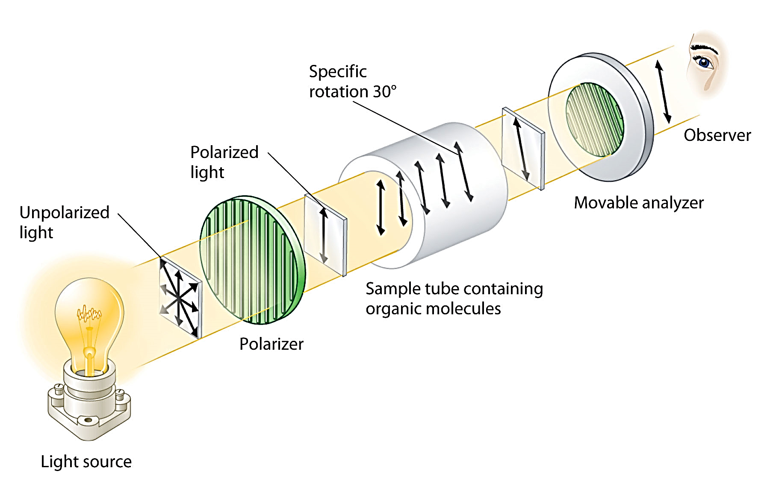

Slide 14
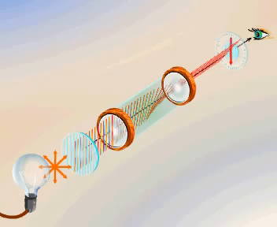

Slide 15
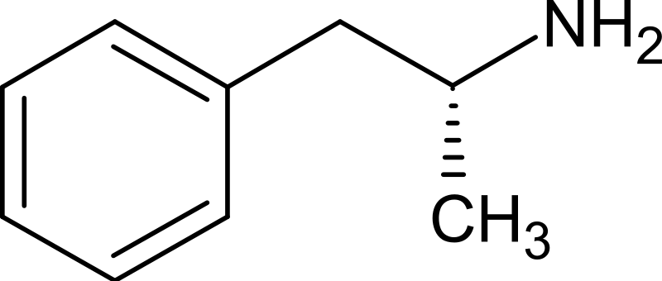
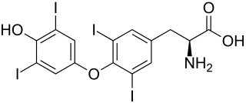
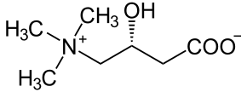
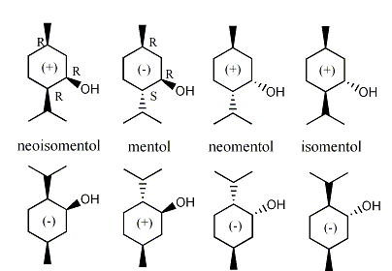
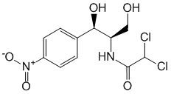
Optical isomerism
L-amphetamine
L-carnitine
L-thyroxin
A racemic mixture is a mixture of equal amounts of enantiomers of the same substance. Does not have optical activity. Almost always, during reactions involving a chiral center, just such a mixture is formed (with the exception of stereospecific and stereoselective reactions)
L-chloramphenicol
Menthol racemic

Slide 16
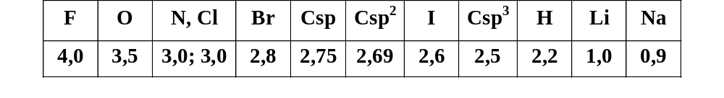
Mutual influence of atoms in the molecules of organic compounds and methods of its transmission
Polarizability - the ability of bond electrons to move under the influence of an external electric field or other reacting particle.
The polarity of the bond is due to the uneven distribution of electron density due to different values of electronegativity (E.N.) of the bonded atoms
E.N. - the ability of an atom in a molecule to hold valence electrons.
Pauling's scale
E.N. depends on:
nuclear charge
type of hybridization of atomic orbitals
influences of substitutes

Slide 17
Inductive effect
Inductive effect - transfer of the electronic influence of substituents along the chain of σ-bonds (Shift of electron density along the chain of σ-bonds under the influence of substituents)Designation : I (+I, -I )
Substituents, in comparison with the H atom, shifting the electron density of the σ-bond more strongly towards the chain (away from itself), increase the electron density in the chain, exhibit + I, electron-donor properties (EDp): radicals, anions, metals.
Substituents that shift the electron density of the σ-bond in their direction more strongly than the H atom, reduce the electron density in the chain, exhibit –I, electron-withdrawing properties (EWp): -OH, -OR, -NH2, -NO2, -COOH, halogens, cations.
Inductive effect property
The effect quickly decays after 3-4 bonds due to the low mobility of σ-bond electrons

Slide 18
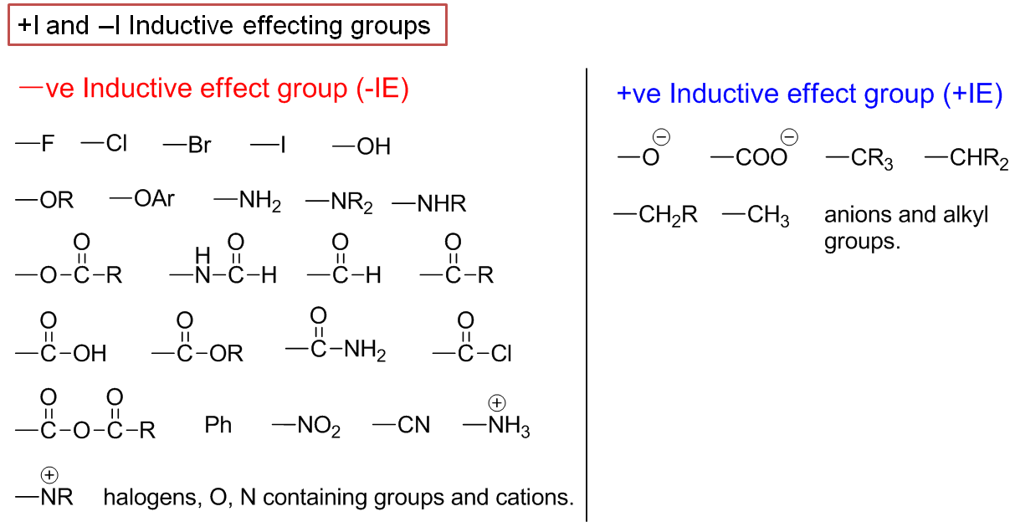

Slide 19
Pairing systems. Pairing. Pairing types.
Systems by mutual arrangement of double bonds:
Cumulated CH₂=C=CH–CH₃ butadiene-1,2
Conjugated CH₂=CH–CH=CH₂ butadiene-1,3
Isolated CH₂=CH–CH₂–CH=CH₂ pentadiene-1,4
Conjugation - redistribution, alignment of electron density in conjugated systems, leading to the formation of a single π-electron cloud, partial alignment of bond lengths, energy release (E conjugation).
The ↑ chain length, the ↑ E conjugation, the ↑ stability of the connection.
Mesomeric effect
Mesomeric effect - transfer of the electronic influence of a substituent along the conjugated system (shift of the electron density along the π-bond of the conjugated system under the influence of the substituent)Designation: М ( +М, –М)
Substituents that shift the electron density towards the chain increase the electron density in the system, show +M, E.N. properties: -NH₂, -OH, -OR, - Cl
Substituents, pulling the electron density from the conjugated system, lower the electron density in the system, show - M, E.N. properties: carboxyl, carbonyl, nitril, sulfonic, nitro groups.
In terms of M > I, halogens are an exception. For them –I > +M. Property of the mesomeric effect: unlike the inductive effect, the mesomeric effect does not decay along the circuit.

