Slide 1
Odessa National Medical University
Faculty of Pharmacy
Department of Pharmaceutical Chemistry
Lecture on General and Inorganic Chemistry №1
«Introductory lecture. The goals and objectives of inorganic chemistry: obtaining and using various chemical elements and their compounds, studying the general regularities and laws of chemical processes. Inorganic chemistry is the basic discipline of other chemical disciplines. The structure of an atom and its electron shells.Electronic energy levels of an atom. Quantum numbers, their characteristics and the values they can take. Principles and rules determining the sequence of filling atomic orbitals with electrons. Electronic and electronic-graphic formulas of atoms of elements and their ions.»

Slide 2
Chemistry as a Science. Aims and objectives of inorganic chemistry
Chemistry is a field of natural science that studies the composition, structure of substances, the laws of qualitative and quantitative changes, decomposition and transformation of substances
Discipline aims:
To form knowledge about chemistry as a science about substances and their transformations
Summarize and consolidate the knowledge gained earlier
To form knowledge about the mechanism of chemical processes, their influence and course in living organisms
Discipline objectives:
to study the relationship of chemical processes and phenomena accompanying them
know the patterns between the chemical composition, structure of substances and their properties
be able to establish the probability and direction of chemical reactions
be able to determine the properties of substances in acid-base and redox processes
know the physical and chemical foundations of the use of inorganic substances in medicine and pharmacy

Slide 3
A brief history of the development of chemistry as a science
Ancient times (Empedocles, Plato, Aristotle). Study of metals and alloys, theory of the structure of substances. The concept of "atom".
Alchemy (search for the philosopher's stone, further study of the properties of metals and non-metals)
Formation of chemistry as a science
Phlogiston theory
Lavoisier and oxygen combustion theory
4. Period of quantitative laws:
The law of equivalents (I. V. Richter)
The law of constancy of composition (J.L. Proust)
Multiple Relations Law (J. Dalton)
The Law of Volumetric Relations (J.L. Gay-Lussac)
Avogadro's Law (A. Avogadro)
5. Chemistry in the second half of the 19th century
Periodic law
Structural chemistry (Liebig, Kekule, Werner)
Physical chemistry
6. Chemistry of the XX-XXI centuries
Atomic structure, elementary particles
Radioactivity

Slide 4
Basic chemical concepts and terms
An atom is the smallest particle of an element that retains its chemical properties, which consists of a positively charged nucleus and electrons surrounding it.
A chemical element is a kind of atoms with the same nuclear charge (number of protons).
Molecule is an electrically neutral particle formed from two or more bonded atoms, which has its chemical properties
3H₂O
the coefficient shows how many molecules are involved or formed in a chemical reaction
the index shows the number of atoms in a molecule
Average (relative) atomic mass (A_{r}) is the ratio of the mass of an atom of a particular element to 0.012 of the mass of an atom of Carbon-12. Specified in the Periodic Table of Chemical Elements.
Relative molecular mass (M_{r}) is the ratio of the mass of a molecule of a certain element to 0.012 of the mass of a carbon-12 atom. It is the sum of the atomic masses of all atoms in a molecule.
М_{r}(CuSO4) = A_{r} (Cu)+A_{r} (S)+ 4 ·A_{r} (O)

Slide 5
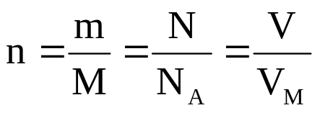
Basic chemical concepts and terms
The amount of substance (n, mol) is a measure of the number of structural elements (molecules, ions, atoms) of which the substance is composed.
Avogadro's number (N_{A}, mol⁻¹) – number of structural elements (molecules, ions and atoms) in 12g Carbon, N_{A} = 6,02·10²³ mol⁻¹.
Molar mass (М, g/mol) – the mass of a substance with an amount of substance of 1 mol. Numerically М= М_{r}
Molar volume (V_{М}, l/mol) – is the volume of a gas with a substance amount of 1 mol. For any gas under normal conditionsV_{М} = 22,4 l/mol

Slide 6
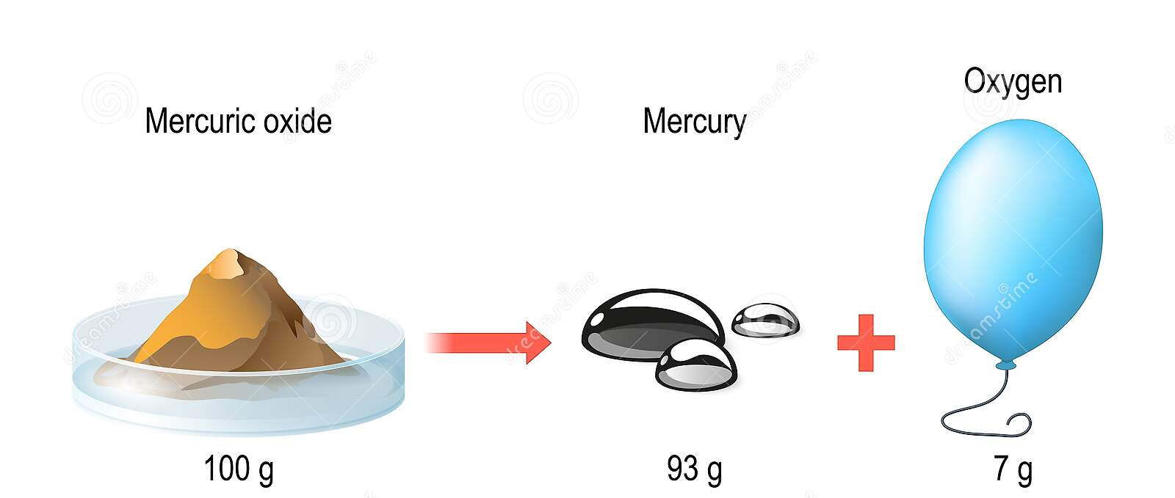
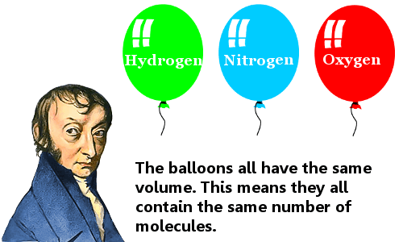
Basic laws of Chemistry
The law of conservation of mass (A. Lauvazier, M.Lomonosov): the total mass of substances present after a chemical reaction is the same as before the reaction.
2. Avogadro's law (А. Avogadro): Equal volumes of gases at the same temperature and pressure contain the same number of molecules.

Slide 7
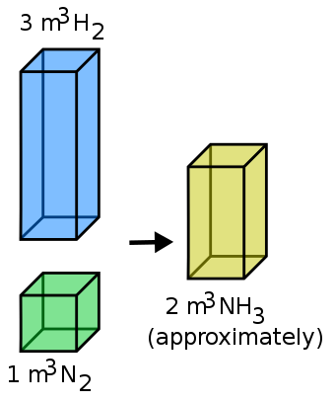
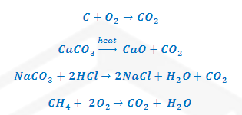
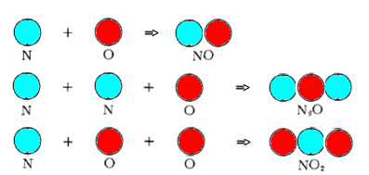
3. The law of volumetric relations (J. Gay-Lussac): the volumes of gaseous substances that react are related to each other and to the volumes of gaseous reaction products as small integers
4. The law of constant composition (J.L. Proust): it isn't matter a way to occur compounds; they always have a constant quantitative and qualitative structure
5. The law of the multiple proportions (Dalton): if two elements combine with each other to form more than one compound, the weights of one element that combine with a fixed weight of the other are in a ratio of small whole numbers.

Slide 8
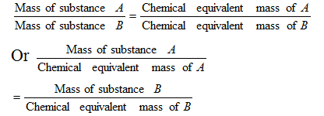
The law of equivalents (I.V. Richter): All substances react and are formed in equivalent ratios.
Equivalent ratio means the same number of mole equivalents.
That the law of equivalents can be formulated differently: the masses of reacting compounds are directly proportional to either equivalent masses
The equivalence factor is a number that indicates what fraction of a real particle of matter X is equivalent to one hydrogen ion

Slide 9


Corpuscle | Equivalence factor | Examples
Element | f_{e}=1/В(Э), В(Э) – element valence | f_{e}(O)=1/2
Simple substance | f_{e}=1/В(Э)·n(Э) n(Э) – number of atoms of an element (index in a chemical formula), В(Э) – element valence | f_{Э}(H₂) = 1/(2⋅1) = 1/2; f_{Э}(O₂) = 1/(2⋅2) = 1/4; f_{Э}(O₃) = 1/(3⋅2) = 1/6
Oxide | f_{e}=1/В(Э)·n(Э), n(Э) – number of atoms of an element (index in a chemical formula), В(Э) – element valence | f_{Э}(Cr₂O₃) = 1/(2⋅3) = 1/6; f_{Э}(CrO) = 1/(1⋅2) = 1/2; f_{Э}(P₂O₅) = 1/(2⋅5) = 1/10
Acid | f_{e}=1/n(H⁺) , n(H⁺) the number of hydrogen ions released during the reaction | f_{Э}(H₂SO₄) = 1/2
Hydroxide | f_{e}=1/n(ОH–) , n(ОH–) – the number of hydroxide ions released during the reaction | f_{Э}(Cu(OH)₂) = 1/2
Salt | f_{e}=1/В(Ме)· n(Ме) , n(Ме) – the number of metal atoms (index in the chemial formula of the salt), В(Ме) – metal valence | f_{Э}(Cr₂(SO₄)₃) = 1/(2⋅3) = 1/6
Particle in RedOx | f_{e}=1/n, n – the number of electrons involved in the oxidation or reduction process | Fe²⁺ + 2→ Fe⁰ f_{Э}(Fe²⁺) =1/2; MnO₄– + 8H⁺ + 5 → → Mn²⁺ + 4H₂O f_{Э}(MnO₄–) = 1/5
Ion | f_{e}=1/z, где z – ion charge | f_{Э}(SO₄^{2–}) = 1/2

Slide 10
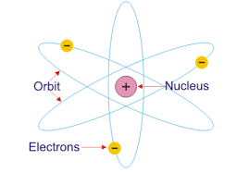
The structure of the atom. Planetary model
In his experiments on scattering alpha particles on thin metal foil, Rutherford found that most alpha particles pass directly through the foil, but some bounce off. Rutherford suggested that there was a positively charged nucleus in the small area from which they bounced.
Just as the Earth revolves around the Sun, the electric charge of an atom is concentrated in the nucleus, around which electrons of the opposite charge revolve, and the electromagnetic field keeps the electrons in the orbit of the nucleus. Therefore, the model is called planetary.

Slide 11
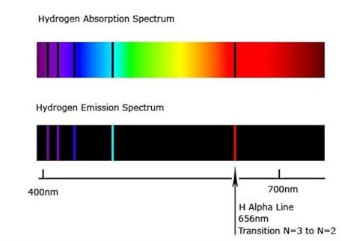
Contradictions in Rutherford's model
If a charged electron revolves around a nucleus, it must radiate energy. Consequently, an electron starting to rotate around the nucleus, as calculations show, in a time equal to 108 с, must fall on the nucleus. However, atoms in an unexcited state do not emit energy and exist indefinitely.
2. An electron, moving around the nucleus in an orbit of an ever-smaller radius, continuously emits energy, that is, the emission spectrum of atoms must be continuous. It is known from experiments that the emission spectrum of an atom consists of individual colored lines separated by dark stripes, which means that the spectrum of the atom is linear.

Slide 12
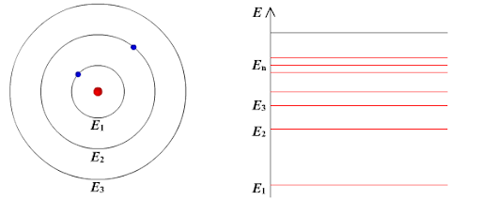
The structure of the atom. Niels Bohr's theory
Bohr's first postulate (postulate of stationary states):
The atom has orbits, called stationary, moving along which the electron does not emit energy.

Slide 13
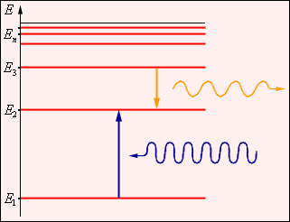
The structure of the atom. Niels Bohr's theory
Bohr's second postulate (rule of frequencies):
Radiation and absorption of energy by an atom occurs during the transition from one stationary orbit to another. The energy of the emitted (absorbed) photon is
hν = E₂ – E₁,
where h - is Planck's constant (6,626176·10^{­34} Дж·с),
ν – frequency of the emitted (absorbed) photon(с⁻¹).
Bohr stationarity condition for the n-th orbit (orbit quantization rule):
mν_{n}r_{n} = nħ,
n – a positive number called the principal quantum number. It indicates the number of the orbit along which the electron can move.

Slide 14
Disadvantages of Bohr's theory
Couldn't explain the intensity of the spectral lines
2. Valid only for hydrogen-like atoms
3. Logical contradictions: the first equation describing the motion of an electron belongs to classical mechanics, and the second equation describing the quantization of orbits belongs to quantum mechanics.

Slide 15
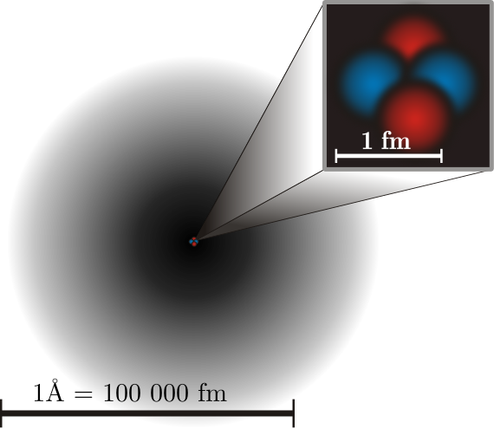
Modern quantum mechanical model of the atom
An atom is the smallest chemically indivisible particle, consisting of a positively charged nucleus and the electrons surrounding it.
Atom
Nucleus
Electrons
Protons
Neutrons
Helium Atom
A proton is an elementary particle that is in the nucleus, has a positive charge and a mass equal to 1 atomic unit (a.u.).
A neutron is an elementary particle that is in the nucleus, has no charge, and its mass is 1 (a.u.).
An electron is a stable negatively charged elementary particle.

Slide 16
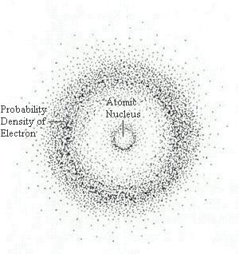
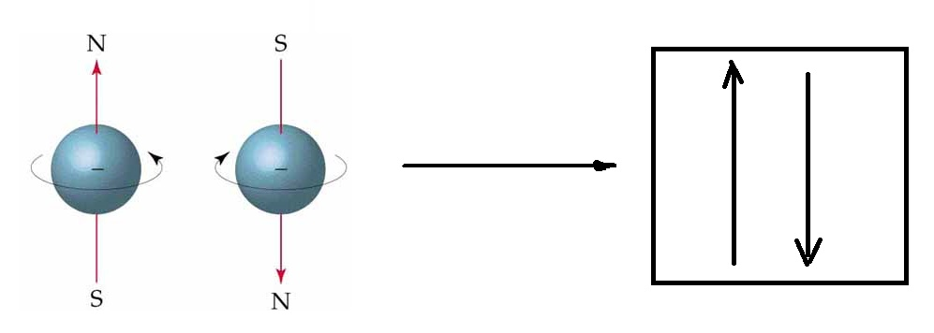
Atomic orbital
All chemical properties of substances are determined by the structure of the electronic shells of atoms. The electron moves at such a high speed that it is actually "smeared" over the atom; it is not located at one specific point, but forms an "electronic cloud".
An atomic orbital is a region of space in which the probability of finding an electron is maximum.
Each orbital can accommodate as much as possible two electrons with equal energy, but differing in a special property, spin.
Graphically, the orbital is usually depicted as a square, and electrons in the form of arrows pointing up or down. Arrows pointing in opposite directions represent electrons with two opposite spins.

Slide 17
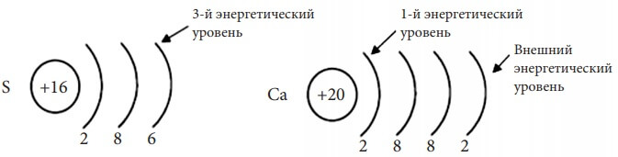
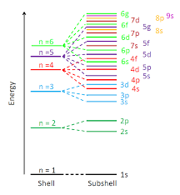
Electronic orbitals
Electronic orbitals have a specific shape and energy.A number of orbitals with equal or similar energies form an energy level (layer).
К
L
M
The level number is indicated by a number (n = 1, 2, 3…) or in capital Latin letter (K, L, M and further alphabetically). Distinguish the first (n = 1 or K), the second (n = 2 or L), the third (n = 3 or M), etc. The energy level number n is called the principal quantum number.
Level n includes exactly n² orbitals, which can contain a maximum of 2n² electrons.

Slide 18
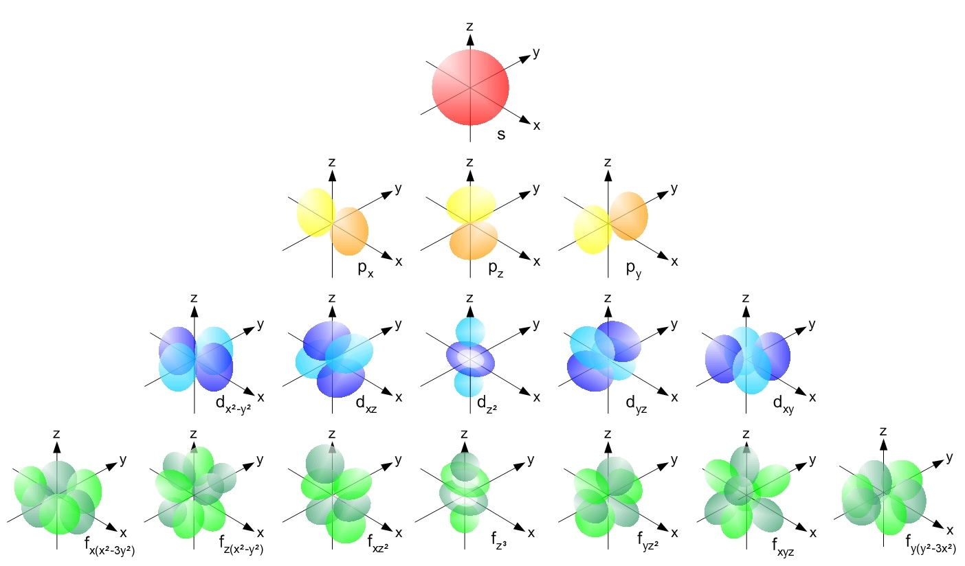
Atomic orbital shapes
Each energy level is divided into energy sublevels, which are formed by orbitals that have the same shape and the same energy. By shape, s-, p-, d- and f-orbitals are distinguished.

Slide 19
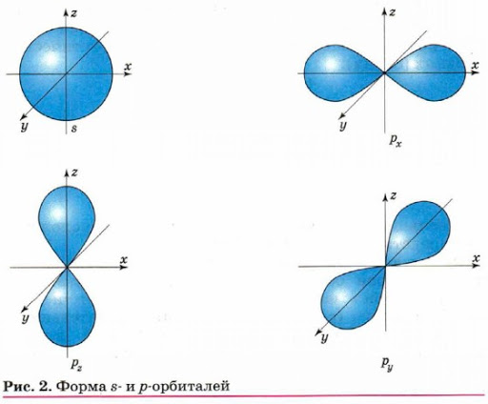
s-orbitals have the shape of a ball, that is, an electron in such an orbital (it is called an s-electron) spends most of its time inside the sphere. The s-orbital located at the first energy level is denoted by 1s, at the second - 2s, etc. Therefore, the s-sublevel has a maximum of 2 electrons.
p-orbitals are dumbbell-shaped. They can be directed along one of three coordinate axes (denoted by px, py, pz), therefore, at each energy level, starting from the second, there are three p-orbitals with the same energy. p-sublevel has a maximum of 6 electrons
The shapes of the d and f orbitals are much more complex. There are 5 forms of d-orbitals and 7 forms of f-orbitals. Consequently, the d-sublevel contains a maximum of 10 electrons, f - 14.

Slide 20

Quantum numbers
The state of each electron in an atom is usually described using four quantum numbers: principal (n), orbital (l), magnetic (ml), and spin (s). The first three characterize the motion of an electron in space, and the fourth - around its own axis.
Quantum number | The values | Property that characterizes | Note
Principal | n = 0…∞ | Energy level (E)Average distance from the core (r) | If n = ∞, then the electron does not interact with the nucleus
Orbital | l= n-1 l=0…(∞-1) | Orbital shape | Usually alphabetic characters are used
Magnetic | m_{l}=-l ..+l | The location of the orbital in space | For any l, the total value m = 2l + 1
Spin | S= | Rotation of an electron around its axis | Stand for ↑ or ↓
l | 0 | 1 | 2 | 3
 | s | p | d | f

Slide 21
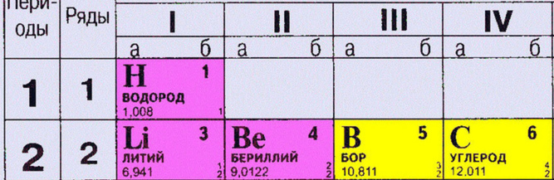
Principles of constructing the electronic configuration of an element
The number of electrons in an atom of an element is equal to its ordinal number (for example, for a Carbon atom = 6)
The number of energy levels of an atom is equal to the number of the period in which the element is located (for a Carbon atom = 2)
The number of electrons at the outer (valence) level is equal to the number of the group in which the element is located (for a Carbon atom = 4)
3
1
2

Slide 22
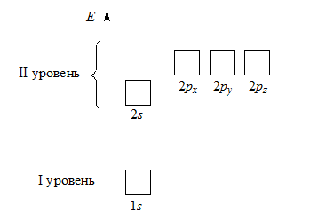
Principles of constructing the electronic configuration of an element
For a complete description of the electronic structure of an atom, it is necessary to know exactly how electrons are distributed over energy levels. The list of energy levels filled with electrons is called the electronic configuration of an atom.
When filling the orbitals with electrons, the following rules are used:
The principle of minimum energy.
Klechkovsky's rule
Pauli principle
Hund's rule

Slide 23
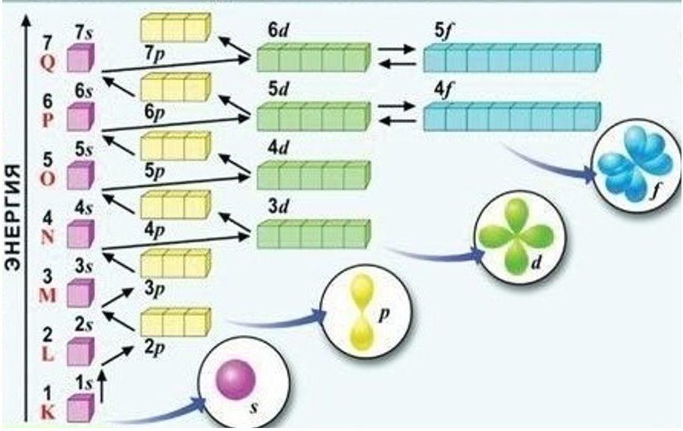
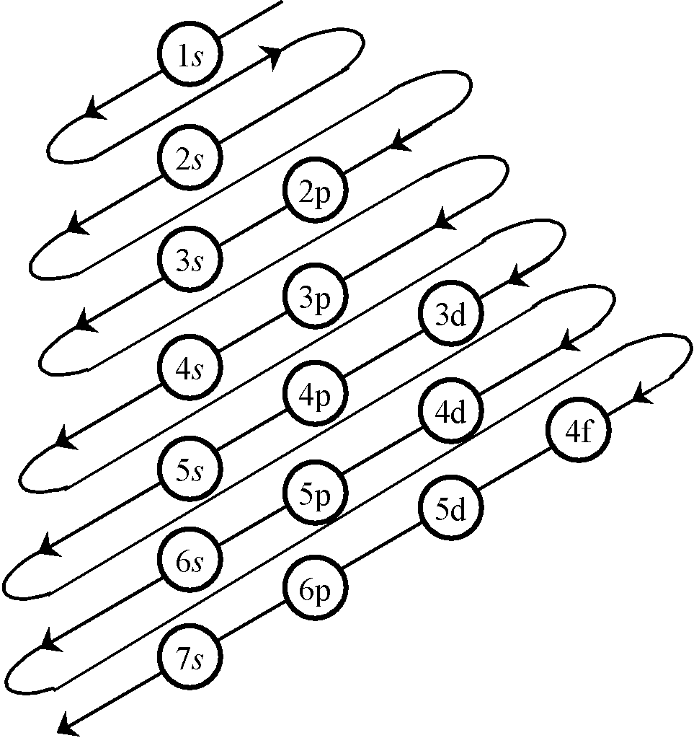
Minimum energy principle
The orbitals are filled in order of increasing energy, from bottom to top. Each electron is located so that its energy is minimal, that is, among the free orbitals, it chooses the orbital with the lowest energy.
The order of filling the energy sublevels can be remembered as a series:
1s < 2s < 2p < 3s < 3p < 4s < 3d < 4p < 5s < 4d < 5p < 6s < 5d ≈ 4f < 6p < 7s….

Slide 24
Klechkovsky's rule
When filling the energy sublevels, one should pay attention to the fact that the 4s sublevel is filled first, and then 3d, although based on the value of the principal quantum number (which characterizes the energy), 3d must first be filled and only then the 4s sublevel.
1s < 2s < 2p < 3s < 3p < 4s < 3d < 4p < 5s < 4d < 5p < 6s < 5d ≈ 4f < 6p < 7s….
However, the electron is influenced not only by the nucleus, but by other electrons. The energy in many-electron atoms is determined not only by the main, but also by the orbital quantum number, or rather by their sum: the energy of atomic orbitals increases as the sum n + l increases; with the same amount, the level with a smaller n and a larger l is first filled.
 | 3d | 4s
n | 3 | 4
l | 2 | 0
n+l | 3+2=5 | 4+0=4
The sum of the main (n) and orbital (l) quantum numbers for the 4s-sublevel is less than for 3d (4 <5), so first we fill in 4s and then 3d

Slide 25


Pauli principle
Each orbital can contain no more than two electrons. If two electrons are in the same orbital, then they have opposite spins (arrows are directed in different directions). Such electrons are called paired. If there is only one electron in the orbital, then it is called unpaired.

Slide 26
Hund's rule
An atom in the ground state must have the maximum possible number of unpaired electrons within a certain sublevel.

Slide 27

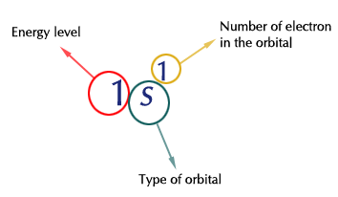
Recording the electronic configuration of an atom
Electronic configurations of atoms
graphically
using squares with arrows
when all occupied energy sublevels are listed with an indication of the total number of electrons on each of them.
in a line

Slide 28
Control questions:
What is chemistry? What sections of chemistry do you know?
What are the main periods in the development of chemistry as a science?
Give a definition to the concepts "atom", "molecule", "chemical element“
What are atomic and molecular masses?
Calculate molar mass for Na₂CO_{3,} AgNO₃, Ca(NO₃)₂, Na₃[Co(NO₂)₆]
Briefly describe the planetary model of the atom. What are its disadvantages?
Bohr's postulates. Contradictions in them.
The modern model of the structure of the atom. What elementary particles are included in the atom?
Write the electronic configuration of the Carbon atom.

