Slide 1
Odessa National Medical University
Faculty of Pharmacy
Department of Pharmaceutical Chemistry
Lecture on General and Inorganic Chemistry №2
«Periodic law of D.I. Mendeleev and his interpretation based on the electronic structure of atoms.The periodic system of elements as a graphic representation of the law of periodicity. The structure of the periodic system of elements: period, group, subgroup, s-, p-, d-, f- families of elements. Metallic, non-metallic and redox properties.»

Slide 2
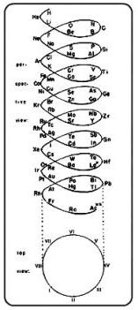
The history of the development of ideas about the periodicity of the properties of elements
By the middle of the 19th century, 63 chemical elements had been discovered, and attempts to find patterns in this set were made repeatedly. The first attempt to arrange the elements in ascending order of atomic weights was made by Alexander Emile Shancourtois (1862), who placed the elements along a helical line and noted the frequent cyclical repetition of chemical properties along the vertical. These models did not attract the attention of the scientific community.

Slide 3
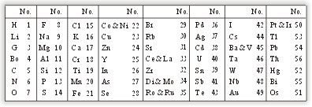
In 1866, chemist and musician John Alexander Newlands proposed his own version of the periodic system, whose model ("the law of octaves") outwardly resembled Mendeleev's. In 1864, Newlands noticed that if you arrange the elements in ascending order of their atomic weight, then about every eighth element is a kind of repetition of the first - just as the note is repeated in musical octaves every 7 notes (law of octaves).
You can see what difficulties Newlands faced - the outlined patterns were quickly destroyed, since his system did not take into account the possibility of the existence of elements that had not yet been discovered.

Slide 4
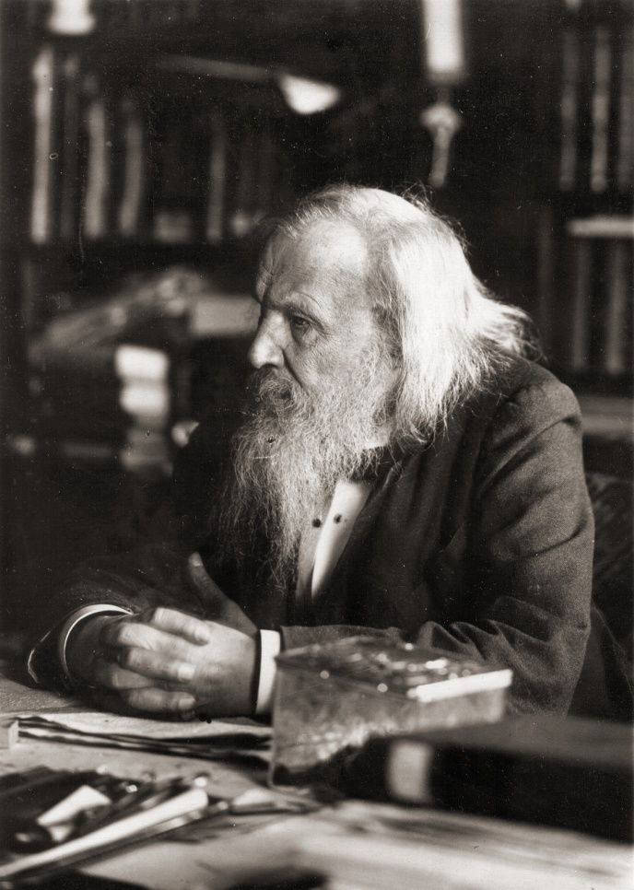
The day of the opening of the periodic law is considered March 1 (February 17, old style), 1869, in which D. I. Mendeleev finished work on the "Experiment of a system of elements based on their atomic weight and chemical similarity."
The essence of Mendeleev's discovery was that with an increase in the atomic mass of chemical elements, their properties change not monotonously, but periodically. After a certain number of elements of different properties, arranged in increasing atomic weight, the properties begin to repeat.
Of course, properties are not exactly repeated; changes are added to them. The difference between the work of Mendeleev and the work of his predecessors was that Mendeleev had not one, but two bases for the classification of elements - atomic mass and chemical similarity. In 1871, on the basis of these works, Mendeleev formulated the Periodic Law, the form of which was somewhat improved over time.

Slide 5
The classical formulation of the periodic law: the properties of simple substances, as well as the properties of their compounds, are periodically dependent on the value of the atomic mass of the elements.
The modern formulation of the periodic law: the properties of simple substances, as well as the properties of their compounds, are periodically dependent on the magnitude of the charge of the nucleus of the elements.

Slide 6
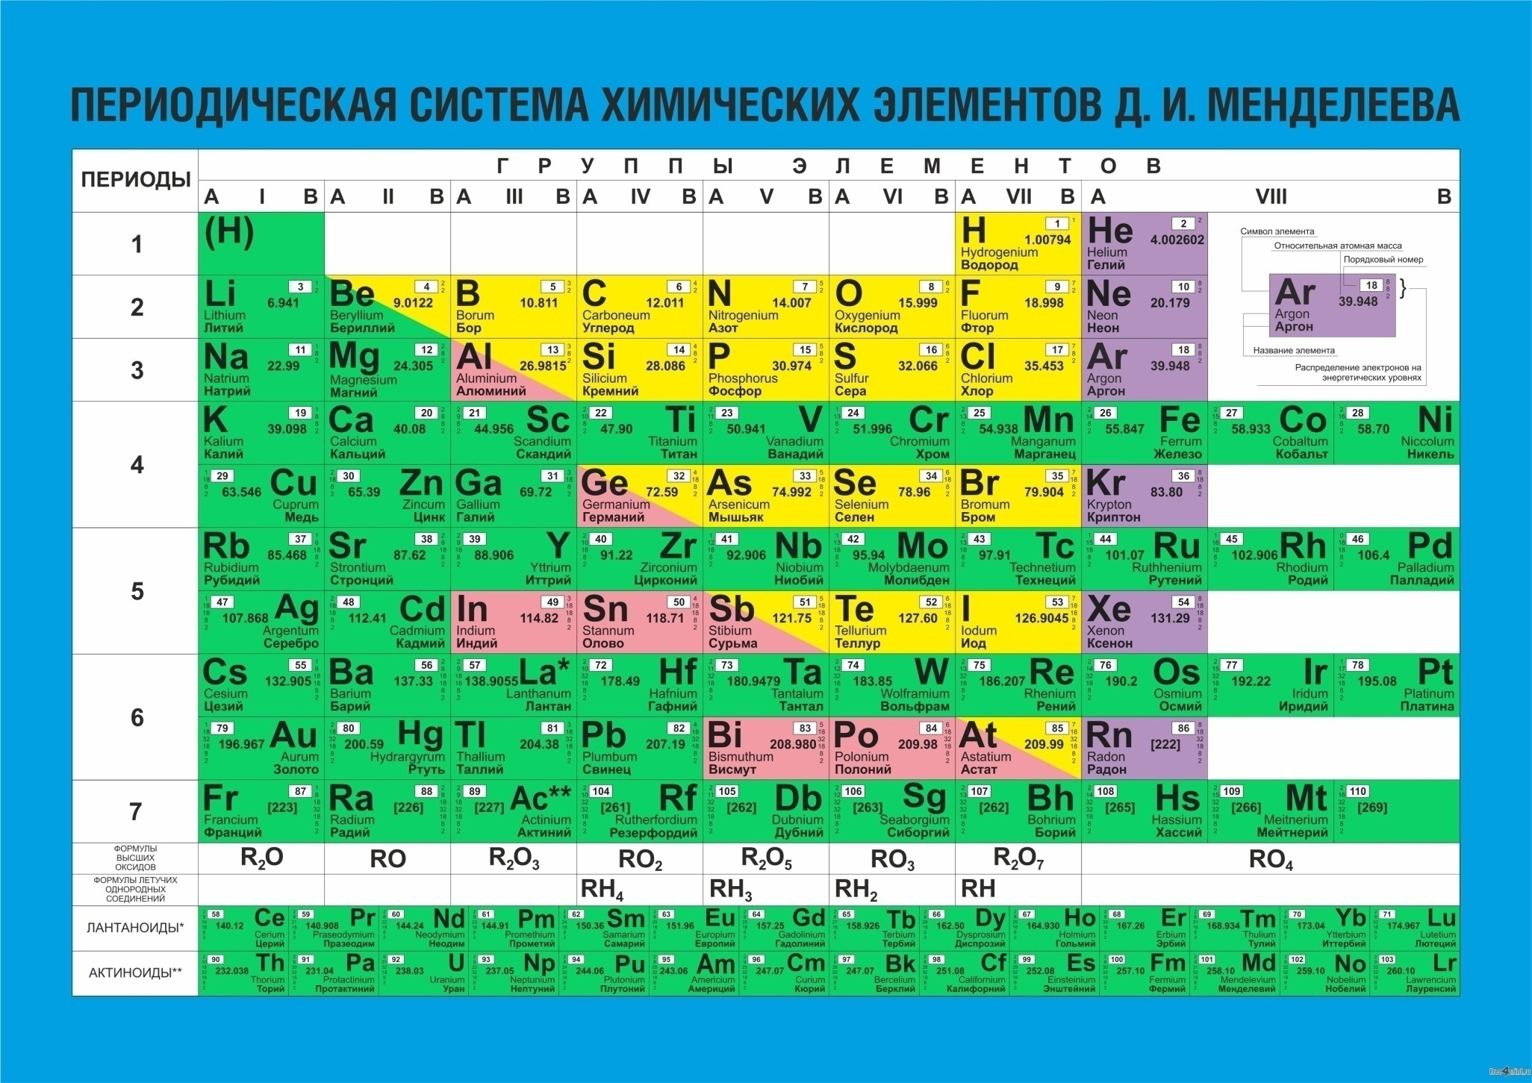
The graphical expression of the periodic law is the periodic table of chemical elements (PTCE) of chemical elements, which is usually presented in the form of a table.
Short form

Slide 7
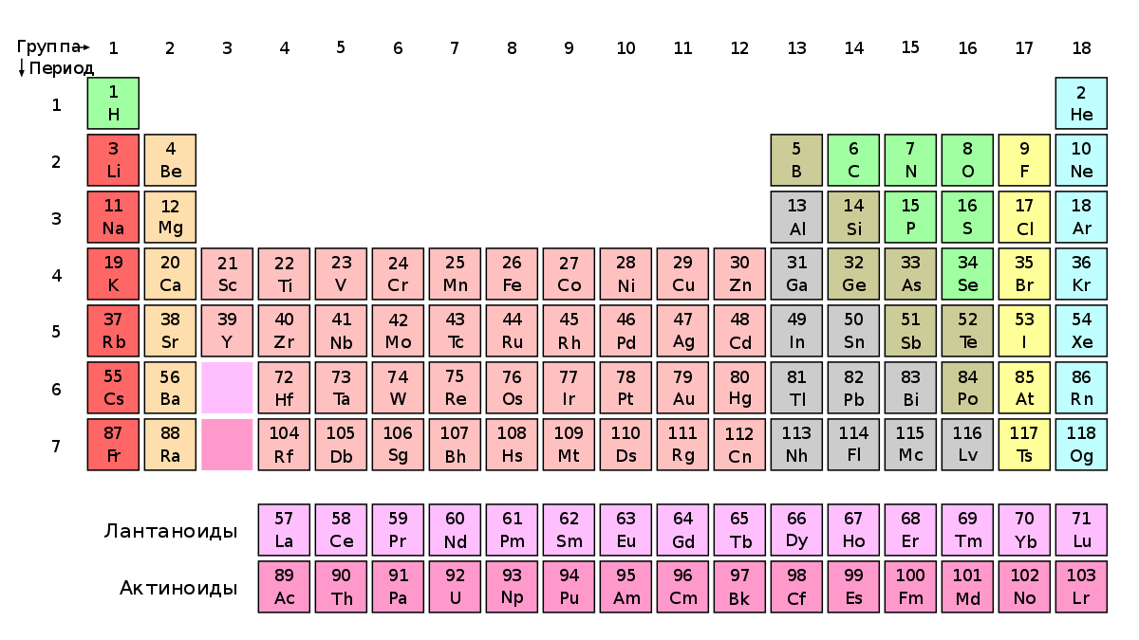
Long form

Slide 8
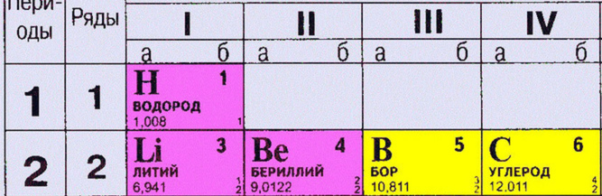
The structure of the PTCE
Period - a horizontal row that begins with an alkali metal (except for the first) and ends with an inert gas
Group - a vertical row in which elements have similar properties
In total, there are 7 periods and 8 groups in the table.
The period number shows the number of energy levels.
The group number in short form shows the number of electrons on the outer layer

Slide 9
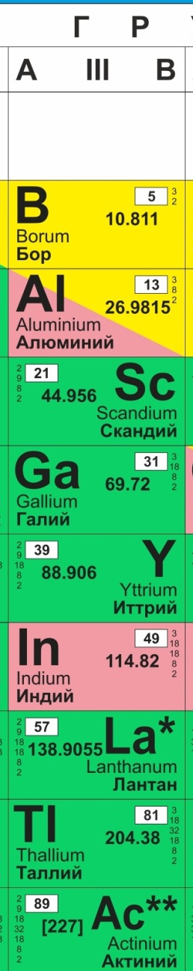
main subgroup
side subgroup
In short form (slide 6), apart from groups, there are also subgroups. Subgroup А is called the main subgroup. It contains only s- and p-elements. Subgroup В is called a side subgroup and contains d-elements.

Slide 10

In the short form (slide 6), in addition to the periods, there are also rows. In the first three periods, one row at a time - they are called small periods. From the 4th to the 7th period, each of them has two rows - such periods are called large.
small periods
large periods
In short and long form (slide 6 and 7) f-elements are separately taken out. They are called lanthanides and actinides.

Slide 11
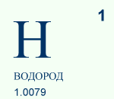
Each cell of the table contains a certain chemical element and information about it
Atomic number.
Shows the number of protons in the nucleus as well as the number of electrons in the atom.
Symbol
Name
Relative atomic mass
Based on these data, you can find the number of neutrons in the nucleus:
atomic mass value – atomic number = number of neutrons

Slide 12
Depending on which level is valence - s, p, d, f - in the table you can select s, p, d, f - elements

Slide 13
Alkaline
metals
Nobel gases
alkaline earth metals
chalcogens
halogens

Slide 14
Changing properties of elements in a period
(for the example of the second period from Lithium to Fluorine)
Li
F
the number of electrons on the outer layer increases
constant number of electronic layers
the radius of atoms and ions decreases
electronegativity increases
ionization energy increases
electron affinity increases
enhanced non-metallic properties
increased oxidizing properties
acidic properties are enhanced
Electronegativity - the ability of an atom in a molecule to displace common electron pairs towards itself, that is, the ability of atoms to attract electrons of other atoms to themselves
Ionization energy (a measure of the manifestation of metallic properties) is the energy required to detach an electron from an atom
Electron affinity is the energy released or absorbed in the process of attaching an electron to a free atom in its ground state with its transformation into an anion.

Slide 15
Changing the properties of elements in a group
(on the example of IVa group from Carbon to Lead)
С
the number of electronic layers increases
constant number of electrons on the outer layer
the radius of atoms and ions increases
decreases electronegativity
decreases ionization energy
decreases electron affinity
enhanced metallic properties
reducing properties are enhanced
the basic properties are enhanced
Pb
Electronegativity - the ability of an atom in a molecule to displace common electron pairs towards itself, that is, the ability of atoms to attract electrons of other atoms to themselves
Ionization energy (a measure of the manifestation of metallic properties) is the energy required to detach an electron from an atom
Electron affinity is the energy released or absorbed in the process of attaching an electron to a free atom in its ground state with its transformation into an anion.

Slide 16
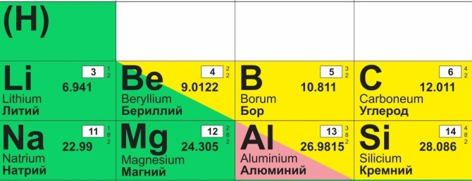
Diagonal similarity
Diagonal similarity - the similarity between the elements that are in the PSCE diagonally from each other, as well as the corresponding simple substances and compounds. It is most pronounced in lithium-magnesium, beryllium-aluminum, boron-silicon vapors. Elements in these pairs (especially the last two) are much more similar to each other than to neighboring elements in the same groups. The similarity is explained by the close charge / radius ratios of the ion.

Slide 17
Control questions:
Formulate the periodic law in a classical and modern form.
What is the group and the period.
How do the properties of hydroxides of elements change in periods and groups with an increase in the ordinal number? Why?
From oxides BaO, K₂O, TiO₂, CaO, Al₂O₃, MgO, ZnO select two oxides with the most pronounced basic properties. Enter the valence electrons of the selected elements.
Describe the position of the element in the table (group number, subgroup (main or secondary), period number, series, ordinal number, atomic mass, number of electrons, protons, neutrons, type of element (s, p, d, f-element):
Carbon, Magnesium, Chromium, Bismuth, Manganese
6. How the properties of the elements in the next row change:Na-Mg-Al-Si-P-S-ClBe-Mg-Ca-Sr-Ba7. Which element is the most electronegative? Explain why.

