Slide 1
Odessa National Medical University
Faculty of Pharmacy
Department of Pharmaceutical Chemistry
Lecture on General and Inorganic Chemistry №3
«Chemical bonding and the structure of molecules. Modern understanding of the nature of chemical bonding. Types of chemical bonds and their characteristics.»

Slide 2
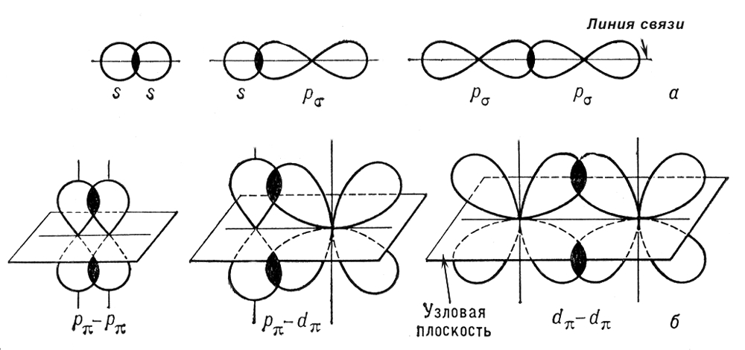
Chemical bond concept
Chemical bond - the interaction between individual atoms, as a result of which a chemically stable system (molecule, ion or crystal) is formed.
A chemical bond is formed by overlapping electron clouds, increasing the electron density between atoms that attract nuclei.
Methods for overlapping electron clouds
σ-bond
The electron clouds overlap along a line that connects the centers of both atoms.
π-bond
p- or d-electron clouds overlap above and below the plane that connects the centers of the atoms

Slide 3
Types of chemical bonds
Types of chemical bonds
Covalent
Non-polar
Polar
Ionic
Metal
Intermolecular hydrogen

Slide 4
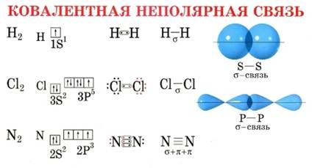
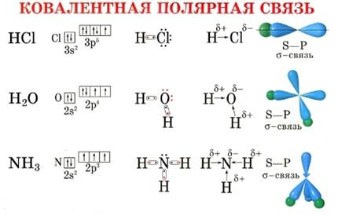
Covalent bond
It arises as a result of the formation of common electron pairs (common electron cloud) between the atoms of non-metals.
Types of covalent bonds
Non-polar
Formed between atoms with the same electronegativity (i.e. between the same atoms)
For example: О₂, Н₂, О₃, N₂
Polar
Formed between atoms with different electronegativity (i.e. between different atoms)
For example: NH₃, Н₂S, N₂О

Slide 5
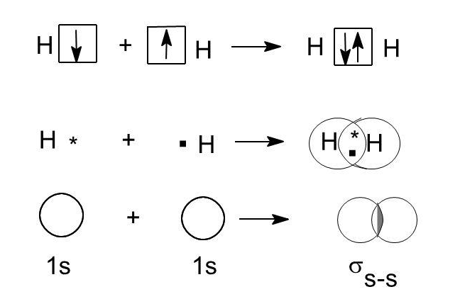
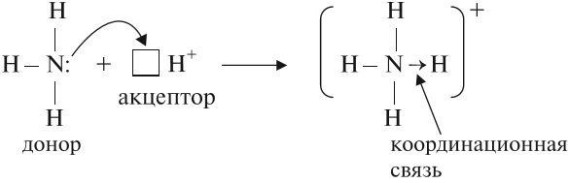
Mechanisms of covalent bond formation
Exchange
In the formation of the common electron pair is involved by electron from each element
Donor-acceptor
In the formation of a common electron pair, one element gives an electron pair (donor), and the other gives a free orbital (acceptor)

Slide 6
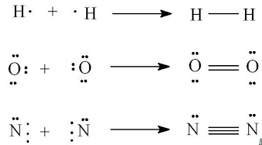
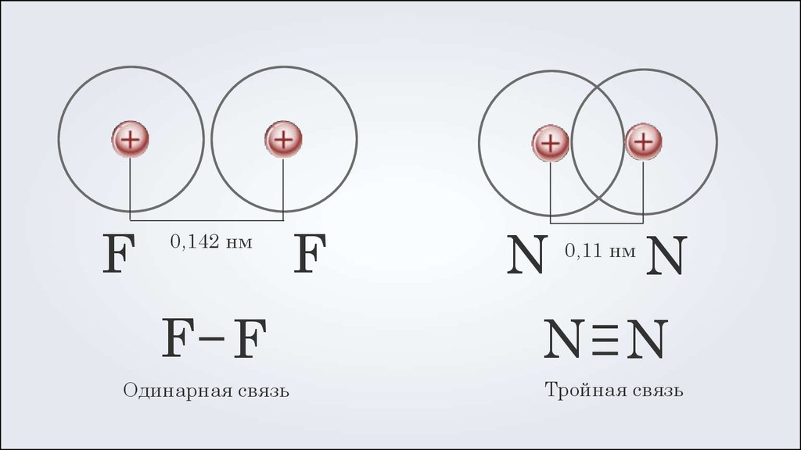
Covalent bond characteristics
Multiplicity - number of shared electron pairs that connect the atoms. If the bond is formed by one electron pair - a single bond, two - double, three - triple.
Bond energy - energy that needs to be spent on breaking a bond (or energy that is spent on forming a bond).
Bond length - the distance between the nuclei of atoms in the molecule.
Polarity - the displacement of the common electron pair to the more electronegative atom.
Saturation - the ability atom form a certain amount of covalent bonds (e.g. hydrogen - one bond, carbon - a maximum of four).

Slide 7
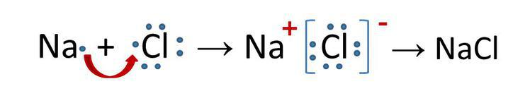
Ionic bond
Can be considered as an extreme case of a covalent polar bond. Formed between metal and non-metal, i.e. the difference between the electronegativity of the elements should be quite large. It occurs as a result of electrostatic interaction.
In this case, a more electronegative atom attracts a common electron pair, thus obtaining a negative charge.
Cl⁰+1e→Cl⁻¹
A charged particle is called an ion. If an ion is negatively charged it is called an anion.
The less electronegative atom donates a common electron pair, thus gaining a positive charge.
Na⁰-1e→Na⁺¹
If an ion is positively charged it is called a cation.
atom
ion
atom
ion

Slide 8
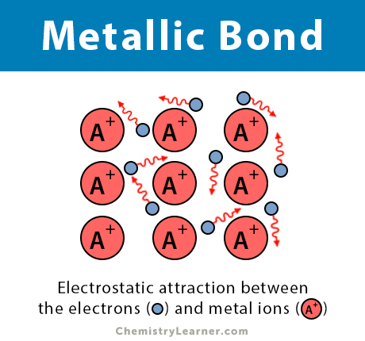
Metallic bond
A metallic bond is a type of chemical bond in which a ‘cloud’ of free moving valence electrons is bonded to the positively charged ions in a metal.
The electrons are detached from the atoms and delocalized throughout the metal, i.e., they move freely. However, the interactions between the ions and electrons are still prevalent. These interactions give rise to a binding force that holds the metallic crystal together. This force is the basis of a metallic bond.

Slide 9
Metallic bond
Metallic bond, force that holds atoms together in a metallic substance. Such a solid consists of closely packed atoms. In most cases, the outermost electron shell of each of the metal atoms overlaps with a large number of neighbouring atoms.
As a consequence, the valence electrons continually move from one atom to another and are not associated with any specific pair of atoms. In short, the valence electrons in metals, unlike those in covalently bonded substances, are nonlocalized, capable of wandering relatively freely throughout the entire crystal.
The atoms that the electrons leave behind become positive ions, and the interaction between such ions and valence electrons gives rise to the cohesive or binding force that holds the metallic crystal together.

Slide 10
Metallic bond
Many of the characteristic properties of metals are attributable to the non-localized or free-electron character of the valence electrons. This condition, for example, is responsible for the high electrical conductivity of metals. The valence electrons are always free to move when an electrical field is applied. The presence of the mobile valence electrons, as well as the nondirectionality of the binding force between metal ions, account for the malleability and ductility of most metals.

Slide 11
Metallic bond
When a metal is shaped or drawn, it does not fracture, because the ions in its crystal structure are quite easily displaced with respect to one another. Moreover, the nonlocalized valence electrons act as a buffer between the ions of like charge and thereby prevent them from coming together and generating strong repulsive forces that can cause the crystal to fracture.

Slide 12
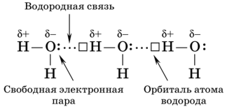
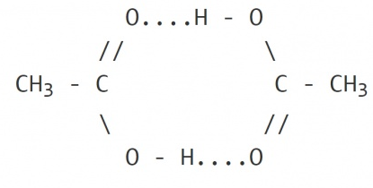
Intermolecular hydrogen bond
Hydrogen bonding is a special type of dipole-dipole attraction between molecules, not a covalent bond to a hydrogen atom. It results from the attractive force between a hydrogen atom covalently bonded to a very electronegative atom such as a N, O, or F atom and another very electronegative atom. First, the hydrogen atom is covalently bonded to a very electronegative atom resulting in a positive charge, which is then attracted towards an electronegative atom resulting in a hydrogen bond

Slide 13
Hydrogen Bond
In molecules containing N-H, O-H or F-H bonds, the large difference in electronegativity between the H atom and the N, O or F atom leads to a highly polar covalent bond (i.e., a bond dipole)
Because of the difference in electronegativity, the H atom bears a large partial positive charge and the N, O or F atom bears a large partial negative charge.
A H atom in one molecule is electrostatically attracted to the N, O, or F atom in another molecule.

Slide 14
Hydrogen bond
Hydrogen bonding between two water (H₂O) molecules. Note that the O atom in one molecule is attracted to a H atom in the second molecule.
Hydrogen bonding between a water molecule and an ammonia (NH₃) molecule. Note that the N atom in the NH₃ molecule is attracted to a H atom in the H₂O molecule.

Slide 15
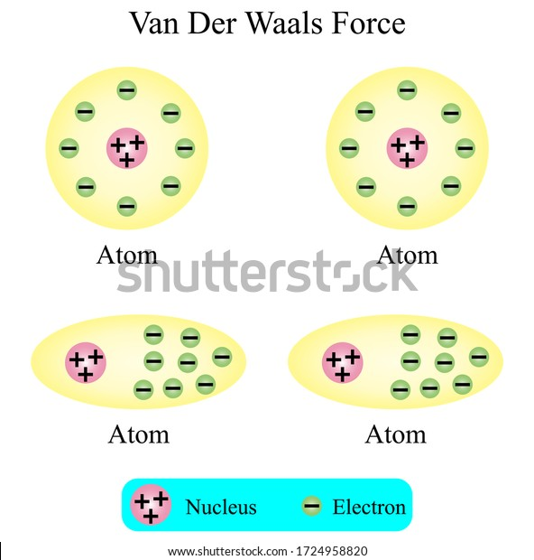
Other Types of Chemical Bonds
Van der Waals Bond
Neutral molecules are held together by weak electric forces known as Van der Waals forces. Van der Waals force is a general term used to define the attraction of intermolecular forces between molecules. This type of chemical bond is the weakest of all bonds.

Slide 16
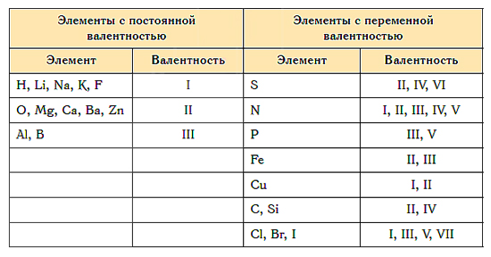
Valence
Valence is the ability of the atoms of an element to combine with a certain number of atoms of other elements. The valence values are written in Roman numerals over chemical symbols. The valence unit is taken to be the valence of hydrogen atoms.

Slide 17
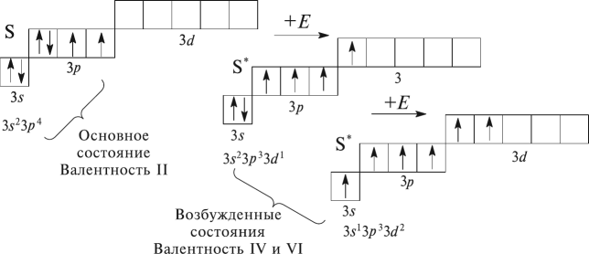
Variable valence is due to the ability of atoms to pass into an excited state. The excited state of an atom arises as a result of the transition of paired electrons to free orbitals.
Using the Sulfur atom as an example:
basic condition
Valence II
excited state
Valence IV and VI

Slide 18
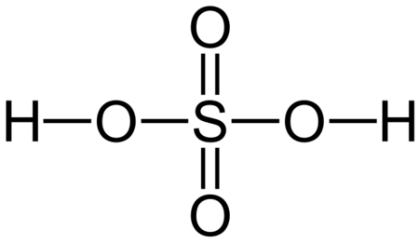
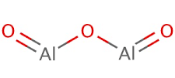
Sulphuric acid
Aluminium oxide

Slide 19
Oxidation state
The oxidation state is the conditional charge of an atom in a compound, which is formed when electrons are attached or removed.
Key points:
In simple substances, there is no shift of electrons, and the oxidation state of atoms is 0.
The sum of all oxidation states in substances must equal (0).
In complex substances, the oxidation state of metal atoms is always positive.
The metals of the main subgroups in the compounds, as a rule, exhibit a constant oxidation state. For metals of group IA, it is equal to (+1)
For IIA group metals, the oxidation state is always (+2)
Oxidation state of aluminum and boron — (+3)
For the most electronegative non-metal fluorine, the oxidation state is constant and equal to (–1)
Oxygen almost always has an oxidation state (–2)
In most compounds, the oxidation state of hydrogen is (+1), but in compounds with metals, it is (–1)

Slide 20
Determination of the oxidation state
To determine the oxidation state of an atom in a chemical compound, you must:
1. Write down the formula of the substance:
P2O5.
2. Write down the values of the oxidation states of oxygen, hydrogen or another element that has a constant (or precisely known) value:
P2O5.
3. Find the sum of the oxidation states and calculate the value of x:
2⋅x+5⋅(−2)=0
2x−10=0
2x=10
x=+5.
The oxidation state of phosphorus is +5.
х
-2

