Slide 1
Odessa National Medical University
Faculty of Pharmacy
Department of Pharmaceutical Chemistry
Lecture on General and Inorganic Chemistry №4
«Classes and nomenclature of inorganic compounds. Simple compounds. Complex compounds. Oxides, peroxides and peroxides. Nomenclature of hydroxides. Nomenclature of acids. Nomenclature of salts.»

Slide 2
Inorganic compounds
Simple
Metal
Non-Metal
Complex
Oxides
Bases
Acids
Salts

Slide 3
Inorganic compounds
Simple
consist of atoms of one chemical element.
Complex
consist of atoms of different elements
For example: O2, N2, C (diamond)
For example: CaO, CuSO4

Slide 4
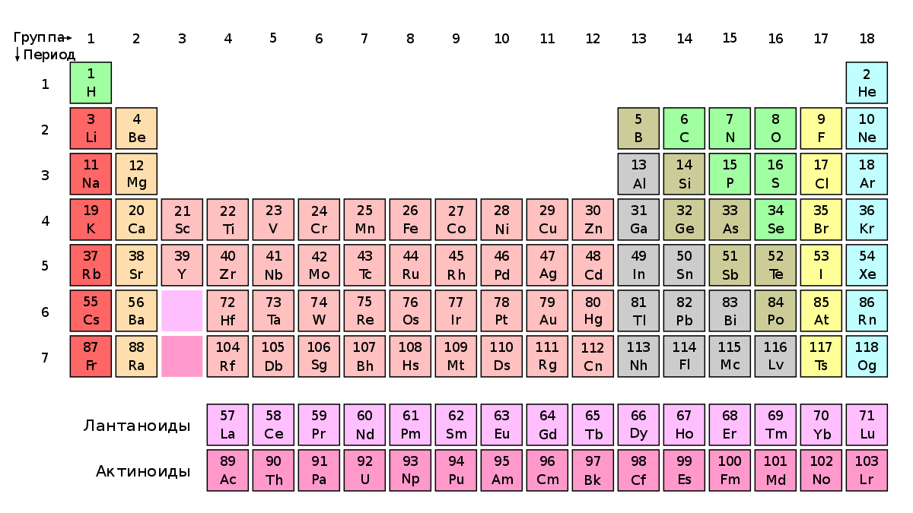

Slide 5
Complex
Oxides
Bases
Acids
Salt

Slide 6
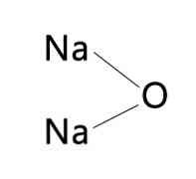
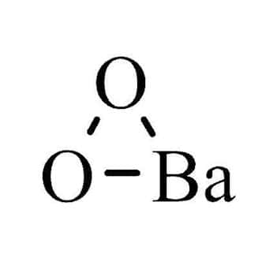
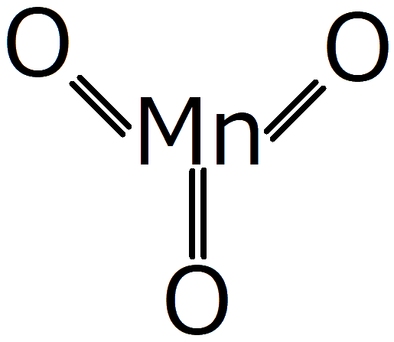
Oxides
Oxides are binary compounds containing oxygen atoms in the oxidation state equal -2.
In oxides, oxygen atoms are not bonded to each other.
Compounds of elements with oxygen, in which there is a bond between oxygen atoms, are called peroxides: Н₂О₂, Na₂О₂ BaO₂

Slide 7
Classification of oxides
Oxides
Non-salt-forming
СO, NO, N₂O
Salt-forming
Basic
Li₂O
Amphoteric
Al₂O₃
Acidic
SO₃

Slide 8
Non-salt-forming oxides are compounds that enter into chemical reactions, but as a result of such reactions, salts are not formed.
Salt-forming oxides are those that react to form salts.

Slide 9
Basic oxides are metal oxides that form bases.
These include oxides of metallic elements of the main subgroups of groups I and II (except beryllium), as well as d-metals in lower oxidation states (FeO, MnO, NiO).
For example, Na₂O, ВаО, FeO, CuO, NiO – is oxides, which correspond to hydroxides (bases) – NaOH, Ba(OH)₂, Fe(OH)₂, Cu(OH)₂, Ni(OH)₂

Slide 10
Correspondence of bases and oxides
Na₂O – NaOH
Li₂O – LiOH
K₂O – KOH
MgO – Mg(OH)₂
CaO – Ca(OH)₂
BaO – Ba(OH)₂
CrO – Cr(OH)₂
FeO – Fe(OH)₂
The oxidation state of the element in the oxide and base must be the same!

Slide 11
Amphoteric oxides are oxides that exhibit the properties of both acids and bases.
These include the following oxides
ZnO, Al₂O_{3,}
Fe₂O_{3 ,} Cr₂O_{3,}
SnO, BeO, PbO_{2,} MnO₂

Slide 12
Oxides, which correspond to acids, are called acidic.
These include oxides of non-metals and metal oxides in the oxidation states +5, +6, +7.
Nonmetal oxides:
SO₂, SO₃, CO₂, P₂O₅, SiO₂, N₂O₅
Metal oxides with oxidation states +5, +6, +7:
V₂О_{5,} СrO_{3,} MnO_{3,} Mn₂O₇

Slide 13
Correspondence of acids and oxides
SO₂ – H₂SO₃
SO₃ – H₂SO₄
CO₂ – H₂CO₃
P₂O₅ – H₃PO₄
SiO₂ – H₂SiO₃
N₂O₃ – HNO₂
N₂O₅ – HNO₃
СrO₃ – H₂CrO₄
Mn₂O₇ – HMnO₄
The oxidation state of the element in oxide and acid must be the same!

Slide 14
Oxides nomenclature
In oxides, a positively charged element is first called, after it, in brackets, Roman numerals indicate its oxidation state and add the word "oxide“
Сr₂О₃ – chromium (III) oxide;
N₂O₅ – nitrogen (V) oxide.
If an element is characterized by only one oxidation state, then it is not indicated:
Na₂O – sodium oxide;
ZnO – zinc oxide.

Slide 15
Obtaining oxides
Oxidation of simple substances with oxygen:
2Ca + O₂ → 2CaO
S + O₂ → SO₂
2S + 3O₂ → 2SO₃
2. Combustion of complex substances
ZnS + O₂ → ZnO + SO₂
3. Decomposition on heating of bases, acids, salts
CaCO₃ → CaO + CO₂
H₂SiO₃ → SiO₂ + H₂O
Al(OH)₃ → Al₂O₃ + H₂O
4. Postoxidation of oxides with a lower oxidation state
2SO₂ + O₂ → 2SO₃

Slide 16
Chemical properties of oxides
 | Basic oxides | Amphoteric oxides | Acidic oxides
Water | Alkali(1) | - | Acid(2)
Basic oxides | - | Salt(3) | Salt(4)
Amphoteric oxides | Salt(3) | - | Salt(5)
Acidic oxides | Salt(4) | Salt(5) | -
Alkali | - | Salt+water (6) | Salt+water (7)
Acid | Salt+water (8) | Salt+water (9) | -

Slide 17
Examples of reactions:
K₂O + H₂O → 2 KOH
SO₃ + H₂O → H₂SO₄
Na₂O + Al₂O₃ → 2 NaAlO₂
K₂O + SO₃ → K₂SO₄
Al₂O₃ + 3SO₃ → Al₂(SO₄)₃
2 KOH + Al₂O₃ → 2 KAlO₂ + H₂O
2 KOH + SO₃ → K₂SO₄ + H₂O
K₂O + H₂SO₄ → K₂SO₄ + H₂O
Al₂O₃ + 3H₂SO₄ → Al₂(SO₄)₃ + 3H₂O

Slide 18
Bases
Bases are complex substances in which an ion of a metal element is combined with one or more hydroxyl groups.
From the point of view of electrolytic dissociation, bases are called electrolytes, which upon dissociation form metal cations and hydroxide anions.
For example,
KOH = К⁺ + ОН–
Ва(ОН)₂ = Ва²⁺ + 2 ОН–.

Slide 19
Base classification
Base
By solubility
Soluble
(alkalis+NH₄OH)
By strength
Strong (alkalis)
Weak
Insoluble

Slide 20
Alkalis
Alkalis include Group IA metal hydroxides and Ca, Sr and Ba from Group IIA
LiOH
NaOH
KOH
RbOH
CsOH
Ca(OH)₂
Sr(OH)₂
Ba(OH)₂

Slide 21
Base nomenclature
The base names are formed from the name of the cation, followed by the oxidation state of the element in brackets in Roman numerals, and the word hydroxide:
Fe(OH)₂ – iron (II) hydroxide;
Ni(OH)₂ – nickel (II) hydroxide.
If an element in compounds exhibits a single oxidation state, then it is not indicated:
NaOH – sodium hydroxide;
La(OH)₃ – lanthanum hydroxide

Slide 22
Methods for obtaining base
Soluble bases can be obtained by interaction:
active metals with water :
2К + 2Н₂О = 2КОН + Н₂,
Ва + 2Н₂O = Ва(ОН)₂ + Н₂,
basic oxides with water :
Li₂O + H₂O = 2LiOH,
ВаО + Н₂О = Ва(ОН)₂
La₂O₃ + 3Н₂О = 2La(OH)₃.
salt with another base (a prerequisite - the resulting salt precipitates)
Na₂SO₄+Ba(OH)₂ = NaOH + BaSO₄↓

Slide 23
Methods for obtaining base
  Insoluble bases can be obtained as a result of the interaction of salts with alkalis:
  FeCl₂ + КОН = Fe(OH)₂↓ + 2КСl,
CuSO₄ + 2NaOH = Cu(OH)₂↓ + Na₂SO₄
As a result of the interaction of a complex salt with an acid
К₃[Аl(ОН)₆] + 3НСl = Аl(ОН)₃↓ + 3КСl + 3Н₂О;
K₂[Zn(OH)₄]+H₂SO₄ = Zn(OH)₂↓ + K₂SO₄ + 2 Н₂О.

Slide 24
Chemical properties of bases
Soluble | Insoluble
React with acids
HCl + NaOH → NaCl + H₂O | 2HCl + Cu(OH)₂ → CuCl₂ + 2H₂O
Dissociation into ions as a result of which the color of the indicator changes (next slide) KOH = К⁺ + ОН– | Decompose when heated Cu(OH)₂ → CuO + H₂O
Reacts with acidic and amphoteric oxides 2NaOH + SO₃ = Na₂SO₄ + H₂O 2 KOH + Al₂O₃ = 2 KAlO₂ + H₂O
Reacts with amphoteric hydroxides 3KOH + Al(OH)₃ = K_{3[}Al (OH)₆]
Reacts with salt solution (a prerequisite - the resulting precipitates or gas) Na₂SO₄+Ba(OH)₂ = NaOH + BaSO₄↓

Slide 25
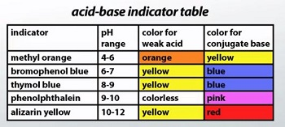

Slide 26
Acids
Acids (H_{x}A) - substances that dissociate in solution into the H⁺ cation and the anion of the acid residue A⁻
Acids classification
Oxygen content
Oxygenated
H₂SO₄, HNO₃
Oxygen-free
HCl, HF, H₂S
Basicity (amount of H +)
Monobasic
HF, HCl, HNO₃
Bibasic
H₂S, H₂SO₄
Tribasic
H₃PO₄
By strength
Strong
H₂SO₄, HCl, HNO₃
Medium
H₃PO₄, HF, HNO₂
Weak
H₂S, H₂CO₃,H₂SiO₃

Slide 27
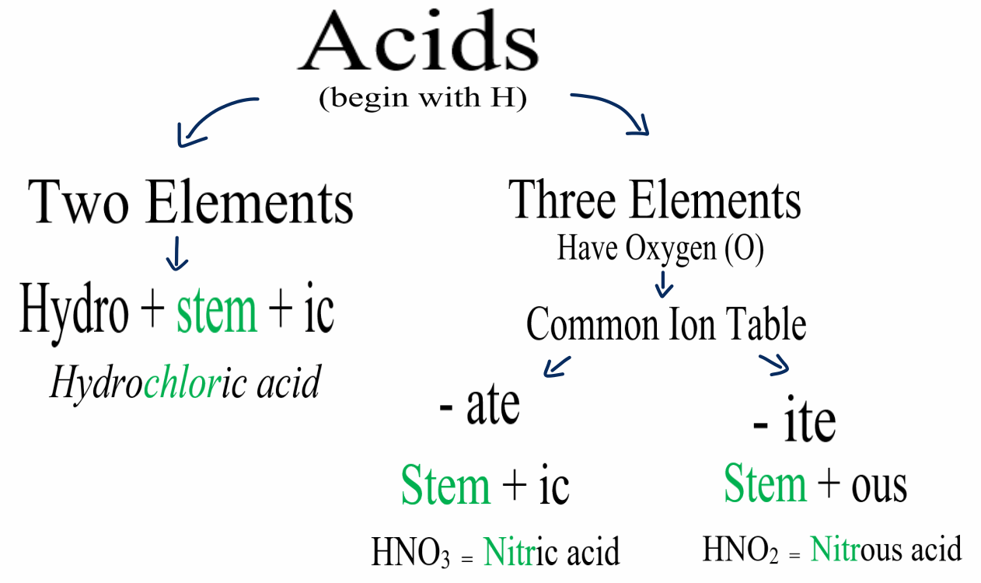

Slide 28
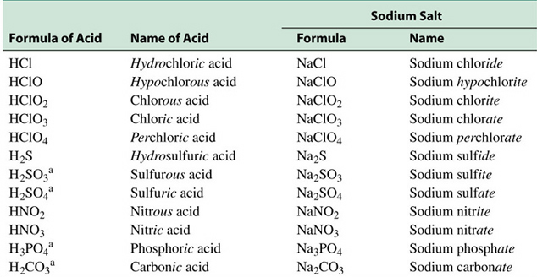
Base nomenclature

Slide 29
METHODS FOR OBTAINING ACIDS
Interaction of acidic oxides with water:
SO₃ + H₂O = H₂SO₄
_{2.} Salt-acid exchange reaction (gas or precipitate):
K₂S + H₂SO₄ = K₂SO₄ + H₂S↑
3. Hydrolysis of halogenated substances:
PI₃ + 3H₂O = H₃PO₃ + 3HI,
SO₂Cl₂ + 2H₂O = H₂SO₄ + 2HCl,
4BF₃ + 2H₂O = HBO₂ + 3HBF₄.
4. Interaction of active non-metals with water:
Сl₂ + Н₂О = НСlO + НСl;
3І₂ + 3Н₂О = НІО₃ + 5НІ.
5. The connection of non-metals with hydrogen
F₂ + H₂ = 2HF;
S + H₂ = H₂S.

Slide 30
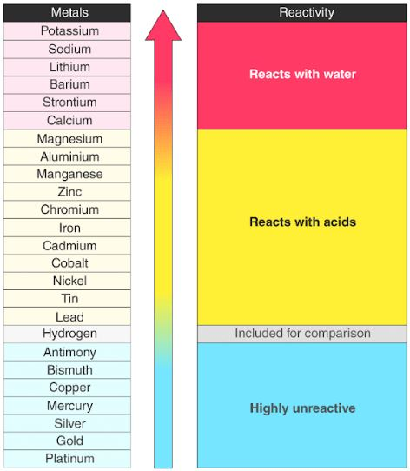
Сhemical properties of acids
1. Reaction with active metals
Ca + H₂SO_{4(diluted)} = CaSO₄ + H₂↑
Cu + H₂SO_{4(diluted)} = don’t react
Nota bene!
Concentrated sulfuric acid can serve as an oxidizing agent
With high activity metal:
Ba + H2SO4 → BaSO₄ + H₂S↑+H₂O
With middle activity metal:
Co + H2SO4 → CoSO₄ + S↓+H₂O
With highly unreactive metal:
Cu + H2SO4 → CuSO₄ + SO₂↑+H₂O
Don’t react with gold, platinum
Aluminium, Chromium, Iron react only after heating

Slide 31
Concentrated and diluted nitric acid can serve as an oxidizing agent
Diluted
With high activity metal:
Ba + HNO3 → Ba(NO₃)₂ + NH₄NO₃+H₂O
With middle activity metal and unreactive metal:
Co + HNO3 → Co(NO3)2 + NO↑+H₂O
Concentrated
With high activity metal:
Ba + HNO3 → Ba(NO₃)₂ + N₂O+H₂O
With middle activity metal and unreactive metal:
Co + HNO3 → Co(NO3)2 + NO₂↑+H₂O
Don’t react with gold and platinum (all concentration)
Aluminium, Chromium, Iron react only after heating (all concentration)

Slide 32
Dissociation into ions as a result of which the color of the indicator changes

Slide 33
Acids react with bases to produce a salt compound and water:
NaOH + H₂SO₄ → NaHSO₄ + H₂O
2NaOH + H₂SO₄ → Na₂SO₄ + H₂O
Acids react with salts (gas or precipitate):
K₂S + H₂SO₄ = K₂SO₄ + H₂S↑
BaCl₂ + H₂SO₄ = BaSO₄↓+ HCl

Slide 34
Salt is a substance produced by the reaction of an acid with a base. A salt consists of the positive ion (cation) of a base and the negative ion (anion) of an acid.
Normal
NaCl, Na₂SO₄, Na₃PO₄ NH4Cl,
Acidic
NaHSO_{4- sodium hydrosulfate}, Na₂HPO_{4 – sodium hydrophosphate}, NaH₂PO_{4 - sodium dihydrophosphate} NH4HSO_{4 – Ammonium hydrosufate}
Basic
MgOHCl – magnesium hydroxochloride, Al(OH)₂NO_{3 - aluminium} dihydroxonitrate
Double and mixed
KAl(SO₄)2- potassium-aluminium sulfate, Fe(NH₄)₂(SO₄)_{2 ,}
CaCl(OCl) - calcium chloride-hypochlorite
or CaOCl₂
Coordination
Na₂[Zn(OH)₄], K₃[Fe(CN)₆] – potassium hexacyanoferrate(III)

Slide 35
Salt names (Salt nomenclature)
The names of the middle salts are formed from the names of cations and anions, indicating the oxidation states of the cation and the acid-forming element, if necessary:
Fe(NO₃)₃ - iron (III) nitrate;
Na₂SO₄ - sodium sulfate.
Acid salts are called the same as average, but with the addition of the prefix hydro- to the name of the anion, which is written together with the corresponding numerical prefix:
KHCO₃ - potassium bicarbonate; potassium hydrocarbonate.
NaH₂PO₄ - sodium dihydrogen phosphate

Slide 36
Basic salts are called the same as middle ones, with the addition of the prefix hydroxo to the name of the anion, which is written together with the corresponding numerical prefix:
Fe(OH)Cl - iron (II) hydroxochloride;
Al(OH)₂NO₃ - aluminum dihydroxonitrate.

