Slide 1
Odessa National Medical University
Faculty of Pharmacy
Department of Pharmaceutical Chemistry
Lecture on General and Inorganic Chemistry №5
«Energetics of chemical and phase transformations. Direction of chemical reactions. Thermochemical equations, their features. Hess's law and its consequences. Standard conditions and standard values of enthalpy of formation and combustion of substances.»

Slide 2
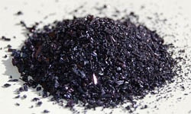
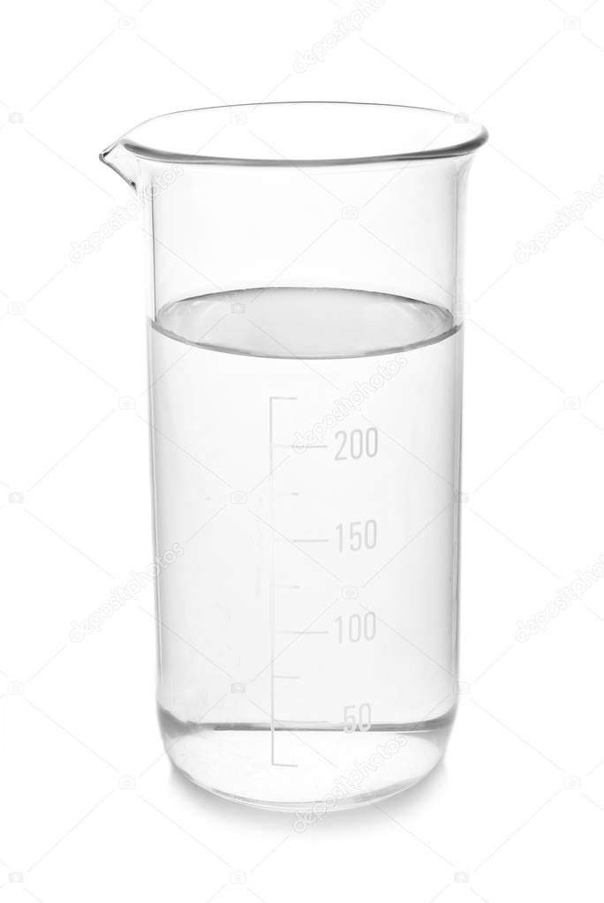
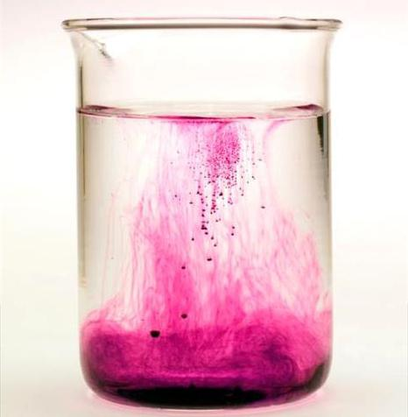
A solution is a homogeneous system of variable composition, which consists of two or more components.
Dissolved substance + solvent = solution
The solvent in the solution is in a larger amount and in the same state of aggregation as the solution.

Slide 3
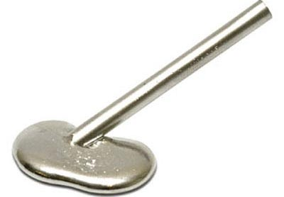
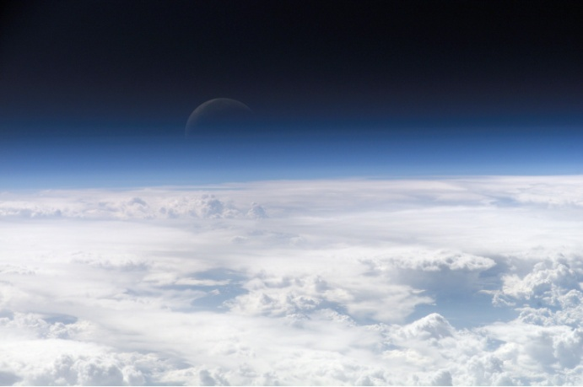
Classifications of solutions
І) By aggregate state
Solution
Liquid
Solid
Gaseous
Salt solutions in water
Metal alloys
Air

Slide 4
Classifications of solutions
ІІ) By particle size
Solution
True (molecular)
Colloid
Sugar in water solution
Suspension
Emulsion

Slide 5
Classifications of solutions
ІІІ) By saturation
Solution
Unsaturated
Saturated
At this temperature and pressure, further dissolution of the substance is possible
At this temperature and pressure, further dissolution of the substance is impossible.
Oversaturated
At a given temperature and pressure, there are more substances than in a saturated solution

Slide 6
Classifications of solutions
ІV) By the ability to conduct electric current (only soluble substances):
electrolyte solutions - substances that conduct electric current (strong and weak electrolytes) (inorganic acids, bases, salts)
solutions of non-electrolytes - substances that are not capable of conducting electric current (organic substances, gases, oxides)

Slide 7
Electrolytic dissociation theory
When dissolved in water, electrolytes dissociate (decompose) into ions - positively charged cations and negatively charged anions:
Bases ↔ Metal cation + hydroxide anion
Ba(OH)₂↔ Ba²⁺+2OH⁻
Acids ↔ Hydrogen cation + acid residue anion
HCl↔H⁺+Cl⁻
H₂SO₄↔2H⁺+SO₄²⁻
Salts ↔ Metal cation + acid residue anion
Al₂(SO₄)₃↔2Al³⁺ + 3SO₄²⁻

Slide 8
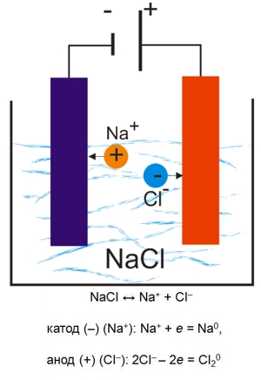
Electrolytic dissociation theory
2. Under the action of an electric current, ions acquire a directional movement: positively charged cations move to a negatively charged cathode, and negatively charged anions move to a positively charged anode.
3. Dissociation is a reversible process, that is, in parallel with the decay, the process of combining ions proceeds. Therefore, instead of the "=" sign, we put "↔"

Slide 9
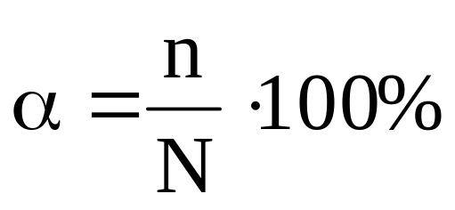
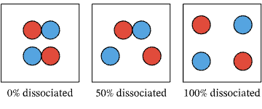
Quantifying dissociation - the degree of dissociation(α, %)
- degree of electrolytic dissociation
n – the number of molecules that have decayed into ions in solution
N – total number of molecules of a substance in a solution

Slide 10
Classification of electrolytes depending on the degree of dissociation
Strong electrolytes | Medium strength electrolytes | Weak electrolytes
α > 30% | 3% ≤ α ≤ 30% | α < 3%

Slide 11
Strong electrolytes
α > 30%
Medium soluble salts : NaCl, K₂SO₄, Ba(NO₃)₂
Alkali and alkaline earth metal hydroxides : LiOH – CsOH, Ca(OH)₂ – Ba(OH)₂,;
Strong mineral acids : H₂SO₄, HNO₃, HClO₄, HCl, HBr, HI

Slide 12
Weak electrolytes
α < 3%
Organic acids : HCOOH, CH₃COOH, C₂H₅COOH
Mineral acids(weak or meadle streight) : HNO₂, HClO, H₂CO₃, H₂SiO₃, H₃BO₃, H₂S
Low-activity metal hydroxides: Cu(OH)₂ , Fe(OH)₃ , Al(OH)₃ , Cr (OH)₃ ,
Ammonium hydroxide:
NH₄OH

Slide 13
Polybasic acids and bases dissociate in steps. Each subsequent stage is worse than the previous one.
Strong electrolyte
H₂SO₄H⁺+ HSO₄⁻ α₁
HSO₄ - H⁺+ SO₄²⁻ α₂
α₁≈ α₂
H₂SO₄2H⁺+ SO₄²⁻
Medium strength electrolyte
H₂SO₃H⁺+ HSO₃⁻ α₁
HSO₃ - H++ SO₃²⁻ α₂
α₁>> α₂
H₂SO₃H⁺+ HSO₃⁻

Slide 14
Conditions of the reaction of ion exchange
Reactions in electrolyte solutions proceed to the end if:
A precipitate forms or dissolves;
Gas is evolved;
A low-dissociating substance is formed (for example, H₂O)

Slide 15
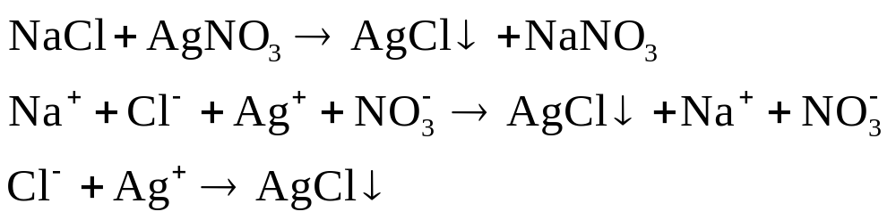
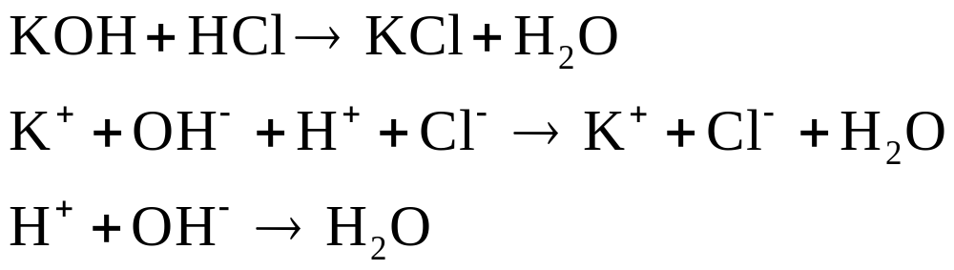
Sediment formation
H₂O formation

Slide 16
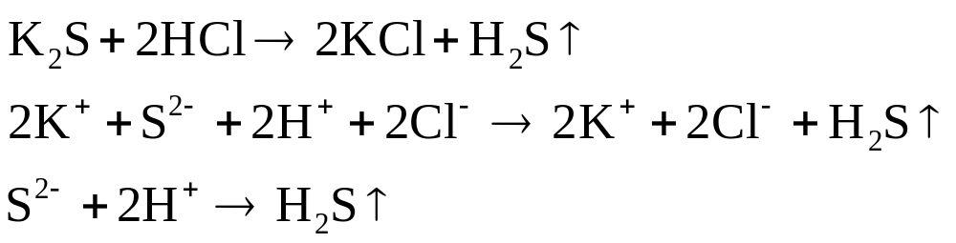
Gas evolution

Slide 17
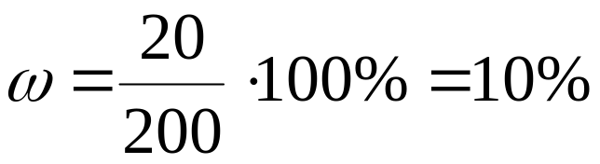
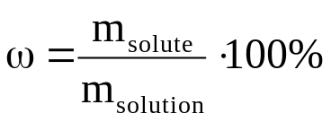
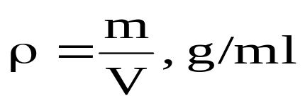
Methods for expressing the concentration of a solute
Mass fraction is the ratio of the mass of the solute to the mass of the solution, expressed as a percentage
20 g
180 g
200 g

Slide 18
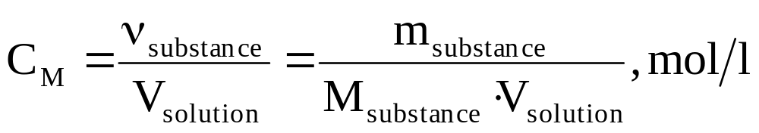
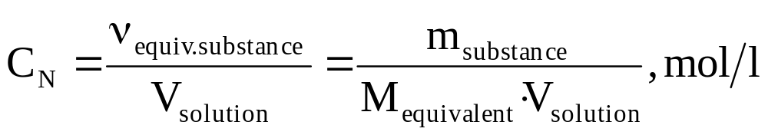
Methods for expressing the concentration of a solute
Molar concentration is the ratio of the amount of a substance( in mole) to the volume of a solution( in Liters).
Normal concentration is the ratio of the equivalent amount of a substance( in mole) to the volume of a solution( in Liters).

Slide 19
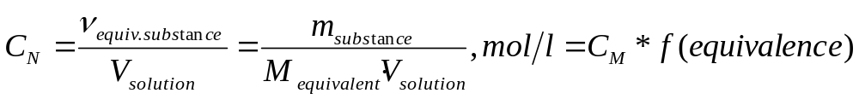

Slide 20
