Slide 1

Lecture 1
Topic:
Subject and objectives of pharmaceutical chemistry, history of development. System of quality assessment of drugs. State Pharmacopoeia of Ukraine, its structure.

Slide 2
Pharmaceutical chemistry a science that studies the methods of obtaining, structure, physical and chemical properties, storage of medicinal substances, as well as the relationship between the chemical structure and the effect of medicinal substances on the body.

Slide 3

Pharmaceutical chemistry is based on knowledge
Chemical Sciences :
inorganic
organic
analytical
physical
biological
Physical and mathematical.
  Biomedical :
  biology
  physiology
  anatomy

Slide 4
Inorganic chemistry - gives the key to understanding the properties of inorganic medicinal substances, indicates the ways to obtain them, as well as the possibility of their action on the body.
Organic chemistry - helps to establish the structure of an unknown compound, develops synthesis schemes, qualitative reactions are used.
    Physical colloid chemistry – offers great quantitative analysis.
    Biological - indicates what transformations with medicinal substances occur in the body and in which enzyme systems of the body this drug is involved.

Slide 5
Pharmaceutical chemistry is closely related to the pharmaceutical sciences, occupies a central position and is a link.
  Pharmacognosy - helps to determine the active substances from plant and animal raw materials. Pharmaceutical chemistry establishes the structure of active substances, develops industrial synthesis, gives an understanding of the proper storage, drying and use of plant materials.
  Pharmaceutical technology - pharmaceutical chemistry helps in the manufacture of drugs, as knowledge about the compatibility of substances, in combination with each other based on the physicochemical properties of drugs.
  Organization and Economics of Pharmacy (OEF) - studies laws aimed at the correct dispensing of medicines. At the same time, knowledge in the storage of these substances is used.
    Forensic, Toxicological Chemistry - applies pharmaceutical chemistry techniques to detect poisonous and potent substances.

Slide 6
MODERN PROBLEMS OF PHARMACEUTICAL CHEMISTRY.
Creation and research of new medicines.
Development of pharmaceutical and biopharmaceutical assay methods.
Quality control of medicines used on the territory of Ukraine.

Slide 7
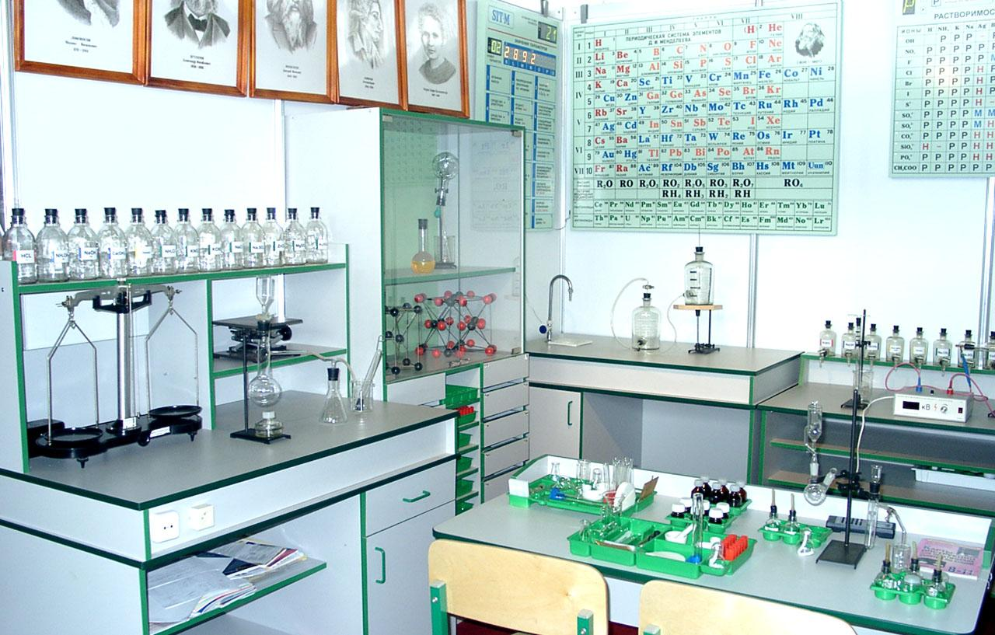
Creation and research of new medicines is necessary for the following reasons:
Insufficient effectiveness of some drugs.
The presence of a side effect.
Limitation of expiration dates.
In connection with new achievements in the field of medical, biological and chemical sciences.

Slide 8
2) Development of pharmaceutical and biopharmaceutical assay methods.
A) For pharmaceutical analysis
Work to improve the accuracy, specificity of pharmaceutical analysis, the desire to analyze small amounts of medicinal substances, automation and speed of analysis.
Development of new titrimetric, without burette, without indicator methods of analysis.
Improvement and implementation of physical and chemical methods in express analysis.
B) For biopharmaceutical analysis
  Development of methods for determining metabolites in biological fluids and body tissues.
  Widespread introduction of electronic computing technology to optimize the processing and interpretation of results.

Slide 9
Principles of Classification of Medicinal Substances
Chemical classification
Divides groups according to chemical structure. Lack of classification, substances of different actions fall into one group.
Pharmacological
Divides all substances according to their effect on the body. The disadvantage is that substances of different chemical structures are combined into one group..
Mixed
All substances are divided into groups that are identical in structure and effect on the body.

Slide 10
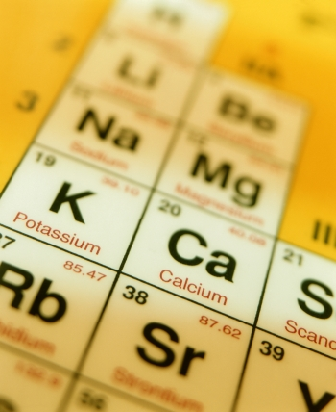
Inorganic Medicinal Substances.
Classified according to regulationselements in the periodic system D.I. Mendeleev.
Organic Medicinal Substances.
Classified into derivatives:
- aliphatic
- aromatic
- heterocyclic
And then on to the main:
- hydrocarbons
- halogen derivatives
- alcohols
- ethers
- aldehydes
- acids.

Slide 11
Legislation of Ukraine on the above mentioned issues:
1. Constitution of Ukraine
https://zakon.rada.gov.ua/laws/show/254%D0%BA/96-%D0%B2%D1%80?lang=en
2. Code of Ukraine on Administrative Offenses
https://zakon.rada.gov.ua/laws/show/80731-10?lang=en
3. Law of Ukraine “On Medicines”
https://zakon.rada.gov.ua/laws/show/123/96-%D0%B2%D1%80?lang=en
4. Law of Ukraine “Licensing of Different Types of Economic Activities”
https://zakon.rada.gov.ua/laws/show/222-19?lang=en
5. Law of Ukraine “On the Main Principles of State Supervision (Oversight) in the Area of Commercial Activity”
https://zakon.rada.gov.ua/laws/show/877-16?lang=en
6. Law of Ukraine “On Amendments to Certain Legislative Acts of Ukraine to Increase Liability for the Falsification or Circulation of Falsified Medicinal Products”
https://zakon.rada.gov.ua/laws/show/5065-17?lang=en

Slide 12
7. Law of Ukraine “Fundamentals of the Legislation of Ukraine on Health Care”
https://zakon.rada.gov.ua/laws/show/2801-12?lang=en
8. Law of Ukraine “On Amendments to Certain Legislative Acts of Ukraine Regarding Preventing Falsification of Medicines”
https://zakon.rada.gov.ua/laws/show/3718-17?lang=en
9. Law of Ukraine «On Citizens’ Appeals»
https://zakon2.rada.gov.ua/laws/show/393/96-%D0%B2%D1%80?lang=en
10. Law of Ukraine “On Access to Public Information”
https://zakon.rada.gov.ua/laws/show/2939-17?lang=en
11. Law of Ukraine «On Ratification of the Council of Europe Convention on the Counterfeiting of Medical Products and Similar Crimes Involving Threats to Public Health»
https://zakon.rada.gov.ua/laws/show/4908-17?lang=en
12. Resolution of the Cabinet of Ministers of Ukraine of August 12, 2015 No. 647 “On Approval of the Regulation on the State Service of Ukraine for Drugs and Drug Control”
https://zakon.rada.gov.ua/laws/show/647-2015-%D0%BF?lang=en
13. Resolution of the Cabinet of Ministers of Ukraine of May 6, 2000 No. 770 “On Approval of the List of Narcotic Drugs, Psychotropic Substances and Precursors”
https://zakon3.rada.gov.ua/laws/show/770-2000-%D0%BF?lang=en

Slide 13
14. Resolution of the Cabinet of Ministers of Ukraine of April 28, 2000, No. 728 “On Approval of the Procedure for the Exit to Ukraine or Destruction of Non-Qualitative and Unusable Goods (Objects) of Humanitarian Aid” (as amended)
https://zakon3.rada.gov.ua/laws/show/728-2000-%D0%BF?lang=en
15. Resolution of the Cabinet of Ministers of Ukraine of September 14, 2005 No. 902 “On Approval of the Procedure of State Quality Control of Medicinal Products, imported into Ukraine ”
https://zakon.rada.gov.ua/laws/show/902-2005-%D0%BF?lang=en
16. Resolution of the Cabinet of Ministers of Ukraine of October 31, 2007 No. 1279 “On Approval of the Procedure for Compensation by the Subject of Expenses Related to the Examination (Testing) of Samples of Products” (as amended)
https://zakon3.rada.gov.ua/laws/show/1279-2007-%D0%BF?lang=en
17. Resolution of the Cabinet of Ministers of Ukraine of October 31, 2007, No. 1280 “On Approval of the Procedure for Sampling for the Determination of Its Quality Indicators and the Form of a Sample Product Sample”
https://zakon3.rada.gov.ua/laws/show/1280-2007-%D0%BF?lang=en

Slide 14
18. Resolution of the Cabinet of Ministers of Ukraine of May 26, 2005 No. 376 “On Approval of the Procedure for State Registration (Re-registration) of Medicinal Products and Amounts of Dues for their State Registration (Re-registration)” (as amended)
https://zakon.rada.gov.ua/laws/show/376-2005-%D0%BF?lang=en
19. Resolution of the Cabinet of Ministers of Ukraine of February 3, 2010 No. 260 “Some Issues of State Quality Control of Medicinal Products” (as amended)
https://zakon3.rada.gov.ua/laws/show/260-2010-%D0%BF?lang=en
20. Resolution of the Cabinet of Ministers of Ukraine of 08.12.2010 No. 1114 “On Approval of the Agreement on Cooperation in Combating the Circulation of Falsified Medicinal Products”
https://zakon.rada.gov.ua/laws/show/1114-2010-%D0%BF?lang=en
21. Resolution of the Cabinet of Ministers of Ukraine of January 15, 1996 No. 73 “On Approval of the Regulation on the Control of the Compliance of Immunobiological Preparations Applied in Medical Practice with the Requirements of State and International Standards”
https://zakon3.rada.gov.ua/laws/show/73-96-%D0%BF?lang=en
22. Order of the Ministry of Health of Ukraine of October 17, 2012 No. 812 “On Approval of the Rules for Production (Manufacturing) and Quality Control of Medicines in Pharmacies” (as amended), registered by the Ministry of Justice of Ukraine of November 2, 2012 No. 1846/22158,
https://zakon3.rada.gov.ua/laws/show/z1846-12?lang=en
23. Order of the Ministry of Health of Ukraine of September 29, 2014 No. 677 “On Approval of the Procedure for Quality Control of Medicinal Products during Wholesale and Retail Trade”, registered by the Ministry of Justice of Ukraine of November 26, 2014 No. 1515/26292
https://zakon3.rada.gov.ua/laws/show/z1515-14?lang=en

Slide 15
24. Order of the Ministry of Health of Ukraine of November 22, 2011 No. 809 “On Approval of the Procedure for Prohibiting (Stoppage) and Renewing the Market Circulation of Medicinal Products on the Territory of Ukraine”, registered by the Ministry of Justice of Ukraine of January 30, 2912 No. 126/20439
https://zakon3.rada.gov.ua/laws/show/z0126-12?lang=en
25. Order of the Ministry of Health of Ukraine of June 17, 2005, No. 287 “On Approval of the Procedure for Interaction between the State Inspection for Drug Quality Control of the Ministry of Health of Ukraine and the State Pharmacological Center of the Ministry of Health of Ukraine in the Sphere of Medicinal Products”
26. Order of the Ministry of Health of Ukraine of December 16, 2003, No. 584″ On approval of the Rules for Storage and Control of the Quality of Medicinal Products in Health Care Institutions”, registered by the Ministry of Justice of Ukraine on March 03, 2004 No. 275/8874
https://zakon.rada.gov.ua/laws/show/z0275-04?lang=en
27. Order of the Ministry of Health of Ukraine of January 14, 2004 No. 10 “On approval of the procedure for conducting sector certification of laboratories for quality control and safety of medicinal products” (as amended), registered by the Ministry of Justice of Ukraine on January 30, 2004 No. 130/8729
https://zakon.rada.gov.ua/laws/show/z0130-04?lang=en
28. Order of the Ministry of Health of Ukraine of January 15, 2003 No. 8 “On approval of lists of auxiliary substances and dyes authorized for use in the manufacture of medicinal products that (medicines) are registered in Ukraine and are made in pharmacy conditions on prescriptions of doctors and orders of medical and preventive establishments “(with changes), registered by the Ministry of Justice of Ukraine on January 29, 2003 No. 69/7390https://zakon.rada.gov.ua/laws/show/z0069-03?lang=en
29. Order of the Ministry of Health of Ukraine of October 26, 2001 No.428 “On Approval of the Instruction on Registration of Administrative Violations of the Ukrainian Laws regarding the Quality Assurance of Medicinal Products”, registered by the Ministry of Justice of Ukraine of January 18, 2002 No. 47/6335
https://zakon.rada.gov.ua/laws/show/z0047-02?lang=en

Slide 16
30. Order of the Ministry of Health of Ukraine of August 25, 2010, No. 722 “On Approval of the Procedure for Marking Drugs in Braille”, registered by the Ministry of Justice of Ukraine on November 5, 2010 No. 1044/18339
https://zakon.rada.gov.ua/laws/show/z1044-10?lang=en
31. Order of the Ministry of Health of Ukraine of April 24, 2015, No. 242 “On Approval of the Rules for the Utilization and Destruction of Medicinal Products”, registered by the Ministry of Justice of Ukraine on May 18, 2015 No. 550/26995
https://zakon.rada.gov.ua/laws/show/z0550-15?lang=en
32. Order of the Ministry of Health of Ukraine of April 26, 2011, No. 237 “On Approval of the Procedure for Importation of Unregistered Medicinal Products, Standard Samples, Reagents into the Territory of Ukraine” (with changes), registered by the Ministry of Justice of Ukraine on August 11, 2011, No. 965/19703
https://zakon.rada.gov.ua/laws/show/z0965-11?lang=en
33. Order of the Ministry of Health of Ukraine of June 06, 2012, No. 422 “On Certain Issues of the Prohibition of the Advertising of Medicinal Products”, registered by the Ministry of Justice of Ukraine on July 16, 2012, No. 1189/21501
https://zakon.rada.gov.ua/laws/show/z1189-12?lang=en
34. Order of the Ministry of Health of Ukraine of December 27, 2006, No. 898 “On Approval of the Procedure for Pharmacovigilance” (as amended), registered by the Ministry of Justice of Ukraine on January 29, 2007 No. 73/13340
https://zakon.rada.gov.ua/laws/show/z0073-07?lang=en

Slide 17
35. Order of the Ministry of Health of Ukraine of October, 01, 2014, No. 698 “On Approval of the Procedure for Controlling the Compliance of Immunobiological Preparations Applied in Medical Practice, with the Requirements of the National and International Standards», registered by the Ministry of Justice of Ukraine on October 29, 2014 No. 1356/26133
https://zakon.rada.gov.ua/laws/show/z1356-14?lang=en
36. Order of the Ministry of Health of Ukraine of January 21, 2013, No. 39 “On Approval of Forms of Documents Applicable to the State Control of the Quality of Medicinal Products Imported into Ukraine”, registered by the Ministry of Justice of Ukraine on February 08, 2013 under No. 234/22766
https://zakon.rada.gov.ua/laws/show/z0234-13?lang=en
37. Order of the Ministry of Health of Ukraine of December 8, 2015, No. 830 “On Approval and Entry into Effect of the State Pharmacopoeia of Ukraine (II Edition)”
38. Order of the Ministry of Health of Ukraine of December 05, 2016, No. 1308 “On Approval and Entry into Force of the Supplement No. 1 to the State Pharmacopoeia of Ukraine (II Edition)”
39. Order of the Ministry of Health of Ukraine of March 14, 2018, No. 476 “On Approval and Entry into Force of the Supplement No. 2 to the State Pharmacopoeia of Ukraine (II Edition)”
40. Order of the Ministry of Health of Ukraine of June 20, 2018, No. 1178 “On Approval and Entry into Force of the Supplement No. 3 to the State Pharmacopoeia of Ukraine (II Edition)”
41. Order of the Ministry of Health of Ukraine of April 22, 2013, No. 321 “On Definition of concepts of” large “and” extra Large “quantities of Falsified Medicinal Products”, registered by the Ministry of Justice of Ukraine on May 15, 2013 No. 743/23275
https://zakon.rada.gov.ua/laws/show/z0743-13?lang=en

Slide 18
State Pharmacopoeia of Ukraine
STATE PHARMACOPOEIA OF UKRAINE (SPhU) is a legal document that contains general requirements for drugs, FS (monographs), as well as methods of quality control (Law of Ukraine "On Medicinal Products", Article 2). SPU has a legislative nature. Its requirements for medicines are mandatory for all enterprises and institutions of Ukraine, regardless of their form of ownership, which manufacture, store, control and use drugs.

Slide 19
State Pharmacopoeia of Ukraine
STATE PHARMACOPOEIA OF UKRAINE (SPhU) is a legal document that contains general requirements for drugs, FS (monographs), as well as methods of quality control (Law of Ukraine "On Medicinal Products", Article 2). SPhU has a legislative nature. Its requirements for medicines are mandatory for all enterprises and institutions of Ukraine, regardless of their form of ownership, which manufacture, store, control and use drugs.
The national part does not contradict the European one, but contains additional requirements for LP, which are not issued under the conditions of good manufacturing practice (GMP) established in the EU. The national part also includes additional information materials and alternative methods.
SPhU contains the following sections:
"General remarks",
"Methods of analysis",
"Reagents",
"General texts",
"General articles on dosage forms",
"General monographs",
"Monographs",
"Homeopathic medicines", etc.
To maintain harmonization with the European Pharmacopoeia, which is updated annually, the SPhU is supplemented.

Slide 20
The State Pharmacopoeia of Ukraine (SPhU) – is the normative document, which is contains general requirements for medicines, monographs and methods of control of active ingredients, medicines products, reagents and etc. Requirements of the SPhU are mandatory for all enterprises and institutions of Ukraine regardless of their form of ownership, which produce, maintain, monitor and implement medicines.
Ukraine is the first country between the countries of former Soviet Union, which had worked out the national Pharmacopoeia. The 1-st edition of the SPhU was installed at the 1 of October of 2001 year.
The second volume (The Supplement 1) was installed at the 1 of April of 2004 year. The third volume (The Supplement 2) was installed at the 1 of February of 2008 year. The forth volume (The Supplement 3) was installed at the 1 of January of 2010 year. The fifth volume (The Supplement 4) was installed at the 1 of May of 2011 year.
The Ukrainian Scientific Pharmacopoeial Centre for Quality of Medicines takes a part in the working out the State Pharmacopoeia of Republic Kazakhstan.
The present time the Department of the SPhU had become the work as for working out the Second edition of the SPhU.
The most important projects of monographs are publishing in the scientific edition of Ukrainian Scientific Pharmacopoeial Centre for Quality of Medicines “Pharmacom”.

