Slide 1
Lecture 2
PHYSICO-CHEMICAL
METHODS OF ANALYSIS

Slide 2
Plan
Classification of physical and physical-chemical methods of analysis
Classification of optical methods of analysis
Light absorption laws
Refractometry
Electrochemistry
Potentiometry
Chromatography

Slide 3
Classification of physical and physico-chemical methods of analysis:
Optical methods.
Chromatographic Methods.
Electrochemical methods.
Radiometric methods.
Thermal methods.
Mass spectrometry.

Slide 4
Classification of optical methods of analysis:
According to the objects under study: atomic and molecular spectral analysis.
By the nature of the interaction of electromagnetic radiation with matter. Distinguish:
Atomic absorption analysis.
Emission spectral analysis.
Flame photometry.
Molecular absorption analysis.
Luminescent analysis.
Spectral analysis using the effect of Raman scattering of light (Raman effect).
Nephelometric analysis.
Turbidimetric analysis.
Refractometric analysis.
Interferometric analysis.
Polarimetric analysis.

Slide 5
By region of the electromagnetic spectrum.
Spectroscopy (spectrophotometry) in the UVI region of the spectrum, i.e. in the near ultraviolet (UV) region - in the wavelength range of 200-400 nm (185-390 nm) and in the visible region - in the wavelength range of 400-760 nm (390-760 nm).
Infrared spectroscopy, which studies a part of the spectrum in the range of 0.76-1000 µm (1 µm = 10⁻⁶ m).
Less commonly used: X-ray spectroscopy, microwave spectroscopy, etc.
By the nature of energy transitions.
Electronic spectra.
Vibrational spectra.
Rotational spectra.

Slide 6




General provisions
Wavelength λ - the distance traveled by the wave during one complete oscillation. More often measured in nm (1 nm = 10-9 m).
The frequency ѵ is the number of times per second when the electric field reaches its maximum positive value. The unit of measurement is hertz (1 Hz = 1 s⁻¹).
Wave number - the number of wavelengths that fit into a unit length = 1/λ. The wavenumber is measured in reciprocal centimeters (cm-1).
Planck's equation:
where is the change in the energy of the elementary system as a result of the absorption or emission of a photon with energy
(h - Planck's constant: h=6.6262 10-34 J s).

Slide 7
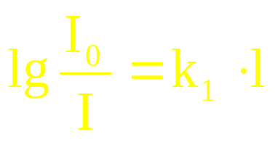
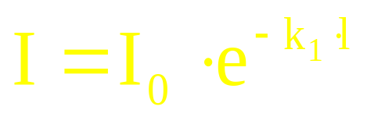
The Bouguer-Lambert law (in 1729 - Bouguer, in 1760 - Lambert): homogeneous layers of the same substance of the same thickness absorb the same fraction of the light energy incident on them at a constant concentration of the solute.
e - the base of natural logarithms;
k₁ - absorption coefficient of the medium;
l - the thickness of the absorbing layer, cm.

Slide 8
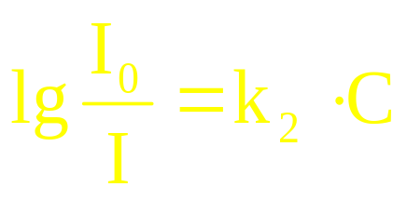
Beer's law (1852): The absorbance of a solution is directly proportional to the concentration of the solute at a constant layer thickness
k₂ - coefficient of proportionality;
C is the concentration of the solute.

Slide 9
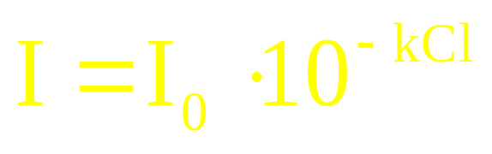

The combined Bouguer-Lambert-Beer law: optical density is directly proportional to the concentration of the solute and the thickness of the absorbing layer of the solution.
k - coefficient of light absorption, depending on the nature of the solute, temperature, solvent and wavelength of light

Slide 10
Absorption spectrum
(ε) А
λ _{max}
λ, нм

Slide 11
REFRACTOMETRY

Slide 12
When light passes from an optically less dense medium (I) to a medium with an optically higher density (2), the angle of incidence of light α is always greater than the angle of refraction β.
1
α
2
β

Slide 13
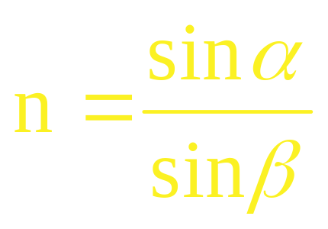
Snell's law of refraction:
        the ratio of the sines of the angles of incidence sin α and refraction sin β is a constant value for each substance, it is called the refractive index n:

Slide 14

Electrochemical methods of analysis. Classification of methods.
Potentiometric analysis.
Chromatographic methods of analysis. Ion exchange chromatography.

Slide 15
Electrochemical methods of analysis are based on measuring the electrochemical parameters of electrochemical phenomena that occur in the test solution.

Slide 16
Classification of electrochemical methods of analysis
Classification based on the nature of the source of electrical energy in the system.
  Methods without the imposition of an external (extraneous) potential.
  Methods with the imposition of an external (extraneous) potential.

Slide 17
Potentiometry
Potentiometric analysis (potentiometry)
– based on the use of the dependence of the electrode potential difference on the concentration (activity) of the analyte in solution.
This dependence is described by the Nernst equation:
Е_{р} = Е⁰ + 0,059/n·lgа

Slide 18
Chromatography
dynamic sorption method for separating mixtures based on the distribution of a substance between two phases, one of which is mobile and the other immobile, and associated with repeated repetition of sorption and desorption acts.

Slide 19
A distinctive feature of chromatographic methods is their versatility, that is, the possibility of using:
— for purification of substances;
— concentration of substances from highly dilute solutions;
— separation of complex mixtures of organic and inorganic substances;
— substance identification;
— determining the quantitative composition.

Slide 20
Chromatography makes it possible to simultaneously identify and quantify the separated components of a mixture.

Slide 21
Ion exchange chromatography
It is based on the reversible exchange of ions contained in the solution for ions that are part of the sorbent (ion exchanger).

Slide 22
Application of ion exchange chromatography
separation of electrolytes
purification from impurities
extraction and concentration
obtaining acids, bases, salts
extraction of rare earth metals
water definitions
quantitative determination of substances

