Slide 1
Lecture 3
Methods of identification of medicinal products

Slide 2
Pharmaceutical Analysis Criteria
For various purposes of the analysis, such criteria as the selectivity of the analysis, sensitivity, accuracy, analysis time, and the amount of the test substance are important.
The selectivity of the analysis is essential in the analysis of complex preparations consisting of several active components. In this case, the selectivity of the analysis is very important for the quantitative determination of each of the substances.
The accuracy and sensitivity requirements depend on the object and purpose of the study. Highly sensitive methods are used when testing for purity or impurities. For the stepwise production control, the factor of time spent on analysis is important.

Slide 3
Reproducibility — Describes the scatter of the test results compared to the mean.
Correctness - reflects the difference between the actual and found content of the substance. The accuracy of the analysis depends on the quality of the instruments, the experience of the analyst, etc. The accuracy of the analysis cannot be higher than the accuracy of the least accurate measurement. This means that if the titration accuracy is ± 0.2 ml plus the leakage error is also ± 0.2 ml, i.e. in total ± 0.4 ml, then when 20 ml of titrant is consumed, the error is 0.2%. With a decrease in the weight and amount of titrant, the accuracy decreases. Thus, titrimetric analysis allows the determination with a relative error of ± (0.2-0.3)%. Each of the methods has its own precision.

Slide 4
Methods for the identification of medicinal substances.
The most important indicator in the testing of medicinal substances is their identification or, as is customary in monographs, the authenticity. Numerous methods are used to determine the authenticity of medicinal substances. All basic and general ones are described in the SPhU 1st edition, issue 1. Historically, the main focus has been on chemical, incl. qualitative color reactions, characterizing the presence of certain ions or functional groups in organic compounds, at the same time, physical methods were widely used. In modern pharmacopoeias, the emphasis is on physicochemical methods.

Slide 5
Let us well on the basic physical methods.
Melting point is a fairly stable constant characterizing a substance, its purity and authenticity. This indicator is widely used to standardize medical substances. Methods for determining the melting point are described in detail in SPhU 1st;
  A pure substance has a constant melting point; however, when impurities are added to it, the melting point usually decreases quite significantly. This effect is called a mixing test and it is the mixing test that allows you to establish the authenticity of the medicine in the presence of a standard sample or a known sample. There are, however, exceptions, so racemic sulfocamphoric acid melts at a higher temperature, and various crystalline forms of indomethacin differ in melting point. Those. this method is one of the indicators that characterize both the purity of the product and its authenticity.
For some medicines, such an indicator as the solidification temperature is used.
Another indicator that characterizes a substance is the boiling point or temperature limits of distillation. This indicator characterizes liquid substances, for example, ethyl alcohol. The boiling point is less characteristic, it strongly depends on the atmospheric pressure, the possibility of the formation of mixtures or azeotropes, and is rarely used.

Slide 6
Among other physical methods, the determination of density and viscosity should be noted. Standard methods of analysis are described in SPhU 1st. The method characterizing the authenticity of the medicine is also the determination of its solubility in various solvents. According to SPhU 1st ed. This method is characterized as a property that can serve as an indicative characteristic of the test medicine.

Slide 7
Physico-chemical methods for determining authenticity.
The most informative in terms of determining the authenticity of substances are physicochemical methods based on the properties of the molecules of substances together with any physical factors.
Physico-chemical methods include:
Spectral methods:
  UV spectroscopy;
  Spectroscopy in visible light;
  IR spectroscopy;
  Fluorescence spectroscopy;
  Atomic absorption spectroscopy;
  X-ray methods of analysis;
  Nuclear magnetic resonance;
  X-ray diffraction analysis;
2. Sorption methods of analysis:
  Thin layer chromatography;
  Gas-liquid chromatography;
  High Performance Liquid Chromatography;
  electrophoresis;
  Iontophoresis;
  Gel Chromatography.
3. Bulk methods of analysis:
  Mass spectrometry;
  Chromatomass Spectrometry.
4. Electrochemical methods of analysis:
  Polarography;
  Electron paramagnetic resonance.
5. Use of standard samples.

Slide 8
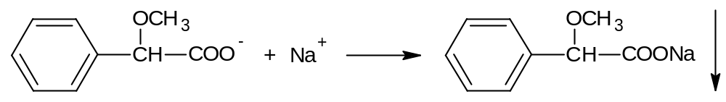
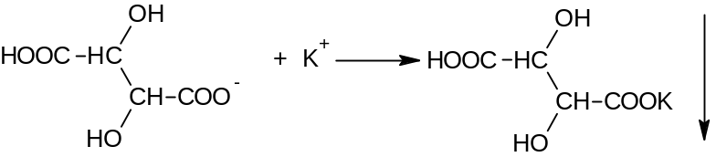
Chemical methods of identification.
Identification of medicinal substances by chemical methods is used mainly for inorganic medicinal substances, because other methods are often not available or they require complex and expensive equipment.
These methods are divided into the following:
Anion and cation precipitation reactions:
Typical examples are the precipitation reactions of sodium and potassium ions with (methoxyphenylacetic and tartaric acid, respectively:
A large number of such reactions are used and they will be discussed in detail in special sections of pharmaceutical chemistry.

Slide 9
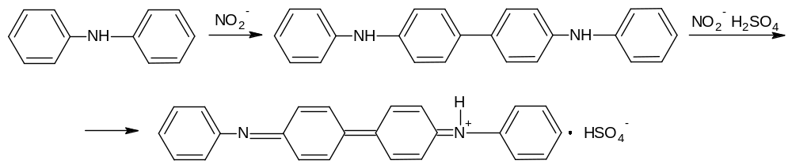
Redox reactions.
Redox reactions are used to reduce metals from oxides. For example, silver with its formalin oxide (the reaction of a silver mirror):
Diphenylamine Oxidation Reaction Underlies Nitrate and Nitrite Authenticity Testing:
R–COH + 2[Ag(NH₃)₂]NO₃ + H₂O → 2Ag↓ + 2NH₄NO₃ + R–COONH₄ + NH₃↑

Slide 10
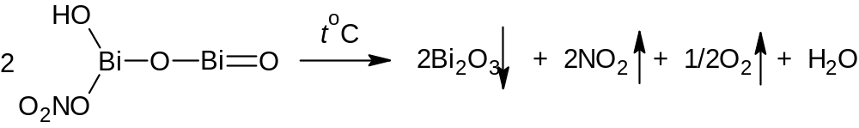
Neutralization reactions and decomposition of anions.
Carbonates and bicarbonates under the action of mineral acids form carbonic acid, which decomposes to carbon dioxide:
CO₃²⁻ + H⁺ → CO₂↑ + H₂O
HCO₃⁻ + H⁺ → CO₂↑ + H₂O
Nitrites, thiosulfates, ammonium salts decompose similarly.
Changes in the color of a colorless flame. Sodium salts color the flame yellow, copper green, potassium purple, calcium brick red. It is this principle that is used in atomic absorption spectroscopy.
Decomposition of substances during pyrolysis. The method is used for preparations of iodine, arsenic, mercury. Of the currently used, the reaction of basic bismuth nitrate is most characteristic, which, when heated, decomposes with the formation of nitrogen oxides:

Slide 11
Identification of organoelement medicinal substances.
Qualitative elemental analysis is used to identify compounds containing arsenic, sulfur, bismuth, mercury, phosphorus, and halogens in an organic molecule. Since the atoms of these elements are not ionized, preliminary mineralization, or pyrolysis, or again pyrolysis with sulfuric acid is used to identify them.
  Sulfur is determined by hydrogen sulfide reaction with potassium nitroprusside or lead salts.
  Iodine is also determined by pyrolysis by the release of elemental iodine.
  Of all these reactions, the identification of arsenic is of interest, not so much as a drug - they are practically not used, but as a method for controlling impurities, but more on that later.
Authenticity Testing for Organic Medicinal Substances.
Chemical reactions used to test the authenticity of organic medicinal substances can be divided into three main groups:
  General chemical reactions of organic compounds;
  Reactions for the formation of salts and complex compounds;
  Reactions used to identify organic bases and their salts.
All these reactions are ultimately based on the principles of functional analysis, that is, the reactive center of the molecule, which reacts to give the appropriate answer. Most often, this is a change in any properties of a substance: color, solubility, state of aggregation, etc.

Slide 12
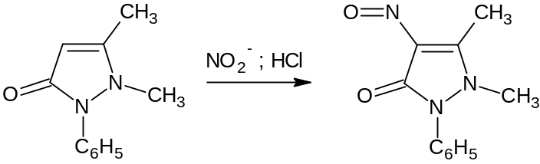
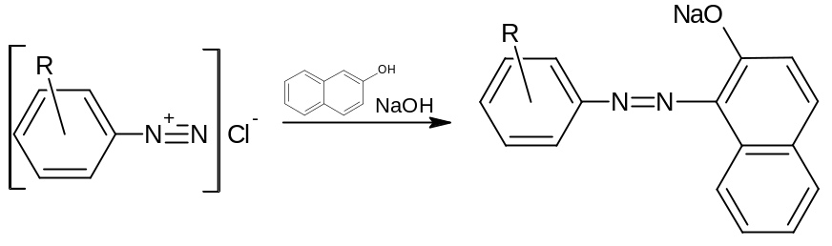
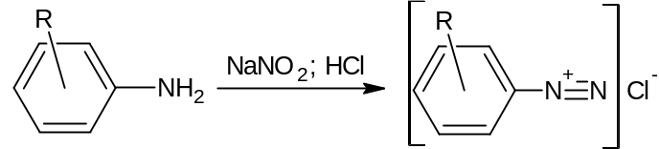
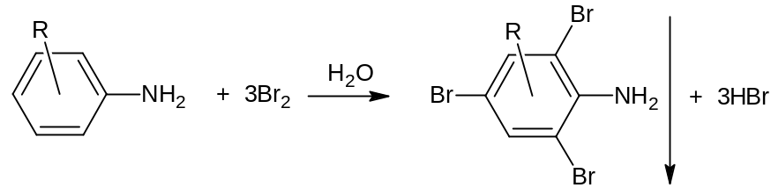
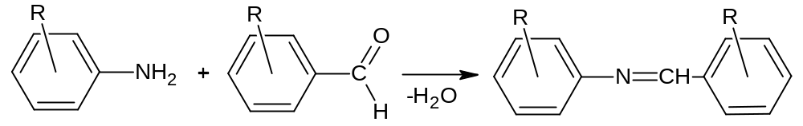
Reactions of nitration and nitrosation. They are used quite rarely, for example, to identify phenobarbital, phenacetin, dicaine, although these drugs are almost never used in medical practice.
Diazotization and azo coupling reactions. These reactions are used to open primary amines. The diazotized amine combines with beta-naphthol, giving a characteristic red or orange color.
Halogenation reactions. Used to open aliphatic double bonds - when bromine water is added, bromine is added to the double bond and the solution becomes colorless. A characteristic reaction of aniline and phenol - when they are treated with bromine water, a tribromo derivative is formed, which precipitates.
Condensation reactions of carbonyl compounds. The reaction consists in the condensation of aldehydes and ketones with primary amines, hydroxylamine, hydrazines and semicarbazide :

Slide 13
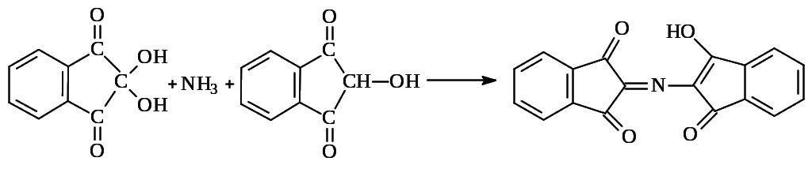
Oxidative condensation reactions.
The process of oxidative cleavage and the formation of azomethine dye underlies the ninhydrin reaction. This reaction is widely used for the discovery and photocolorimetric determination of α- and β-amino acids, in the presence of which an intense dark blue color appears. It is due to the formation of a substituted salt of diketohydrindylidene diketohydramine, a condensation product of excess ninhydrin and reduced ninhydrin with ammonia, released during the oxidation of the tested amino acid:

Slide 14
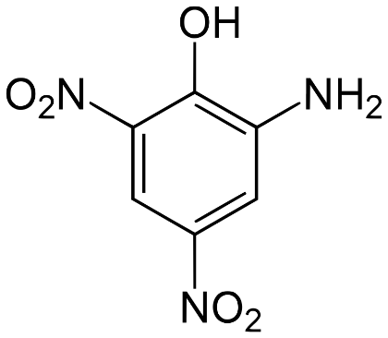
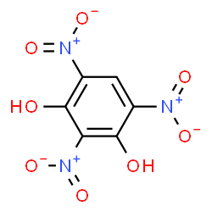
Identification of organic bases and their salts.
This group of methods is most often used in ready-made forms, especially in the study of solutions..
So, salts of organic amines, when alkalis are added, form a precipitate of a base (for example, a solution of papaverine hydrochloride) and vice versa, salts of organic acids, when a mineral acid is added, precipitate an organic compound (for example, sodium salicylate).
To identify organic bases and their salts, the so-called precipitation reagents are widely used. More than 200 precipitation reagents are known, which form water-insoluble simple or complex salts with organic compounds.
An example is:
Scheibler reagent - phosphorowolframic acid (H₃PO₄•12WO₃);
Picric acid (HO-C₆H₂-(NO₂)₃);
Styphnic acid;
Picramic acid.
All these reagents are used for the precipitation of organic bases (for example, nitroxoline).

Slide 15
General requirements for reactions that are used in tests for acceptable and unacceptable impurities:
  Sensitivity;
  Specificity;
  Reproducibility of the reaction used.
The results of reactions occurring with the formation of colored products are observed in reflected light on a dull white background, and white precipitates in the form of turbidity and opalescence are observed in light on a black background.

Slide 16
Purity tests (presence of impurities)
Reaction to chlorides.
Definition based on reaction:
Сl⁻ + Ag ⁺ → AgCl ↓ (White curdled sediment).
2. Reaction to sulfates.
Definition based on reaction:
Вa²⁺ + SO₄²⁺ → BaSO₄ ↓ (white precipitate).
3. Reactions to calcium salts.
Solutions of calcium salts with solutions of ammonium oxalate give a white finely crystalline precipitate or whitish turbidity, which disappears from the application of hydrochloric or nitric acid:
Ca²⁺ + C₂O₄²⁻ → CaC₂O₄↓
CaC₂O₄ + 2HC1 → CaCl₂ + H₂C₂O₄
4. Reactions to iron salts.
Solutions of 2+ and 3+ iron salts, depending on the concentration, give brown-red or yellow solutions of ferrylsulfosalicylate complexes with a solution of sulfosalicylic acid in an ammonia medium:
  [Fe (COO⁻) ONS₆H₃SO] + PH = 0.5 - 2.0 (purple color);
  [Fe (COO⁻) OH (C₆H₃SO)₂] + pH = 7 (red);
  [Fe (COO⁻) (O ⁻) (C₆H₃SO)₂] + pH = 8 - 12 (yellow).

Slide 17
5. Reactions to zinc salts.
The test is carried out with potassium ferrocyanide (potassium ferrocyanide) in hydrochloric acid medium:
3Zn²⁺ + 2K ⁺ + 2[Fe(CN)₆] ⁴⁻ → K₂Zn₃[Fe(CN)₆]₂ ↓
A white precipitate is formed, insoluble in diluted mineral acids, but soluble in alkalis.
6. Reactions to salts of heavy metals.
Heavy metals include metals with a density greater than 5. When determining them, the SPhU recommends discovering lead. Solutions of lead salts, depending on the concentration, give a black precipitate with a solution of sodium sulfide or a brown color of the solution:
Pb²⁺ + S²⁻ → PbS↓
In organic compounds, lead, as well as calcium and iron, is determined after burning the preparation in the presence of concentrated sulfuric acid, followed by calcination. And then this impurity is determined in the ash residue (heavy metals).

