Slide 1
Lecture 4
Chemical methods of quantitative analysis.

Slide 2
General concepts
Analytical signal - the average value of the results of measuring a physical quantity in the final stage of the analysis, functionally related to the content (concentration) of the determined component. Analytical signal - background signal and useful analytical signal.

Slide 3
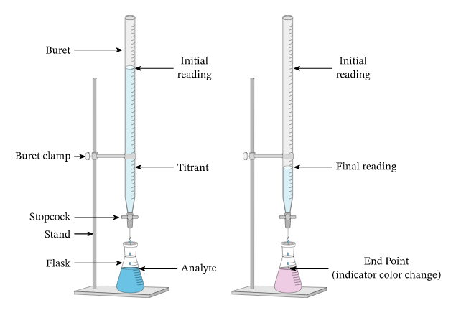

Slide 4
Classification of analysis methods
Chemical methods - based on the use of a chemical reaction.
  Titrimetric methods are methods based on measuring the amount of a reagent consumed for a complete reaction with an analyte.
  Gravimetry is a set of quantitative analysis methods based on measuring the mass of a substance or its constituents, isolated in pure form or in the form of compounds of precisely known composition.
Electrochemical methods - based on measuring the signal (potential, current, resistance, etc.) as a result of the interaction of the analyzed substance with electric current on the surface of the electrodes or in the near-electrode space.
Spectral methods of analysis - methods based on measuring the signal as a result of the interaction of the analyzed substance with electromagnetic radiation of a certain range.

Slide 5
Classification of analysis methods
Chromatographic methods - hybrid methods of analysis based on the separation of analytes with subsequent detection of separated compounds.
Electrophoresis is a separation method based on the electrokinetic phenomenon of the movement of particles of a dispersed phase (colloidal or protein solutions) in a liquid or gaseous medium under the action of an external electric field, followed by detection.
Biological methods of analysis are based on the use of living organisms as indicators for the formation of an analytical signal. Protein-binding methods - methods based on the measurement of a signal resulting from the interaction of an analyte with biological polymers.
Mass spectrometry is a method for studying analytes, based on determining the ratio of mass to charge of ions formed during the ionization of sample components.
Thermal methods of analysis - a group of physical methods based on the study of the results of the interaction of a substance with a change in temperature (calorimetry, thermography, thermogravimetry).

Slide 6
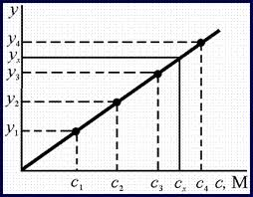


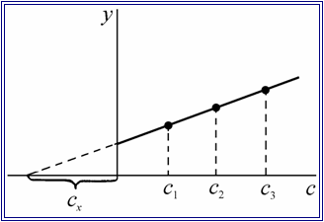
Methods for calculating the content of the analyte
Calibration curve method.
  External standard method.
  Internal standard method.
Standards method (method of one or two standards).
Additive method.

Slide 7
Classification of titrimetric methods of analysis
By type of chemical reaction:
  Acid-base titration (protolytic reactions).
  Complexometric titration (formation of soluble complex compounds).
  Redox titration (Redox reactions).
  Precipitation titration (precipitation reactions).
By way of execution:
  Direct (titrant is added directly to the analyte).
  Back (an excess of titrant-1 is added to the analyte, then the excess of titrant-1 is titrated with titrant-2).
  Substituent titration (with the participation of an auxiliary reagent, a product is obtained that is titrated).
  Indirect (the analyte reacts with the reagent, and the reagent is titrated).

Slide 8
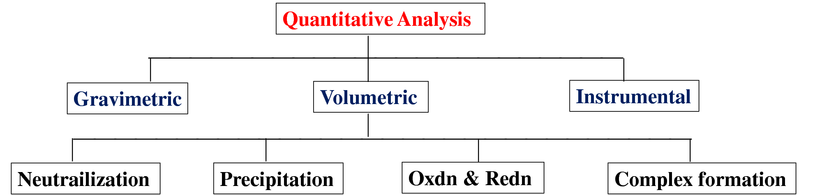
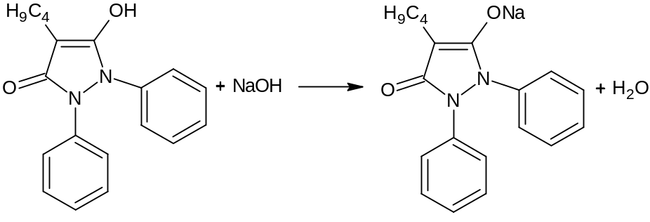
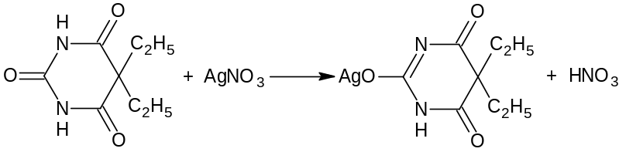
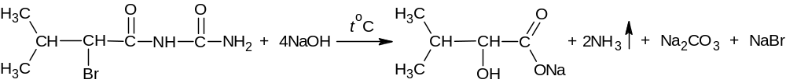
Diredct titration
By way of execution
Substitution titration
HNO₃ + NaOH → NaNO₃ + H₂O
Back titration
NaBr + AgNO₃ → AgBr↓ + NaNO₃
AgNO₃ + NH₄SCN → AgSCN↓ + NH₄NO₃
3NH₄SCN + NH₄Fe(SO₄)₂ → Fe(SCN)₃ + 2(NH₄)₂SO₄

Slide 9
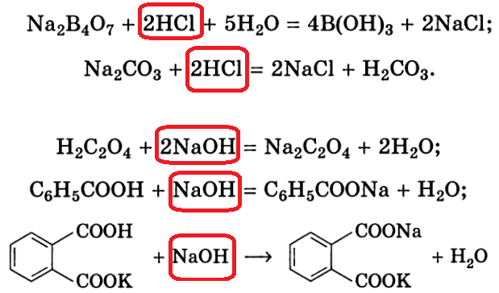
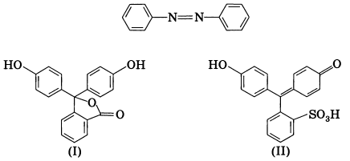
Acid-base titration (in aqueous, mixed and non-aqueous media)
Titrants :
Acid (HCl).
Alkalis (NaOH).
Standardization of titrants:
Indicators - based on azo dyes, sulfophthaleins or potentiometric equivalence pointing
9

Slide 10
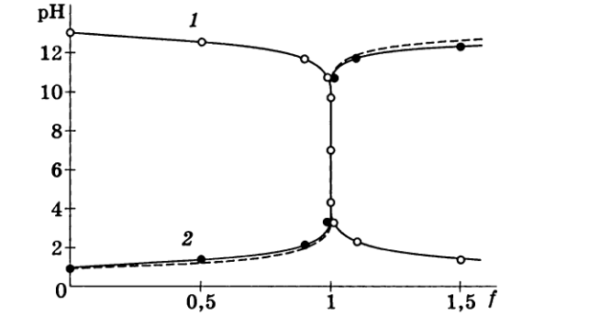
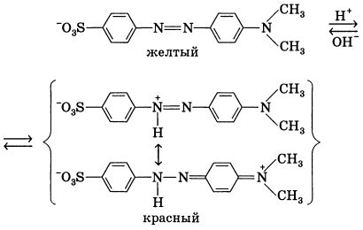
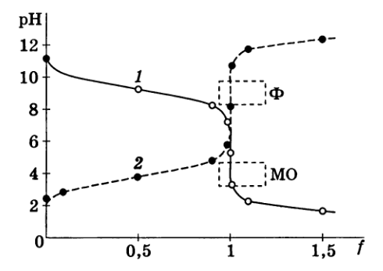
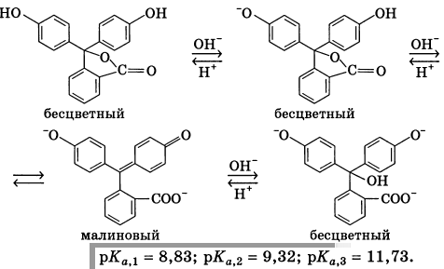
Acid-base titration indicators Titration curves (aqueous media)
yellow
red
colorless
colorless
crimson
colorless

Slide 11
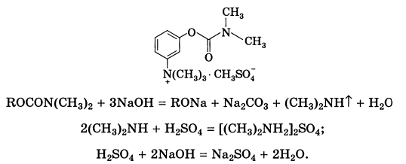
Acid-base titration (in aqueous medium)
Determination of nitrogen by the Kjeldahl method
Steps: mineralization (total or partial) or hydrolysis, stripping of ammonia (or alkylamines) with steam, absorption of ammonia with acid, titration of unreacted acid.

Slide 12
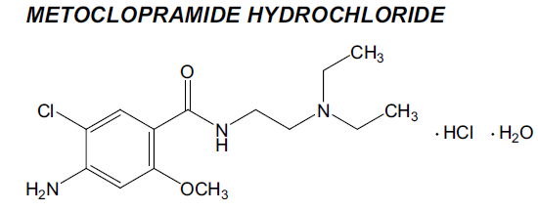
Acid-base titration (in mixed media)
Used when the drug is poorly soluble in water (an organic solvent is used to improve the dissolution of the drug) or aqueous solutions of the drug show weak acidic or basic properties to determine the end point of the titration (ethanol or acetone is used to enhance the acidic or basic properties).
For example, metoclopramide (a weak conjugate acid) is titrated with 0.1M NaOH in a 90:10 water-ethanol medium. The resulting base of metoclopramide is also soluble in ethanol and does not interfere with precise potentiometric setting of the end point of the titration.

Slide 13
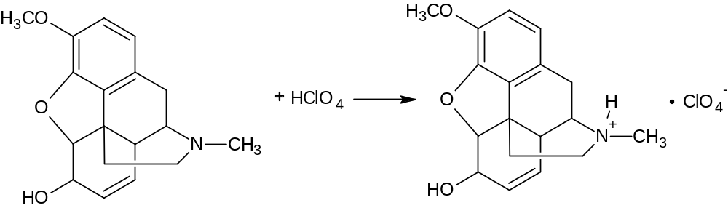
Acid-base titration (in non-aqueous media)
Solvent Selection Criteria :
For bases, an acid is selected (anhydrous acetic, formic, etc.), for acids, a solvent with good proton acceptor properties.
Low value of autoprotolysis constant.
High dielectric value.
Good dissolving power.
No toxicity (or low toxicity), the possibility of obtaining a pure reagent.
For example, titration of a weak acid :

Slide 14
Complexometric titration
A group of titrimetric methods based on the reactions of formation of soluble complex compounds.
Trilonometry (polydentate complexes - Trilon B or ethylenediaminetetraacetate - EDTA), indicator - metallochromic compound:

Slide 15
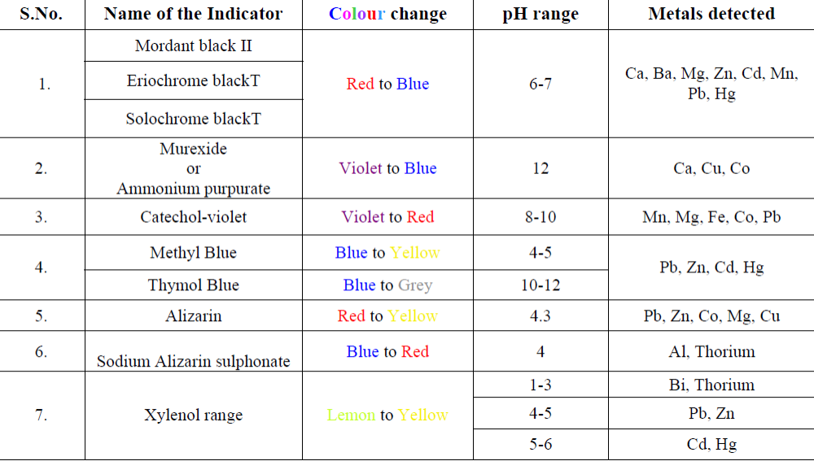
Metallochromic/ Complexometric indicators

Slide 16
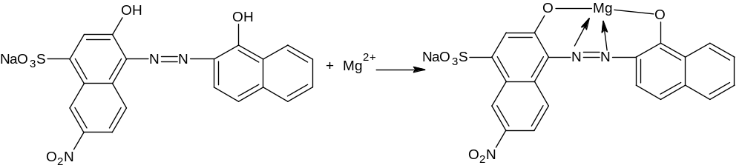
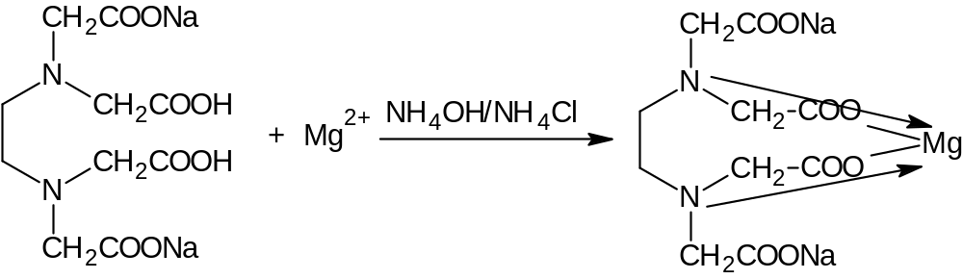
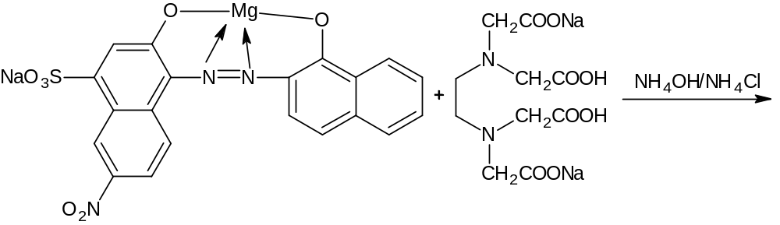
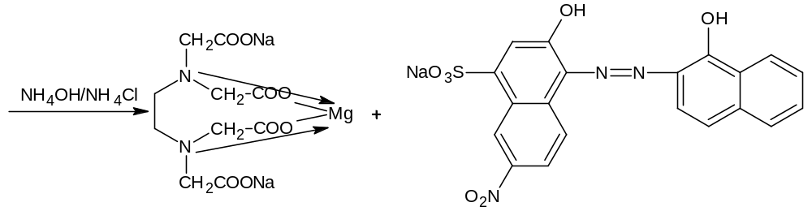

Slide 17
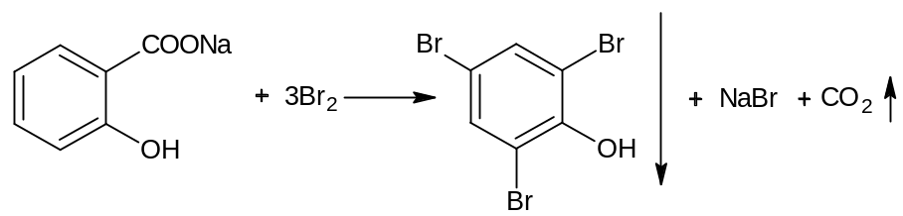
Redox Titration
A group of titrimetric methods based on the use of Redox reactions.
Iodometric titration. Back titration. Indicator - starch
2CCl₃CH(OH)₂ + 2I₂ + 3Na₂CO₃ → 2CCl₃COONa + 4NaI + 3H₂O + 3CO₂↑
I₂ + 2Na₂S₂O₃ → 2NaI + Na₂S₄O₆
Bromatometry. Back titration. Indicator - starch
KBrO₃ + 5KBr + 3H₂SO₄ → 3Br₂ + 3K₂SO₄ + 3H₂O
2KI + Br₂ → I₂ + 2KBr
I₂ + 2Na₂S₂O₃ → 2NaI + Na₂S₄O₆

Slide 18
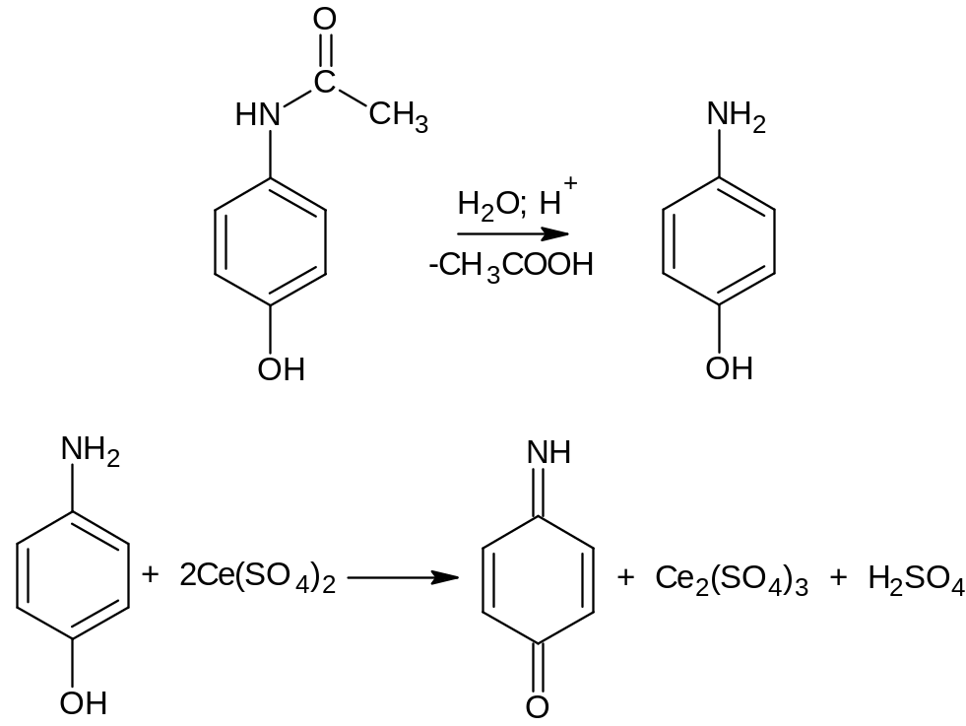
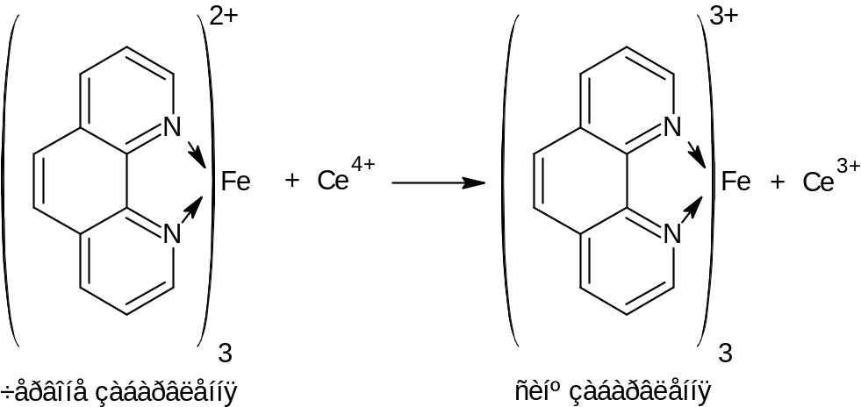
Cerimetry. titrate with cerium (IV) sulfate, indicator - feroin
Red color Blue color

Slide 19
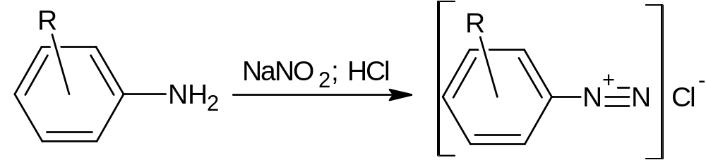
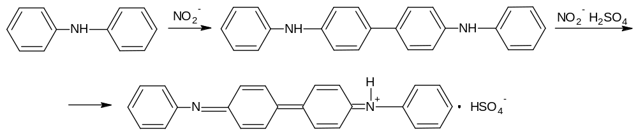
Nitritometry. Direct titration. Indicator – dipfenilamine

Slide 20
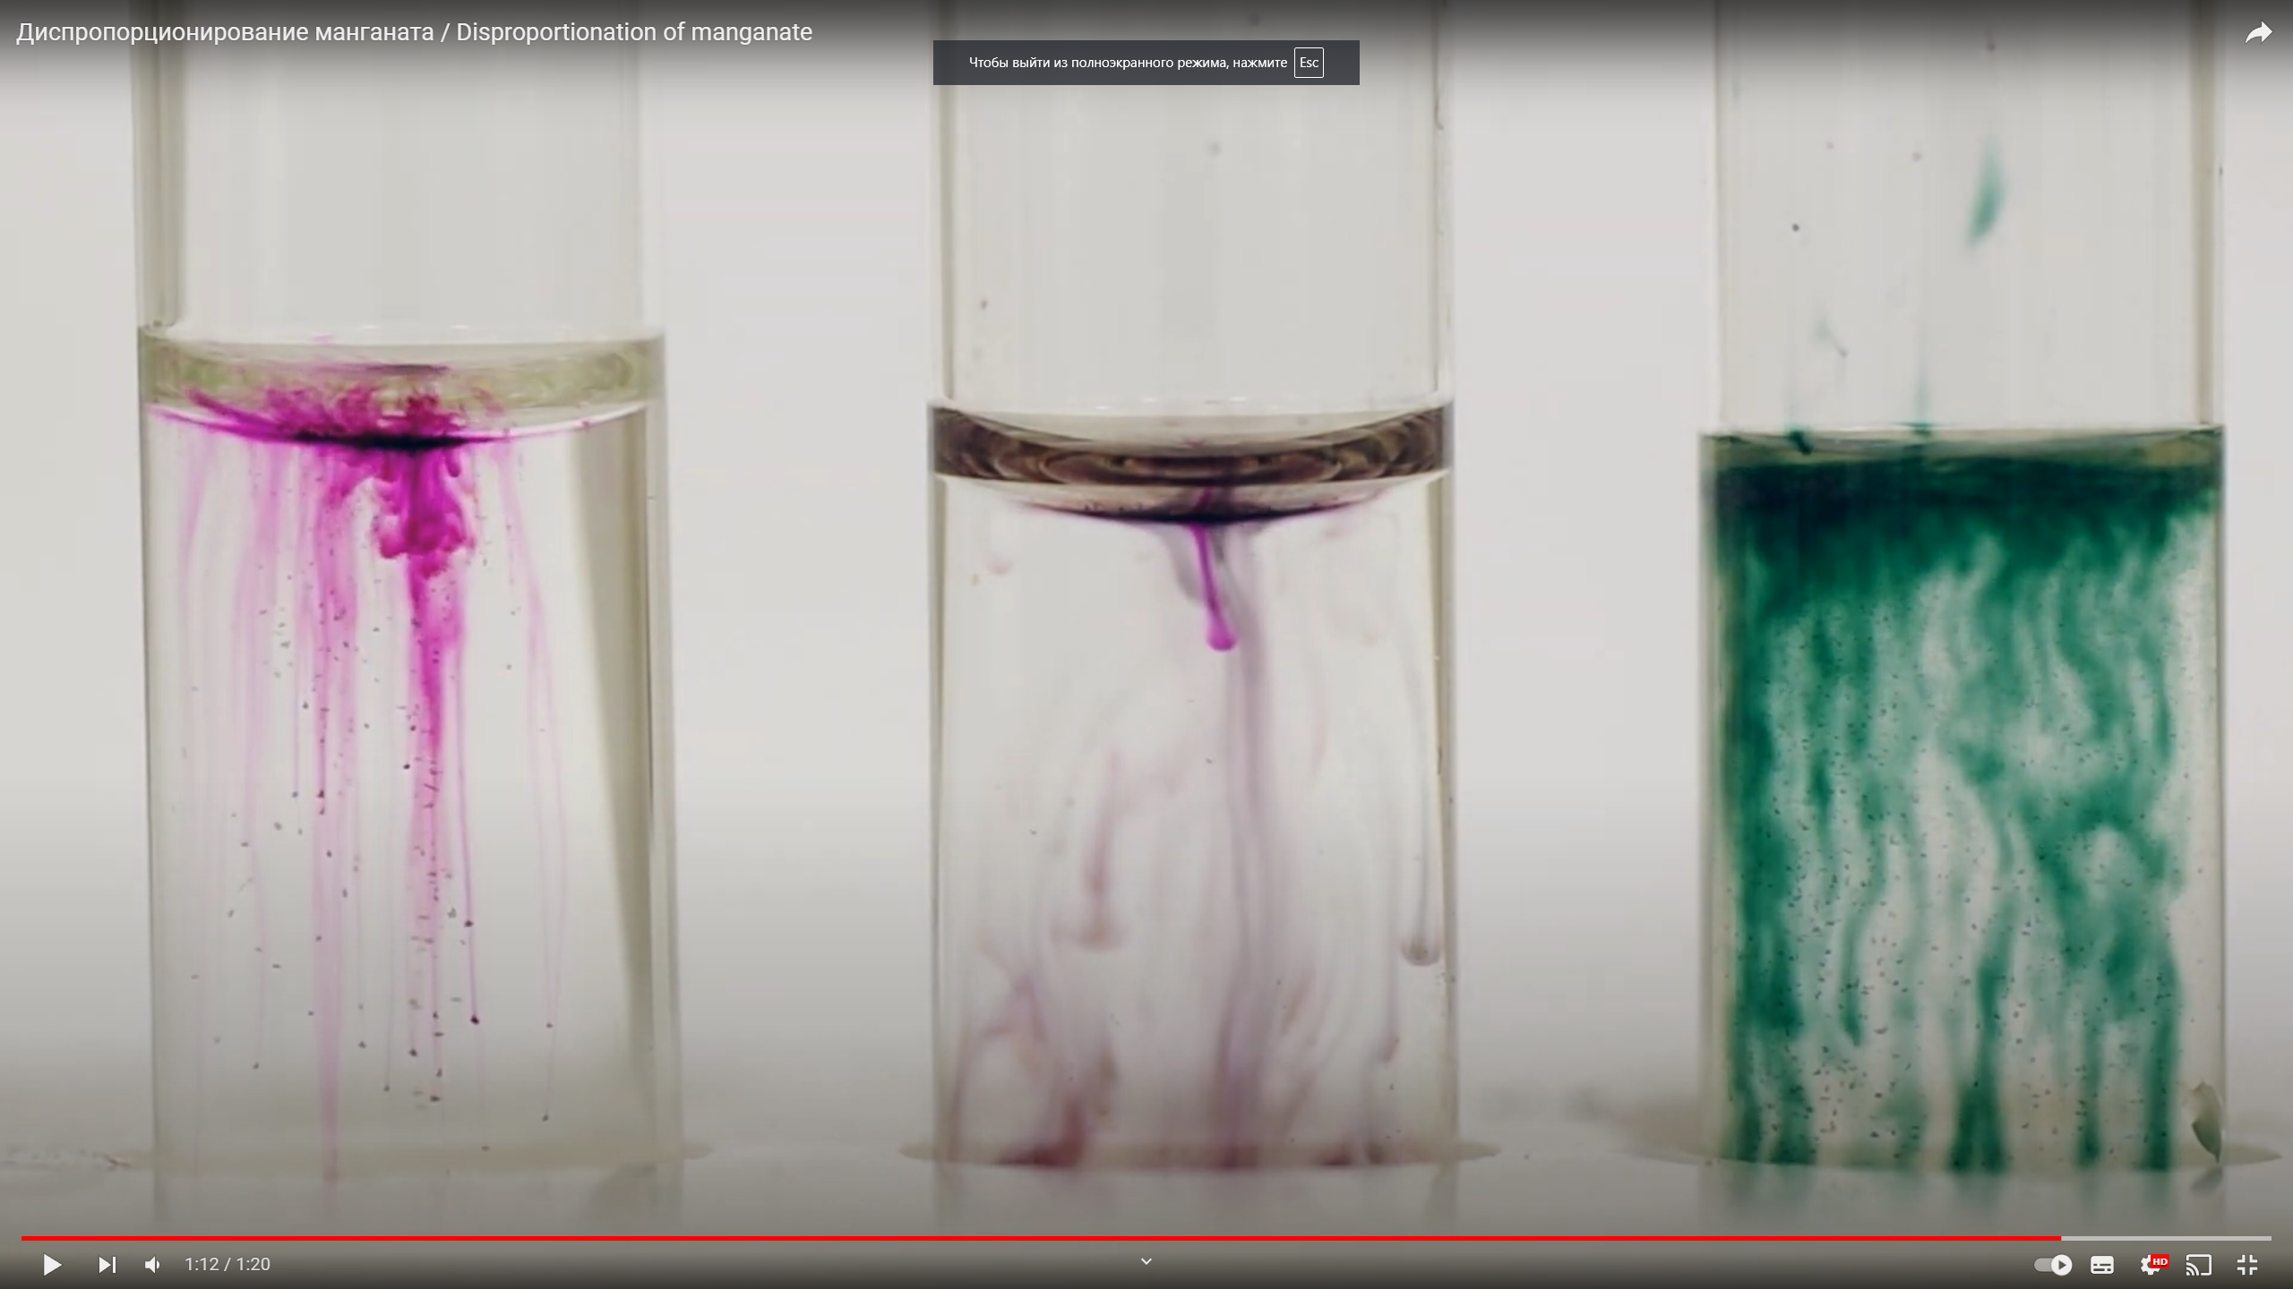
Permangonatometry. Direct titration. Indicator – without indicator
5NO₂– + 2MnO₄– + 6H⁺ → 5NO₃– + 2Mn²⁺ + 3H₂O
MnO₄–
pH‹7
pH=7
pH›7
Mn²⁺
MnO₂
MnO₄^{2–}

Slide 21





Calculation formulas in titrimetric analysis
Method of individual weights:
Pipetting method:
$$\%= \frac{VT × TT/O×Cf ×100}{m}$$
$$\%= \frac{VT × TT/O×Cf ×100 ×Vм.к.}{m ×Vп}$$
(direct and substitution titration)
(direct and substitution titration)
$$\%= \frac{(VT1−VT2) × TT/O×Cf ×100}{m}$$
$$\%= \frac{\left(VT1−VT2\right)× TT/O×Cf ×100×Vм.к}{m ×Vп}$$
(back titration)
(back titration)
Titer of the titrant by the analyte
$$TT/O= \frac{Em ×СN}{1000}$$
Em – equivalent mass of test substance; C_{N} – normal titrant concentration.

Slide 22
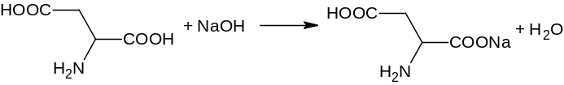

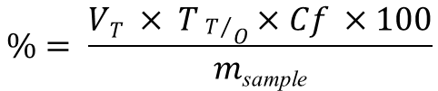



Calculate the mass of a sample of glutamic acid (M.m. = 147.13), if 20.06 ml of 0.1 N sodium hydroxide was used for titration by direct alkalimetry, Cf = 1.0000. Percentage of active substance - 99.1 %.
Given :
М.м. = 147,13
V_{(titrant)} = 20,06 ml
C_{N} = 0,1N
КП = 1,0000
% = 99,1%
Solution :
1. Calculation formula:
$$\%= \frac{VT × TT/O×Cf ×100}{m\text{sample}}$$
2. Reaction equation :
3. Calculation of the titer of the titrant for the analyte :
$$TT/O= \frac{Em ×СN}{1000}$$
$$TT/O= \frac{147,13 ×0,1}{1000}=0,0147 g/ml$$
To find :
m _{sample} - ?
4. Calculation of the mass of the active substance :
$$m= \frac{VT ×КП ×TT/O ×100}{\%}$$
$$m= \frac{20,06 ×1,0000 ×0,0147 ×100}{99,1}$$
m = 0,297 g

Slide 23
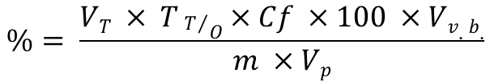
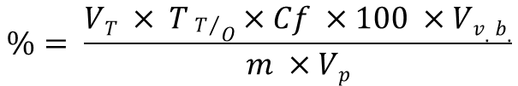
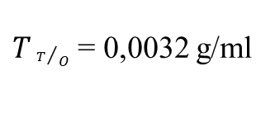


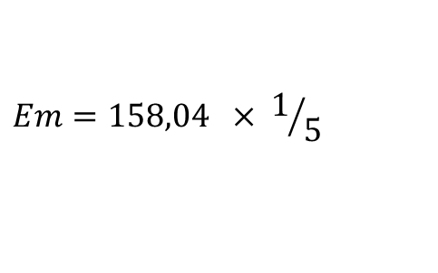


Calculate the mass of a sample of potassium permanganate (M.m. = 158.04), if 23.68 ml of 0.1N sodium thiosulfate (Cf = 1.0000) was used for titration using back iodometry; percentage in the substance - 99.8%. The volume of the volumetric flask is 100 ml, the volume of the pipette is 25 ml.
Given :
М.м. = 158,04
V_{(titrant)} = 23,68 ml
C_{N} = 0,1Н
Cf = 1,0000
% = 99,8%
V_{v.b.} = 100 ml
V_{p} = 25 ml
Solution :
1. Calculation formula :
$$\%= \frac{VT × TT/O×Cf ×100 ×Vv.b.}{m ×Vp}$$
2. Reaction equation :
KMnO₄ + Na₂S₂O₃ + H₂SO₄ → MnSO₄ + Na₂SO₄ + K₂SO₄ + H₂O
MnO₄⁻ + 8H⁺ + 5e → Mn²⁺ + 4H₂O
3. Calculation of the titer of the titrant for the analyte :
$$TT/O= \frac{Em ×СN}{1000}$$
$$Em=М.м. ×f$$
$$Em=158,04 × 1/5$$
Em = 31,61
To find :
m _{sample} - ?
$$TT/O= \frac{31,61 ×0,1}{1000}$$
$TT/O$ = 0,0032 g/ml
4. Calculation of the mass of the active substance :
$$\%= \frac{VT × TT/O×Cf ×100 ×Vv.b.}{m ×Vp}$$
$$99,8= \frac{23,68 ×0,0032×1,0000 ×100 ×100.}{m ×25}$$
m = 0,3037 g

