Slide 1
RADIATION HYGIENE, RADIATION PROTECTION IN MEDICAL INSTITUTIONS.
METHODS AND MEANS OF RADIATION CONTROL – COMPUTATIONAL AND INSTRUMENTAL
ODESSA NATIONAL MEDICAL UNIVERSITY
DEPARTMENT OF HYGIENE AND MEDICAL ECOLOGY

Slide 2
RADIATION HYGIENE INCLUDES
dosimetrical
(investigation of radiation sources and levels)
Radio-biologic directions (experimental and epidemiological researches of ionising radiation influence upon health),
theory and methodology of hygienic certification of admissible levels of irradiation
Sanitary organisation direction making ways for antiradiation protection.

Slide 3
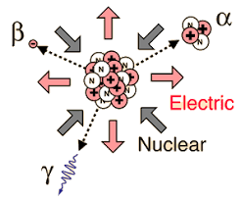
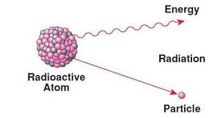
RADIOACTIVITY
spontaneous transformation of elements nuclei in other ones with formation of ionising radiation.

Slide 4
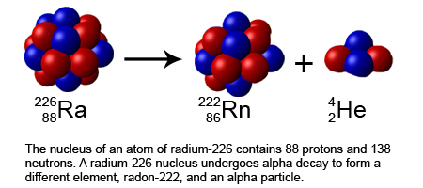
There are the following kinds of radioactive decay:
α-decay is very typical for natural radioactive elements with high numbers (they have low link energy):
α-particles are helium nuclei.

Slide 5
α-decay
Their energy is spent on exaltation and ionising of atoms in the interaction with matter mainly (but if α-particles has penetrated in nucleus it’s able to do nuclear reaction).
Length of α-particles track depends on their initial energy, number, atom mass and substance density.
Linear density (quantity of ion pair on the unit of track) of ionisation depends on the particles energy but volume density of ionisation depends also on a depth of their penetrating.
Penetrative capacity of α-particles is low (for α-particles with energy 4MeV length of track in air is 2.5 cm, in biologic tissue — 31 μ, in aluminum — 16 μ) because they have big mass and charge, but indices of linear and volume density of ionisation are high.

Slide 6
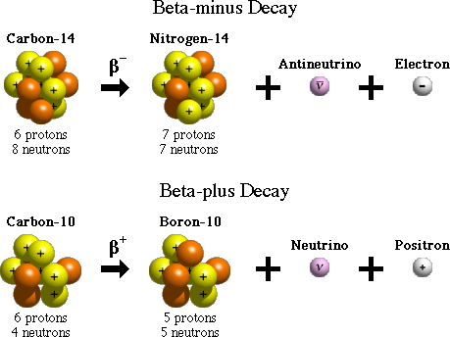
Electronic β-decay is typical for natural and artificial elements:

Slide 7
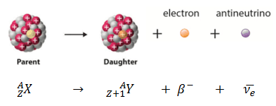
There are an elastic and inelastic interactions of
β-radiation with substance.
Inelastic interaction are inelastic dispersion, atom ionising, nuclei exaltation, brake radiation.
Length of β-particles track formula is: for air — R = 400 × Eβ; for light materials (aluminum, glass) — Rβ = 0.2 Eβ, if E < 0.5 MeV.
For β-particles volume density of ionising is in 1,000 times less than for α-particles.
For β-particles with energy 4 MeV the length of track is 17.8 m in air, 2.6 cm — in water, 9.8 mm — in aluminum.

Slide 8
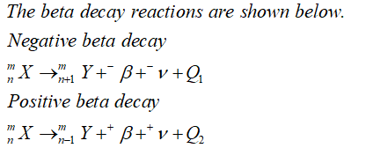
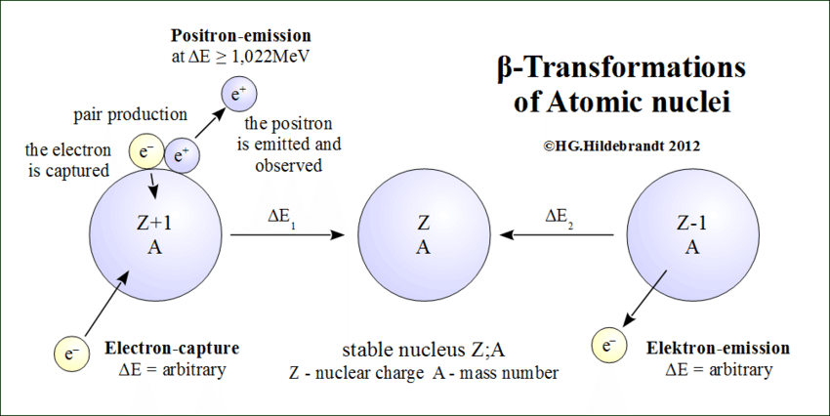
Positronic β-decay occurs for some artificial isotopes:

Slide 9
The radioactive decay law
quantity of isotope atoms transformed in 1 s is proportional to their general quantity or in equal time intervals there takes place the nuclear transformation of equal parts of active isotope atoms

Slide 10
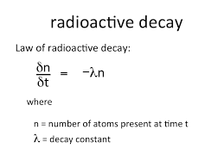
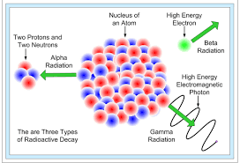
The radioactive decay law
after integralization of the equation we have: λ =0.693/Τ,
where T — a half-life period (time for decaying of an half of all isotope atoms) and (λ — is the constant of life.

Slide 11
ISOTOPES ARE DIVIDED
short-living (period of half-life is calculated in seconds, minutes, hours, days)
long-living (from some month to billions of years).

Slide 12
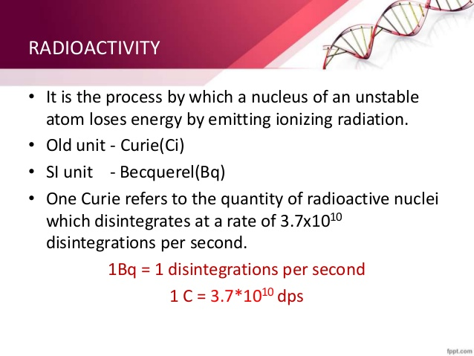

Slide 13
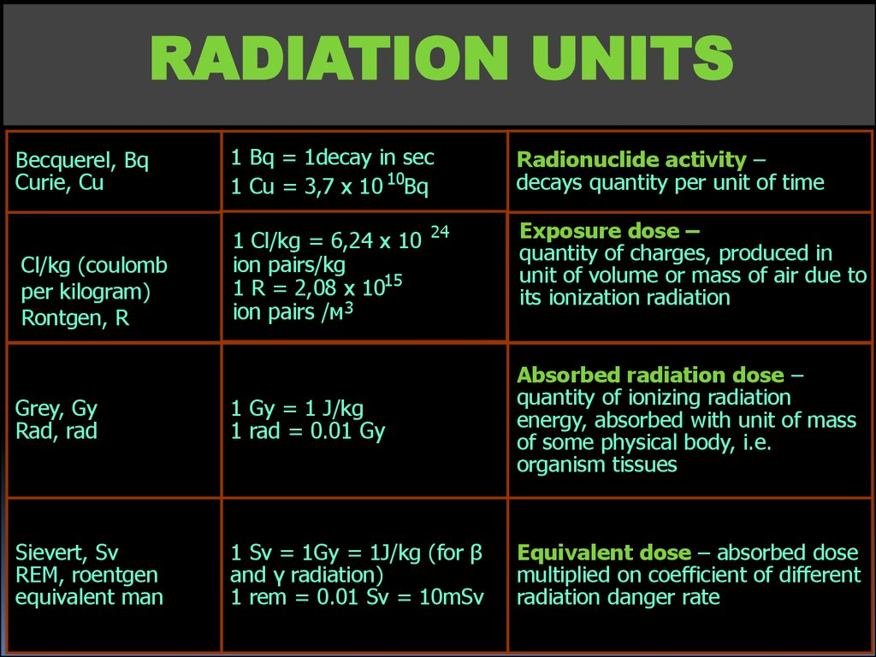
For characterizing of ionising radiation interaction with substances it’s being used exponential, absorbed, effective and equivalent doses.
Effective dose characterizes the biologic effect for all human body and its organs from influence of ionising radiation. The units are the same as for
equivalent dose.

Slide 14
Biologic action of ionising radiation.
Interaction of ionising radiation with biologic tissue has three stages:
Physical — absorption of ionising radiation energy in described interactions. It takes only 1.10-19 s.
It’s able to destroy cells if energy of radiation is
enough high. Intracellular water absorbed 50% of energy and organelles and biomolecules take 50% too.
2. Physical-chemical — production of active
radicals. The main process is water radiolysis, the
process takes about 10-11 s.
3. Biochemical — interactions of primary and
secondary radicals with biosubstances. The most
sensitive process is oxidative phosphorilation; the
enzyme dysfunction expresses in damage of ATP
production system. Protein molecules and dezoxiribonucleinic complexes (DNA in complexes with
proteins, RNA and enzymes).

Slide 15
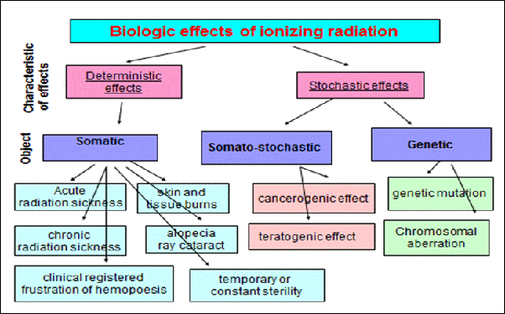
The biologic effects of ionising radiation is divided into three groups: somatic, somato-stochastic and genetic

Slide 16
For calculation of cancer risk they use laws of “dose-effect” interaction in the low doses.
There are simple statistic models (linear, square, linear-square.
The preference is given back to the last.
The question about threshold level for cancerogenic effect is unclear now
If they are found, all the system of hygienic reglaments should be changed.

Slide 17
The principal tasks of radiation safety system are:
1) to prevent the determined effects by limiting
irradiation dose under threshold values;
2) to use all maintenance and measures to increasing of probability of stochastic consequences taking into ac-
count social and economical vectors

Slide 18
Principles of radiation safety:
1) the principle of the norm setting not to exceed an established dosage limit;
2) the principle of evidence practice (exclusion of any ungrounded, additional to prognosed, irradiation);
3) the principle of optimization (lowering of radiation dose to a possible low level).

Slide 19
The critic group is the biggest by quantity group of the category B persons with uniform life condition, age, gender or other factors if it had a maximal level of radiation influence in the limits of institution, its sanitaric-guarding zone and observation zone.
Sanitary-guarding zone is the territory around
institution or the source of radiation contamination
where it is a risk of highing of admissible levels of irradiation (in the state of normal work of institution).
Observation zone — is the territory where there is a possibility of irradiation due to established levels.

Slide 20
The critical organs group:
I – gonades, marrow
II – lens, endocrinic, muscular, parenchimatous, lymphoid tissue
III – bones, fibrous connective tissues

Slide 21
Categories of irradiated person:
A: people working with radiation sources (constantly or temporary): physicists, radiologists, workers of atomic power station, roentgenologists, etc.
B: people living or working in condition with
possibility of irradiation (near atomic power station, in geochemical provinces with a high level of radiation background, surgeons, nurses of radiological department in hospital, etc).
C: other population.

Slide 22
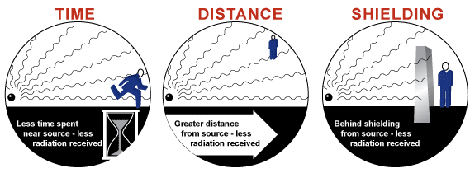
Radiation safety

Slide 23
Radiation safety
“Protection by time” has been used for work with low active sources. For protection they use manipulators and other distension tool, system of automatic control and operating include multi-media technology. A principle of protection by shielding is used in combination with other principles. The best material for protection from X-rays and γ-rays is lead and steal. For protection from radiation they use water, paraffin, concrete and other materials containing a lot of hydrogenous atoms. For shields absorbing β-radiation they use light material organic glass,
plastic, aluminum, but for very power β-sources they should use additional shields for protection from brake radiation.

Slide 24
Open sources of ionising radiation are risky for radioactive contamination of surrounding. The radionuclides pass to the environment as the gases (222Rn, 31H, 89Cr, 133Xe, etc).
The radiation protection for work with open sources is presented by principles of protection by quantity, time, distance, shielding, as well as isolation of technological processes; optimization of sanitary-technical equipment; using of individual protective means; personal hygiene of staff; dosimetric control; decontamination.

Slide 25
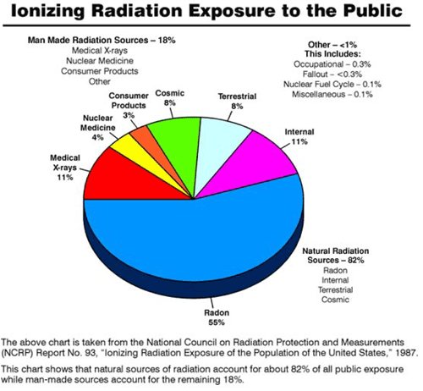
NATIONAL RADIATION BACKGROUND

Slide 26
Works of I class are provided only in a separate
building with an isolate entrance. All buildings are
divided into 3 zones:
I — “hot” (“dirty”) — for placing equipment of
chambers (boxes), communication and other main sources of radioactive pollution.
II — periodically served repairing — transport
rooms.
III — rooms for personnel: operating rooms, etc.
Works of II class should be provided in isolated
departments, III class — in special rooms. The air
changes rate in the second class rooms is 5, and in
the third class — 3.

Slide 27
Laboratories of I–II classes have 2 sewage systems: household-fecal and special. If daily volume of liquid radioactive waste does not exceed 200 1 so these are collected in special containers for future transfer to centralized special burial place. Internal decoration of premises for III class work include: painting walls with oil paint by 2 m from floor, and other surfaces — with glue oil. The floors should be covered with linoleum or plastic. Corners should be rounded, covering of floor — rised to walls without cracks. Using of soft furniture is forbidden. Water supply is provided from independent inputs. The tops should have mixers and turn on with pedal or elbow device.

Slide 28
Individual protective equipment can be for everyday using or for short-time using. All equipment
should be suitable for decontamination, be steady to chemical agents.
The important direction of radiation safety is “radiation aseptic”. It’s a prevention of contamination of worker’s overall and skin. Decontamination — is the complex of preventive measures for decreasing of radiation pollution of environmental objects.
They use physical (mechanical means, dissolving, using of electro-magnetic fields, ultra-sonic,etc.) and chemical (complexones, detergents, mineral acids and oxidants). For control of efficiency of desactivation measures and radiation loading on personal (population) they use dosimetry.

Slide 29
Sanitary dosimetric control is an important element of radiation safety. Radiometry is measuring of radioactivity in food-stuffs, building materials, industrial raw materials and dosimetry is the sanitary control of irradiation of personnel.
The main tasks of dosimetric service are: control of power of γ- and neutron pencils in industrial premises; control of radioactive gases and aerosols in the working zone air; dosimetric control of all work with radionuclides; individual dosimetric control of external radiation; individual control on the contents of radionuclides in the organism or separate critical body; training of personnel; control of radionuclide emission into the atmosphere; keeping of special documentation (operative register of the duty team).
Principles of dosimetry equipment are based on the processes of ionisation and scintillation; they use photochemical (and photographic); thermoelectrical and biological dosimetry.

Slide 30
Modern classification of radiation disasters
I — without radiation loading to personnel (population) or contamination;
II — personnel (population) took external irradiation higher than DL;
III — contamination of environment;
IV — external and internal irradiation of the per-
sonnel (population);
V — contamination of environment and external and internal irradiation of the personnel (population).

