Slide 1
Definition
Drug Safety (Pharmacovigilance) is the practice of receiving, reviewing, assessing and reporting adverse events from drugs produced and administer during the different phases of clinical trails and post-marketed studies.
Major aims of pharmacovigilance are:
1. Early detection of unknown adverse reactions and interactions
2. Detection of increases in frequency of (known) adverse reactions
3. Identification of risk factors and possible mechanisms underlying adverse reactions
4. Estimation of quantitative aspects of benefit/risk analysis and dissemination of information needed to improve drug prescribing and regulation.
The ultimate goals of pharmacovigilance are:
• the rational and safe use of medical drugs
• the assessment and communication of the risks and benefits of drugs on the market
• educating and informing of patients.

Slide 2
A side effect is ‘any unintended effect of a pharmaceutical product occurring at doses normally used in man, which is related to the pharmacological proprieties of the drug’. Essential elements in this definition are the pharmacological nature of the effect, that the phenomenon is unintended, and that there is no overt overdose.
An adverse reaction is ‘a response to a medicine which is noxious and unintended, and which occurs at doses normally used in man’. In this description it is of importance that it concerns the response of a patient, in which individual factors may play an important role, and that the phenomenon is noxious (an unexpected therapeutic response, for example, may be a side effect but not an adverse reaction).
An unexpected adverse reaction is ‘an adverse reaction, the nature or severity of which is not consistent with domestic labelling or market authorisation, or expected from characteristics of the drug’. Here the predominant element is that the phenomenon is unknown.
A signal refers to ‘reported information on a possible causal relationship between an adverse event and a drug, the relationship being unknown or incompletely documented previously’. Usually more than a single report is required to generate a signal, depending upon the seriousness of the event and the quality of the information.

Slide 3
Serious adverse events can be defined as those that:
a. are life-threatening or fatal
b. cause or prolong hospital admission
c. cause persistent incapacity or disability; or
d. concern misuse or dependence.
Type A effects (‘drug actions’) are those which are due to (exaggerated) pharmacological effects. Type A effects tend to be fairly common, dose related (i.e. more frequent or severe with higher doses) and may often be avoided by using doses which are appropriate to the individual patient. Such effects can usually be reproduced and studied experimentally and are often already identified before marketing.
Interactions between drugs, especially pharmacokinetic interactions, may often be classified as Type A effects, although they are restricted to a defined sub-population of patients (i.e. the users of the interacting drug).
Type B effects (‘patient reactions’) characteristically occur in only a minority of patients and display little or no dose relationship. They are generally rare and unpredictable, and may be serious and are notoriously difficult to study. Type B effects are either immunological or non-immunological and occur only in patients, with - often unknown - predisposing conditions. Immunological reactions may range from rashes, anaphylaxis, vasculitis, inflammatory organ injury, to highly specific autoimmune syndromes. Also non-immunological Type B effects occur in a minority of predisposed, intolerant, patients, e.g. because of an inborn error of metabolism or acquired deficiency in a certain enzyme, resulting in an abnormal metabolic pathway or accumulation of a toxic metabolite. Examples are chloramphenicol aplastic anaemia and isoniazid hepatitis.
Type C effects refer to situations where the use of a drug, often for unknown reasons, increases the frequency of a ‘spontaneous’ disease. Type C effects may be both serious and common (and include malignant tumours) and may have pronounced effects on public health. Type C effects may be coincidental and often concern long term effects; there is often no suggestive time relationship and the connection may be very difficult to prove.

Slide 4
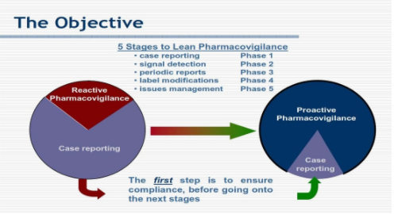

Slide 5
REPORTING OF ADVERSE DRUG REACTIONS
the major source of information in pharmacovigilance is a Spontaneous reporting - a regional or country-wide system for the reporting of suspected adverse drug reactions

Slide 6
case report in pharmacovigilance
A case report in pharmacovigilance can be defined as: A notification relating to a patient with an adverse medical event (or laboratory test abnormality) suspected to be induced by a medicine.
A case report should contain information on the following elements:
1. The patient: age, sex and brief medical history (when relevant). In some countries ethnic origin may need to be specified.
2. Adverse event: description (nature, localisation, severity, characteristics), results of investigations and tests, start date, course and outcome.
3. Suspected drug(s): name (brand or ingredient name + manufacturer), dose, route, start/stop dates, indication for use (with particular drugs, e.g. vaccines, a batch number is important).
4. All other drugs used (including self-medication): names, doses, routes, start/stop dates.
5. Risk factors (e.g. impaired renal function, previous exposure to suspected drug, previous allergies, social drug use).
6. Name and address of reporter (to be considered confidential and to be used only for data verification, completion and case follow-up).
Reporting should be as easy and cheap as possible. Special free-post or business reply reporting forms can be distributed throughout the target area to healthcare professionals at regular intervals (for example, four times a year).
Also telephone, fax and electronic mail or internet may be easy means of reporting where reliable technology is available and accessible.

Slide 7
Reporting by whom?
Professionals working in healthcare are the preferred source of information in pharmacovigilance, for example family practitioners, medical specialists and pharmacists. Dentists, midwives, nurses and other health workers may also administer or prescribe drugs and should report relevant experiences.
In addition pharmacists and nurses can play an important role in the stimulation of reporting and in the provision of additional information (for example, on co-medication and previous drug use).
Pharmaceutical manufacturers, being primarily responsible for the safety of their products, have to ensure that suspected adverse reactions to their products are reported to the competent authority. If adverse reactions are reported directly by patients to the national or local centre, it is useful to consider the possibility of communication with their physicians for additional information and data verification.

Slide 8
In the early stages of any pharmacovigilance system, reports on all suspected adverse reactions - known or not, serious or not - are welcome and useful, because it is necessary to create a notification culture in which the instinctive response to any suspected adverse drug reaction is to report it. Healthcare professionals need to learn how and what to notify, and the staff of the pharmacovigilance centre need to gain experience in assessment, coding and interpretation.
In established pharmacovigilance systems it is common practice to request the reporting of all suspected reactions, including minor ones for new drugs. For established drugs the reporting of serious or unusual suspected adverse reactions is of particular importance, whereas known and minor reactions are of less interest . If an increased frequency of a given reaction is suspected this is also a reason for reporting.
Although pharmacovigilance is primarily concerned with pharmaceutical medicines (including radiologic contrast media, vaccines and diagnostics), adverse reactions associated with drugs used in traditional medicine (e.g. herbal remedies) should also be considered. Special fields of interest are drug abuse and drug use in pregnancy (teratogenicity) and lactation.
In addition, the reporting of lack of efficacy and suspected pharmaceutical defects is recommended, especially when there is the possibility of manufacturing problems, counterfeit pharmaceuticals or of the development of resistance (e.g. antibiotics). Pharmacovigilance and poison control are closely related activities, since the problems encountered with accidental or intentional overdose may cast doubt on the safety of a medical drug.
Also, adverse reactions to cosmetics may need to be reported, especially when cosmetics contain obsolete or toxic ingredients (e.g. mercury compounds or corticoids in bleaching creams).

Slide 9
In many countries the reporting of adverse drug reactions is voluntary, but in an increasing number of countries some legal reporting obligations on healthcare professionals have been established (although a penalty is not usually associated with failure to report). In addition, in many countries it is mandatory for pharmaceutical companies to report suspected adverse drug reactions to the health authorities.

Slide 10
Under-reporting
Under-reporting is a common phenomenon in all countries. Correcting for under-reporting is difficult, however, because its extent is unknown and very variable. Even at established centres the reported proportion of serious reactions may not be more than 10%. Several of the countries participating for many years in the WHO Drug Monitoring Programme receive 200 or more adverse reactions per million inhabitants annually from about 10% of physicians. In many other countries, however, the reporting rates are much lower.
Under-reporting may delay signal detection and cause underestimation of the size of a problem. However, in signal detection not only the quantity but also the relevance of case reports and the quality of data are important.
There are also a number of more elusive issues which require attention. Sometimes healthcare professionals fear that the acknowledgement of adverse reactions may reflect negatively on their competence or put them at risk of litigation. Some are reluctant to report adverse reactions because of doubts regarding the causal role of the drug (although, of course, it is essential that suspected reactions are reported). Under-reporting is both a technical and a psychological issue. Clarity of criteria for reporting, simple procedures and good motivational practice are all influential in addressing the problem.

Slide 11
Defining medication errors
“any preventable event that may cause or lead to inappropriate medication use or patient harm while the medication is in the control of the health care professional, patient, or consumer.
Such events may be related to professional practice, health care products, procedures, and systems, including prescribing, order communication, product labelling, packaging, and nomenclature, compounding, dispensing, distribution, administration, education, monitoring, and use”

Slide 12
Classification
There are a number of different approaches to classifying medication errors . One approach is to base the classification on the stage in the sequence of medication use process, such as prescribing, transcribing, dispensing, administration or monitoring. Another approach is to consider the types of errors occurring, such as wrong medication, dose, frequency, administration route or patient. A further approach classifies errors according to whether they occur from mistakes made when planning actions (knowledge-based or rule-based mistakes) or errors in the execution of appropriately planned actions (action-based errors, known as “slips”, or memory-based errors, known as “lapses”). Errors may also be classified according to their level of severity. These approaches are not mutually exclusive and there is no strong evidence to support particular methods of defining or classifying errors specifically in primary care. The approach taken will depend on the setting and the purpose of the classification.

Slide 13
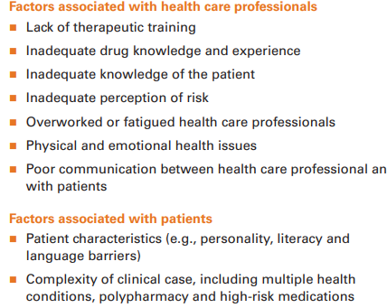
Factors that may influence medication errors

Slide 14
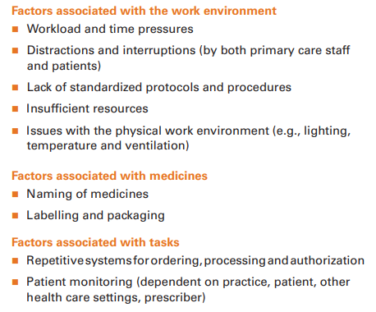

Slide 15
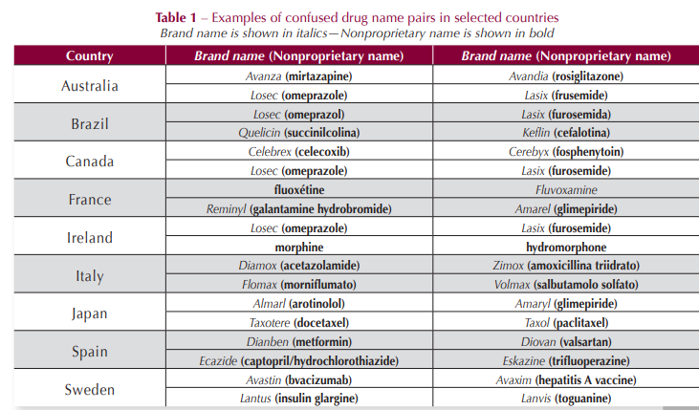
Look-Alike, Sound-Alike Medication Names

Slide 16
