Slide 1
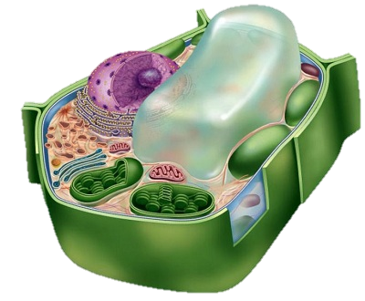
Lecture №2
Introduction to Phytohistology.Plant tissues, their classifications. Meristematic, covering, excretory tissues; mechanical,conductive tissues. Phloem and xylem, conductive bundles
Odessa National Medical University
Department of Pharmacology and Pharmacognosy
Course of pharmacognosy
Discipline: Pharmaceutical Botany
Speaker:
Bogatu Svitlana Igorivna,
PhD
Assistant of Department of Pharmcology and Pharmacognosy
2022

Slide 2
Classification of tissues
Natural tissues - group of cells similar by structure, functions and origin.
Natural tissues are characteristic to higher plants but they appear in highly organized lower plants (brown algae, red algae).
Lower plants have false tissues that differ from natural by the fact that they don’t have the common origin.
According to the origin plant tissues are divided into:
-meristematic and permanent tissue;
-primary and secondary ones.
According to the functions they can be divided into the following groups of tissues:
*meristematic (or meristems) tissues;
*protective (covering and mechanical tissues);
*tissues providing metabolism (excretory, conductive, basic and absorption tissues).
According to the structure they can be divided into:
*simple (meristematic, mechanical, basic) tissues;
*complex (covering, conductive, absorption) tissues

Slide 3
Meristematic tissues
Meristems form all permanent tissues in the plant.
Meristem cells are alive, parenchymatous, tightly closed with thin wall. They have large nucleus, thick cytoplasmic fluid and numerous ribosomes, and with tiny vacuoles or no vacuoles at all. Chloroplasts and chromoplasts are absent; there are proplastids and leucoplasts.
Meristems are divided according to the location in the plant and functions:
Apical (or terminal) meristems;
Lateral meristems;
Intercalary (intermediate) meristems;
Traumatic meristems.

Slide 4
Apical (terminal) meristems are situated on the apical shoot and tip of the root.
They are formed from one cell, which is called initial cell or from the group of cells (Magnoliophyta plants). Apical meristems provide the lengthwise growth of plants organs.
Intercalary meristems are situated in the basal part of shoot’s and leaves’ internodes and provide their growth.
Lateral meristems can be primary (procambium and pericycle) and secondary (cambium and phellogen, or cork cambium) according to the origin.
Procambium is situated below of the apical meristem. Primary phloem and xylem are formed from procambium. Primary elements of floem and xylem and mechanical tissues of cortex are formed from procambium. Pericycle is situated on periphery of central cylinder. Lateral roots are formed from pericycle.
Cambium are situated between secondary phloem and xylem. Cambium is formed from procambium or cells of basic tissues. Phelogen is formed from pericycle or basic tissues. Secondary covering tissue – periderm – formed by means of phellogen activity.
Traumatic meristems appear in the places of plant’s damaging

Slide 5
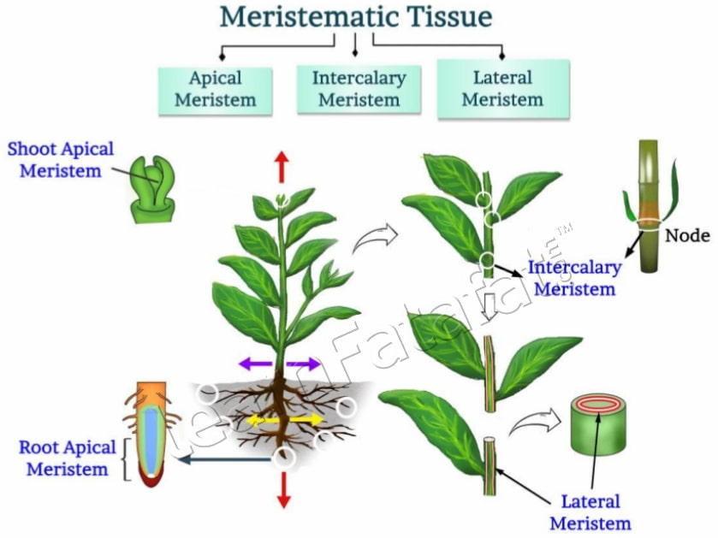
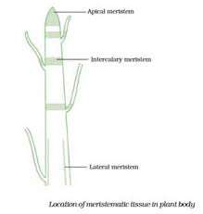
Types of meristems

Slide 6
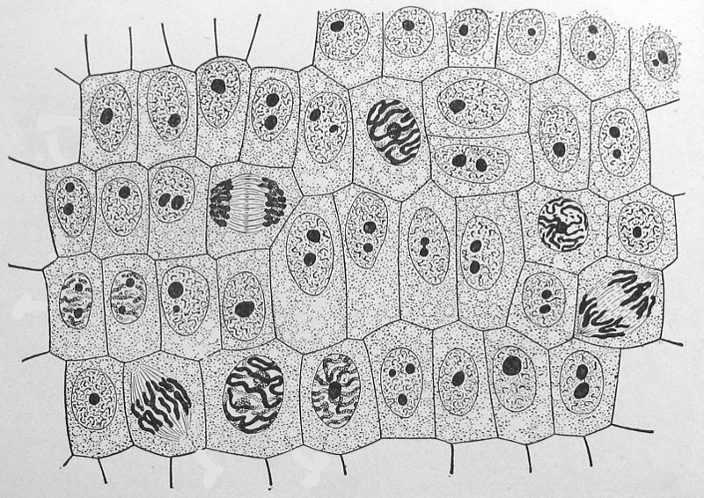
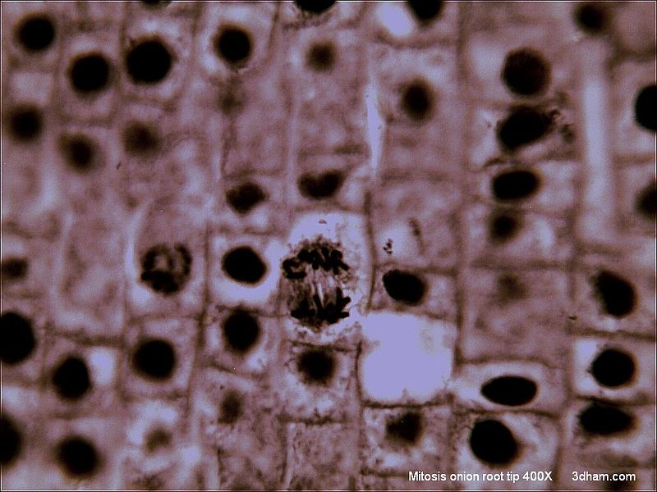

Slide 7
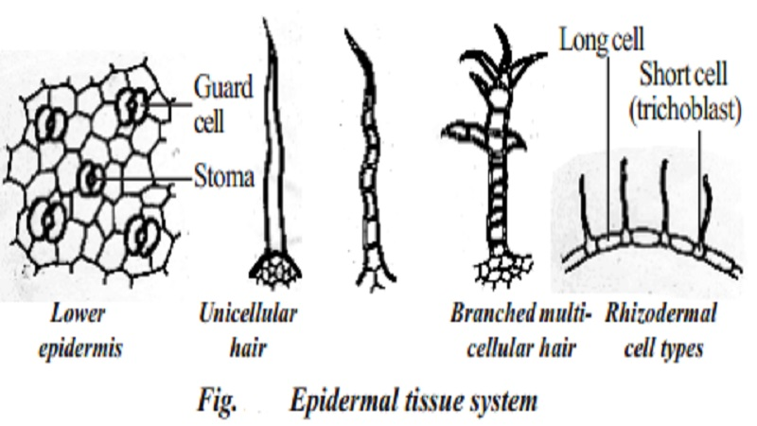
Covering tissues
According to the origin and structure, there can be 4 types of covering tissues:
epiderma;
epiblema;
periderm;
cortex.

Slide 8
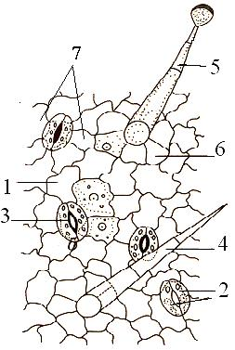
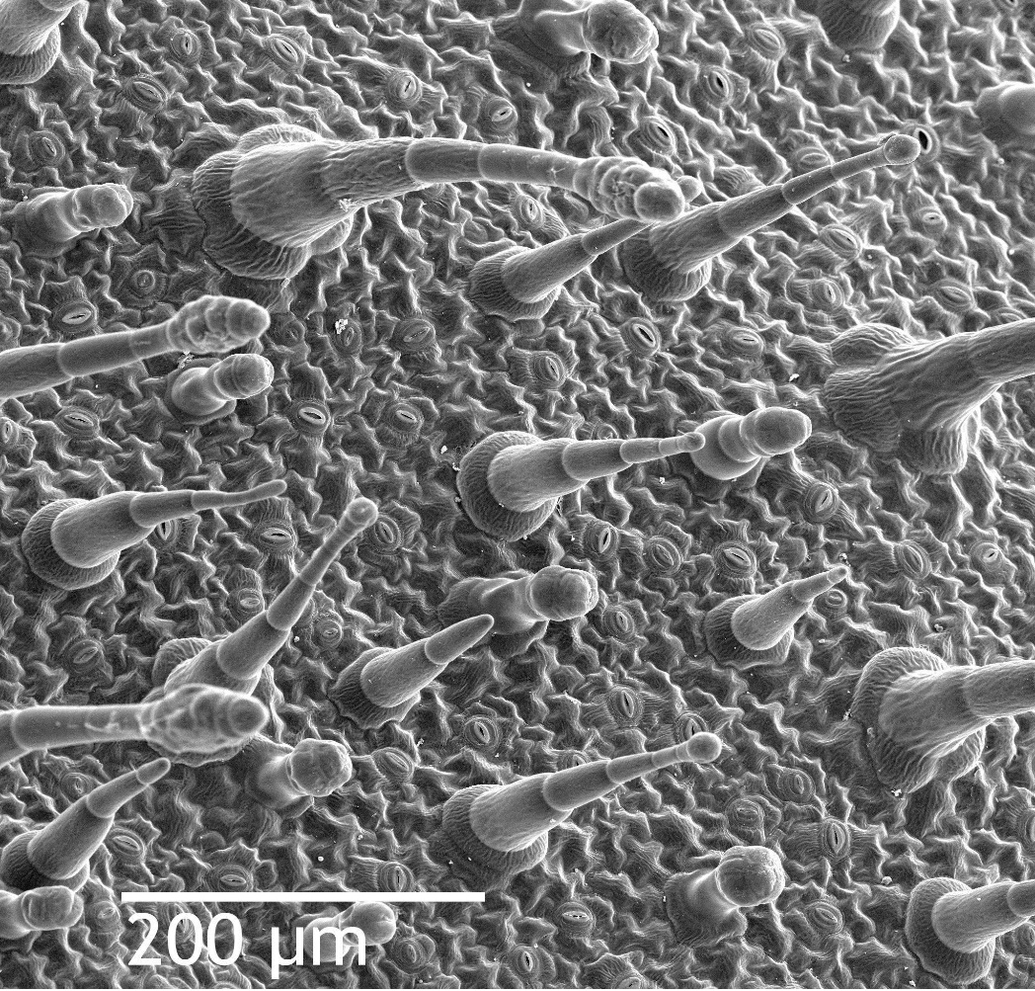
Epiderma
The epidermis is the outermost cell layer of the primary plant body. In some older works the cells of the leaf epidermis have been regarded as specialised parenchyma cells, but the established modern preference has long been to classify the epidermis as dermal tissue, whereas parenchyma is classified as ground tissue. The epidermis is the main component of the dermal tissue system of leaves (diagrammed below), and also stems, roots, flowers, fruits, and seeds; it is usually transparent (epidermal cells have fewer chloroplasts or lack them completely, except for the guard cells.)
The cells of the epidermis are structurally and functionally variable. Most plants have an epidermis that is a single cell layer thick. Some plants like Ficus elastica and Peperomia, which have periclinal cellular division within the protoderm of the leaves, have an epidermis with multiple cell layers. Epidermal cells are tightly linked to each other and provide mechanical strength and protection to the plant. The walls of the epidermal cells of the above ground parts of plants contain cutin, and are covered with a cuticle. The cuticle reduces water loss to the atmosphere, it is sometimes covered with wax in smooth sheets, granules, plates, tubes or filaments. The wax layers give some plants a whitish or bluish surface color. Surface wax acts as a moisture barrier and protects the plant from intense sunlight and wind. The underside of many leaves have a thinner cuticle than the top side, and leaves of plants from dry climates often have thickened cuticles to conserve water by reducing transpiration.

Slide 9
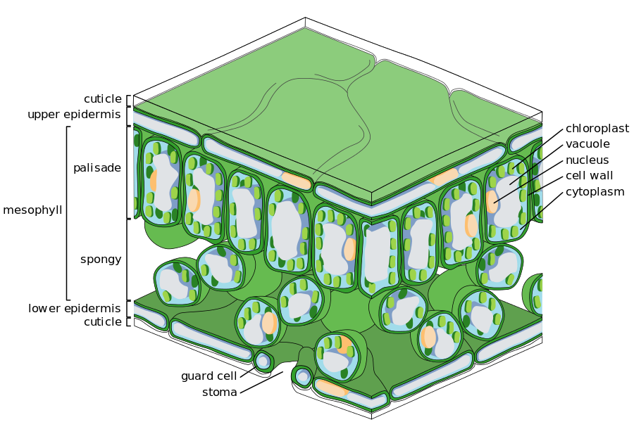
Notes:
The epidermal tissue includes several differentiated cell types: epidermal cells, guard cells, subsidiary cells, and epidermal hairs (trichomes). The epidermal cells are the most numerous, largest, and least specialized. These are typically more elongated in the leaves of monocots than in those of dicots.

Slide 10
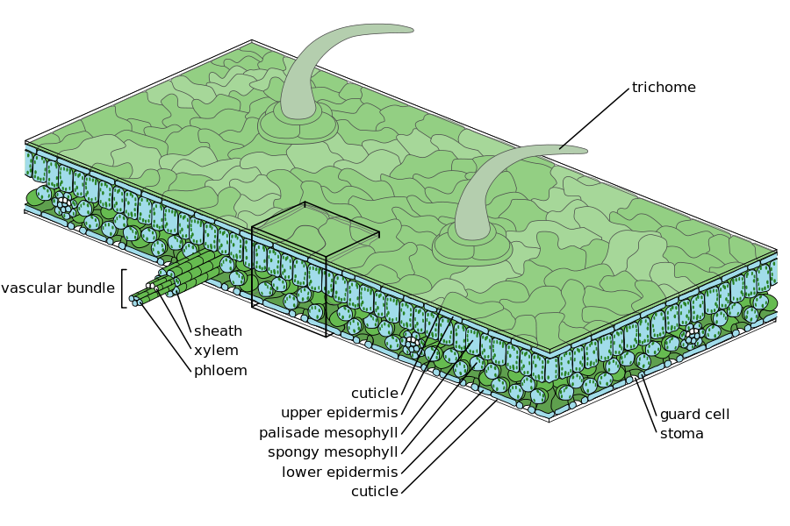
Notes:
Trichomes or hairs grow out from the epidermis in many species. In root epidermis, epidermal hairs, termed root hairs are common and are specialized for absorption of water and mineral nutrients.
In plants with secondary growth, the epidermis of roots and stems is usually replaced by a periderm through the action of a cork cambium.

Slide 11
Trichomes
Trichomes have many different features that vary between both species of plants and organs of a singular plant. These features affect the subcategories that trichomes are placed into.
Some defining features include:
Straight (upright with little to no branching), Spiral (corkscrew-shaped) or Hooked (curved apex)
Presence of cytoplasm
Glandular (secretory) vs. Eglandular
Tortuous, Simple (unbranched and unicellular), Peltate (scale-like), Stellate (star-shaped)
Adaxial vs. Abaxial determines whether trichomes are present, respectively, on the upper surface or inner surface of the plant
In a model organism, C. salvifolius, there are more abaxial trichomes present on this plant because this surface suffers from more UV, solar irradiance light stress than the adaxial surface.
Trichomes can protect the plant from a large range of detriments, such as UV light, insects, transpiration, and freeze intolerance.

Slide 12
Trichomes on plants are epidermal outgrowths of various kinds. The terms emergences or prickles refer to outgrowths that involve more than the epidermis. This distinction is not always easily applied (see Wait-a-minute tree). Also, there are nontrichomatous epidermal cells that protrude from the surface.
A common type of trichome is a hair. Plant hairs may be unicellular or multicellular, branched or unbranched. Multicellular hairs may have one or several layers of cells. Branched hairs can be dendritic (tree-like) as in kangaroo paw (Anigozanthos), tufted, or stellate (star-shaped), as in Arabidopsis thaliana.
Another common type of trichome is the scale or peltate hair, that has a plate or shield-shaped cluster of cells attached directly to the surface or borne on a stalk of some kind. Common examples are the leaf scales of bromeliads such as the pineapple, Rhododendron and sea buckthorn (Hippophae rhamnoides).
Any of the various types of hairs may be glandular, producing some kind of secretion, such as the essential oils produced by mints and many other members of the family Lamiaceae.
In describing the surface appearance of plant organs, such as stems and leaves, many terms are used in reference to the presence, form, and appearance of trichomes. The most basic terms used are glabrous—lacking hairs— and pubescent—having hairs.
Details are provided by:
glabrous, glabrate – lacking hairs or trichomes; surface smooth
hirsute – coarsely hairy
hispid – having bristly hairs
articulate – simple pluricellular-uniseriate hairs
downy – having an almost wool-like covering of long hairs
pilose – pubescent with long, straight, soft, spreading or erect hairs
puberulent – minutely pubescent; having fine, short, usually erect, hairs
pubescent – bearing hairs or trichomes of any type
strigillose – minutely strigose
strigose – having straight hairs all pointing in more or less the same direction as along a margin or midrib
tomentellous – minutely tomentose
tomentose – covered with dense, matted, woolly hairs
villosulous – minutely villous
villous – having long, soft hairs, often curved, but not matted
Notes:
The size, form, density and location of hairs on plants are extremely variable in their presence across species and even within a species on different plant organs. Several basic functions or advantages of having surface hairs can be listed. It is likely that in many cases, hairs interfere with the feeding of at least some small herbivores and, depending upon stiffness and irritability to the palate, large herbivores as well. Hairs on plants growing in areas subject to frost keep the frost away from the living surface cells. In windy locations, hairs break up the flow of air across the plant surface, reducing transpiration. Dense coatings of hairs reflect sunlight, protecting the more delicate tissues underneath in hot, dry, open habitats. In addition, in locations where much of the available moisture comes from fog drip, hairs appear to enhance this process by increasing the surface area on which water droplets can accumulate.

Slide 13
Glandular trichomes have been vastly studied, even though they are only found on about 30% of plants. Their function is to secrete metabolites for the plant. Some of these metabolites include: terpenoids, which have many functions in the plant related to growth and development; phenylpropanoids, which have a role in many plant pathways, such as secondary metabolites, stress response, and act as the mediators of plant interactions in the environment; flavonoids, methyl ketones, acyl sugars.
Non-glandular trichomes
Non-glandular trichomes are important for plant protection against UV light.
The model plant, Cistus salvifolius, is found in areas of high-light stress and poor soil conditions, along the Mediterranean coasts. It contains non-glandular, stellate and dendritic trichomes that have the ability to synthesize and store polyphenols that both affect absorbance of radiation and plant desiccation. These trichomes also contains acetylated, which can absorb UV-B and non-acetylated flavonoids, which absorb the longer wavelength of UV-A.

Slide 14
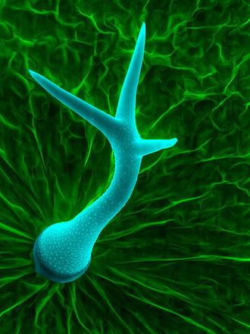
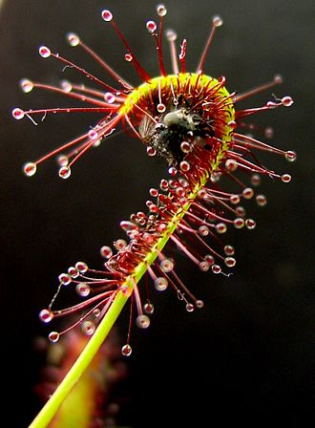
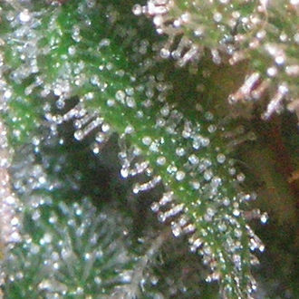
Scanning electron micrograph of a trichome on a leaf Arabidopsis thaliana. The structure is a single cell.
Sticky trichomes of a carnivorous plant, Drosera capensis with a trapped insect, contain proteolytic enzymes.
Trichomes on Cannabis, rich in cannabinoids

Slide 15
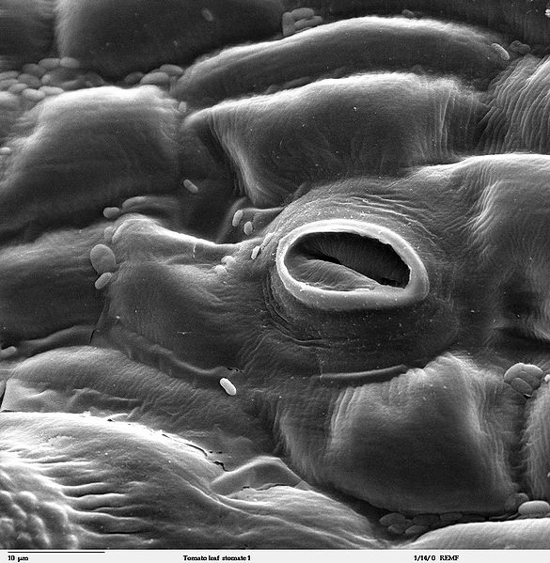
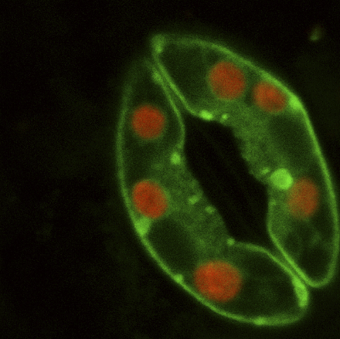
Stomal apparatus
A stoma (plural "stomata"), also called a stomate (plural "stomates")^{[1]} (from Greek στόμα, "mouth"), is a pore, found in the epidermis of leaves, stems, and other organs, that facilitates gas exchange. The pore is bordered by a pair of specialized parenchyma cells known as guard cells that are responsible for regulating the size of the stomatal opening.
The term is usually used collectively to refer to the entire stomatal complex, consisting of the paired guard cells and the pore itself, which is referred to as the stomatal aperture. Air enters the plant through these openings by gaseous diffusion and contains carbon dioxide which is used in photosynthesis and oxygen which is used in respiration. Oxygen produced as a by-product of photosynthesis diffuses out to the atmosphere through these same openings. Also, water vapor diffuses through the stomata into the atmosphere in a process called transpiration.
Stoma in a tomato leaf shown via colorized scanning electron microscope image

Slide 16
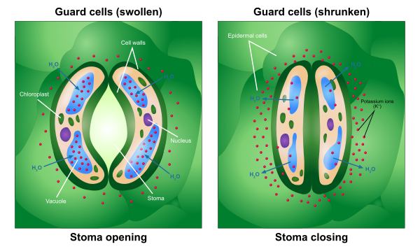
Stomal apparatus
When conditions are conducive to stomatal opening (e.g., high light intensity and high humidity), a proton pump drives protons (H⁺) from the guard cells. This means that the cells' electrical potential becomes increasingly negative. The negative potential opens potassium voltage-gated channels and so an uptake of potassium ions (K⁺) occurs. To maintain this internal negative voltage so that entry of potassium ions does not stop, negative ions balance the influx of potassium. In some cases, chloride ions enter, while in other plants the organic ion malate is produced in guard cells. This increase in solute concentration lowers the water potential inside the cell, which results in the diffusion of water into the cell through osmosis. This increases the cell's volume and turgor pressure. Then, because of rings of cellulose microfibrils that prevent the width of the guard cells from swelling, and thus only allow the extra turgor pressure to elongate the guard cells, whose ends are held firmly in place by surrounding epidermal cells, the two guard cells lengthen by bowing apart from one another, creating an open pore through which gas can move.
Guard cells have more chloroplasts than the other epidermal cells from which guard cells are derived. Their function is controversial.

Slide 17
Different classifications of stoma types exist. One that is widely used is based on the types that Julien Joseph Vesque introduced in 1889, was further developed by Metcalfe and Chalk,and later complemented by other authors. It is based on the size, shape and arrangement of the subsidiary cells that surround the two guard cells.
They distinguish for dicots:
actinocytic (meaning star-celled) stomata have guard cells that are surrounded by at least five radiating cells forming a star-like circle. This is a rare type that can for instance be found in the family Ebenaceae.
anisocytic (meaning unequal celled) stomata have guard cells between two larger subsidiary cells and one distinctly smaller one. This type of stomata can be found in more than thirty dicot families, including Brassicaceae, Solanaceae, and Crassulaceae. It is sometimes called cruciferous type.
anomocytic (meaning irregular celled) stomata have guard cells that are surrounded by cells that have the same size, shape and arrangement as the rest of the epidermis cells. This type of stomata can be found in more than hundred dicot families such as Apocynaceae, Boraginaceae, Chenopodiaceae, and Cucurbitaceae. It is sometimes called ranunculaceous type.
diacytic (meaning cross-celled) stomata have guard cells surrounded by two subsidiary cells, that each encircle one end of the opening and contact each other opposite to the middle of the opening. This type of stomata can be found in more than ten dicot families such as Caryophyllaceae and Acanthaceae. It is sometimes called caryophyllaceous type.
hemiparacytic stomata are bordered by just one subsidiary cell that differs from the surrounding epidermis cells, its length parallel to the stoma opening. This type occurs for instance in the Molluginaceae and Aizoaceae.
paracytic (meaning parallel celled) stomata have one or more subsidiary cells parallel to the opening between the guard cells. These subsidiary cells may reach beyond the guard cells or not. This type of stomata can be found in more than hundred dicot families such as Rubiaceae, Convolvulaceae and Fabaceae. It is sometimes called rubiaceous type.

Slide 18
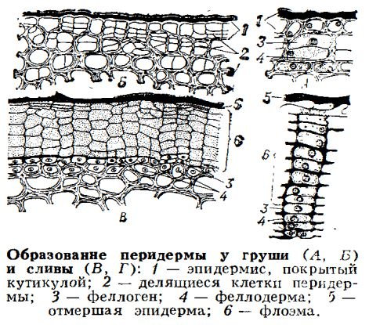
Periderm
Periderm is the secondary integumentary complex tissue, which is formed in the perennial dicots and gymnosperm plants by the end of the first year of living as the result of phelogen’s activity. Sometimes, it covers stems of arboreal plants, roots; it forms on the fruit and other parts of the plant. Periderm consists of cork, phellogen and phelloderm. Phellogen is a meristematic secondary tissue. Cells of the phellogen divide and form the cork and phelloderm.
Cork cells are impregnated with suberin; these cells are dead. Walls don’t moisten with water, don’t let water and gas in and don’t decompose.
The function of the cork is protection of plants from bacteria, fungus, mechanical damages.
Phelloderm is alive, mono-layered, contains chloroplasts.

Slide 19
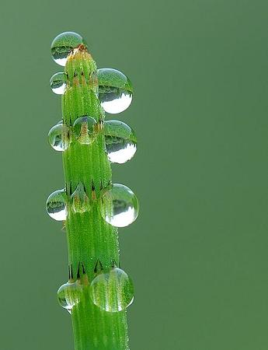
Excretory tissues
External secretory structures
Hydathodes are structures that release water with some substances from the interior of the leaf to its surface. This process is called guttation and occurs by water pressure coming from the root.
Hydathodes are modifications of some parts of the leaves and are located along the margins or at the tip of the leaf. Structurally, hydathodes consist of a) terminal tracheids of leaf nerves, b) the epithem, which consists of thin-walled and few chloroplasts parenchyma cells located at the leaf nerve endings, c) a sheath or envelope that is continuous with the epidermis (the sheath cells may be suberized and may even have Caspary bands), d) an watery opening or pore (watery pores are small nonfunctional stomata who have lost the ability to regulate opening and closing). Although this is the general organization, there may be variations, such as lack the sheath, or the epithem, or may even have an opening which is not a stoma.
Although hydathodes are normally found at the margins and tips of leaves, in some species, they also appear on the surface and are called laminar hydathodes. Hydathodes are generally associated with the release of water from the plant tissues, but in many xerophytic species they are specialized in the absorption of condensed fog or dew water, i.e., the opposite process. Some authors have described the active hydathodes, also known as trichome-hydathodes, as glandular trichomes that release water. These structures would release water without being influenced by the osmotic pressure, hence they are considered active as opposed to the others that would be passive.
Notes:
In plants, it is difficult to distinguished between excretion and secretion processes, since the products of both of them are usually stored in the same plant compartments. In general, it can be said that the secretion is the accumulation of secondary products resulting from metabolism that are not going to be immediately used and primary metabolites that are going to immediately participated in metabolic reactions in the cell. Secretory cells arise after the differentiation of epidermal or parenchyma cells, and do not form real tissues. The structures responsible for the secretion have highly diverse morphologies and are located in diferent parts of the plant. In fact, they can be found in both internal and external parts of the plant, and can be a single secretory cell or multicellular secretory structure. In addition, they can produce a wide variety of products. Here, we are going to classify secretory structures according to their location inthe body of the plant: external (the surface) or internal.
External secretory structures
There are many secretory cells on the surface of plants, either as unicellular or multicellular glandular trichomes in the epidermis or as part of the epidermal layer. These secretory cells originate by division and differentiation of epidermal cells. Some of them release mainly hydrophilic (water-loving) or lipophilic (water-hating) substances, and others release both hydrophilic and lipophilic substances. There are superficial secretory cells in stems, leaves, fruits and flowers. For example, there is abundant secretion in petals, where the released molecules cause the fragrance of flowers. Although these cells are highly specialized in secretion, all epidermal cells are actually secretory since all of them release substances that are deposited on their walls or released to the environment.

Slide 20
Nectaries are secretory structures that release sugar-rich solutions made from the substances supplied by the phloem. Two categories can be distinguished: floral nectaries, which are directly associated with pollination, and extrafloral nectaries, which are found on the vegetative parts of the plant. There is a huge variation in nectary structure, from simple epidermal glandular surfaces to more complex structures.
Osmophores are secretory structures that produce the fragrance of flowers through secretion of volatile substances. Plants growing in saline habitats (halophytes) have salt glands to secrete ions, which is the best known mechanism for regulating the salt content of plant shoots.

Slide 21

Glandular trichomes are external secretory structures, which are present in about 30% of plant species. For instance, the smell of plants is mostly because of the volatile substances released by these structures. Glandular trichomes are commonly multicellular, with glandular cells at the distal end attached to the epidermis by non-glandular cells known as basal cells and by other forming a stalk or peduncle. However, some thrichomes are unicellular. Glandular cells have a primary cell wall, sometimes covered by a cuticle at the joining area with the stalk cells, and contain a cytoplasm with abundant organelles such as mitochondria, endoplasmic reticulum and Golgi cistern stacks. However, there are differences between glandular cells of different species. For example, glandular cells releasing terpenes contain very scarce Golgi apparatus or it is not visible at all.
Notes:
Glandular trichomes contain cells that release substances with different functions to the environment, either volatile or substances that remain on the surface of the plant. Glandular cells can synthesize the molecules to be released, even they have sometimes the ability to perform photosynthesis. It means that some glandular cells may live as rather independent units. However, in other cases the molecular building blocks for synthesizing the compounds to be release are coming from the underlying plant tissues through the stalk cells of the trichome.
Glandular trichomes are classified according to the compounds they release or the trichome morphology. There are thichomes with a basal cell, one or more in the stalk, and a few secretory cells at the distal end. These trichomes commonly release not very volatile substances that are laid on the surface of the plant. Other types of trichomes show a basal cell, a short cell in the stalk, and a head with one or several secretory cells showing a large cavity between the cuticle and the primary cell wall, which is filled with substances. There are many other examples of glandular trichomes. It can be found different types of trichomes in the same plant, even in the same organ. For example, in carnivorous plants, there are trichomes for fetching the insect by releasing mucilaginous substances or nectar, and others release proteolitic enzymes for digestion. The amount of trichomes, both glandular and not glandular, is influenced by the environment. For instance, it can be increased after the attack of a herbivore.
The release of secretory compounds may be achieved by different ways. Those secretory products stored between the cell wall and the cuticle are released when the trichome is touched and the cuticle is detached. In other cases, the cuticle has small channels to guide substances to the environment. Some glandular cell store the substances in their cytoplasms so that they are released when the cell breaks. Initially, the precursor molecules arrive to secretory cells through the stalk cells of the trichome, but the final secretory products synthesized in the secretory cells do not travel back to the plant organ. This is because the mature secretory cells get a thicker cuticle and the cells of the stalk cells close to the secretory cells work now as a barrier.
There is a wide variety of glandular trichomes regarding the compounds they release. Some synthesize and release organic acids, others release salt, mucilage (polysacharides), terpens, mixings of terpens and mucilage, nectar, proteolytic enzymes by trichomes of carnivore plant, etcetera. Some of these substances may be antimicrobianes. One important function of glandular trichomes is mediating interactions between plants and animals. For instance, released terpens may attract insects or be toxic to them, produce alarm, regulate insect development, or other effects depending on the insect species. More curious, some terpens attract insect predators or insect parasites. This last strategy is known as indirect defense.

Slide 22
Internal secretory structures
Secreting cells. They are isolated cells that differ from the surrounding cells and may be from isodiametric forms to forms enlarged in length like sacs or tubes. They synthesize and store a wide variety of products, such as resins, mucilage, tannins, oils, gums, and even crystallized substances. Many secretory cells contain mixtures of substances, but in many others the contents have not yet been identified. When the secretory cells appear as specialized cells, they are often referred to as idioblasts, more specifically secretory idioblasts.
Notes:
Internal secretions are products stored inside plant tissues, sometimes throughout the lifespan of the plant. Internal secretory structures are far from the epidermis and are located mainly in the cortical parenchyma of stems, leaves, roots, and fruits. We can distinguish three types of internal secretory structures:

Slide 23
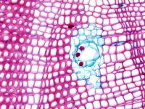
Secretory cavities and ducts (canals) differ from secretory cells in that they secret substances into intercellular spaces. Secretory cavities are short secretory spaces, whereas secretory ducts are long secretory spaces. These spaces may be located anywhere in the plant and can be formed by two different cellular processes: schizogeny and lysogeny. They are commonly produced by the separation of cells of vascular tissues or ground tissues, resulting in an intercellular space lined with secretory epithelial cells. These spaces are called schizogenous secretory cavities and ducts, as it is the case of most resin ducts. They can also be originated by the disintegration and dissolution (autolysis) of the glandular cells. In this case, the secretory product is formed in the cells that eventually break down, but the compounds remain in the resultant space. These spaces are known as lysogenic spaces, like the lysogenic cavities of the citric fruits. Some authors also recognize a third pattern of development, the schizolysogeny. The formation of schizolysogenous cavities and ducts is initially schizogenous (separation of intact cells), but followed by lysogeny at later stages, when the epithelial cells lining the space undergo autolysis, further enlarging the space. The resin ducts in the bud scales of Pinus pinaster is an example of ducts following a schizolysogenous pattern of development.

Slide 24
Laticifers refer to individual cells or groups of connected cells containing a liquid called latex. When formed of several cells, they can produce complex tube-like structures. According to the structure, they can be classified into articulated and nonarticulated laticifers. Articulated laticifers are composed of longitudinal chains of connected cells, whereas the nonarticulated laticifers consist of long tube-like single cells. Laticifers are found in a wide variety of species, from herbaceous to woody plants. The term latex refers to a heterogeneous secretory substance which greatly varies in appearance (color) and composition (it may contain substances such as carbohydrates, organic acids, salts, sterols, fats, and mucilages), thus resulting in many types of latex.

Slide 25
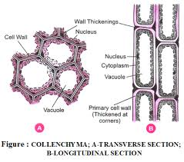
Mechanical tissues
Mechanical tissues strengthen plants; protects them from laceration, fracture, inflexion, straining and mechanical damages. Mechanical tissues consists of parenchymatous or prosenchymatous cells with thickened, usually lignificated walls and they are as strong as steel.
The mechanical tissues are collenchyma and sclerenchyma.

Slide 26
Collenchyma
Alive tissue with cellulose irregularly thickened cell wall. The size of cells varies from parenchymal to prosenchymatous with slant, sometimes, mucronated points. There are chloroplasts and, sometimes, tannins in the cavity of cells. According to the character of walls thickening and density of the cell location there are angular, lamellar and lacunar collenchyma.
The cells of the angular collenchyma are tightly joined, walls are thickened by angels; tangent sides are thickened in the lamellar collenchyma; lacunar collenchyma differs from other types of collenchyma by the presence of intercellular spaces.
Collenchyma is typical to dicots. It is situated at the periphery of the stem as entire, interrupted cylinders or separate bands. In costate stems and petioles it fills costas; in the leaves it is situated from one or both sides of veins and along the edges of the leaf blade.

Slide 27
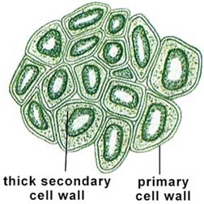
Sclerenchyma
Is a dead tissue with thickened usually evenly considerably lignificated walls. It is divided into sclereids (or stone cells) and fibers.
Sclereids (or stone cells) have different size and forms. It is situated single or in groups. Their walls have chinked or branched pits. Sclereids are situated in the pericarp, axial organs, seed cover, flesh of leaves (supporting cells) and others.

Slide 28
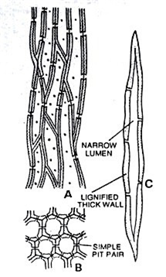
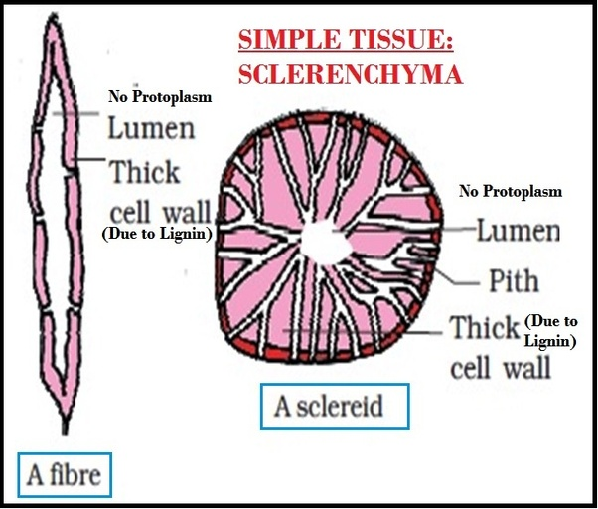
Sclerenchyma

Slide 29
Sclerenchyma
Fibers consists of prosenchymatous cells, which are situated in the form of bands, cylinders, sheaths or singly in the cortex, phloem and xylem.
According to the origin and location in organs of plants they can be bast (or phloem fibers), libriform (or wood, or xylem fibers), pericycle (perivascular fibers), sheath fibers and cortex fibers.
Bast (or phloem) fibers are very long cells with thickened, staty, cellulose, partly lignificated or non-lignificated cell walls that are penetrated by oblique pits.
Foliation of walls depends on interchange of layers with a different content of cellulose, hemicellulose and pectin substances, and striation depends on cancellated location of fibrils. The forms of the phloem fibers and their joining are the specific characteristic of a plant.

Slide 30
Sclerenchyma
Libriform (or xylem, or wood) are situated in the wood and make it firm and crusty.
The length of filaments varies from 1 to 2 mm.
According to the stage of fibers forming and its structure distinguish such types of libriform as replacing and laster libriform are distinguished.
Perivascular fibers are formed by pericycle and are situated at the periphery of the central cylinder.
Sclerenchyma that forms the mechanical sheath around conductive bundles is formed from the procambium or the basic tissue.
Cortex fibers are formed in the cortex of stems in the form of bands or entire celinders. They are often situated under the epidermis in monocots.

Slide 31
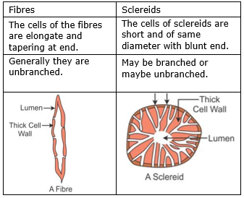
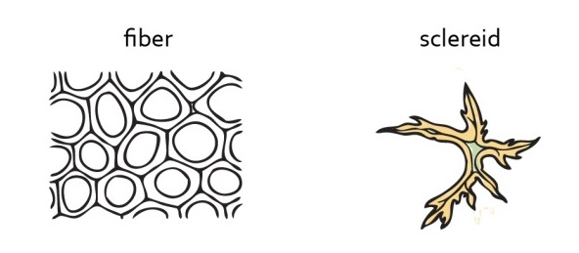
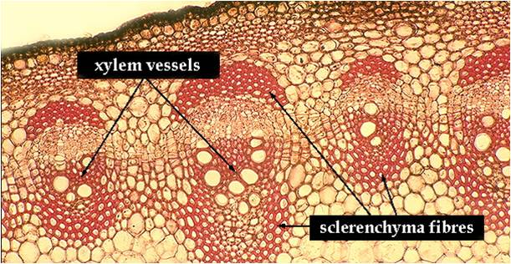

Slide 32
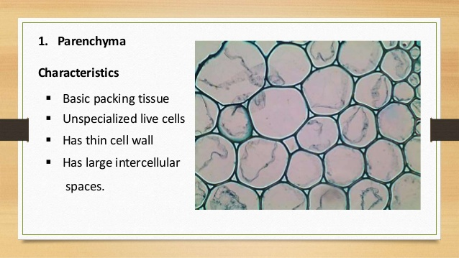
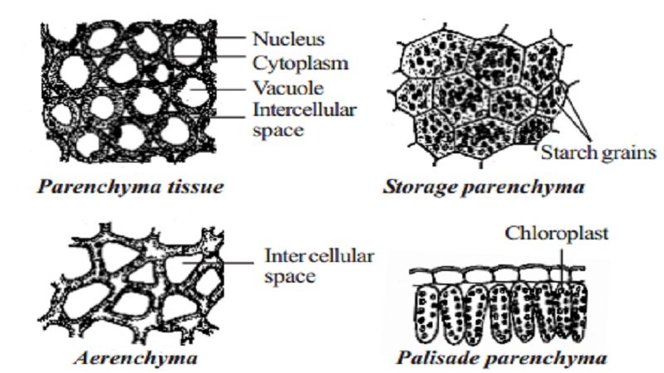
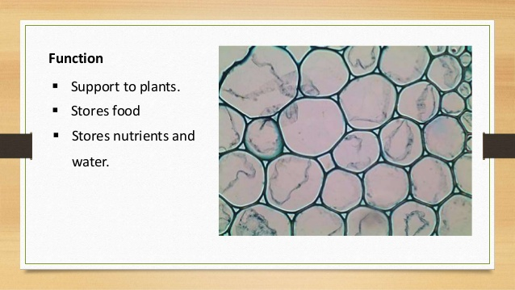
Basic (ground) tissues

Slide 33
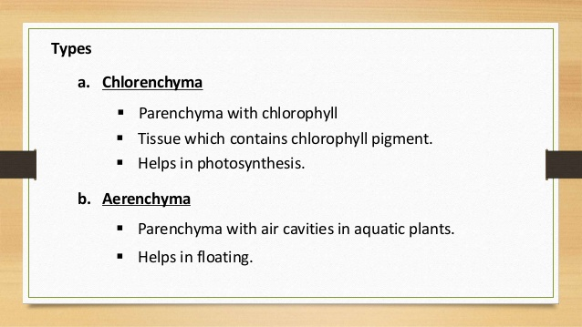
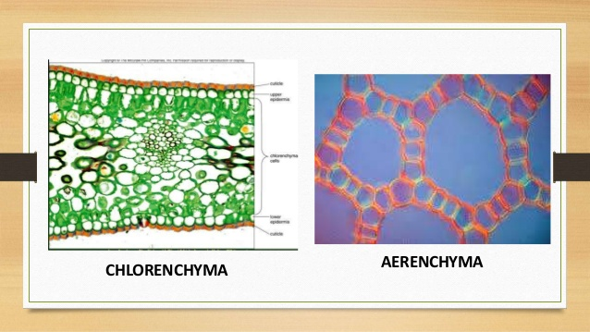

Slide 34
Conductive tissues
The vascular tissues are specialized to transport food, water and minerals. They consist of long, narrow cells arranged end-to-end, forming tubes. There are two different types of vascular tissues, called xylem and phloem. Both are shown in figure below.
Xylem is vascular tissue that transports water and dissolved minerals from roots to stems and leaves. This type of tissue consists of dead cells that lack end walls between adjacent cells. The side walls are thick and reinforced with lignin, which makes them stiff and water proof.
Phloem is vascular tissue that transports food (sugar dissolved in water) from photosynthetic cells to other parts of the plant for growth or storage. This type of tissue consists of living cells that are separated by end walls with tiny perforations, or holes.

Slide 35
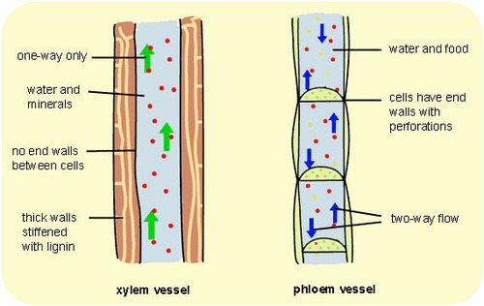
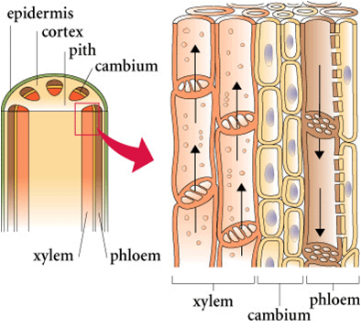
Pits of tracheids consist of a pit membrane and the torus in a center, there are no openings. The presence of tracheids and/or vessel elements has evolutionary significance. Vessels (made of vessel members) are more effective; consequently, more “primitive” plants have more tracheids whereas more “advanced” have more vessel members. As an example, gymnosperms have only tracheids while most flowering plants have tracheids and vessel members. Individual development also mimics this evolutionary trend. Younger flowering plants have more tracheids whereas mature plants have more vessel members. Primary xylem mostly has tracheids and vessels with scalariform perforations whereas secondary xylem (which originates from cam73 bium) consists mostly of vessels with open perforations. The common name for secondary xylem is wood
Notes:
It is a mistake to think that tracheids are better than vessels. In fact, the main problem is frequently not too slow but too fast water transport. Tracheids have an advanced connection system (called torus) which has the ability to close pore if the water pressure is too high and therefore more controllable. Leaking would be less dangerous in tracheids. And in water-poor environments (like taiga in winter), plants with tracheids will have the advantage. Contrary, having vessels is like to have race car for ordinary life; only flowering plants “learned” how to use them effectively. Dead cells are useful but hard to control. However, if xylem transport needs to be decreased, there is a way. Xylem parenchyma cells will make tyloses (“stoppers”) which will grow into dead tracheary elements and stop water if needed. Many broadleaved trees use tyloses to lower xylem transport before the winter

Slide 36
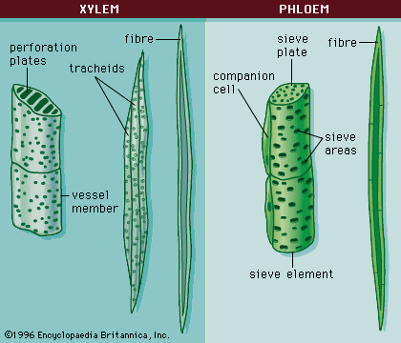
The phloem generally occurs adjacent, or right next to, the xylem, with the xylem facing the inner part of the plant and the phloem facing the outer part of the plant. The main functions of the phloem are the transportation of sugars and mechanical support. The four types of phloem cells are: sieve tube cells, companion cells, fibers (the only dead cells in phloem), and parenchyma. Sieve tube cells of flowering plants have cytoplasm flowing through perforations (sieve plates) between cells but do not contain nuclei. Companion cells will make proteins for them. However, in gymnosperms and more “primitive” plants there are no companion cells at all, so sieve tube cells do contain nuclei. This is comparable to red blood cells in vertebrates: while mammals have them anucleate, erythrocytes of other vertebrates contain nucleus. The secondary phloem generally has more fibers than the primary phloem

Slide 37
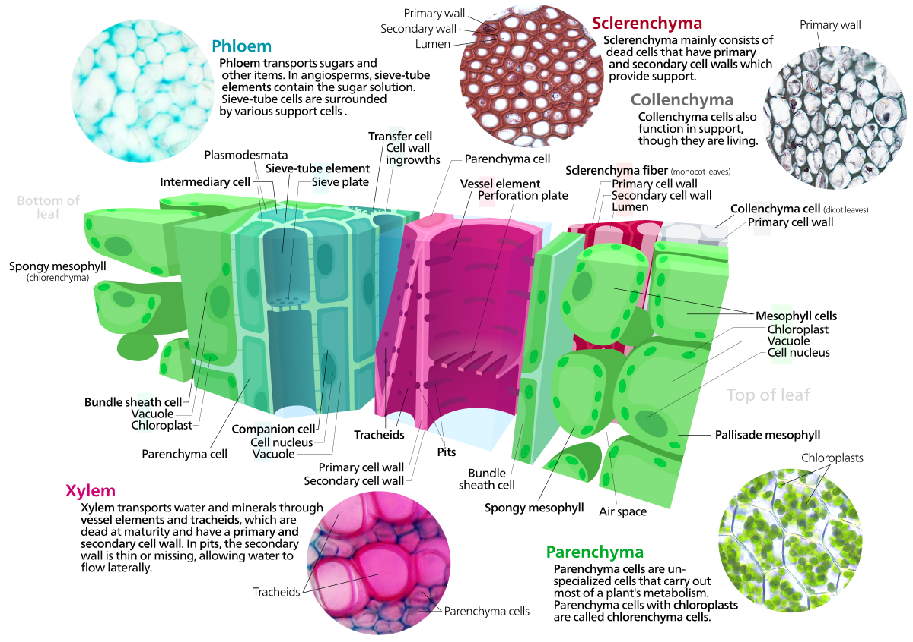

Slide 38


Thanks for your attention!
https://t.me/FB_FGstudents

