Slide 1
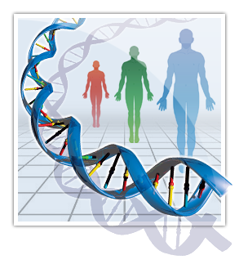
Organism level of organization of genetic information.
Laws of heredity.

Slide 2
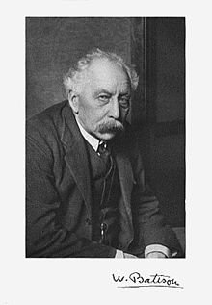
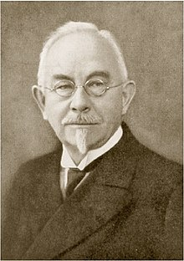
MAIN TERMS OF GENETICS
Genetics – science about heredity and variation.
William Bateson (1861 – 1926) first suggested using the word "genetics" (from the Greek gennō, "to give birth") to describe the study of inheritance variation in1906
The term Gene (from Greek genea "generation, race," and root gene - "give birth, beget.“) was coined 1905 by Danish scientist Wilhelm Ludwig Johannsen (1857-1927).
Notes:
William Bateson 1894 book Materials for the Study of Variation was one of the earliest formulations of the new approach to genetics. Bateson first used the term "genetics" publicly at the Third International Conference on Plant Hybridization in London in 1906.Although this was three years before Wilhelm Johannsen used the word "gene" to describe the units of hereditary information, De Vries had introduced the word "pangene" for the same concept already in 1889, and etymologically the word genetics has parallels with Darwin's concept of pangenesis. Bateson and Edith S. aunders also coined the word "allelomorph" ("other form"), which was later shortened to allele
Wilhelm Ludwig Johannsen Danish botanist, plant physiologist, and geneticist. He is best known for coining the terms gene, phenotype and genotype, and for his 1903 "pure line" experiments in genetics

Slide 3
Heredity is an ability of organisms to pass on their characteristics to next generations
Variation is an ability of organisms to change during ontogenesis
Gene is consider as unit of heredity; it is DNA region that specifies synthesis of polypeptide
Phenotype – a complex of external and internal features which appears under the control of genotype and influenced of the environmental factors.
Genotype – set of the genes in diploid set of chromosomes.

Slide 4
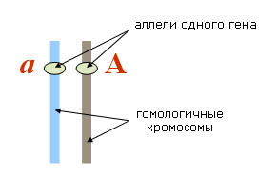
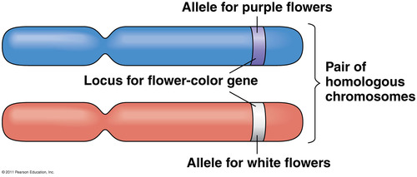
Allelic genes - genes that are in the same loci of homologous chromosomes and encode same trait
Alleles – the different variants of the gene that control alternative traits; are formed due to mutations.
Alternative characters are different manifestations of the same feature (blue or brown eyes, polydactyly or 5 fingers, are freckles or not)

Slide 5
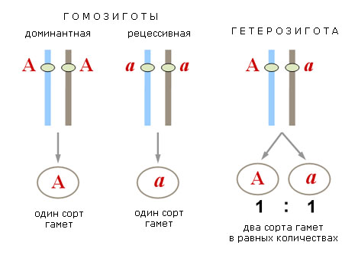
Homozygous person - both allele of the gene
are same, dominant /AA/ or recessive /aa/.
Heterozygous person – alleles are different /Aa/.

Slide 6
MILESTONES OF GENTICS HISTORY
1. The study of heredity and variation on the organism level.
Gregor Mendel - the laws of inheritance.
2. The study of heredity on the cellular level.
Thomas Hunt Morgan - chromosome theory of heredity.
3. Level of molecular genetics: 1920 to 1940 - discovering of induced mutagenesis; development of biochemical genetics, immunogenetics, population genetics.
From 1953 (James Watson and Francis Crick) - study of the fine structure of the gene, mechanisms of transmission and realization of hereditary information
4. Mobile genetics: 1972 - received 1st recombinant DNA -development of genetic engineering, deciphering the human genome, the development of gene therapy(directed changes of genotypes). Epigenetic level - regulation of gene expression

Slide 7
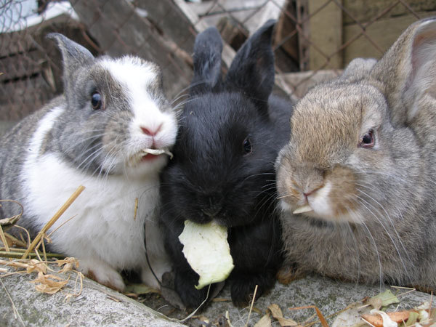
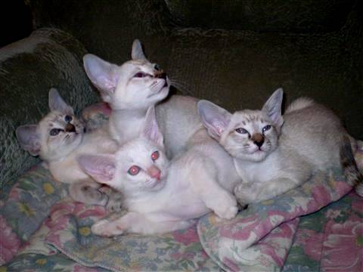
However, genetics has a long history.
For thousands of years before our era the people taken out domestic breeds of animals and cultivated varieties of seeds.
The Bible says: "... his cattle without taking in you breed, not sow your field two kinds of seed ", which indicates
the knowledge of the ancient Jews, the importance of supported of pure lines of animals and plants.

Slide 8
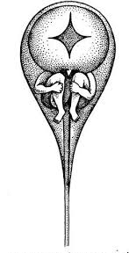
The first theory of heredity were formed in ancient Greece. The famous physician HIPPOCRATES /5. BC / believed that in the egg or the mother's body should be small, but fully formed organism. Such beliefs later became known as preformism /lat. praeformo-pre-image of /.
Less than 100 years after ARISTOTLE expressed opposing views: the organism develops from an unstructured, homogeneous mass, gaining peculiar structure in the process of embryonic development - The theory of epigenesis (neoformism).
Both trends - preformism and epigenesis - reached most common in XVII and XVIII centuries.

Slide 9
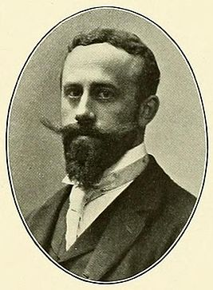
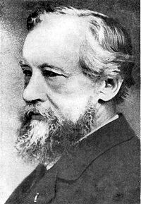
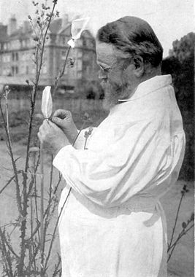
Genetics as a science begins in 1900,
when three scientists - H.de Vries /Netherlands/, C. Correns /Germany/ and E. Tchermak /Austria/ independently rediscovered regularities of heredity already formulated in 1865 G. Mendel
Hugo Marie de Vries
(1848-1935)
Erich von Tschermak
(1871-1962)
Carl Erich Correns
(1864-1933)
Notes:
Botanists, one of the first geneticists? Tchermak - agronomist

Slide 10
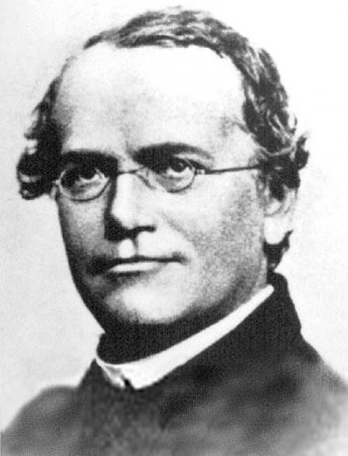
The founder of genetics –
Czech scientist Gregor Mendel.
Was born in 1822 in Heinzendorf bei Odrau (Austrian Empire, now Hynčice, Czech Republic)
1840 -1843 - studied practical and theoretical philosophy and physics at the Philosophical Institute of the University of Olomouc
1843 - became a friar of Augustinian St Thomas's Abbey in Brno
1851 - 1854 studied science in University of Vienna
1867 - become an abbot of the monastery.
died in 1884, at the age of 61, in Brno
Notes:
Mendel was born in a German-speaking family^{[3]} in the Silesian part of the Austrian Empire (today's Czech Republic) and gained posthumous recognition as the founder of the modern science of genetics. Though farmers had known for millennia that crossbreeding of animals and plants could favor certain desirable traits, Mendel's pea plant experiments conducted between 1856 and 1863 established many of the rules of heredity, now referred to as the laws of
University Olomouc is the oldest university in Moravia and the second-oldest in the Czech Republic. It was established in 1573 as a public university led by the Jesuit order in Olomouc, which was at that time the capital of MoraviaPalacký

Slide 11
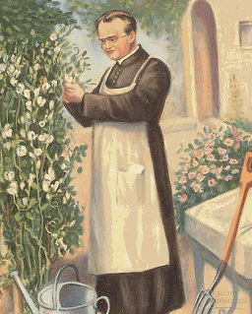
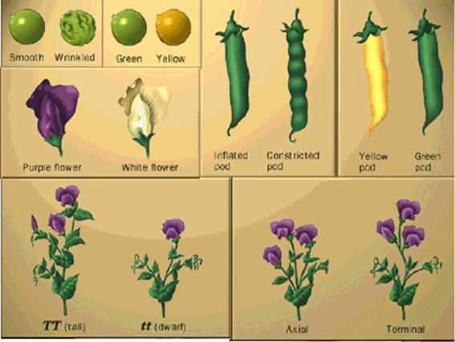
Since 1856 Gregor Mendel began to conduct in the monastery garden /width 7 m and a length of 35 m/ well-designed extensive experiments in plant hybridization.
Mendel studied inheritance of
7 alternative characters of pea plants

Slide 12
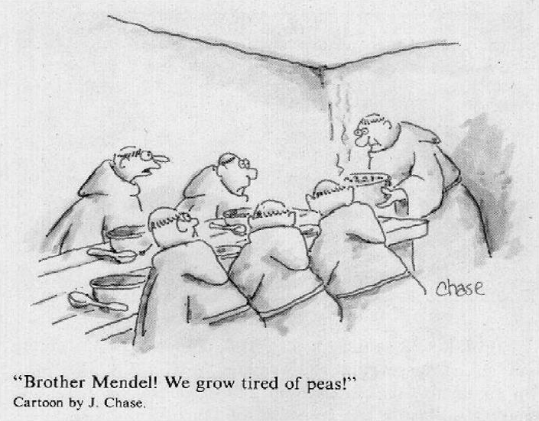
8 years of experiments with peas

Slide 13
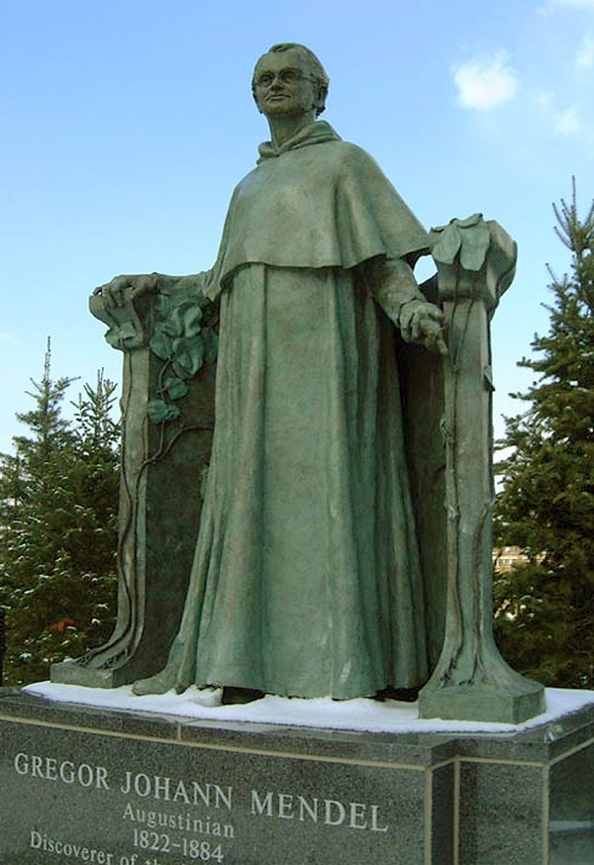
In 1865 G. Mendel presented his paper, "Versuche über Pflanzenhybriden" (“Experiments on plant hybridization"), at two meetings of the Natural History Society of Brno/
A new era in understanding of the mechanisms of heredity starts/
Gregor Mendel become the founder of Mendelism, that became the basement of genetics and is considered as one of the greatest discovery in biology past 500.

Slide 14
Hybridization method is based on the experimental crossing
Selection of pure lines (homozygous forms) with alternative characters. A pure line is a population that originates trough inbreeding or self-fertilization. Organisms of a pure line are always homozygous.
Analyzing the inheritance of each investigating trait separately.
Exact calculations of an offspring with different traits in each generation.
Studying the characteristics in several successive generations.

Slide 15
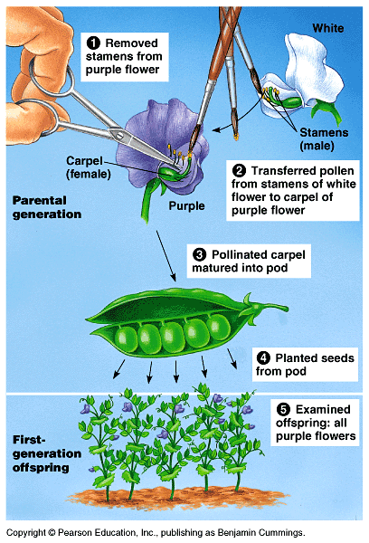
Peculiarity of flower structure: it is self-pollinated plant, but self-fertilization may be artificially prevented easily
Plant has a short life cycle, a great number of offspring and is convenient in handling.

Slide 16
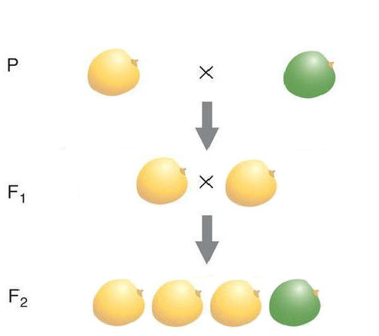
Mendel was first pointed out the need to study the behavior of one pair of signs
Monohybrid cross - crossing parent individuals that differ by one pair of alternative signs.
All offspring of the first generation (F1) demonstrated same traits.
The trait that appeared in hybrids of the first generation was named dominant (A) by Mendel.
Recessive (a) trait - a sign suppressed in the F1.
Notes:
Морщинистая форма – ген, отвечающий за аллель синтез разветвленных молекуд крахмалаю Рецессивный признак – нет ферментаб накаплтвается сахарозарастет осмотическое давление внутри семениб а кол-во воды снижыется

Slide 17
In the second generation (F2) Mendel discovered two phenomena:
Sign /green color of seeds/, which was absent in F1 appears again;
Ratio of plants with purple and white flowers was about 3: 1. (from 8023 pea seeds 6022 were yellow, and 2001 - green /3,01: 1/)
Not traits but themselves, but certain inner factors that control traits are inherited
Each trait is controlled by two factors

Slide 18
Based on the results of experiments Mendel
formulated two conclusions, which were subsequently named the first and second laws of Mendel.
The law of dominance (1-st Mendel law) hybrids.
In the crossing of two homozygous individuals that differ by one or more pairs of alternative characters, first generation hybrids are uniform both in phenotype /all have dominant character/ and genotype /Aa/.
A - yellow P:♀ AA × ♂ aa
a – green yellow green
Gametes: A a
F₁: Aa
100% yellow

Slide 19
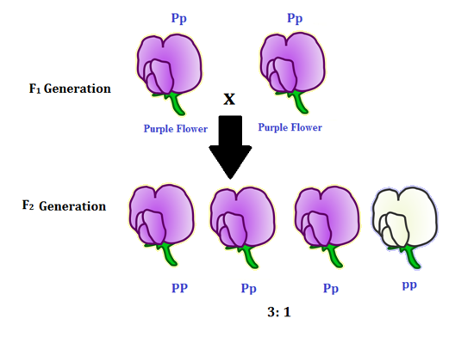

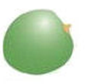

Law of segregation (2-nd Mendel law)
When crossing two heterozygous individuals in the second generation the segregation is in the ratio
3:1 in phenotype.
1:2:1 in genotype
F₁: ♀ Aa × ♂ Aa
yellow yellow
G: A,a A,a
F₂: AA , Aa , Aa , aa
yellow yellow yellow green

Slide 20
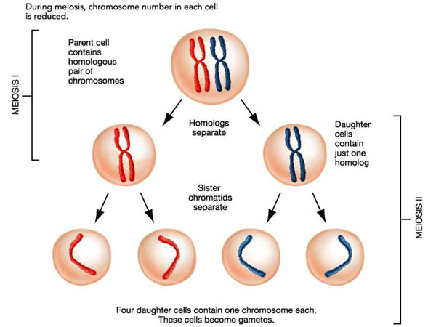
For explanation of crossing results Mendel proposed hypothesis of gametes purity, which now is termed as the law of purity of gametes:
In hybrids of F1 generation dominant and recessive alleles do not mix with each other and segregate during gametogenesis, in such a way that each gamete receives only one from allelic pair.

Slide 21
Studied in peas characteristics are monogenic
their appearance is determined by single gene.
A number of traits in humans are monogenic and inherited in accordance with universal laws of inheritance established by Mendel.
Mendelian characters are inherited according to Mendel’s laws. Many of single gene disorders are Mendelian characters.
Mendelian traits can be inherited as autosomal- dominant, autosomal - recessive, X-linked or Y-linked characteristics.

Slide 22
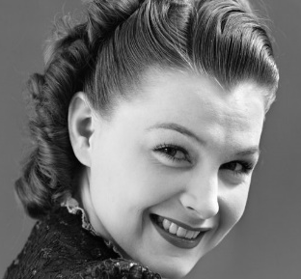
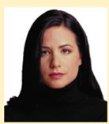
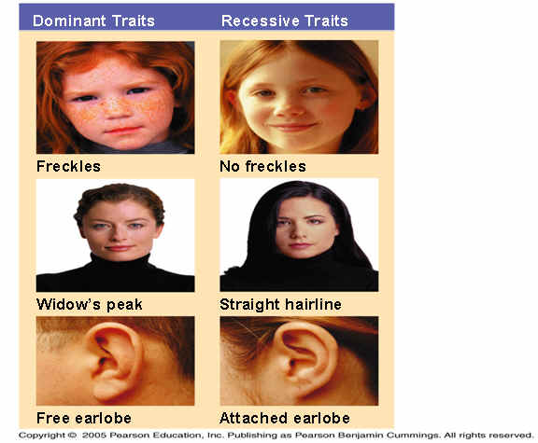
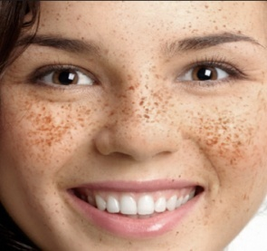
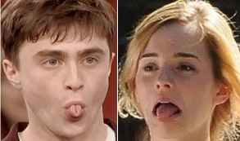
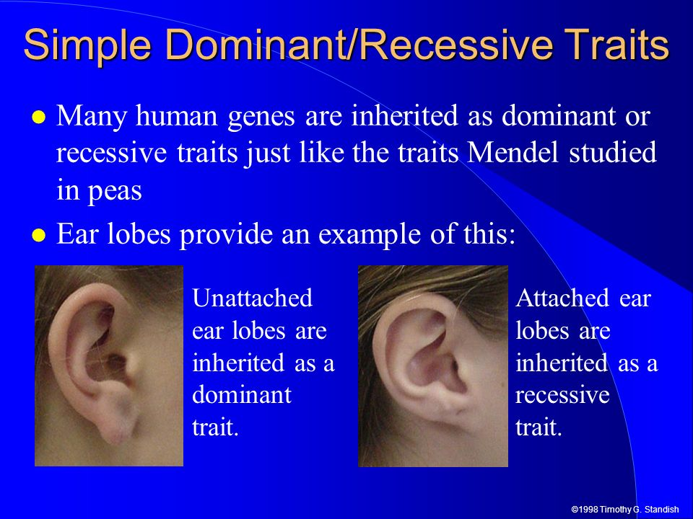
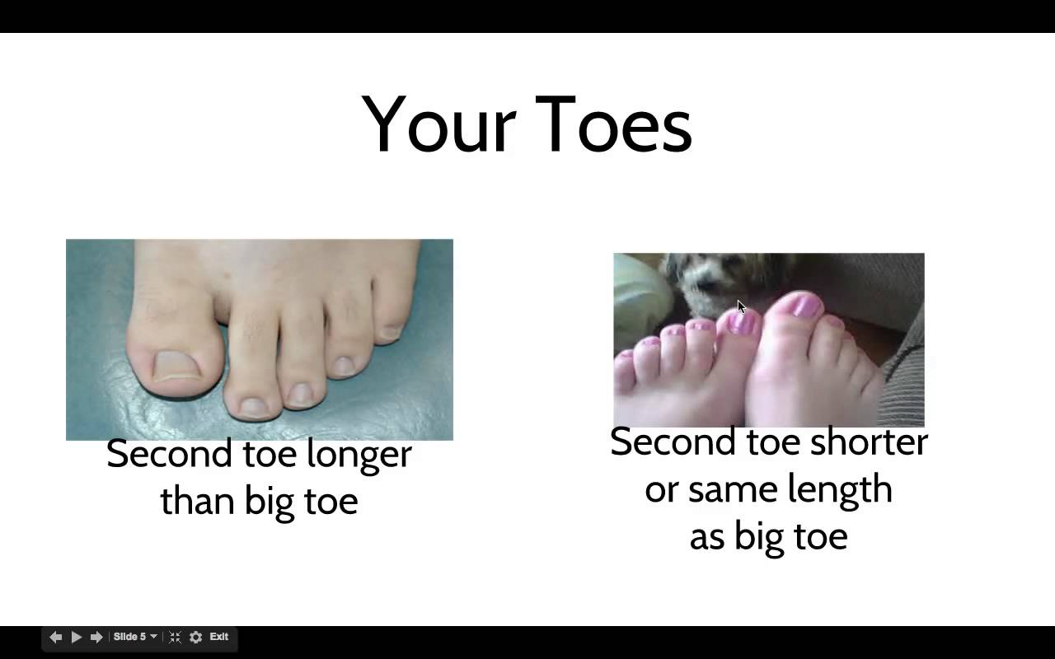
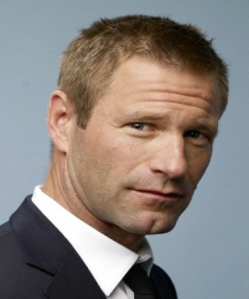
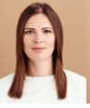
Mendelian characters
DOMINANT | RECESSIVE
Widows peak | Strait hair line
Freckles | No freckles
Cheek dimples | No dimples
Thick lips | Thin lips
Ability to roll tongue | Inability to roll tongue
Cleft in chin | No cleft in chin
Free ear lobes | Attached year lobes

Slide 23

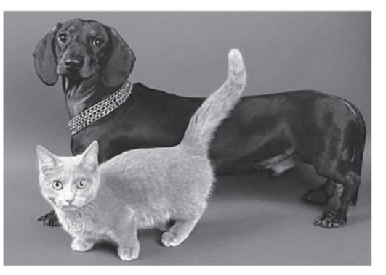
Autosomal-dominant disorders
Achondroplasia

Slide 24
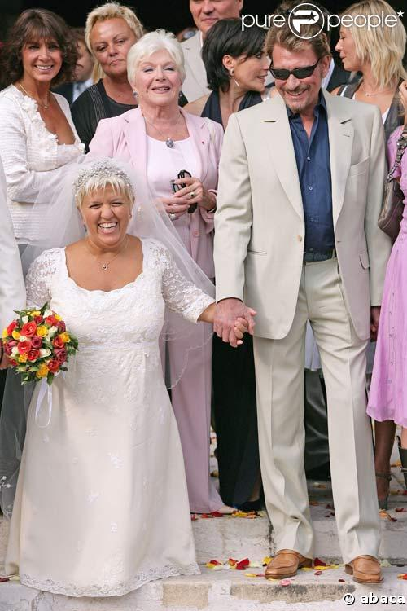
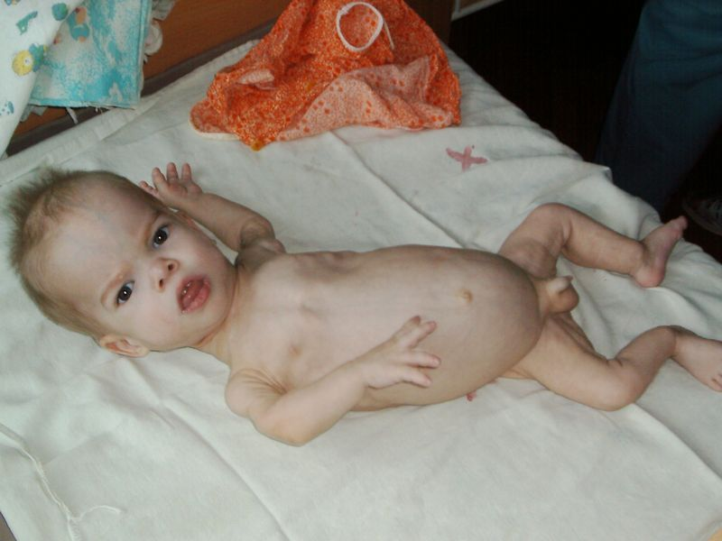
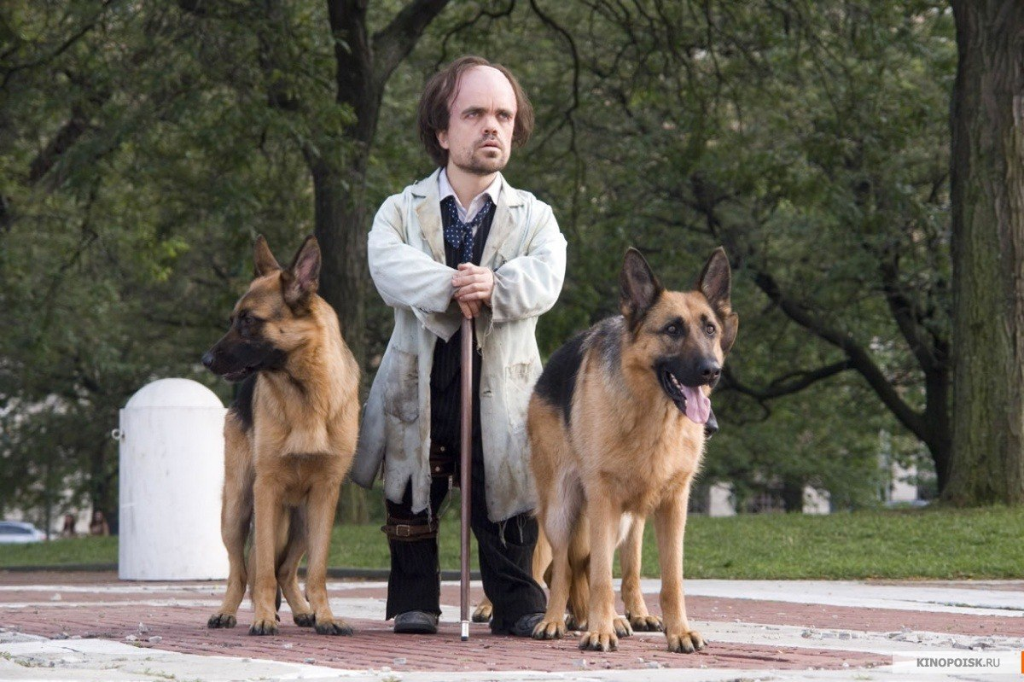

Slide 25
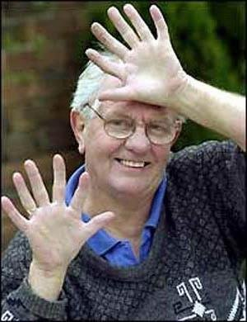
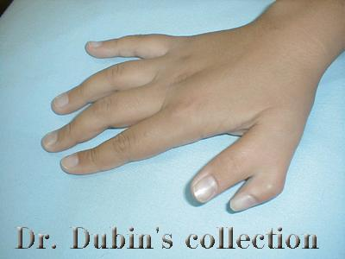
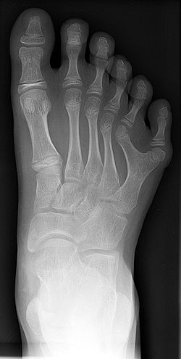
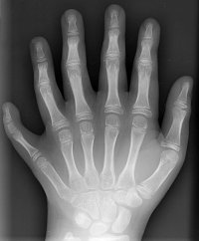
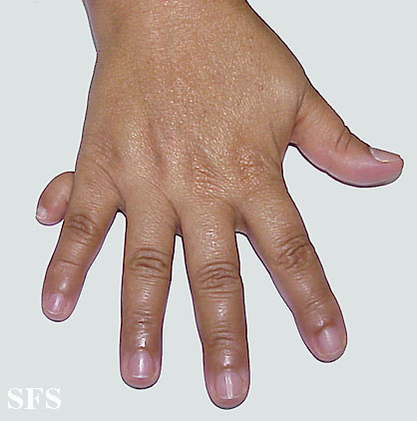
Polydactyly

Slide 26
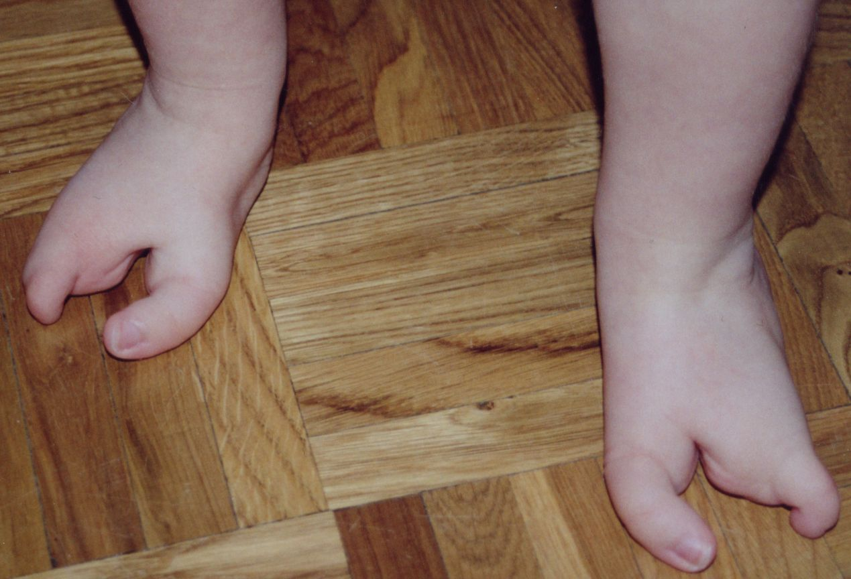
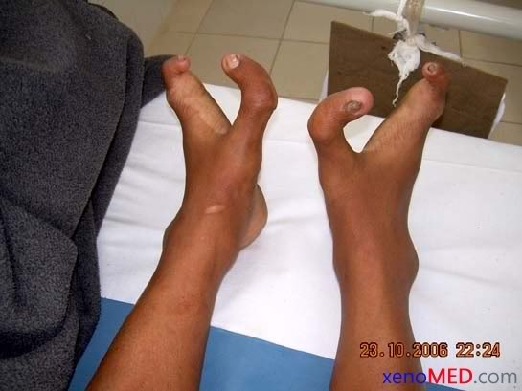
Ectrodactyly

Slide 27
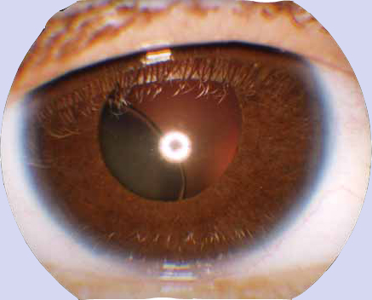
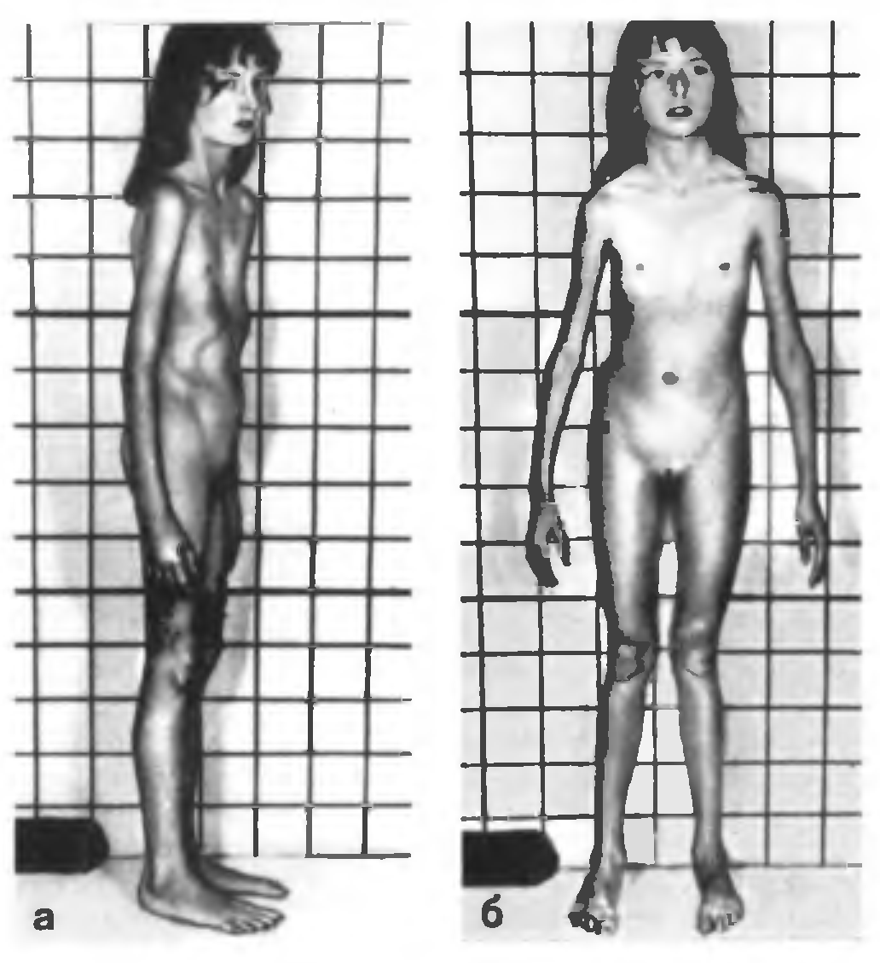
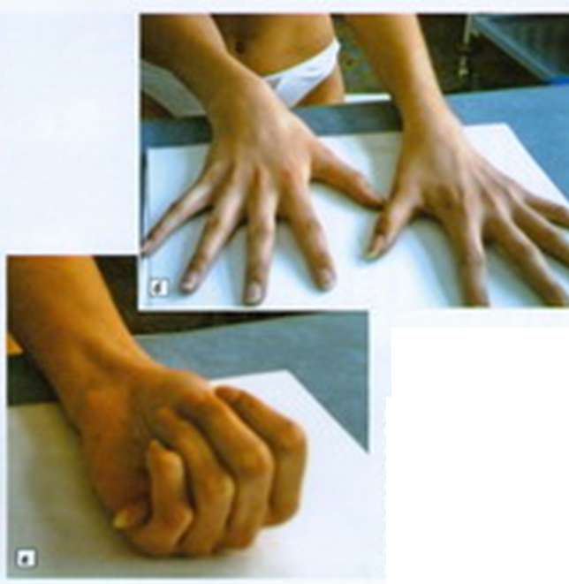
Marfan syndrome

Slide 28
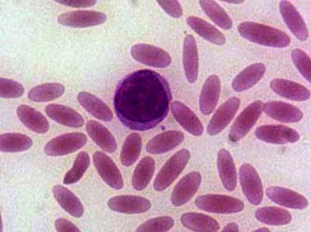
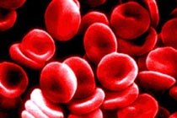
Elliptocytosis

Slide 29
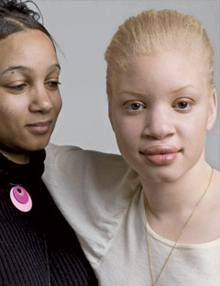
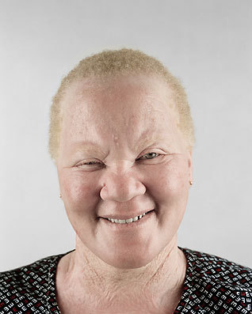
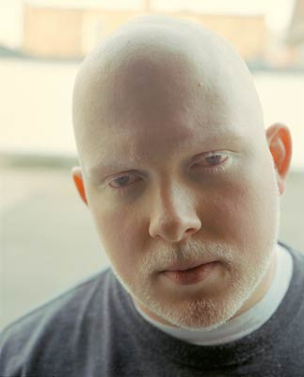
Autosomal-recessive disorders
Albinism

Slide 30





Slide 31

Cystic fibrosis

Slide 32

The test cross
Homozygous and heterozygous individuals apparently do not differ in dominant trait.
For the analysis of genotype individuals with an dominant phenotype are mated with recessive homozygous
manifestation of traits in offspring, it is possible to determine the genotype:
P ♀ AA x ♂ aa P ♀ Aa x ♂ aa
G: A; a G: A , a;
F1 Aa-100% F1 Aa 50%, aa-50%.
All individuals have -½ of the individuals dominant have dominant sign character

Slide 33

Dihybrid cross - cross between two individuals that
differ by two pairs of alternative /contrasting/ signs
Mendel crossed the plants with
A - yellow seeds, B - smooth.
a - green seeds; b - wrinkled
P ♀ AABB x ♂ aabb
yellow green
smooth wrinkled
G: AB ab
F1 AaBb
yellow smooth
In the cross of two homozygous all offspring had the dominant characters of one of the parents that is the same regularity of monohybrid cross repeated.

Slide 34

P ♀ AaBb x ♂ AaBb
produce 4 types of gametes:
AB, Ab, aB, ab
in equal numbers.
Two plants producing such gametes, when crossed produce 16 possible combinations.
To determine genotypes of offspring we use Punnett‘s square.

Slide 35

Phenotype ratio of F2 plants are:
9 showing both dominant characters,
3 + 3 recombinants with one dominant and one recessive characters,
1 showing both recessive characters.
9/16 - yellow round (A_B_);
3/16 - yellow wrinkled (A_bb);
3/16 - green round (aaB_);
1/16 - green wrinkled (aabb).
The genotypic ratio is: 1AABB: 2AABb: 2AaBB: 4AaBb: lAAbb: 2Aabb:1aaBB: 2aaBb: 1aabb
The ratio of each character taken separately is 3 : 1 ( 12 yellow and 4 green; 12 round and 4 wrinkled), so segregation of each pair of characters occurs independently.

Slide 36
Pea plants pass on to descendants hereditary characteristics in the form of discrete units.
Hereditary factors are distributed in the offspring by chance, discovered laws are statistical in nature. If the number of offspring is large enough, their ratio will more accurately expressed (the laws of probability).
LAW OF INDEPENDENT ASSORTMENT (the third Mendel law)
If parents differ in two or more pairs of contrasting characteristics, the inheritance of each pair occurs independently, if genes coding these characteristics are located in different pairs of chromosomes.

Slide 37

Cytological bases of Mendelian inheritance – random segregation of maternal and paternal chromosomes in meiosis

Slide 38
Multiple alleles
More than 2 allelic genes form a series
multiple alleles.
They arise as a result of multiple mutations of the same locus in the chromosome.
Between gene A and gene a appear
intermediate genes, which in relation to
dominant gene behave as recessive, but in relation to recessive - as dominant alleles of the same gene.
Examples: - the inheritance of blood groups of ABO system / 3 allele/;
- Inheritance of hemoglobin /> 100 alleles/.
But each individual diploid organism
be the bearer of not more than 2 alleles.

Slide 39


Slide 40

Currently known 35 systems of erythrocyte blood groups, which include more than 300 different antigens:
ABO, Rh, MN, P, Duffy, Lewis,
Lutheran, Kell, Kidd, Diego, Cromer, etc.

Slide 41
Inheritance of blood groups of ABO system
was discovered by the Austrian bacteriologist
K. Landsteiner in 1900
Blood Antigene of Antibodies Genes Genotype
group R.B.C. of plasma
I (0) - α, β I^{O} I^{O}I^{O}
II (A) A β I^{A} I^{A}I^{A}, I^{A}I^{O}
III (B) B α I^{B} I^{B}I^{B}, I^{B}I^{O}
IV (AB) A, B - I^{A}, I^{B} I^{A} I^{B}
4 groups of blood are determined by three alleles
one gene I (I^{A}, I^{B}, I^{O}), which are arranged in 9th pair of chromosomes. Alleles I^{A} and I^{B} dominant in relation to the I^{O} allele, but codominant in relation to each other.
When there are three possible alleles 6 genotypes.
I^{A}> I^{O} <I^{B}

Slide 42


Slide 43


Slide 44


Slide 45
Blood groups are stable, easily definable, are available in the study of the frequency of the phenotype in the population;
Inheritance of blood groups is according to the laws of Mendel, is characterized by genetic determination, does not depend on the external environment and does not change throughout life.
Ethnic group | Blood groups
 | 0(I) | A(II) | B(III) | AB(IV)
Caucasians | 44% | 43% | 9% | 4%
Blacks | 49% | 27% | 20% | 4%
Asians | 43% | 27% | 25% | 5%

Slide 46

Importance in practical medicine:
1. In transfusion - the selection of donors
2. In forensic medicine - the exclusion of paternity, to identify a person.
3. AB0 blood groups are associated with some multifactorial diseases.

Slide 47

In 1940 K. Landsteiner and A. Wiener described another antigen / protein that is found in rhesus macaque monkeys, and then a man / named
Rh-factor and
opened a new group of blood - rhesus Rh.
In 85% of people contained in blood this factor -
Rh-positive / Rh + /.
In 15% of Rh-negative / Rh-/ /
K. Landsteiner

Slide 48
Inheritance of Rh- factor depends on
Rhesus factor is a group of antigens depending on two tightly linked genes (RHD and RHCE) located next to each other on chromosome 1.
In practice we distinguish 2 groups:
- Rh-positive - their blood contains the Rh antigen - have dominant gene D ,
- Rh-negative - have recessive gene d.
Consequently, the Rh factor is inherited as
autosomal dominant Mendelian trait.

Slide 49
The appearance of antibodies in the ABO system occurs naturally, and in the Rhesus - because of the reaction of immunization.
Importance in practical medicine:
- In the transfusion – the second transfusion of Rh + blood to rh-person can lead to death.
- In obstetrics – Rh- incompatibility; Rh (-) women and Rh (+) fetus is the cause of immune conflict, leading to
erythroblastosis fetalis (hemolytic disease of newborns) in the second pregnancy.

Slide 50


Slide 51


Slide 52

Lethal alleles are the genes that in homozygous state cause death of an individual. In the heterozygous state organisms
remain alive / the ratio in F2 2:1 /.
Examples:
- Brachydactyly / shortened fingers /: sign
manifested in the heterozygous state. In AA - death in the early stages of embryogenesis;

Slide 53



- thalassemia / AA / - death in early childhood;
- Sickle-cell anemia / aa / - die in early childhood.

