Slide 1
Gene interactions. Chromosomal theory of heredity

Slide 2
GENES
ALLELIC
Are located at the same locus of homologous chromosomes and control same characteristics
Are labeled by the same letters of Latin alphabet
NON-ALLELIC
Are located in different loci of homologous chromosomes or in non-homologous chromosomes and control different traits
Are labeled by different letters of Latin alphabet
В
b
Х Х
А
а
F V
f v
or
E
e

Slide 3
INTERACTION OF GENES
Allelic: Non-allelic:
1.Complete dominance; 1.Complementerity
2.Incomplete dominance; 2. Epistasis;
3. Overdominance; 3. Polymery;
4. Codominance; 4. “Position effect“.
5.Allelic exception;

Slide 4
Complete dominance
Just one of the alleles is manifested in heterozygote state
Hybrids of F1 generation have dominant phenotype
х
АА
аа
Аа
Аа

Slide 5
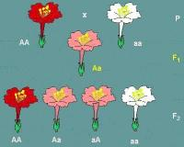
Incomplete dominance
/ or intermediate inheritance/ - dominant allele does not suppress recessive completely.
Classic example - the inheritance of color
flowers at 4 o‘clock plant.
The ratio by
genotype and phenotype
in the F2 is
1:2:1

Slide 6
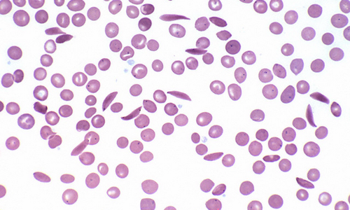
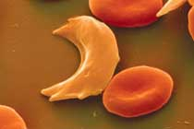
Sickle-cell anaemia
hereditary disorder (aa), characterized by atypical hemoglobin molecule and sickle (crescent) shape of red blood cells. Such erythrocytes break down easily (hemolysis) that leads to anemia, fatigue, enlargement of liver and spleen, delayed growth.
Heterozygous carriers (Aa) usually do not have symptoms of the diseases. In low oxygen levels, high attitudes, dehydration and some other conditions they can demonstrate attacks of the disease caused by hemolysis of RBCs.

Slide 7
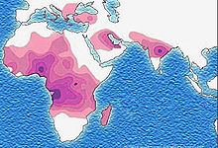
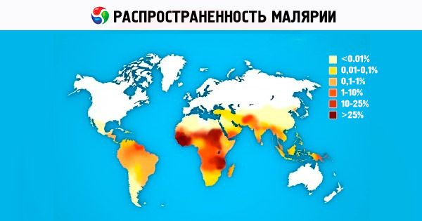
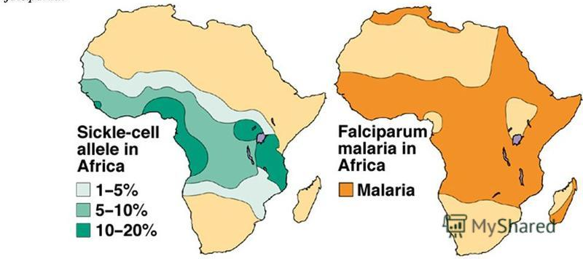
Disease is more common in regions with high prevalence of malaria

Slide 8
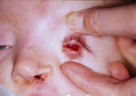
Anophtalmos: congenital absence of the eye ball in recessive homozygous state, heterozygous persons have small eye balls.
CYSTINURIA: cystine stones in the kidneys have
homozygous persons, heterozygous excrete
increased amount of cystine with urine.
Notes:
A married couple is screened to assess the risk for Gaucher disease in their children. The activities of
glucocerebrosidase in the sera of the mother and father are 45% and 55%, respectively, of the reference value. The
couple has one child. Which of the following is the probability of the child possessing one or more alleles of the
Gaucher mutation?

Slide 9
CODOMINANCE:
Manifestation in heterozygous signs determined by both alleles. I^{A}I^{B} - IV blood group ABO system;
I^{M}I^{N} - MN group system MN.
I^{В}
I^{А}
ANTIGEN A
ANTIGEN B
erythrocyte

Slide 10
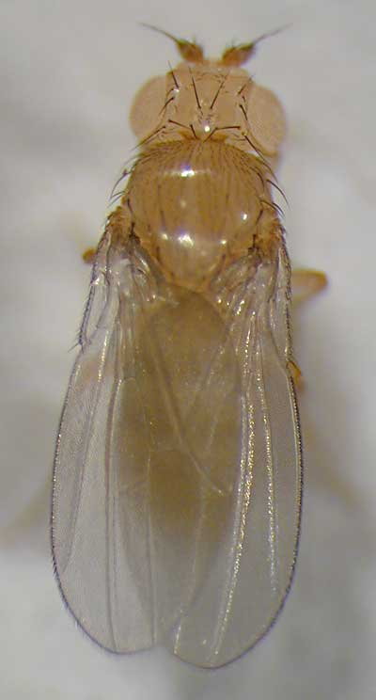
Overdominance:
Dominant gene in heterozygous condition
is more expressed than in homozygous;
The life span in Drosophila:
- AA - a normal life span;
- Aa - increased life span;
- aa - fatal.

Slide 11
5. Allelic EXCEPTION:
In heterozygotes in some cells active one allele, and others - another.
as a result of random inactivation one of the two
X-chromosomes, in different
body cells phenotypically
manifest different alleles of
maternal or paternal
X - chromosome.

Slide 12
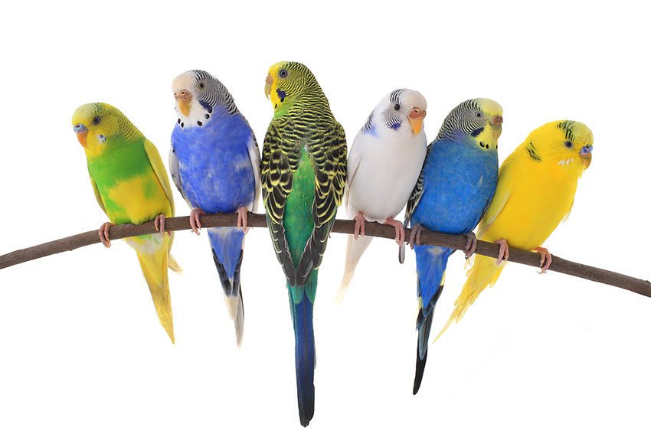
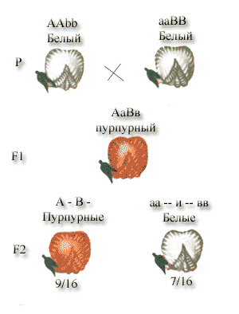
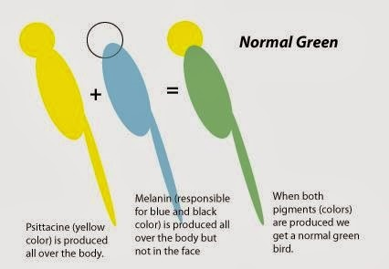
Interaction of nonallelic genes.
Complementarity A manifestation of a new trait in the presence of 2-dominant non-allelic genes ;
Budgie color inheritance
Inheritance of flower colour at sweet pea.
In F2: ratio is 9 (red flowers) : 7 (white).

Slide 13
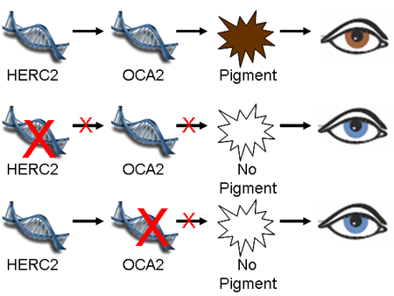
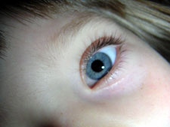
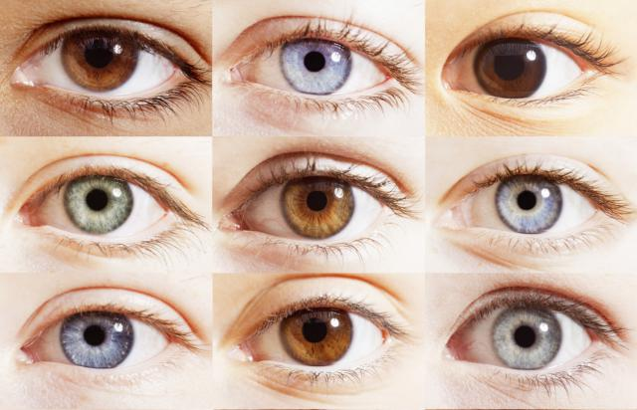
может быть кареглазый ребенок:
P ааBB x ААbb
G аB Аb
F1 AaBb
100% - brown eyes
The OCA2 gene (formerly called the P gene) provides instructions for making a protein called the P protein. This protein is located in melanocytes, where it may transport molecules into and out of melanosomes (where melanin is produced) (15q)
A mutation in the HERC2 gene adjacent to OCA2, affecting OCA2's expression in the human iris, is found common to nearly all people with blue eyes.
Eye color is determined by level of pigmentation and scattering of light by the stroma of iris; 16 genes are identified
Notes:
HERC-2 next to Oca 1. E3 ubiquitin-protein ligase that regulates ubiquitin-dependent retention of repair proteins on damaged chromosomes. A regulatory element within in an intron of the HERC2 gene inhibits OCA2 promoter.

Slide 14
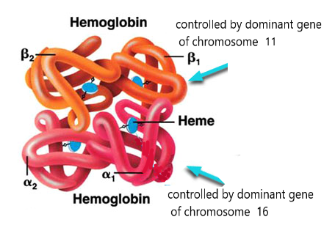
Examples of complementarity in humans
-
Synthesis of hemoglobin;
Synthesis of interferon
Hereditary myopia;
Hereditary blindness;
Glaucoma;
Pigmentation of hair;
Development of normal hearing
Deaf-and-dumbness;

Slide 15
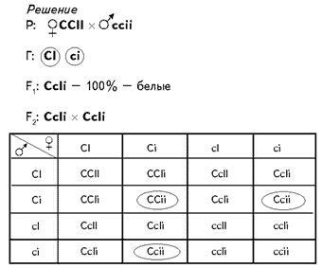
2.EPISTASIS:
- Gene of one allele pair (dominant or
recessive) inhibits the action of non-allelic
gene of another pairs.
Gene- SUPPRESSOR - I or i > C-hypostatic gene.
Classic example: the inheritance of color
feathering in
chickens.
13 white to
3 black in
F2

Slide 16
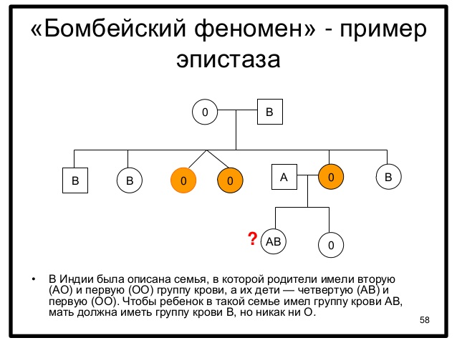
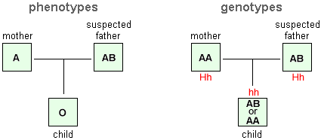
Examples of epistasis in humans:
"Bombay phenomenon“– unusual inheritance of ABO blood groups.
P ♀ I^{A}I⁰Hh × ♂ I^{B}I⁰Hh
F1 I^{A}I^{B}hh

Slide 17
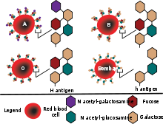

Slide 18
3. POLYMERY.
Dominant genes from different allelic pairs
enhances the manifestation of the same trait
called polymeric.
The interaction of these genes in the process of formation feature called polymeria
(polygenic or quantitative inheritance).
With the help of polymeric gene inherited
quantitative or polygenic traits.
Polymeric genes are marked by the same Latin letter with a different indices -
- A1A1A2A2A3A3.

Slide 19
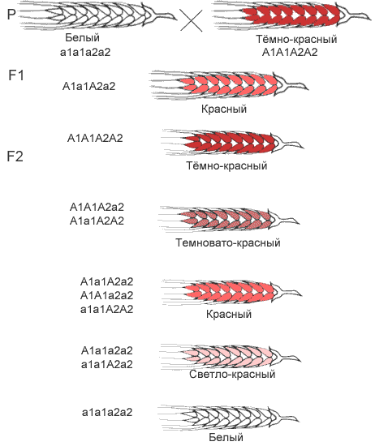
Polymeria was discovered and studied by Swedish geneticist Nilsson-Elhe in 1908 when studying inheritance of kernel color in wheat.
An important feature of polymeria - the summation action of non allelic genes on the development of a quantitative trait.

Slide 20
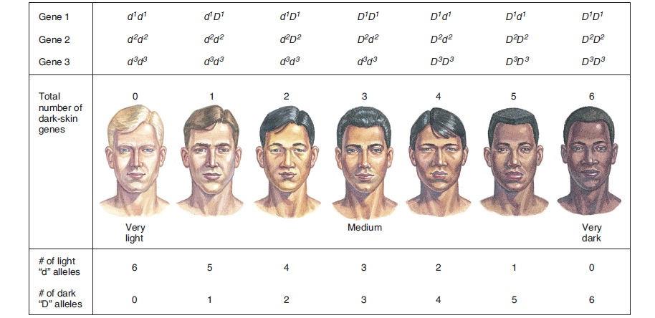
For instance, polymeric gene interaction, controlling skin color and eye color
skin color depends on type, amount, and packaging of melanin in the skin cells (more than twenty genes involved)
Notes:
Eye color is a polygenic phenotypic characterdetermined by two distinct factors: the pigmentation of the eye's iris^{[1][2]} and the frequency-dependence of the scattering of light by the turbid medium in the stroma of the iris.[

Slide 21
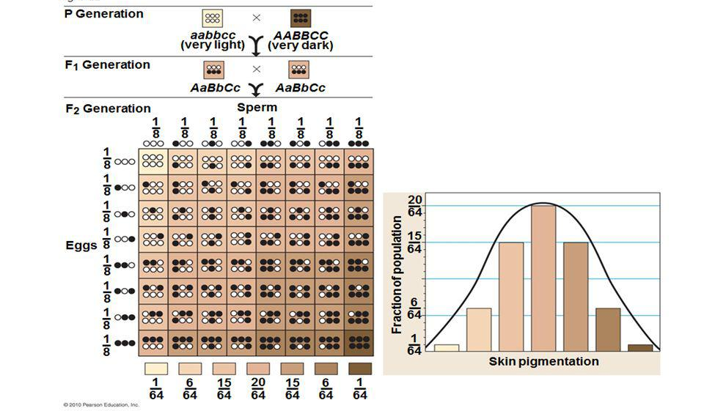
Quantitative inheritance in dihybrid cross

Slide 22

PLEIOTROPY
One gene is responsible for the presence of several signs [multiple gene action].
Red hair gene
Red hair (pheomelanin pigment)
White skin
Freckles
High risk of skin cancer

Slide 23
Marfan‘s syndrome [arachnodactyly].
abnormal development of connective tissue
Anomalies Defects of the cardio- Anomalies
of the skeleton vascular system of the eye
Elongation phalanges Aneurysm Myopia
fingers of arms of the aorta
and toes
Subluxation The high arch of the lens
Deformed breast

Slide 24
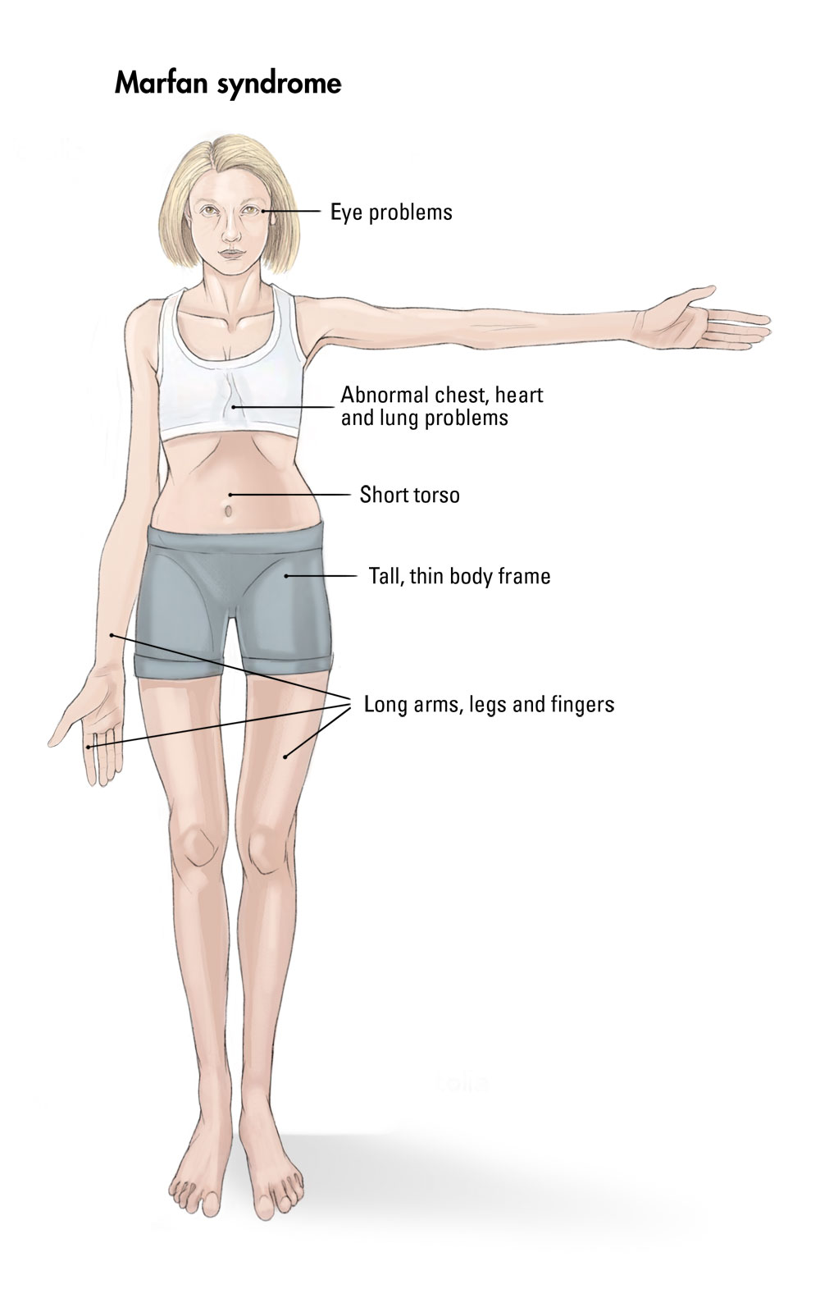
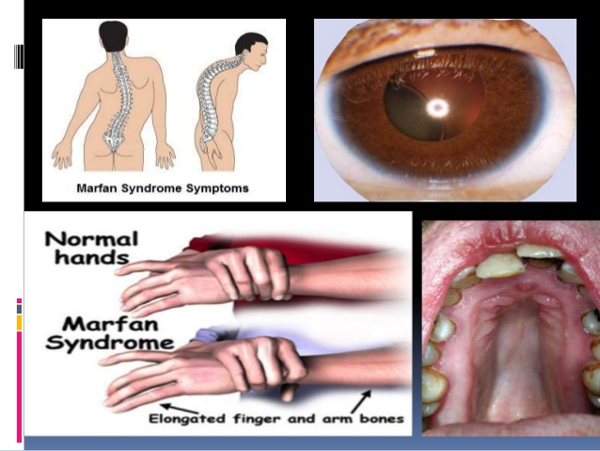

Slide 25
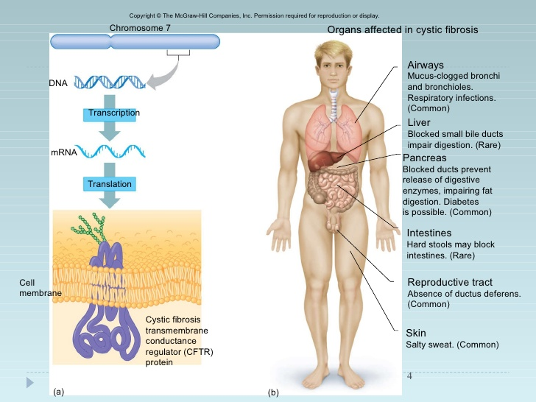

Slide 26
In 1902, B. Sutton, and T. Boveri independently came to the conclusion that the chromosomes were the carries of genes.
A number of properties and characteristics of many organisms, always inherited in a certain combination with each other / the phenomenon of linkage of genes was discovered in 1906, by Bateson and R. Pennet.
The explanation of this phenomenon was given by an American scientist T. Morgan and his staff, working with fruit fly - Drosophila melanogaster.
CHROMOSOME THEORY OF Heredity was formulated by T. Morgan and his colleagues
K. Bridges, A. Sturtevant, G. Moeller in 1925.,
that was the result of studying the basic regularities - of heredity at the level of the cell.

Slide 27
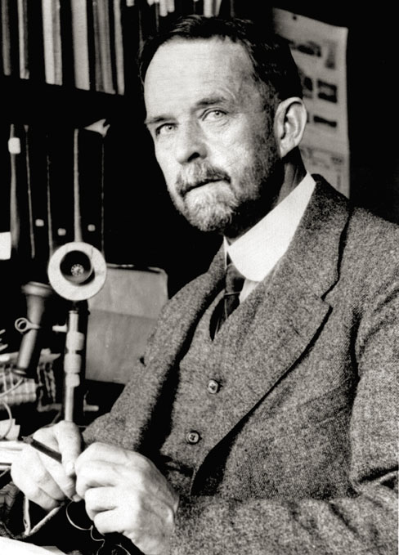
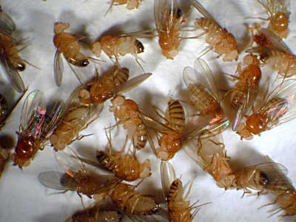
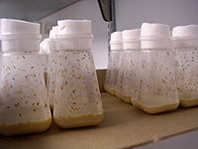
CHROMOSOME THEORY OF HEREDITY.

Slide 28
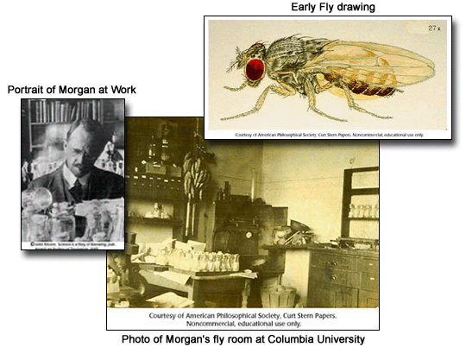

Slide 29
By the beginning of the XX-th century were made following research discoveries, which played an important role in the development of this stage of genetics:
1. H.de Vries, C. Correns, and E. Tschermak rediscovered laws of Mendel.
2. A.Weisman formulated hypothesis that the hereditary material is to be located in the chromosomes.
3. The processes of mitosis and meiosis were studied.
4. F. Janssen described the formation of chiasmata in the process meiosis in the formation of gametes in insects.
5. Differences in the chromosome sets in cells of male and female organisms were established .

Slide 30
Contributed to the success of T. Morgan, thanks
fortunate choice of the object of research:
1.Drosophilae flies unpretentious, its easy to keep in laboratory conditions.
2.They are fertile enough / life cycle 2 weeks / to create up to 20 generations per year.
3. They are rich with mutations obtained in
laboratory conditions, which allows conduct of hybridization analysis.
4.Have only 4 pairs of chromosomes, which gave the possibility to identify the linkage groups for many genes.

Slide 31
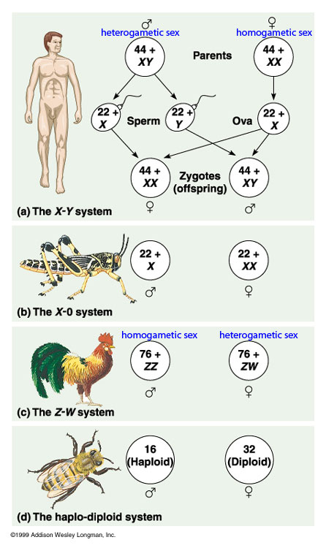
Sex determination systems

Slide 32
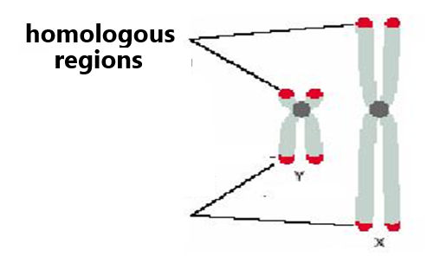
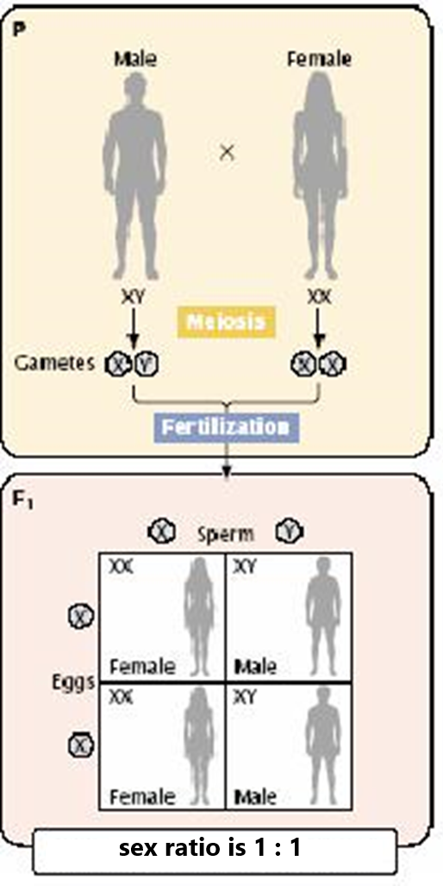
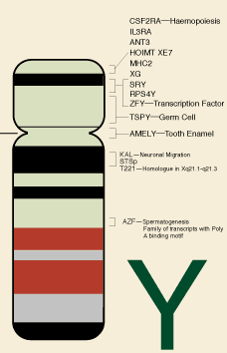

Slide 33
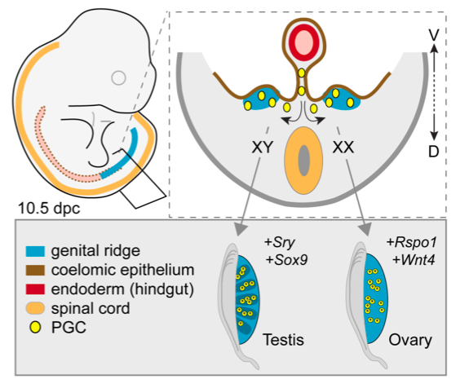
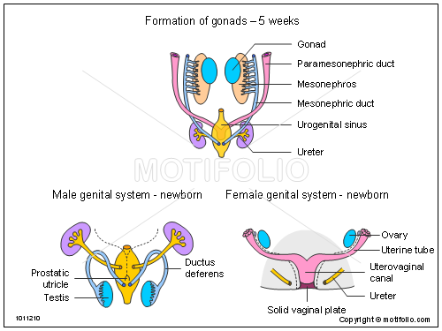
Early human embryo has non-differentiated primary gonads and two primitive ducts that can give rise to either the male or the female reproductive tracts (Wolffian or mesonephric and Mullerian or (paramesonephric ducts)
Notes:
ormation of the testes or ovaries from embryonic genital ridges.
Top left: Illustration of a mouse embryo 10.5 days after fertilization, which is similar to a human embryo at an analogous stage (about 6 weeks gestation), showing the position of the genital ridges in blue. Top right: Diagram of a cross-section of the embryo, showing the genital ridges in blue. Bottom right: Each genital ridge can develop into a testis or an ovary, depending on the genetic signals received. In XX embryos, ovaries usually form, but in XY embryos, testes usually form.
Rspo 1 he encoded protein is a ligand for leucine-rich repeat-containing G-protein coupled receptors (LGR proteins) and positively regulates the Wnt signaling pathway. In critical gonadal stages, between six and nine weeks after fertilization, the ovaries upregulate it while the testes downregulate it

Slide 34
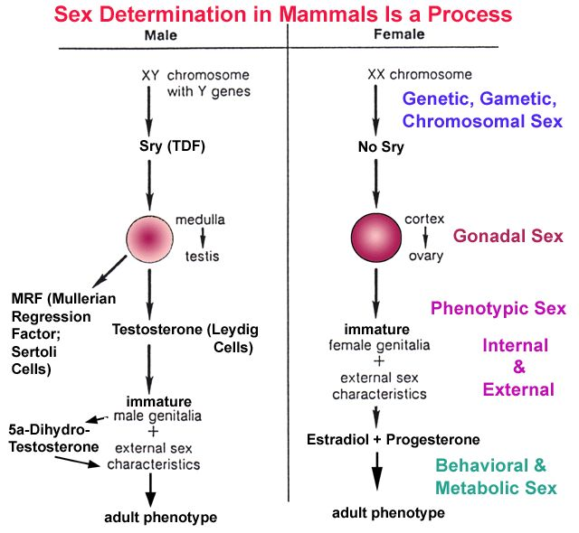
6 week of embryogenesis – activation of SRY
end of week 9 Leydig cells start to produce testosterone
Sertoli cells produce MIF

Slide 35
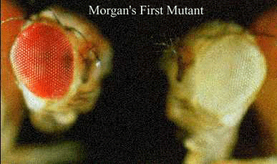
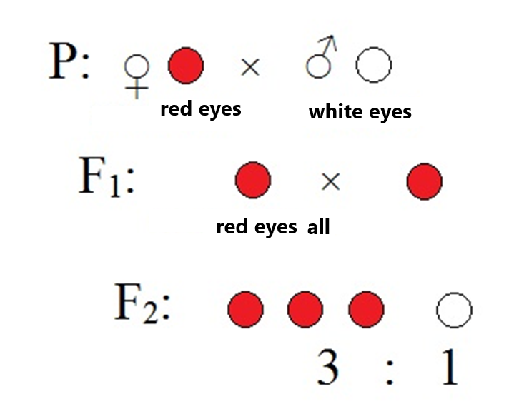
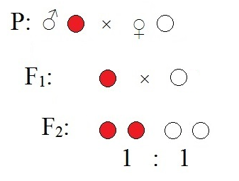
Sex-linked inheritance was discovered by T.H.Morgan in experiments with drosophila fly

Slide 36
The scheme of hemophilia inheritance:
X^{H} – normal blood clotting,
X^{h} – hemophilia.
P ♀ X^{H}X^{H} x ♂X^{h}Y P ♀X^{H}X^{h} x ♂X^{H}Y
healthy sick carrier healthy
G X^{H} X^{h}, Y G X^{H}, X^{h} X^{H}, Y
F1 X^{H}X^{h}, X^{H}Y F1 X^{H}X^{H},X^{H}Y,X^{H}X^{h},X^{h}Y
healthy healthy sick
P ♀ X^{H}X^{h} x ♂ X^{h}Y
carrier sick
G X^{H},X^{h} X^{h},Y
F1 X^{H}X^{h}, X^{H}Y, X^{h}X^{h}, X^{h}Y
h h s s

Slide 37
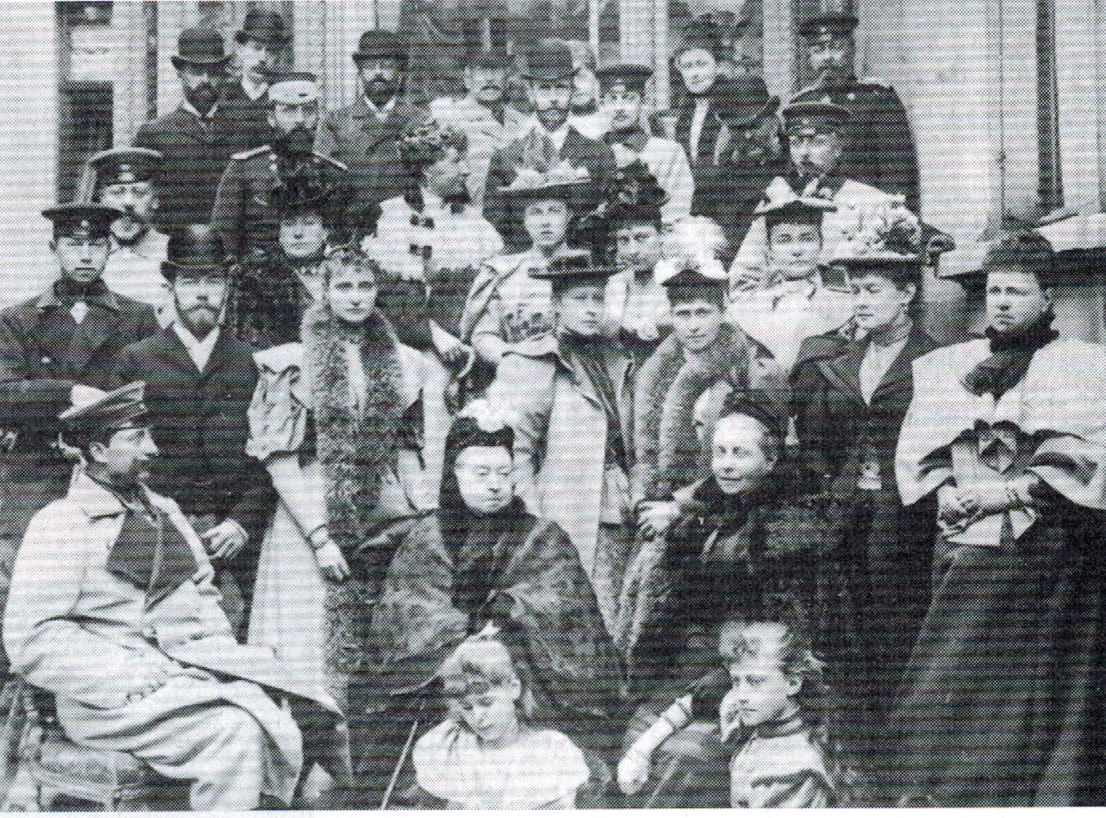

Slide 38
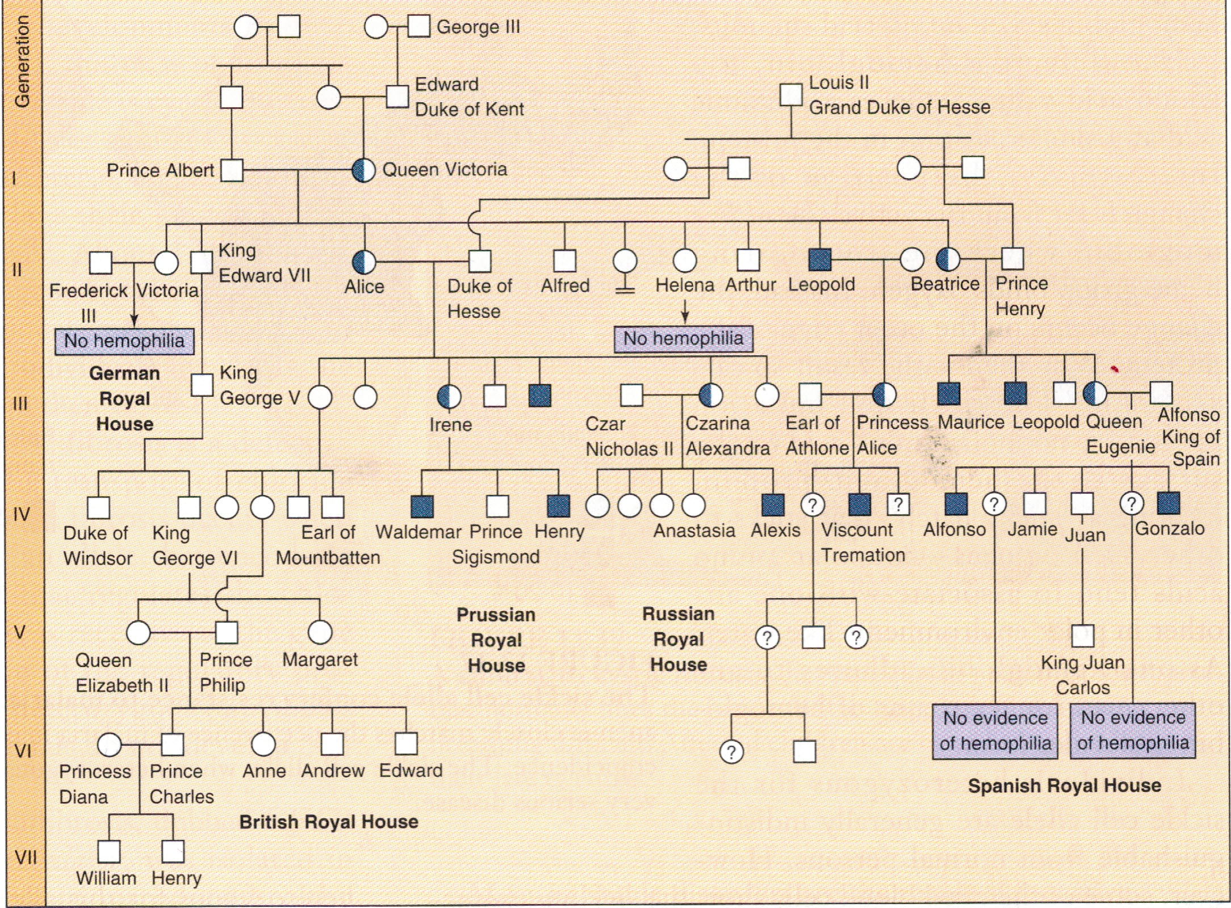

Slide 39
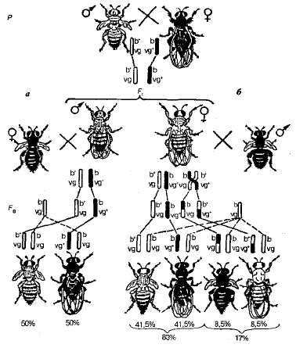
Further experiments of T. Morgan on dihybrid
cross gave results do not coincide with the laws of Mendel.

Slide 40
B -a gray body, V - a long wings,
b - a black body, v - a short wings.
P ♀ BBVV × ♂ bbvv
G BV bv
F1 BbVv - 100%
(I) F1 ♀ bbvv × ♂ BbVv (II) F1 ♀ BbVv × ♂ bbvv
G bv BV, bv G BV,Bv,bV,bv bv
F BbVv, bbvv F2 BbVv, Bbvv, bbVv, bbvv
50%: 50% 41,5%: 8,5%: 8,5%: 41,5%
complete linkage incomplete linkage

Slide 41
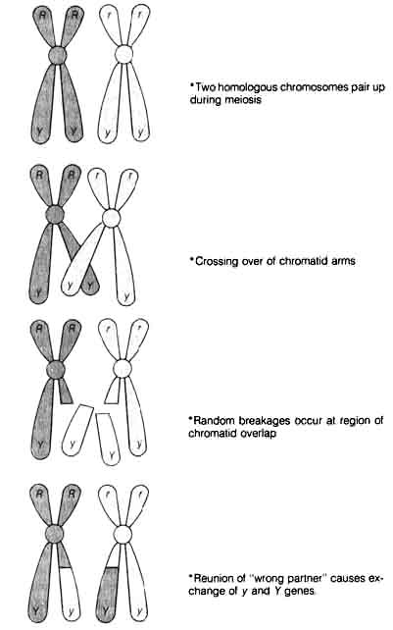
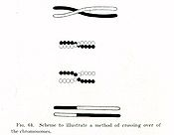
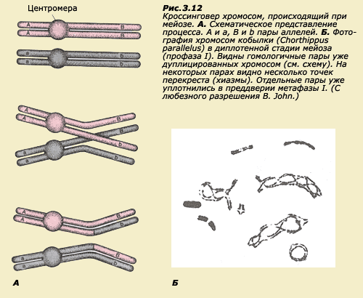

Slide 42
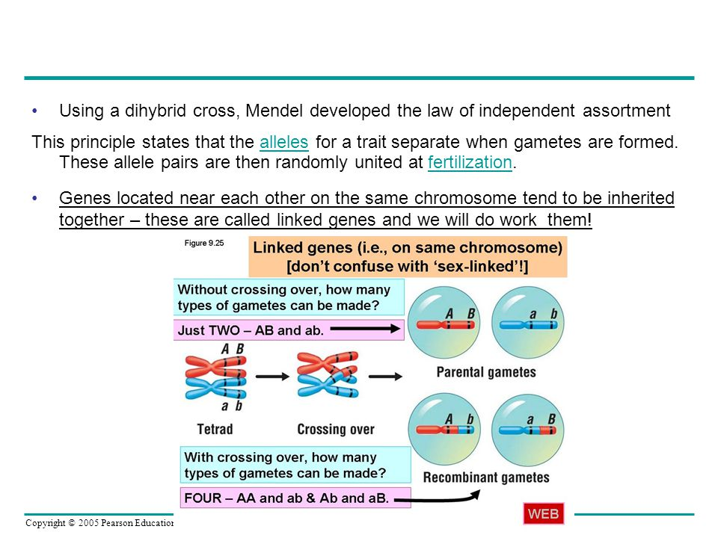

Slide 43
The main postulates of the chromosome theory.
1.Genes are located in the chromosomes, various chromosomes contain unequal number of genes, set of genes of each non-homologous chromosomes is unique.
2.Genes are located in the chromosome in linear order, each gene in chromosome occupies a certain locus.
3.Genes of one chromosome form a group of linkage and is inherited together, the number of linkage groups is equal to the haploid set of chromosomes of this species.
4.Linkage of genes may be incomplete because homologous chromosomes are capable of exchanging of alleles genes /crossing over/.
5. The percentage of crossing-over is proportional to the distance between genes.

Slide 44
The existence of crossing-over allowed Morgan school to develop principle constructing genetic maps of chromosomes in 1911-1914.
The basis for maps laid the fact that genes are located along the length of the chromosome in a linear order.
Genetic map of chromosomes - is a segment line, which schematically indicate the order of genes location and the distance between them in centiMorgans.
It is based on analyzing the results of test cross, analysis of pedigrees, hybridization of somatic cells
Physical maps are maps composed by direct DNA studying. Distance is measured in base pairs.
One centiMorgan matches to about one million base pairs in humans on average.

Slide 45
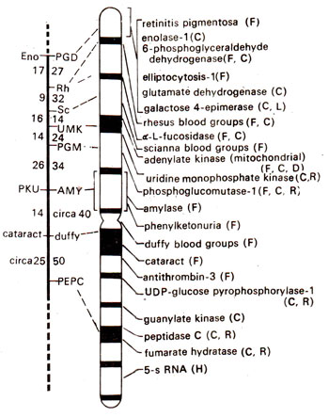
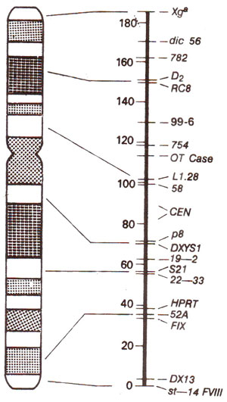
Notes:
Map of chromosome-1 of the human genome and the genes that have been identified. In the figure on the left, linkage group is shown with location of genes and the recombination frequencies (figures on left are from male and those on right from female meiosis; note higher frequencies in female). Broken line shows terminal region where no genes could be located till 1983. In the figure on right G bands, centromere and location of different genes are shown. Methods used for chromosome mapping are shown in parentheses (F = family linkage; C = cell hybrids; R = radiation induced loss; LD = linkage disequilibrium with another marker; H = in situ hybridization; D = deletion mapping (redrawn from Fincham-Genetics, 1983; current map will be much more extensive; see Table 24.4)
Genetic map of human X-chromosome; in the figure on the left, the G-bands of the X-chromosome are shown; in the figure on the right, linkage map is shown with distances (recombination frequencies as centimorgan or cM units) on one side and location of genes on the other side.
http://www.biocyclopedia.com/index/genetics/human_genetics/chromosome_mapping_in_humans_including_rflps.php

Slide 46
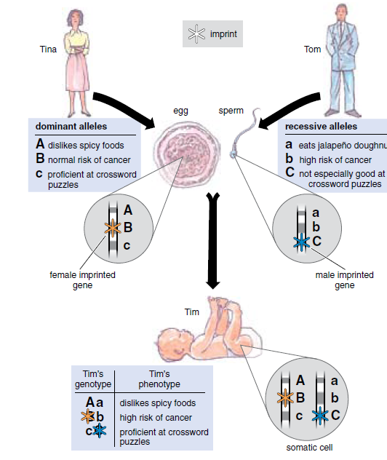
Non-mendelian inheritance
Genome imprinting - mono-allele expression of some genes in a parent-of-origin dependent manner.
Inactive gene is termed imprinted

