Slide 1
Variation in human
as a peculiarity
of life and genetic phenomenon.

Slide 2
Human genetic variation
is the genetic differences in and among populations.
On average, in DNA sequence, each human is 99.5% similar to any other human
A single nucleotide polymorphism (SNP) is a difference in a single nucleotide between members of one species that occurs in at least 1% of the population.
An insertion/deletion polymorphism, “indel,” is a type of genetic variation in which a specific nucleotide sequence is present (insertion) or absent (deletion)
As of 2017, the Single Nucleotide Polymorphism Database which lists SNP and other variants, listed 324 million variants found in sequenced human genomes
Notes:
The 1000 Genomes Project (2015) set out to provide a comprehensive description of common human genetic variation by applying whole-genome sequencing to a diverse set of individuals from multiple populations. completion of the project, having reconstructed the genomes of 2,504 individuals from 26 populations using a combination of low-coverage whole-genome sequencing, deep exome sequencing, and dense microarray genotyping. We find that a typical genome differs from the reference human genome at 4.1 million to 5.0 million sites . Although >99.9% of variants consist of SNPs and short indels, structural variants affect more bases: the typical genome contains an estimated 2,100 to 2,500 structural variants (~1,000 large deletions, ~160 copy-number variants, ~915 Alu insertions, ~128 L1 insertions, ~51 SVA insertions, ~4 NUMTs, and ~10 inversions), affecting ~20 million bases of sequence.
NUMT, pronounced "new might,” is an acronym for “nuclear mitochondrial DNA segment” coined by molecular evolutionary biologist, Jose V. Lopez, which describes a transposition of any type of cytoplasmic mitochondrial DNA into the nuclear genome of the eukaryotic organisms
As of 2017, the Single Nucleotide Polymorphism Database (dbSNP), which lists SNP and other variants, listed 324 million variants found in sequenced human genomes

Slide 3
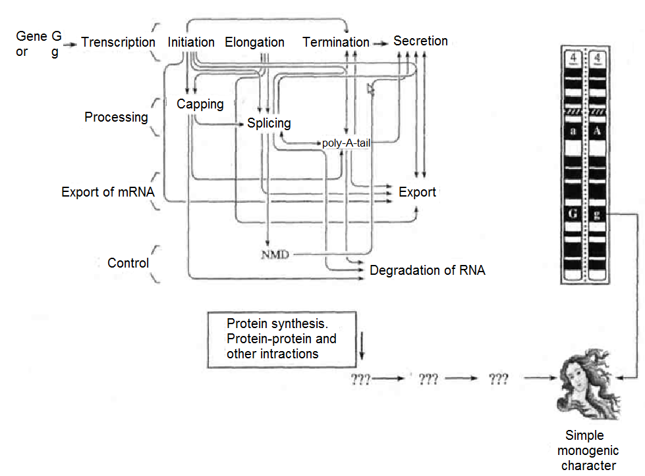
Phenotype is the set of all individual traits of an organisms that are formed in ontogenesis.

Slide 4
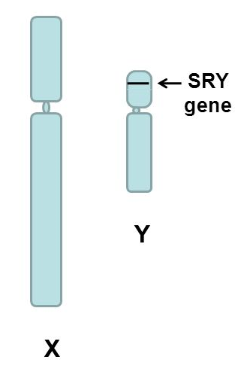
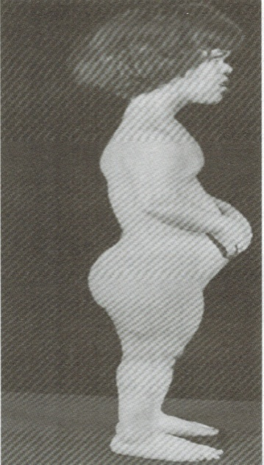
Phenotype is determined by many factors:
Presence of certain allele of gene
SRY gene
SRY deletion leads to infertile females with karyotype 46, XY;
Translocation of SRY on X chromosome leads to infertile males with karyotype 46, XX
FGFR 3 gene
(fibroblast growth factor receptor 3)
Variant G in1138 position (Gly) - normal variant
Variant A or C (Arg)- dwarfism (achondroplasia)

Slide 5
2. Certain combination of alleles
combination of ABO blood groups alleles I^{A.},I^{B}, i :
O(I) blood group (ii);
A (II) blood group (I^{A}I^{A} or I^{A}i);
B (III) blood group(I^{B}I^{B} or I^{B}i);
AB (IV) blood group (I^{A}I^{B}).

Slide 6
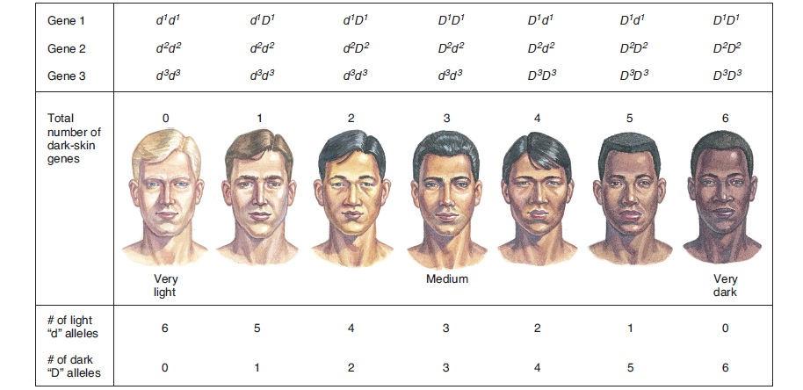
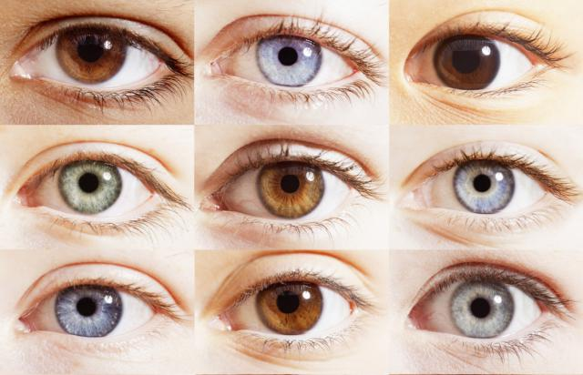
3.Certain combinations and interactions of non-allele genes
For instance, polymeric gene interaction, controlling skin color and eye color
skin color depends on type, amount, and packaging of melanin in the skin cells(more than twenty genes involved)
Eye color is determined by level of pigmentation and scattering of light by the stroma of iris; 16 genes are identified

Slide 7
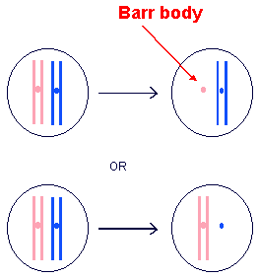
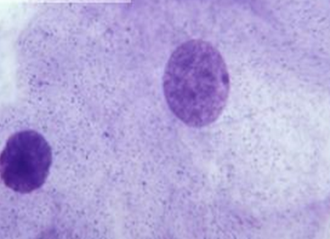
4. Dosage effect
extra chromosome 21 brings about 1% of extra genes but it manifests as Down syndrome.
Dosage compensation in females is inactivation of one of the X chromosomes . Process is random, so monozygotic female twins some times differ in X-linked characteristics

Slide 8
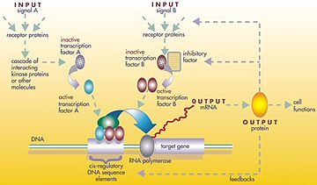
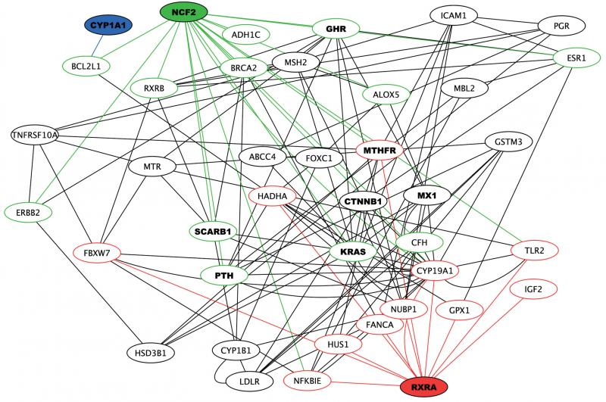
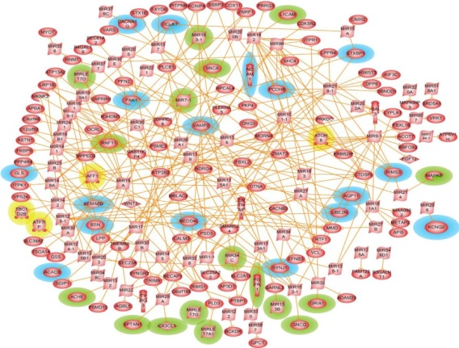
5. Influences of other genes in the gene network (interaction and regulatory).
.
Network of interactions associated with immune response to smallpox vaccination
Regulatory network in Parkinson disease
Notes:
Network of interactions associated with immune response to smallpox vaccination from a genetic study of 136 volunteers that assayed 1536 SNPs.

Slide 9
6.Environmental factors that influence gene expression
Epigenetic regulation - any mechanism that provides regulatory information to a genome without altering its primary nucleotide sequence (modification of histone proteins, DNA methylation)
Incomplete (reduced) penetrance
Variable expressivity

Slide 10
Penetrance is the proportion of people with a particular genotype who exhibit signs associated with this genotype.
If some people with this genotype do not develop traits depending on it, the condition is said to have incomplete (or reduced) penetrance.
Variable expressivity refers to the range of signs that can occur in different people with the same genetic condition

Slide 11
VARIATION is an ability of organisms to change their features and properties.
Variation is a common property of all living systems. It is one of the most important properties which are influenced by environment.
Variation is an event contrary to heredity and provides the variety of organisms.
It may concern PHENOTYPE and GENOTYPE and
always manifests itself by phenotypic changes.

Slide 12
VARIATION
Phenotypic variation
(modifications)
Genetic variation
Recombination
Mutations
Genome mutations
Chromosomal aberrations
Gene mutations

Slide 13

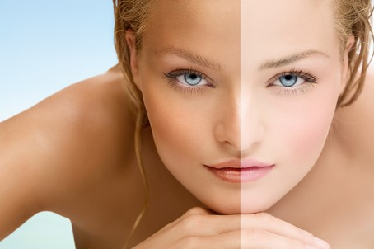
Phenotypic Variation or Modifications
The acquisition of new characters and properties under the influence of environmental factors that do not change genotype is called PHENOTYPIC VARIATION.
Examples of modifications in humans
- suntan
- increase of the muscle volume after the high physical exertions.

Slide 14
Modifications share several characteristics:
modifications are not inheritable as do not change genotype.
modifications are adaptive.
For example, increasing of erythrocytes number and amount of hemoglobin in the highland adapt to low oxygen pressure; rising of temperature and increasing of leukocytes are defense mechanisms.
modifications are single-vectored, which means that the same factors of environment cause the similar changes of the phenotype in organisms of a certain genotype.
For example, in summer all Caucasians get suntan under the action of UV rays

Slide 15
Modifications occur in a mass character — similar changes occur in all individuals of the species.
level of expression of variation depends on the intensity and duration of its action.
As a rule, modifications are reversible
If dangerous environmental factors act for a long time during the period of development, the changes are irreversible (for example, skeleton deformation due to Vit D deficient rickets if not treated).
Such changes in phenotype are called morphosis.

Slide 16
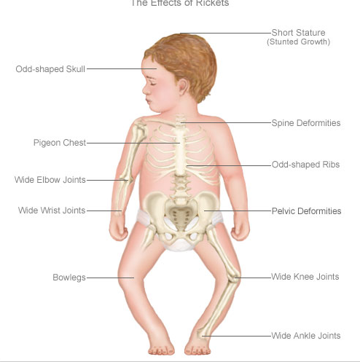
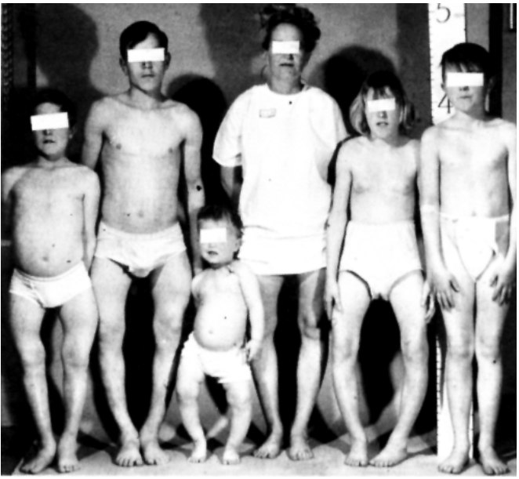
A condition of environmental etiology that mimics a condition usually of genetic etiology is termed PHENOCOPY.
Vitamin D- deficient rickets caused by low Vit D in diet is a phenocopy of
Vitamin D-resistant rickets caused by mutation of VDR gene (abnormal receptor for Vit D)
.

Slide 17
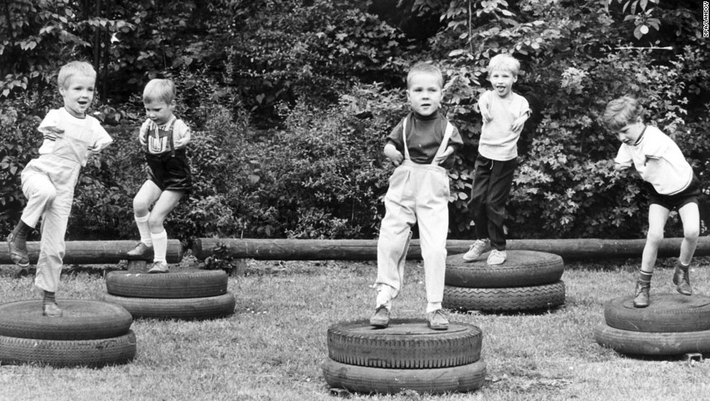
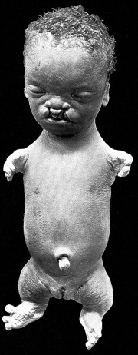
Absence of limbs (amelia) or malformed limbs (phocomelia) in children was caused when pregnant women used thalidomide. Throughout the world, about 10,000 cases were reported of infants with phocomelia due to thalidomide
Tetra-amelia and phocomelia (Roberts syndrome) is rare autosomal-recessive genetic disorders (Pseudothalidomide Syndrome)
Notes:
Tetra-amelia is caused by mutation of WNTR3 geneThe WNT3 protein also appears to play an important role in determining the anterior-posterior axis (the imaginary line that runs from head to tail in animals) during the earliest stages of embryonic development. Additionally, the effects of mutations in the human WNT3 gene suggest that the protein may be involved in the normal formation of the facial features, head, heart, lungs, nervous system, skeleton, and genitalia.
ESCO2, located on human chromosome 8, has been labeled as the gene responsible for Roberts syndrome. In fact, ESCO2 is the only known gene that has demonstrated RBS-causing mutations. Also, all individuals that have been cytogenetically diagnosed with Roberts syndrome have also had mutations in the ESCO2 gene.^{[3]}
In order to contract Roberts syndrome, a child must inherit the defective gene in an autosomal recessive manner. In other words, the child must inherit two copies of the defective gene (one from each parent). The ESCO2 gene has a specific effect on cell division in Roberts syndrome patients. In normal cell division, each chromosome is copied and then attached to its newly formed copy at the centromere (the center portion of a chromosome). However, in Roberts syndrome cell division, the copies are frequently not attached at the centromere. As a result, the chromosomes do not get lined up properly, which causes the cell to divide very slowly or even to not divide at all. The new cells typically will have too many or too few chromosomes. The odd number of chromosomes causes the defective cells to die, which leads to the malformations associated with Roberts syndrome.^{[1]}
Many of the physical malformations associated with Roberts syndrome are very similar to the malformations that occur in children whose mothers took thalidomide during pregnancy. The physical similarities suggest that there is a similar underlying biology between ESCO2 and thalidomide. As a result, it is speculated that thalidomide affects chromosomes and cell division in a similar manner to ESCO2. For this reason, Roberts syndrome is sometimes called Pseudothalidomide Syndrome.

Slide 18
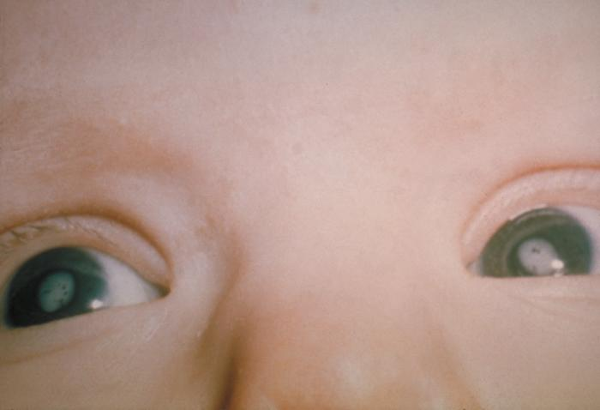
Cataract and microphthalmia in children occurs in congenital rubella syndrome,
It is a phenocopy of hereditary cataract (most frequently autosomal dominant, but can also be autosomal recessive or X-linked) and microphthalmia (autosomal recessive)

Slide 19
Phenotypic variation is characterized by norm of reaction
Norm of reaction - is genetically determined limits of the character varieties under the action of different external conditions.
The norm of reaction is
Zero Narrow Wide
norm of reaction norm of reaction norm of reaction
ABO blood groups Height Body weight,
number of RBC, WBC
The wider is norm of reaction the greater is the influence of the environment and the less the influence of the genotype during ontogenesis.
Traits with wide norm are not qualitative but quantitive. They depend on a great number of genes and are not inherited as Mendelian traits.

Slide 20
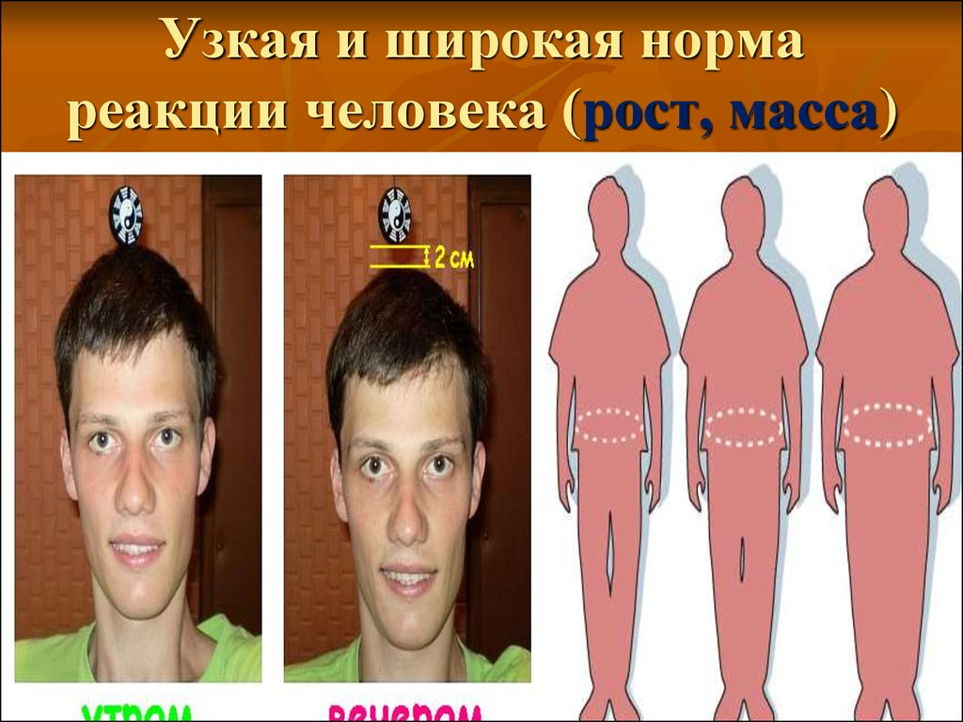
NORM OF REACTION
Narrow norm of reaction Wide norm of reaction

Slide 21
GENETIC VARIATION.
Genetic variation is a variation concerning the genotype.
There are two types of genetic variation:
Recombination Mutations
Recombination is a process which makes new combinations of genetic information.
The organisms which express characters of both the parents are known as recombinants and the events responsible for mixing maternal and paternal characters in sexually reproducing organisms are called recombinations.

Slide 22
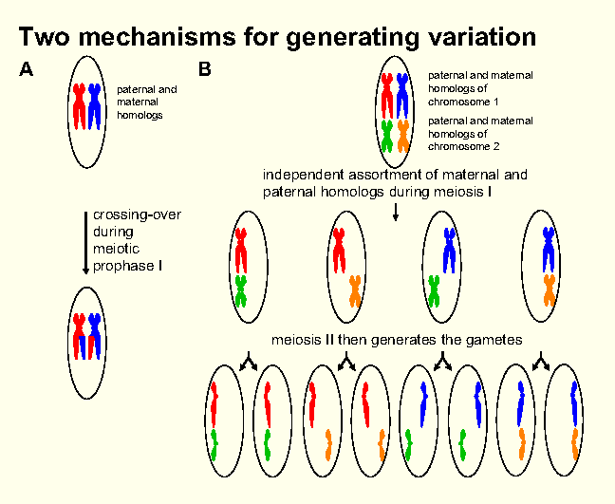
New combinations appear by the following ways:
- reciprocal recombination of linked genes in chromosomes by crossing over in Prophase I of meiosis;
- independent assortment of chromosomes in Аnaphase I of meiosis;

Slide 23
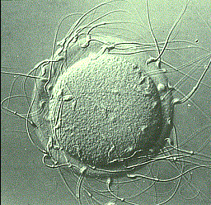
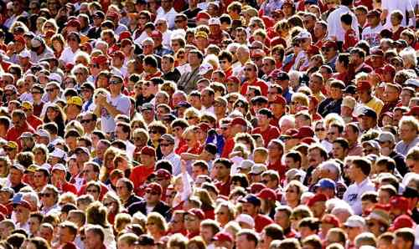
- random fertilization;
chance of marriage;
multiple alleles.
Recombination leads to re-distribution of already existing genes in population.
It brings diversity in genotype and phenotype of different organisms but gene pool in a population remains unchanged.

Slide 24
MUTATIONS
are sudden changes of hereditary information
The term “mutation” was coined by Hugo de Vries (1901).
The typical properties of mutations:
Are inherited by next generations
occur suddenly in single individuals. It is impossible to predict in what individual, when and what kind of mutation will appear;
non adaptive as a rule / seldom have an adequate and, consequently, useful character. More often they decrease the organism viability/
appear spontaneously.

Slide 25
are irreversible and –
non adequate to the acting factor;
The same external factor may cause different mutations and, vice versa, the same mutations are sometimes caused by different factors.
Biological significance of mutations is great. As they are inherited they are an elementary material of evolution.
The product of mutations is called mutant.

Slide 26
According to the type of cells
Mutations
Somatic:
Germinal:
not inherited during the sexual reproduction
Cause formation of tumors
May cause changes of cell antigens that leads to autoimmune aggression
inherited during the sexual reproduction
Give material for natural selection
Cause birth of children with hereditary disorders

Slide 27
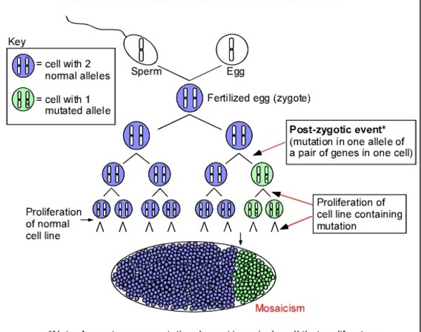
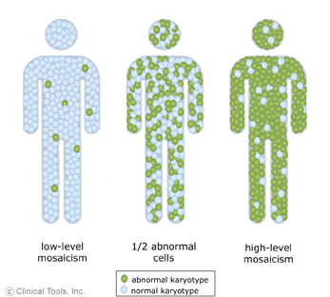
If a somatic mutation takes place during the embryonic development, an adult organism may have both the normal and mutant somatic cells.
Such an organism is termed MOSAIC
Example is eyes of different color

Slide 28
According to the phenotypic manifestation mutations are:
- dominant (appear in mutants); are haploinsuffient
- recessive (are not expressed in heterozygotes); are haplosufficient
- neutral; - harmful; - useful (seldom).
Harmful mutations cause hereditary disorder or are lethal (result in the death of the organism).

Slide 29
Depending on the impairment of genetic material
mutations are subdivided into:
- genome ( numerical chromosomal aberrations);
- chromosomal ( structural chromosomal aberrations);
- gene (point).
GENOME MUTATIONS
Variation in the normal diploid (2n) chromosome number is termed PLOIDY. There are 3 types:
Polyploidy Aneuploidy Haploidy
(euploidy) (heteroploidy) (monoploidy)

Slide 30
HAPLOIDY is the state of having the haploid (n) set of chromosomes. In the majority of animals haploidy is lethal.
POLYPLOIDY is phenomenon of having more than two sets of chromosomes /diploid number or 2n / or genomes.
An organism having more than two genomes is called
POLYPLOID
triploid tetraploid pentaploid hexaploid so on
3n 4n 5n 6n 7n, 8n.

Slide 31
Polyploids with odd number of genomes (3n, 5n) are
sexually sterile because the odd chromosomes do not form synapsis. They are, therefore, propagated vegetatively.
Polyploids also do not cross-breed freely with diploids.
They generally have a prmoting effect at both morphological and biochemical levels due to increase in frequency of dominant alleles.
Polyploidy is of 3 types:
- autopolyploidy: a numerical increase of the same genome.
- allopolyploidy: contain 2 or more different types of genomes
- autoallopolyploidy: the individual possess two types of
genomes but one genomes is repeated for many times
(AAAABB).

Slide 32
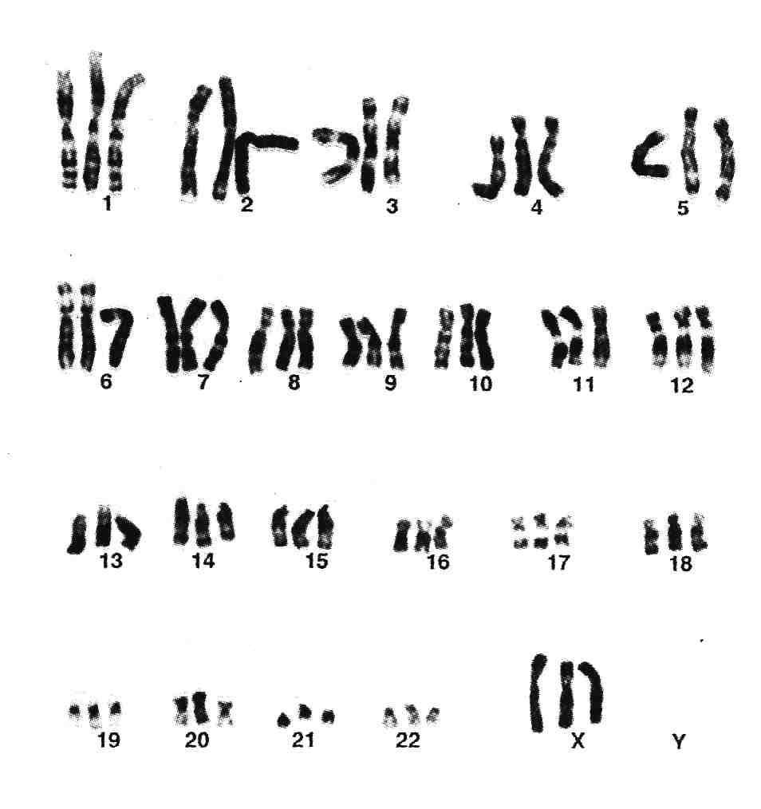
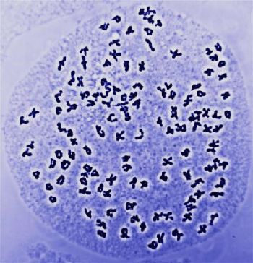
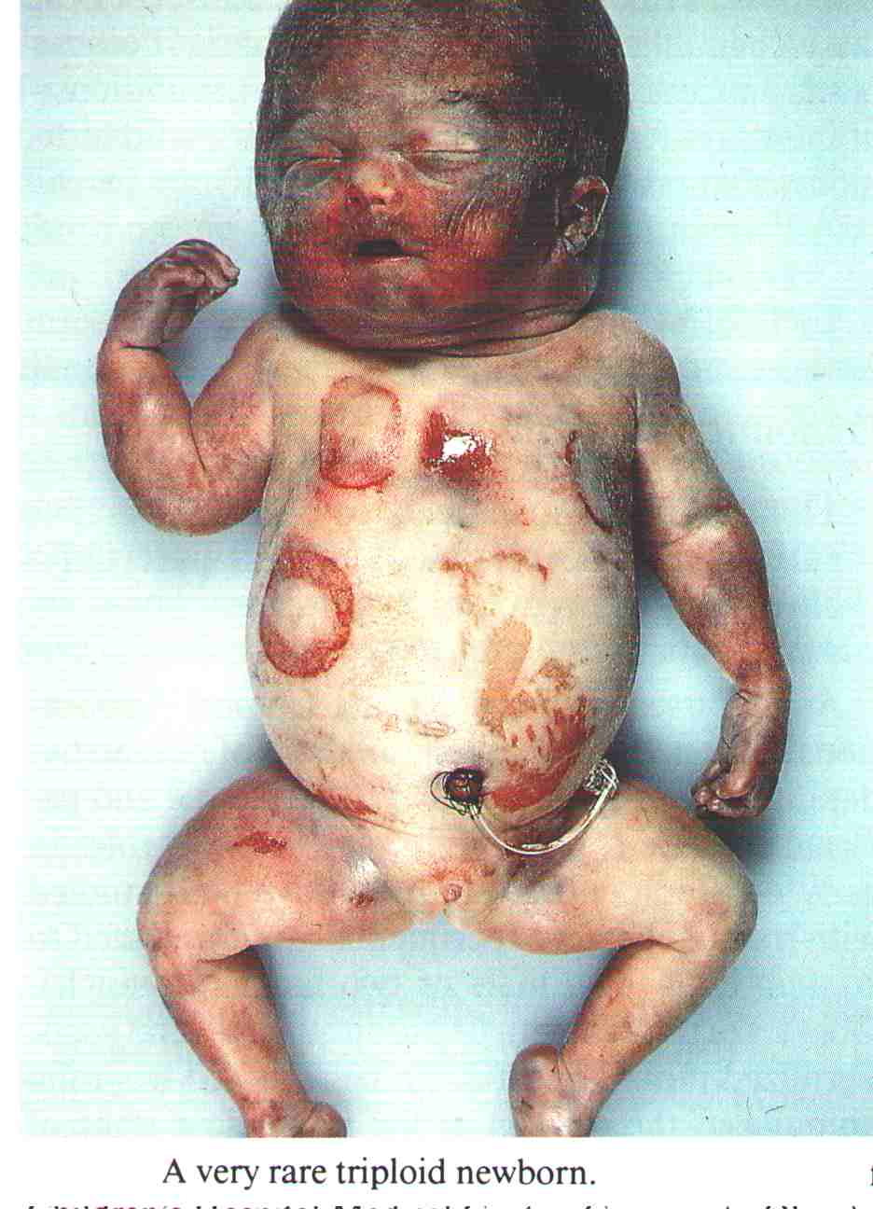
Polyploidy is beneficial in plants and a rare harmful state in animals. In humans triploidy (69 chromosomes) causes severe congenital defects and death

Slide 33
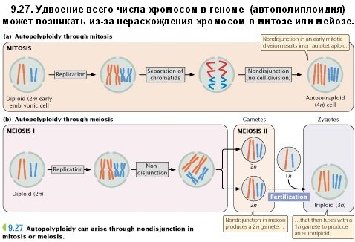
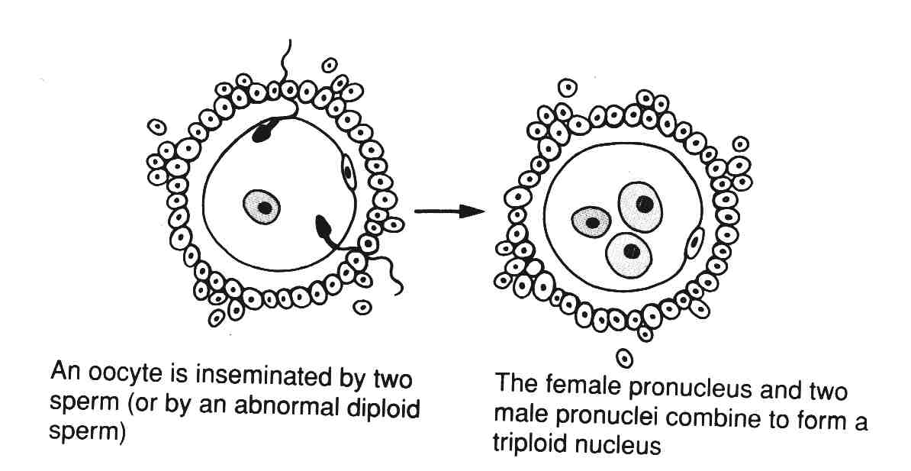
Тетраплоидия (4n)

Slide 34
ANEUPLOIDY
change in chromosome number unequal to haploid set.
This generally occurs due to the non disjunction of the
chromosomes during anaphase of the cell division.
Polysomy:
- trisomy – 2n+1. In such cases one of the chromosomes
is present in three copies;
- tetrasomy – 2n+2;
- pentasomy – 2n +3.
Monosomy – 2n-1; In humans it is lethal, except the Turner‘s syndrome/45,X0/.
Nullisomy – 2n-2.

Slide 35
Various types of syndromes in human being.
Down syndrome Trisomy of 21st pair
Edwards syndrome Trisomy of 18st pair
Patau syndrome Trisomy of 13st pair
Klinefelter X chrom. is extra in ♂ (47,XXY)
Turner X chrom. is lost in ♀ (45,X)
Superfemale X chrom. extra in ♀ (47,XXX)
Supermale Y chromosome is extra in ♂(47,XYY).

Slide 36
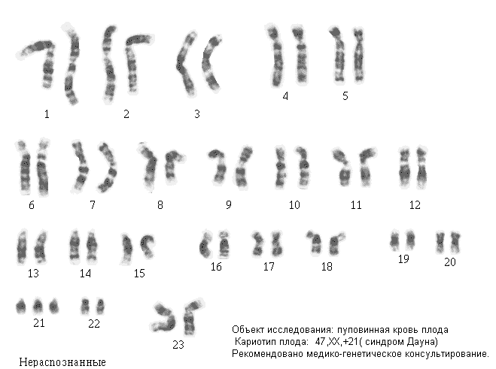

Slide 37
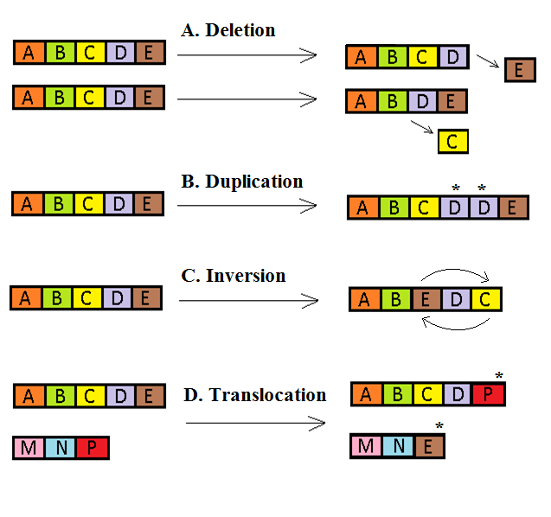
Chromosomal aberrations (structural chromosomal aberrations) are characterized by the change of chromosome' s structure.
DELETION. It is the lost of an segment of a
chromosome:
DUPLICATION. A section of a chromosome duplicates.

Slide 38
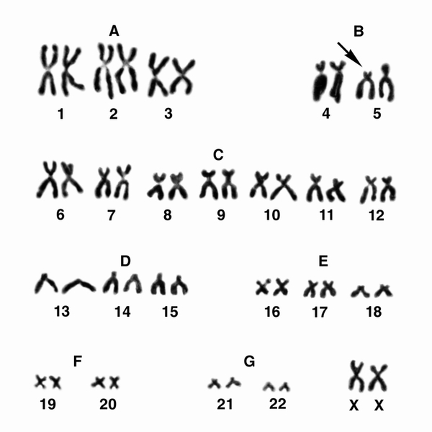
“Cat cry syndrome” – deletion of the short arm of the chromosome 5 (46,XX or XY del5p).

Slide 39
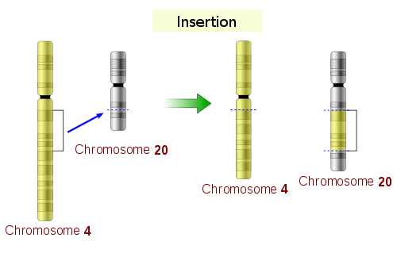
INVERSION. A portion of a chromosome breaks off,
turns around and joins in opposite direction.
TRANSLOCATION. A section of a chromosome breaks
up and joins to another non-homologous chromosome.
Simple translocation (insertion) – a segment of one chromosome breaks and is transferred to another non-homologous chromosome.
As a result one chromosome represents deletion, while other has an additional segment.

Slide 40
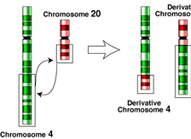
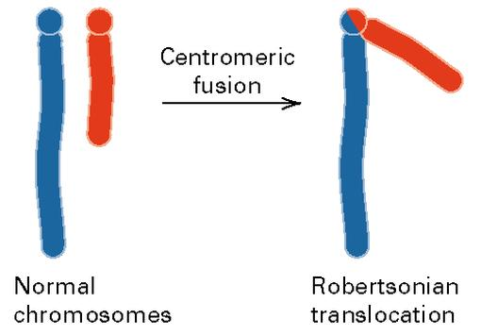
Reciprocal translocation – a mutual exchange of parts between two non-homologous chromosomes.
Robertsonian translocation – fusion of long arms of acrocentric chromosomes

Slide 41
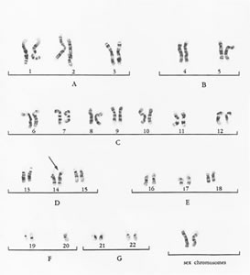
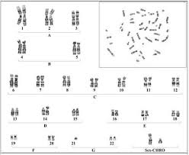
Robertsonian translocations can cause Down syndrome
Balanced translocation
Unbalanced translocation

Slide 42
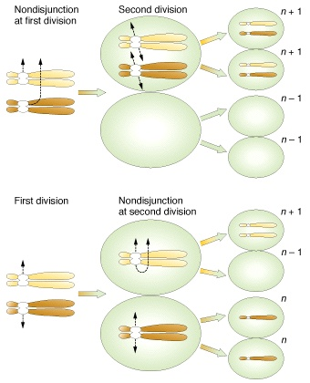
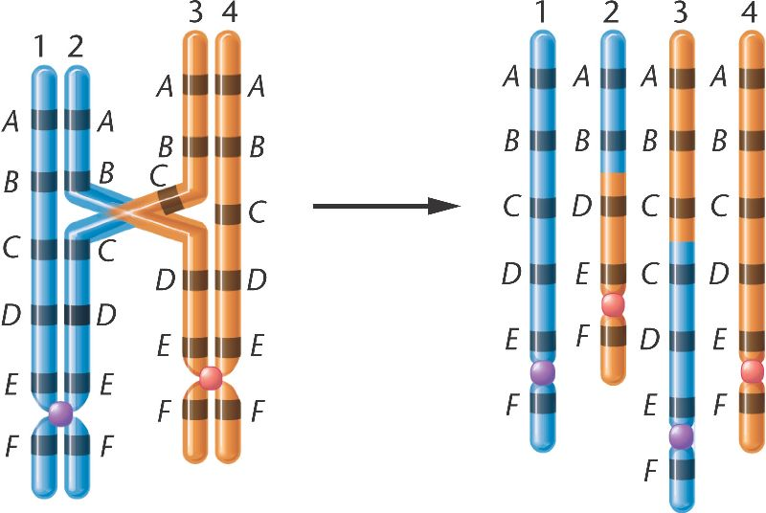
Non-disjunction, of chromosome in meiosis result in aneuploidy, (numerical chromosomal aberration)
Unequal crossingover results in structural cromosomal aberration
These conditions are associated with chromosomal disorders in children

Slide 43
GENE MUTATIONS
are characterized by changes of the nucleotides normal sequence of gene (DNA) structure;
Types of gene mutations:
I. Substitutions – one or more base pairs are substituted by others.
Transitions: Transversions:
one purine is replaced by a purine is replaced by another purine or one pyrimidine or vice versa.
pyrimidine is replaced by
another pyrimidine.

Slide 44
Substitutions lead to silence, missense or non-sense mutations
- INSERTIONS – one or more additional bases (nucleotides) are inserted (incorporated) into the DNA
molecule, so that the frame of genetic information
becomes changes.
- DELETIONS – one or more bases (nucleotides)
are lost from the DNA molecule.

Slide 45
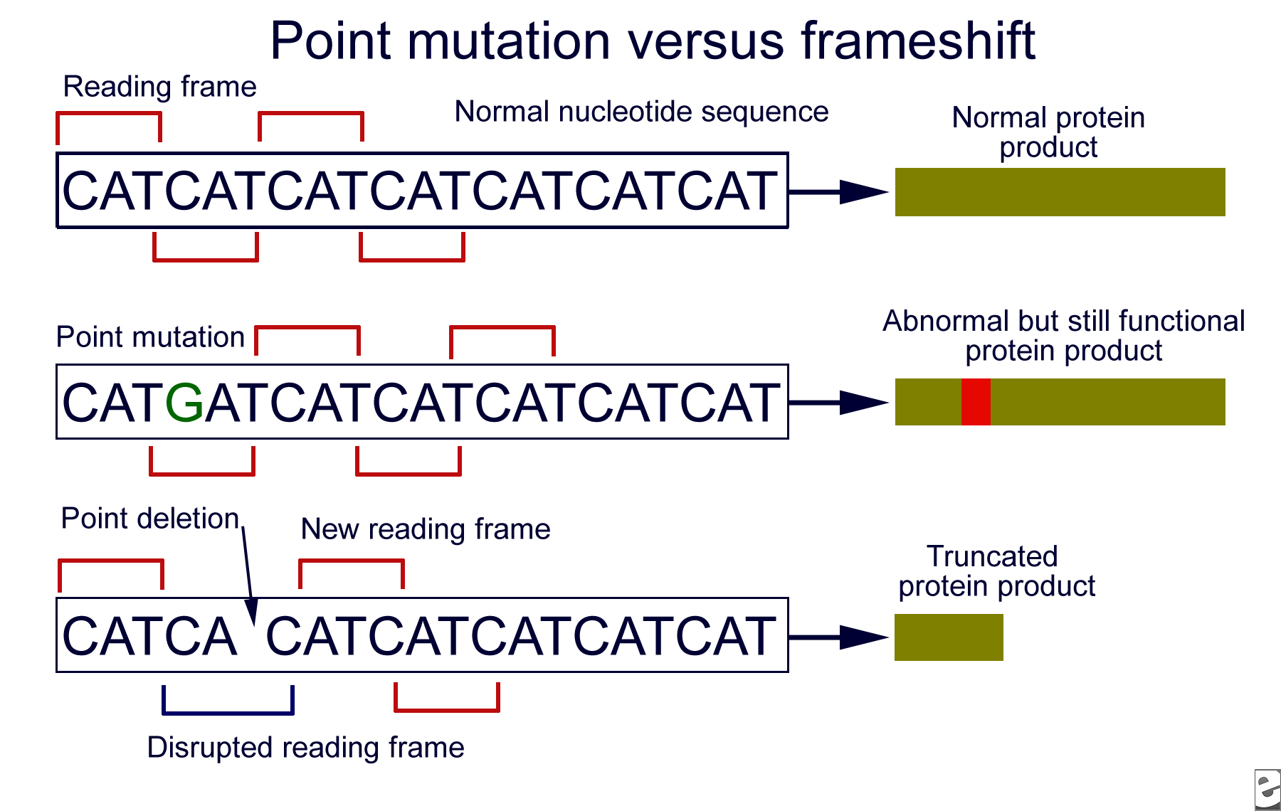
FRAMESHIFT MUTATIONS
a nucleotides not multiple three are either deleted or added to DNA (gene)
Due to these mutations, entire frame of the genetic information ( of gene) becomes out of order (since genetic code is comma-less). These are very harmful mutation as the expression of gene gets completely changes.

Slide 46
Gene mutations result in single gene disorders like hemophilia, sickle cell anemia, phenylketonuria, etc.
The process of genetic material change is called
MUTAGENESIS.
According to the cause mutations are
Spontaneous Induced
Occur due to natural reasons induced artificially
as a result of replication by mutagenic agents. and repair errors,
Modification of nitrogenous
bases etc.

Slide 47
MUTAGENIC FACTORS
PHYSICAL
Ionizing radiation
UV rays
CHEMICAL
Some drugs (cytostatics)
Cigarette smoke
BIOLOGICAL
Viruses
Aflatoxin (Aspergillus)
High temperature
Herbicides
Liver fluke

Slide 48
Antimutagenic mechanisms:
Proofreading in replication.
DNA repair mechanisms
3. Degeneracy of genetic code (silence mutations)
4. Substitution of amino acids some times don't shift protein activity
5. Gene amplification
6. Diploid set of chromosomes

