Slide 1
Ecology

Slide 2
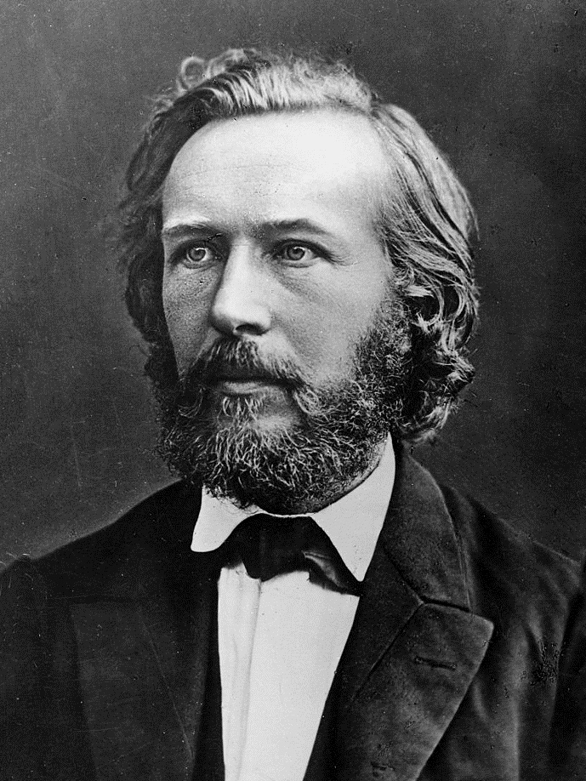
The term “ecology” (from Greek eikos – house or dwelling and logos – science) was introduced by Ernst Haekel in1869
Ecology studies relations and interactions between organisms, populations and communities
and their environment including other organisms

Slide 3
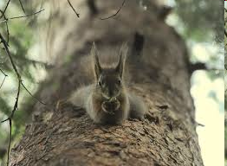
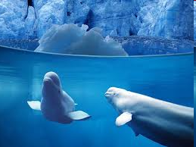
Autoecology focuses on the biological relationship between an individual organism or an individual species and its environment.
Synecology studies the relations between groups of organisms of coexisting biological communities.

Slide 4
The environment is a set of factors that can directly or indirectly influence the living organisms.
Any factor that influences living organism is termed as ecological factor.
Ecological factors are
Biotic
Abiotic
Anthropogenic

Slide 5
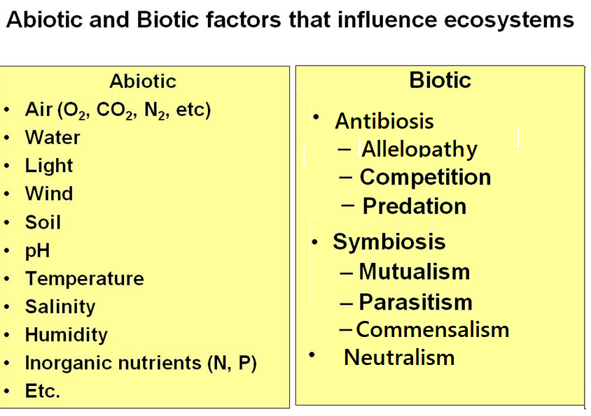
Allelopathy is a biological phenomenon by which an organism produces one or more biochemicals that influence the germination, growth, survival, and reproduction of other organisms.

Slide 6
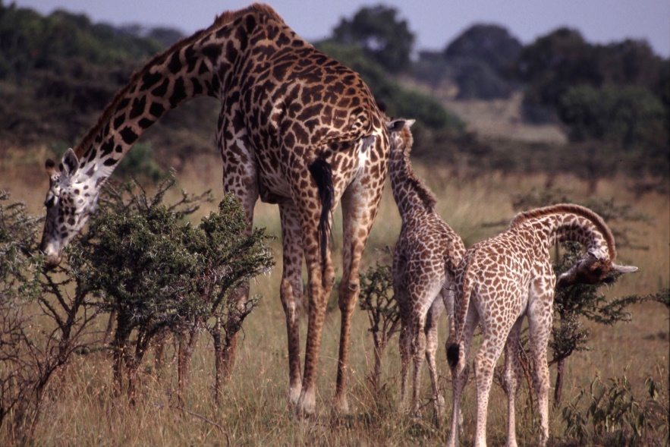
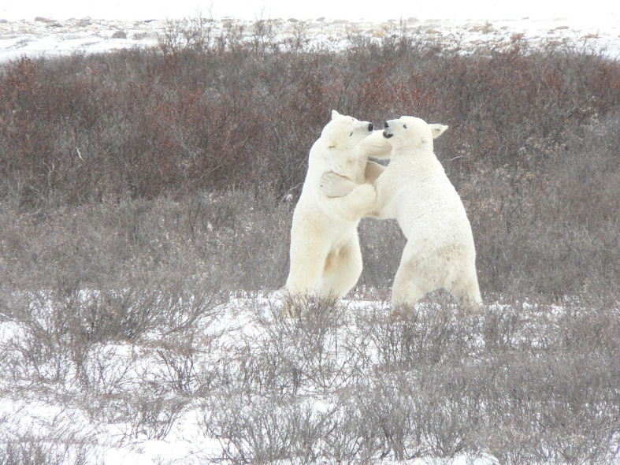
Temperature: all animals are divided into poikilothermic (cool-blooded) and homeothermic (warm-blooded)
Bergman’s rule states that warm-blooded animals tend to have larger size and greater body mass with the increasing latitude (towards the poles) and decreasing average temperatures.
Allen’s rule that warm-blooded animals tend to have protruding body parts(limbs, ears, tails) longer in hot climate and more compact body shape in cold climate.

Slide 7
Light: UV (10%), wavelength up to 0.4 microns
up to 0.29 microns - destructive for all living organisms (the ozone screen protects), 0.29-0.4 microns - chemically active
Visible rays (45%) wavelength 0.41-0, 74 microns
photosynthesis energy source; perceived by the organ of vision, promotes orientation in the spaces; regulation of daily activity
Infrared rays (45%), length 0.75 microns or more - heat rays, heating the Earth

Slide 8
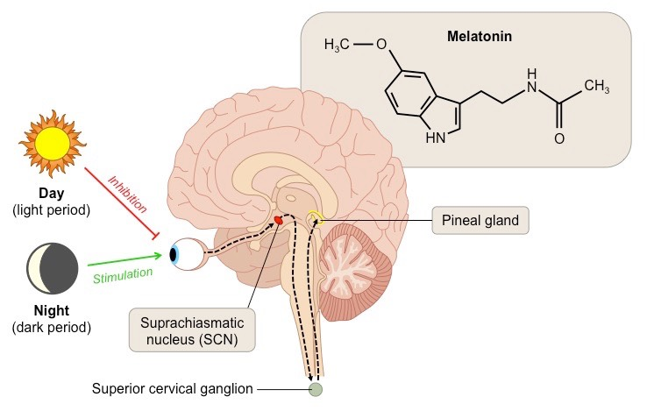
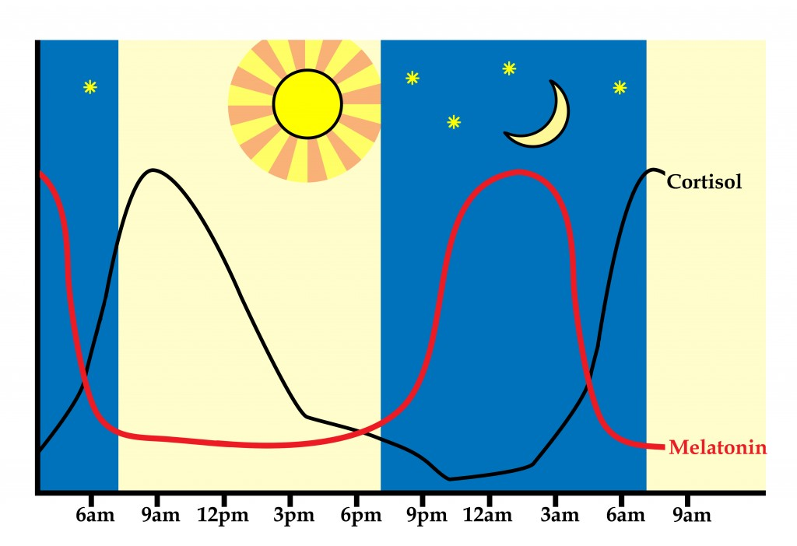
Periodic changes of day and night cause diurnal biological rhythms.
Physiological reactions of the organism to season changes of the length of day or night are termed as photoperiodism

Slide 9
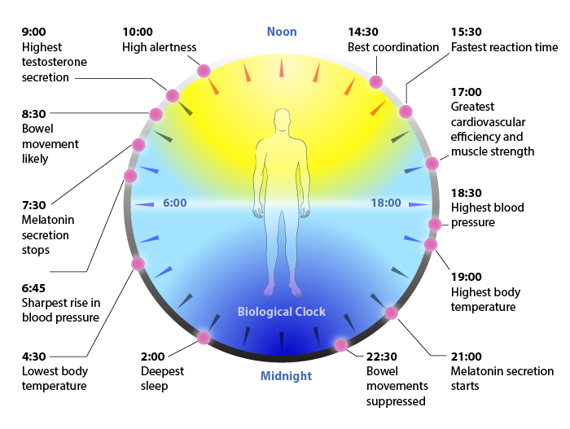

Slide 10
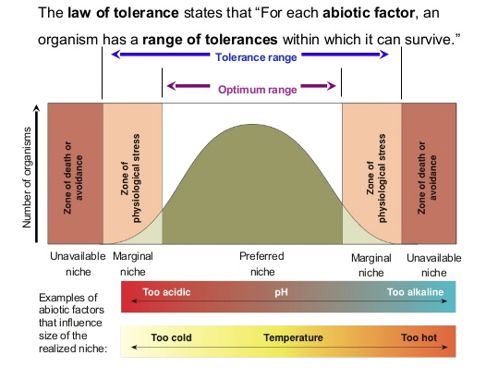

Slide 11
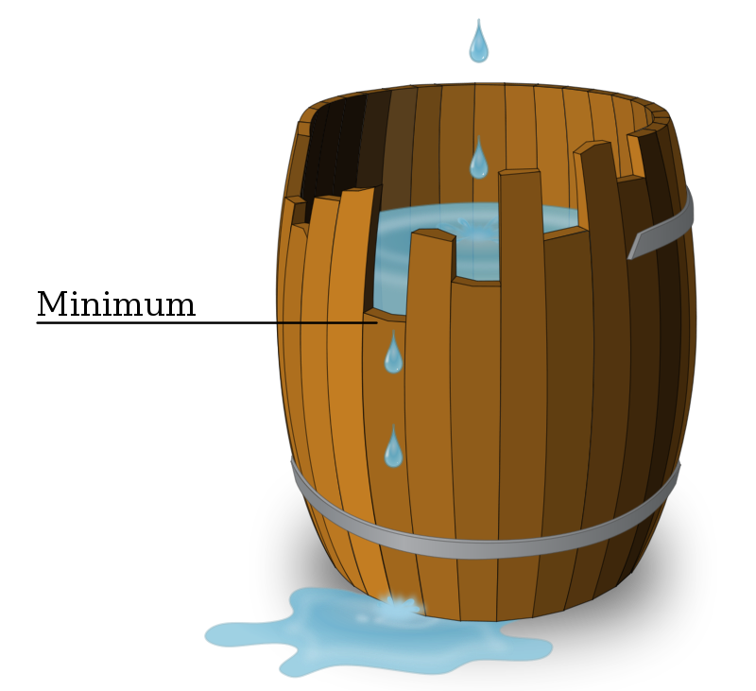
The Liebig’s law of minimum (proposed by German chemist Justus Liebig, 1840) states that if the factor is depleted below the critical minimum level the organism will fail to grow or will grow abnormally. (success of an organism is determined by crucial ingredient that is in short supply).
A figurative representation of this law is named after the scientist - the so-called "Liebig barrel". The essence of the model is that when the barrel is filled, water begins to overflow through the smallest board in the barrel, and the length of the other boards does not matter anymore.

Slide 12
Shelford’s law of tolerance (proposed by American zoologist Victor Shelford, 1911) states that not only less but also the excess amount of the same factor can be limiting.
Blackman’s law of limiting factor (proposed by British plant physiologist Frederick Blackman, 1909) states that any organism is under the action of number of ecological factors and deficiency of any of them will aﬀect an organism.

Slide 13
Eugene Odum (1975) introduced an addition to the law:
1) organisms have both a wide range of tolerance to one factor and a narrow range to another
2) organisms with a larger range of tolerance are usually widespread
3) if the conditions of existence determined by one environmental factor , change beyond the optimum, then the range of tolerance to other environmental factors also changes
4) the period of reproduction, growth, as a rule, is critical, the limits of tolerance of the organism at this time are much narrower than that of an adult.

Slide 14
A range of gradient between maximum and minimum makes limits of tolerance
The range of tolerance varies greatly in different species, some of them have narrow range of tolerance, while others survive within wider limits.
Organisms with narrow range of tolerance are specialist species (stenobiotics)
Organisms with wide ranges of tolerance are generalist species (eurybiotics)

Slide 15
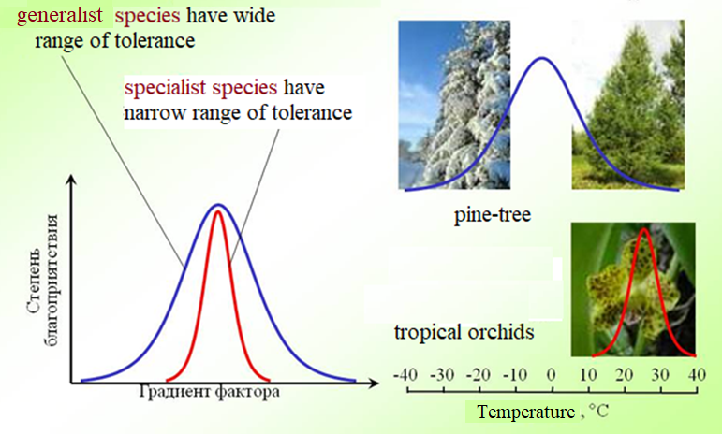
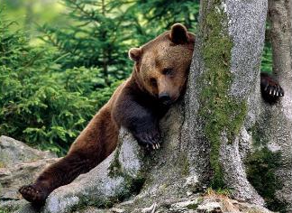
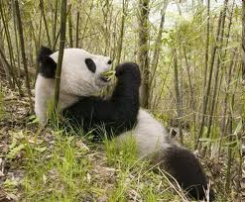
generalist species
specialist species

Slide 16
Anthropogenic factors are caused by human activities.
According to its nature are chemical, physical and combined (climatic, relief-forming).
1830 year – 1 milliard people
1930 – 2 milliard
1960 – 3 milliard
1975 – 4 milliard
1987 – 5 milliard
12.10.1999 – 6 milliard
31.10.2011 – 7 milliard
2030 – expected 9 milliard
Urbanization – cities occupy 0.5% of the area of the planet, home to 40% of the population.

Slide 17
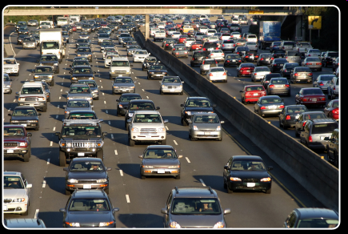
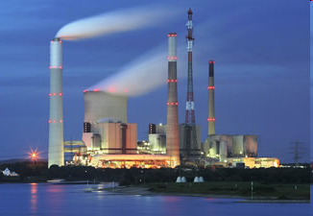
Examples of anthropogenic influence are
  Air and water pollution (non-degradable and biodegradable pollutants)
  Acid rains (sulphur dioxide and nitrogen oxides in air).
  Greenhouse effect (increase in atmospheric carbon dioxide)
  Ozone depletion (chloroflurocarbons (CFCs) that were used in aerosol cans and as refrigerants)

Slide 18
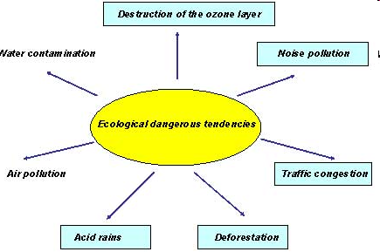

Slide 19
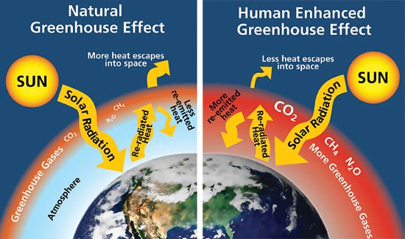

Slide 20
Bhopal gas tragedy
Chemical accident on the night of 2–3 December 1984 at the Union Carbid India Limited (UCIL) pesticide plant in Bhopal
Over 500,000 people were exposed to methyl isocyanate gas (the highly toxic substance) The small towns located near the plant were affected
Official number of immediate deaths being 2,259. In 2008, the Government of Madhya Pradesh had paid compensation to the family members of 3,787 victims killed in the gas release, and to 574,366 injured victims.
Notes:
The world’s worst industrial disaster, carbamate pesticides prodsuction

Slide 21
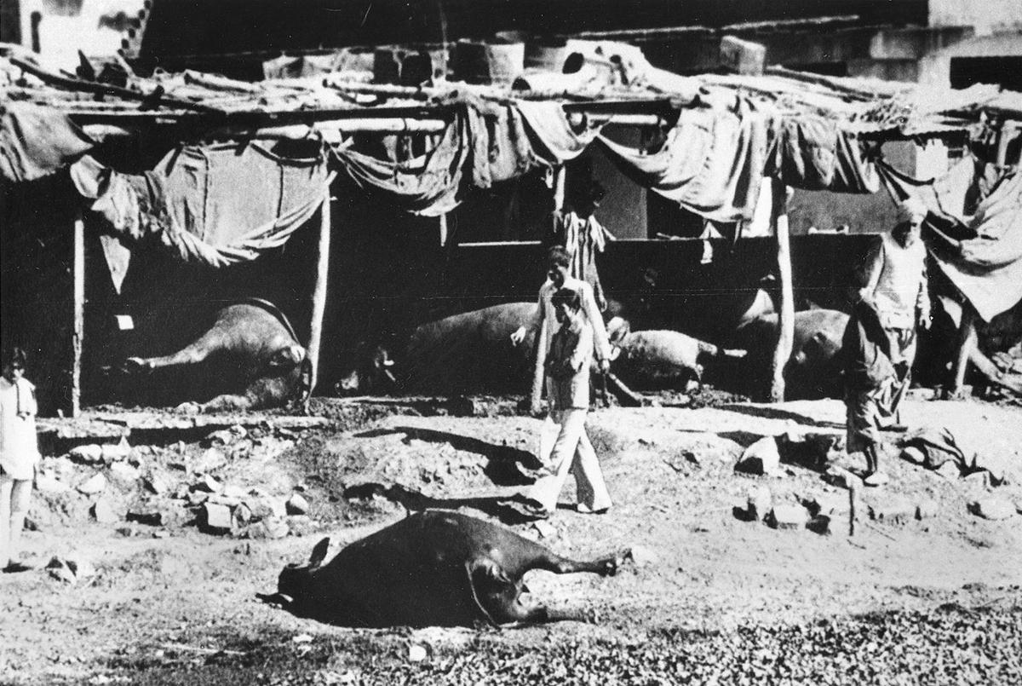

Slide 22
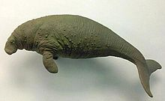
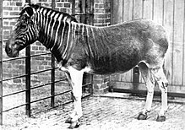
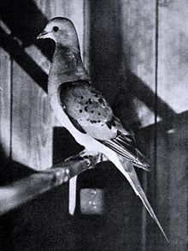
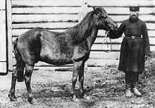
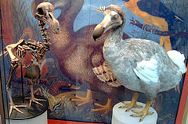
Extinct species
Steller’s sea cow
Quagga
Dodo
Passenger pigeon
Tarpan

Slide 23
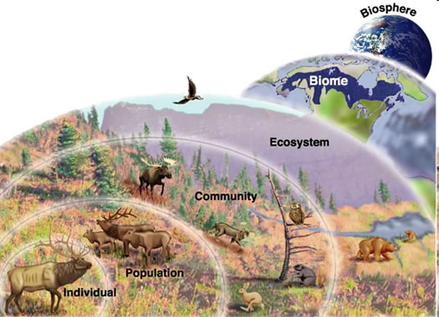
Ecological systems can be arranged in progressively increasing levels of organizational complexity.

Slide 24
A natural association of the interdependent populations of different species inhabiting a common environment is called biocenosis (biotic community):
    zoocenosis (faunal community),
    phytocenosis (flora community)
    microbiocenosis (microbial community)
A geographic area of uniform environmental conditions providing a living place to certain biotic community is called biotope.

Slide 25
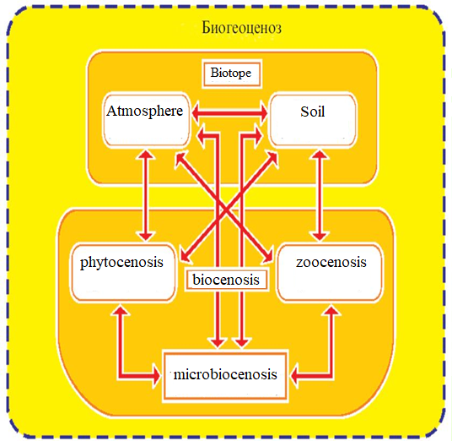
Biotope with inhabiting it biocenosis form ecosystem (biogeocenosis)
Ecosystem is a community of organisms and their physical environment interacting as an ecological unit

Slide 26
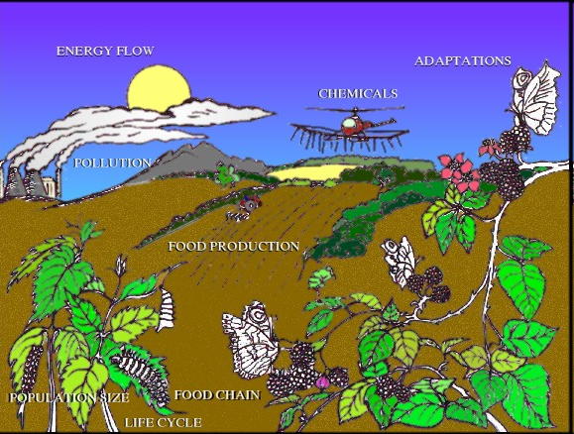
Ecosystem exists as a stable open self-regulating system with certain spatial boundaries, energy flow and matter recycling.
Based on the biotope peculiarities ecosystems are fresh-water, marine or terrestrial.

Slide 27
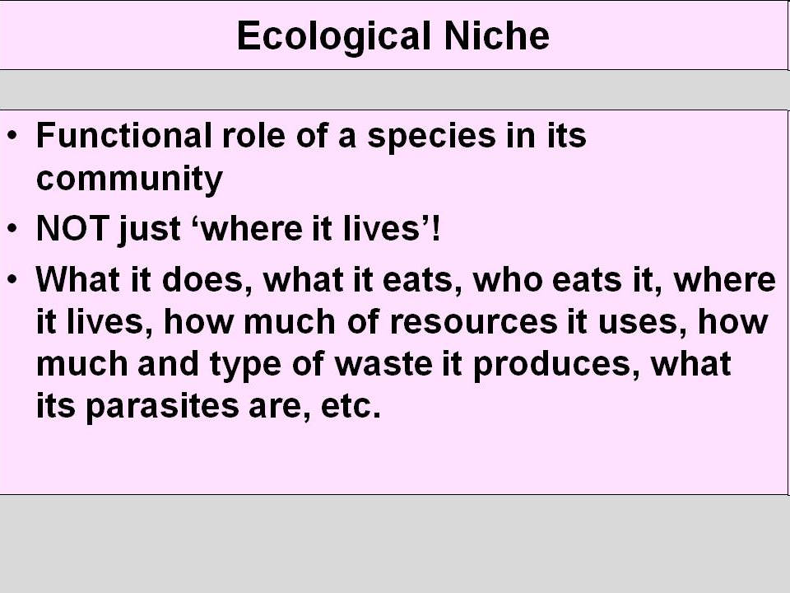
Each organism has it’s own role within the structure and function of a community – ecological niche.
It’s a totality of an organisms adaptations, use of resources and lifestyle to which it is fitted

Slide 28
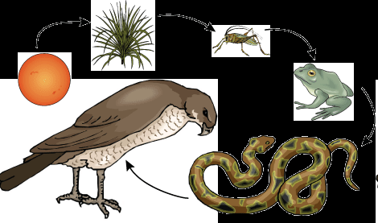
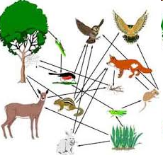
Any ecosystem is characterized by certain set of species linked through the food chains.
Most animals consume a varied diet and in turn, provide food for many organisms forming a network of food chains – food webs

Slide 29
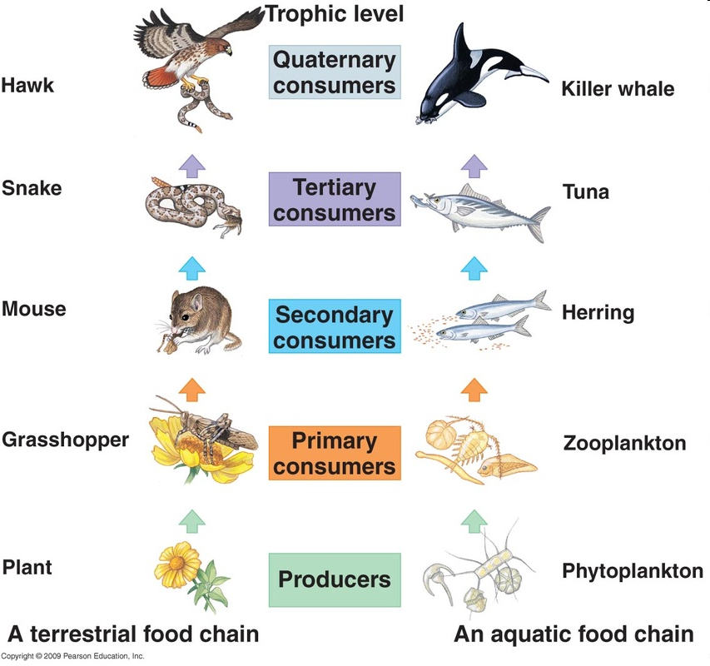
The structure of feeding relationship in ecosystem is called trophic structure
Producers - plants producing organic matter) through photosynthesis
primary consumers – herbivorous animals
secondary consumers -carnivorous that feed on herbivorous.
tertiary consumers eat secondary consumers
decomposers break down biomass in a form of dead organism and fecal matter

Slide 30
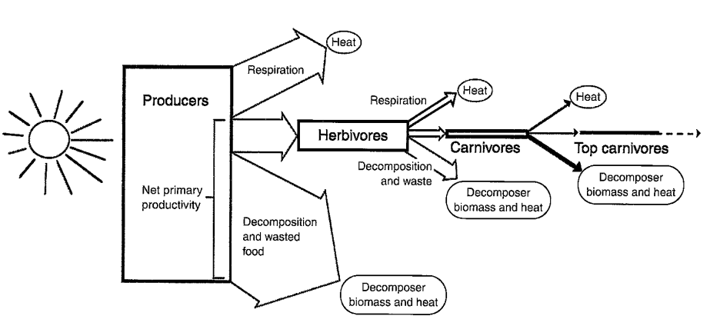
RULE OF ECOLOGICAL PYRAMID
Only about 10% of biomass and chemical energy at one trophic level is converted into biomass and energy at the next trophic level.

Slide 31
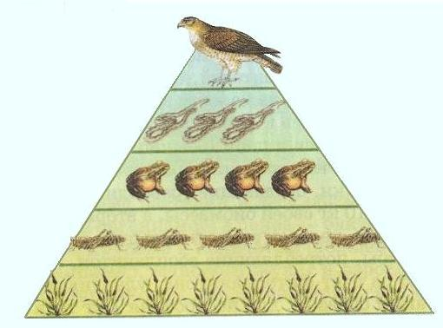
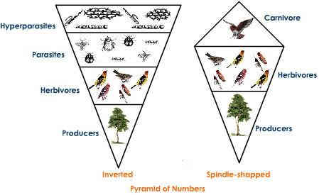
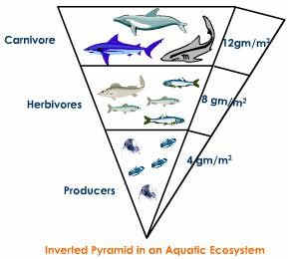
The are pyramid of energy (always upward), pyramid of biomass (almost always upward; exclusion occurs in some aquatic systems) and pyramid of numbers (be upward, inverted or spindle-shaped depending on size of the organism)

Slide 32
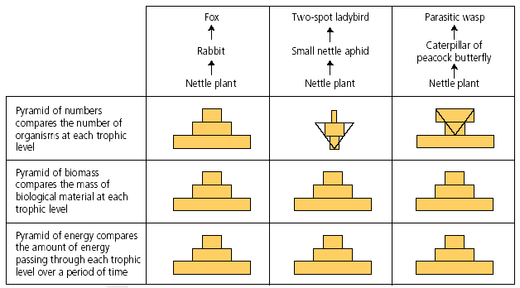

Slide 33
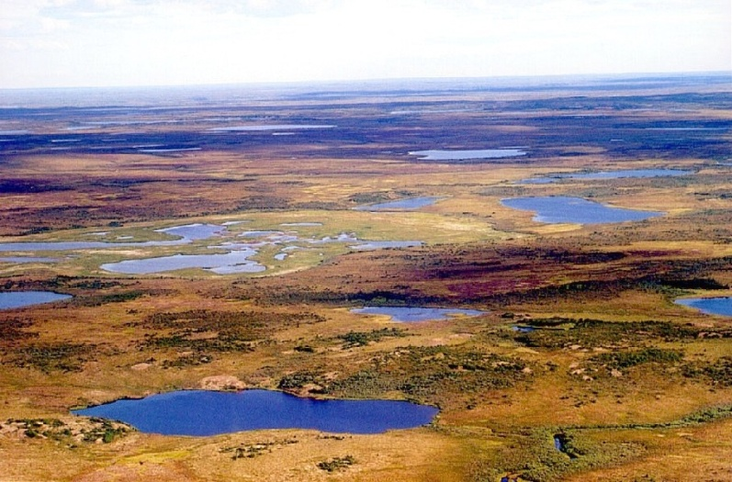
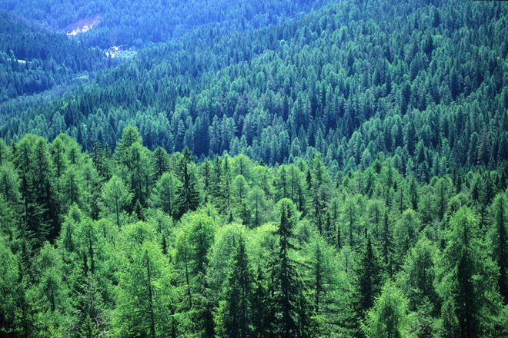
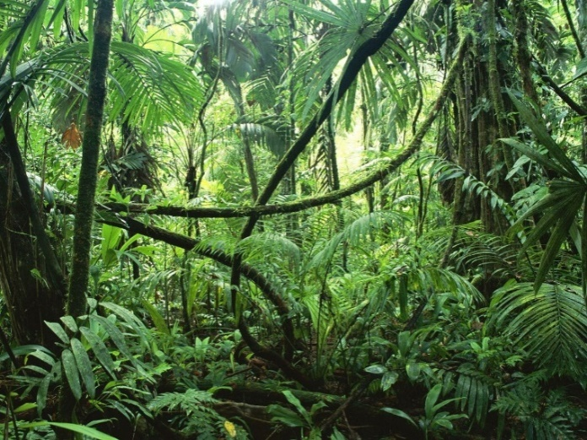

The totality of ecosystems of same climate zone is called biome. Each biome has unique weather and temperature patterns, plant and animal communities (tundra, forest (tropical rain forest, temperate deciduous forest, taiga), grassland and desert. Aquatic biomes include fresh-water, ocean and coral reef biomes).
.

Slide 34
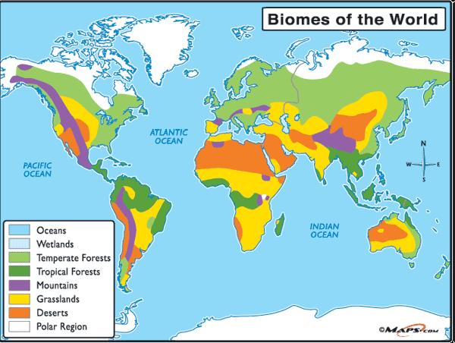
Biome a basic unit of biosphere

Slide 35
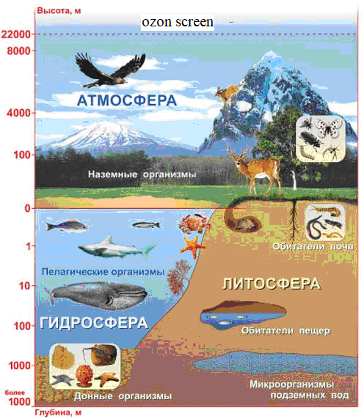
.
-
Sum of biomes make up a biosphere. Biosphere is the part of our planet in which life exists and it is the largest scale of ecological organisation
Limits of biosphere:
Entire hydrosphere
22 km – atmosphere
4-5 km – lithosphere

Slide 36
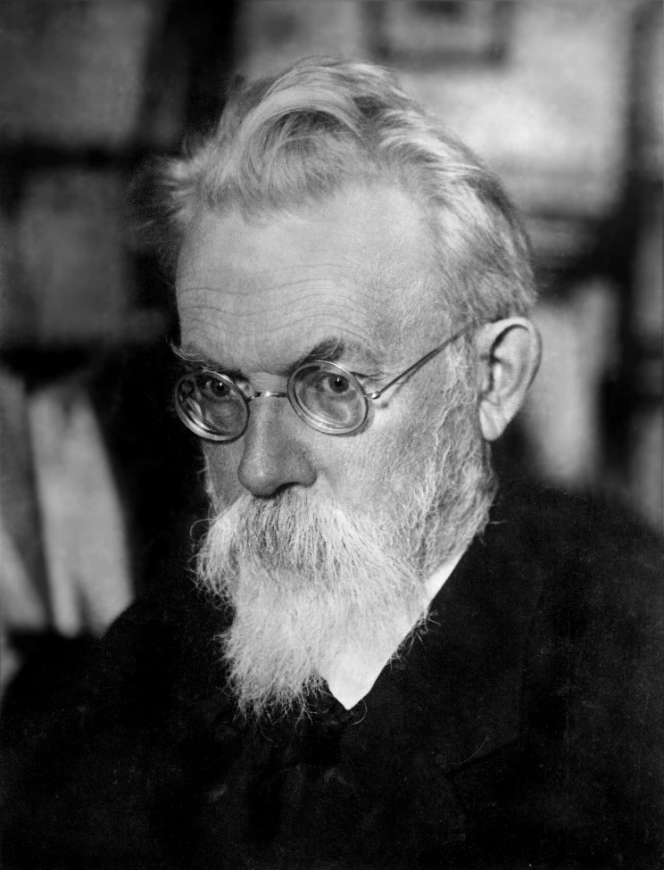
Modern state of biosphere is termed as noospher (From Greek noos – mind and sphaira –sphere). Concept of nooshere was introduced by V. Vernadsky.
Nooshere is a sphere of interaction between society and nature, within the limits of which reasonable
human activity becomes the determining factor of development

Slide 37
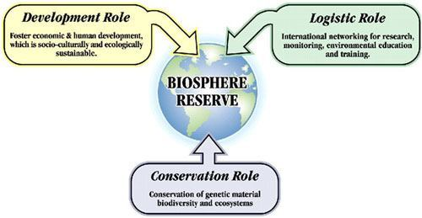

Slide 38
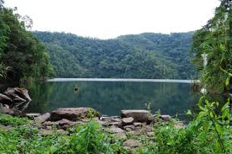
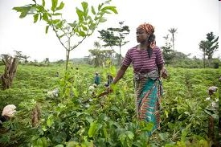
Human ecology is the study of the mutual relationships, interactions or interconnections between people and their environments
natural habitat – natural ecosystems, inhabited by certain human populations. This environment directly or indirectly affects the human species and, in turn, is affected by human activities.
agroecosystems – natural ecosystems that have been modified by humans for the production of food.

Slide 39
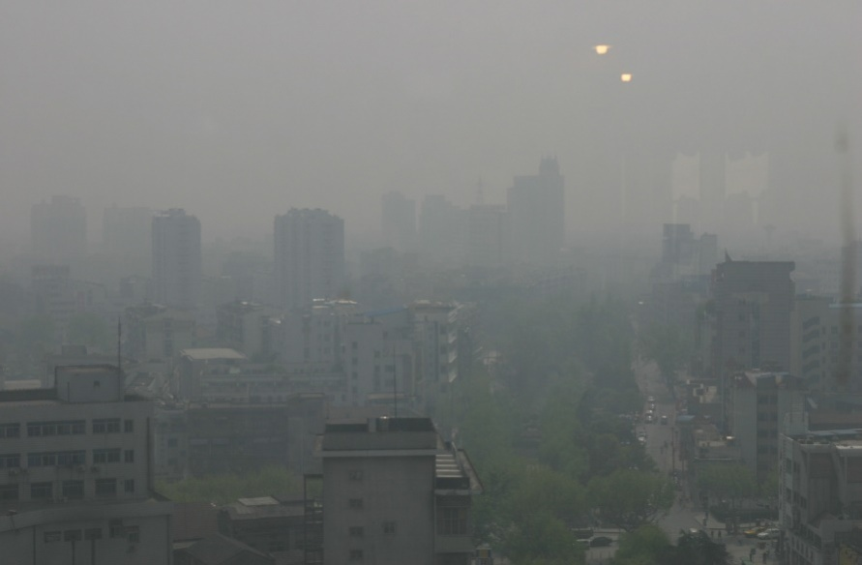
built environment (built world) is the man made surrounding that provide people with living, working and recreational space.
Urban ecosystems
Completely or partially lack producers, so are strongly dependent from energy and matter input (heterotrophic ecosystem).
More active energy flow with usage of electricity and fuel energy and produced excess heat. Rainwater infiltration into the local soil is less.
Air and soil is polluted with heavy metals, dust, different toxins, and waste materials.
Diversity of animal and plant species is restricted to those become adapted to urban conditions.
High density of human population promotes circulation of infectious and parasitic disorder

Slide 40
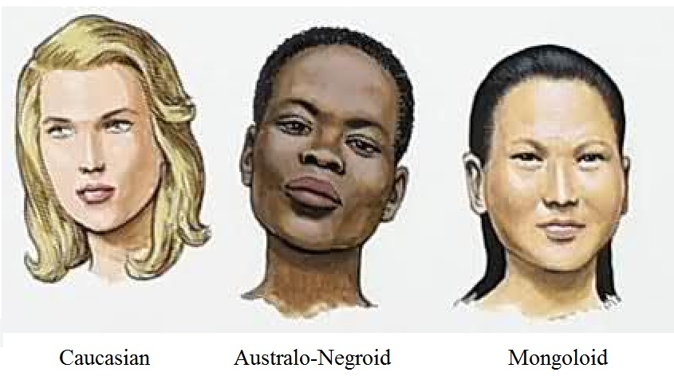
HUMAN RACES
Race is large human population that has common origin, stable set of morpho-physiological traits and reflects adaptation to certain environment.
Races can be defined as distinct evolutionary lineage within a same species. Most anthropologists recognize three main races: Caucasian (or Europid), Mongoloid and Australo-Negroid.

Slide 41
Australo-Negroid populations inhabit Africa, Australia, South Asia. The typical features are dark skin color (adaptive in high UV radiation in order to protect from mutations), dark curly hair, large dark eyes, broad nose, thick lips, and increased perspiration.
Mongoloid race populations inhabit Asia, North and South America, Arctic, and the Pacific Islands. Individuals within these populations have light or dark skin, straight dark hair, narrow eyes with epicanthal folds (skin fold in the inner eye corner, protects eyes from wind carrying dust and sand), broad nose, thin lips.

Slide 42
Caucasian race includes population of Europe, the Caucasus, North Africa, North India, Asia Minor. Caucasoids have light or swarthy skin (adaptive in low UV radiation in order to make sufficient vitamin D), straight or wavy light hair, large eyes of gray or blue color, narrow long nose (heating of air), thin lips. Blood cholesterol level is higher than in individuals of other races.
Each major race is subdivided into distinct anthropologic types called minor races (totally 22), the latter, in turn, include ethnic groups.

Slide 43
Adaptation mechanisms to same specific environment are similar in humans even of different races. A population of organisms that share one or more adaptation (morphological, physiological, biochemical) to certain habitat is called adaptive type or ecotype. The main adaptive ecotypes in humans are:
arctic ecotype,
mounting ecotype,
tropical ecotype,
arid ecotype,
ecotype of temperate climate.

Slide 44
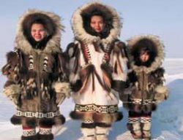
ARCTIC ADAPTIVE TYPE
Arctic ecotype demonstrates adaptation to cold moist climate.
People are short with comparatively large trunk and short limbs (illustration of the Bergman’s and Allen’s rules)
Musculoskeletal system is well developed, bone mineralization and red bone marrow content is high
level of hemoglobin, proteins and cholesterol in blood is elevated. Important morphological adaptation is fat insulation of vital organs
High fat content in food and blood serum and increased ability for its utilization high metabolic rate and
increased heat production; an average basic metabolic rate is 13–16 % more intensive than in strangers
Air and soil contains small number of microorganisms, eggs of helminthes and cysts of protists, so people of Arctic type have relatively low immunity

Slide 45
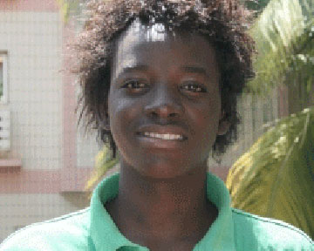
TROPICAL ECOTYPE
The main ecological factors here are high temperature with high humidity that makes loosing the excess body heat hard. Vegetative food with low protein is prevalent.
Air, soil and water contain a lot of bacteria, environmental conditions favor circulation of parasitic disorders.
People of tropical adaptive type usually are tall and thin with comparatively short trunk and long extremities (illustration of the Bergman’s and Allen’s rules), narrow chest, decreased muscle mass and little body fat.
Number of sweat gland per 1 cm² of skin is increased, perspiration is more active (however, inhabitants of tropical rain forests sweat less as sweat cannot evaporate).
Basic metabolic rate and blood cholesterol is low; specific regulation of water-salt balance .

Slide 46
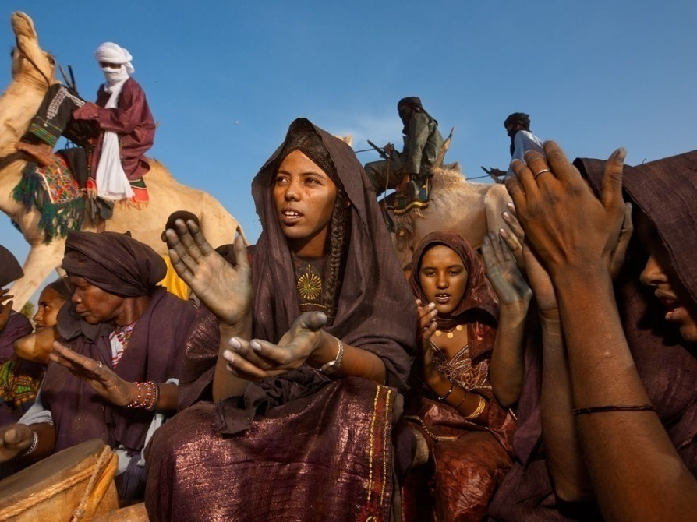
ARID ECOTYPE
adapted to the hot dry air and large diurnal temperature fluctuations.
long bodied morphological types are more common, the muscular and fatty components develop poorly (as in the tropics). However, the total body size of the inhabitants of the deserts is greater (reaction to lower environmental temperatures).
The level of basal metabolism, blood cholesterol, mineralization of the skeleton is low.
vascular regulation of heat loss is more effective.

Slide 47

MOUNTING ECOTYPE
adaptation to high altitudes with low partial oxygen pressure and hypoxia.
enlarged lung volumes and breath more rapidly.
Better oxygenation is reached by high hemoglobin concentration (in Andeans) and high oxygen saturation, increased net of capillaries. Level of myoglobin is elevated also.
Intensive oxygen delivery, including cerebral flow, is provided by high level of nitric oxide in blood (nitric oxide dilates blood vessels).

Slide 48

ADAPTIVE TYPE OF TEMPERATE CLIMATE
temperature and humidity doesn’t reach critical values, climatic changes are seasonal, external conditions vary
People demonstrate intermediate morphological features and metabolic rate between Arctic and tropic adaptive types.

Slide 49

URBAN ECOTYPE
is characterized by the lability of mental reactions, which allows experiencing a state of constant stress and high rate of life.
Accumulation of environmental pollution, overcrowding, increase in cigarette smoking, alcohol and fat consumption in urban populations result in increased incidence and prevalence of “diseases of civilization”. These are chronic disorders that become a dominant health problem in industrialized countries: cancer, disorders of cardiovascular system, bronchial asthma and other disorders with allergic component, metabolic disorders (obesity, diabetes).

Slide 50
Non-hereditary short-term changes in which an individual organism adjusts to it environment (a change in altitude, temperature, humidity) within the lifetime is called acclimatization.
If acclimatization occurs during organism’s growth and development it can cause irreversible changes, known as developmental adjustment or developmental acclimatization.
Both short-term and developmental acclimatization are modifications
Successfulness and rate of acclimatization is influenced by genetic polymorphism.

Slide 51
Types of human constitution according to reaction towards new extreme conditions
”sprinter”, develop powerful physiological responses to the violent short-term effects of extreme environment, explained by large reserve of regulating and life support systems and a high capacity for their rapid mobilization. The restoration processes are slow, so long-term action of unfavourable factors is poorly tolerated
“stayer” are poorly adapted to the powerful short-term environmental stress, as their backup capacity and ability of rapid mobilization are low. However, after a short-term adjustment, they are able to tolerate long, monotonous influence of environmental stressors. Working loads in “stayers” are accompanied by optimal restoration processes.
“mixt” is characterized by intermediate abilities to adaptation.

Slide 52


Slide 53


