Slide 1
Odesa National Medical University
Department of Family Medicine and Polyclinic Therapy
Elective course “ECG in General Practice”
Content module 1
Basics of electrocardiography

Slide 2
Theme 1
Electrophysiological basis of ECG

Slide 3
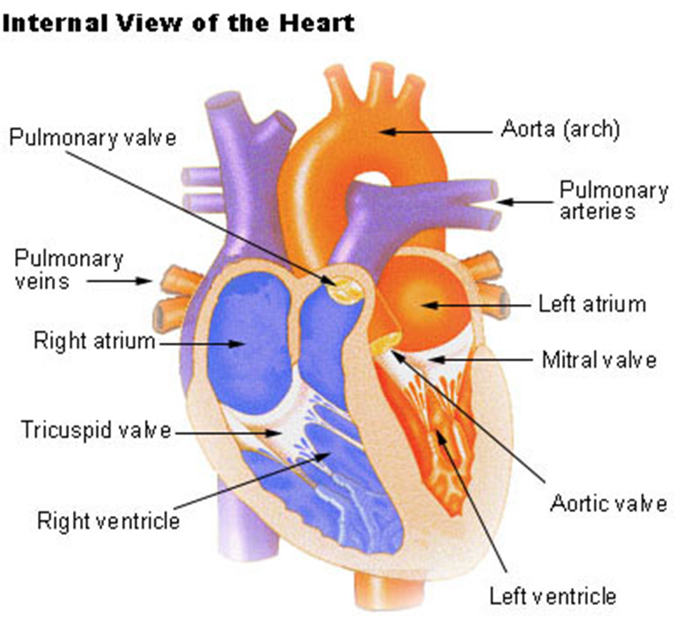
The heart is a mechanical pump whose activity is governed by the electrical conduction system.
It is essential to possess a strong understanding of the physiology of the cardiac cells as this will help you appreciate how the heart works and the implications of findings on the ECG.
The heart has four chambers:
The right atrium receives blood from the veins and pumps it to the right ventricle.
The right ventricle receives blood from the right atrium and pumps it to the lungs, where it is loaded with oxygen.
The left atrium receives oxygenated blood from the lungs and pumps it to the left ventricle.
The left ventricle (the strongest chamber) pumps oxygen-rich blood to the rest of the body. The left ventricle’s vigorous contractions create our blood pressure.

Slide 4
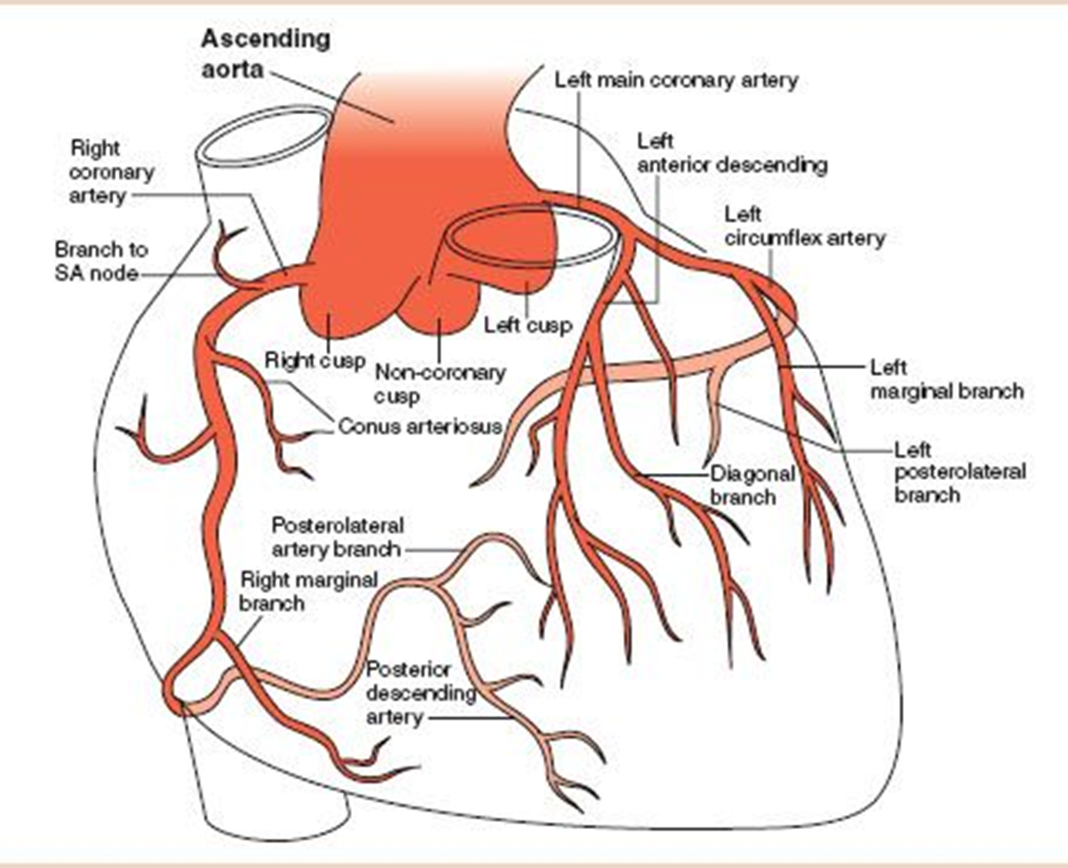
The following regions supplied by the different coronary arteries.
Inferior Wall - Right coronary artery
Anteroseptal - Left anterior descending artery
Anteroapical - Left anterior descending artery (distal)
Anterolateral - Circumflex artery
Posterior Wall - Right coronary artery
Knowing which ECG leads corresponds to specific arteries helps localize the obstruction in acute ST-elevation myocardial infarction or an age-indeterminate Q-wave infarction by observing predictable patterns on the ECG.

Slide 5
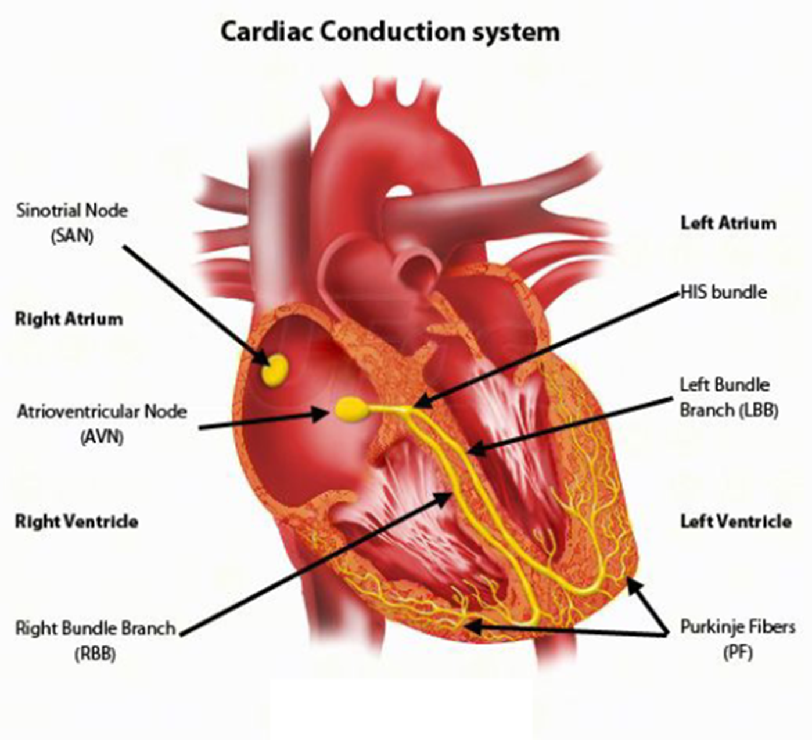
Mechanical work of pumping blood to the whole body occurs in a synchronized manner and is under the control of the cardiac conduction system. It is comprised of two types of cells, pacemaker and non-pacemaker cells.
Pacemaker cells are located primarily in the SA and AV node, and it is the SA node that drives the rate and rhythm of the heart. The AV node gets suppressed by the more rapid pace of the SA node.
The specialized function associated with the pacemaker cells is their spontaneous depolarization with no true resting potential.
When spontaneous depolarization reaches the threshold voltage, it triggers a rapid depolarization followed by repolarization.
The non-pacemaker cells mainly comprise the atrial and ventricular cardiac muscle cells and Purkinje fibers of the conduction system.
They consist of true resting membrane potential, and upon initiation of an action potential, rapid depolarization is triggered, followed by a plateau phase and subsequent repolarization.
Action potentials are generated by ion conductance via the opening and closing of the ion channels.

Slide 6
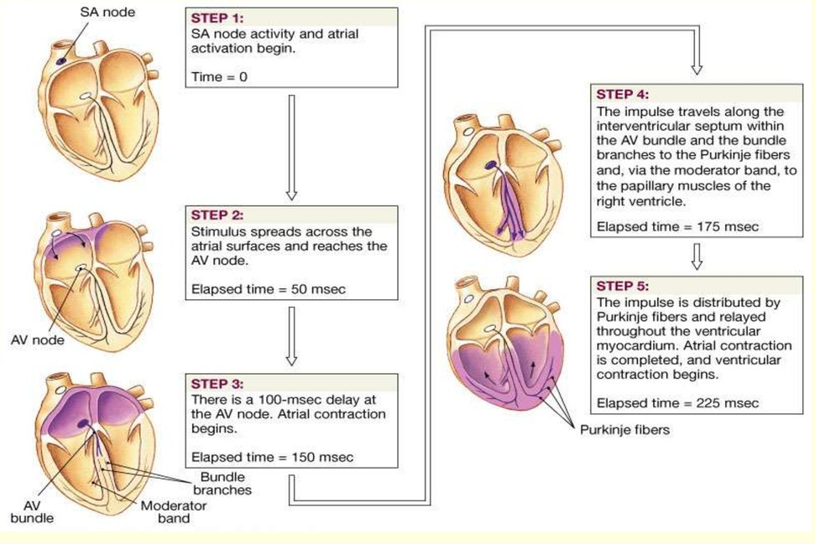
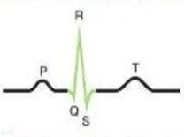
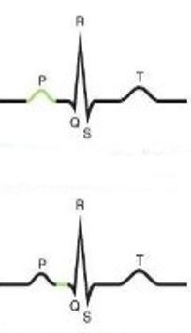
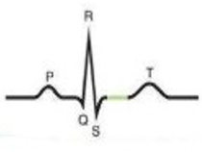
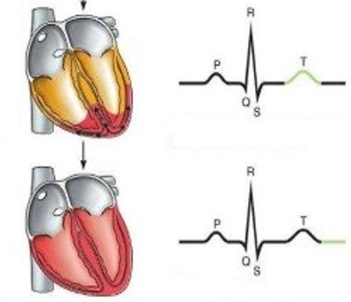
Depolarization
Repolarization

Slide 7
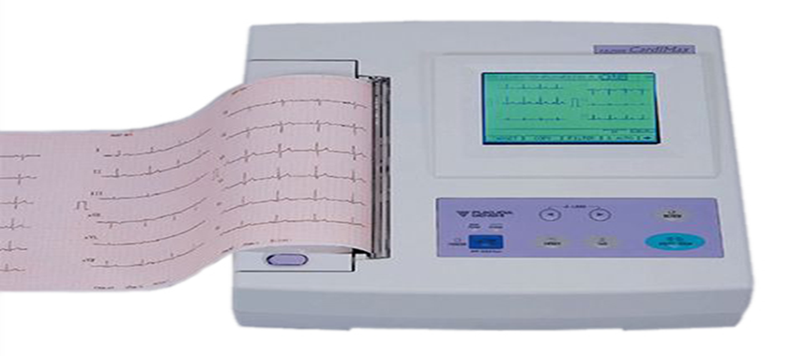
Electrocardiogram (ECG or EKG)
An ECG records the electrical signals in the heart.
It's a common and painless test used to quickly detect heart problems and monitor the heart's health.
ECG is often done in a health care provider's office, a clinic or a hospital room.
ECG machines are standard equipment in operating rooms and ambulances.

Slide 8
Owing to its widespread use in the field of medicine, the ECG has several indications listed below:
Symptoms are the foremost indication of the ECG, including palpitation, dizziness, cyanosis, chest pain, syncope, seizure, and poisoning
Symptoms or signs associated with heart disease include tachycardia, bradycardia, and clinical conditions including hypothermia, murmur, shock, hypotension, and hypertension
To detect myocardial injury, ischemia, and the presence of prior infarction
Rheumatic heart disease
ECG changes in cases like drowning and electrocution are very valuable in determining necessary interventions
Detecting pacemaker or defibrillator device malfunction, evaluating their programming and function, verifying the analysis of arrhythmias, and monitoring for delivery of the appropriate electrical pacing in patients with defibrillators and pacemakers
Evaluation of metabolic disorders
Helpful for the assessment of blunt cardiac trauma
Cardiopulmonary resuscitation
Valuable aid in the study and differential diagnosis of congenital heart diseases
Electrolyte imbalance and rhythm disorders
To monitor the pharmacotherapeutic effects and adverse effects of drug therapy
Perioperative anesthesia monitoring, such as preoperative assessment and intraoperative and postoperative monitoring
Screening tool in a sports physical exam to rule out cardiomyopathy

Slide 9
Patient may need an ECG in cases of any of the following signs and symptoms:
Chest pain
Dizziness, lightheadedness or confusion
Heart palpitations
Rapid or slow pulse
Shortness of breath
Weakness, fatigue or a decline in ability to exercise
The American Heart Association doesn't recommend using electrocardiograms to assess adults at low risk who don't have symptoms.
But if patient has a family history of heart disease the health care provider might suggest an electrocardiogram as a screening test, even if patient has no symptoms.

Slide 10
Preparation
Electrocardiogram requires special preparation.
Before the procedure, a brief history regarding drugs and allergies to adhesive gel is necessary.
The temperature of the room must be kept optimal to avoid shivering.
The patient should be in a gown, and electrode sites identified.
For good contact between the body surface and electrodes, it is advised to shave the chest hair and then apply the electrocardiographic adhesive gel to the electrodes.
Any metallic object, like jewelry or a watch, requires removal.
Limb and precordial leads should be accurately placed to avoid vector misinterpretation.
Finally, the patient must lie down and relax before recording the standard 10-second strip.

Slide 11
Complications
An electrocardiogram is a safe, non-invasive, painless test with no major risks or complications.
An allergic reaction or skin sensitivity to the adhesive gel can occur and usually resolves as soon as the electrode patches are removed and, in most cases, do not require any treatment.
Artifacts and distortions pose serious diagnostic difficulties and may result in an inaccurate interpretation of the ECGs, potentially resulting in an adverse therapeutic intervention.
There can be a potential for misdiagnosis due to the inadvertent misplacement of ECG leads.

Slide 12
12-lead ECG
10 electrodes required to produce 12-lead ECG
4 Electrodes on all 4 limbs (RA, LL, LA, RL)
6 Electrodes on precordium (V1–V6)
Monitors 12 leads (V1–V6), (I, II, III) and (aVR, aVF, aVL)
Allows interpretation of specific areas of the heart
Inferior (II, III, aVF)
Lateral (I, aVL, V5, V6)
Anterior, septal, axis (V1–V4)

Slide 13
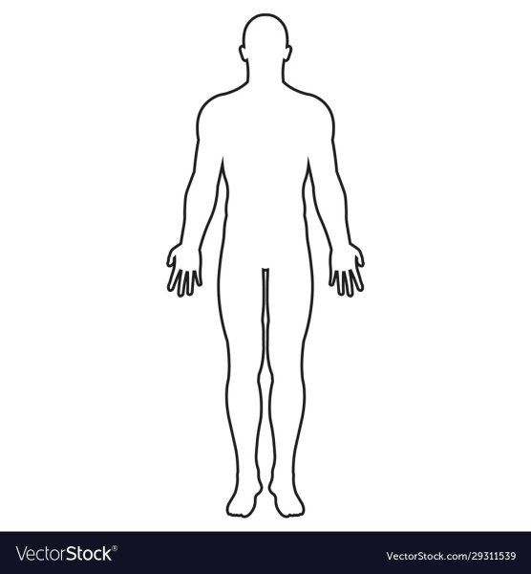

(R) – red on right arm
(L) – yellow on left arm
(N)– black on right ankle
(F) – green on left ankle

Slide 14
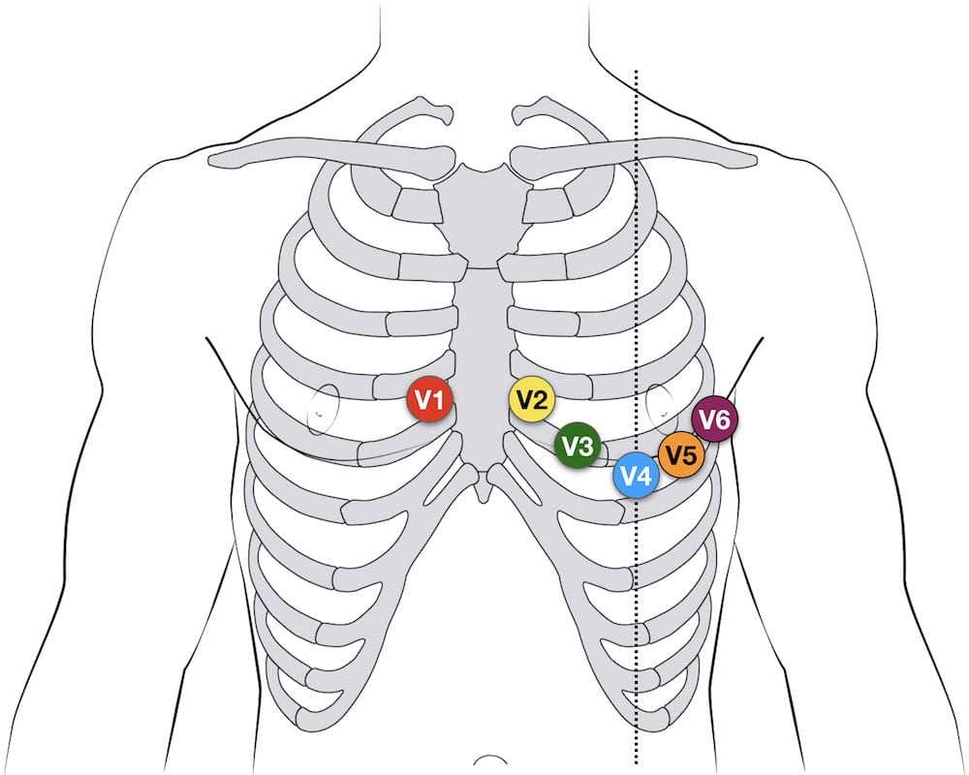
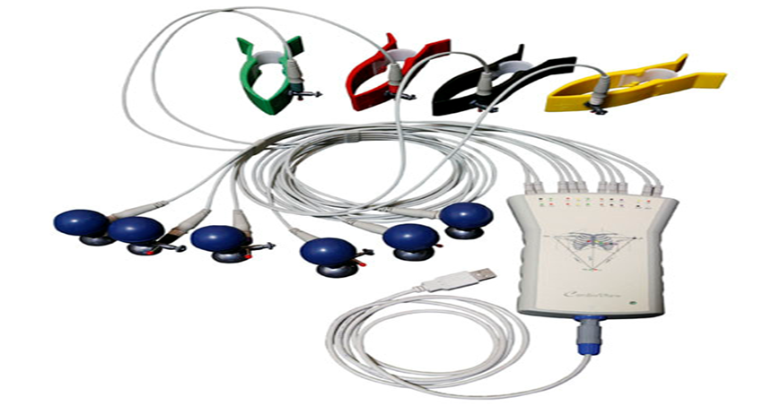
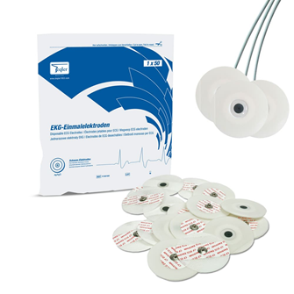
12-lead Precordial lead placement
V1 | 4th ICS, RIGHT margin of the sternum
V2 | 4th ICS along the LEFT margin of the sternum
V4 | 5th ICS, mid-clavicular line
V3 | midway between V2 and V4
V5 | 5th ICS, anterior axillary line (same level as V4)
V6 | 5th ICS, mid-axillary line (same level as V4)
single-use electrodes
ICS – intercostal space
reusable electrodes

Slide 15
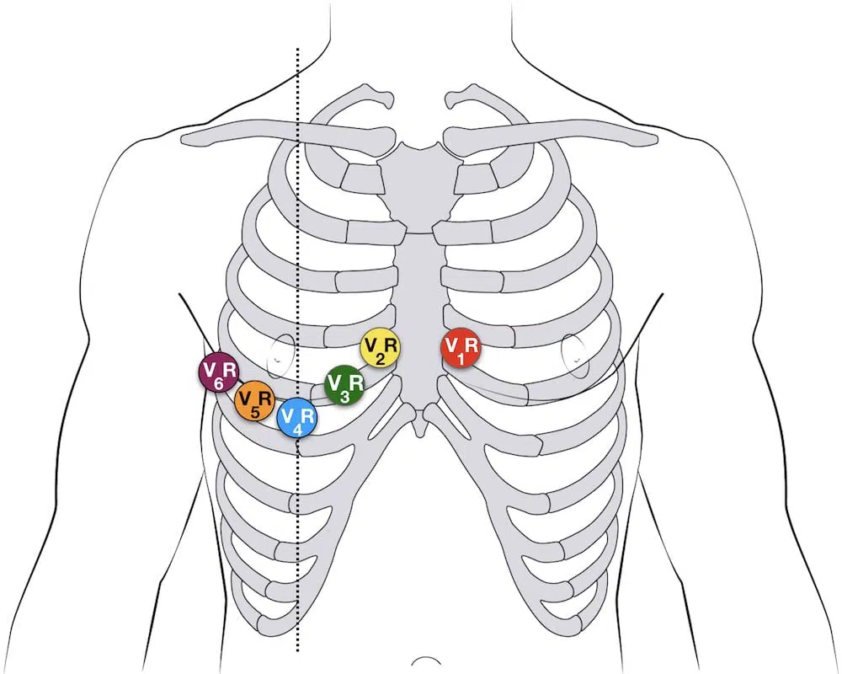
Additional Lead placements
Right sided ECG electrode placement
There are several approaches to recording a right-sided ECG:
A complete set of right-sided leads is obtained by placing leads V1-6 in a mirror-image position on the right side of the chest.
It can be simpler to leave V1 and V2 in their usual positions and just transfer leads V3-6 to the right side of the chest (i.e. V3R to V6R).
The most useful lead is V4R, which is obtained by placing the V4 electrode in the 5th right intercostal space in the mid-clavicular line.
ST elevation in V4R has a sensitivity of 88%, specificity of 78% and diagnostic accuracy of 83% in the diagnosis of RV MI.

Slide 16
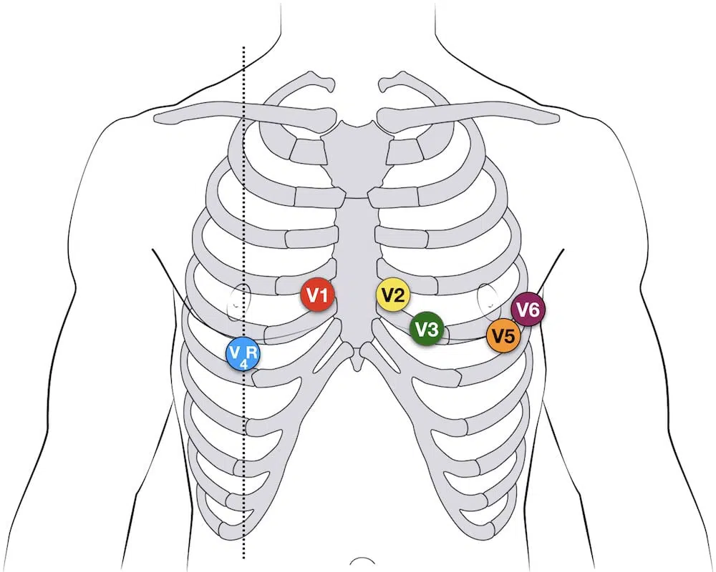
Erhardt et al first described the use of a right sided precordial lead (CR4R or V4R) in the diagnosis of right ventricular infarction which had previously been thought to be electrocardiographically silent.
V4R ECG lead placement

Slide 17
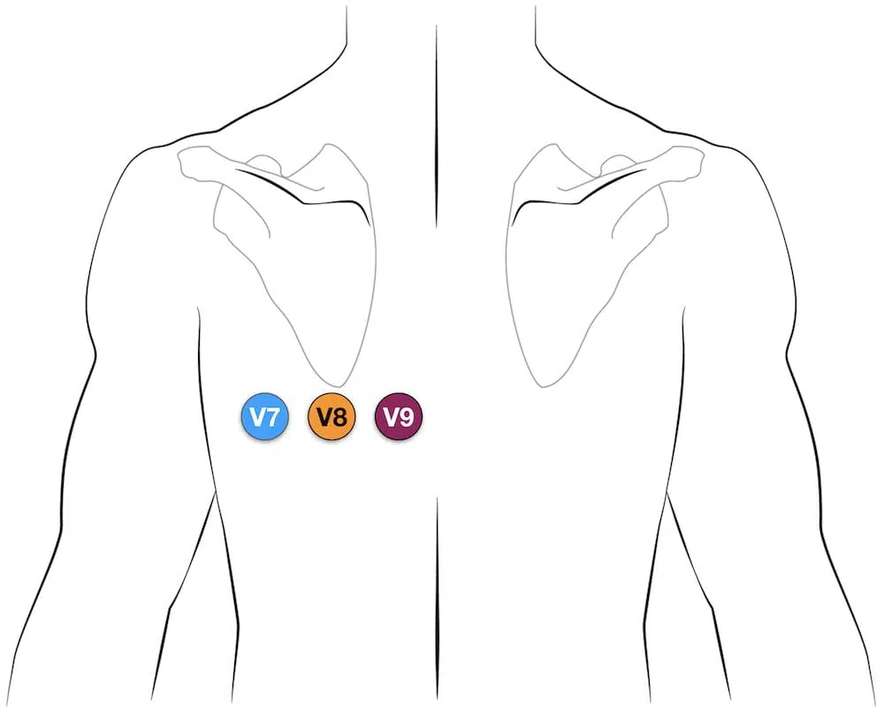
Posterior leads
Leads V7-9 are placed on the posterior chest wall in the following positions:
V7 | Left posterior axillary line, in the same horizontal plane as V6
V8 | Tip of the left scapula, in the same horizontal plane as V6
V9 | Left paraspinal region, in the same horizontal plane as V6
Clinical significance of Posterior MI.
The leads V4-V6 are removed and substituted for V7-V9. It is important to cross out the labels for V4-V6 and write in V7-V9.

Slide 18
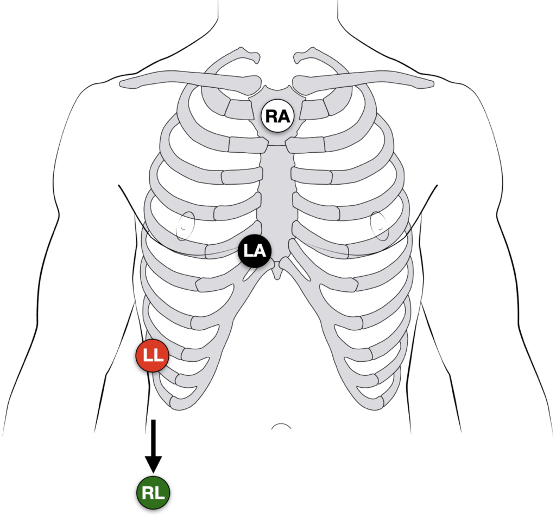
Lewis lead (S5-lead)
The Lewis lead configuration can help to detect atrial activity and its relationship to ventricular activity.
Useful in:
Observing flutter waves in atrial flutter
Detecting P waves in wide complex tachyarrhythmia to identify atrioventricular dissociation
Lewis lead placement
Right Arm (RA) electrode on manubrium
Left Arm (LA) electrode over 5th ICS, right sternal border.
Left Leg (LL) electrode over right lower costal margin.
Monitor Lead I

Slide 19
Understanding paper speeds
Paper output speed is the rate at which the ECG machine produces a trace
If a different paper speed is used, standard rate calculations will have to be modified appropriately (see other examples below)
Standard output is 25mm per second
Other paper speeds: 50mm/sec
Doubling the standard rate will cause the ECG to appear drawn out or wider complex than 25mm/sec paper speeds
The rhythm strip will thus comprise 5 seconds total capture compared to the standard 10 seconds.
Doubling the standard rate can reveal subtle ECG findings hidden at the slower rates, in particular atrial flutter waves in a 2:1 block
Paper speed: 10mm/sec

Slide 20
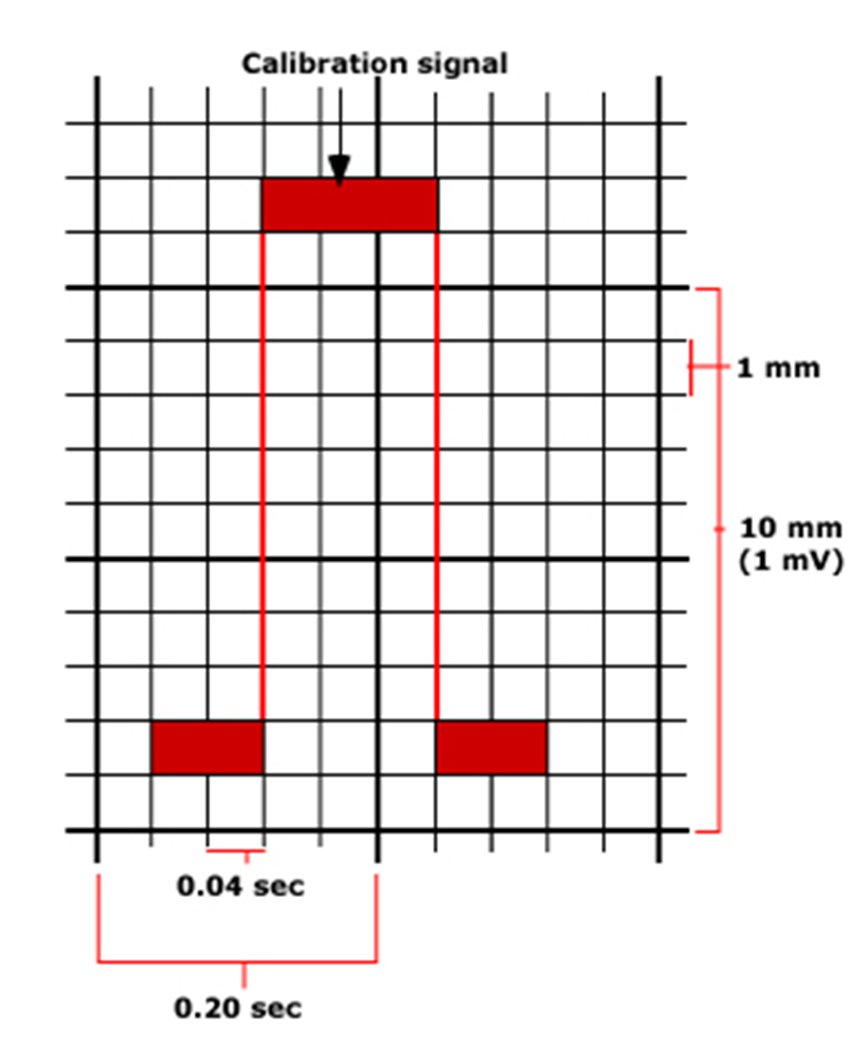
Calibration
Horizontal Axis ‘x’ time/seconds | 1 Small Square = 0.04 sec
 | 1 Large Square = 0.2 sec
 | 5 Large Squares = 1 sec
Vertical Axis ‘y’ milivolts/mm | 1 Small Square = 1 mm (0.1 mV)
 | 1 Large Square = 5 mm (0.5 mV)
 | 2 Large Squares = 10 mm (1 mV)
The electrocardiograph moves at a speed of 25 mm/sec.
Time is plotted on the x-axis and voltage on the y-axis.
On the x-axis, 1 second is divided into five large squares, each representing 0.2 sec. Each large square is further divided into five small squares of 0.04 sec each.
The ECG machine is calibrated in such a way that an increase of voltage by 1 mVolt should move the stylus by 1 cm.

Slide 21
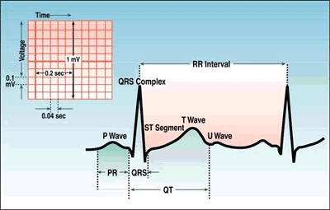
ECG Complex

Slide 22
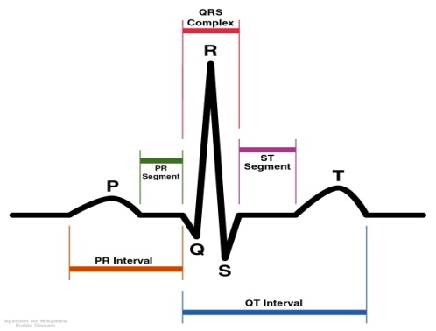
Ventricular Depolarization
The time required for the propagating impulse to advance from the atria to ventricles
The period of complete ventricular depolarization, when the cardiac muscle is contracted
Ventricular Repolarization
Atrial Depolarization
electrical systole of the ventricles

Slide 23

P wave, PR interval and PR segment
The P wave reflects atrial depolarization (activation).
The PR interval is assessed in order to determine whether impulse conduction from the atria to the ventricles is normal.
The PR segment reflects the slow impulse conduction through the atrioventricular node. The PR segment serves as the baseline of the ECG curve.
The amplitude of any deflection/wave is measured by using the PR segment as the baseline.

Slide 24
The QRS complex
The QRS complex represents the depolarization (activation) of the ventricles.
It is always referred to as the “QRS complex” although it may not always display all three waves.
Since the electrical vector generated by the left ventricle is many times larger than the vector generated by the right ventricle, the QRS complex is actually a reflection of left ventricular depolarization.
A short QRS complex is desirable as it proves that the ventricles are depolarized rapidly, which in turn implies that the conduction system functions properly.
Wide (broad) QRS complexes indicate that ventricular depolarization is slow, which may be due to dysfunction in the conduction system.

Slide 25
The J point and the ST segment
The ST segment corresponds to the plateau phase (phase 2) of the action potential.
The ST segment must always be studied carefully since it is altered in a wide range of conditions.
Many of these conditions cause rather characteristic ST segment changes.
The ST segment is of particular interest in the setting of acute myocardial ischemia.
There are two types of ST segment deviations.
ST segment depression - below the level of the PR segment.
ST segment elevation - above the level of the PR segment.
The magnitude of depression/elevation is measured as the height difference (in millimeters) between the J point and the PR segment.
The J point is the point where the ST segment starts. If the baseline (PR segment) is difficult to discern, the TP interval may be used as the reference level.

Slide 26
The T wave and the U-wave
The T wave reflects the rapid repolarization of contractile cells (phase 3) and T wave changes occur in a wide range of conditions.
T wave changes are frequently misunderstood in clinical practice.
The transition from the ST segment to the T wave should be smooth (and not abrupt).
The normal T wave is slightly asymmetric, with a steeper downward slope.
The U wave is seen occasionally. It is a positive wave occurring after the T wave.
Individuals with prominent T waves, as well as those with slow heart rates, display U waves more often.
Its amplitude is generally one-fourth of the T wave’s amplitude.
The U wave is most frequently seen in leads V2–V4.
The genesis of the U wave remains elusive.

Slide 27
QT duration and QTc duration
QT duration reflects the total duration of ventricular depolarization and repolarization.
The QT duration is inversely related to heart rate (i.e. the QT interval increases at slower heart rates and decreases at higher heart rates).
Therefore to determine whether the QT interval is within normal limits, it is necessary to adjust for the heart rate. The heart rate-adjusted QT interval is referred to as the corrected QT interval (QTc interval)
A long QTc interval increases the risk of ventricular arrhythmias.

Slide 28
Any questions?

