Slide 1
Odesa National Medical University
Department of Family Medicine and Polyclinic Therapy
Elective course “ECG in General Practice”
Content module 1
Basics of electrocardiography

Slide 2
Theme 2
Approach to ECG interpretation
Department of Family Medicine and Polyclinic Therapy
Assistant of Department Veronika Nazarian

Slide 3
Significance
This is arguably one of the most important theme throughout this course.
At the heart of ECG interpretation lies the ability to determine whether the ECG waves and intervals are normal.
We will focus on the ECG waves in terms of morphology (appearance), durations and intervals. A rather extensive discussion is provided in order to give you firm knowledge of normal findings, normal variants (i.e less common variants of what is considered normal) and pathological variants.
Thus, in this theme you will learn the physiological basis of all ECG waves and how to determine whether the ECG is normal or abnormal.
Also you will learn fundamental aspects of rhythm and ECG axis interpretation.

Slide 4
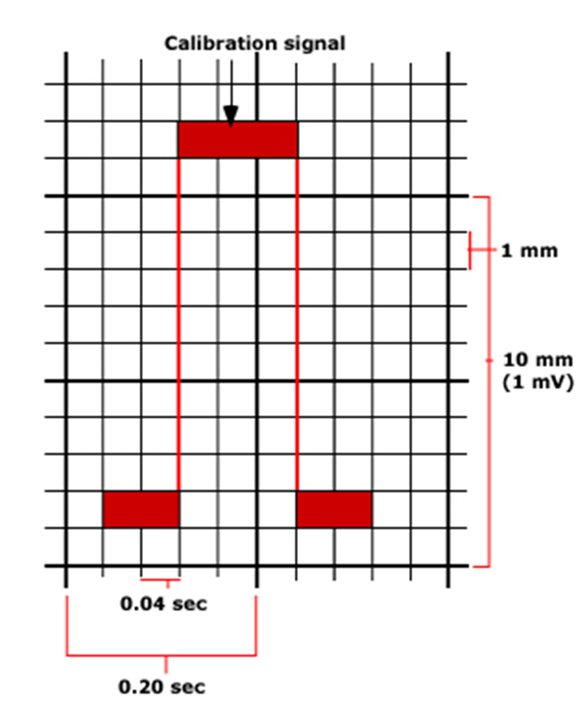
Calibration
Horizontal Axis ‘x’ time/seconds | 1 Small Square = 0.04 sec
 | 1 Large Square = 0.2 sec
 | 5 Large Squares = 1 sec
Vertical Axis ‘y’ milivolts/mm | 1 Small Square = 1 mm (0.1 mV)
 | 1 Large Square = 5 mm (0.5 mV)
 | 2 Large Squares = 10 mm (1 mV)
The electrocardiograph moves at a speed of 25 mm/sec.
Time is plotted on the x-axis and voltage on the y-axis.
On the x-axis, 1 second is divided into five large squares, each representing 0.2 sec. Each large square is further divided into five small squares of 0.04 sec each.
The ECG machine is calibrated in such a way that an increase of voltage by 1 mVolt should move the stylus by 1 cm.

Slide 5
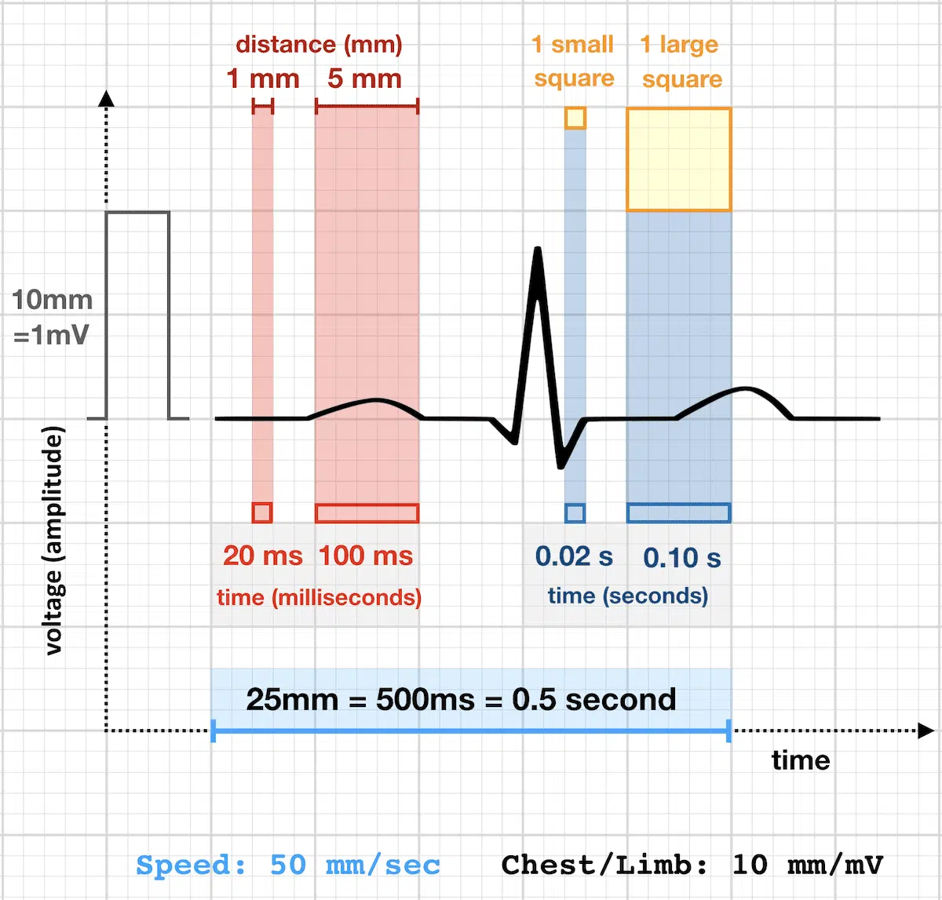

Slide 6
APPROACH TO ECG INTERPRETATION
A systematic approach to interpreting an ECG is essential for correct diagnosis.
Step 1: Rate
Step 2: Rhythm
Step 3: Axis
Step 4: Intervals
Step 5: P wave
Step 6: QRS complex
Step 7: ST segment-T wave
Step 8: Overall interpretation

Slide 7
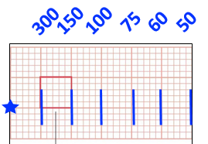
The Rate
There are three main methods of calculating ECG rate.
There is no specific best method, and preference varies between clinicians.
However, certain methods may be better suited for rhythms such bradyarrhythmias or tachyarrhythmias.
Speed of paper 25 mm/sec:
1 small square = 0.04 sec
1 large square = 0.2 sec
5 large squares = 1 sec
300 large squares= 60 sec
Speed of paper 50 mm/sec:
1 small square = 0.02 sec
1 large square = 0.1 sec
5 large squares = 0.5 sec
600 large squares= 60 sec
Speed of paper 10 mm/sec:
1 small square = 0.1 sec
1 large square = 0.5 sec
5 large squares = 2.5 sec
120 large squares= 60 sec

Slide 8
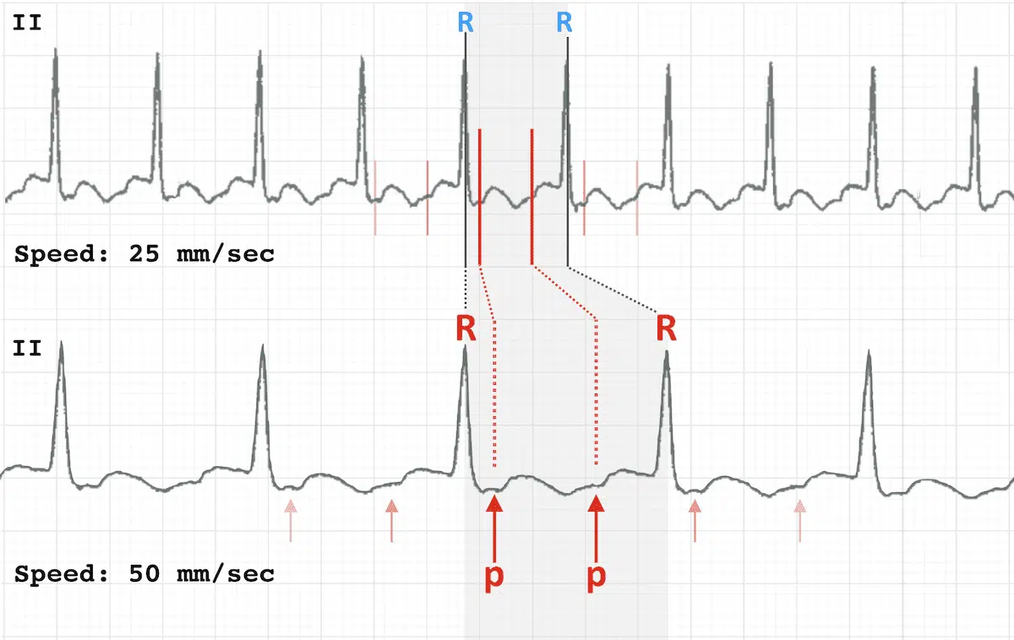
Doubling the standard rate can reveal subtle ECG findings hidden at the slower rates, in particular atrial flutter waves in a 2:1 block:
At 50mm/sec, P waves are more clearly discernible in a 2:1 ratio to QRS complexes

Slide 9
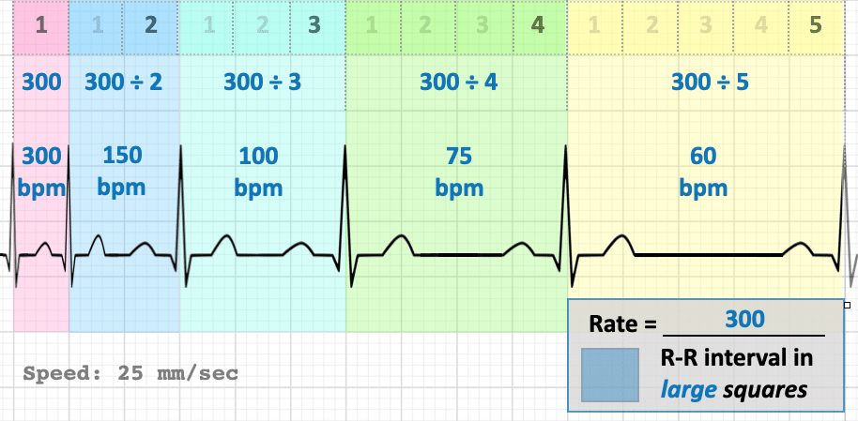
The Rate
1) Large square method
Recall above that 300 large squares is equal to 1 minute at a paper speed of 25mm/sec
We can thus calculate bpm by dividing 300 by the number of LARGE squares between each R-R interval (space between two consecutive R waves = one beat)
Useful as quick calculation for regular rhythms at regular rate
For example, two large squares between each R-R interval implies a rate of 150 bpm, three implies a rate of 100 bpm and so forth

Slide 10
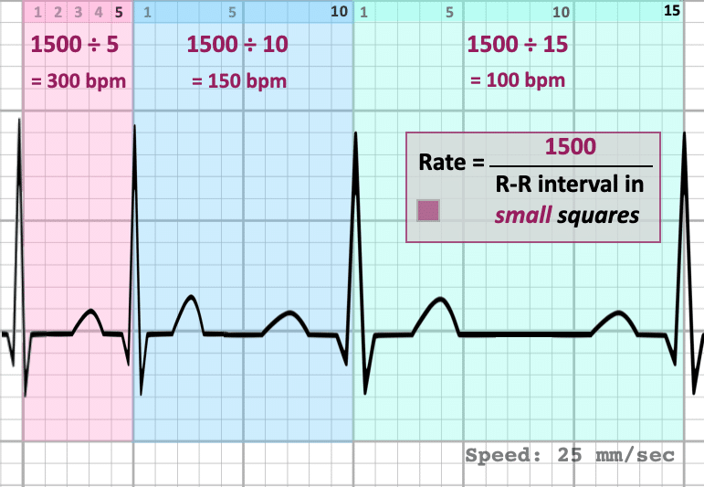
The Rate
2) Small square method
Similar to above, except 1500 is divided by the number of SMALL squares between consecutive R waves
Useful for very fast regular rhythms, as likely to provide more accurate rate than large square method
For example, 10 small squares between R-R interval implies a rate of 150 bpm, 15 implies a rate of 100 bpm, and so forth.
also
Rate= 60 / R-R interval in small boxes * 0,04

Slide 11
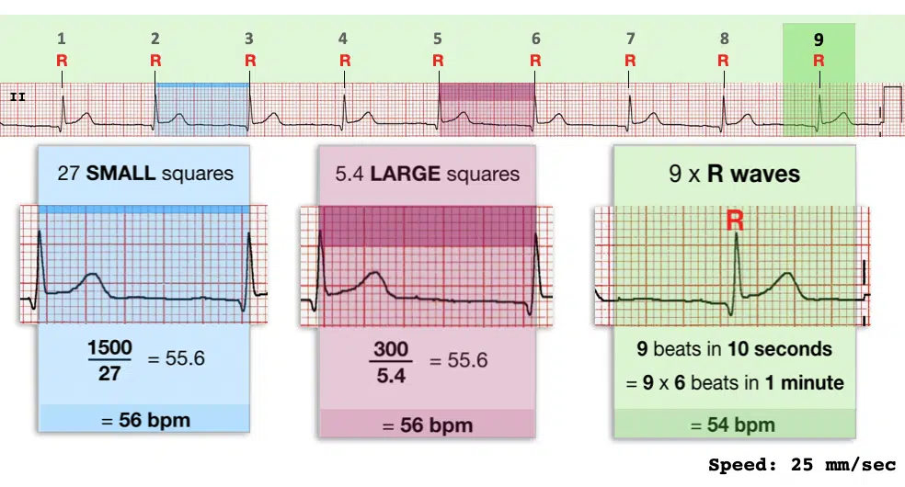
The Rate
3) R wave method
Count the number of complexes on the rhythm strip (each rhythm strip is typically 10 seconds long).
Multiply the number of complexes by 6 (giving you the average number of complexes in 1 minute).
Useful for slow and/or irregular rhythms
Rate = number of R waves (rhythm strip) X 6
(if rhythm strip 10 sec)

Slide 12
Note:
Calculate atrial and ventricular rates separately if they are different (e.g. complete heart block)
The machine reading can also be used and is usually correct — however, it may occasionally be inaccurate in the presence of abnormal QRS/T-wave morphology, e.g. may count peaked T waves as QRS complexes or miss QRS complexes with reduced amplitude.

Slide 13
Interpretation (adults)
Normal Heart Rates in Children
Normal: 60 – 100 bpm
Tachycardia: > 100 bpm
Bradycardia: < 60 bpm
Newborn: 110 – 150 bpm
2 years: 85 – 125 bpm
4 years: 75 – 115 bpm
6 years+: 60 – 100 bpm

Slide 14
RHYTHM ANALYSIS
Location of the P waves
Relationship between P waves and the QRS complex
Do the QRS complexes occur at regular intervals or are they irregular?
If the complexes are irregular, is there a pattern to the irregularity?
A patient’s heart rhythm can be regular or irregular.
Irregular rhythms can be either:
Regularly irregular (i.e. a recurrent pattern of irregularity)
Irregularly irregular (i.e. completely disorganised)
Mark out several consecutive R-R intervals on a piece of paper, then move them along the rhythm strip to check if the subsequent intervals are similar.

Slide 15
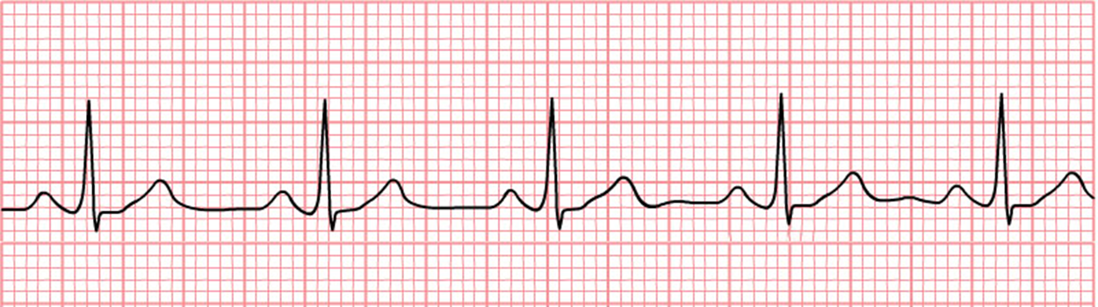
RHYTHM ANALYSIS
ECG features of normal sinus rhythm
Regular rhythm with <10% variation in the shortest and longest durations between successive P waves
Normal heart rate of 60-100 bpm (or age-appropriate rate in children)
Normal P wave before each QRS complex: P waves have normal morphology, upright in leads I and II, inverted in aVR
Normal PR interval, QRS complex and QT interval.
QRS complex positive in leads I, II, aVF and V3–V6, and negative in lead aVR.

Slide 16
Interpret the rhythm in the clinical setting
Often, the clinical history, including drugs being taken, can be helpful in establishing a diagnosis.
As an example, a regular wide complex rhythm in an older patient with a history of ischemic cardiomyopathy is most likely ventricular tachycardia.
Similarly, a narrow complex tachycardia of sudden onset in a young person with no medical history is likely AV nodal re-entrant or AV reciprocating tachycardia.
However, the clinical presentation and associated hemodynamic findings do not necessarily correlate with the etiology of an abnormal rhythm. The presence of hemodynamic stability during a tachycardia, for example, does not imply a supraventricular etiology, nor does instability mean that the diagnosis is ventricular tachycardia.
Hemodynamic changes are related to the rate of the arrhythmia and the presence and extent of underlying heart disease.

Slide 17
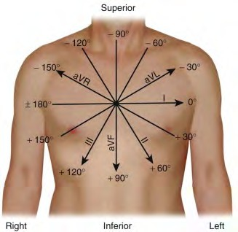
Hexaxial System

Slide 18
What is cardiac axis?
The electrical activity of the heart starts at the sinoatrial node then spreads to the atrioventricular (AV) node.
It then spreads down the bundle of His and then Purkinje fibres to cause ventricular contraction.
Whenever the direction of electrical activity is towards a lead you get a positive deflection in that lead.
Whenever the direction of electrical activity is away from a lead you get a negative deflection in that lead.
Cardiac axis gives us an idea of the overall direction of electrical activity.

Slide 19
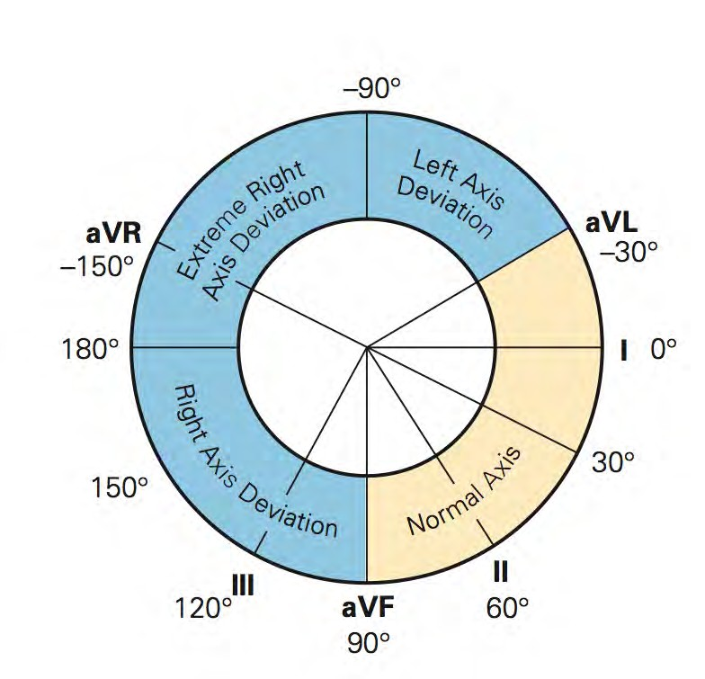
Axis

Slide 20
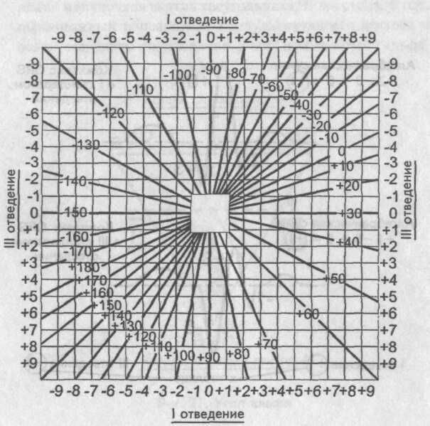
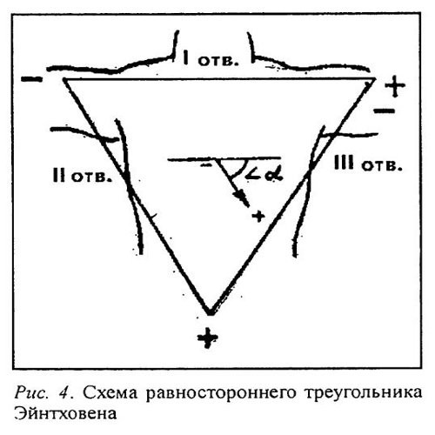

Slide 21
Normal cardiac axis
The axis is the direction of the sum vector of ventricular depolarization.
In healthy individuals, you would expect the axis to lie between -30° and +90º.
The overall direction of electrical activity is towards leads I, II and III. As a result, you see a positive deflection in all of these leads, with lead II showing the most positive deflection as it is the most closely aligned to the overall direction of electrical spread.
You would expect to see the most negative deflection in aVR. This is due to aVR looking at the heart in the opposite direction.

Slide 22
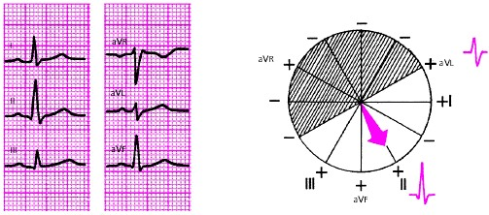
Normal cardiac axis
Typical ECG findings for normal cardiac axis:
Lead II has the most positive deflection compared to leads I and III which are positive.
* The Isoelectric Lead

Slide 23
Left axis deviation
Left axis deviation (LAD) involves the direction of depolarisation being distorted to the left (between -30° and -90°).
This results in the deflection of lead III becoming negative (this is only considered significant if the deflection of lead II also becomes negative).
LAD is usually caused by conduction abnormalities.

Slide 24
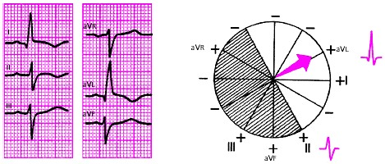
Left axis deviation
Typical ECG findings for left axis deviation:
Lead I has the most positive deflection.
Leads II and III are negative.

Slide 25
Right axis deviation
Right axis deviation (RAD) involves the direction of depolarisation being distorted to the right (between +90º and +180º).
The most common cause of RAD is right ventricular hypertrophy. Extra right ventricular tissue results in a stronger electrical signal being generated by the right side of the heart. This causes the deflection in lead I to become negative and the deflection in lead aVF/III to be more positive.
RAD is commonly associated with conditions such as pulmonary hypertension, as they cause right ventricular hypertrophy. RAD can, however, be a normal finding in very tall individuals.

Slide 26
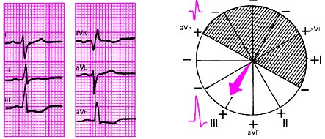
Right axis deviation
Typical ECG findings for right axis deviation:
Lead III has the most positive deflection and lead I should be negative.
Right axis deviation is associated with right ventricular hypertrophy.

Slide 27
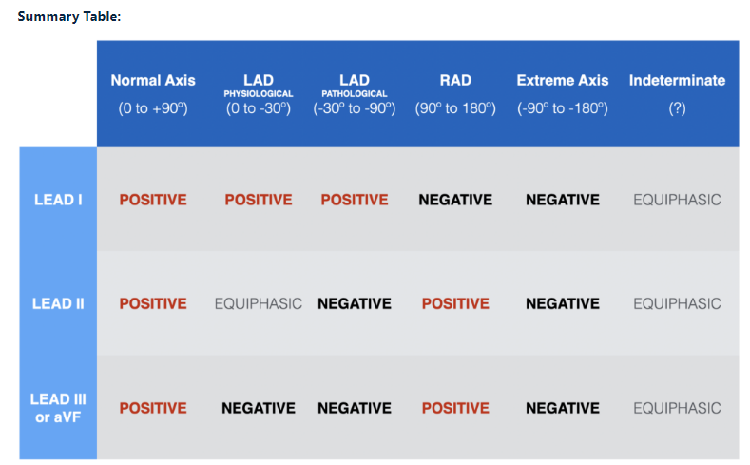

Slide 28
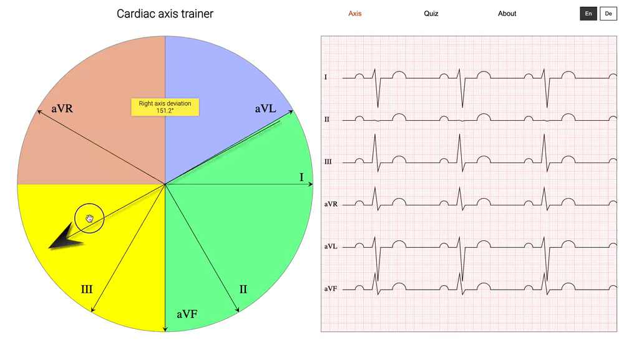

Slide 29
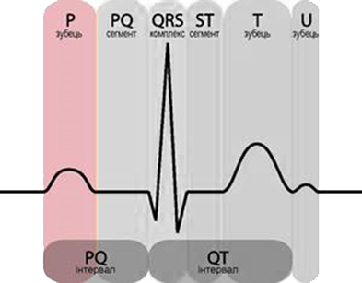
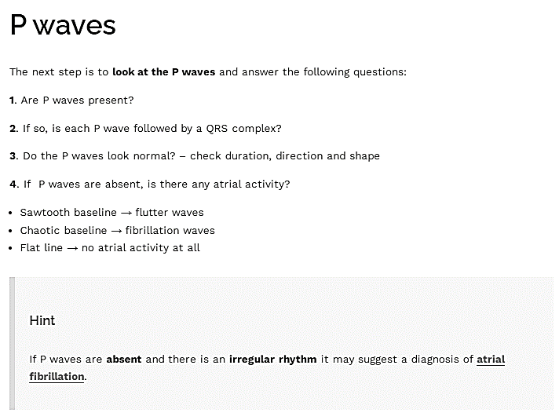
P waves
Duration ≤0,12 seconds.
Amplitude <2,5 mm in the limb leads.

Slide 30
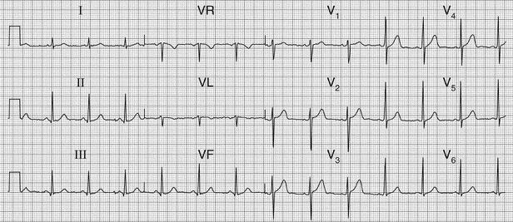
frequently biphasic in V1 (occasionally in V2).
The negative deflection is normally <1 mm.
P waves
negative in aVR
always positive in II lead during sinus rhythm
virtually always positive in I, aVL, aVF, V4-V6

Slide 31
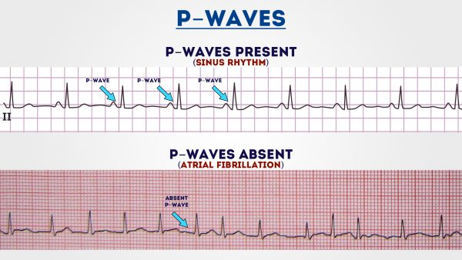

Slide 32
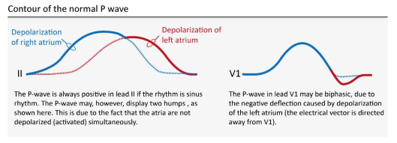

Slide 33
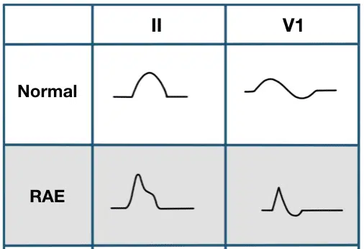
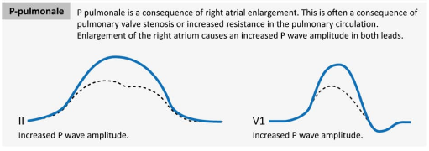
ECG Criteria of Right Atrial Enlargement
Right atrial enlargement produces a peaked P wave (P pulmonale) with amplitude:
> 2.5 mm in the inferior leads (II, III and AVF)
> 1.5 mm in V1 and V2

Slide 34
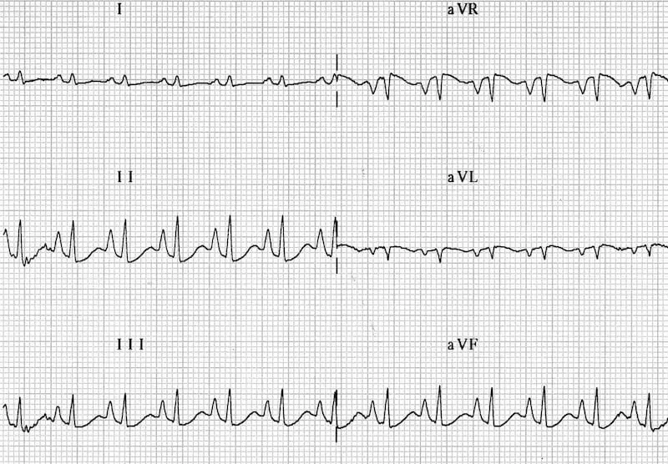
Right atrial enlargement: P pulmonale
P wave amplitude > 2.5mm in leads II, III and aVF

Slide 35
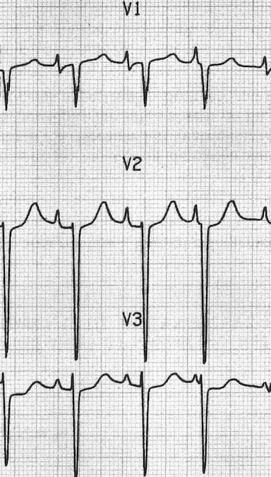
Right atrial enlargement: P wave amplitude > 1.5 mm in V1 and V2

Slide 36
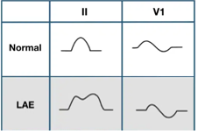
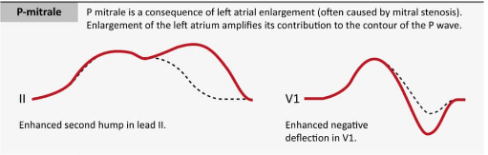
ECG Criteria for Left Atrial Enlargement
LAE produces a broad, bifid P wave in lead II (P mitrale) and enlarges the terminal negative portion of the P wave in V1.
In lead II
Bifid P wave with > 40 ms between the two peaks
Total P wave duration > 110 ms
In V1
Biphasic P wave with terminal negative portion > 40 ms duration
Biphasic P wave with terminal negative portion > 1mm deep

Slide 37
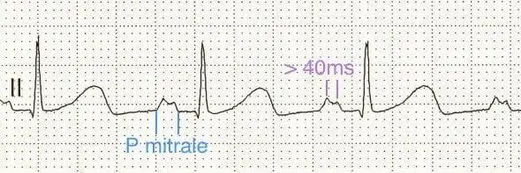
Broad (>110ms), bifid P wave in lead II (P mitrale) with > 40ms between the peaks
P wave terminal portion > 40 ms duration in V1

Slide 38
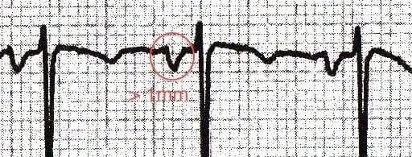
P waves with terminal portion > 1mm deep in V1

Slide 39
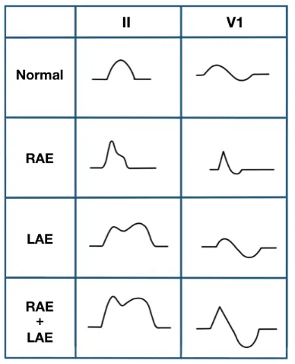
ECG Criteria for Biatrial Enlargement
The spectrum of P-wave changes in leads II and V1 with right, left, and biatrial enlargement is summarised below:
In lead II
Bifid P wave with
Amplitude ≥ 2.5mm AND
Duration ≥ 120 ms
In V1/V2
Biphasic P waves with
Initial positive deflection ≥ 1.5mm tall AND
Terminal negative deflection ≥ 1mm deep AND
Terminal negative deflection ≥ 40 ms duration
Combination criteria
P wave positive deflection ≥ 1.5 mm in leads V1 or V2 AND
Notched P waves with duration >120 ms in limb leads, V5 or V6

Slide 40
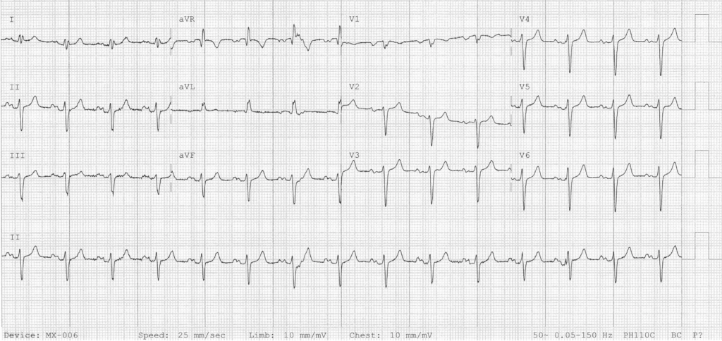
Biatrial enlargement:
Lead II: Bifid P wave with Amplitude ≥ 2.5mm AND Duration ≥ 120 ms
P wave positive deflection ≥ 1.5 mm in lead V2
Leads V5 and V6: Notched P waves with duration >120 ms in limb leads

Slide 41
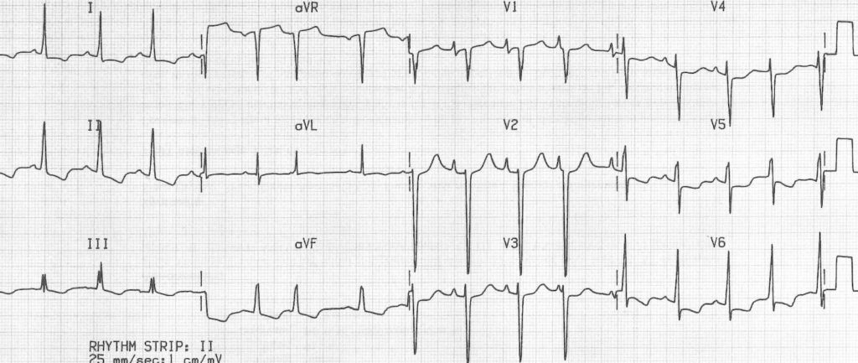
Biatrial enlargement due to idiopathic cardiomyopathy:
Biphasic P waves in V1 with a very tall positive deflection (almost 3 mm in height!) and a negative deflection that is both deep (> 1 mm) and wide (> 40 ms).

Slide 42
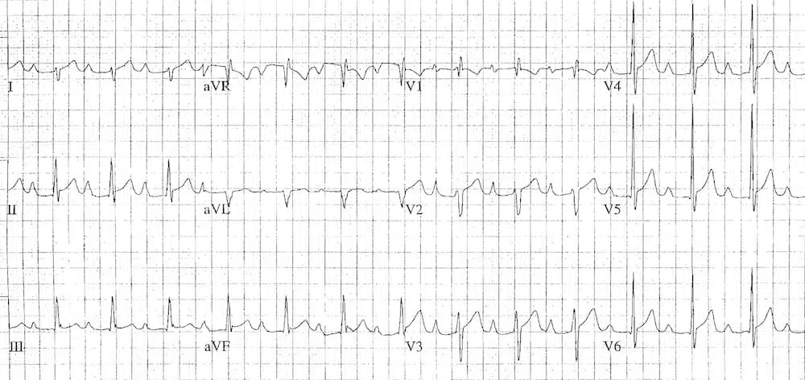
Biatrial enlargement:
P waves in lead II are tall (> 2.5mm) and wide (> 120 ms).
P waves in V2 are tall (> 1.5 mm), while the terminal negative portion of V1 is deep (> 1mm) and wide (> 40 ms).

Slide 43
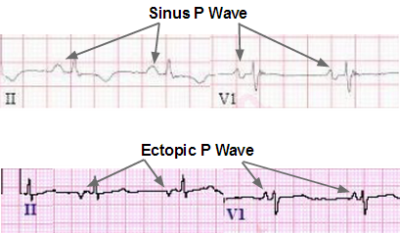
If the atria are depolarized by impulses generated by cells outside of the sinoatrial node (i.e by an ectopic focus), the morphology of the P wave may differ from the P-waves in sinus rhythm.
If the ectopic focus is located close to the sinoatrial node, the P wave will have a morphology similar to the P-wave in sinus rhythm.
However, an ectopic focus may be located anywhere, so the P wave may have different morphology.
If it is located near the atrioventricular node, the activation of the atria will proceed in the opposite direction, which produces an inverted (retrograde) P-wave.

Slide 44
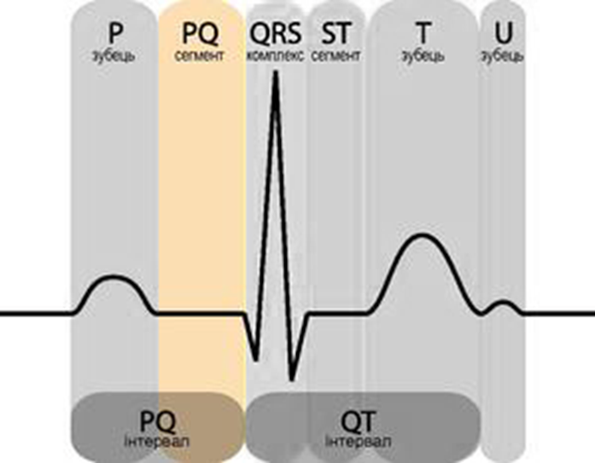
PR interval
The PR interval reflects conduction through the AV node.
Normal duration is120 – 200 ms (0.12-0.20 s) (three to five small squares).
If the PR interval is > 200 ms – heart block
PR interval < 120 ms – pre-excitation (the presence of an accessory pathway between the atria and ventricles) or AV nodal (junctional) rhythm.
PR depression

Slide 45
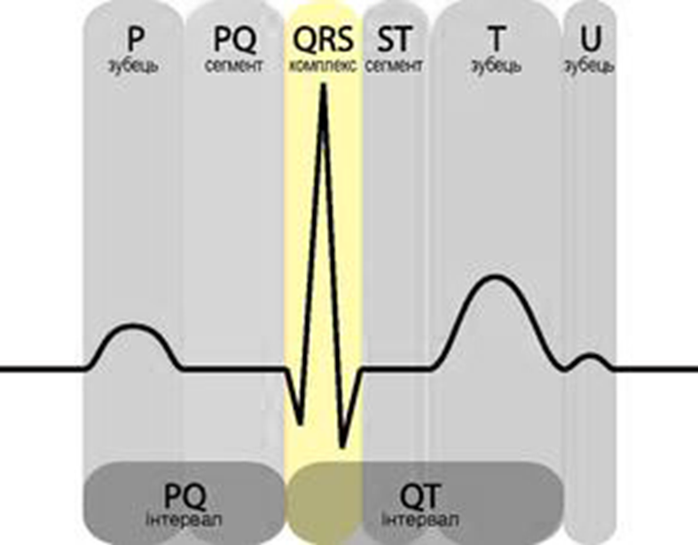
QRS Complex
Morphology
Main features to consider:
Width of the complexes: narrow versus broad.
Voltage (height) of the complexes.
Spot diagnoses: specific morphology patterns that are important to recognise.

Slide 46
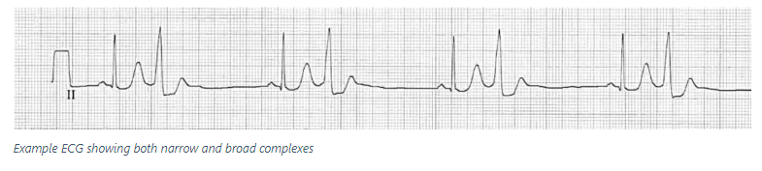
QRS Width
Normal QRS width is 70-100 ms (a duration of 110 ms is sometimes observed in healthy subjects).
The QRS width is useful in determining the origin of each QRS complex (e.g. sinus, atrial, junctional or ventricular).
Narrow complexes (QRS < 100 ms) are supraventricular in origin.
Broad complexes (QRS > 100 ms) may be either ventricular in origin, or due to aberrant conduction of supraventricular complexes (e.g. due to bundle branch block, hyperkalaemia or sodium-channel blockade).

Slide 47
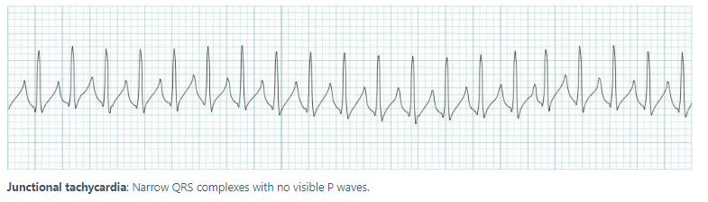
Narrow QRS Complex Morphology
Narrow (supraventricular) complexes arise from three main places:
Sinoatrial node (with normal P wave)
Atria (with abnormal P wave / flutter wave / fibrillatory wave)
AV node / junction (with either no P wave or an abnormal P wave with a PR interval < 120 ms)

Slide 48
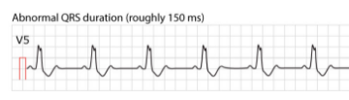
Broad QRS Complex Morphology
Broad/Wide QRS Complexes
A QRS duration > 100 ms is abnormal
A QRS duration > 120 ms is required for the diagnosis of bundle branch block or ventricular rhythm
Broad complexes may be ventricular in origin or due to aberrant conduction secondary to:
Bundle branch block (RBBB or LBBB)
Hyperkalaemia
Poisoning with sodium-channel blocking agents (e.g. tricyclic antidepressants)
Pre-excitation (i.e. Wolff-Parkinson-White syndrome)
Ventricular pacing
Hypothermia
Intermittent aberrancy (e.g. rate-related aberrancy)

Slide 49
High Voltage QRS Morphology
Increased QRS voltage is often taken to infer the presence of left ventricular hypertrophy.
There are multiple “voltage criteria” for left ventricular hypertrophy.
Voltage criteria must be accompanied by non-voltage criteria to be considered diagnostic of left ventricular hypertrophy.
Low Voltage QRS Morphology
The QRS is said to be low voltage when:
The amplitudes of all the QRS complexes in the limb leads are < 5 mm; or
The amplitudes of all the QRS complexes in the precordial leads are < 10 mm
Electrical Alternans
This is when the QRS complexes alternate in height.
The most important cause is massive pericardial effusion, in which the alternating QRS voltage is due to the heart swinging back and forth within a large fluid-filled pericardium.

Slide 50
The naming of the waves in the QRS complex is easy but frequently misunderstood. The following rules apply when naming the waves:
A deflection is only referred to as a wave if it passes the baseline.
If the first wave is negative then it is referred to as Q-wave. If the first wave is not negative, then the QRS complex does not possess a Q-wave, regardless of the appearance of the QRS complex.
All positive waves are referred to as R-waves. The first positive wave is simply an “R-wave” (R). The second positive wave is called “R-prime wave” (R’). If a third positive wave occurs (rare) it is referred to as “R-bis wave” (R”).
Any negative wave occurring after a positive wave is an S-wave.
Large waves are referred to by their capital letters (Q, R, S), and small waves are referred to by their lower-case letters (q, r, s).

Slide 51
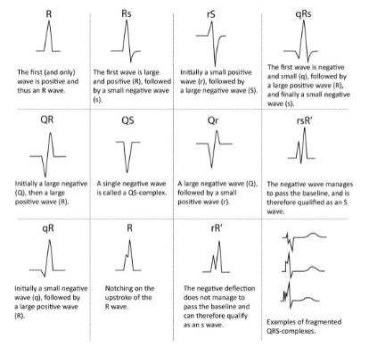

Slide 52
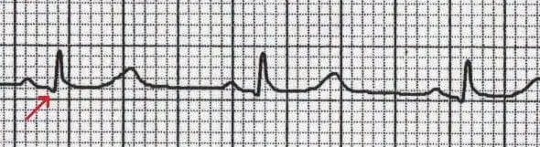
Q Wave
Q wave is any negative deflection that precedes an R wave (normally < ¼ of R wave)
The Q wave represents the normal left-to-right depolarisation of the interventricular septum
Small Q waves are normal in most leads
Small ‘septal’ Q waves are typically seen in the left-sided leads (I, aVL, V5 and V6)
Deeper Q waves (>2 mm) may be seen in leads III and aVR as a normal variant
Under normal circumstances, Q waves are not seen in the right-sided leads (V1-3)

Slide 53
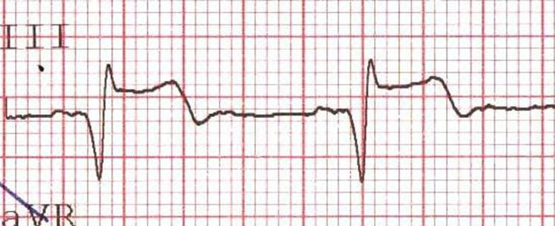
Pathological Q Waves
Q waves are considered pathological if:
> 40 ms (1 mm) wide
> 2 mm deep
> 25% of depth of QRS complex
Seen in leads V1-3
Pathological Q waves usually indicate current or prior myocardial infarction.
Loss of normal Q waves
The absence of small septal Q waves in leads V5-6 should be considered abnormal. It is most commonly due to LBBB.

Slide 54
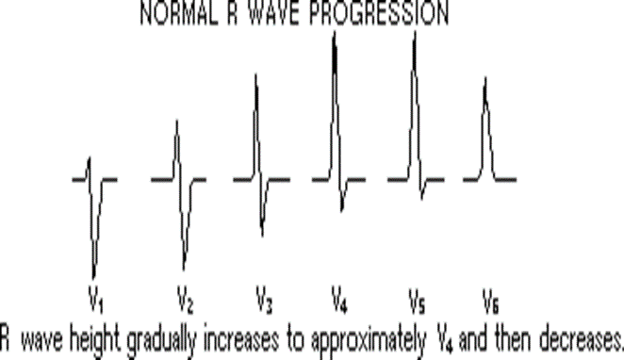
R and S waves
Assess the R wave progression across the chest leads (from small in V1 to large in V6).
The transition from S > R wave to R > S wave should occur in V3 or V4.
Poor progression (i.e. S > R through to leads V5 and V6) can be a sign of previous MI but can also occur in very large people due to poor lead position.

Slide 55
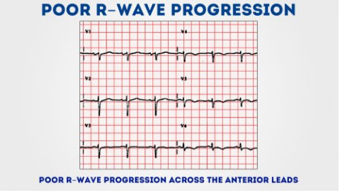

Slide 56
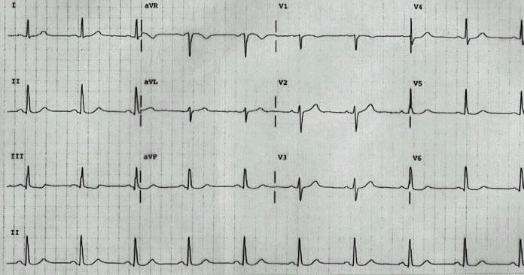
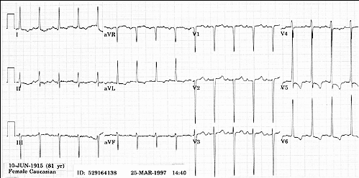
Left Ventricular Hypertrophy
Compare these two 12-lead ECGs. What stands out as different with the second one?

Slide 57
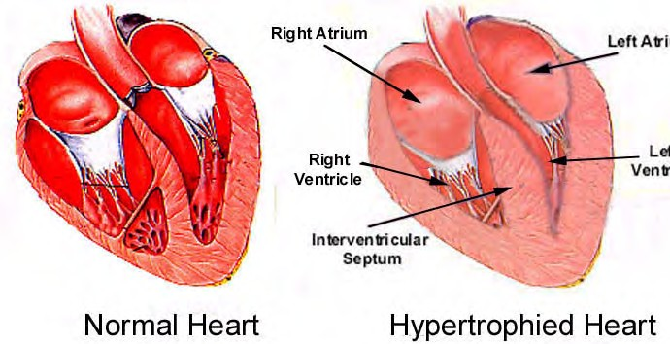
Left Ventricular Hypertrophy
As the heart muscle wall thickens there is an increase in electrical forces moving through the myocardium resulting in increased QRS voltage

Slide 58
Criteria for LVH
There are numerous voltage criteria for diagnosing LVH, summarised below
The most commonly used are the Sokolov-Lyon criteria: S wave depth in V1 + tallest R wave height in V5-V6 > 35 mm
Voltage criteria must be accompanied by non-voltage criteria to be considered diagnostic of LVH

Slide 59
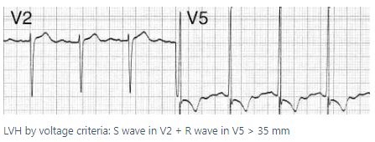
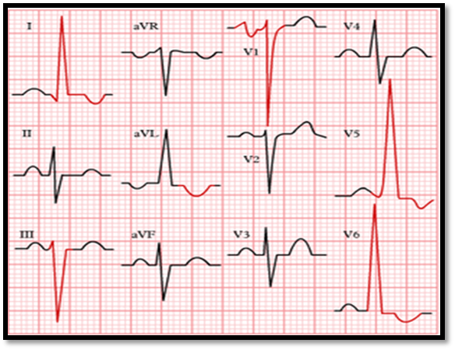
Criteria for LVH
VOLTAGE CRITERIA
Limb Leads
R wave in lead I + S wave in lead III > 25 mm
R wave in aVL > 11 mm
R wave in aVF > 20 mm
S wave in aVR > 14 mm
Precordial Leads
R wave in V4, V5 or V6 (the largest) > 26 mm
R wave in V5 or V6 (the largest of them) + S wave in V1 > 35 mm
Largest R wave plus largest S wave in precordial leads > 45 mm
Non Voltage Criteria
Increased R wave peak time > 50 ms in leads V5 or V6
ST segment depression and T wave inversion in the left-sided leads: AKA the left ventricular ‘strain’ pattern

Slide 60
Additional ECG changes seen in LVH
Left atrial enlargement
Left axis deviation
ST elevation in the right precordial leads V1-3 (“discordant” to the deep S waves)
Prominent U waves (proportional to increased QRS amplitude)

Slide 61

Markedly increased LV voltages: huge precordial R and S waves that overlap with the adjacent leads (SV2 + RV6 > 35 mm).
R-wave peak time > 50 ms in V5-6 with associated QRS broadening.
LV strain pattern with ST depression and T-wave inversions in I, aVL and V5-6.
ST elevation in V1-3.
Prominent U waves in V1-3.
Left axis deviation.

Slide 62

Right Ventricular Hypertrophy
Electrocardiographic Features
Diagnostic criteria
Right axis deviation of +110° or more.
Dominant R wave in V1 (> 7mm tall or R/S ratio > 1).
Dominant S wave in V5 or V6 (> 7mm deep or R/S ratio < 1).
QRS duration < 120ms (i.e. changes not due to RBBB).
Supporting criteria
Right atrial enlargement (P pulmonale).
Right ventricular strain pattern = ST depression / T wave inversion in the right precordial (V1-4) and inferior (II, III, aVF) leads.
S1 S2 S3 pattern = far right axis deviation with dominant S waves in leads I, II and III.
Deep S waves in the lateral leads (I, aVL, V5-V6).
Other abnormalities caused by RVH
Right bundle branch block (complete or incomplete).

Slide 63

Typical appearance of RVH:
Right axis deviation (+150 degrees).
Dominant R wave in V1 (> 7 mm tall; R/S ratio > 1)
Dominant S wave in V6 (> 7 mm deep; R/S ratio < 1).
Right ventricular strain pattern with ST depression and T-wave inversion in V1-4.

Slide 64

Right axis deviation (+150 degrees)
P pulmonale (P wave in lead II > 2.5 mm)
Incomplete Right Bundle Branch Block
Right ventricular strain pattern with T-wave inversion and ST depression in the right precordial (V1-3) and inferior (II, III, aVF) leads.

Slide 65


Slide 66
Biventricular Hypertrophy
Hypertrophy of both the left and right ventricles.
The ECG has a low sensitivity for the diagnosis of biventricular hypertrophy (BVH), as the opposing left and right ventricular forces tend to cancel each other out.
There may be signs of both Left Ventricular Hypertrophy (LVH) and Right Ventricular Hypertrophy (RVH) on the same ECG – e.g. positive diagnostic criteria for LVH with some additional features suggestive of RVH.
The Katz-Wachtel phenomenon – large biphasic QRS complexes in V2-5. This is the classic ECG pattern of BVH, most commonly seen in children with congenital heart disease e.g. ventricular septal defect (VSD).

Slide 67
In the presence of LVH
In the presence of RVH
Additional signs indicating RVH include:
Right atrial enlargement.
Right axis deviation.
Tall biphasic QRS complexes in multiple leads.
Deep S waves in V5-6.
Additional signs indicating LVH include:
Tall R waves and deep S waves in V2-5.
QRS amplitude > 50 mm.

Slide 68

Biventricular hypertrophy:
Large biphasic QRS complexes in V2-5.
LVH: Voltage criteria for LVH (S V2 + R V5 = 35 mm, R aVL > 11 mm) with signs of LV strain (T-wave inversion in V4-6).
Persistent S waves in V5-6 suggestive of associated RVH.

Slide 69

QT interval
The QT interval is inversely proportional to heart rate:
The QT interval shortens at faster heart rates
The QT interval lengthens at slower heart rates
An abnormally prolonged QT is associated with an increased risk of ventricular arrhythmias, especially Torsades de Pointes
Congenital short QT syndrome has been found to be associated with an increased risk of paroxysmal atrial and ventricular fibrillation and sudden cardiac death

Slide 70
QT interval
Corrected QT interval (QTc)
The corrected QT interval (QTc) estimates the QT interval at a standard heart rate of 60 bpm
This allows comparison of QT values over time at different heart rates and improves detection of patients at increased risk of arrhythmias
QTc is prolonged if > 470ms in men or > 480ms in women
QTc > 500 is associated with an increased risk of torsades de pointes
QTc is abnormally short if < 330ms
A useful rule of thumb is that a normal QT is less than half the preceding RR interval

Slide 71


J point
J point is present in all ECGs and marks the transition of QRS complex to ST segment
J wave deflection occurs before the J point
The position of the J point in relation to a slurred terminal QRS is still debated.
J point in a) normal; b) c) J point elevation; d) J point depression; e) with J wave (Osborn wave)

Slide 72

Abnormalities of the J point
Elevation or depression of the J point is seen with the various causes of ST segment abnormality. It may be elevated as a result of injury currents during acute myocardial ischemia and pericarditis, as well as in various other patterns of both normal and abnormal ECGs
Elevation of the J point occurs with benign early repolarisation
A positive deflection prior to the J point is termed a J wave (Osborn wave) and is characteristically seen with hypothermia.

Slide 73





Slide 74

T waves
Normal T wave characteristics
Upright in all leads except aVR and V1
Amplitude < 5mm in limb leads, < 10mm in precordial leads (10mm males, 8mm females)
Duration relates to QT interval
T wave abnormalities
Peaked T waves
Hyperacute T waves
Inverted T waves
Biphasic T waves
‘Camel Hump’ T waves
Flattened T waves
NOTE:
Dynamic T-wave inversions are seen with acute myocardial ischaemia
Fixed T-wave inversions are seen following infarction, usually in association with pathological Q waves

Slide 75



Slide 76



Slide 77



Slide 78



Slide 79


Slide 80


Slide 81


Slide 82


Slide 83


Slide 84


Slide 85


Slide 86
Thank you for your attention
Questions?

