Slide 1
Odesa National Medical University
Department of Family Medicine and Polyclinic Therapy
Elective course “ECG in General Practice”
Content module 2
Changes on the ECG in the case of heart rhythm and conduction disorders

Slide 2
Theme 4
ECG signs of paroxysmal supraventricular tachycardia
Atrial flutter and atrial fibrillation
Ventricular flutter and ventricular fibrillation

Slide 3
Tachyarrhythmia is defined as an abnormal rhythm with a ventricular heart rate of 100 beats per minute or more.
It can be further classified based on the origin of the arrhythmia into:
Tachyarrhythmia
Supraventricular Tachycardia (SVT) – arrhythmia originating from above the AV node (from atrial origin or AV junction origin):
Ventricular Tachycardia (VT) – the origin of the arrhythmia is below the AV node:
Atrial fibrillation (AFib)
Atrial flutter
Atrial tachycardia
Atrial premature complex (PAC)
Atrioventricular nodal reentrant tachycardia (AVNRT)
Atrioventricular reentrant tachycardia (AVRT)
AV junctional extrasystoles
Ventricular fibrillation (V-fib)
Ventricular premature beats (PVC)
Ventricular tachycardia (sustained or non-sustained)

Slide 4

Tachyarrhythmias can also be classified based on the QRS complex duration into:
Narrow QRS complex tachycardia when QRS is <120 milliseconds in duration:
sinus tachycardia
atrial tachycardia (AT)
atrial flutter
atrioventricular nodal reentrant tachycardia (AVNRT)
atrioventricular reentrant tachycardia (AVRT)
junctional ectopic tachycardia
sinoatrial nodal reentrant tachycardia (SANRT)
atrial fibrillation (irregular QRS complexes)
Wide QRS complex tachycardia (QRS ≥120 milliseconds in duration) is classified as:
monomorphic ventricular tachycardia
polymorphic ventricular tachycardia
ventricular fibrillation.

Slide 5
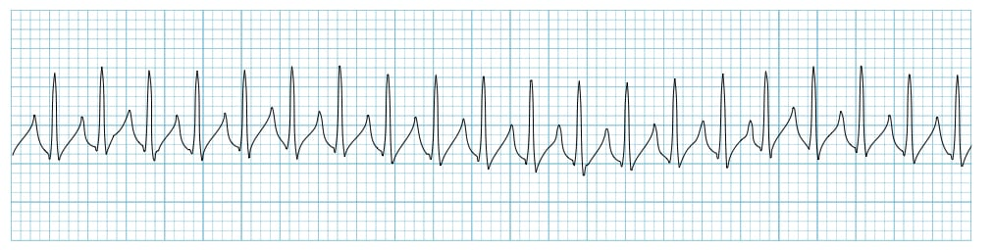
Supraventricular Tachycardia (SVT)
Definition
The term supraventricular tachycardia (SVT) refers to any tachydysrhythmia arising from above the level of the Bundle of His, and encompasses regular atrial, irregular atrial, and regular atrioventricular tachycardias
It is often used synonymously with AV nodal re-entry tachycardia (AVNRT), a form of SVT
In the absence of aberrant conduction (e.g. bundle branch block), the ECG will demonstrate a narrow complex tachycardia

Slide 6
Classification
SVTs can be classified based on:
  Site of origin (atria or AV node) or;
  Regularity (regular or irregular)
Classification based on QRS width is unhelpful as this is also influenced by the presence of pre-existing bundle branch block, rate-related aberrant conduction, or presence of accessory pathways.

Slide 7
Classification of SVT by site of origin and regularity
Regular Atrial
Sinus tachycardia
Atrial tachycardia
Atrial flutter
Inappropriate sinus tachycardia
Sinus node reentrant tachycardia
Regular Atrioventricular
AVRT
AVNRT
Automatic junctional tachycardia
Irregular Atrial
Atrial fibrillation
Atrial flutter (variable block)
Multifocal atrial tachycardia

Slide 8
Paroxysmal SVT (pSVT) describes an SVT with abrupt onset and offset – characteristically seen with re-entrant tachycardias involving the AV node such as:
AV-node re-entrant tachycardia (AVNRT)
or
atrioventricular re-entry tachycardia (AVRT)

Slide 9
AV Nodal Re-entry Tachycardia (AVNRT)
This is the commonest cause of palpitations in patients with structurally normal hearts
AVNRT is typically paroxysmal and may occur spontaneously or upon provocation with exertion, caffeine, alcohol, beta-agonists (salbutamol) or sympathomimetics (amphetamines)
It is more common in women than men (~ 75% of cases occurring in women) and may occur in young and healthy patients as well as those suffering chronic heart disease
The tachycardia typically ranges between 140-280 bpm and is regular in nature. It may self-resolve or continue indefinitely until medical treatment is sought
The condition is generally well tolerated and is rarely life threatening in patients with pre-existing heart disease

Slide 10


Patients will typically complain of the sudden onset of rapid, regular palpitations.
Other associated symptoms may include:
Presyncope or syncope due to a transient fall in blood pressure
Chest pain, especially in the context of underlying coronary artery disease
Dyspnoea
Anxiety
Rarely, polyuria due to elevated atrial pressures causing release of atrial natriuretic peptide

Slide 11
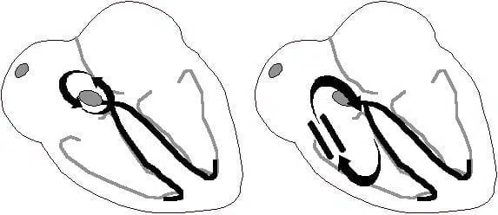
Pathophysiology
In comparison to AVRT, which involves an anatomical re-entry circuit (Bundle of Kent), in AVNRT there is a functional re-entry circuit within the AV node.
Alrternate re-entry loops: Functional circuit in AVNRT (left), anatomical circuit in AVRT (right)

Slide 12
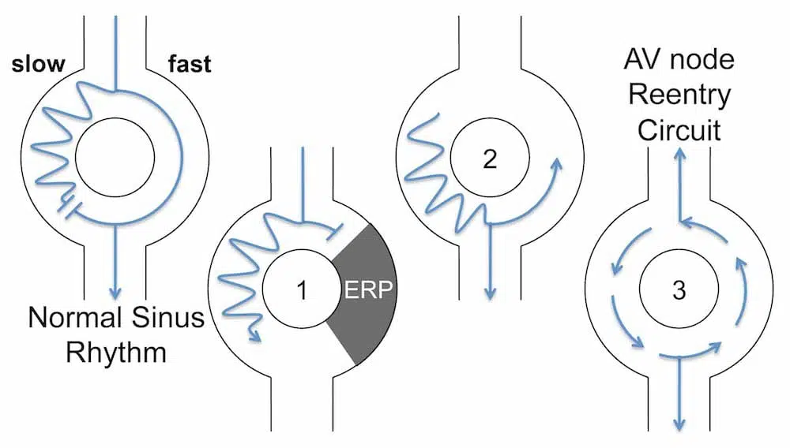
Functional pathways within the AV node
There are two pathways within the AV node:
The slow pathway (alpha): a slowly-conducting pathway with a short refractory period.
The fast pathway (beta): a rapidly-conducting pathway with a long refractory period.
Mechanism of re-entry in “slow-fast” AVNRT:
A premature atrial contraction (PAC) arrives while the fast pathway is still refractory, and is directed down the slow pathway
The effective refractory period (ERP) in the fast pathway ends, and the PAC impulse travels retrogradely up the fast pathway
The impulse continually cycles around the two pathways

Slide 13
Electrocardiographic Features
ECG features of AVNRT
Regular tachycardia ~140-280 bpm
Narrow QRS complexes (< 120ms) unless there is co-existing bundle branch block, accessory pathway, or rate-related aberrant conduction
P waves if visible exhibit retrograde conduction with P-wave inversion in leads II, III, aVF. They may be buried within, visible after, or very rarely visible before the QRS complex
Associated features include:
Rate-related ST depression, which may be seen with or without underlying coronary artery disease
QRS alternans – phasic variation in QRS amplitude associated with AVNRT and AVRT, distinguished from electrical alternans by a normal QRS amplitude

Slide 14
Subtypes of AVNRT
Different subtypes vary in terms of the dominant pathway, and the R-P interval, which is the time between anterograde ventricular activation (R wave) and retrograde atrial activation (P wave).
Slow-Fast AVNRT (80-90%)
Fast-Slow AVNRT (10%)
Slow-Slow AVNRT (1-5%)

Slide 15
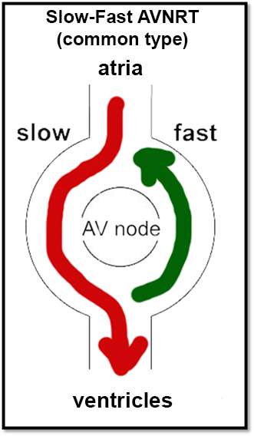
Slow-Fast AVNRT (Common AVNRT)
Accounts for 80-90% of AVNRT
Associated with Slow AV nodal pathway for anterograde conduction and Fast AV nodal pathway for retrograde conduction.
The retrograde P wave is obscured in the corresponding QRS or occurs at the end of the QRS complex as pseudo r’ or S waves

Slide 16
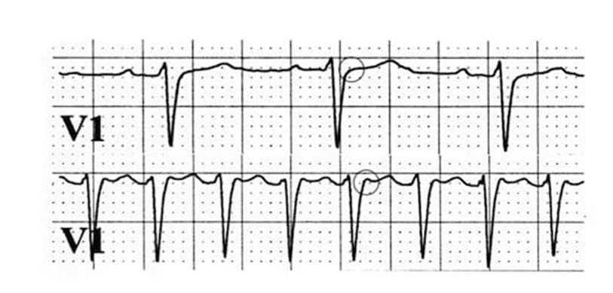
ECG:
P waves are often hidden – being embedded in the QRS complexes.
Pseudo r’ wave may be seen in V1 (RP interval < 70 msec)
Pseudo S waves may be seen in leads II, III or aVF.
In most cases this results in a ‘typical’ SVT appearance with absent P waves and tachycardia
Top strip: Normal sinus rhythm. Absence of pseudo-R waves
Bottom strip: Paroxysmal SVT. The P wave is seen as a pseudo-R wave (circled) in lead V1 during tachycardia. This very short ventriculo-atrial time is frequently seen in typical Slow-Fast AVNRT

Slide 17
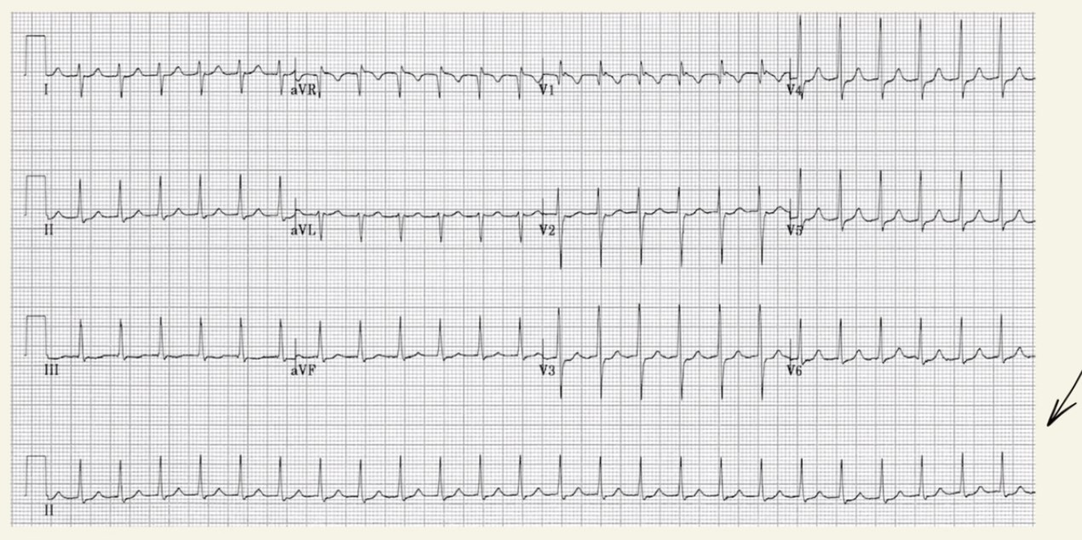
Typical AVNRT (slow-fast)
pseudo r’ wave in V1
RP interval < 70 msec

Slide 18
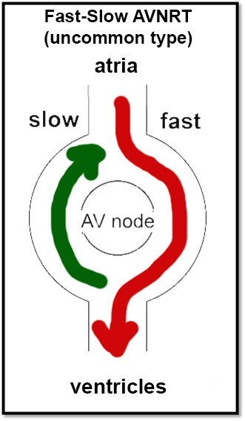
Fast-Slow AVNRT (Uncommon AVNRT)
Accounts for 10% of AVNRT
Associated with Fast AV nodal pathway for anterograde conduction and Slow AV nodal pathway for retrograde conduction.
The retrograde P wave appears after the corresponding QRS

Slide 19
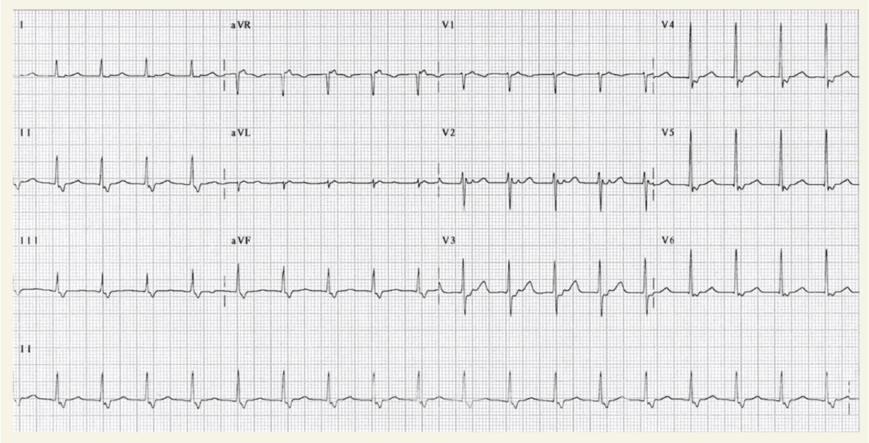
ECG
QRS -P-T complexes
P waves are visible between the QRS and T wave
retrograde Р wave
retrograde Р wave
similar RR

Slide 20
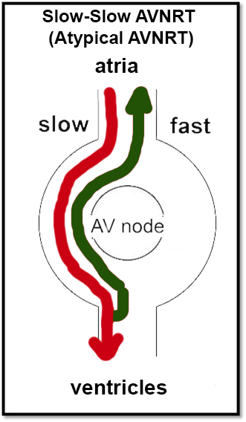
Slow-Slow AVNRT (AtypicalAVNRT)
1-5% AVNRT
Associated with Slow AV nodal pathway for anterograde conduction and Slow left atrial fibres approaching the AV node as the pathway for retrograde conduction.
ECG features:
Tachycardia with a P-wave seen in mid-diastole, effectively appearing “before” the QRS complex.
May be misinterpreted as sinus tachycardia

Slide 21
Summary of AVNRT subtypes
No visible P waves? –> Slow-Fast
P waves visible after the QRS complexes? –> Fast-Slow
P waves visible before the QRS complexes? –> Slow-Slow

Slide 22
Other types of SVT
Most other types of SVT are discussed elsewhere (follow links in classification table). Two less common types include:
Inappropriate Sinus Tachycardia Typically seen in young healthy female adults Sinus rate persistently elevated above 100 bpm in absence of physiological stressor Exaggerated rate response to minimal exercise ECG indistinguishable from sinus tachycardia | Sinus Node Reentrant Tachycardia (SNRT) Caused by reentry circuit close to or within the sinus node Abrupt onset and termination P wave morphology is normal Rate usually 100 – 150 bpm May terminate with vagal manoeuvres

Slide 23
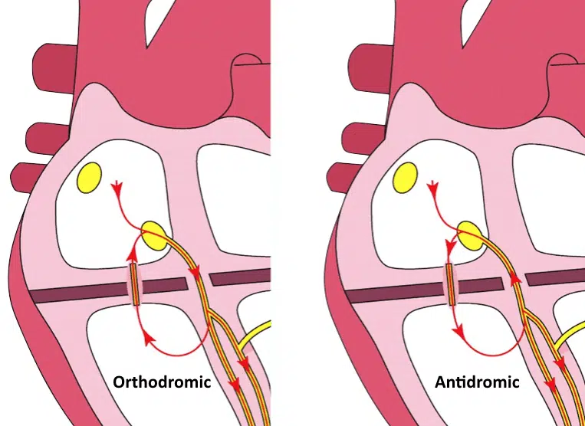
Atrioventricular Re-entry Tachycardia (AVRT)
Atrioventricular Re-entry Tachycardia (AVRT) is a form of paroxysmal supraventricular tachycardia that occurs in patients with accessory pathways, usually due to formation of a re-entry circuit between the AV node and accessory pathway. ECG features depend on the direction of conduction, which can be orthodromic or antidromic.

Slide 24
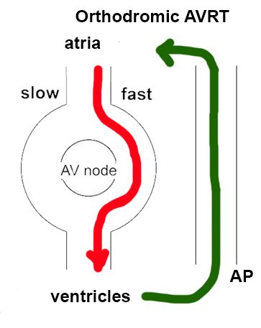
In orthodromic AVRT, anterograde conduction is via the AV node, producing a regular narrow complex rhythm (in the absence of pre-existing bundle branch block)
In orthodromic AVRT, anterograde conduction occurs via the AV node, resulting in a normal direction of ventricular depolarisation.
This can occur in patients with a concealed pathway (AP that conducts retrograde only, not evident on sinus rhythm ECG).

Slide 25
ECG features of AVRT with orthodromic conduction:
Rate usually 200-300 bpm
Retrograde P waves are usually visible, with a long RP interval
QRS < 120ms unless pre-existing bundle branch block, or rate-related aberrant conduction
QRS alternans: phasic variation in QRS amplitude associated with AVNT and AVRT, distinguished from electrical alternans by a normal QRS amplitude
Rate-related ischaemia is common

Slide 26
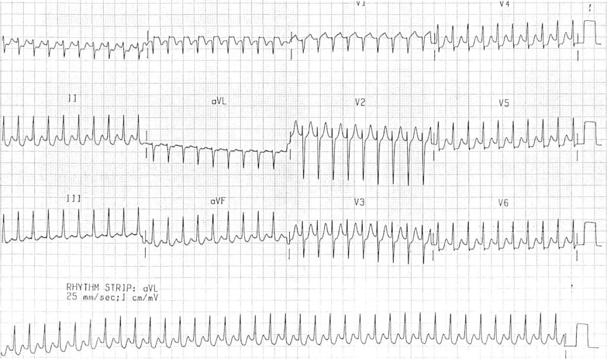
Orthodromic AVRT: Regular, narrow complex tachycardia

Slide 27
Orthodromic AVRT, or just AVNRT?
This rhythm can appear very similar to AVNRT, but the RP interval can assist us to differentiate:
In typical AVNRT, retrograde P waves occur early, so we either don’t see them (buried in QRS) or partially see them (pseudo R’ wave at terminal portion of QRS complex)
In AVRT, retrograde P waves occur later, with a long RP interval > 70 msec
In the above example, look closely at V1 — P waves are evident as a small notch at the beginning of the T wave, with a long RP interval, indicating this is likely orthodromic AVRT.
Fortunately, treatment is fairly similar for both.

Slide 28
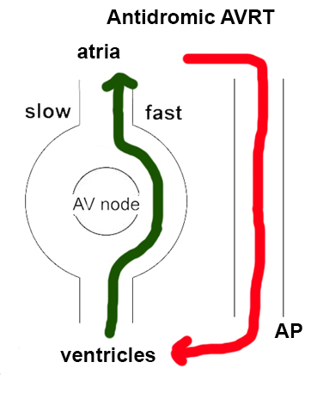
In antidromic AVRT, anterograde conduction is via the accessory pathway (AP), producing a regular wide complex rhythm. This can be difficult to distinguish from ventricular tachycardia (VT)
Antidromic AVRT is rare, and makes up only 5% of tachyarrhythmias in patients with WPW.
As the name suggests, it involves anterograde conduction via the AP. Retrograde conduction is usually via the AV node, but can also be via another AP.
The abnormal direction of ventricular depolarisation results in a broad complex tachycardia, which can be easily mistaken for VT.

Slide 29
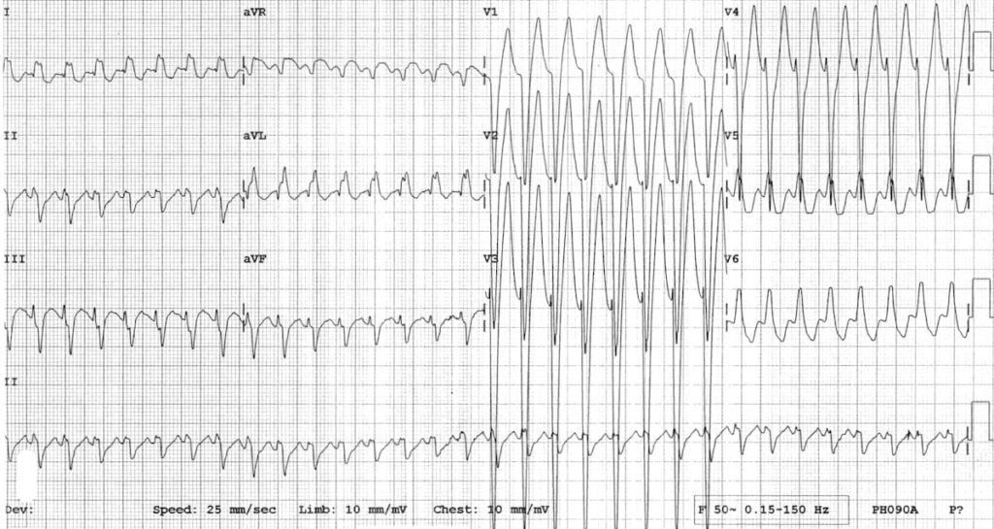
ECG features of AVRT with antidromic conduction:
Rate usually 200-300 bpm
Wide QRS complexes due to abnormal ventricular depolarization via AP
Antidromic AVRT: Regular broad complex tachycardia

Slide 30
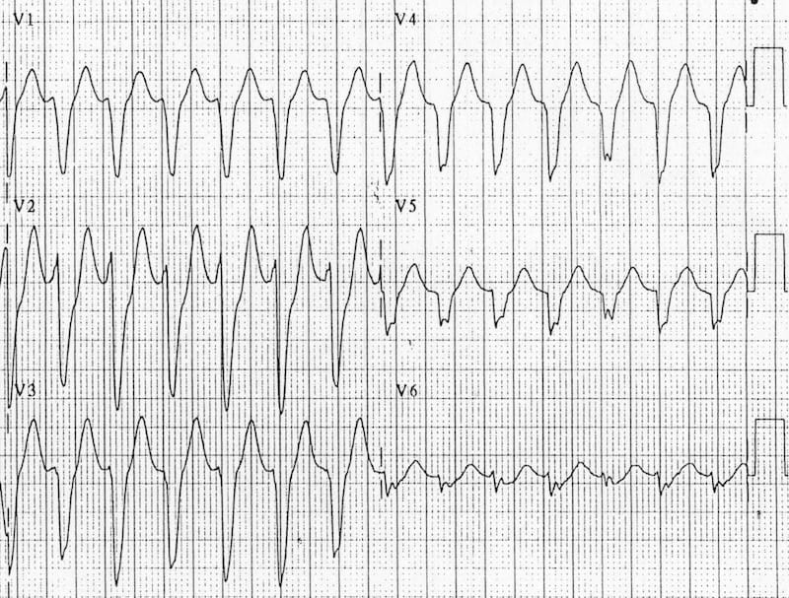
ECG features increasing the likelihood of VT
Electrocardiographic features that increase the likelihood of VT include:
Absence of typical RBBB or LBBB morphology
Extreme axis deviation (“northwest axis”): QRS positive in aVR and negative in I and aVF
Very broad complexes > 160ms

Slide 31
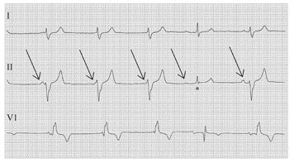
AV dissociation:
P and QRS complexes at different rates
P waves are often superimposed on QRS complexes and may be difficult to discern
Capture beats: Occur when the sinoatrial node transiently “captures” the ventricles in the midst of AV dissociation, producing a QRS complex of normal duration
Fusion beats: Occur when a sinus and ventricular beat coincide to produce a hybrid complex

Slide 32
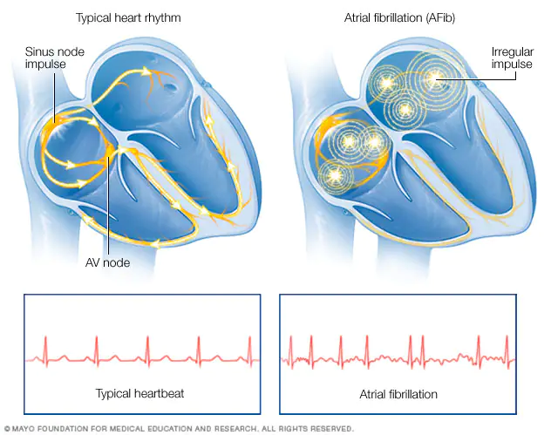

Slide 33
Atrial fibrillation
Atrial fibrillation (AF) is the most common sustained arrhythmia. It is characterised by disorganised atrial electrical activity and contraction.
The incidence and prevalence of AF is increasing. Lifetime risk over the age of 40 years is ~25%.
Complications of AF include haemodynamic instability, cardiomyopathy, cardiac failure, and embolic events such as stroke.

Slide 34
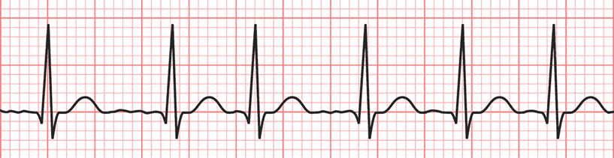
ECG Features of Atrial Fibrillation
Irregularly irregular rhythm
No P waves
Absence of an isoelectric baseline
Variable ventricular rate
QRS complexes usually < 120ms, unless pre-existing bundle branch block, accessory pathway, or rate-related aberrant conduction
Fibrillatory waves may be present and can be either fine (amplitude < 0.5mm) or coarse (amplitude > 0.5mm)
Fibrillatory waves may mimic P waves leading to misdiagnosis

Slide 35
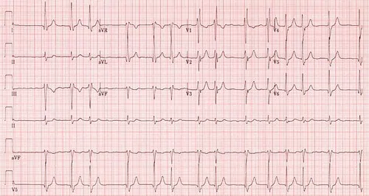

Slide 36
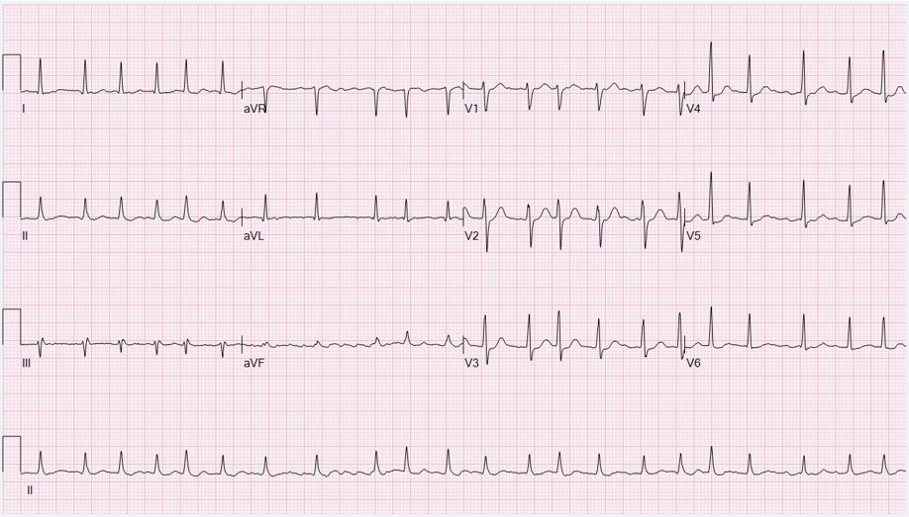

Slide 37
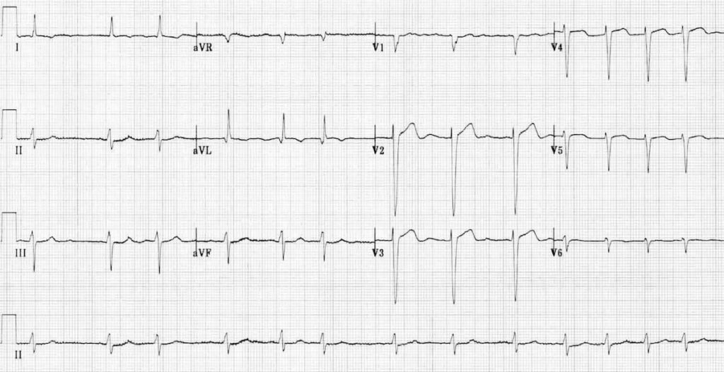

Slide 38
Atrial Fibrillation in Wolff-Parkinson-White Syndrome
Atrial fibrillation can occur in up to 20% of patients with Wolff-Parkinson-White Syndrome (WPW)
The accessory pathway allows for rapid conduction directly to the ventricles bypassing the AV node
Rapid ventricular rates may result in degeneration to VT or VF
ECG features of Atrial Fibrillation in WPW:
Rate > 200 bpm
Irregular rhythm
Wide QRS complexes due to abnormal ventricular depolarisation via accessory pathway
QRS complexes change in shape and morphology
Axis remains stable, unlikely polymorphic VT

Slide 39
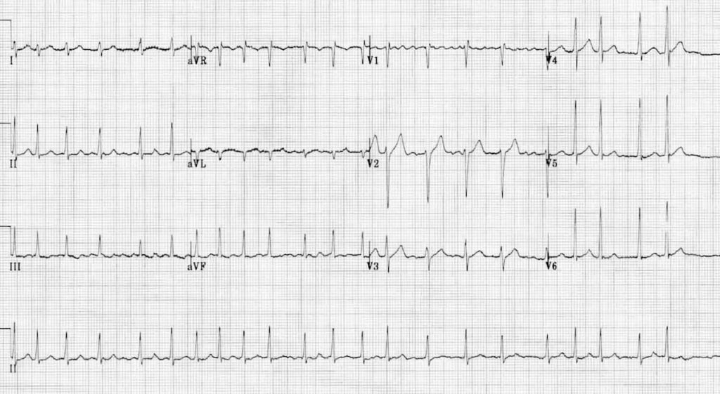
AF with rapid ventricular response
Irregular narrow-complex tachycardia at ~135 bpm
Coarse fibrillatory waves in V1

Slide 40
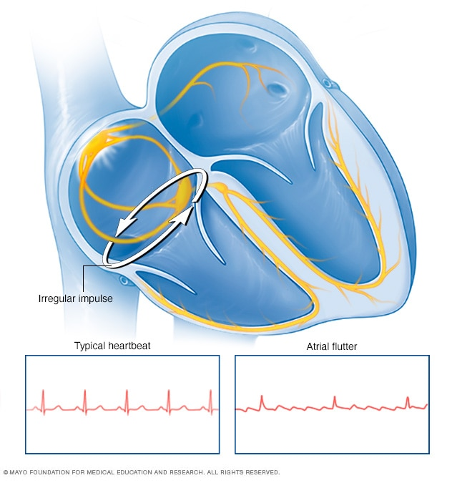
Atrial Flutter

Slide 41
Atrial Flutter
In atrial flutter, the heart's upper chambers (atria) beat too quickly. This causes the heart to beat in a fast, but usually regular, rhythm.
Atrial flutter is a type of heart rhythm disorder (arrhythmia) caused by problems in the heart's electrical system.
Atrial flutter is similar to atrial fibrillation, a common disorder that causes the heart to beat in irregular patterns. People with atrial flutter have a heart rhythm that's more organized and less chaotic than that of atrial fibrillation. Sometimes a person may have episodes of both atrial flutter and atrial fibrillation.
People with atrial flutter may not have symptoms. However, the disorder can increase the risk of stroke, heart failure and other complications. There are effective treatments for atrial flutter, including medication or procedures designed to scar small areas of heart tissue (ablation).

Slide 42
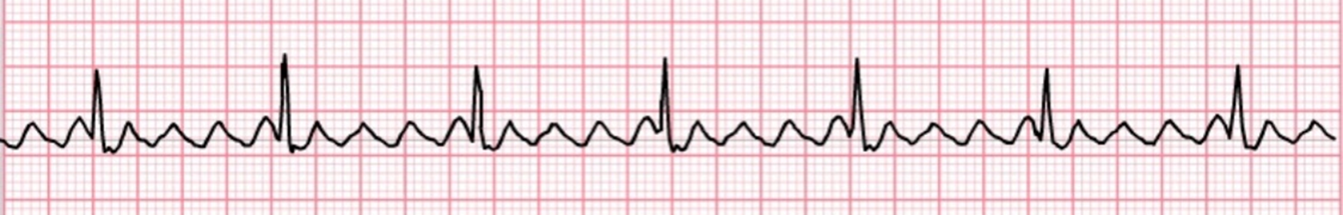
ECG features of atrial flutter
Narrow complex tachycardia
Regular atrial activity at ~300 bpm
Loss of the isoelectric baseline
“Saw-tooth” pattern of inverted flutter waves in leads II, III, aVF
Upright flutter waves in V1 that may resemble P waves
Ventricular rate depends on AV conduction ratio
Note: the above pattern of inverted flutter waves in inferior leads and upright flutter waves in V1 occurs in atrial flutter due to anticlockwise reentry, which makes up 90% of cases.

Slide 43
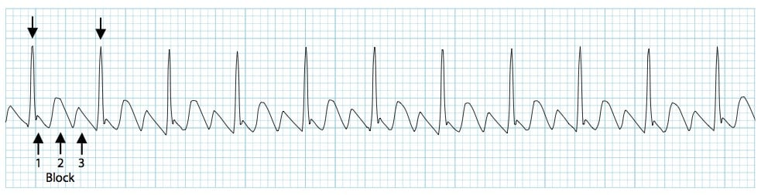
Fixed AV conduction ratio (“AV block”)
Ventricular rate is a fraction of the atrial rate, for example:
2:1 block = 150 bpm
3:1 block = 100 bpm
4:1 block = 75 bpm
Variable AV conduction ratio
The ventricular response is irregular and may mimic atrial fibrillation (AF)
On closer inspection, there may be a pattern of alternating 2:1, 3:1 and 4:1 conduction ratios
Atrial flutter with a 3:1 block

Slide 44
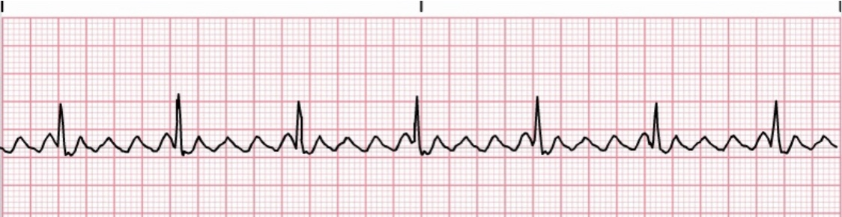
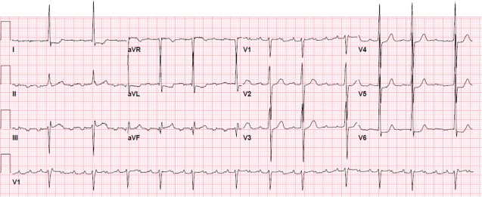
Typical
Atypical

Slide 45
Typical atrial flutter (common)
Sometimes known as type I flutter, this involves the IVC & tricuspid isthmus in the reentry circuit. Further classified based on the direction of the reentry circuit (anticlockwise or clockwise):
Anticlockwise Reentry: Commonest form of atrial flutter (90% of cases). Retrograde atrial conduction produces:
Inverted flutter waves in leads II,III, aVF
Positive flutter waves in V1 — may resemble upright P waves
Clockwise Reentry: This uncommon variant produces the opposite pattern:
Positive flutter waves in leads II, III, aVF
Broad, inverted flutter waves in V1

Slide 46
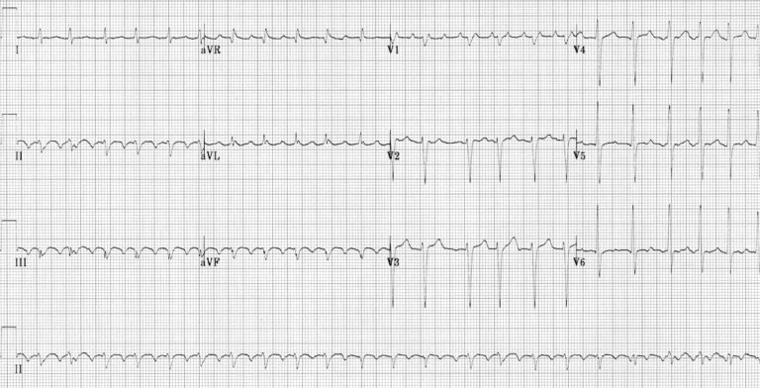
Atrial Flutter with 2:1 Block
2:1 AV block resulting in a ventricular rate of 150 bpm
Note the occasional irregularity, with a 3:1 cycle seen in V1-3

Slide 47
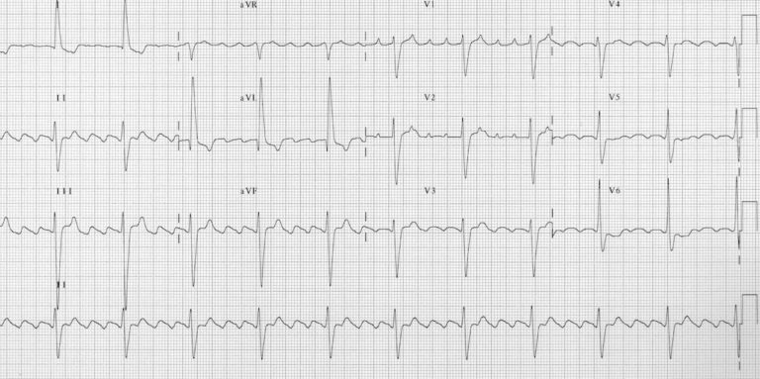

Slide 48
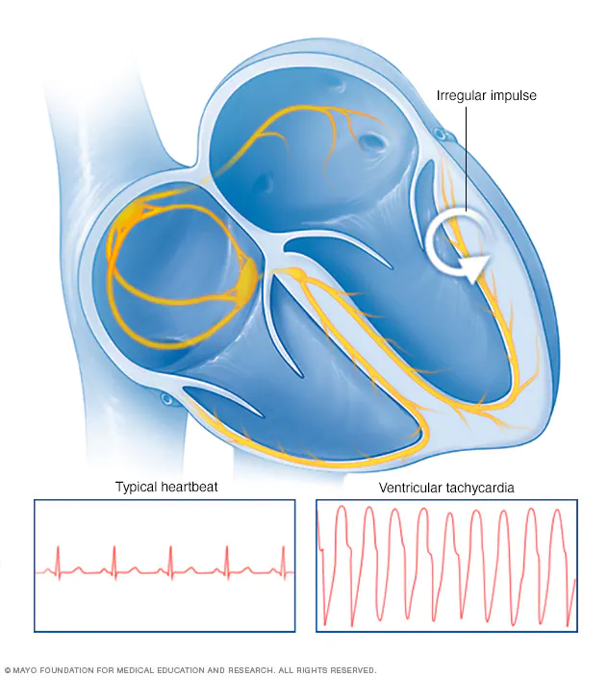
Ventricular Tachycardia

Slide 49
Ventricular Tachycardia
Ventricular Tachycardia = 3 or more ventricular ectopic beats (VEB) at a rate of > 130 beats/min
If > 30 seconds = sustained
can be monophoric or polymorphic
TYPES
treatment is the same for both
Monomorphic most common associated with MI | Polymorphic QRS at 200 beats/min or more which change amplitude and axis so they appear to twist around the baseline

Slide 50
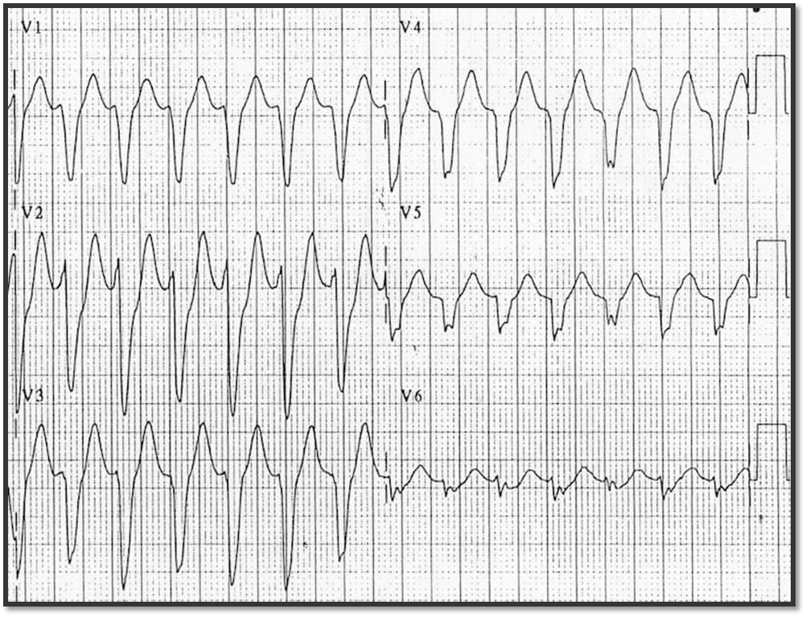

Slide 51
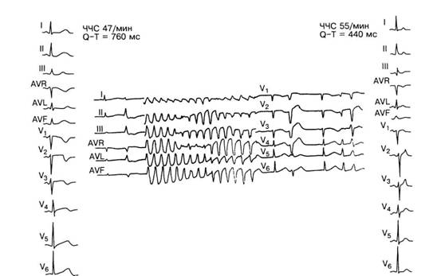
Torsade de Pointes

Slide 52
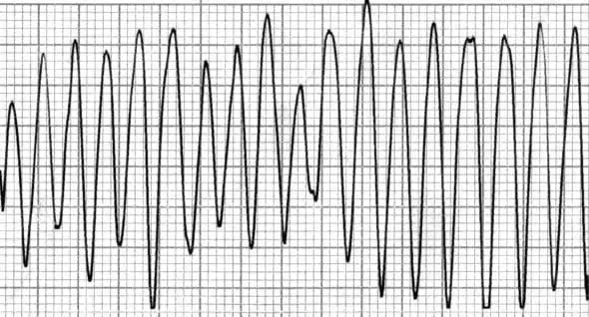
Ventricular Flutter
Extreme form of ventricular tachycardia (VT) with loss of organised electrical activity
Associated with rapid and profound hemodynamic compromise
Usually short lived due to progression to ventricular fibrillation
As with ventricular fibrillation rapid initiation of advanced life support is required
How to Recognize Ventricular Flutter
Continuous Sine Wave
No identifiable P waves, QRS complexes, or T waves
Rate usually > 200 beats / min
Clinical Pearl
The ECG looks identical when viewed upside down!

Slide 53
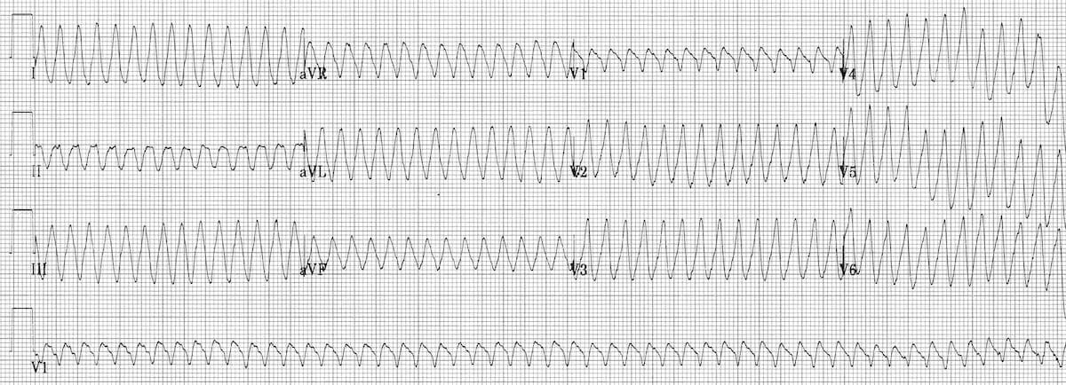

Slide 54
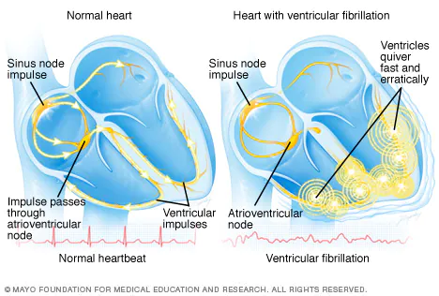

Slide 55
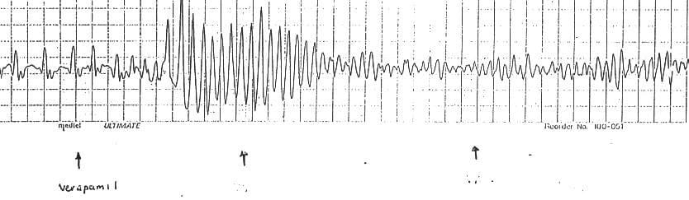
Ventricular Fibrillation
Ventricular fibrillation (VF) is the most important shockable cardiac arrest rhythm. It is invariably fatal unless advanced life support is rapidly instituted.

Slide 56
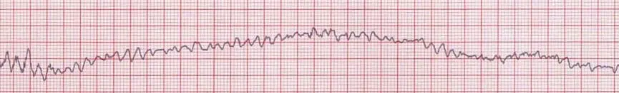
ECG findings in Ventricular Fibrillation (VF)
Chaotic irregular deflections of varying amplitude
No identifiable P waves, QRS complexes, or T waves
Rate 150 to 500 per minute
Amplitude decreases with duration (coarse VF –> fine VF)
Ventricular fibrillation (rhythm strip): Chaotic irregular deflections without identifiable P-QRS-T waves

Slide 57
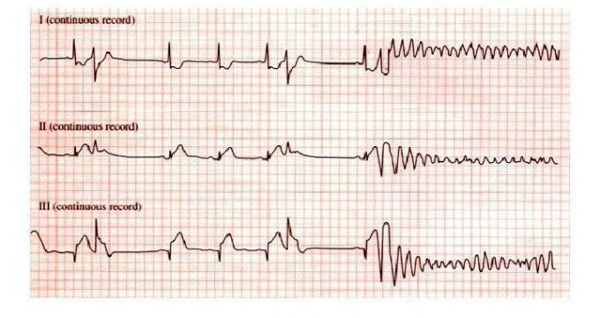
Ventrical fibrillation

Slide 58

Thank you for your attention

