Slide 1
Odesa National Medical University
Department of Family Medicine and Polyclinic Therapy
Elective course “ECG in General Practice”
Content module 3
Electrocardiography in the diagnosis of diseases of the cardiovascular system and extracardiac pathology

Slide 2

Theme 7
ECG diagnosis of the repolarization abnormalities

Slide 3
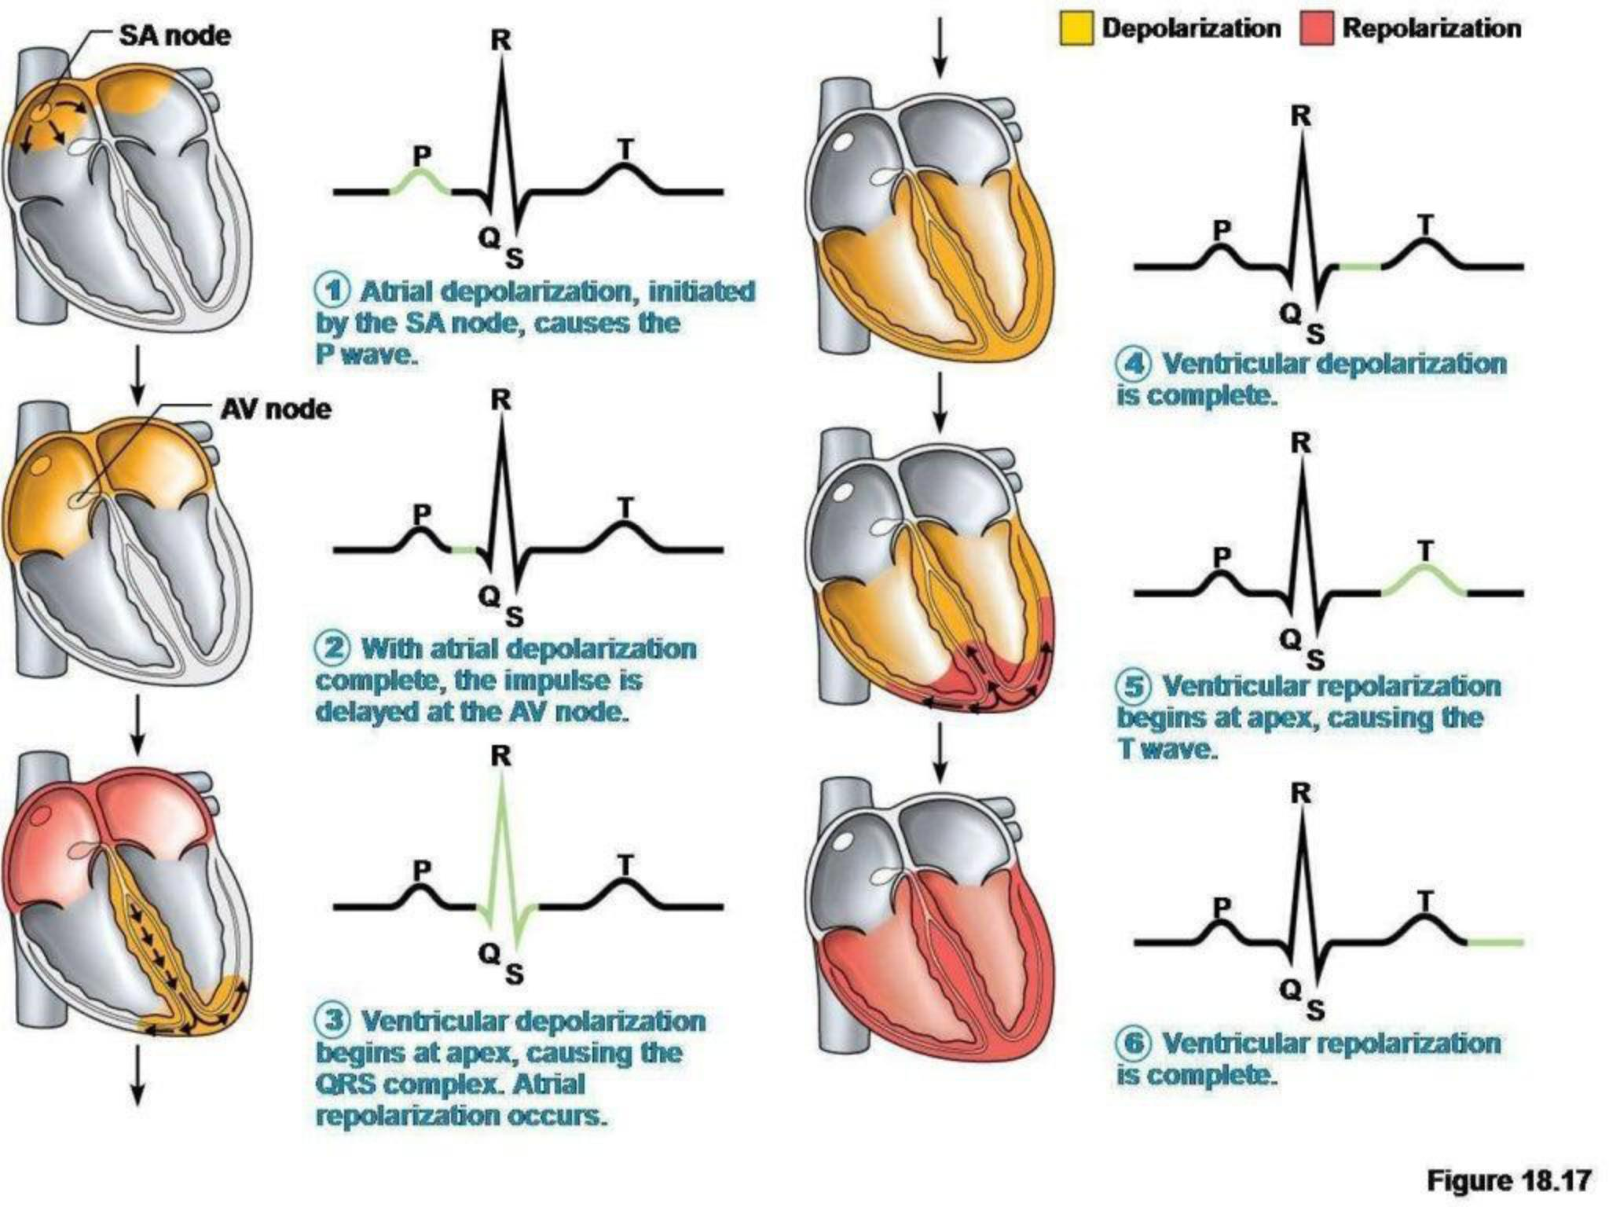

Slide 4
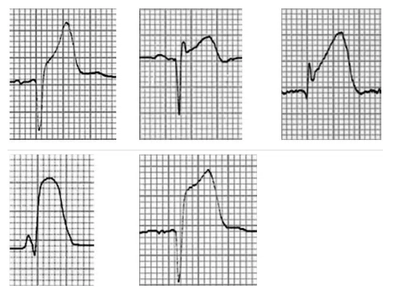
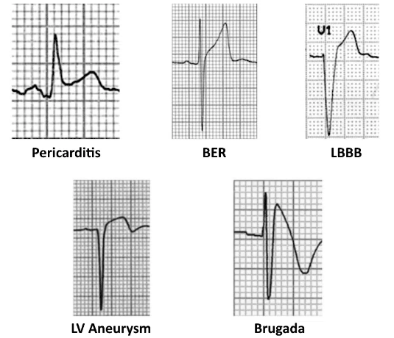
Morphology of the ST elevated segment
Myocardial infarction
Other conditions
Acute STEMI may produce ST elevation with either concave, convex or obliquely straight morphology

Slide 5
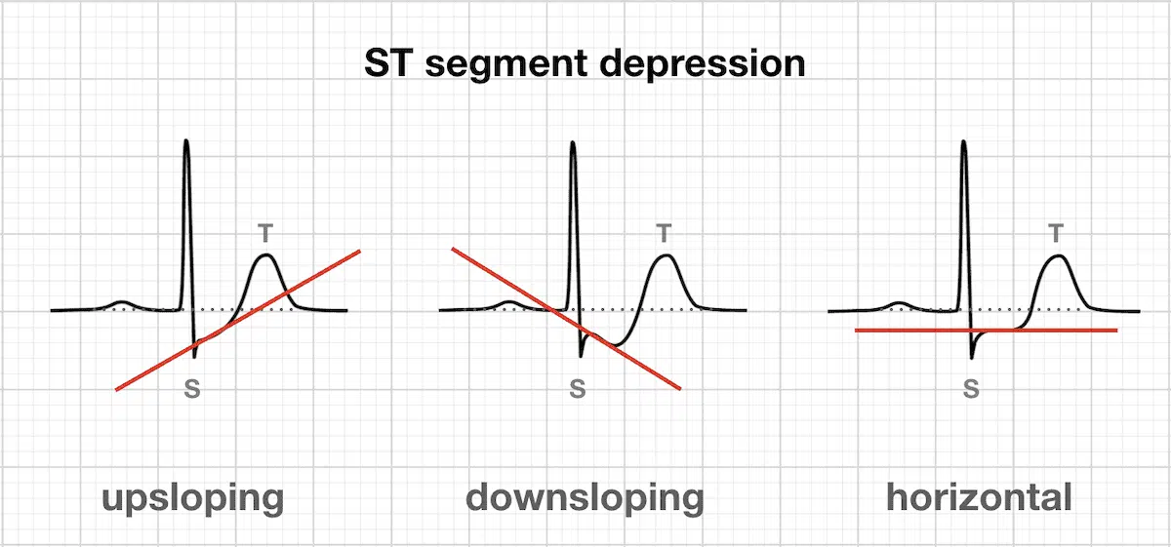

Slide 6
Early Repolarization Syndrome
Early Repolarization Syndrome (ERS) is a usually benign ECG pattern producing widespread ST segment elevation that is commonly seen in young, healthy patients < 50 years of age. Also known as “high take-off” or “J-point elevation”, it may mimic pericarditis or acute MI.
Clinical Relevance
Widespread ST elevation in ERS may mimic pericarditis or acute MI
Up to 10-15% of ED patients presenting with chest pain will have ERS on their ECG, making it a common diagnostic challenge for clinicians. ERS is less common in patients over 50, and particularly rare in those over 70, wherein ST elevation is more likely to represent myocardial ischemia
The physiological basis of ERS is poorly understood. It is generally thought to be a normal variant that is not indicative of underlying cardiac disease, but recently a link has been made between the global ERS pattern and future risk of idiopathic ventricular fibrillation (VF)
Avoid diagnosing ERS in patients over the age of 50, especially those with risk factors for ischemic heart disease.

Slide 7
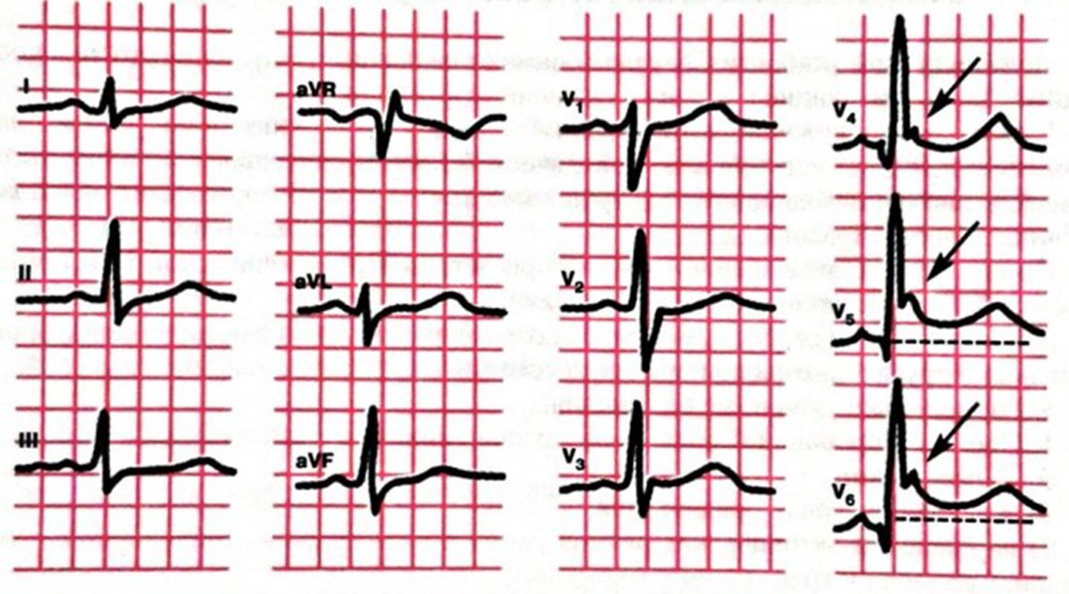
Early Repolarization Syndrome
ECG Features
Widespread concave ST elevation, most prominent in the mid-to-left precordial leads (V2-5)
Notching or slurring at the J point
Prominent, slightly asymmetrical T waves that are concordant with the QRS complex
ST elevation : T wave height ratio in V6 < 0.25 (see below)
No reciprocal ST depression to suggest Occlusion MI

Slide 8
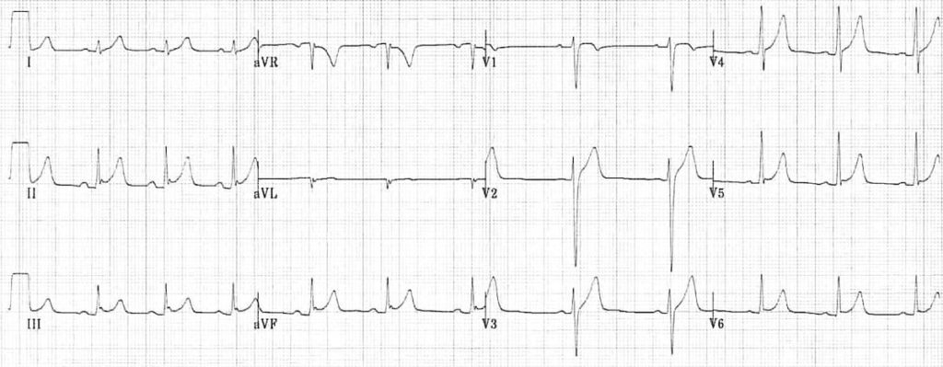
ECG of Early Repolarization Syndrome (ERS), demonstrating:
1) Generalized concave ST elevation in precordial (V2-6) and limb leads (I, II, III, aVF)
2) J-point notching is evident in the inferior leads (II, III and aVF)
3) ST elevation : T wave ratio < 0.25 in V6

Slide 9
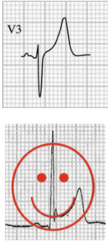
ST segment / T wave morphology
The ST segment-T wave complex in ERS has a characteristic appearance:
There is elevation of the J point
The T wave is peaked and slightly asymmetrical
The ST segment and the ascending limb of the T wave form an upward concavity
The descending limb of the T wave is straighter and slightly steeper than the ascending limb

Slide 10
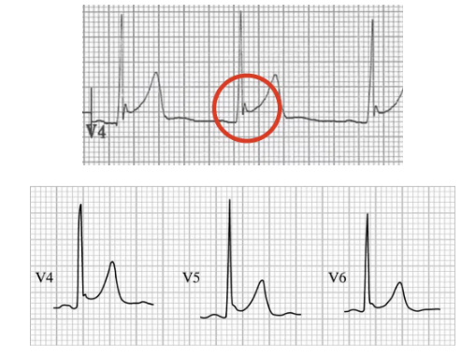
J-point morphology
One characteristic feature of ERS is the presence of a notched or irregular J point: the so-called “fish hook” pattern. This is often best seen in lead V4.

Slide 11
Temporal Stability of ERS
Although the ST elevation of ERS does not show rapid progression like STEMI, nor evolution over several weeks like pericarditis, the ECG pattern is not entirely static over time:
The degree of ST elevation may fluctuate in response to changes in autonomic tone, diminishing with increased sympathetic tone / exercise / tachycardia or increasing when the heart rate slows
The ST elevation may gradually disappear over time as the patient ages: up to 30% of patient with ERS will have resolution of ST elevation on ECGs taken many years later

Slide 12
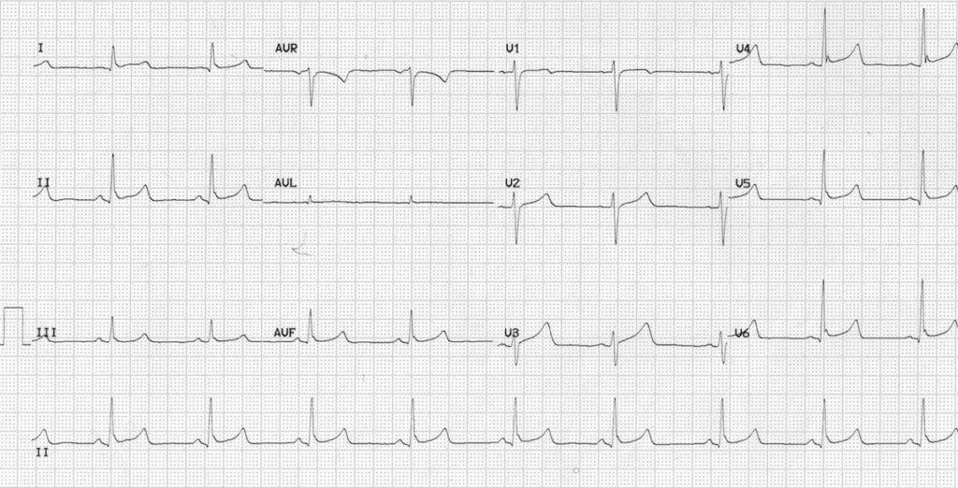
Variation with Heart Rate
The following two ECGs were taken 24 hours apart from a healthy 17-year old female who was admitted to hospital following a benzodiazepine overdose. She had no chest pain, and cardiac biomarkers were normal. You can see how the ECG features of ERS vary with the heart rate:
Example 1 (heart rate = 54 bpm)
ST elevation and J-point notching are more prominent at a slower heart rate.

Slide 13
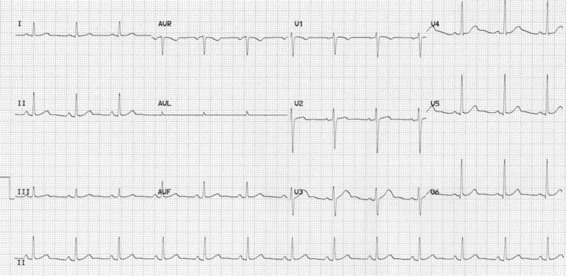
Example 2 (heart rate = 76 bpm)
ST elevation and J-point notching become less prominent as the heart rate increases.

Slide 14
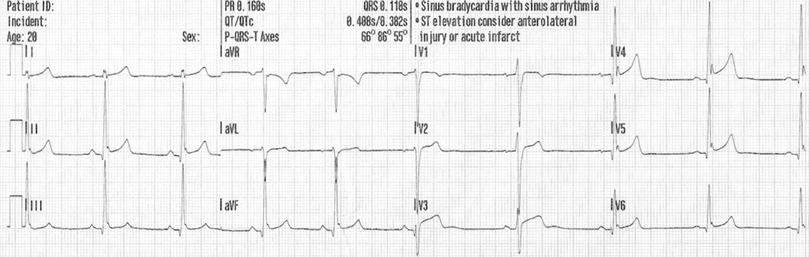
Examples of ERS

Slide 15
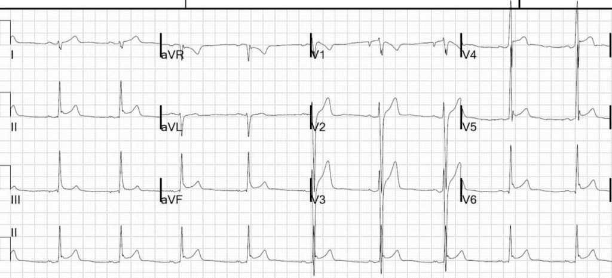

Slide 16
Not So “Benign”?
Initially introduced as a benign ECG pattern, subsequent literature has raised links between early Repolarization patterns and sudden cardiac death:
A 2008 study found a higher incidence of ERS patterns among patients resuscitated following idiopathic VF arrest (OR 10.9). These patterns were present on pre-morbid ECGs.
A large Finnish cohort study published in NEJM Dec 2009 found that an early-repolarization pattern in the inferior leads was associated with an increased risk of death from cardiac causes in middle-aged subjects over a 30-year follow-up period.
The difficulty lies in discerning which patients are at risk of these events, as ERS is prevalent in healthy young individuals (3-5%) whom which do not suffer adverse events
Early Repolarization Syndrome (ERS) refers to the presence of a ERS ECG pattern in individuals resuscitated following arrest due to idiopathic VF. There is some literature suggesting global early Repolarization (compared with isolated lateral leads) gives a higher predisposition to onset or recurrence of idiopathic VF

Slide 17
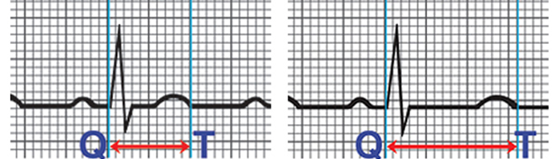
Long QT Syndrome
LQTS produces prolonged ventricular Repolarization -> predisposes to malignant ventricular arrhythmias (torsades de pointes) and elevated risk of sudden cardiac death

Slide 18
Normal QT interval
The normal range for the rate-corrected QT interval (QTc) is similar in males and females from birth until the start of adolescence, while after puberty and in adults, females have slightly longer QT intervals than males.
Age | QTc, msec
Before puberty, a QTc <450 ms is considered normal, between 450 and 459 borderline
after puberty in males | 460 to 469 is borderline
post-pubertal females | 460 to 479 is borderline

Slide 19
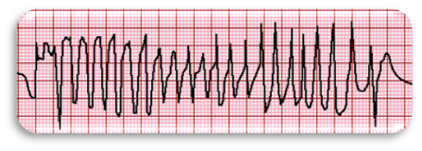
*Torsades de pointes
Torsades de pointes (TdP) is a form of polymorphic VT that classically occurs in the setting of acquired or congenital QT interval prolongation.
In the specific case of TdP, these variations take the form of a progressive, sinusoidal, and cyclic alteration of the QRS axis. The peaks of the QRS complexes appear to "twist" around the isoelectric line of the recording, hence the name torsades de pointes or "twisting of the points."
This is an atypical, rapid, and bizarre form of ventricular tachycardia that is characterized by a continuously changing axis of polymorphic QRS morphologies.

Slide 20
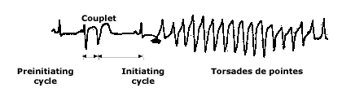
Typical features of TdP include an antecedent prolonged QT interval, particularly in the last beat preceding the onset of the arrhythmia.
The stereotypical short-long-short sequence is an important trigger for initiation of TdP.
Additional typical features include:
a ventricular rate of 160 to 250 beats per minute
irregular RR intervals
a cycling of the QRS axis through 180 degrees every 5 to 20 beats.
TdP is usually short-lived and typically terminates spontaneously. However, most patients experience multiple episodes of the arrhythmia. These episodes of TdP can recur in rapid succession, potentially degenerating to ventricular fibrillation and sudden cardiac death (SCD)
The electrocardiographic rhythm strip shows TdP. There is a short, preinitiating RR interval due to a ventricular couplet, which is followed by a long, initiating cycle resulting from the compensatory pause after the couplet.

Slide 21
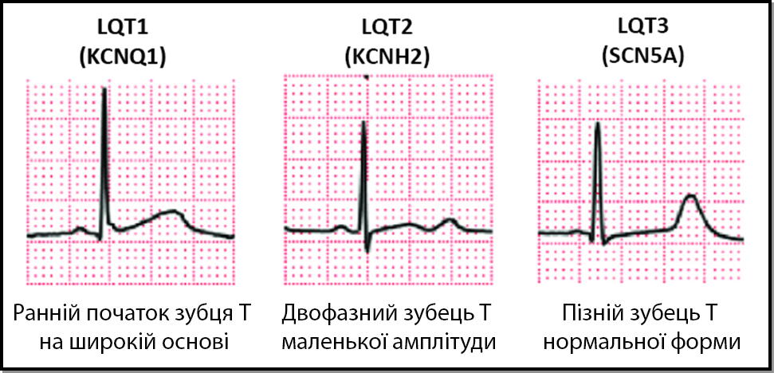

Slide 22
Drugs Causing QT Prolongation and high risk TdP
Antiarrhythmic: amiodarone, sotalol, ibutilide, procainamide, dronedaron,
quinidine, flecainide
Antibacterial: levofloxacin, moxifloxacin
azithromycin, erythromycin, clarithromycin
Antifungal: fluconazole, pendamidine
Antiemetics: ondansetron, domperidone
Antidepressants: escitalopram, citalopram
Antipsychotics atypical: sulpiride (eglonil), sertindol
antiemetics: droperidol, Chlorpromazine(aminazine)

Slide 23
Drugs Causing QT Prolongation and high risk of TdP
Neuroleptics: thioridazine(sonapax), Levomeprazine(ticerzine)
Antimalarial: chloroquine, hydroxychloroquine, halofantrine
General anesthetics: propofol, sevoflurane
Anti-cancer: oxaliplatin, aclarubicin, vandetanib
Inhibitor phosphodiesterases3: cilostazol, anagrelide
Methadone, cocaine
https://crediblemeds.org

Slide 24
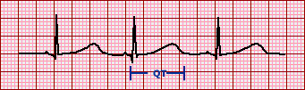
How to measure the QT interval
The computer-derived QTc should always be confirmed or corrected manually.
The QT interval is measured from the onset of the QRS complex to the point at which the T wave ends or the tangent reaches the baseline if the end of T wave cannot be precisely determined.
Accurate measurements can be technically challenging, largely due to difficulties in clearly identifying the end of the T wave.
The QT interval should be measured in multiple beats and in several leads (lead II, and lead V5 is often favored because of the clarity of T wave termination)

Slide 25

How to measure the QT interval
The QT interval is usually measured in either lead II or V5-6, however the lead with the longest measurement should be used
Several successive beats should be measured, with the maximum interval taken
Large U waves (> 1mm) that are fused to the T wave should be included in the measurement
Smaller U waves and those that are separate from the T wave should be excluded
The maximum slope intercept method is used to define the end of the T wave (see below)

Slide 26
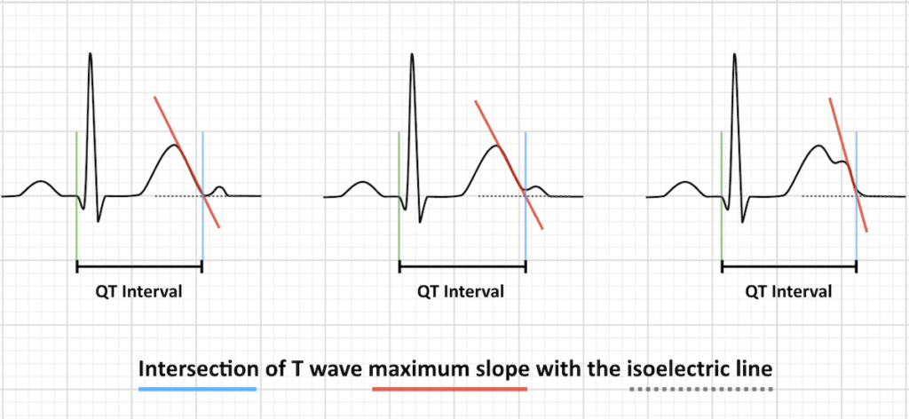
Identifying the termination of the T wave can be particularly difficult when a prominent U wave is present.
The U wave should not be included if it is distinct from and smaller than 50 percent of the T wave.
Erroneous inclusion of the U wave in the QT interval measurement can lead to overdiagnosis of LQTS. Sometimes, a prominent U wave may exaggerate the appearance of a prolonged QTU.
The maximum slope intercept method defines the end of the T wave as the intercept between the isoelectric line with the tangent drawn through the maximum down slope of the T wave (left).
When notched T waves are present (right), the QT interval is measured from the beginning of the QRS complex to the intersection point between the isoelectric line and the tangent drawn from the maximum down slope of the second notch.

Slide 27
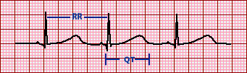
Corrected QT interval (QTc)
The corrected QT interval (QTc) estimates the QT interval at a standard heart rate of 60 bpm
This allows comparison of QT values over time at different heart rates and improves detection of patients at increased risk of arrhythmias
There are multiple formulas used to estimate QTc:
Bazett formula: QTC = QT / √ RR
Fridericia formula: QTC = QT / RR 1/3
Framingham formula: QTC = QT + 0.154 (1 – RR)
Hodges formula: QTC = QT + 1.75 (heart rate – 60)
Note: The RR interval is given in seconds (RR interval = 60 / heart rate).
Fortunately, there are now multiple phone apps that will calculate QTc for you.

Slide 28
QTc > 500 ms is associated with an increased risk of torsades de pointes
QTc is abnormally short if < 330 ms
A useful rule of thumb is that a normal QT is less than half the preceding RR interval

Slide 29
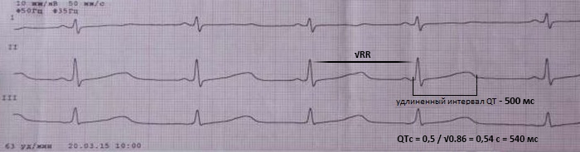
LQTS1

Slide 30
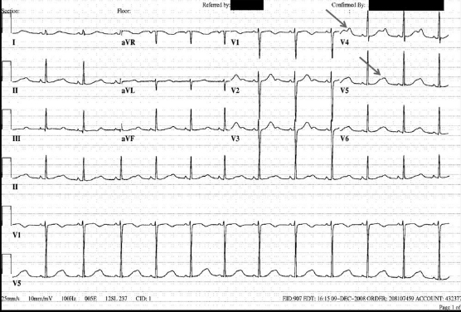
LQTS2

Slide 31
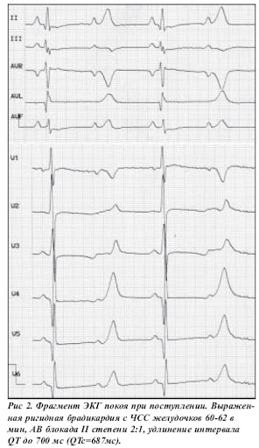
LQTS3
A fragment of an ECG at rest. Rigid bradycardia with a heart rate of 40-42 per minute,
AV-block II degree 2:1,
Long QT interval up to 700 ms (QTc= 687 ms)

Slide 32
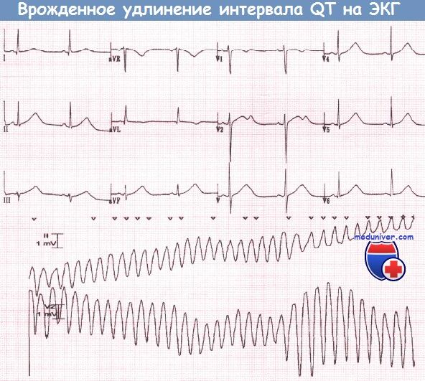

Slide 33
Short QT Syndrome
SQTS is usually defined as QT_{c} ≤330 ms, or QT_{c} interval <360 ms and one or more of the following: history of cardiac arrest or syncope, family history of sudden cardiac death (SCD) at age 40 or younger or a family history of SQTS
Familial arrhythmogenic disease associated with paroxysmal atrial and ventricular fibrillation, syncope, and sudden cardiac death
Genetically-inherited cardiac channelopathy, on the same spectrum as other familial arrhythmogenic diseases such as Long QT syndrome (LQTS), Brugada Syndrome, and Catecholamine Polymorphic Ventricular Tachycardia (CPVT)
At present, there are no diagnostic criteria for SQTS. The diagnosis is based upon the patient’s symptoms (e.g. syncope, palpitations), family history (of syncope, sudden death or atrial fibrillation at an early age) and characteristic findings on the 12-lead ECG.

Slide 34
Patients are typically young and healthy, with no structural heart abnormalities; age at first presentation ranges from a few months to the sixth decade of life (median age = 30 years)
The most common initial presenting symptom is cardiac arrest (in one-third of cases); other patients may present with palpitations or syncope due to rapid atrial fibrillation or self-terminating ventricular arrhythmias
Witnessed cardiac arrest within the first year of life and unexplained infant deaths have been observed in patients and families with SQTS, making it a possible cause of sudden infant death syndrome (SIDS)
SQTS is still a relatively new disease – it was first described in 2000, and elucidation of the genetic, electrophysiological and clinical abnormalities associated with the disease has only taken place over the past few years

Slide 35
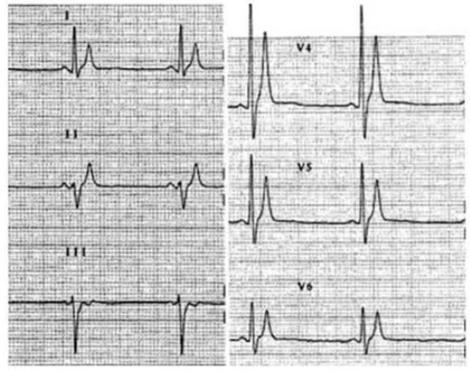
ECG features
Short QT interval
Lack of normal changes in QT interval with heart rate
Peaked T waves, particularly in precordial leads
Short, or absent, ST segments
Paroxysmal episodes of atrial or ventricular fibrillation

Slide 36
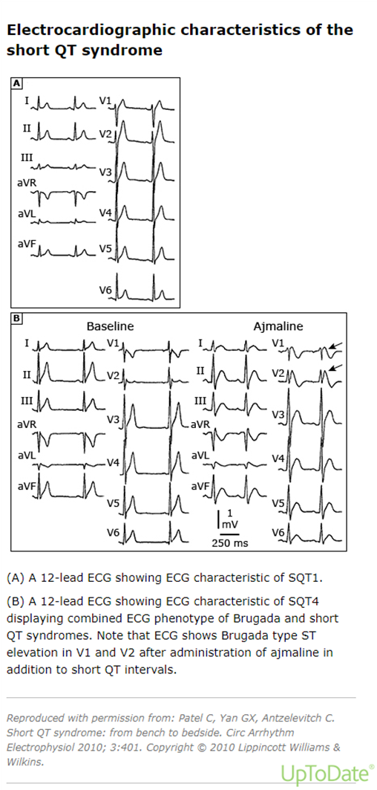
ECG signs of the shortened syndromeQT

Slide 37
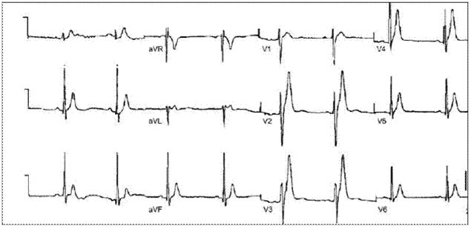

Slide 38
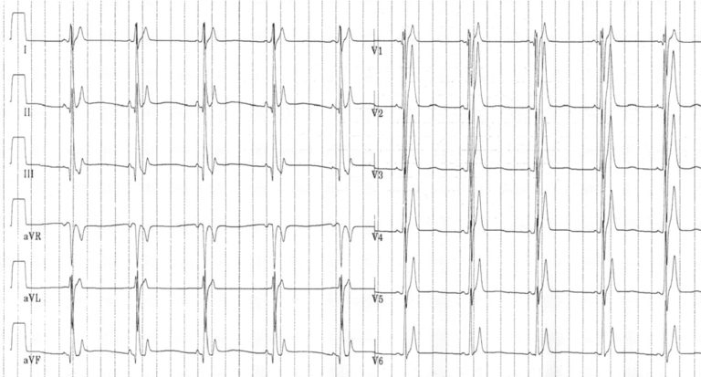

Slide 39
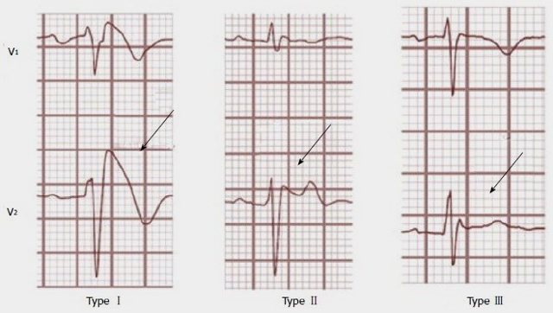
Brugada pattern/Brugada Syndrome

Slide 40
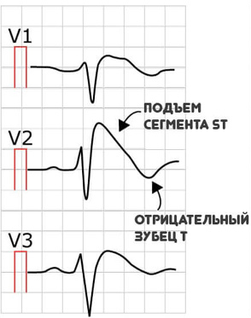
Diagnostics
Type 1
Coved ST segment elevation >2mm in >1 of V1-V2 followed by a negative T wave.
This is the only ECG abnormality that is potentially diagnostic.
It is often referred to as Brugada sign.
ST elevation
NEGATIVE
T wave
This ECG abnormality must be associated with one of the following clinical criteria to make the diagnosis:
Documented ventricular fibrillation (VF) or polymorphic ventricular tachycardia (VT).
Family history of sudden cardiac death at <45 years old .
Coved-type ECGs in family members.
Inducibility of VT with programmed electrical stimulation .
Syncope.
Nocturnal agonal respiration.

Slide 41
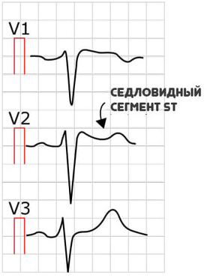
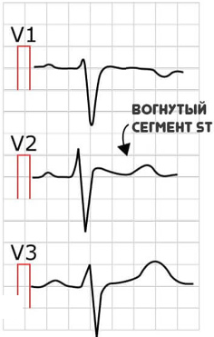
These two types of Brugada are non-diagnostic but possibly warrant further investigation
Type 2
saddleback shaped ST elevation >2mm
Type 3
can be the morphology of either type 1 or type 2, but with <2mm of ST segment elevation

Slide 42
For asymptomatic patients whose resting ECG shows the type 2 (3) Brugada pattern and who have a family history of sudden cardiac death at less than 45 years of age and/or a family history of type 1 Brugada pattern ECG changes, a drug challenge with antiarhytmic drug (I class) is proceeded.

Slide 43
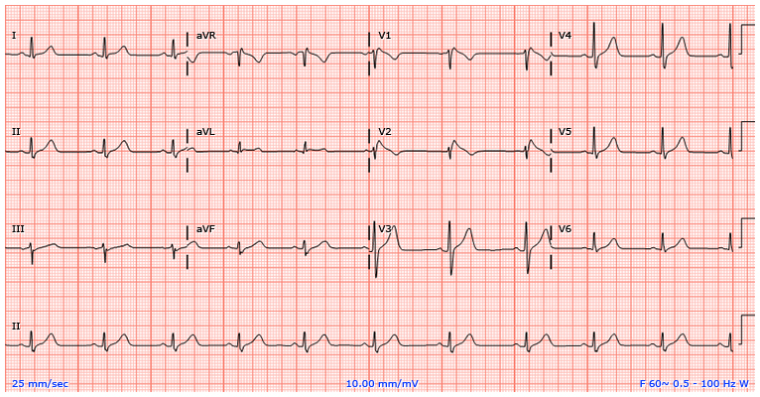
Patient with Brugada pattern ECG. Note the presence of pseudo-right bundle branch block and persistent ST segment elevation in leads V1 to V2.

Slide 44
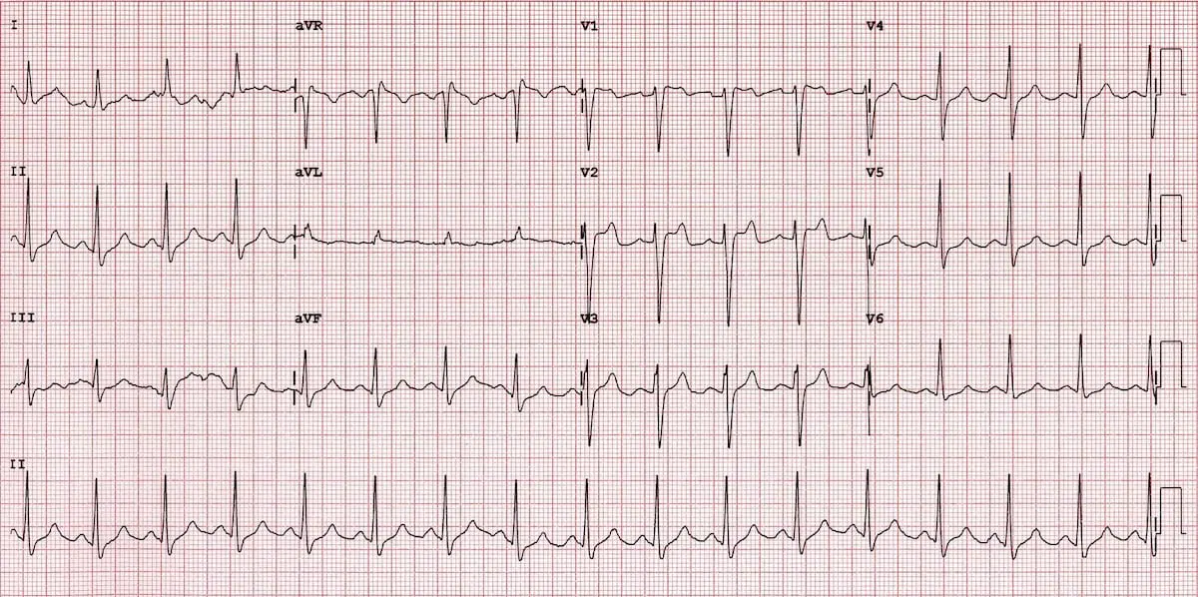
Type 2

Slide 45
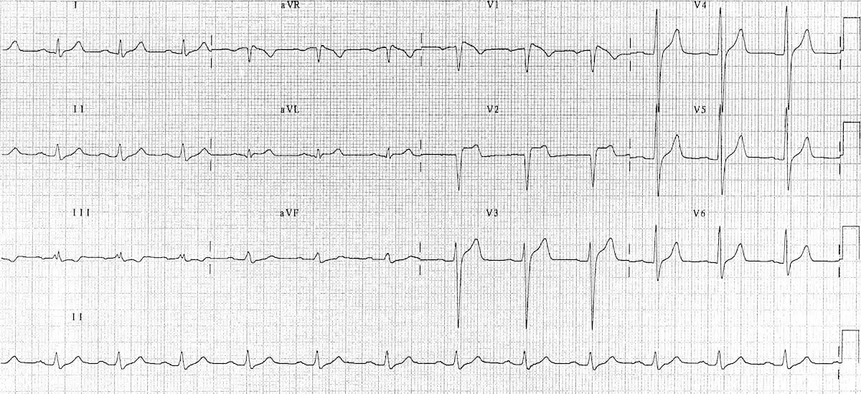
Type 3

Slide 46
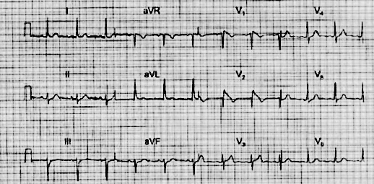

Slide 47
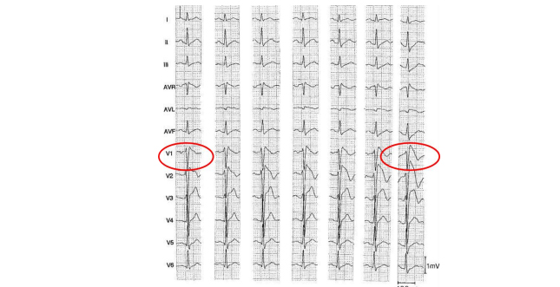
From left to right: control ECG and ECG at 1st, 2nd, 3rd, 4th and 5th minutes of administrationAymalin. Type 2 ECG changes to Type 1 on the last ECG

Slide 48
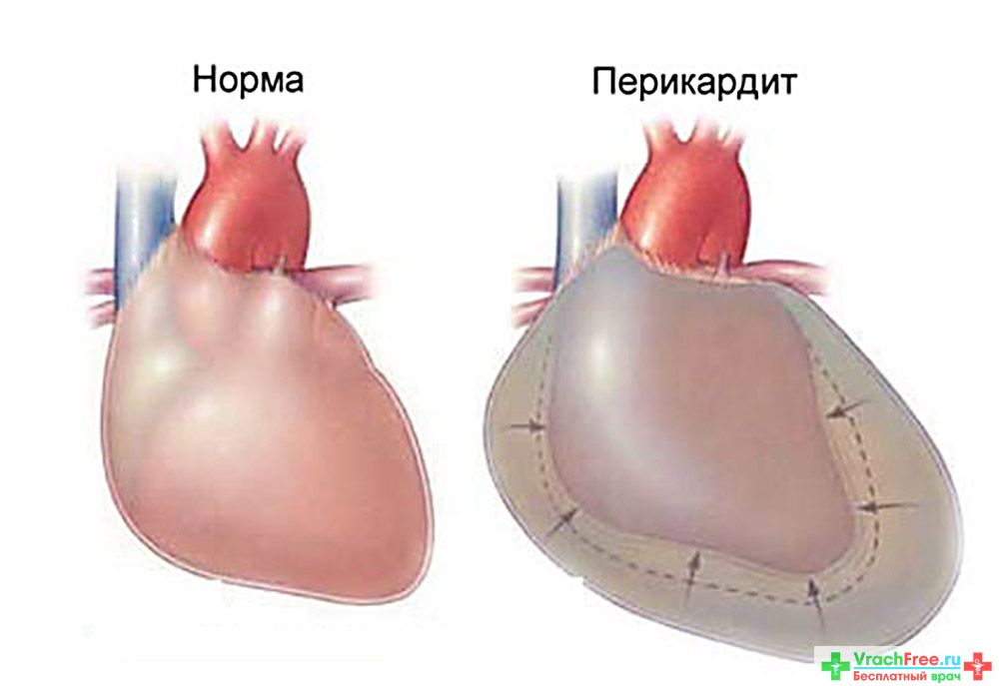
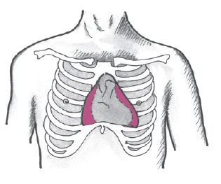
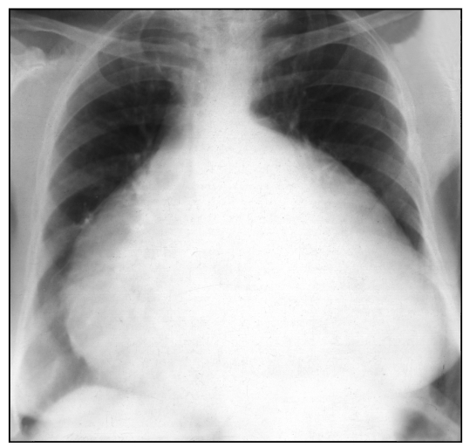
Pericarditis
Inflammation of the pericardium secondary to infection, localised injury or systemic disorders producing characteristic chest pain, dyspnoea and serial ECG changes.

Slide 49
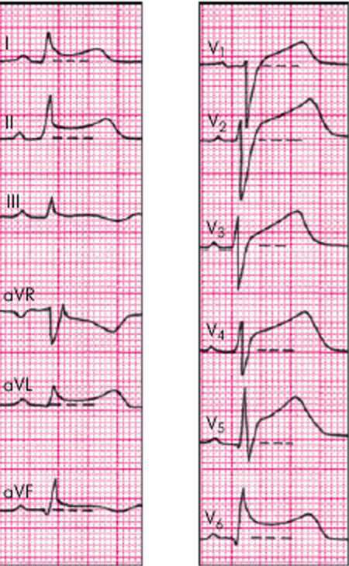
Characteristic ECG changes
Widespread concave ST elevation and PR depression throughout most of the limb leads (I, II, III, aVL, aVF) and precordial leads (V2-6)
Reciprocal ST depression and PR elevation in lead aVR (± V1)
Sinus tachycardia is also common in acute pericarditis due to pain and/or pericardial effusion
The ST / T wave ratio > 0.25 is consistent with pericarditis
NB. ST- and PR-segment changes are relative to the baseline formed by the T-P segment. The degree of ST elevation is typically modest (0.5 – 1mm).

Slide 50
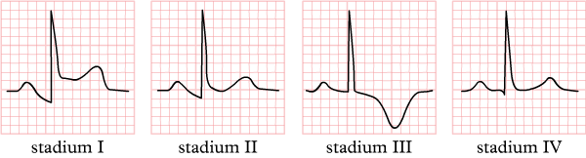
Stages of Pericarditis
Pericarditis is classically associated with ECG changes that evolve through four stages.
Stage 1 – widespread STE and PR depression with reciprocal changes in aVR (occurs during the first two weeks)
Stage 2 – normalisation of ST changes; generalised T wave flattening (1 to 3 weeks)
Stage 3 – flattened T waves become inverted (3 to several weeks)
Stage 4 – ECG returns to normal (several weeks onwards)
NB. Less than 50% of patients progress through all four classical stages and evolution of changes may not follow this typical pattern.

Slide 51
Early Repolarization Syndrome vs Pericarditis
Pericarditis can be difficult to differentiate from Early Repolarization Syndrome (ERS), as both conditions are associated with concave ST elevation. One useful trick to distinguish between these two entities is to look at the ST segment / T wave ratio and the Fish Hook Pattern.
ST segment / T wave ratio:
The vertical height of the ST segment elevation (from the end of the PR segment to the J point) is measured and compared to the amplitude of the T wave in V6:
ST / T wave ratio of > 0.25 suggests pericarditis
ST / T wave ratio of < 0.25 suggests ERS

Slide 52
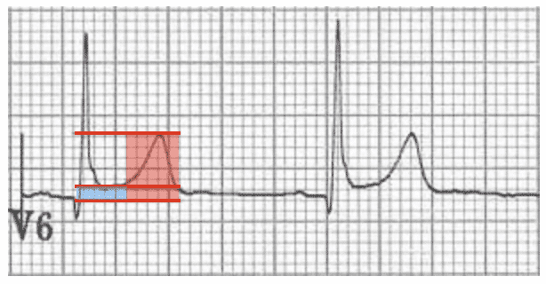
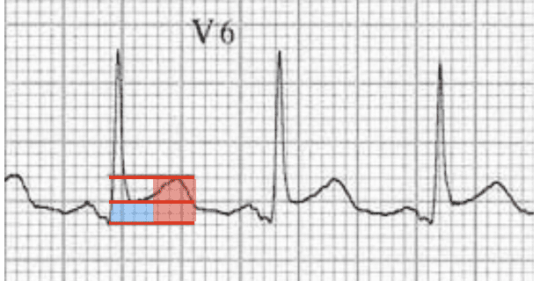
Example 1: Early Repolarization Syndrome
ST segment height = 1 mm
T wave height = 6 mm
ST / T wave ratio = 0.16
The ST / T wave ratio < 0.25 is consistent with ERS
Example 2: Pericarditis
ST segment height = 2 mm
T wave height = 4 mm
ST / T wave ratio = 0.5
The ST / T wave ratio > 0.25 is consistent with pericarditis

Slide 53
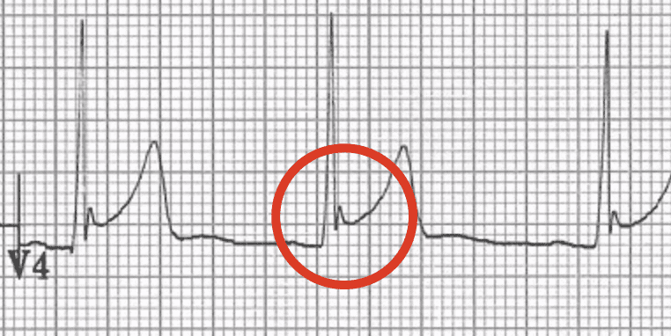
Fish Hook Pattern
Another clue that suggests ERS is the presence of a notched or irregular J point: the so-called “fish hook” pattern. This is often best seen in lead V4.

Slide 54
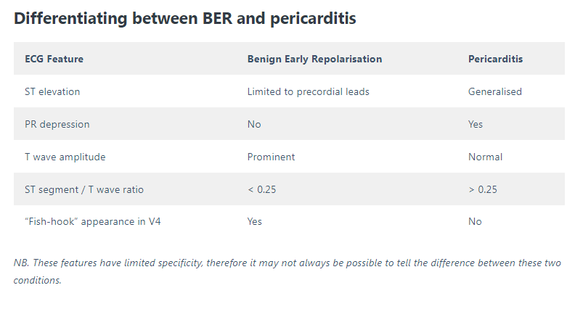

Slide 55
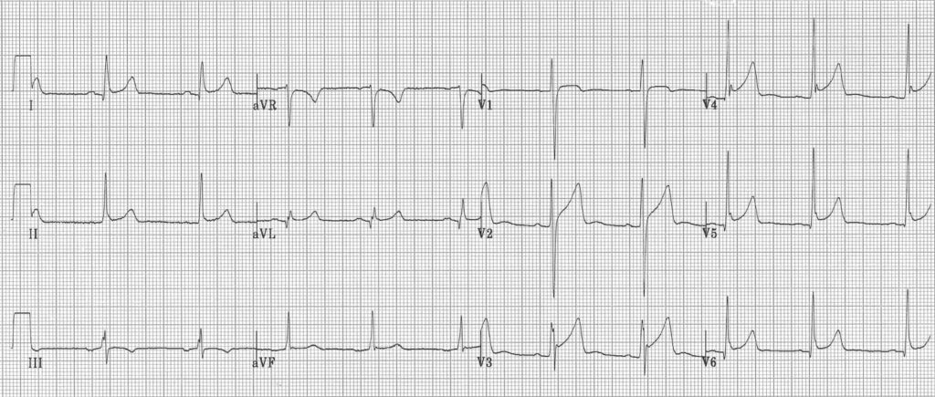
Is this ERS or pericarditis?
These ECG appearances could be caused by ERS alone, although it is possible that this ECG represents ERS with superimposed pericarditis. This ECG demonstrates the difficulty in differentiating between these two very similar conditions.
Remember that it is possible for a patient with ERS to get pericarditis!
There are features suggestive of ERS:
ST elevation is markedly more prominent in precordial leads (especially V2-5)
J-wave notching with fish-hook pattern in V3-4
Prominent precordial T waves
ST / T wave ratio of 0.16
But also features suggestive of pericarditis:
Widespread concave ST elevation
Subtle downsloping PR depression in limb (I, aVL) and precordial (V3-6) leads
Subtle PR elevation in aVR

Slide 56
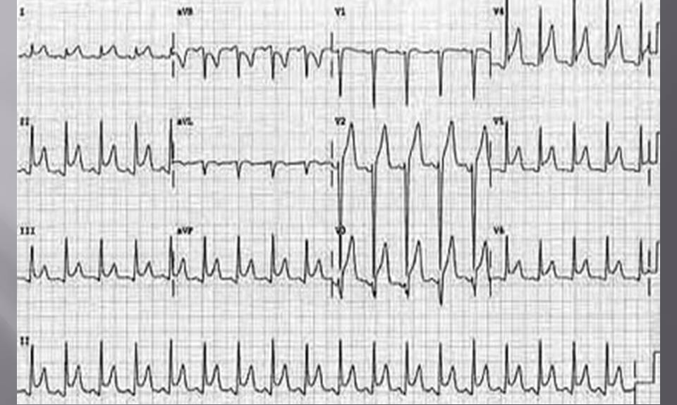

Slide 57
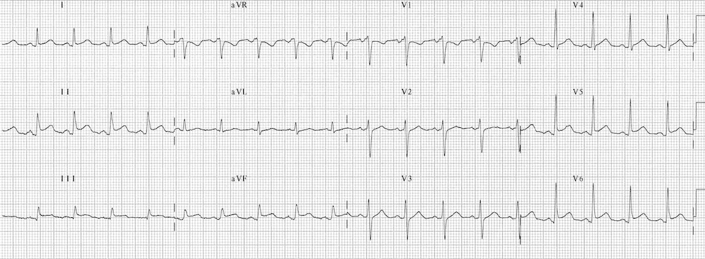
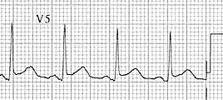

Slide 58
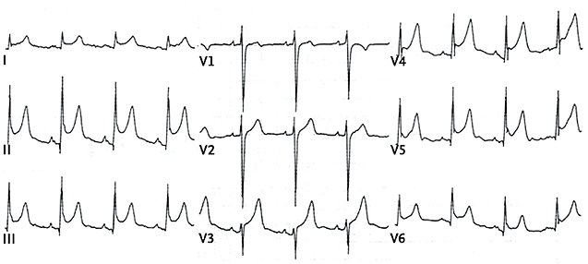

Slide 59

Pericarditis
Acute Pericarditis causes widespread concave (“saddleback”) ST segment elevation with PR segment depression in multiple leads, typically involving I, II, III, aVF, aVL, and V2-6.
Concave “saddleback” ST elevation in leads I, II, III, aVF, V5-6 with depressed PR segments.
There is reciprocal ST depression and PR elevation in leads aVR and V1.
Spodick’s sign was first described by David H. Spodick in 1974 as a downward sloping TP segment with specificity for acute pericarditis.

Slide 60

Coronary Vasospasm (Prinzmetal’s angina)
This causes a pattern of ST elevation that is very similar to acute STEMI — i.e. localised ST elevation with reciprocal ST depression occurring during episodes of chest pain.
However, unlike acute STEMI the ECG changes are transient, reversible with vasodilators and not usually associated with myocardial necrosis.
It may be impossible to differentiate these two conditions based on the ECG alone.

Slide 61

Left Bundle Branch Block (LBBB)
In Left bundle branch block (LBBB), the ST segments and T waves show “appropriate discordance” — i.e. they are directed opposite to the main vector of the QRS complex.
This produces ST elevation and upright T waves in leads with a negative QRS complex (dominant S wave), while producing ST depression and T wave inversion in leads with a positive QRS complex (dominant R wave).
Note the ST elevation in leads with deep S waves — most apparent in V1-3.
Also note the ST depression in leads with tall R waves — most apparent in I and aVL.

Slide 62

Left Ventricular Hypertrophy (LVH)
Left Ventricular Hypertrophy (LVH) causes a similar pattern of repolarization abnormalities as LBBB, with ST elevation in the leads with deep S-waves (usually V1-3) and ST depression/T-wave inversion in the leads with tall R waves (I, aVL, V5-6).
Left axis deviation
Deep S waves with ST elevation in V1-3
ST depression and T-wave inversion in the lateral leads V5-6

Slide 63

Ventricular Aneurysm
This is an ECG pattern of Ventricular Aneurysm – residual ST elevation and deep Q waves seen in patients with previous myocardial infarction. It is associated with extensive myocardial damage and paradoxical movement of the left ventricular wall during systole.
There is ST elevation with deep Q waves and inverted T waves in V1-3.
This pattern suggests the presence of a left ventricular aneurysm due to a prior anteroseptal MI.

Slide 64

Digoxin overdose

Slide 65

Thank you for attention

