Slide 1
Odesa National Medical University
Department of Family Medicine and Polyclinic Therapy
Elective course “ECG in General Practice”
Content module 3
Electrocardiography in the diagnosis of diseases of the cardiovascular system and extracardiac pathology

Slide 2

Theme 8
ECG changes in case of extracardiac pathology

Slide 3
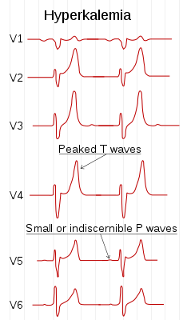
Hyperkalemia
ECG features of hyperkalaemia
Peaked T waves
P wave widening/flattening, PR prolongation
Bradyarrhythmias: sinus bradycardia, high-grade AV block with slow junctional and ventricular escape rhythms, slow AF
Conduction blocks (bundle branch block, fascicular blocks)
QRS widening with bizarre QRS morphology

Slide 4
With worsening hyperkalaemia… (> 9.0 mmol/L):
Development of sine wave appearance (pre-terminal rhythm)
Ventricular fibrillation
PEA with bizarre, wide complex rhythm
Asystole
Note: Serum potassium level may not correlate closely with ECG changes. Patients with a relatively normal ECG can suffer sudden hyperkalaemia cardiac arrest. In any patient who has suffered a bradycardia PEA arrest, suspect and treat for hyperkalaemia.

Slide 5
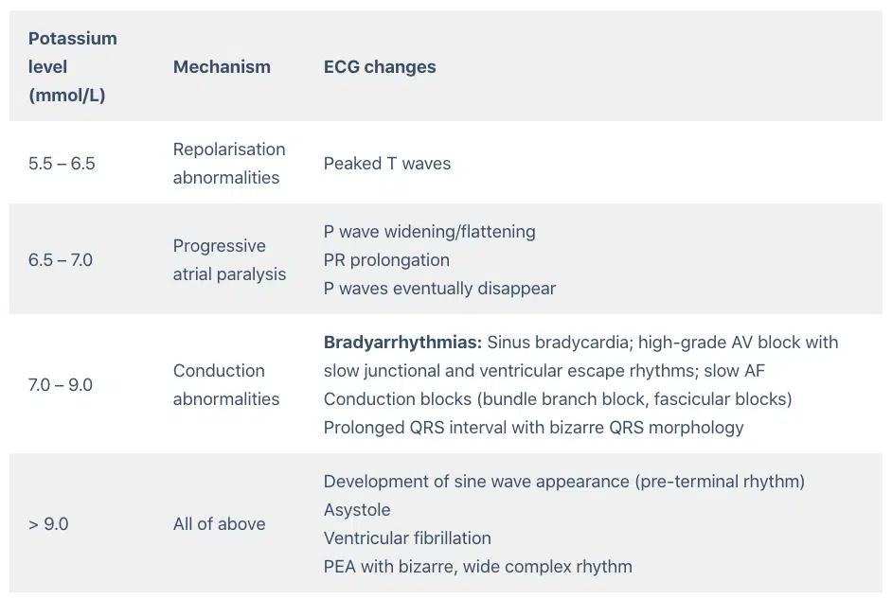

Slide 6
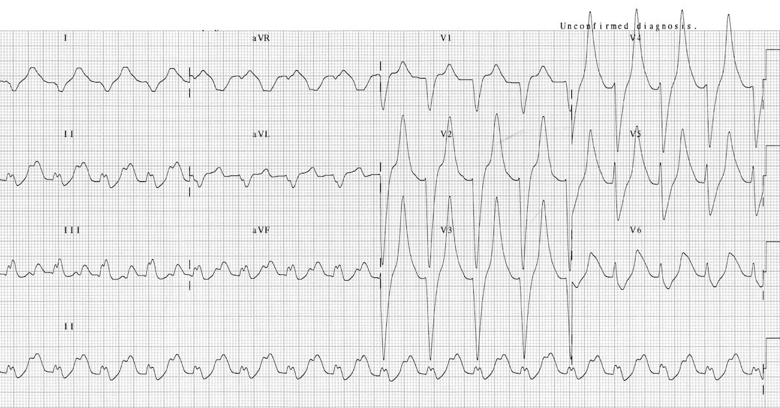
This ECG displays many of the features of hyperkalaemia:
Prolonged PR interval.
Broad, bizarre QRS complexes — these merge with both the preceding P wave and subsequent T wave.
Peaked T waves.
This patient had a serum K+ of 9.3

Slide 7
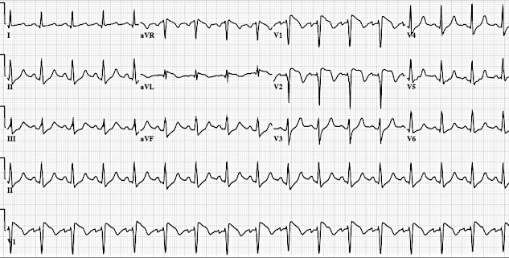

Slide 8
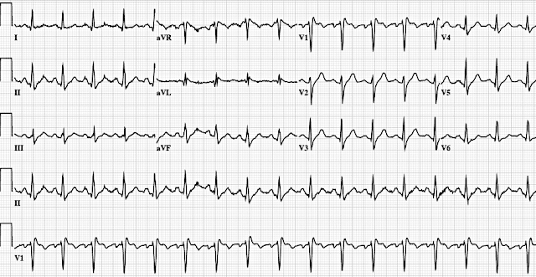
After introduction CaCl

Slide 9
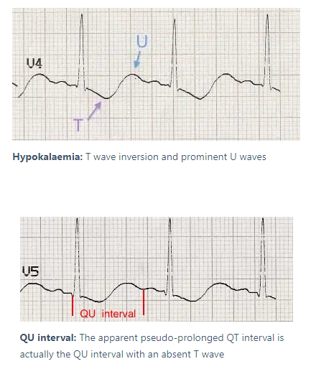
Hypokalemia
Hypokalaemia is defined as a serum potassium level of < 3.5 mmol/L. ECG changes generally do not manifest until there is a moderate degree of hypokalaemia (2.5-2.9 mmol/L). The earliest ECG manifestation of hypokalaemia is a decrease in T wave amplitude.
ECG features of hypokalaemia (K < 2.7 mmol/L)
Increased P wave amplitude
Prolongation of PR interval
Widespread ST depression and T wave flattening/inversion
Prominent U waves (best seen in the precordial leads V2-V3)
Apparent long QT interval due to fusion of T and U waves (= long QU interval)

Slide 10
With worsening hypokalaemia…
Frequent supraventricular and ventricular ectopics
Supraventricular tachyarrhythmias: AF, atrial flutter, atrial tachycardia
Potential to develop life-threatening ventricular arrhythmias, e.g. VT, VF and Torsades de Pointes
Handy tips
Hypokalaemia is often associated with hypomagnesaemia, which increases the risk of malignant ventricular arrhythmias
Check both potassium and magnesium levels in any patient with an arrhythmia

Slide 11
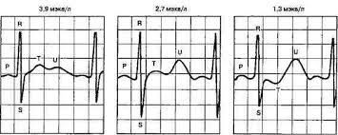
EKG signs hypokalaemia

Slide 12
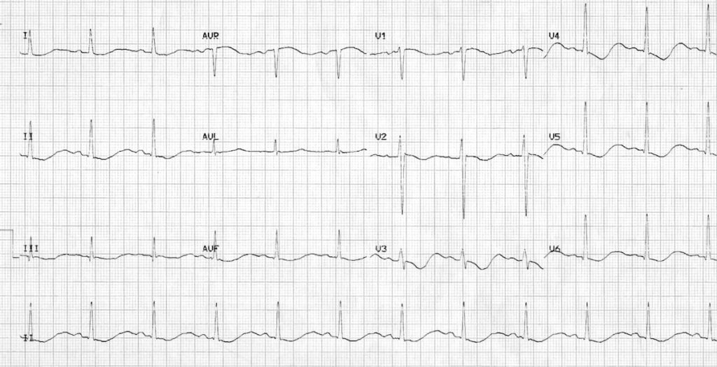
Hypokalaemia:
Widespread ST depression and T wave inversion
Prominent U waves
Long QU interval
This patient had a serum K+ of 1.7

Slide 13
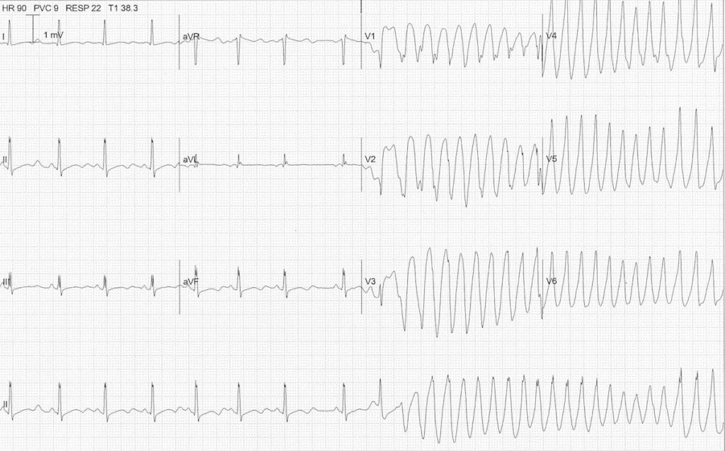

Slide 14
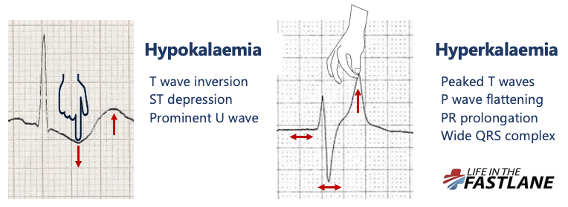
Hypokalaemia creates the illusion that the T wave is “pushed down”, with resultant T-wave flattening/inversion, ST depression, and prominent U waves
In hyperkalaemia, the T wave is “pulled upwards”, creating tall “tented” T waves, and stretching the remainder of the ECG to cause P wave flattening, PR prolongation, and QRS widening

Slide 15
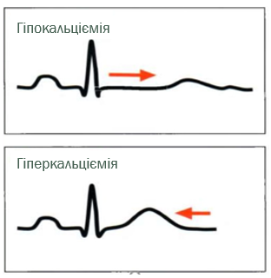
Hypercalcaemia/Hypocalcaemia
ECG Changes in Hypercalcaemia
The main ECG abnormality seen with hypercalcaemia is shortening of the QT interval
In severe hypercalcaemia, Osborn waves (J waves) may be seen
Ventricular irritability and VF arrest has been reported with extreme hypercalcaemia
ECG changes in Hypocalcaemia
Hypocalcaemia causes QTc prolongation primarily by prolonging the ST segment
The T wave is typically left unchanged
Dysrhythmias are uncommon, although atrial fibrillation has been reported
Torsades de pointes may occur, but is much less common than with hypokalaemia or hypomagnesaemia

Slide 16
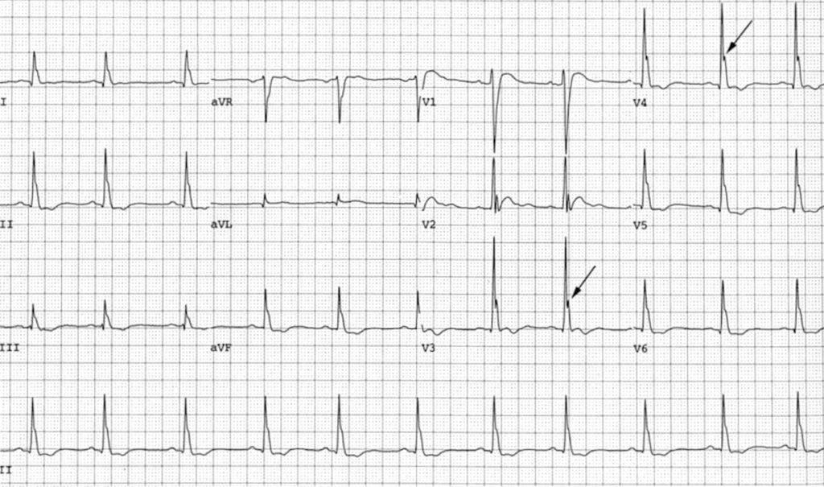
Hypercalcaemia
Osborn waves in severe hypercalcaemia (4.1 mmol/L)

Slide 17
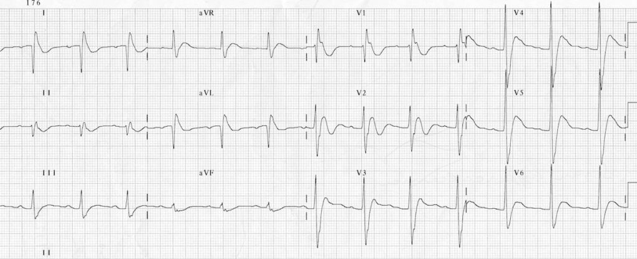
This is the ECG of a 41-year old man with a parathyroid adenoma who presented to ED critically unwell with a serum calcium of 6.1 mmol/L. He suffered a VF arrest not long after this ECG was taken. The ECG shows:
Bizarre-looking QRS complexes
Very short QT interval
J waves = notching of the terminal QRS, best seen in lead V1

Slide 18
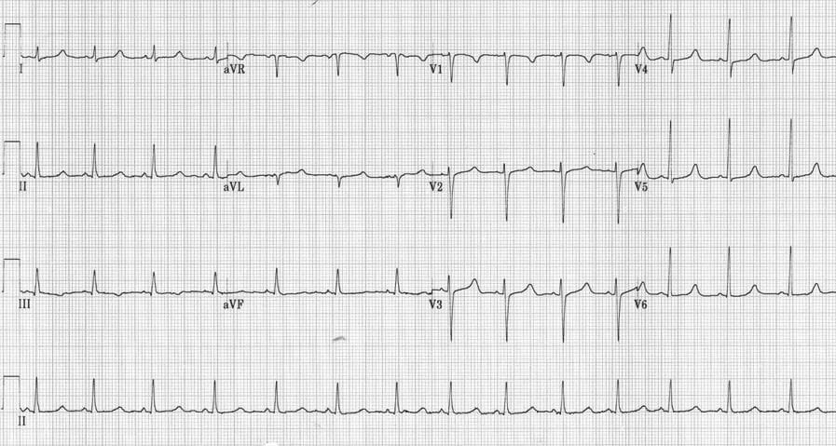
Hypocalcaemia:
QTc 500ms in a patient with hypoparathyroidism (post thyroidectomy) and serum corrected calcium of 1.40 mmol/L

Slide 19
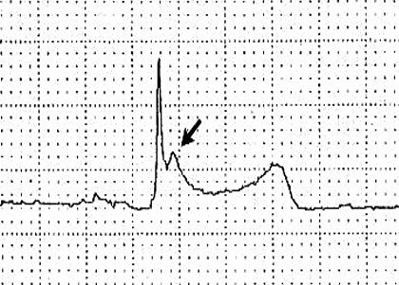
Hypothermia
ECG Changes
Bradyarrhythmias
Osborne Waves (= J waves)
Prolonged PR, QRS and QT intervals
Shivering artefact
Ventricular ectopics
Cardiac arrest due to VT, VF or asystole
Patients may manifest a variety of bradyarrhythmias:
Sinus bradycardia (may be marked)
Atrial fibrillation with slow ventricular response
Slow junctional rhythms
Varying degrees of AV block (1st-3rd)

Slide 20
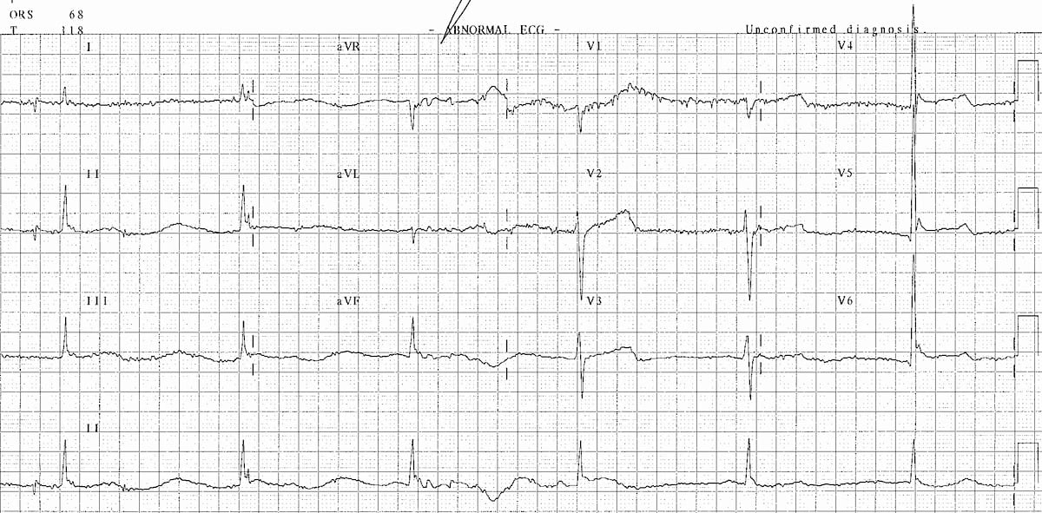
ECG with the classic features of hypothermia: bradycardia, Osborn waves and shivering artefact.

Slide 21
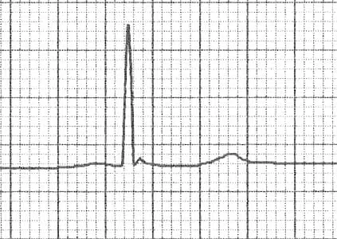
Subtle J waves in mild hypothermia [Temp: 32.5°C (90.5°F)]
The height of the J wave is roughly proportional to the degree of hypothermia

Slide 22
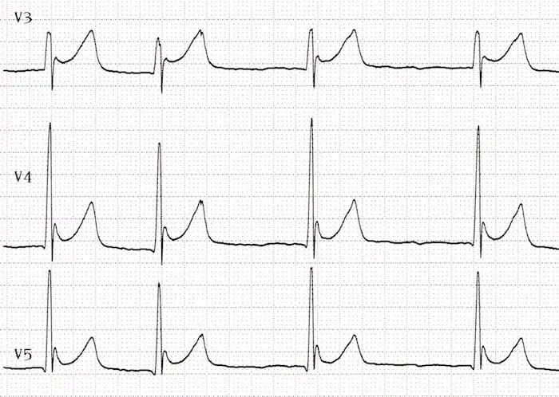
J waves in severe hypothermia. [Temp: 28°C (82.4°F)]

Slide 23
ECG changes in Pulmonary Embolism
The ECG changes associated with acute pulmonary embolism may be seen in any condition that causes acute pulmonary hypertension, including hypoxia causing pulmonary hypoxic vasoconstriction.
ECG Features:
Sinus tachycardia – the most common abnormality (seen in 44% of patients with PE)
Complete or incomplete RBBB (18%)
Right ventricular strain pattern – T wave inversions in the right precordial leads (V1-4) ± the inferior leads (II, III, aVF). This pattern is associated with high pulmonary artery pressures (34%)
Right axis deviation (16%). Extreme right axis deviation may occur, with axis between zero and -90 degrees, giving the appearance of left axis deviation (“pseudo left axis”)
Dominant R wave in V1 – a manifestation of acute right ventricular dilatation
Right atrial enlargement (P pulmonale) – peaked P wave in lead II > 2.5 mm in height (9%)
SI QIII TIII pattern – deep S wave in lead I, Q wave in III, inverted T wave in III (20%). This “classic” finding is neither sensitive nor specific for PE
Clockwise rotation – shift of the R/S transition point towards V6 with a persistent S wave in V6 (“pulmonary disease pattern”), implying rotation of the heart due to right ventricular dilatation
Atrial tachyarrhythmias – AF, flutter, atrial tachycardia (8%)
Non-specific ST segment and T wave changes, including ST elevation and depression (50%)

Slide 24
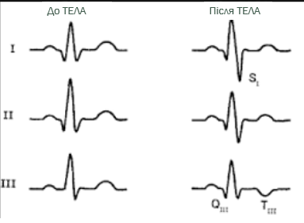
Before PE
PE
Simultaneous T wave inversions in the inferior (II, III, aVF) and right precordial leads (V1-4) is the most specific finding in favour of PE, with reported specificities of up to 99% in one study.

Slide 25
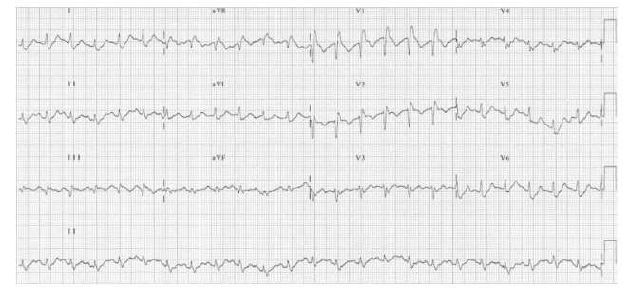
Massive bilateral pulmonary embolus
Sinus tachycardia
RBBB
T-wave inversions in the right precordial leads (V1-3) as well as lead III

Slide 26
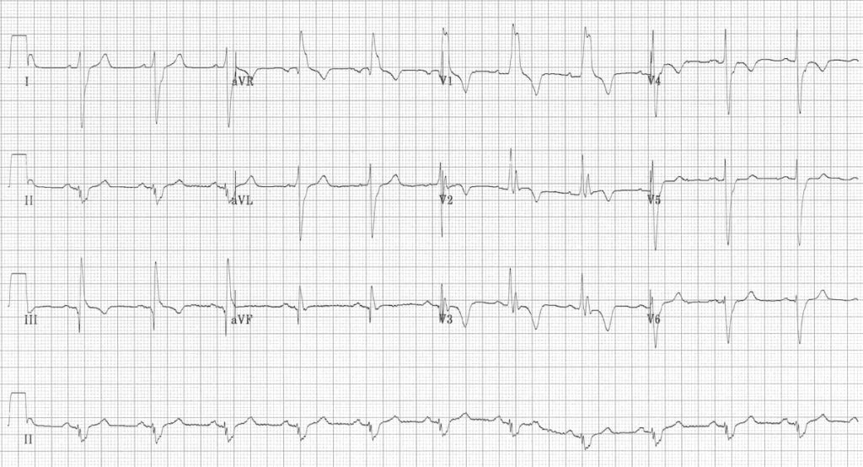
Massive bilateral pulmonary embolus
RBBB
Extreme right axis deviation (+180 degrees)
S₁ Q₃ T₃
T-wave inversions in V1-4 and lead III
Clockwise rotation with persistent S wave in V6

Slide 27
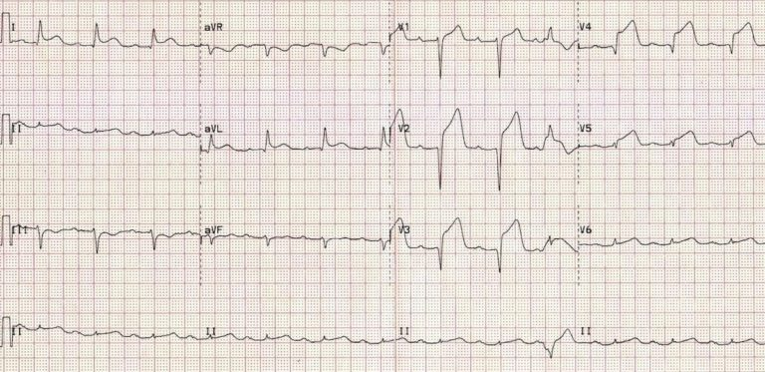
Coronary Vasospasm (Prinzmetal’s angina)
This causes a pattern of ST elevation that is very similar to acute STEMI — i.e. localised ST elevation with reciprocal ST depression occurring during episodes of chest pain.
However, unlike acute STEMI the ECG changes are transient, reversible with vasodilators and not usually associated with myocardial necrosis.
It may be impossible to differentiate these two conditions based on the ECG alone.

Slide 28
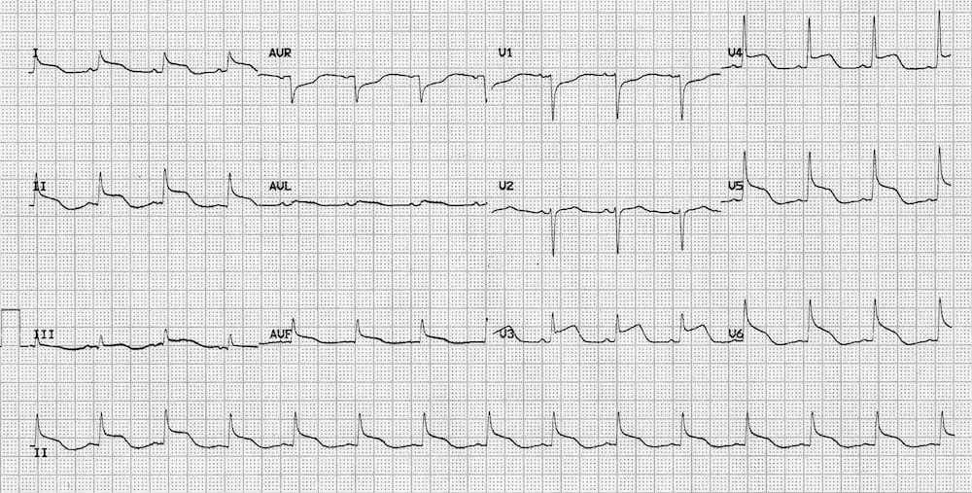
Raised Intracranial Pressure
Raised Intracranial Pressure (ICP) (e.g. due to intracranial hemorrhage, traumatic brain injury) may cause ST elevation or depression that simulates myocardial ischemia or pericarditis.
More commonly, raised ICP is associated with widespread, deep T-wave inversions (“cerebral T waves“).
Widespread ST elevation with concave (pericarditis-like) morphology in a patient with severe traumatic brain injury.

Slide 29

Thank you for attention

