Slide 1
Topic 3. Clinic, diagnosis and differential diagnosis, screening of type 2 diabetes

Slide 2
The main clinical symptoms of diabetes
The main symptoms of diabetes :
excessive urination ;
thirst ;
permanent feeling of hunger;
loss masses bodies ;
feeling fatigue ;
deterioration vision

Slide 3
Diagnostics of diabetes
Today , as criteria for establishment diagnosis of " diabetes ". diabetes " are used criteria American Diabetes Association ( ADA) :
Level HbA1c 6.5% or above (the test must be performed in a laboratory using a certified method National program standardization glycohemoglobin ( NGSP) or such that responds Reference Diabetes Control and Complications Trial ( DCCT )
Level glucose in plasma of blood fasting (GPN) - 7.0 mmol/l or above ( on an empty stomach - absence consumption calories for at least 8 hours)
2-hour level glucose in plasma blood 11.1 mmol/l or above during the glucose tolerance test ( OGTT, consumption of 75 g of glucose internally )
Random level glucose in plasma blood 11.1 mmol/l or higher in patients with classic symptoms of hyperglycemia ( polyuria , polydipsia , polyphagia , weight loss )

Slide 4
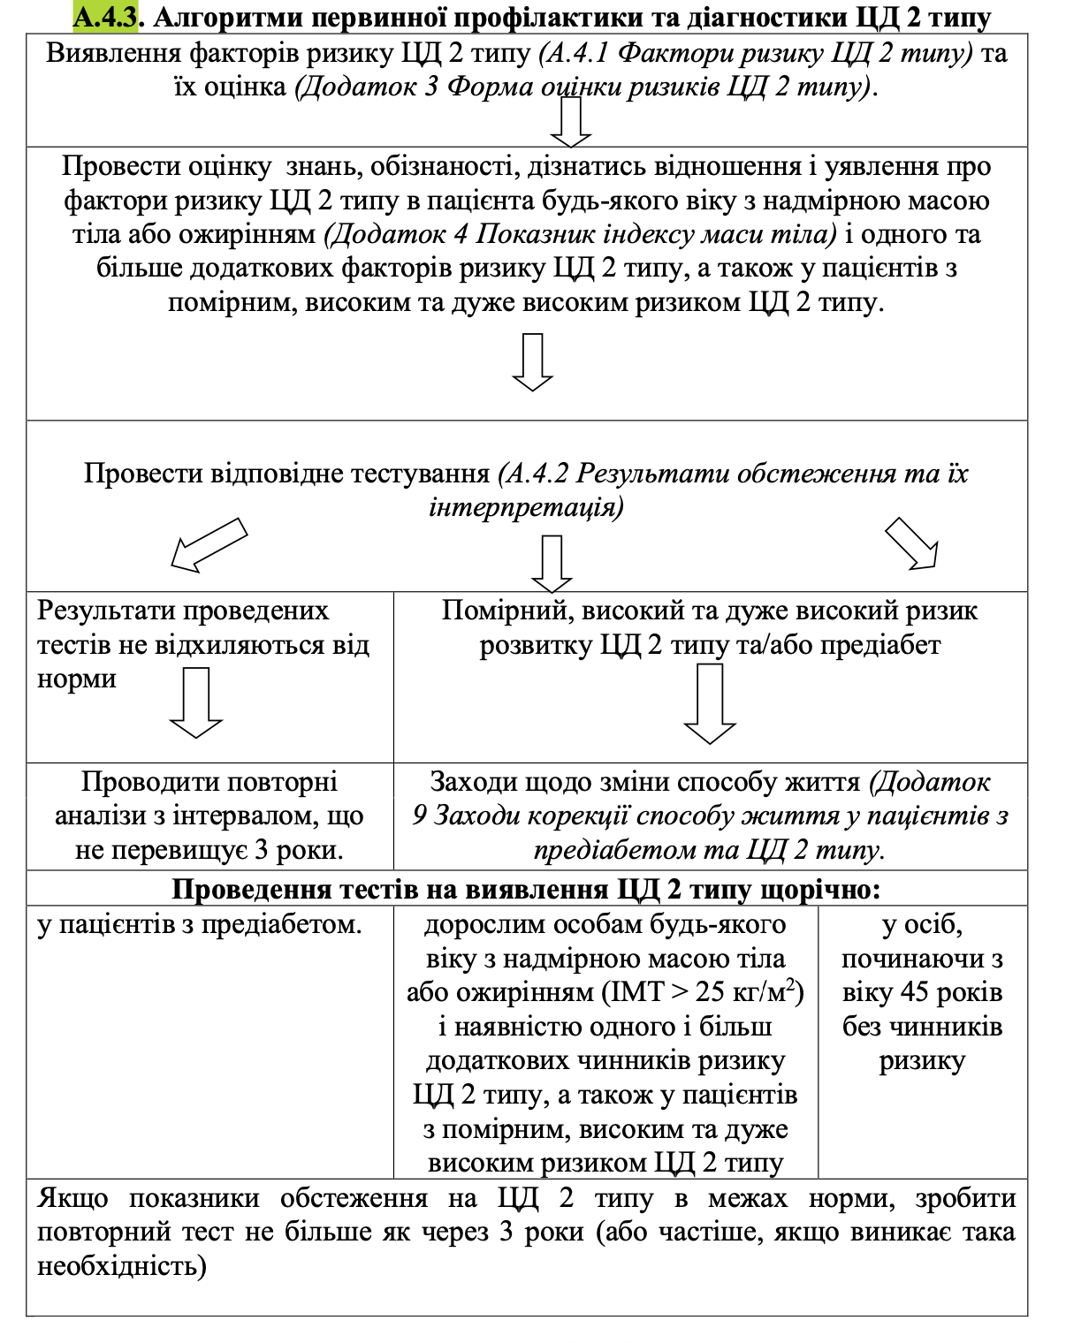
Screening of type 2 diabetes and testing for presence of risk factors

Slide 5
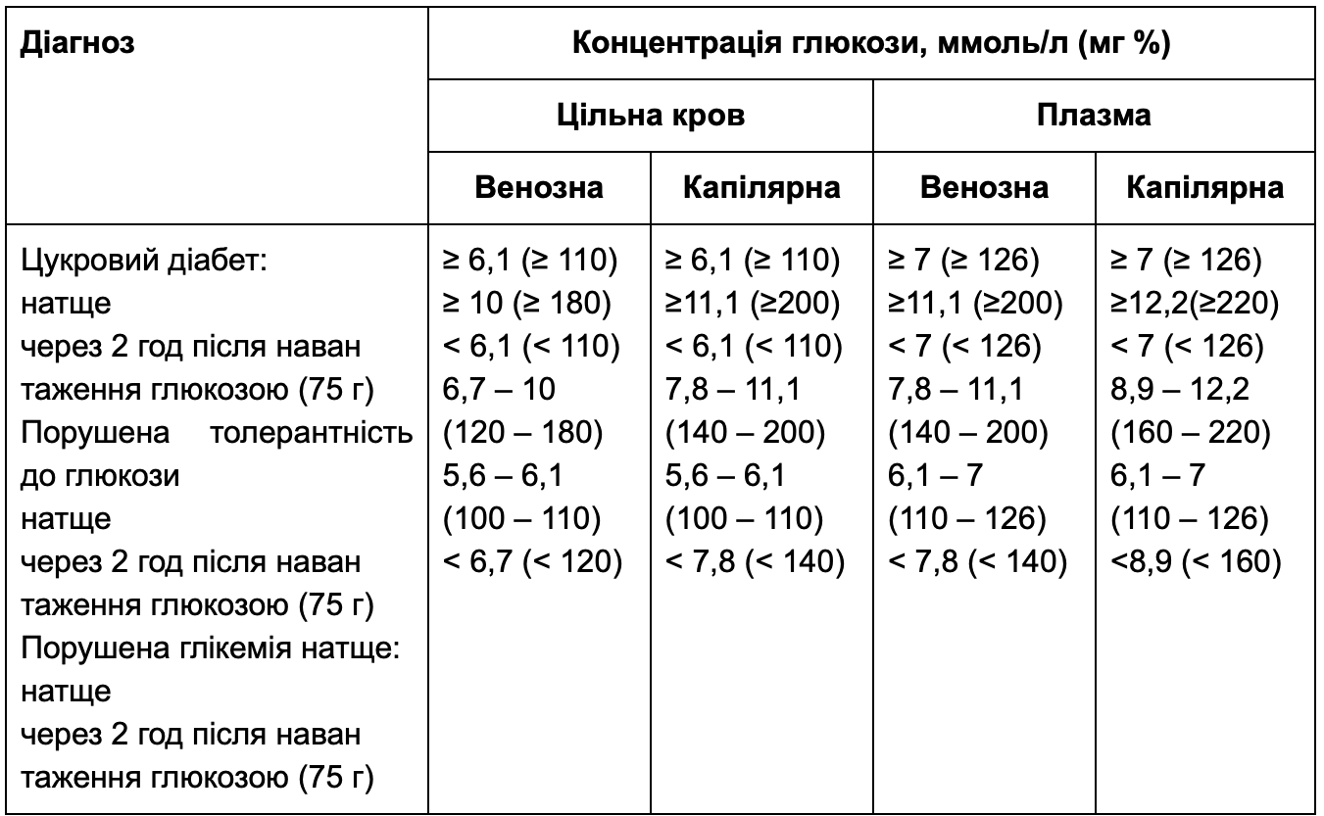
Diagnostic criteria of diabetes and others categories hyperglycemia .

Slide 6
Additional research methods .
If the measurement has not been carried out in the last year, we measure:
Fasting lipid profile
Functional tests of the liver
The ratio of albumin and creatinine in urine
Serum creatinine (with estimated glomerular filtration rate)
- In patients with type 1 diabetes, we also periodically measure:
Serum thyroid-stimulating hormone (TSH)
Antibodies to celiac disease to screen for celiac disease, which may be asymptomatic

Slide 7
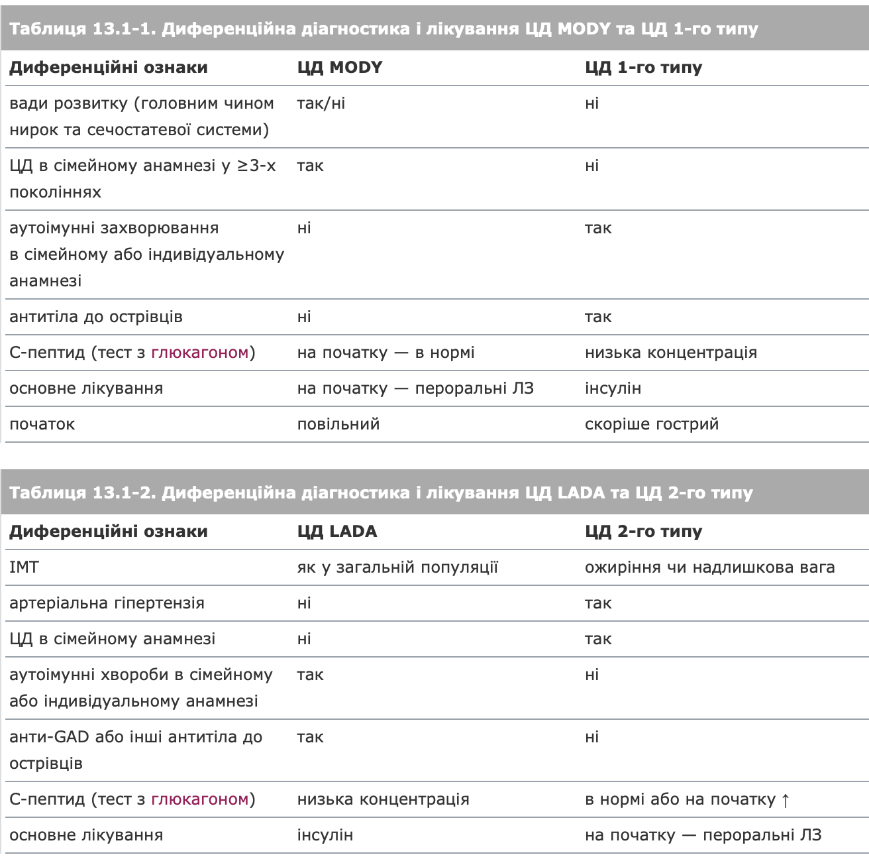
Differential diagnosis of type 2 diabetes with others diseases

Slide 8
Thank you for attention

