Slide 1
Topic 3. Modification of the lifestyle of patients with diabetes as a method of compensating for the disease and preventing complications and improving the prognosis

Slide 2
Management of diabetes .
Medicinal diet therapy
Reduction masses bodies
Diet
Pharmacological therapy
Surgical therapy
Physical exercises
Intense lifestyle modification _
Psychological intervention
Planning pregnancy

Slide 3
Modification of the lifestyle of patients with type 2 diabetes
The main tasks of non-pharmacological treatment of patients with type 2 diabetes are correction of nutrition and reduction of body weight, if the patient is overweight or obese, performing dosed physical exercises by the patient, modification of lifestyle.

Slide 4
Assessment of lifestyle and implementation of nutritional correction, regulation of physical activity, fight against bad habits and overweight.
1. Nutrition correction
• In order to achieve target equal glucose blood of persons with prediabetes and type 2 diabetes should follow individual diets developed by a nutritionist .
• Monitoring consumption carbohydrates ( calc quantity grams carbohydrates in food , bread units or rating content carbohydrates , based on experience patient ) remains key strategy to achieve target equal glucose in the blood .
• In people with type 2 diabetes mellitus glycemic index products and glycemic load provides moderate additional benefit for glycemic control ̈ compared to accounting only general consumption carbohydrates
• Accept dietary fiber (14 g of fiber per 1000 kcal) and products that contain whole grains (they should make half of everyone grains products diet ).
• Saturated fats should draw up less than 7% of total caloric content daily diet

Slide 5
Assessment of lifestyle and implementation of nutritional correction, regulation of physical activity, fight against bad habits and overweight.
Consumption of products that contain trans isomers fat acid should be minimized .
Food supplements that contain antioxidants , such as vitamins E, C and carotene, are not recommended for routine use , as they are currently unavailable evidence their taking into account efficiency and safety remote forecast.
Benefit from inclusion of supplements that contain chromium, in food ̆ ration people with type 2 diabetes or obesity is not definitively defined , and therefore them use is not recommended .
Short -term (up to 1 year) diets with low content carbohydrates or fats and restrictions calories ̆ are effective for reduction masses body
In patients who adhere to diets with low content carbohydrates , a trace conduct monitoring concentration of lipids blood , functional state of kidneys and consumption control proteins (if available nephropathy ̈), as well as correction of doses of hypoglycemic drugs , if necessary .

Slide 6
Assessment of lifestyle and implementation of nutritional correction, regulation of physical activity, fight against bad habits and overweight.
For people ̆ who have overweight, set initial the loss masses of the body by 5-10% , while remembering that it is smaller loss masses bodies can be useful , but more loss masses body in the long- term perspective will have beneficial ̆ effect on metabolic activity
Patients with type 2 diabetes and obesity should be recommended individual approaches to decrease masses bodies ( correction of lifestyle , pharmacological or surgical methods ) and for improvement metabolic control

Slide 7
Assessment of lifestyle and implementation of nutritional correction, regulation of physical activity, fight against bad habits and overweight.
2. Regulation physical load
recommend moderate physical load to improve glycemic control and reduction cardiovascular risk (at least 150 min . per week ), while the heart rate reductions should reach 50-70% of maximum ( the maximum heart rate during exercise should not exceed 130 beats/ min for people under 50 and 120 beats/ min for people over 50 ).
In the absence Contraindications for people with type 2 diabetes are possible recommend forceful exercises 3 times for 7 days .
Physical load and the correct ̆ method life is important components measures of decrease masses body and are especially useful for support reduced weight.
Physical load must be regular
Recommendations regarding to physical loads must be individual , taking into account glycemic control and foot care.

Slide 8
Assessment of lifestyle and implementation of nutritional correction, regulation of physical activity, fight against bad habits and overweight.
3. Struggle with harmful habits
• Everyone patients trace convince refuse from smoking
• Counseling of rejection from smoking and others forms therapy of nicotine addiction _ should be included in routine management practice patients with type 2 diabetes and be conducted according to the Standards of primary medical care upon termination use tobacco products .
• Necessary continue monitoring the smoking status of everyone patients
• If patients with type 2 diabetes drink alcohol, then it daily consumption should be reduced to moderate doses (30 ml of ethanol per day for men and 15 ml for women ).

Slide 9
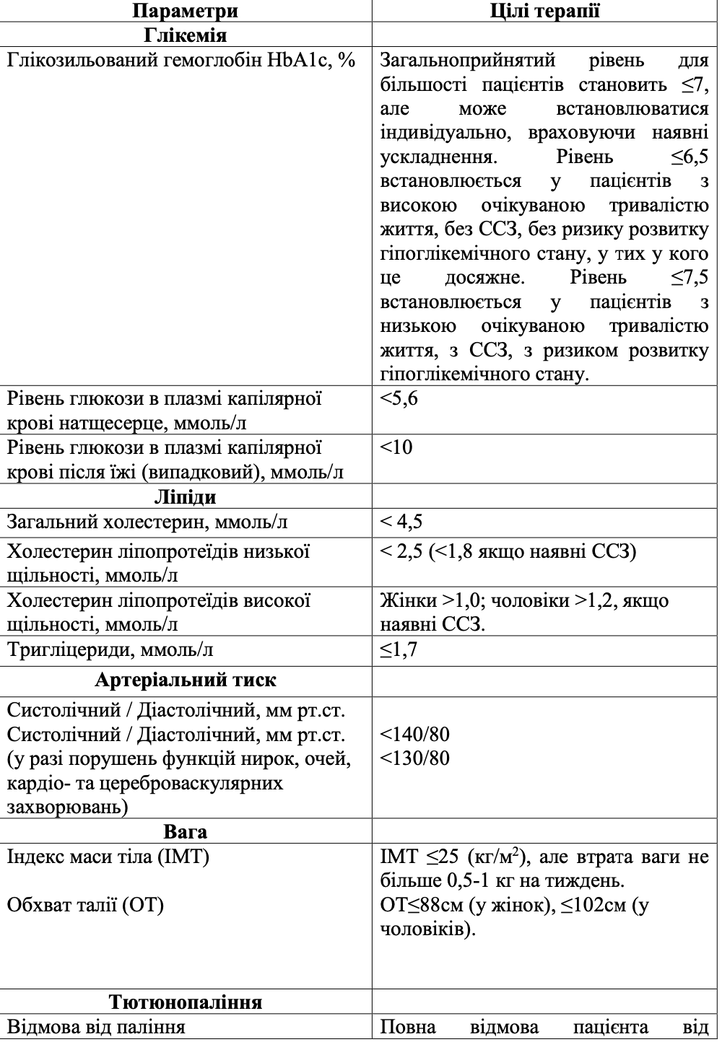
Glycemic goals in diabetes

Slide 10
Thank you for your attention

