Slide 1
Treatment of type 2 diabetes and indications for switching to insulin therapy

Slide 2
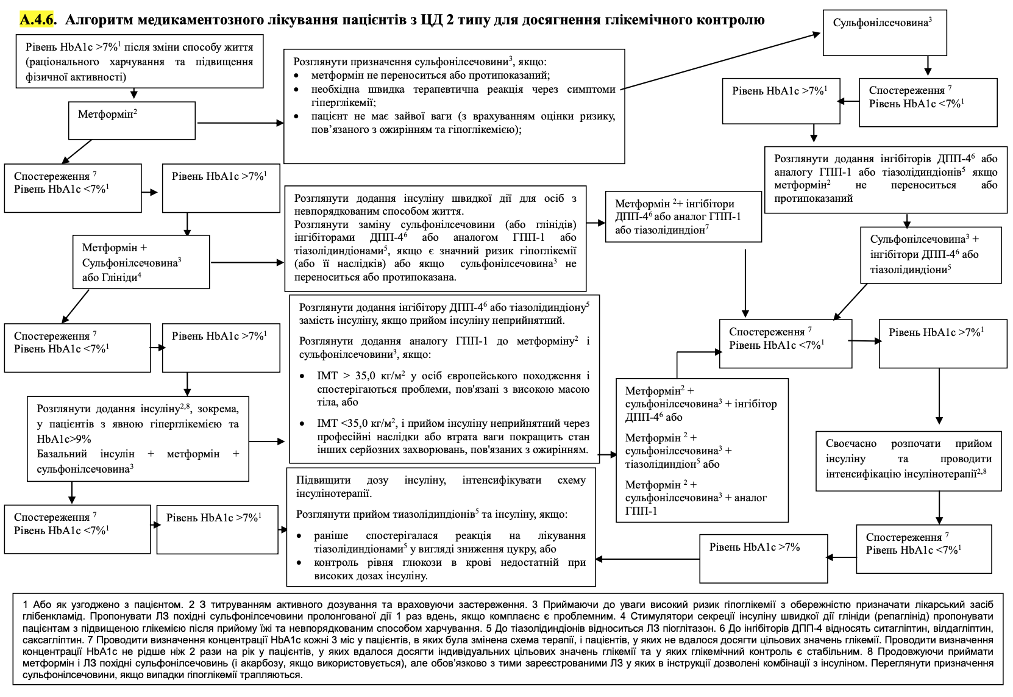

Slide 3
Intervention | Expected A1C reduction with monotherapy (%) | Benefits | Disadvantages
Initial therapy
Lifestyle changes to reduce weight and increase activity | 1.0 to 2.0 | Wide benefits | Inadequate for most patients due to loss and maintenance of body weight (BW)
Metformin | 1.0 to 2.0 | Does not affect body weight | Side effects from the gastrointestinal tract, contraindicated in renal failure (GFR <30 ml/min/1.73 m ² )
Additional therapy
Insulin (usually a single daily injection of intermediate- or long-acting insulin initially) | 1.5 to 3.5 | No dose limitation, rapid effectiveness, improved lipid profile | 1 to 4 injections per day, monitoring, increased MT, hypoglycemia, insulin analogs are expensive
Sulfonylurea (preferably short-acting drugs) | 1.0 to 2.0 | Fast and effective | Increased MT, hypoglycemia (especially when using glibenclamide or chlorpropamide)
GLP-1 receptor agonist (daily or weekly injections) | 0.5 to 1.5 | Reduction of MT, reduction of serious adverse cardiovascular events ( liraglutide , semaglutide , dulaglutide ) in patients with established cardiovascular disease and potentially for those at high risk of cardiovascular disease | Injections are required, gastrointestinal side effects are frequent, and treatment is expensive
Thiazolidinedione | from 0.5 to 1.4 | Improvement of lipid profile ( pioglitazone ) | Fluid retention, heart failure, increased MT, bone fractures, potential increased MI ( rosiglitazone ) and bladder cancer ( pioglitazone )
Glinide | from 0.5 to 1.5 | Fast and effective | Increase in MT, 3 times a day, hypoglycemia
SGLT2 inhibitor | from 0.5 to 0.7 | Reduction of MT, reduction of systolic blood pressure, reduction of cardiovascular mortality in patients with established CVD, improvement of renal outcomes in patients with nephropathy | Vulvovaginal candidiasis , urinary tract infections, bone fractures, lower limb amputations
DPP-4 inhibitor | from 0.5 to 0.8 | Does not get drunk on MT | It is possible to increase the risk of HF when using saxagliptin , an expensive treatment
Alpha-glucosidase inhibitor | from 0.5 to 0.8 | Does not get drunk on MT | Frequent gastrointestinal side effects, taking 3 times a day

Slide 4
No established cardiovascular or kidney disease
hb A1C >9 % – we offer insulin or a GLP-1 receptor agonist for initial therapy
hb A1C ≤9 % - in addition to insulin or GLP-1 receptor agonists include sulfonylurea, SGLT2 inhibitors ( sodium and glucose cotransporter 2 ) , DPP-4 inhibitors ( dipeptidyl peptase 4 ) , repaglinide or pioglitazone .

Slide 5
Indications for insulin therapy .
Indication for appointment insulin therapy in patients for the first time detected type 2 diabetes serves initial level HbA1c > 8.5–9% or impossibility achievement target for this the patient equal HbA1c at the maximum doses of the combination two or three PCZP. Timely start of insulin therapy for the first time allows the detected diabetes quickly and efficiently achieve target equal compensation hydrocarbon exchange and, according to experts American diabetic association and European study associations _ diabetes , in some in cases, transfer the patient to oral in the future hypoglycemic therapy through the removal of the phenomenon of glucose toxicity and the restoration of the secretory in this way activity insular device

Slide 6
Thank you for attention

