Slide 1
overweight and obesity . Definition. Epidemiology . Etiology . Classification . Diagnostics .

Slide 2
Overweight and obesity
" Conducting obesity » is used to describe improvements related with health , and not only results losses masses body (MT). If because of intervention observed weight loss , it should not be the only goal that does not count improvement of health and quality of life.
overweight determined in the case of BMI from 25 to 29.9 kg/m2. IS the need for isolation of this state, since he precedes development obesity and needs medicinal intervention
Behavioral therapy is intervention of changes behavior with the help of programs which help patients achieve their own behavioral goals in the industry health ( nutrition , physical activity , sleep, decrease stress etc. ) or protection health ( for example , improvement of quality of life, treatment obesity ).

Slide 3
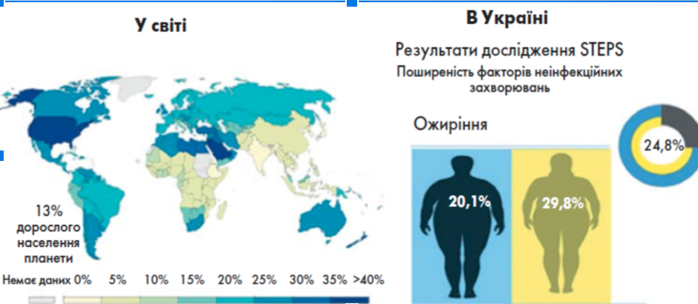
Epidemiology .

Slide 4
Etiology .
Drugs that cause weight gain
Hypothalamic surgery
Dietary obesity
Rules for feeding babies
Progressive hyperplastic obesity
Meal frequency
High fat diets
Overeating
Neuroendocrine obesity
Hypothalamic obesity
Hypothyroidism
Seasonal affective disorder
Cushing's syndrome
Polycystic ovary syndrome
Hypogonadism
Growth hormone deficiency
Pseudohypoparathyroidism
Drugs that cause weight gain
Hypothalamic surgery
Dietary obesity
Rules for feeding babies
Progressive hyperplastic obesity
Meal frequency
High fat diets
Overeating
Neuroendocrine obesity
Hypothalamic obesity
Hypothyroidism
Seasonal affective disorder
Cushing's syndrome
Polycystic ovary syndrome
Hypogonadism
Growth hormone deficiency
Pseudohypoparathyroidism

Slide 5
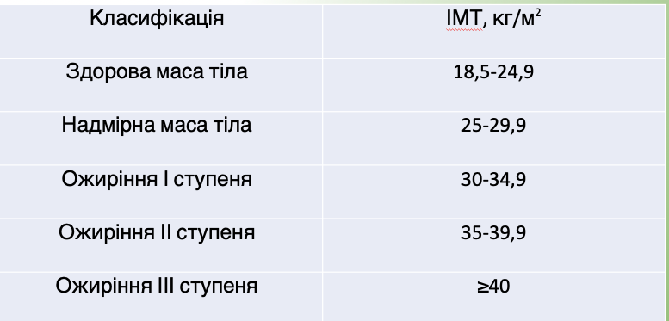
Classification .

Slide 6
Diagnostics
Necessarily rate :
• all available symptoms ;
• all underlying causes - overweight or obesity ;
• food habits ;
• the presence of any comorbidities ( for example , type 2 diabetes, hypertension, CVD, osteoarthritis, dyslipidemia , and apnea in dreams );

Slide 7
Diagnostics
• the presence of any factors risk identified during the assessment lipid profile ( preferably defined fasting ), blood pressure measurement and determination HbA1c;
• method life ( food and physical activity );
• all psychosocial stress ;
• all factors from the environment , society and family , including family anamnesis NadMT or obesity and comorbidities became

Slide 8
Thank you for attention

