Slide 1

Treatment of obesity in children.

Slide 2

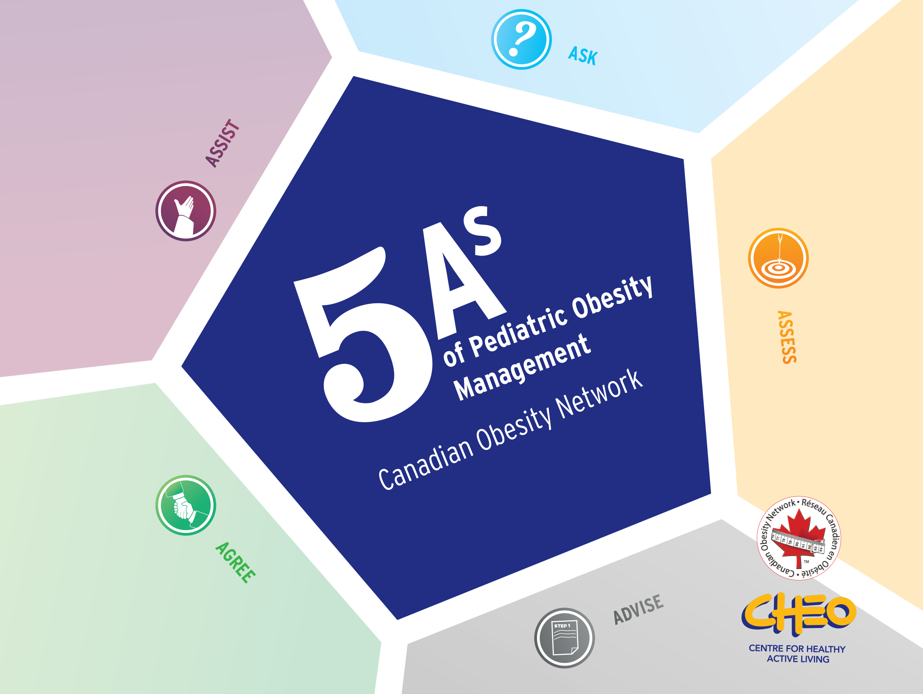

to ask
Help
5As Framework for
Obesity Management
Evaluate
Arya M. Sharma, MD/PhD, FRCPC
Scientific Director & CEO
Canadian Obesity Network
To agree
Advise

Slide 3


^{Basic principles}
Treating obesity is about improving health and well-being, not just reducing numbers on the scale
- Success in managing an overweight or obese child should be measured by changes in general health and improvement in overall health - how/what you eat, how you move and how you cope, not by numbers on a scale.
- Changes in the organization of daily life can lead to a significant improvement in health and well-being with little or no change in body weight.

Slide 4

^{Basic principles}
Prejudice toward hyperthyroidism or obesity can become an obstacle in the management of patients
A prejudicial attitude towards a child living with overweight or obesity can negatively affect self-esteem, quality of life and lead to social isolation.
Obese children are often victims of bullying and stigmatization.
Fear of judgment can prevent parents from seeking help from doctors.
Making assumptions about the family's not quite correct health behavior can lead to ineffective treatment of hyperthyroidism or obesity in a child .

Slide 5

^{Basic principles}
Support should include addressing the "root causes" of OVERBMT or obesity and removing barriers for families to make healthy changes
Managing an overweight or obese child requires identifying and eliminating the "root causes" of unhealthy weight gain and barriers to health and well-being.
Unhealthy weight gain can be the result of poor eating habits or reduced physical activity, which is the result of biological, psychological or socioeconomic factors.
Complications associated with hyperlipidemia or obesity (eg, sleep apnea, hypertension, hyperlipidemia , diabetes) can also pose significant barriers to patient management .

Slide 6

^{Basic principles}
A child's "best" BMI may never be his or her "ideal" BMI
An "ideal" BMI is not a realistic goal for many children with overweight or obesity, and setting unattainable goals can set children and families up for failure.
Obesity is often a chronic condition. A child's "best" BMI is achieved through sustained positive lifestyle modification.
Helping children and their families improve BMI and move toward body size acceptance is important.

Slide 7
Permission to discuss body weight is requested
Help in overcoming obstacles and barriers; education and resources; follow-up medical care
Assess obesity risks and potential causes of weight gain
Agree on a realistic plan for achieving results in lifestyle modification
Help - advice on obesity risk, discuss benefits and options

Slide 8


Ask permission to discuss the child's body weight
Overweight or obesity is a sensitive issue. Many children and parents may be confused or afraid of accusations and stigmatization, so "asking" is an important first step.

Slide 9
ASK
- be non- judgmental
- find out readiness for change
- use motivational interview in conversation with the family

Slide 10


ASK

Slide 11
Create a favorable environment for patients with Hyperthyroidism or obesity
ASK
- Services: wide doors, large toilets, floor toilets,
Weights: over 160 kg, available on wheels, located in a private area
Reception room: sturdy armchairs without arms, suitable reading material - no glossy fashion magazines
- Examination room: gowns are wide and sturdy couches, extra large blood pressure cuffs, longer needles, long-handled shoe horns

Slide 12


ASSESS obesity risk and potential “root causes” of weight gain

Slide 13
EVALUATE
- Assess the degree of obesity
- Assessment of obesity factors, complications and barriers
- Assess the main causes of weight gain

Slide 14
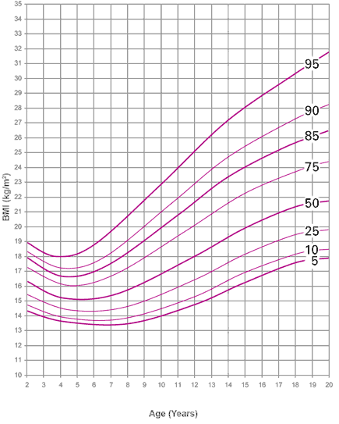
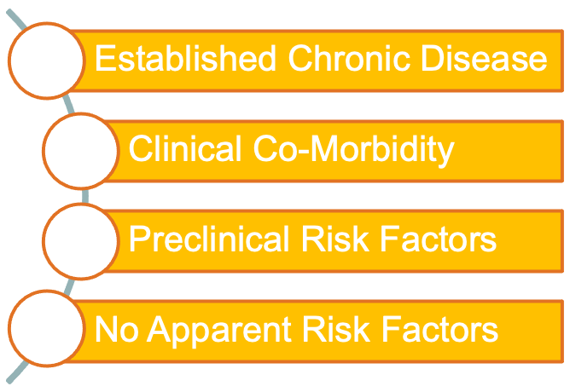
EVALUATE
Class adiposity
BMI for age percentiles
Stages of obesity ( EOSS-P *)
3
2
1
0
* Edmonton Obesity Staging System - Pediatrics

Slide 15
EVALUATE
mental
mechanical
Metabolic
Environment
Obstructive sleep apnea
Musculoskeletal pains
Gastroesophageal reflux disease
Enuresis
Fecal incontinence
skin diseases
Anxiety , depression, perception of one's own body, speech disorders, sleep disorders, eating disorders, injuries
Type 2 diabetes
non-alcoholic fatty liver disease
Dyslipidemia
Hypertension
Gallstone disease
PCOS
Parents
Health/disability
Stress in the family
Family income
Bullying
Attending school
School support

Slide 16
Etiology of childhood obesity
EVALUATE
Endocrine
Monogenetic
Genetic syndromes
Acquired
Central nervous system/hypothalamus
low growth rate
Hypothyroidism
Growth hormone deficiency
Cushing's syndrome
Occurrence of obesity after the age of 6 months
Increased appetite
Leptin deficiency
dysmorphic features
Neurocognitive assessment
Syndrome Pradera - Willy
Hypothalamic obesity
Increased appetite
reduction expenses energy
Hypopituitarism
normal or accelerated growth
intralesional effects

Slide 17


ADVISE about risks of obesity, discuss benefits and treatment options

Slide 18
ADVISE
- Counseling on the risks of obesity
- Explain the benefits of lifestyle modification
- Explain the need for a long-term strategy
- Advice on lifestyle modification options

Slide 19
Advise on family-based management options
ADVISE
Sleep
will significantly improve eating behavior, as well as mood and behavior at school
sitting behavior
should be limited by minimizing screen time, prefer active transport over motorized, increase active games and active family time
food behavior
you should focus on the hygiene of eating and drinking. Extreme diets are not recommended in the long term
mental health
detection of concomitant diseases. Interventions can improve self-esteem, reduce emotional eating.
physical activity
not to focus on "burned calories", but on increasing physical activity to improve physical fitness, general health and overall well-being
bariatric surgery

Slide 20


AGREE on a realistic, reasonable plan to achieve results

Slide 21
AGREE
Agree on a behavior change plan with the child and family
Agree on the goals of sustainable behavior and the results that the child will get

Slide 22
Agree on firm goals and outcomes
AGREE
- Focus on sustainable changes behavior , and not on specific ones targeted indicators masses bodies
- Objectives behavior must be INTELLIGENT:
- Specific
- Measurable
- Achievable
- Appropriate
- Timely

Slide 23
AGREE
- Unrealistic expectations for weight loss can lead to DISAPPOINTMENT and a decrease in MOTIVATION.
For some children, PREVENTION or SLOWING of weight gain may be the best goal.

Slide 24
Agree on a management plan
AGREE
- Management plans must be REALISTIC and SUSTAINABLE.
- Remember the need to set goals for both the teenager and the parents, as the goals may differ
- Management plans should CONSIDER factors influencing weight gain (eg, anxiety, sleep apnea, fatty liver disease, family history).
- TREATMENT SUCCESS should be measured in improvements in HEALTH and WELLBEING (eg, self-esteem, body image, sleep, physical activity, blood sugar, etc.).

Slide 25


HELP LIVE in solving obstacles and barriers; education and resources; follow-up medical care

Slide 26
HELP
- to families in identifying and solving the problems of obstacles and barriers
- provide education and resources
- contact the relevant specialist
- organize further actions

Slide 27
Organize follow-up
HELP
Given the chronic nature of obesity, LONG TERM cooperation is ESSENTIAL.
Success is directly related to the FREQUENCY of contact between the doctor and the patient.
Cycling and weight gain should not be seen as "failure" - rather, they are a natural and expected consequence of dealing with this chronic disease.

Slide 28
Resource
Canadian Obesity Network www.obesitynetwork.ca
2006 Canadian Clinical Practice Guidelines for the Treatment and Prevention of Obesity in Adults and Children CMAJ - April 10, 2007.
Best Weight - A Practical Guide to Managing Obesity in the Office, Doctors. Yoni Friedhoff and Aria Sharm
Childhood Obesity - Etiology, Pathogenesis, and Treatment Editor Michael Freemark
A cognitive behavioral book for weight management by Dr. Michelle Laliberte, Randy McCabe, Valerie Taylor

Slide 29
Resource
Motivational Interviewing in Healthcare Dr. Steven Rolnick, William Miller, Christopher Butler
Obesity Free Solutions for Kids by Dr. Miriam Voss
Eat Mindfully: How to End Mindless Eating and Enjoy a Balanced Relationship with Food by Dr. Susan Albers
200 Ways to Raise a Girl's Self-Esteem by Will Glennon
How to Talk to Teens So They Listen and Listen to Teens Talk by Adele Faber and Elaine Mazlish

Slide 30
WHAT TO DO AFTER ASSESSMENT OF ALL FACTORS AND WHAT HELP TO PROVIDE TO THE PATIENT

Slide 31
Children with excess body weight (BMI >85th to 94th percentile)
All children and their families should be counseled on healthy lifestyle modifications
The goal of treatment for such children is to maintain a reduction in the rate of weight gain (or to maintain a stable body weight after the completion of linear growth) and carefully assess the increase in BMI percentiles or the effect of other existing risk factors

Slide 32
Children with excess body weight (BMI >85th to 94th percentile)
Children with existing additional risk factors (eg, family history of type 2 diabetes, non-Caucasian race, and/or conditions associated with insulin resistance such as acanthokeratoderma, polycystic ovary syndrome, hypertension, or dyslipidemia) should be referred to more intensive ( detailed) consultations for structuring the algorithm for further weight loss. Some patients benefit from losing weight at a rate of no more than 0.9 kg per week to eventually achieve a BMI below the 85th percentile.
Changes in food stereotypes, eating habits and physical activity are the same as for children with BMI≥85th percentile.

Slide 33
Treatment of obesity in children with BMI > 95th to 99th percentile.
All children and their families should be counseled on healthy lifestyle modifications.
- in children aged 2-11 years, the goal of treatment is to maintain a stable level of body weight or to gradually reduce body weight at a rate of no more than 0.45 kg per month.
- In children aged 12 to 18 years, the goal of treatment is to reduce body weight at a rate of no more than 0.9 kg per month

Slide 34
Treatment of morbid obesity in children with BMI >99th percentile.
All children and their families should be counseled on healthy lifestyle modifications .
Treatment of a child with excess body weight or obesity can be considered only depending on age without detailing the gradation of BMI.

Slide 35
Treatment of morbid obesity in children with BMI >99th percentile.
- In the first 6 months of life, the choice of nutrition is exclusively breastfeeding.
-An obese child (2-4 years old) should have three meals plus 1-2 snacks each day (per day).
The goal of treatment for children aged 2-5 years is to reduce body weight at a rate of no more than 0.45 kg per month.

Slide 36
Treatment of morbid obesity in children with BMI >99th percentile.
- Obese children in the age group of 5–9 years should consume 3 main meals a day plus 1–2 snacks. Food groups should include 3 servings of protein per day, 1-2 servings of dairy products per day, and 4-5 servings of non-starchy vegetables per day.
For children aged 6-11 years, the goal of treatment is to reduce body weight at a rate of no more than 0.9 kg per month

Slide 37
Treatment of morbid obesity in children with BMI >99th percentile.
The goal of treatment is to reduce body weight at a rate of no more than 0.9 kg per month in the age group from 12 to 18 years. If the child does not show appropriate changes in body weight, the child should be referred to tertiary care for interventions that may include pharmacotherapy or bariatric surgery

Slide 38
Children with BMI≥85th to 94th percentile without other health risks
1st line – lifestyle change ± counseling
Children with BMI≥85th to 94th percentile without other health risks
1st line – lifestyle change + intensive consultations

Slide 39
Children with BMI>95th to 99th percentile
age 2-11 years
1st line – lifestyle change ± counseling

Slide 40
age 12-18 years
1st line – lifestyle change ± additional counseling – Drug treatment
Children with BMI>99th percentile
age 2-5 years
1st line – lifestyle change ± counseling
age 6-11 years
1st line – lifestyle change ± counseling
age 12-18 years
1st line – lifestyle change ± counseling
additionally – drug treatment
additionally - surgical operations

