Slide 1

Lecture №1. Theoretical foundations of "commodity science". Regulatory documentation in commodity analysis.
MINISTRY OF HEALTH OF UKRAINE
ODESSA NATIONAL MEDICAL UNIVERSITY
Department of Pharmacy Organization and Economics
Prepared by senior teacher Oksana Stepanova

Slide 2

The term "commodity science" comes from the words "commodity" and "to know" and means the purposeful activity of studying goods as objects of consumption.
The product's ability to satisfy specific needs determines its consumer value.
It follows from the definition of the product that the product of labor became a product with the beginning of the development of production and money circulation and, accordingly, was endowed with value, the form of monetary expression of which is the price in a monetary unit.

Slide 3
Consumer value is a property, the ability of a product to satisfy certain needs of people either as an object of personal consumption or as a means of production.
For example, a person has a need to be healthy, this need is satisfied in various ways: you can not have bad habits (smoking, drinking alcohol, etc.), you can run in the morning, you can take vitamins, that is, lead a healthy lifestyle.
However, when a person gets sick, the need for health can only be met with the help of various medical interventions, treatment procedures and medicines.

Slide 4
Consumer value is a property, the ability of a product to satisfy certain needs of people either as an object of personal consumption or as a means of production.
For example, a person has a need to be healthy, this need is satisfied in various ways: you can not have bad habits (smoking, drinking alcohol, etc.), you can run in the morning, you can take vitamins, that is, lead a healthy lifestyle.
However, when a person gets sick, the need for health can only be met with the help of various medical interventions, treatment procedures and medicines.

Slide 5

Consumer value is a property, the ability of a product to satisfy certain needs of people either as an object of personal consumption or as a means of production.
For example, a person has a need to be healthy, this need is satisfied in various ways: you can not have bad habits (smoking, drinking alcohol, etc.), you can run in the morning, you can take vitamins, that is, lead a healthy lifestyle.
However, when a person gets sick, the need for health can only be met with the help of various medical interventions, treatment procedures and medicines.

Slide 6

Consumer goods are products that people buy and do not use to make other things that are then sold. They are also called final goods because when somebody buys them, they have reached their final destination.
Consumer goods are the end result of manufacturing and production. All the food and drink that we purchase in the supermarket, all medicines and medical things that we purchase in the pharmacy, for example, are consumer goods.
Consumers are people or other entities that buy goods or services. Consumers do not sell what they bought – they ‘consume’ them.
Goods are products. We exchange money, for example, for goods and services.

Slide 7

Consumer goods vs. capital goods
Capital goods
Capital goods are things that businesses buy to make other things. These type of goods last a long time, i.e., they are durable.
Pharmaceutical machinery, vehicles, and computers, for example, are capital goods.
Consumer goods
We do not buy consumer goods to make something else that we aim to sell. These goods satisfy personal needs and not the needs required for the production of other products.

Slide 8
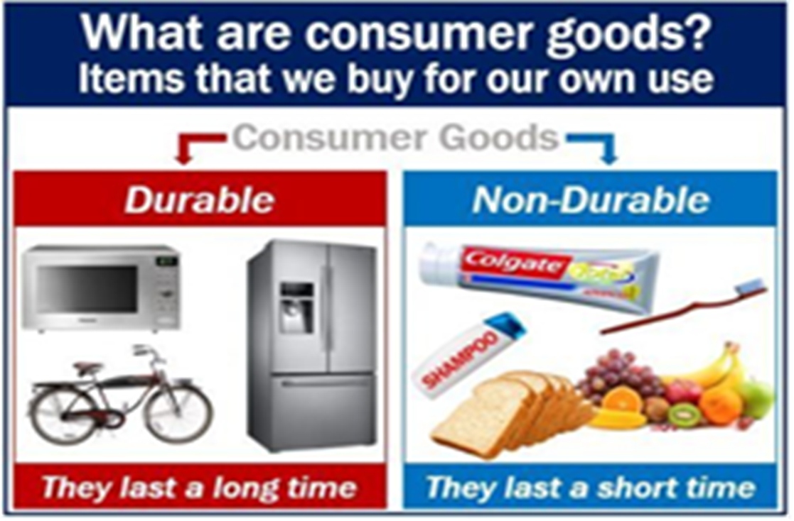
Consumer goods vs. capital goods
Three types of consumer goods
Consumer goods are classified into three categories:
Durable goods.
Non-durable goods.
Services

Slide 9
Durable and non-durable goods
Durable goods are things that last a long time. Medical instruments and devices (glucometers, tonometers, thermometers), refrigerators, for example, are durable goods. We do not buy them every week or every month.
Non-durable
We all buy food and drink on a regular basis. We buy bread, for example, usually at least once a week. Bread is a non-durable good. Medical preparations, dressings, things for personal hygiene, and food, for example, are non-durable goods.
If something is non-durable, it means that it does not last for a long time.

Slide 10
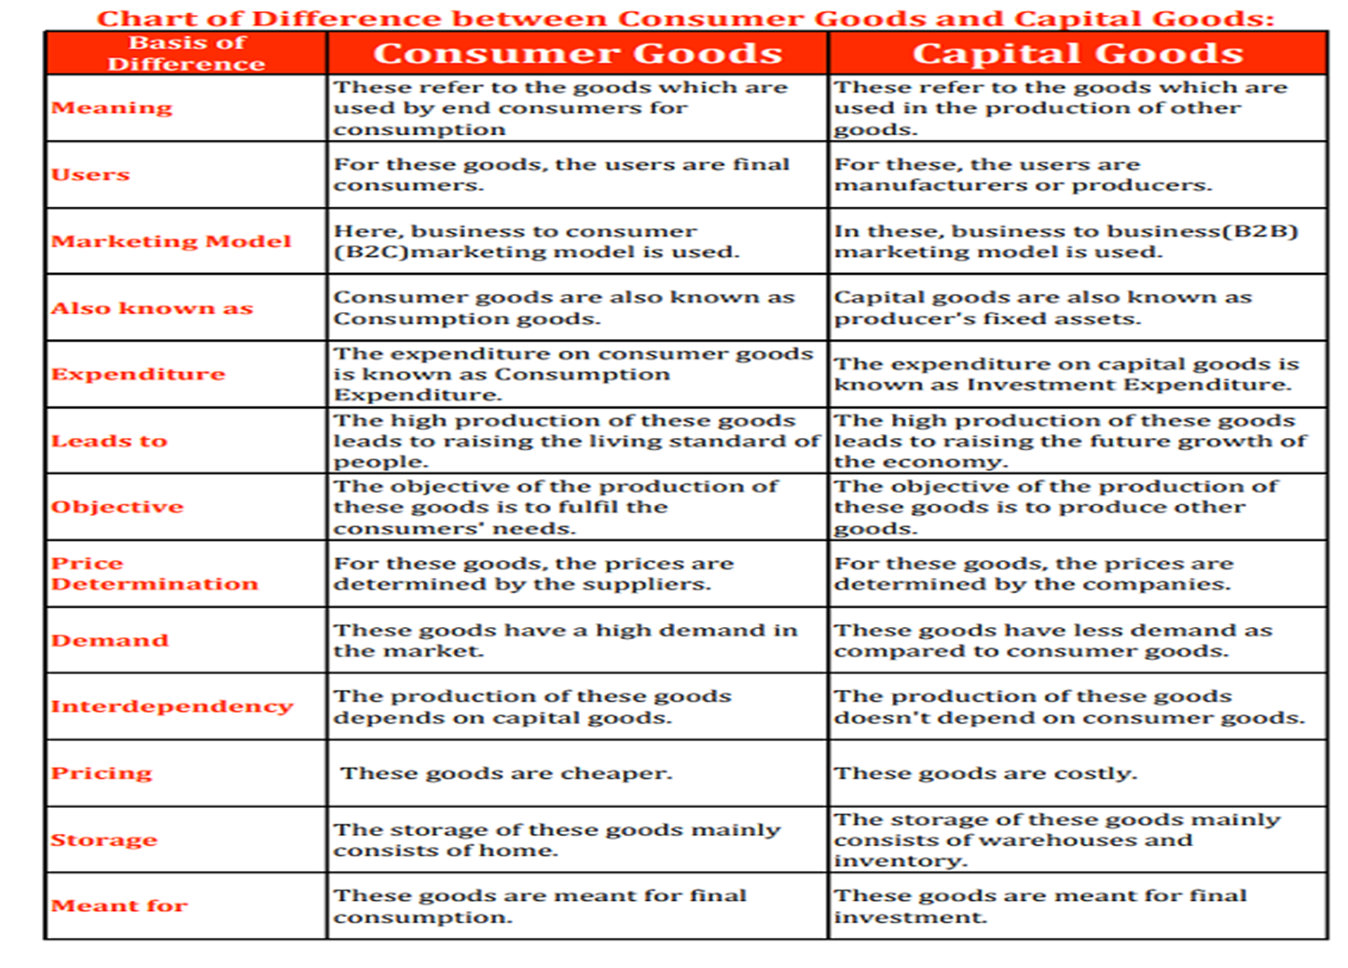

Slide 11

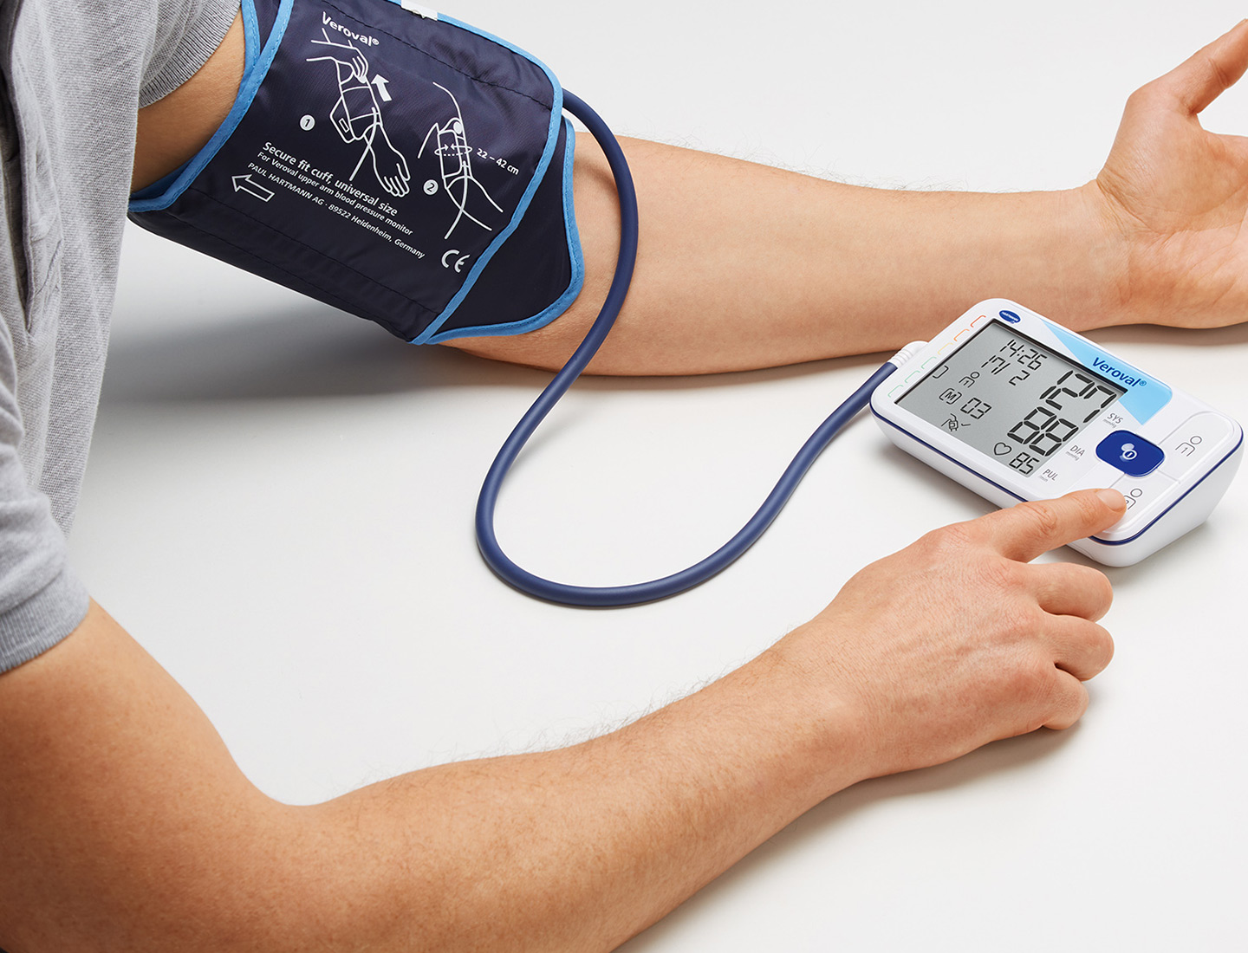
Essential pharmaceutical services :
delivery of medications
medication counseling
written medication information
blood pressure monitoring
blood glucose monitoring
osteoporosis screening
immunization

Slide 12


Slide 13

Normative documents
Normative documents consist of the broad category of documents that provides rules, guidelines or characteristics for activities or their results.
In the ESS context three types of normative documents exist: legal acts, standards, other normative documents.
In this context a “document” means any medium with information recorded on or (not necessarily in the form of document) in it e.g. guidelines, methodologies, algorithms, IT specifications, software, services, models, templates, codes lists, legal acts, vocabularies, checklists etc.

Slide 14

Product Standardization
One of the main roles in solving quality issues is played by standardization, which is an effective way to ensure the quality of products and services.
Product standardization is the process of setting generally uniform characteristics for a particular good or service.
Product standardization provided by different businesses operating in technology-based industries can be useful for consumers since it permits competition among the various suppliers.

Slide 15
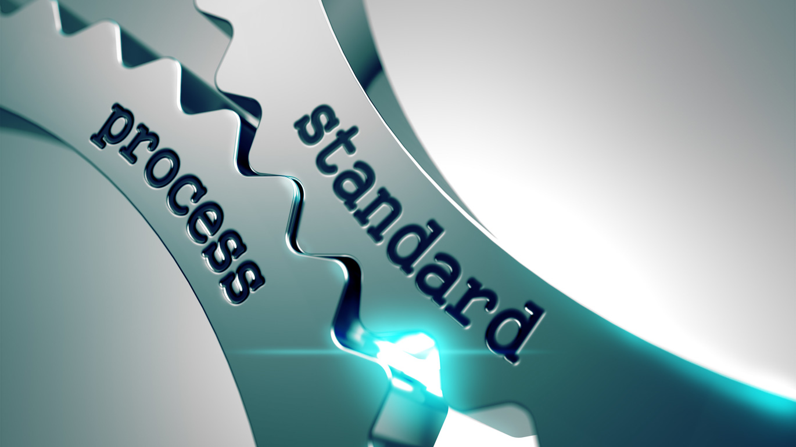
Standardization and certification have undergone a continuous development in recent years, closely related to the development of the specific legislation.
The term “standard” has been used related to characteristics (dimensions, forms, physical or chemical properties, etc) of products as well as related to the conditions for safety at work or to the skills of employers and good behavior of people.
The significance of the term “standard” used to be: a generally accepted document that provides rules, guidelines or characteristics for activities or their results, whatever the provider of the document is (tradition, a manufacturer, a governmental authority or a standardization association).

Slide 16

The first standards appeared during the Industrial Revolution with the need to make interchangeable part and dealt with sizes for screws, nuts bolts and other threaded fasteners, then pipe sizes or shoe size. In the late 19th century safety standards appeared, prepared by governmental authorities in United States of America and England. At the beginning of the 20th century standardization organizations have been formed.
In the late years, in order to avoid misunderstanding, the international standards organizations made efforts to establish a clear terminology making the difference between the rules depending the provider, as:

Slide 17
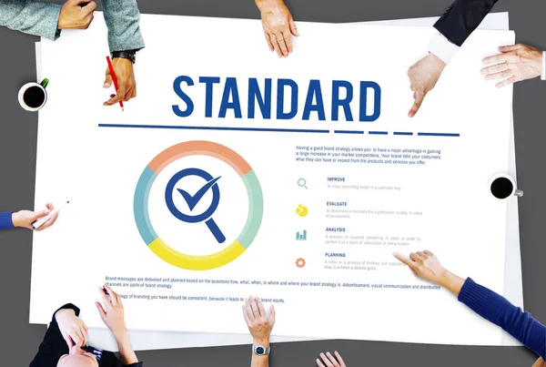
Standard - ‘document, established by consensus and approved by a recognized body, that provides, for common and repeated use, rules, guidelines or characteristics for activities or their results, aimed at the achievement of the optimum degree of order in a given context’.
Standards have public availability and should be based on the consolidated results of science, technology and experience, and aimed at the promotion of optimum community benefits.

Slide 18

Normative document - ‘document (any medium with information recorded on or in it ) providing rules, guidelines or characteristics for activities or their results; it covers standards, technical specifications, codes of practice and regulations’;
Technical specification -document prescribing technical requirements to be fulfilled by a product, process or service; it may be a standard, a part of a standard or independent of a standard’;

Slide 19
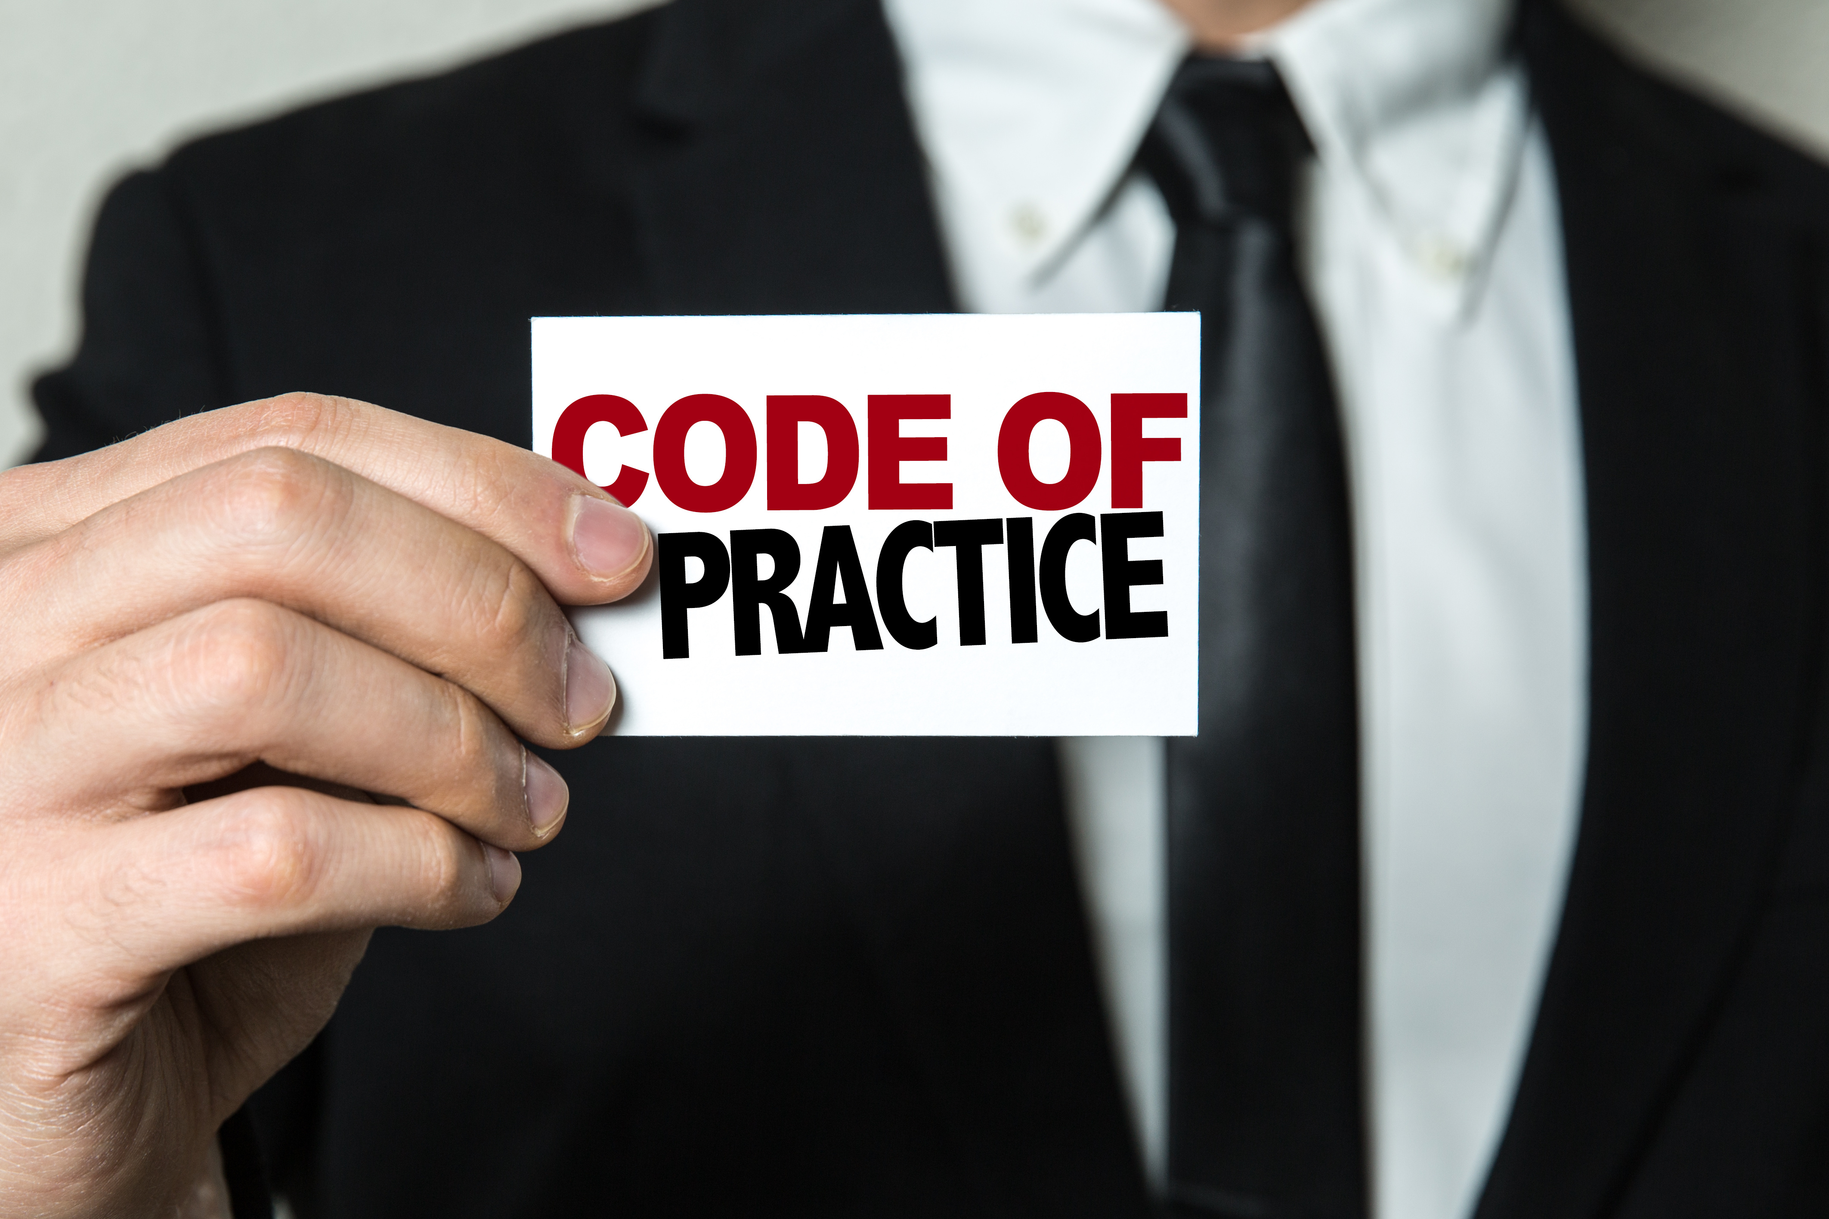
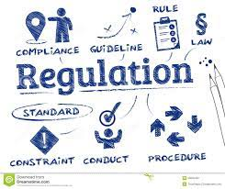
Code of practice- ‘document that recommends practices or procedures for the design, manufacture, installation, maintenance or utilization of equipment, structures or products; it may be a standard, a part of a standard or independent of a standard’;
Regulation- ‘document providing binding legislative rules, adopted by an authority’;

Slide 20
Standardization consists in activity of ‘establishing, with regard to actual or potential problems, provisions for common and repeated use, aimed at the achievement of the optimum degree of order in a given context’.
In particular, the activity consists of the processes of formulating, issuing and implementing standards..
The subject of standardization can be any topic to be standardized, meaning any material, component, equipment, system, interface, protocol, procedure, function, method or activity; the phrase ‘a product, a process or a service’ is usually used. Standardization can cover different fields: engineering, pharmacy practice, transport, agriculture; quantities and units.

Slide 21
Standardization consists in activity of ‘establishing, with regard to actual or potential problems, provisions for common and repeated use, aimed at the achievement of the optimum degree of order in a given context’.
In particular, the activity consists of the processes of formulating, issuing and implementing standards..
The subject of standardization can be any topic to be standardized, meaning any material, component, equipment, system, interface, protocol, procedure, function, method or activity; the phrase ‘a product, a process or a service’ is usually used. Standardization can cover different fields: engineering, pharmacy practice, transport, agriculture; quantities and units.

Slide 22

What is the Difference between Standards and Standardization?
With these two terms now defined we can see clearly how they work together and how they are different.
A standard is considered to be the "best way" of performing something while standardization is the process by which the standard is established and improved upon.

Slide 23


Slide 24
Objectives and application
Standardization may have one or more specific aims, to make a product, process or service fit for its purpose, comprising but not restricted to:
▪ variety control or variety reduction, meaning the selection of the optimum number of sizes or types of products, processes or services to meet prevailing needs;
▪ usability;
▪ compatibility, suitability of products, processes or services for use together under specific conditions, without causing unacceptable interactions;
▪ interchangeability or the ability of one product, process or service to be used in place of another to fulfill the same requirements; it may be “functional interchangeability”, or “dimensional interchangeability”;

Slide 25
Objectives and application
health;
safety = freedom from unacceptable risk of harm;
protection of the environment;
product protection against climatic or other adverse conditions during its use, transport or storage;
mutual understanding, achievement of an easier communication, facilitation of processes and tasks;
economic performance;
trade.

Slide 26
A standard is used by companies or authorities as references in order to:
prove, towards the customers, a certain level of quality /the performances of a product;
ensure compatibility, allowing the new product to be used by the consumers in connection with others owned product;
ensure interchangeability;
improve efficiency to handle people, their interactions, cases, modernization, bureaucratization, homogenization, and centralization of society (in social sciences, when establishing criteria for diagnosing mental disease);

Slide 27
enable organizations to focus their attention on delivering excellence in customer service, whilst providing recognition of success through a third party organization;
demonstrate the compliance with the regulations.
Standardization improves the suitability of products, processes and services for their intended purposes, prevents the barriers to trade and facilitates the technological cooperation. In European Union, it is considered that standardization can make an important contribution to the development of sustainable industrial policy, unlock the potential of innovative markets and strengthen the position of European economy by capitalizing more efficiently on its knowledge basis.

Slide 28
Levels of Standards
The geographical, political or economic extent of involvement in standardization process leads to the levels of standardization given in Table 1.
Each level is coordinated by a standardization organization, gathering interested parties from the relevant region: individual manufacturers and users/ consumers or professional organizations, trade-unions, representative of research institutes or testing laboratories , public authorities, certification bodies etc.

Slide 29
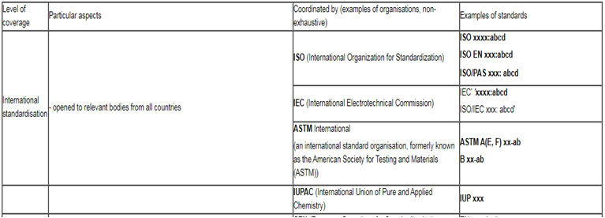

Slide 30
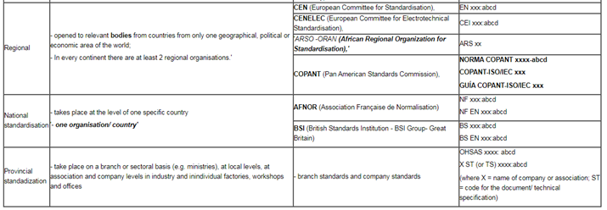

Slide 31

ISO (International Organization for Standardization) is the world's largest developer and publisher of International Standards. ISO is a non-governmental organization, including 163 countries national standardization organizations (one member per country), with a Central Secretariat in Geneva, Switzerland.
https://www.youtube.com/watch?v=YBx8Nw0GxtQ
Other international organizations, governmental and non-governmental, in liaison with ISO also take part in the process of elaboration of new standards. ISO has developed over 19,000 International Standards. Over 1,000 new ISO standards are published every year.

Slide 32

CEN (The European Committee for Standardization is the major provider of European Standards and technical specifications and the only European organization recognized, according to European Directive 98/34/EC.
In general, each country or economy has a single recognized National Standards Body, which is the sole member in ISO, as well as in CEN.
A National Standards Body may be either public or private sector organizations, or combinations of the two. The national standardization includes a process of adoption of international or regional standards, as well as a process of development of new, specific standards.

Slide 33
Types of Standards and Other Normative Documents
Each standard is identified by a code composed by groups of letters specific to the standards organization (see table 1) and a unique numeric index, followed by the year of approval.
The normative documents can be classified taking into account:
the level of standardization (see above);
the process of standardization;
the content, the subject of standardization;
the way of implementation.

Slide 34
Depending on the process of standardization, the documents established by the international standards organizations (ISO, CEI) as well as by CEN are delivered as:
- Standard – document issued when the process of standardization respects all the established rules;
- Publicly Available Specification (eg. ISO/PAS) - a document representing the consensus of a working group, which have been approved by the simple majority of the members of the Technical Committee; usually, it is a consultative document, giving more solutions;
-

Slide 35
Technical Specification (e.g. ISO/TS ) - a pre-standard, submitted to a simplified vote procedure in a Technical Committee which contains technical requirements for innovative technology or various alternatives which need to coexist in anticipation of future harmonization;
Technical Report (e.g. ISO/TR 10017) - a document that has not the content of a standard, prepared when it is considered urgent to give additional information or advise on a subject and submitted to a simplified vote procedure in a Technical Committee;
Guide - a document providing rules, orientation, advice or recommendations relating to European standardization (e.g.: information or guidance on matters of conformity assessment in relation to the standardization activities).

Slide 36
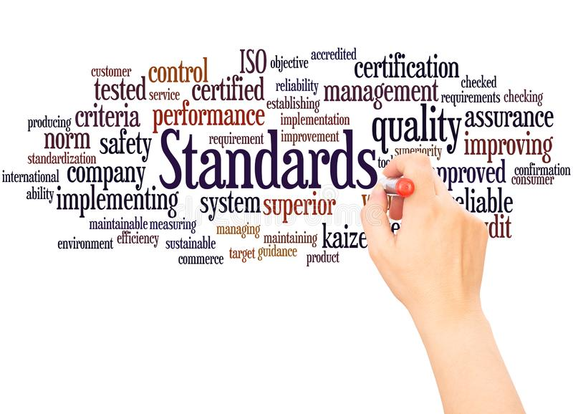
Following the subject of standardization,
the standards can be classified, for example, in:
Basic standard
Terminology standard
Testing standard
Product standard
Process standard
Service standard
Safety standards
Environmental standard
Interface standard
Standard on data to be provided
https://www.youtube.com/watch?v=yUvUTK4wvR4

Slide 37


