Slide 1
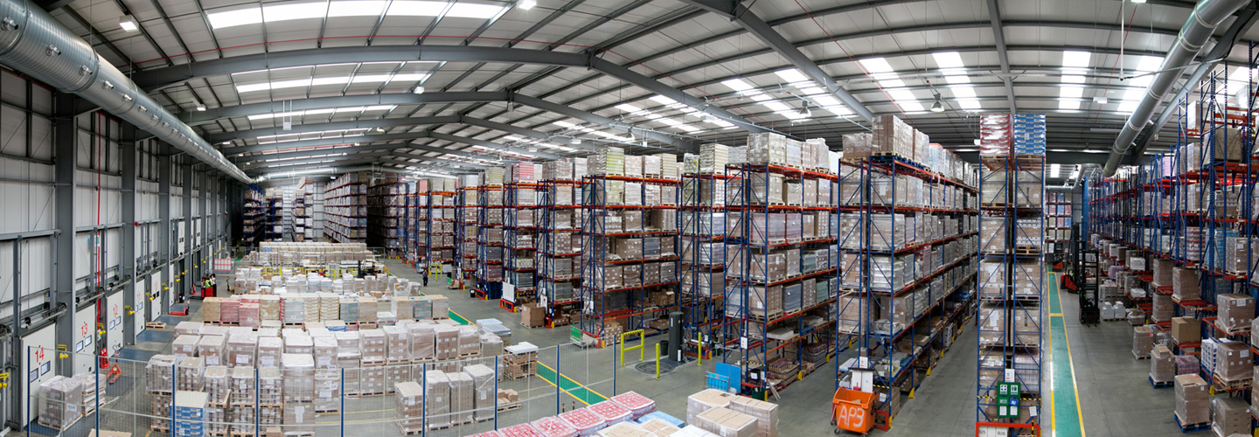
Lecture № 8. Acceptance of goods to the pharmacy warehouse.
MINISTRY OF HEALTH OF UKRAINE
ODESSA NATIONAL MEDICAL UNIVERSITY
Department of Pharmacy Organization and Economics
Prepared by senior teacher Oksana Stepanova

Slide 2
According to the resolution of the CMU dated 30.11.2016 No. 929 "Aboutapproval Licensingwas able toproceedings economic activitywithproduction medical means,wholesaleandretail trade medicinal means,import medical means(except active pharmaceutical ingredients)",
wholesale trade medicinal means -activitywithacquisition medical meansinmanufacturers medical means or others subjects management,what have appropriate license,storage,transportationand salemedical meanswithpharmacy made up(Base)others subjects wholesale or retail trade medicinal means,which receivedonit corresponding license,manufacturers medical means,directly therapeutic and preventiveinstitutionsor legalpersonsstructural subdivisions whose therapeutic and preventiveinstall;

Slide 3
As a resultimplementation strategies integrationin the EU inUkrainebecameassertiononlegislative levels leadership"Medicinal means.Properpracticedistribution"ST-N MOZU 42-5.0: 2008,approvedby order of the Ministry of Healthof Ukraine kind16.02.2009 No. 95.Let's consider concept"distribution"and"distributor".

Slide 4
As a resultimplementationstrategies integrationin the EU inUkrainebecamestatementsonlegislative levels leadership"Medicinal means.Properlypracticedistribution"ST-N MOZU 42-5.0: 2008, APPROVED by resolutionCabinet Ministersby order of the Ministry of Healthof Ukrainedated February 16, 2009 No. 95.Let's consider Concept"distribution"and"distributor".

Slide 5
Characteristicwholesale pharmaceutical enterprises
Atall similarities market activity wholesale pharmaceutical firms, intheir organizationalstructuresare observed certain disagreements,what conditions classification differences mediators. First of all,difference is definedformproperty.

Slide 6
INUkraine are functioning:
state;
communal;
collective;
Private wholesale pharmaceutical enterprises;
Firm partial foreign investment;
Firm one hundred percent foreign investment.

Slide 7
wholesale mediators you can divideonsuch groups:
1. Nationalwholesale pharmacists-tic firm,whichbyterritorial representation,branches,pharmacy make up,brandedpharmaciesconstantly are developingAlleconomic regions countries(East,West, center,North,South)
2.Interregional firm,whichbyyour structural subdivisions constantly are presentinseveral regions state.

Slide 8
3.Regional firms, which, through their structural subdivisions, constantly work within a separate region.
4.Local firms, which have only basic structural subdivisions and which operate permanently within one or more regions.

Slide 9
Allocatethree main areas of specialization:
- according to the specifics of the supply subjects (foreign and/or domestic producers and/or other intermediaries, large and/or small producers, etc.);
- according to the specifics of the predominant sales of certain groups of medicines (specialization with insulins, antibiotics,oncopreparations, dermatological and cosmetic products, etc.);
- according to the specifics of buyers (pharmacies and/or medical and preventive institutions).

Slide 10
II. Tasks and functions of pharmacy warehouses (bases).
Pharmacy warehouse (base)- a health care institution, the main task of which is to provide medicines to other subjects of wholesale or retail trade, health care and medicine manufacturers.byits implementation of wholesale trade.

Slide 11
Pharmacy warehouses (bases) perform two functions:
Trading(Performance of wholesale sale of drugs, IMN, other pharmaceutical products);
Informational(Information support of trade and intermediary activities in the pharmaceutical market).

Slide 12
The structure of the pharmacy
Production premises:separate premises, areas or areas for receiving and storing medical supplies and their release/shipping, auxiliary materials and containers with a total area of ​​at least250 square metersProduction areas include premises (areas) in which pharmaceuticals are received and stored, premises (areas) for assembly and release/shipping of pharmaceuticals (forwarding), premises (areas) for storage of auxiliary materials and containers, quality control of pharmaceuticals, storage of quarantine products.

Slide 13
Householdrooms.
The minimum set of household premises includes: staff premises (0.75sq.m per employee of one work shift, but not less8sq.m), a toilet, where there is a water pipe, sewage system (forcalculation, but no less2sq.m). The household premises also include: a toilet, a shower room, a room forreceptionfood (canteen), etc.

Slide 14
Auxiliary premises
The minimum set of auxiliary premises includes rooms or cabinets for storing cleaning items with an area of ​​no less than4sq.m. Auxiliary premises also include: rooms for preparing disinfectant solutions, operator room, archive, server room, security rooms, study rooms, room for storing work tools for loading and unloading work, etc.

Slide 15
Office premises
The office premises include: premises for the preparation and processing of accompanying documentation, the office of the manager, the office of the deputy manager, rooms of personnel involved in the technological process: processing of claims and complaints, returns, preparation of documents for the execution of processesreception, assembly and release/shipment of products, premises (zones) for technological equipment of automated warehouses, etc.

Slide 16
Additional premises
Additional premises include: corridors, vestibules, stairwells, elevator shafts,electrical panel, boiler rooms,vent cameras(Mines), etc.

Slide 17
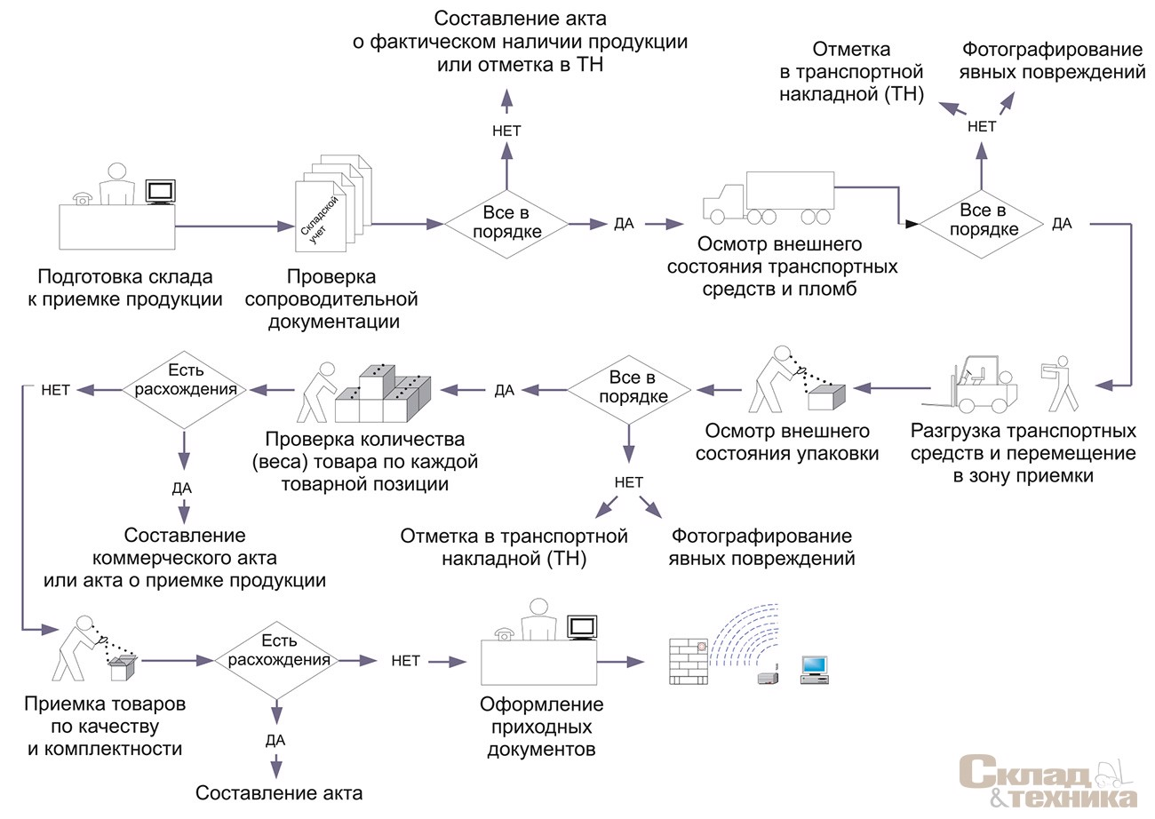
Creation of the admission committee

Slide 18
Algorithm for conducting visual control of packages of pharmaceuticals and alcoholic beverages by an authorized person without opening the package (1, 2, 3, 4) and with opening the package (1, 2, 3, 4, 5)
5. Inspection of the appearance of pharmaceuticals and pharmaceuticals with the opening of the packaging:
- Color (uniform, uneven);
- Form, aggregate state;
- absence of visible mechanical impurities in liquid medicines;
- transparency;
- the number of units in the package;
tablets:- Smoothness of the surface;
- the uniformity of the coating in the presence of a shell, the presence of a chamfer, engraving and dividing lines;
soft drugs:- Absence of rancid smell, physical instability (delamination); - homogeneity;
suspension:- The sediment present must quicklydisperse, forming a homogeneous state;
tinctures:- transparency,
- The presence of a slight sediment that settles upon standing;
Drugs for parenteral use:
- transparency, color;
- Absence of visible impurities.
Packaging of pharmaceuticals and pharmaceuticals
1.Audit group,secondary
andprimarypackaging:
- integritys;
-absencevisibleinjuries;
- quality of packaging materials;
- Availability of instructions for medical use;
- size of packaging and containers;
- Absence of extraneous sounds when turning the package in the hands.
2. Clogging check:
- tightness;
- The integrity of the protection of the first autopsy.
4. Checking the labeling of primary and secondary packaging:
- the language of packaging labeling and instructions available to the consumer;
- Having a registration number of Ukraine;
- conformity of the name of the medicinal product on the packaging in the manufacturer's quality certificate;
- correspondence of series numbers and expiration dates on the package, in the instructions and the manufacturer's quality certificate;
- storage conditions;
- Special warnings.
3. Checking the appearance medicinal product
without opening the package:
- Color;
- Form;
-aggregate state.

Slide 19
The results of testing the packaging of pharmaceuticals and pharmaceuticals
deviations
not found,
the test result is satisfactory
Medicinal products suspected to be falsified orsubstandard
Resultunsatisfactory
Selection of the necessary number of samples of medicinal products (an act of selection of samples of medicinal products for laboratory quality control is drawn up) and referral to the laboratory of the State Inspection (an urgent notification to the territorial state inspection for quality control of medicinal products is drawn up)
Issuance of the acceptance certificate
Carrying out control with the opening of the package
Selection of the necessary number of drug samples (the act of selection of drug samples for laboratory quality control is drawn up) and referral to the State Inspection laboratory (urgent notification to the territorial state inspection for drug quality control is drawn up)
Permission to implement
Issuance of an act of non-compliance and resolution of the issue of returning a series of medicinal products to the supplier
Prohibition of the sale of medicinal products until the result of the inspection is obtained
State Inspection

Slide 20

Order of the Ministry of Health No. 677 "AboutapprovalControl orderquality medical means underhourwholesaleandretail trade»
Ordercarrying out incomingcontrolquality medical means,which are comingtosubject management,what conduct economic activity with wholesale trade medicinal means:
1)to purchase and receive medical means trace onlyinsubjects management,which have licenseonproceedings economic activity with production medical means,wholesale trade medicinal means,import medical means.Copysuchlicenses are addedtocontractsaboutsupply(forsuppliers-residents)and are storedinsubject management for three years;

Slide 21

2)inputcontrol is carried out inplace acceptance products.received series medical means shouldpassinputCONTROLauthorizeda person Toreceiving kind authorizedindividualswritten conclusion incomingcontrolquality trade received medicinal means is prohibited;

Slide 22
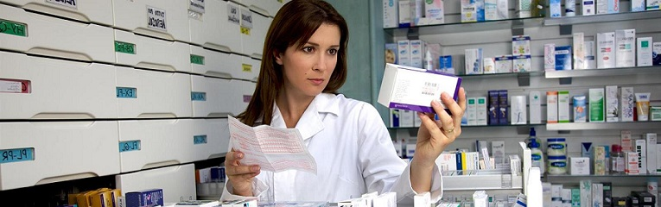
3)authorizedpersonchecks conformity acquired medical means accompanyingdocumentsof quantity,dosage,rooms series,terms suitability,registrationstatus,name,medical forms,manufacturer.Skin series medical meansguiltyto be accompanied copies certificate quality,what appears the manufacturer,conclusionaboutquality importedinUkraine medicinal tool(formedical means foreign production),conclusionaboutconformityMIBPrequirements state and state and international standards(formedical immunobiological drugs),certifiedsealthe last supplier;

Slide 23
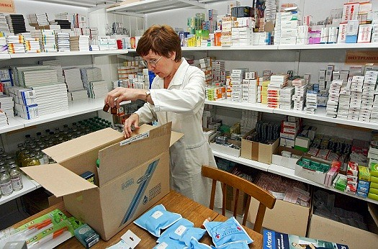
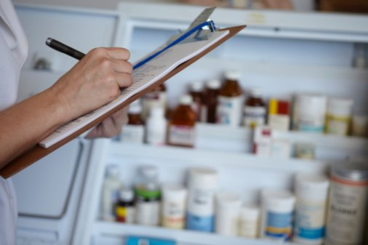
4)groupcontainer,external(secondary) andinternal(primary) packaging,marking,instructionformedical application medicinal tool,external appearancewithoutdisclosurepackagingare checkedonintegrity,homogeneity,availability damage,quality packaging materials. Atneed medical means are checked with disclosurepackagesof sizes,forms,color,homogeneity,quantity unitsinpackaging,availability pollution;

Slide 24
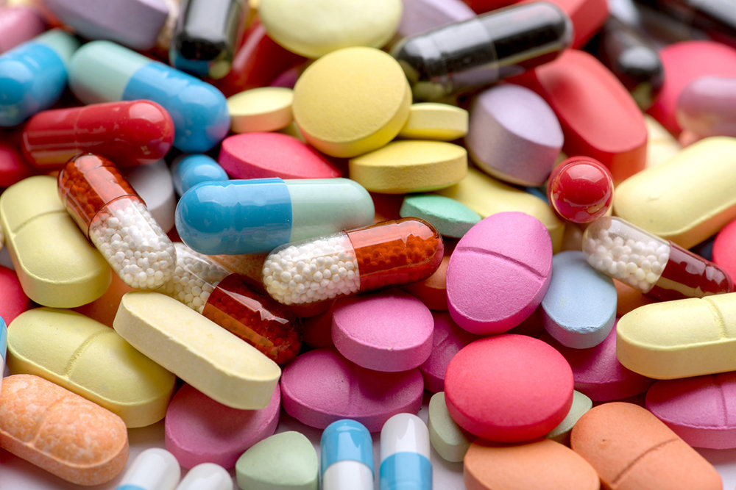
5) when positiveas a result incomingcontrolauthorizedpersongives permissiononoutput(implementation)acquired series medical means;
6) when negativeas a result authorizedpersonmakes upthe act ofdiscovered defects,which is basisforreturn party supplier;
7) incase occurrence doubt of quality medical meansatperformance visualcontrolauthorizedpersonselects samples doubtful medical meansanddirects theirtoterritorialbody of the central bodyexecutive authorities,which implements state politicsin areas of controlqualityandsecurity medical means. Per hourcarrying outsuchof researchto the residualsolution questionabouttheir quality series doubtful medical means areinspecially allocated,clearly determined,marked quarantine zone(indoors),separately kind another products,with designation"Quarantine"from indicationreasonswithdrawal with turnoverandgive moving.

Slide 25
Organization of storage of medicines and medical products

Slide 26
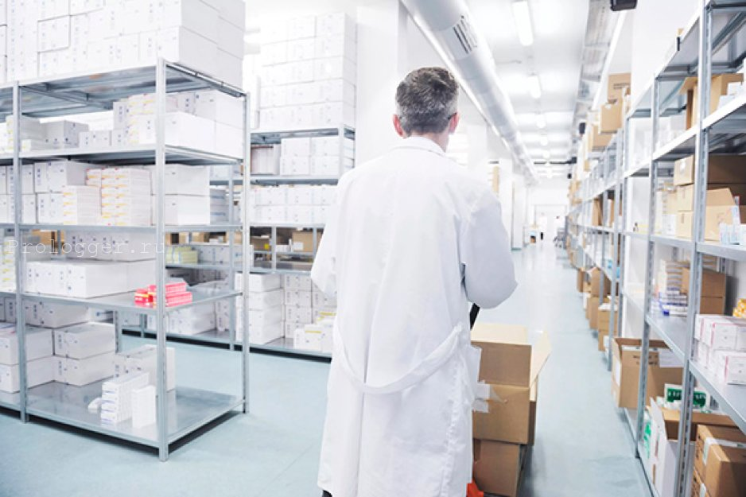
The high quality of pharmaceutical products is ensured by strict compliance with the requirements of regulatory documentation (AND, regulations,GOSTs, TU, SOU), production control and implementation of preventive measures:
proper storage of raw materials, semi-finished products, water of purified finished products;
compliance with instructions regarding the sanitary regime;
compliance with technological instructions;
compliance with packaging instructions;
ensuring the serviceability of technological equipment;
ensuring the accuracy of devices (calibration and verification).

Slide 27
General requirements for premises and equipment
The pharmacy base (warehouse) must have:
production premises for:
taking medicines
storage of different groups of medicinal products taking into account their physico-chemical properties and the effect of various environmental factors on them
containers
medical products
pharmaceutical products
configuration
leave of production (expedition)
office premises:
a staff room equipped with a wash basin
premises for storing household equipment
toilet.

Slide 28
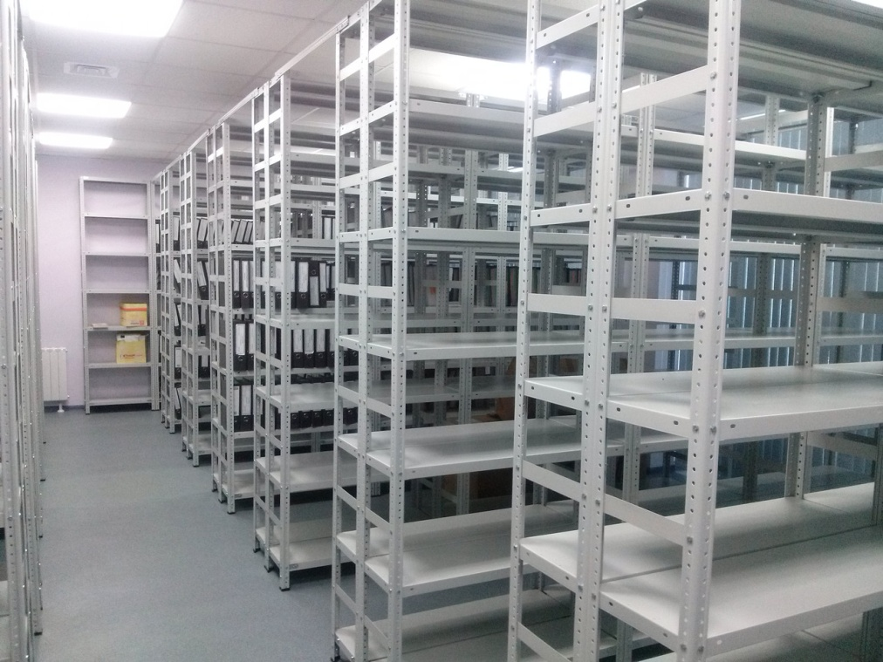
Installation of shelves and cabinets for the storage of pharmaceutical products is carried out in such a way that they are placed at a distance:
from the outer walls - 0.6-0.7 m
from the ceiling - not less than 0.5 m
from the floor - not less than 0.25 m.

Slide 29
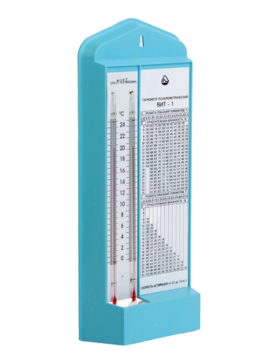
Warehouses must be equipped with thermometers and hygrometers, which are attached to the inner walls of the warehouse away from heating devices at a height of 1.5-1.7 m from the floor and at a distance of at least 3 m from the door. A temperature and relative humidity record card must be kept in each room. Control devices must be calibrated and tested.

Slide 30
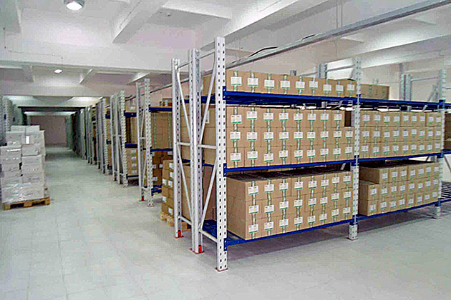
The sanitary condition of the premises and equipment of the pharmacy base (warehouse) must meet the current requirements. The floor is washed at least once a day, the walls and doors are cleaned at least once a week with the use of disinfectants, the ceiling is cleaned of dust once a month. The equipment is subject to daily assembly.

Slide 31
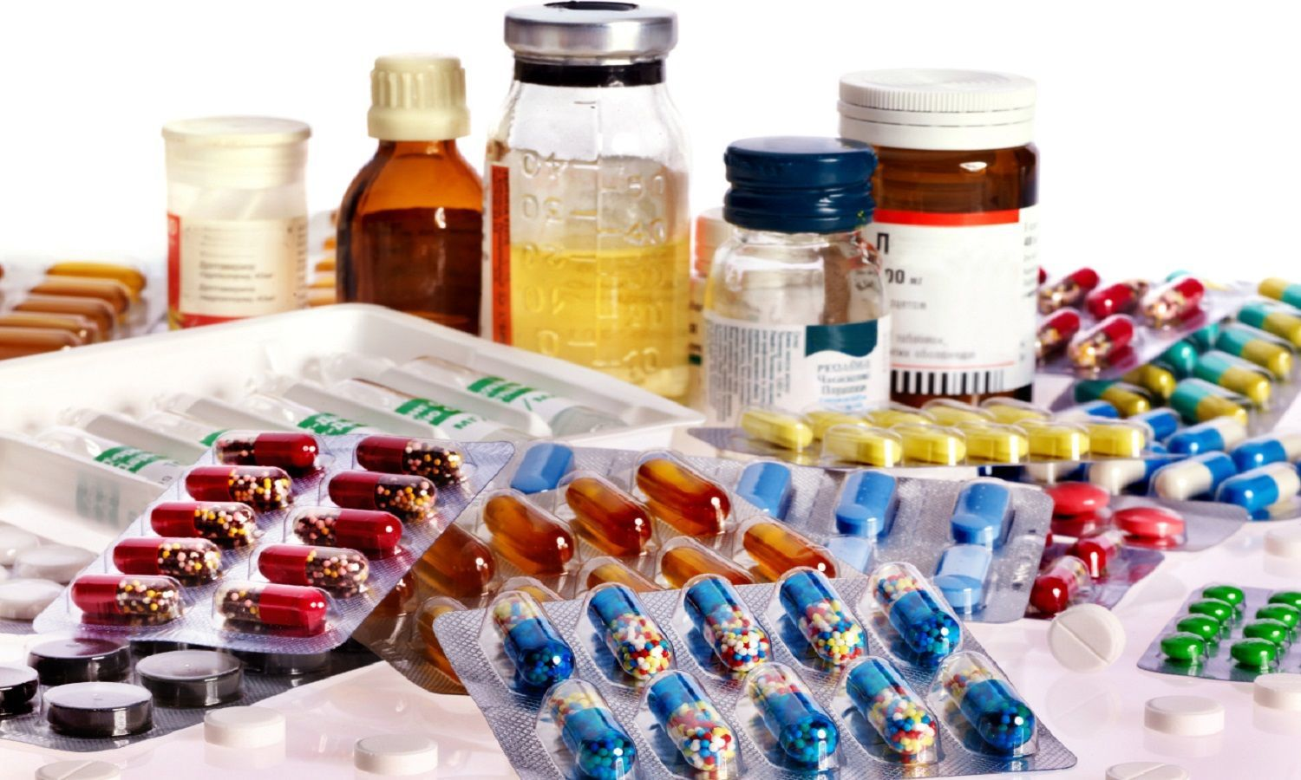
Medicinal products should be stored separately from other products, in groups and under the conditions specified by the manufacturer, to avoid deterioration due to exposure to light, moisture or inappropriate temperature.

Slide 32
Medicines are recommended to be placed separately in storage rooms:
in strict accordance with the toxicological groups:
narcotic and psychotropic substances,
poisonous substances,
potent substances,
general list;
according to pharmacological groups;
depending on the method of reception(Internal, external);
by state of aggregation(separately liquid, loose, gaseous,ointment-likeetc.);
according to the physical and chemical properties and the influence of various factors of the external environment;
taking into account the expiration datesand;
taking into account the nature of various medicinal forms.
Poisonous medicines are stored in safes or locked metal cabinets. Potent medicines are stored in metal or wooden cabinets.

Slide 33
Pharmaceutical products and medical products are stored separately by group:
dressing materials and ready-made dressings;
rubber products;
plastic products;
items of sanitary hygiene and patient care;
medicinal plant raw materials;
containers, sealing means and packaging materials;
oxygen and gypsum;
detergents and perfumery and cosmetic products;
disinfectants and disinfectants;
chemical reagents;
pharmacy and laboratory furniture;
household items/equipment and auxiliary materials for the work of a pharmacy/medical institution;
equipment and medical equipment.

Slide 34
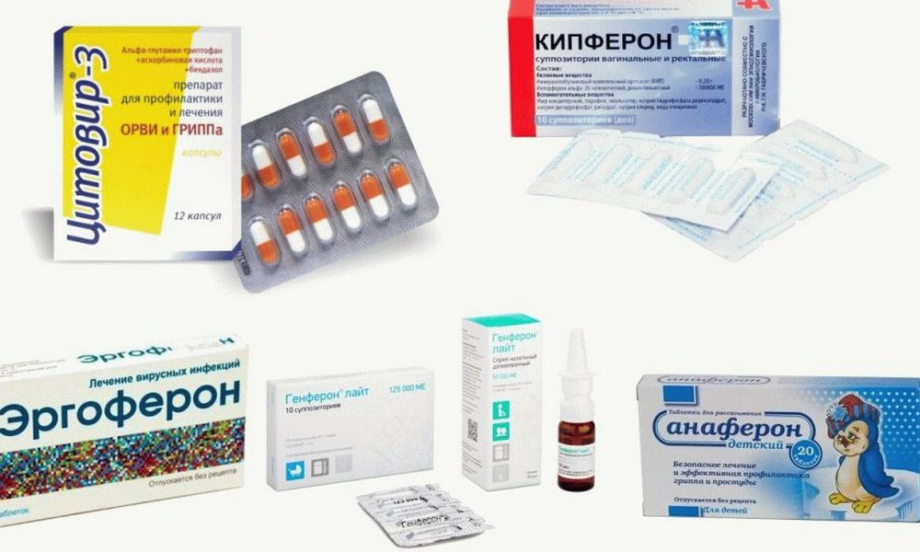
Requirements for containers for medicines and medical products
Medicinal products and medical products should be stored and transported in primary, secondary, group, transport containers provided for by current regulatory documentation.

Slide 35
Rules of transportation of medicinal products
Medicinal products should be transported in such a way that:
a) the possibility of their identification was not lost;
b) they were notcontaminatedother drugs or substances and not themselvescontaminatedtheir;
c) appropriate precautions have been taken to prevent damage and theft;
d) they were protected and were not excessively exposed to such factors as high or low temperature, light, humidity and other negative influences, and were not damaged by microorganisms or harmful insects and animals.

Slide 36
Thank you by attention!!!

