Slide 1
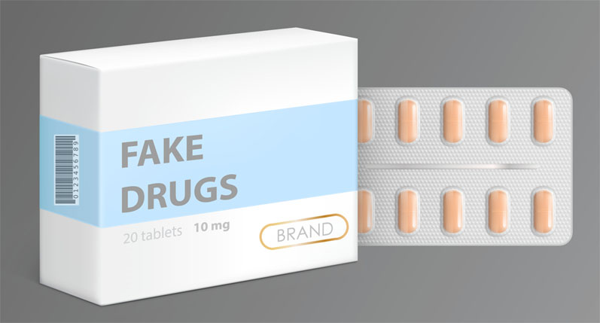
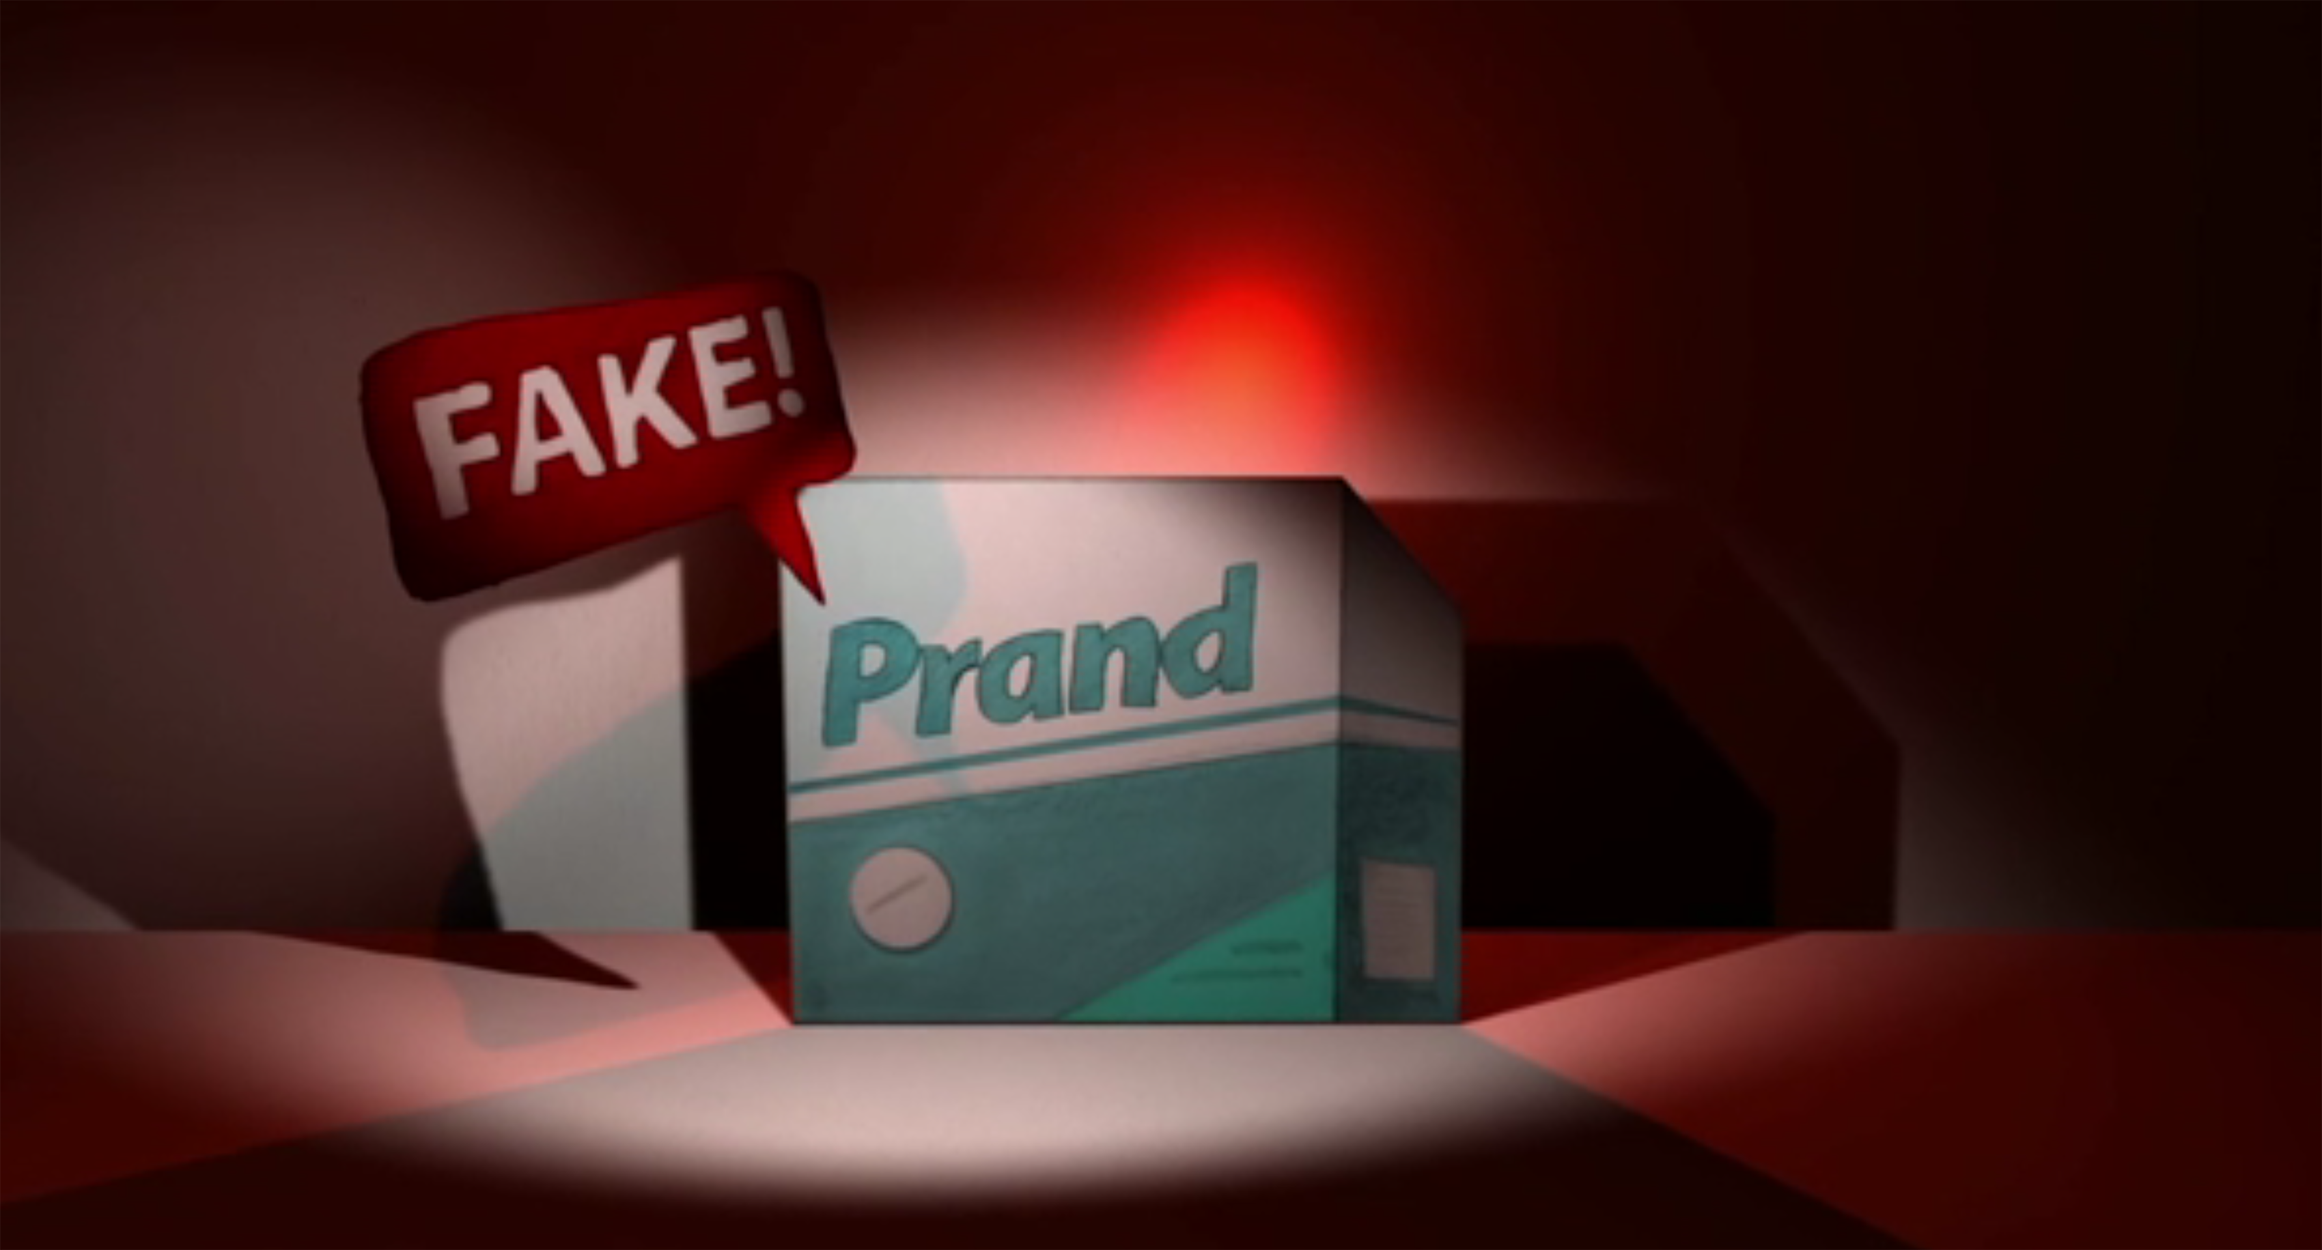
MINISTRY OF HEALTH OF UKRAINE
ODESSA NATIONAL MEDICAL UNIVERSITY
Department of Pharmacy Organization and Economics
Lecture № 9. Protection of the pharmaceutical market from counterfeit, substandard medicines and medical devices.
Prepared by
senior teacher Oksana Stepanova

Slide 2
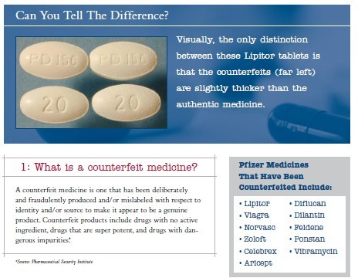
Protecting EU Citizens from Counterfeit Pharmaceuticals
When did Pfizer publish this ? And what has happened in the meantime ?

Slide 3
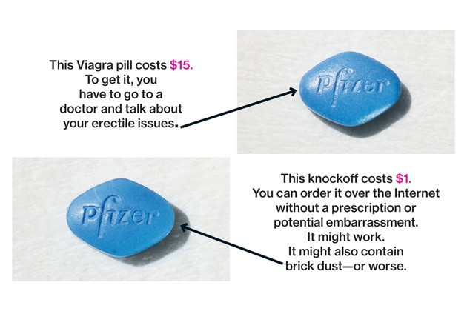
Protecting EU Citizens from Counterfeit Pharmaceuticals
When did Pfizer publish this ? 2005 !!
And what has happened in the meantime ? Not much one is forced to say, except that organized crime was even more successful in the last 10 years.
•
•
What did companies do during this period? Business week article provides a hint:
http://www.businessweek.com/articles/2013-01-17/inside-pfizers-fight-against- counterfeit-drugs#p1
Intro to the article

Slide 4
Protecting EU Citizens from Counterfeit Pharmaceuticals
•
Apparently, big pharma has hired whole armies of former law enforcement people in an attempt to COMBAT the problem; from the article:
•
Donnelly, 56, is director of Pfizer’s global security team in the Americas. A pharmacist by training with a Ph.D. in pharmacology and toxicology, Donnelly is also a detective. For 21 years before joining Pfizer, he worked as a special agent for the FBI.
•
Among counterfeiters, Viagra is prize. It’s the king of the erectile dysfunction market, racking up $1.04 billion in U.S. sales in 2011, according to IMS Health. It’s been fighting
off counterfeiters almost since its introduction in 1998, which happened to coincide with the rise of the INTERNET.
•
Pfizer’s squad, says Donnelly, benefits consumers and protects the Viagra brand.
•
One of the criminal distributors was caught and sentenced to 10 months and a fine of 5100 Dollars
Two months after the sentencing, the distribution website hardtofindrx.com is going strong, although it has yet to respond to a request for comment. A recent look revealed offers for Viagra Herbal, Viagra Oral Jelly, Viagra Professional (generic), Viagra strips, Viagra Super Active, and Red Cialis Viagra. The site sells dozens of other medications ranging from “morning after pill” to “Slimmer X” to “Boob builder.” Satisfaction is guaranteed.

Slide 5
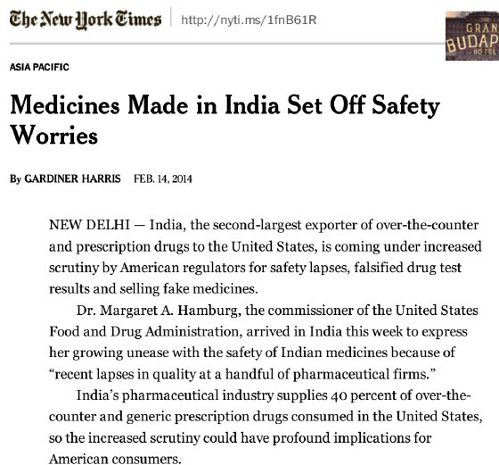
Protecting EU Citizens from Counterfeit Pharmaceuticals

Slide 6


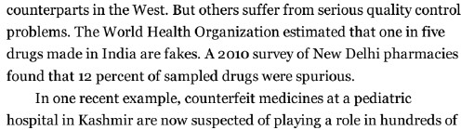
From the same article: …...........
Protecting EU Citizens from Counterfeit Pharmaceuticals
…...... infant deaths.

Slide 7
Protecting EU Citizens from Counterfeit Pharmaceuticals
Another case, another “related problem”
Ranbaxy ordered to pay 500 milion Dollars in fines in mid-May 2013; as a result of manufacturing standards (GMP) not being maintained at an Indian manufacturing plant; triggering a loss in Ranbaxy's share prize of 44% in roughly 3 months
People are now asking the question of whether it is sufficient for the US when manufacturers like Ranbaxy return to full GMP compliance; given the fact that WHO statistics seem to confirm an overall counterfeit rate of 20 % in the Indian pharmaceuticals market; and Indian generics manufacturers hold 40 % of the US market
•
Conclusion: No matter how well GMP is policed in India, 8 % of the US generics market will likely remain to be counterfeit product! Is this acceptable??
•

Slide 8
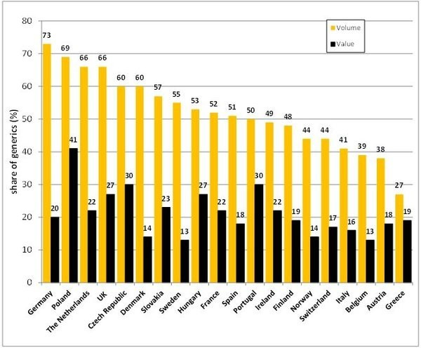
What has this got to do with Europe? Generics market share 2014
Protecting EU Citizens from Counterfeit Pharmaceuticals

Slide 9
What has this got to do with Europe?
Protecting EU Citizens from Counterfeit Pharmaceuticals
The Institute of Research Against Counterfeit Medicines (IRACM) reports in late 2013
Summer 2013 - 500 Million packages of pharmaceuticals seized in Switzerland sent from China to Africa
October 2013 - 1 million of fake Xanax packs seized at Zurich/Kloten Airport
Low penal risk for this kind of criminal wrongdoing (as we saw in the Pfizer case); the criminal business is dramatically increasing and might, in the future, engage different forms of international organized crime, including terror organizations
Are there any solutions at all ?

Slide 10

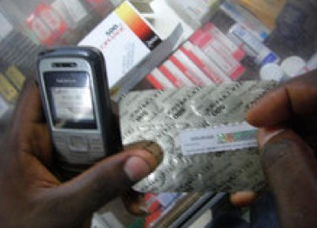
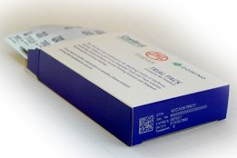
Serialization as a government mandated approach
Protecting EU Citizens from Counterfeit Pharmaceuticals
●
United States: The Drug Supply Chain Security Act (DSCSA) mandates that manufacturers begin serializing all drug products at the saleable unit and case level for the U.S. market starting in Nov. 2017, with repackager deadlines beginning in 2018.
●
European Union: Manufacturers serving the EU are preparing to meet serialization requirements (the EU Falsified Medizines Directive) at the package level which are now expected to phase in from early 2018, requirements that include supporting both global and national identifiers and following strict uniqueness regulations.
●
China: Drug products on the Essential Drugs Lists (2009, 2012) already need to be serialized in China following unique China requirements for serial number acquisition, serial number and product data formatting, and barcode labeling. All drug products will need to be serialized, both domestically manufactured and imported medicines, by December 31, 2015.
●
Brazil: RDC 54 regulations establish very complex new serialization requirements for all registered drug products which phase in starting in Dec. 2015. Manufacturers will need to apply unique Brazilian IUM identifiers into 2D DataMatrix barcodes for each saleable unit, serialize each transport container
(case) and ensure aggregation relationships.
s.

Slide 11
Serialization in the US and Europe
Protecting EU Citizens from Counterfeit Pharmaceuticals
➢
From late 2017/early 18 new serialization standards will become effective in both territories
Is it going to help?
We fear not
And why not ?
Because as usual, governments and big industry have driven these standards towards the lowest common denominator; I am calling it the stakeholder trapdoor
As a result none of the new standards is going to directly require
marking of product; instead only primary or secondary packaging gets marked! We are still dreaming of a better world requiring the marking of packages or blisters (when most pharma products in the US and the developing world are not even packaged in blisters)
➢
➢
➢

Slide 12
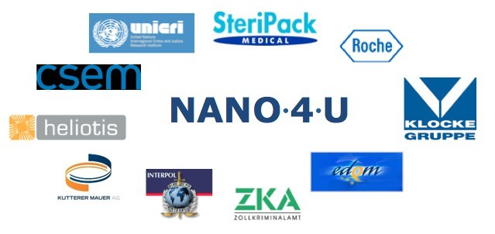
SaveMed – tackling counterfeit pharmaceuticals & medicines
Protecting EU Citizens from Counterfeit Pharmaceuticals
's catalogue of custom anti-counterfeiting solutions

Slide 13
Tackling counterfeit pharmaceuticals & medicines in general
Protecting EU Citizens from Counterfeit Pharmaceuticals
catalogue of custom anti-counterfeiting solutions
•
Only marking the products themselves (tablets, syringes, vials, medical devices etc.) AND linking this information with coded packaging will prevent organized crime in this area from further growing exponentially
•
Having said that, production mechanisms in industry and approval processes need to be affected as little as possible – no changes in pharmaceutical recipes, no changes in high-speed embossing of tablets etc.; keep the cost for manufacturers as low as possible while making it almost impossible for organized crime to continue

Slide 14
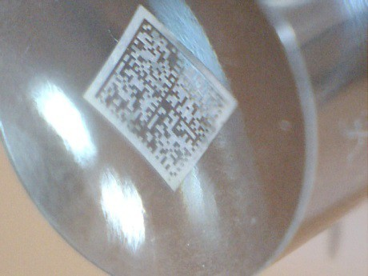
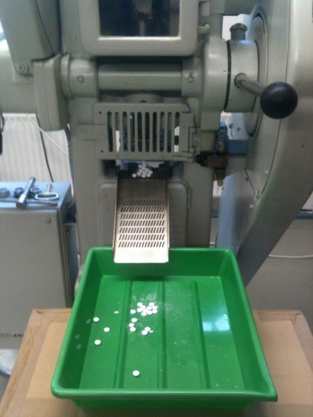
Datamatrix codes for self-verification between product and packaging.
Protecting EU Citizens from Counterfeit Pharmaceuticals
•
Datamatrix codes have been laser structured onto the steel tooling used for tablet stamping. The codes are structured at different surface levels.
•
The codes contain enough data for track & trace plus cryptographic signature to check for genuine product.
•
The codes have been successfully embossed onto tablets using a normal industrial tableting press.

Slide 15
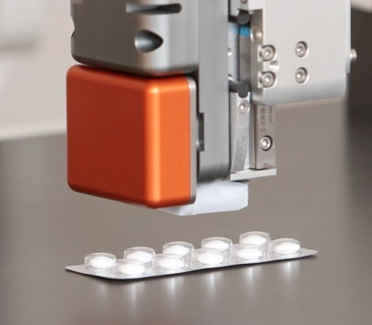
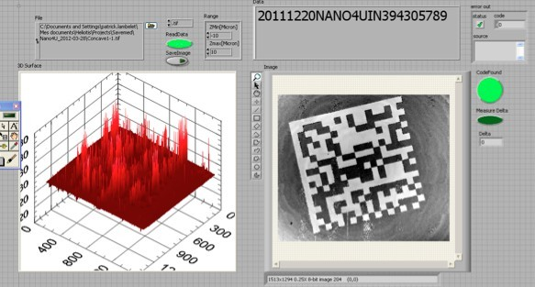
Datamatrix codes for self-verification between product and packaging.
– continued.
Protecting EU Citizens from Counterfeit Pharmaceuticals
Embossed codes on the tablets can be scanned and read using appropriate «reading» system
The scanner uses a special type of industrially proven tomography to read through clear blister packs or slightly porous materials to detect each interface at a microscopic level.
Algorithms for scanning & decoding have been proven.
•
Measurement on coated tablets and through coatings has been achieved, hiding the code completely in the surface of, or beneath the coating of, the tablet.

Slide 16
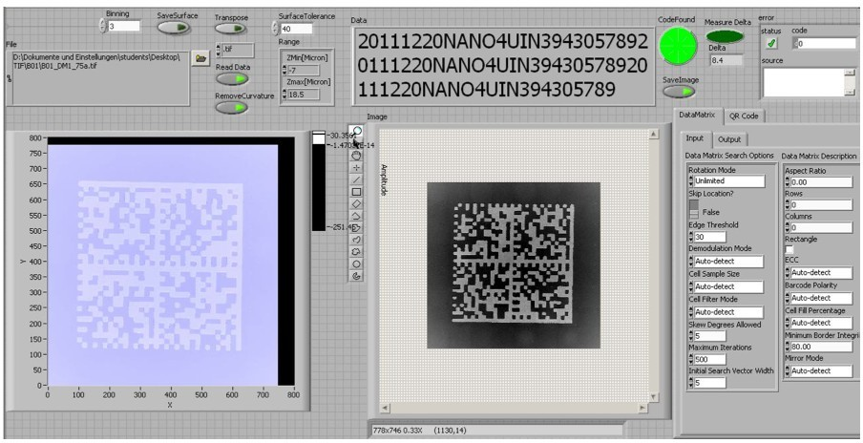
Device for product/package verification.
Protecting EU Citizens from Counterfeit Pharmaceuticals
Rapid optical scan of structured surface (eg.
Datamatrix.)
Point cloud of height data.
Adaption of data file using specific algorithms.
Decoding using standard Datamatrix or QR Code program.

Slide 17

Device for product/package verification
Protecting EU Citizens from Counterfeit Pharmaceuticals
●
We are now also providing in the field or end-user authentication solutions that work with SMART phone apps
●
Some on product coding in the tabletting arena can also use random product characteristics instead of nanoscale markings (ongoing EUREKA research project)
●
Product markings and/or random coding can also be used to create a link with coded packaging (GTIN etc.)
●
anti-counterfeiting solutions also use state-of-the art cryptography, thereby preventing the need to store, safeguard, and access huge amounts of identification data
●
In-the-field authentication thereby becomes possible without external database access

Slide 18
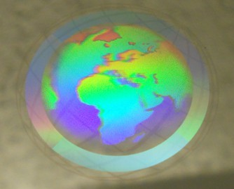
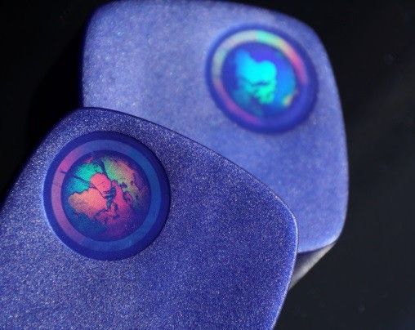
Holograms including covert features.
Protecting EU Citizens from Counterfeit Pharmaceuticals
●
We also offer the application of holographic gratings to flat or curved hardened steel surfaces such as those used in injection moulds and embossing tools.
●
The new process can be used to apply simple and complex grating structures, Moiré structures, or random fingerprint structures directly onto steel tooling.

Slide 19
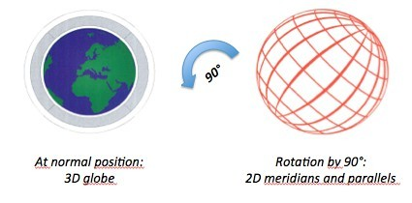

Moulded hologram security features
Protecting EU Citizens from Counterfeit Pharmaceuticals
•
Level 1: Holographic logo or pattern that diffracts the light to different colours at different angles (see plastic cap picture on previous slide).
•
Level 2: Complex hologram that changes appearance when viewed from different angles. Example: Globe hologram (see below).
•
Level 3: Hidden detail (only visible when inspected at a specific point or using a specific method). Examples include microtext, reflected diffractive patterns.

Slide 20
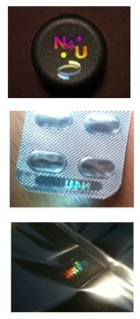
Holograms including covert features
Protecting EU Citizens from Counterfeit Pharmaceuticals
●
High-contrast holograms have been injection moulded onto plastic packaging directly from injection moulds with no secondary process.
●
Using inserts from the special steel structuring process, holograms have been directly embossed onto blister packs in a standard packaging line.
●
Holograms have also been embossed onto medical pouches as part of a standard film converting line.
●
Optical gratings have been produced to locally couple light into a plastic material and reveal a hologram that was previously not obvious.

Slide 21
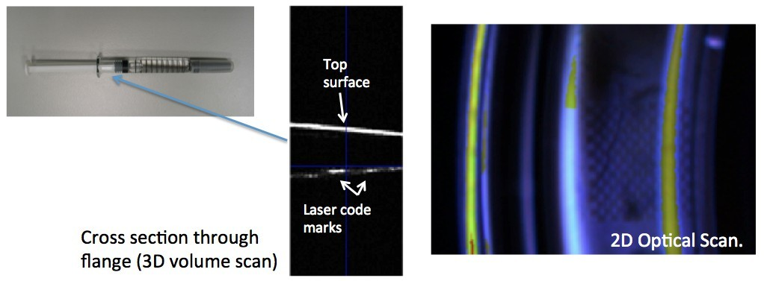
NANO 4 U anti-counterfeiting products in the area of glass vials & syringes.
Protecting EU Citizens from Counterfeit Pharmaceuticals
•
Rapid optical scan allows coding at more than one level within the glass.
•
Code laser-written inside glass and decoded using high speed optical scan.
Code is impossible to read using a normal microscope and can include hidden information levels.

Slide 22
NANO 4 U’s current activities in the field
Protecting EU Citizens from Counterfeit Pharmaceuticals
•
Collaboration with a blister machine supplier in the pharmaceutical market
Various discussions with pharma manufacturers about implementation of NANO 4 U products into their serialization solutions (custom application development)
Upscaling of glass-marking system in packaging lines for liquid pharmaceuticals
Early stage development projects in the luxury goods markets (drinks, perfume, sunglasses, jewelry, high-level brand protection)
•
•
•
Please do not hesitate to contact us for any contribution to your ongoing discussions!
THANK YOU

