Slide 1

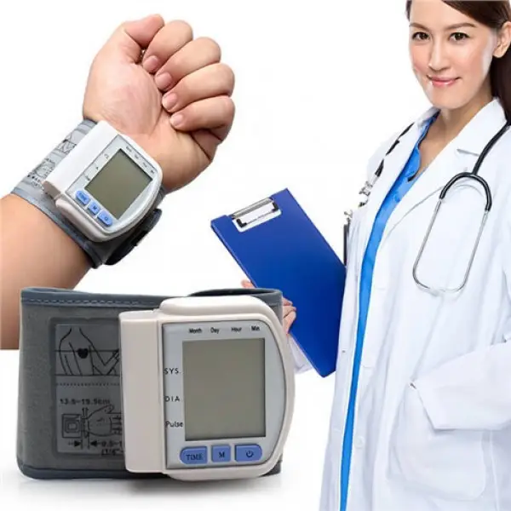
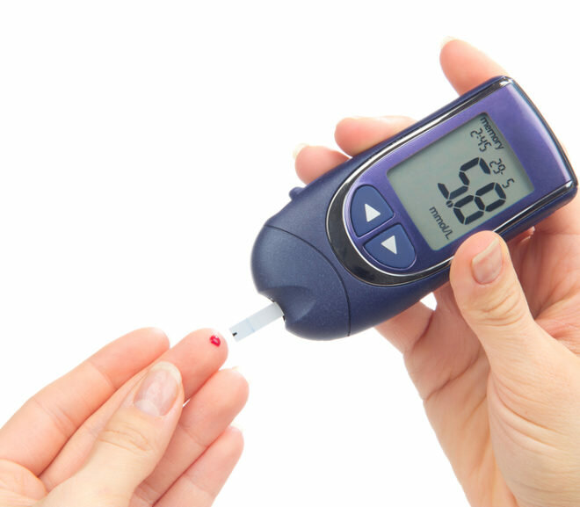
Lecture № 10. Commodity analysis of devices for diagnosing the state of the body.
Translated from Ukrainian to English - www.onlinedoctranslator.com
ODESSA NATIONAL MEDICAL UNIVERSITY
FACULTY OF PHARMACY
Department of Pharmacy Organization and Economics
Prepared by senior teacher Stepanova Oksana Anatoliivna

Slide 2
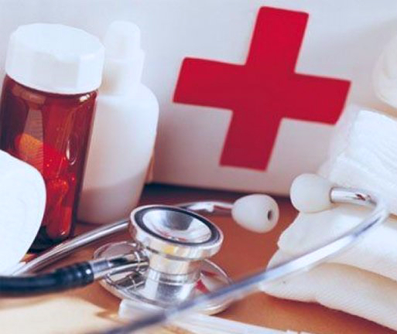
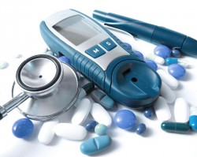
Medical product
a device used to diagnose, prevent or treat various diseases. Includes instruments, apparatus, implants, reagents in a test tube, consumables, devices, appliances, furniture and other products.

Slide 3
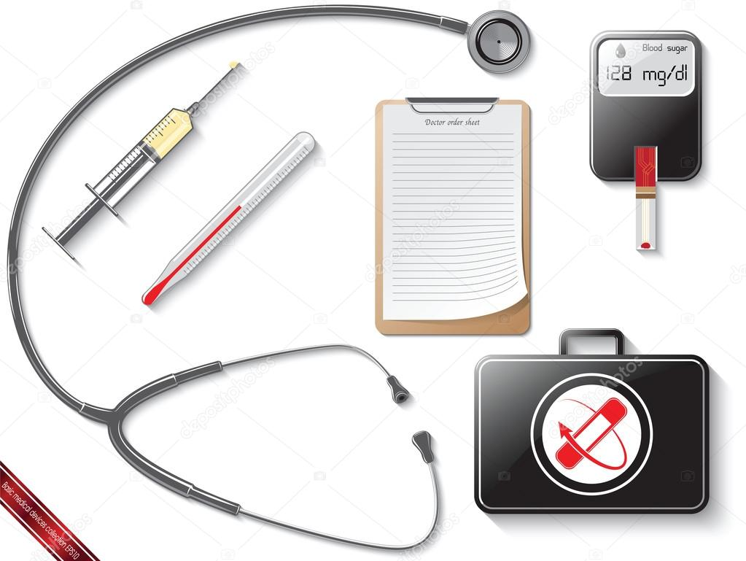
Medical devices occupy approximately 40.5% of the medical equipment market. Domestic manufacturers produce endoscopic, X-ray, fluorographic equipment, electrocardiographs, monitors, etc. (approximately 29.3%).
Expensive computerized diagnostic equipment on the market is presented mainly by foreign manufacturers.

Slide 4
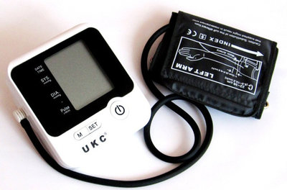
Tonometer
this is a special device for determining the level of blood pressure. It allows you to control this variable, but such an important parameter of human health.
Tonometers are mechanical and electronic (automatic and semi-automatic). Before deciding which option is better, you need to understand the specifics of each of them.

Slide 5
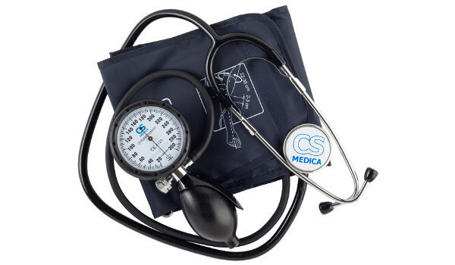
Mechanical tonometers
Slightlya cuff is put on above the elbow joint, air enters it with the help of a pear, then the doctor releases the air with precise coordinated movements until he hears a tone and records the indicators. A mechanical device is durable, it is difficult to fail, and the price is usually more affordable.
One of its significant disadvantages is the difficulty of use. In old age, it is difficult to properly inflate and deflate, see the oscillations of the tonometer needle or hear tones.

Slide 6
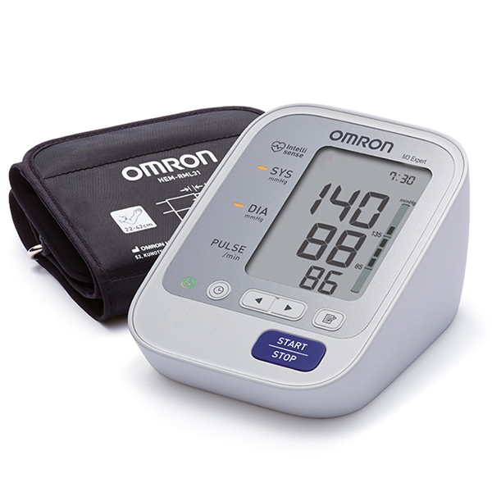
Electronic tonometers
Automatic - this option practically does not require human intervention, it is fixed on the hand, then the measurement of blood pressure takes place independently.
Main disadvantages: possible breakdowns, as the electronic mechanism is more sensitive to environmental changes and mechanical damage.

Slide 7
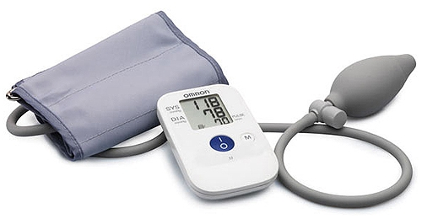
Semi-automatic tonometer
Air is pumped into the cuff with the help of a pear, thereby relieving the work of the electronic mechanism. Less energy is consumed, the device lasts longer. Then the tonometer measures the pressure independently.

Slide 8
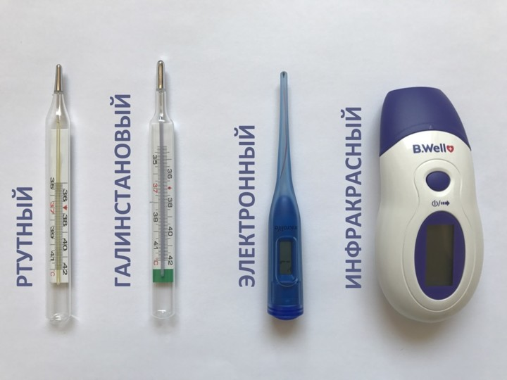
Thermometers- devices for measuring human body temperature. As you know, temperature is an indicator of the balance of physical and chemical processes in the human body, which is regulated by special nerve cells and a heat-sensitive substance.

Slide 9
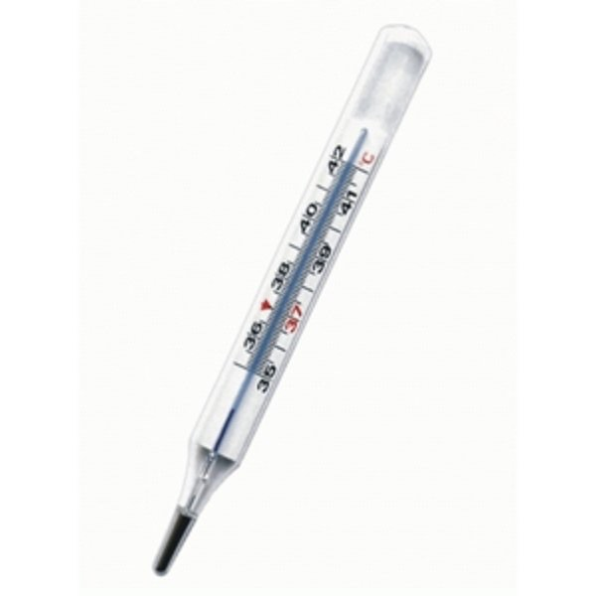
Mercury thermometer
Преимущества
Привычное большинству устройство для измерения температуры. Стеклянная колба с капилляром, который содержит ртуть. Такой термометр еще называют максимальным, потому что столбик из ртути поднимается до последней точки нагрева – и без встряхивания не опускается.
Недостатки
Ртутный термометр самый точный, но и самый опасный из-за ртути. Это опасный для человека металл, пары которого негативно влияют на здоровье.
Разбитие такого термометра может обернуться серьезными проблемами.

Slide 10
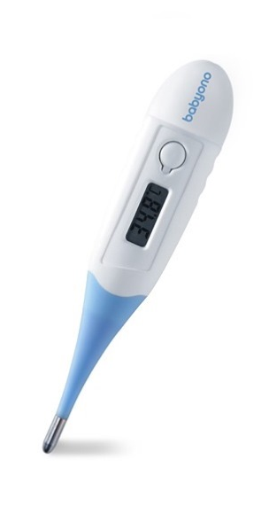
Electronic medical thermometers
the most common modern devices for measuring the patient's body temperature. They do not contain fragile glass and poisonous mercury.
They are made in a convenient plastic case and have a large number of advantages:
compact;
moisture resistant
have sound notification
memory to measure
auto shutdown

Slide 11
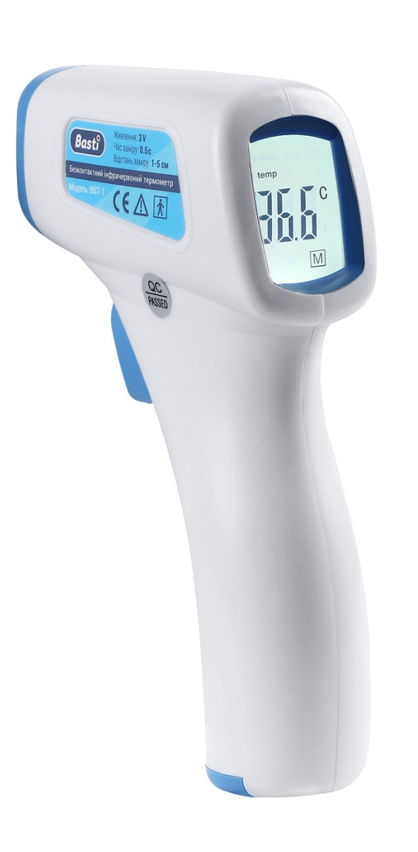
Infrared thermometer
Преимущества
Использовать прибор такого типа просто и удобно, особенно для измерения температуры тела у детей
Измерение температуры займёт не более 1 секунды, а показатели крупными цифрами высветятся на дисплее устройства. Функциональные особенности прибора позволяют сохранить в его памяти данные последнего измерения.
Недостатки
Инфракрасный термометр стоит весьма недешево – от 1200 рублей и выше. Фактическая погрешность прибора ±0,2 °С. Для того, чтобы добиться точности необходимо, провести серию измерений. При этом использовать такой прибор необходимо строго на определенных участках тела – на лбу, висках или в ушной раковине.

Slide 12
GLUCOMETER
Main characteristicsglucometer:
Average size modernglucometerapproximately equal to the size of the palm. Suchglucometersrun on batteries.
Test strips are a single-use item containing chemicals that react with the glucose contained in a drop of blood and are used during each measurement. In some models, this element is in the form of a plastic strip with a small soaked spotglucose oxidasesand otherscomponents.
Because test strips can vary from lot to lot, some models require the user to manually enter the code located on the test strip bottle or on the disc that comes with the test strips. By entering the code inglucometer, the instrument will be calibrated for this batch of test strips.

Slide 13
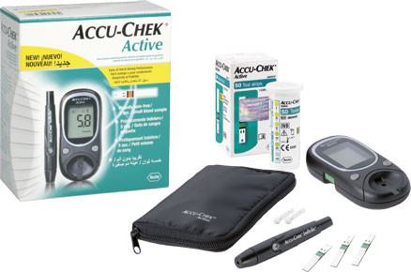
Time is the manifestation of results. The time spent reading the test strip can vary from 3 to 60seconds,depending on different models.
Blood sample volume: The blood drop size required for different models varies from 0.3 to 1mcl. (Older models require a larger blood sample, usually defined as a "hanging drop" from the finger.)

Slide 14

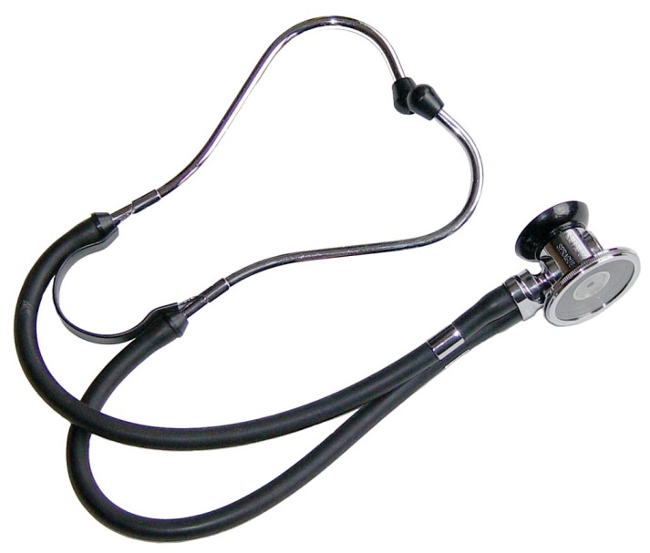
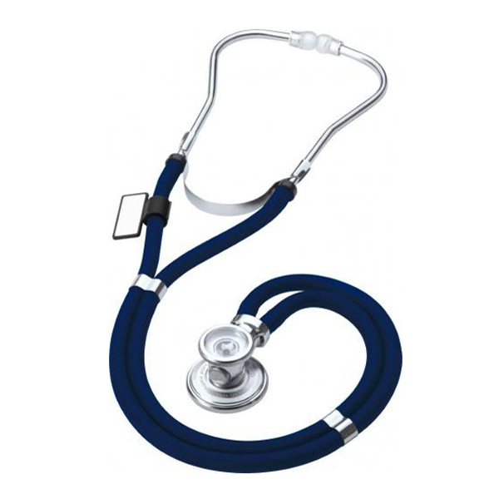
PHONENDOSCOPES
Phonendoscopes
Stethophone endoscopes
Stethoscopes

Slide 15
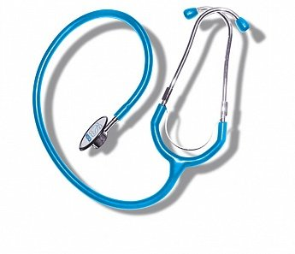
Phonendoscope
it is a medical drug-diagnostic device used for the initial examination of the patient, in particular, listening to heart sounds, breathing noises and other sounds that occur in the body (auscultation).
A phonendoscope is only binaural (consisting of two tubes, the ends of which are inserted into the ears) and differs from a flexible stethoscope in that the sound-receiving chamber is closed by a rigid membrane to amplify the sounds heard.

Slide 16
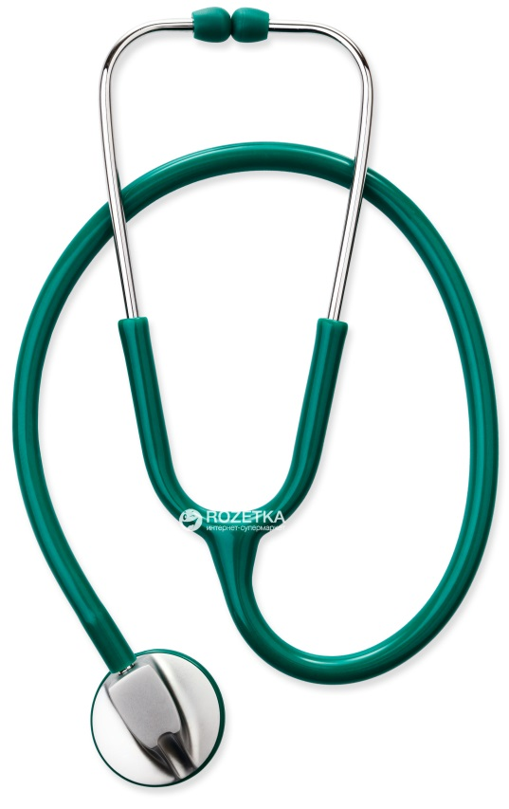
a device for listening to heart sounds, breathing noises, and other natural sounds that occur in the human and animal body. Invented in 1816 by the founder of the diagnostic method of auscultation by the French doctor R.Laennek(1781-1826).
Stethoscope
simple (solid)Stethoscopes havethe shape of a tube made of wood, ebonite, etc. with funnels of different diameters at the ends.
Benefits:
transmission of sound not only through the column of air, but also through the hard part of S. and the temporal bone of the researcher.

Slide 17
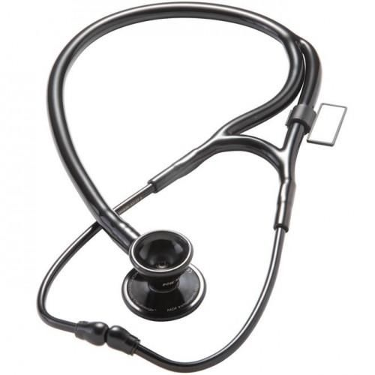
Stethophone endoscope
it is a device for binaural auscultation - listening to the sounds of internal human organs.
It is a combination of a soft stethoscope (a funnel and several elastic tubes) and a phonendoscope (a sound-amplifying membrane and a sound-capturing chamber). This is a device of which there are many varieties today.

Slide 18
Currently, the following types of phonendoscopes are available on the market of medical devices:
Кардиологические фонендоскопы
позволяют слышать высоко- и низкочастотные звуки, бесступенчато переключаться. Мембрана обычно изготавливается диаметром 40 мм, длина трубок 53 см.
Фонендоскопы с плоской головкой
предназначены для выслушивания шумов внутренних органов: лёгких, бронхов, сердца, сосудов, кишечника и др. Подходят для всех типов ЛПУ и видов терапевтической деятельности.

Slide 19
The following types are represented on the market of medical devicesstethoscopes:
Obstetric (single-ended) stethoscope is used for auscultation in obstetrics, ideal for all midwives and expectant parents.
A pediatric (single-sided) stethoscope is designed specifically for children. The diameter of the orifice is calculated for the size of the body of small patients, and the elastic silicone orifice gives a pleasant warmth to the touch.
An adult (one-sided) stethoscope is well suited for auscultation of adult patients, especially for listening to tones when measuring blood pressure.
Cardiological (double-sided) stethoscope - for cardiologists and therapists.
Pediatric (double-sided) stethoscope for pediatricians.

Slide 20
Marking of phonendoscopes must meet the requirementsand guiltycontain:
товарный знак предприятия-изготовителя: наименование или обозначение типа (вида, модели) изделия
номер изделия по системе нумерации предприятия-изготовителя. при необходимости
год изготовления изделия (или две его последние цифры)
знак Государственного реестра (для средств измерений, внесенных в Государственный реестр)
обозначение стандартов или технических условий на изделие
другие данные в зависимости or требовании к изделиям (класс точности для средств измерений, символы обслуживания, номинальное напряжение сети, потребляемая мощность при номинальном режиме работы, национальный знак соответствия)

Slide 21
Packaging
The packaging should provide protection against the effects of mechanical and climatic factors during transportation and storage, as well as the most complete use of the carrying capacity (capacity) of vehicles and the convenience of carrying out loading and unloading operations.
Components of products and their accessories must be placed in the nest of cases or consumer packaging. It is allowed to fasten the components wrapped in paper inside the product or on the product, depending on its design.

Slide 22
Nebulizer
Compressors
nebulizers
The advantages of compressorsnebulizersthere is high reliability, a relatively low price and the possibility of using a wide range of medicinal products (inincluding. hormonal drugs and antibiotics).
Ultrasonic
nebulizers
Advantageultrasonic nebulizersthere is a relative silence of work.
Membrane
nebulizers
The advantages of suchnebulizersthere are ultra-compact sizes, a wide range of used drugs, noiselessness, minimal residual volume of the drug, as well as the possibility of inhalation at any angle of inclination.nebulizercamera

Slide 23
Complete set nebulizer
In the inhaler, various options for administering the drug were thought out: through masks (infant, children and adults), mouthpiece tubes for mouth inhalation and nasal nozzles for treating nasal cavities. This allows you to choose the optimal nozzle, taking into account the specifics of the disease and the age of the patient.
In addition, it is important to pay attention to the duration of operation of the device without interruption (if a large volume of spraying is required)were not, it is necessary to choose inhalers that work without a break for at least 30-40 minutes), the volume of the container for medicines (other things being equal, larger tanks are preferred) and last but not least - the cost. And it is also worth providing references about the manufacturer: Asian, European and domestic models are presented on the market.
INin general, compressor inhalers are more versatile, because they are guaranteed to preserve the pharmacological properties of the raw materials poured into them, they are less likely to clog and become unusable. According to the ratio "price-quality" thesenebulizersalso lead in the ranking of the best models.

Slide 24
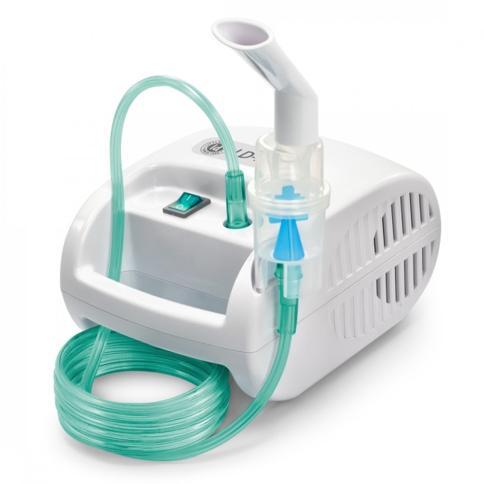
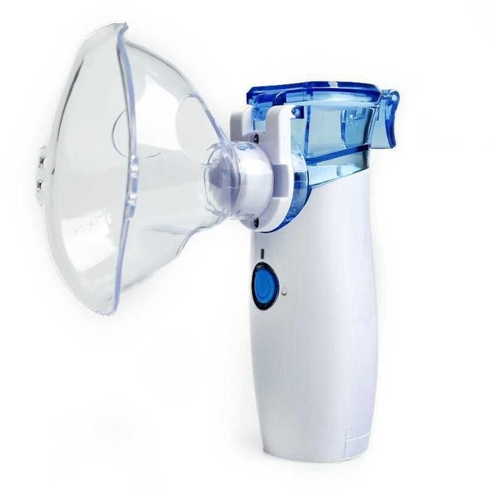
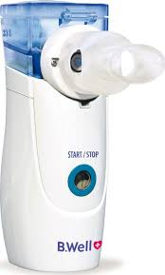
COMPRESSOR NEBULISER
ULTRASONIC NEBULISER
MEMBRANE NEBULISER

Slide 25
Thank you!

