Slide 1
Odesa National Medical University
Department of Family Medicine and Polyclinic Therapy
Elective course “ECG in General Practice”
Content module 2
Changes on the ECG in the case of heart rhythm and conduction disorders

Slide 2
Theme 3
Heart arrhythmias
ECG signs in ectopic heart rhythm disorders

Slide 3
Introduction
Arrhythmia is an abnormal rhythm of the heart.
The only normal rhythm of the heart is a normal sinus rhythm. In this rhythm, an impulse is generated in the sinoatrial (SA) node, which is conducted through and slowed down while passing through the atrioventricular node (AV). It is then conducted through the bundle of His, to the left and right bundle branches, and eventually into the Purkinje fibers. Any deviation from this conduction pathway results in arrhythmia.
Arrhythmias can be classified based on various criteria.
The most common way to categorize them is based on the rate of conduction as bradyarrhythmia with a heart rate of fewer than 60 beats per minute (bpm) and tachyarrhythmia with a heart rate higher than 100 bpm. They are further divided according to the origin, means of transmission, and syndromes associated with it.

Slide 4
Some examples of various arrhythmias include:
Supraventricular arrhythmias
Atrial fibrillation
Atrial flutter
Supraventricular tachycardia (SVT).
Premature atrial contractions (PACs)
Ventricular arrhythmias
Ventricular fibrillation (VFib)
Ventricular tachycardia (VT)
Premature ventricular contractions (PVCs)

Slide 5
Clinical Significance
The prevalence of arrhythmias is expected to be 1.5% to 5% in the general population, with atrial fibrillation being the most common.
Patients with an arrhythmia may exhibit a broad spectrum of clinical presentation from being entirely asymptomatic to sudden cardiac arrest. Arrhythmias can be paroxysmal, leading to difficulty in estimating true prevalence.
The overall presence of arrhythmia is associated with higher morbidity and mortality.

Slide 6
Evaluation of Arrhythmia
In patients suspected of arrhythmias, an electrocardiogram (EKG) is the first step and will usually give the diagnosis. However, at times, the patient may suffer from paroxysmal arrhythmia. The following modalities can be used for diagnosing based on the frequency of the symptoms a patient has secondary to a suspected arrhythmia.
Ambulatory EKG monitoring for patients with frequent symptoms
The event recorder needs to be triggered by the patient to record and will not a viable choice for patients with syncope.
Loop event recorder records up to 2 minutes before the trigger. It is good for patients with syncope.
Implantable loop recorder for patients with less frequent symptoms.

Slide 7

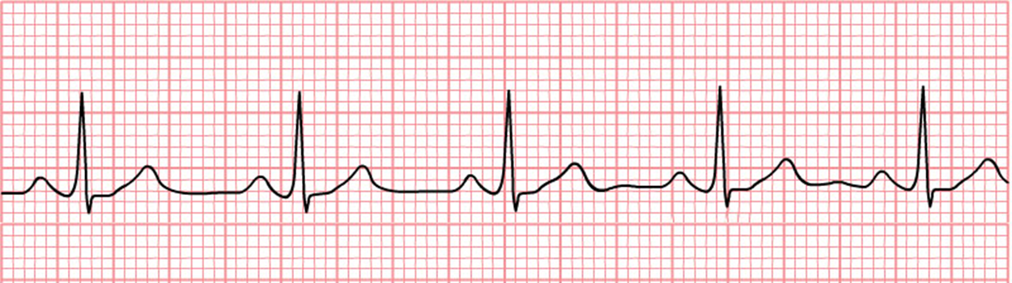
ECG features of normal sinus rhythm
Regular rhythm with <10% variation in the shortest and longest durations between successive P waves
Normal heart rate of 60-100 bpm (or age-appropriate rate in children)
Normal P wave before each QRS complex: P waves have normal morphology, upright in leads I and II, inverted in aVR
Normal PR interval, QRS complex and QT interval.
QRS complex positive in leads I, II, aVF and V3–V6, and negative in lead aVR.

Slide 8
Variations on sinus rhythm
Sinus tachycardia = sinus rhythm with resting heart rate > 100 bpm in adults, or above the normal range for age in children
Sinus bradycardia = sinus rhythm with resting heart rate < 60 bpm in adults, or below the normal range for age in children
Sinus arrhythmia = sinus rhythm with a beat-to-beat variation in the P-P interval (the time between successive P waves), producing an irregular ventricular rate

Slide 9
Origin of Ectopic Beats
Groups of pacemaker cells throughout the conducting system are capable of spontaneous depolarisation
The rate of depolarisation decreases from top to bottom: fastest at the sinoatrial node; slowest within the ventricles
Ectopic impulses from subsidiary pacemakers are normally suppressed by more rapid impulses from above
However, if an ectopic focus depolarises early enough — before the arrival of the next sinus impulse — it may “capture” the ventricles, producing a premature contraction
Premature contractions (“ectopics”) are classified by their origin — atrial (PAC), junctional (PJC) or ventricular (PVC)

Slide 10
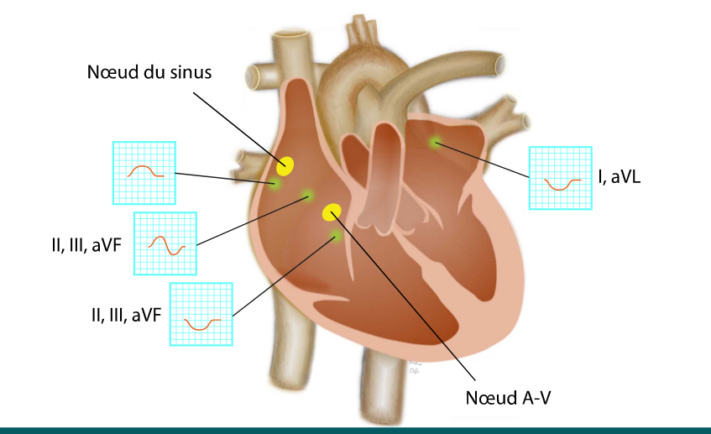

Slide 11
Premature Atrial Complex (PAC)
A premature atrial complex (PAC) is a premature beat arising from ectopic pacemaking tissue within the atria. There is an abnormal P wave, usually followed by a normal QRS complex.
AKA: atrial ectopics, atrial extrasystoles, atrial premature beats, atrial premature depolarisations.

Slide 12
Clinical significance of PACs
PACs are a normal electrophysiological phenomenon not usually requiring investigation or treatment
Frequent PACs may cause palpitations and a sense of the heart “skipping a beat”
In patients with underlying predispositions (e.g. left atrial enlargement, ischaemic heart disease, WPW), a PAC may be the trigger for the onset of a re-entry tachyarrhythmia — e.g. Atrial fibrillation, atrial flutter, AVNRT, AVRT

Slide 13
Causes of PACs
Frequent or symptomatic PACs may occur due to:
Anxiety Sympathomimetics Beta-agonists Excess caffeine | Hypokalaemia Hypomagnesaemia Digoxin toxicity Myocardial ischaemia

Slide 14
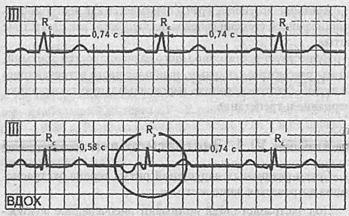
ECG features of PACs
Abnormal (non-sinus) P wave usually followed by a normal QRS complex (< 120 ms)
Post-extrasystolic pauses may be present — PACs that reach the SA node may depolarise it, causing the SA node to be “reset”, with a longer-than-normal interval before the next sinus beat arrives
PACs may also be conducted aberrantly (usually RBBB morphology), or not conducted at all. P waves will still be visible in both cases
Unlike with a premature ventricular complexe (PVC), the post-extrasystolic pause is not equal to double the preceding RR interval

Slide 15
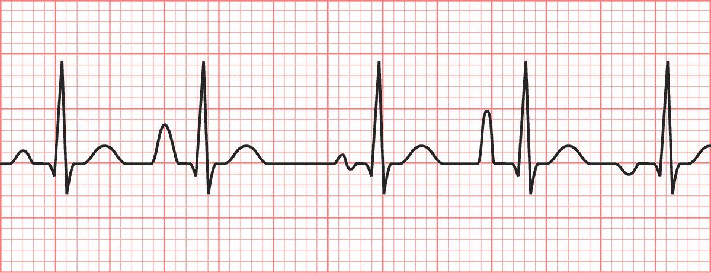
Classification of PACs
PACs may be either:
Unifocal – arising from a single ectopic focus; each PAC is identical.
Multifocal – arising from two or more ectopic foci; multiple P-wave morphologies.
PACs often occur in repeating patterns:
Bigeminy — every other beat is a PAC
Trigeminy — every third beat is a PAC
Quadrigeminy — every fourth beat is a PAC
Couplet – two consecutive PACs
Triplet — three consecutive PACs

Slide 16
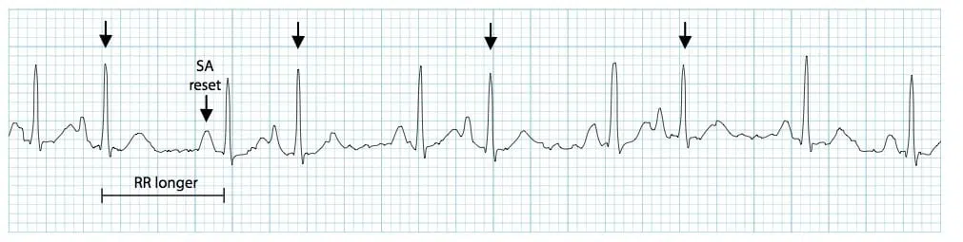
P wave morphology
The P wave typically has a different morphology and axis to the sinus P waves
PACs arising close to the AV node (“low atrial” ectopics) cause retrograde activation of the atria, producing an inverted P wave with a relatively short PR interval ≥ 120 ms (PR interval < 120 ms is classified as a PJC)
The abnormal P wave may be hidden in the preceding T wave, producing a “peaked” or “camel hump” appearance — if this is not appreciated the PAC may be mistaken for a premature junctional complex (PJC)
Frequent PACs (arrows): Note differing P wave morphology and post-extrasystolic pauses

Slide 17
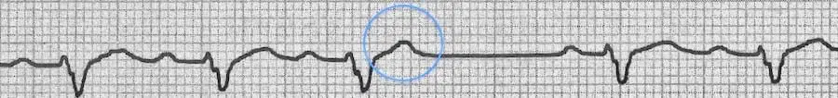
Aberrancy and “blocked” PACs
PACs arriving early in the cycle may be conducted aberrantly, usually with a RBBB morphology (as the right bundle branch has a longer refractory period than the left). They can be differentiated from PVCs by the presence of a preceding P wave
Similarly, PACs arriving very early in the cycle may not be conducted to the ventricles at all. In this case, you will see an abnormal P wave that is not followed by a QRS complex (“blocked PAC”). It is usually followed by a compensatory pause as the sinus node resets
Blocked PAC:
This hidden PAC gives a peaked appearance to the T wave (circled)
The PAC is not not followed by a QRS complex, indicating that it has not been conducted to the ventricles (“blocked PAC”)
It is followed by a compensatory pause

Slide 18
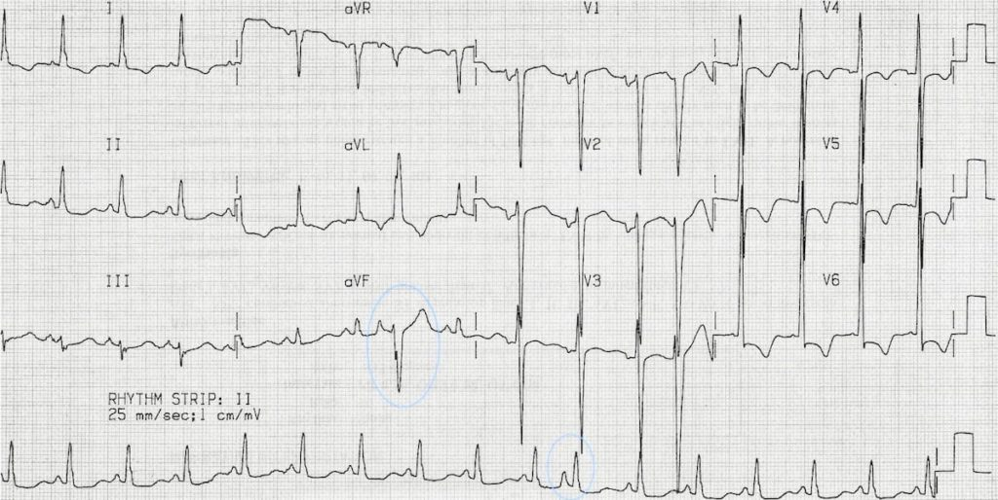
Normally and aberrantly-conducted PACs:
There is an aberrantly conducted PAC, best seen in aVL and aVF (circled)
This could be mistaken for a ventricular ectopic — however, it is clearly preceded by an abnormal P wave
A normally-conducted PAC is also present on the rhythm strip (circled)
NB: This rhythm strip is not recorded simultaneously

Slide 19
Premature Junctional Complex (PJC)
A premature beat arising from an ectopic focus within the Atrioventricular (AV) junction.
AKA: Junctional Ectopics, Junctional Extrasystoles, Junctional Premature Beats, Junctional Premature Depolarisations
Junctional Ectopics
Junctional ectopics are much less common than PACs or PVCs.
These arise from the region of the AV node, so the ventricles are usually activated normally.

Slide 20
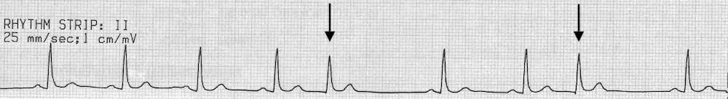
Electrocardiographic Features of PJCs
Narrow QRS complex, either (1) without a preceding P wave or (2) with a retrograde P wave which may appear before, during, or after the QRS complex. If before, there is a short PR interval of < 120 ms and the “retrograde” P waves are usually inverted in leads II, III and aVF.
Occurs sooner than would be expected for the next sinus impulse.
Followed by a compensatory pause.
PJCs that arrive early in the cycle may be conducted aberrantly, most commonly with a RBBB morphology.
Typical appearance of PJCs:
Premature QRS complexes without a preceding P wave.
The QRS morphology is very similar to the sinus complexes.

Slide 21
Premature Ventricular Complex (PVC)
A premature ventricular complex (PVC) is a premature beat arising from an ectopic focus within the ventricles.
AKA: ventricular ectopics, ventricular extrasystoles, ventricular premature beats, ventricular premature depolarisations.
Electrophysiology of Ventricular Ectopics
Ectopic firing of a focus within the ventricles bypasses the His-Purkinje system and depolarises the ventricles directly
This disrupts the normal sequence of cardiac activation, leading to asynchronous activation of the two ventricles
The consequent interventricular conduction delay produces QRS complexes with prolonged duration and abnormal morphology

Slide 22
Clinical Significance
PVCs are a normal electrophysiological phenomenon not usually requiring investigation or treatment
Frequent PVCs may cause palpitations and a sense of the heart “skipping a beat”
In patients with underlying predispositions (e.g. ischaemic heart disease, WPW), a PVC may trigger the onset of a re-entrant tachydysrhythmia — e.g. VT, AVNRT, AVRT
Frequent PVCs are usually benign, except in the context of an prolonged QTc, when they may predispose to malignant ventricular arrhythmias such as Torsades de Pointes by causing “R on T” phenomenon

Slide 23
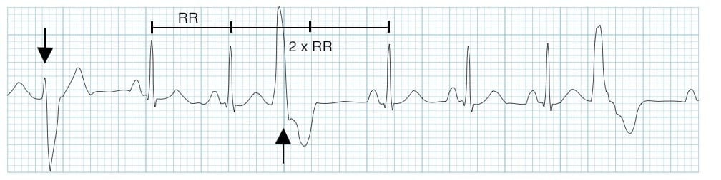
ECG features of PVCs
Broad QRS complex (≥ 120 ms) with abnormal morphology
Premature — i.e. occurs earlier than would be expected for the next sinus impulse
Discordant ST segment and T wave changes.
Usually followed by a full compensatory pause
Retrograde capture of the atria may or may not occur
Sinus rhythm with PVCs of two different morphologies (arrows)
Note the appropriately discordant ST segments / T waves
The pause surrounding the PVC is equal to double the preceding R-R interval (= a full compensatory pause)

Slide 24

Discordance
Appropriate discordance describes a pattern of repolarisation abnormality (typically seen with left bundle branch block, paced rhythms, VT) in which the ST segment and T wave are directed opposite to the main vector of the QRS complex. Because there is abnormal depolarisation, there is subsequent abnormal repolarisation which is discordant:
ST depression and T wave inversion in leads with a dominant R wave
ST elevation with upright T waves in leads with a dominant S wave
With a full compensatory pause, the next normal beat arrives after an interval that is equal to double the preceding R-R interval
Retrograde capture describes the process whereby the ectopic impulse is conducted retrogradely through the AV node, producing atrial depolarisation. This is visible on the ECG as an inverted P wave (“retrograde P wave“), usually occurring after the QRS complex.
PVCs are said to be “frequent” if there are more than 5 PVCs per minute on the routine ECG, or more than 10-30 per hour during ambulatory monitoring.

Slide 25
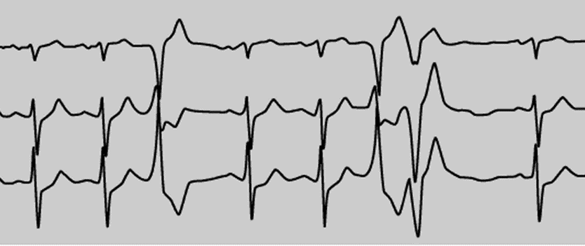
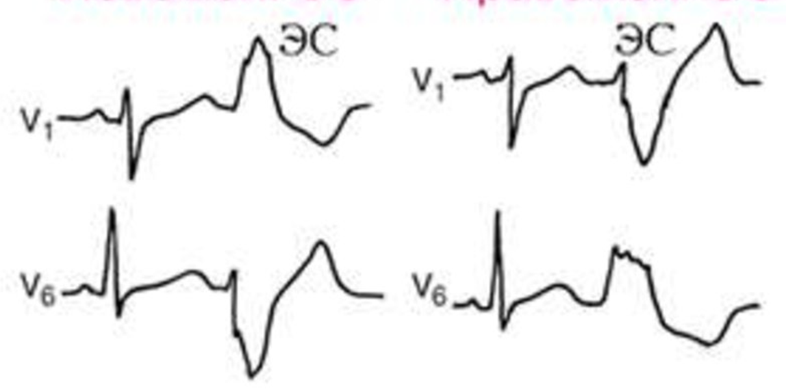
Classification
PVCs may be either:
Unifocal — arising from a single ectopic focus; each PVC is identical
Multifocal — arising from two or more ectopic foci; multiple QRS morphologies
The origin of each PVC can be discerned from the QRS morphology:
PVCs arising from the right ventricle have a left bundle branch block morphology (dominant S wave in V1)
PVCs arising from the left ventricle have a right bundle branch block morphology (dominant R wave in V1)
LV
RV

Slide 26
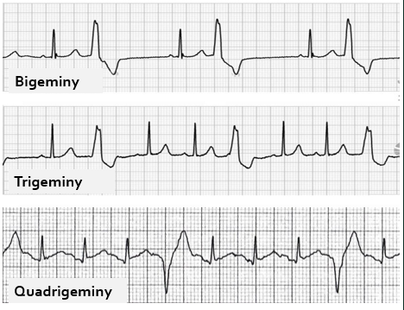
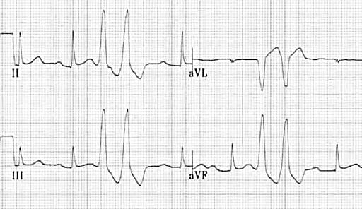
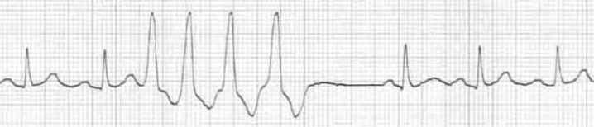
PVCs often occur in repeating patterns:
Bigeminy — every other beat is a PVC
Trigeminy — every third beat is a PVC
Quadrigeminy — every fourth beat is a PVC
Couplet — two consecutive PVCs
Non- sustained ventricular tachycardia (NSVT) — between three and thirty consecutive PVCs

Slide 27
Clinical Significance
PVCs are a normal electrophysiological phenomenon not usually requiring investigation or treatment
Frequent PVCs may cause palpitations and a sense of the heart “skipping a beat”
In patients with underlying predispositions (e.g. ischaemic heart disease, WPW), a PVC may trigger the onset of a re-entrant tachydysrhythmia — e.g. VT, AVNRT, AVRT
Frequent PVCs are usually benign, except in the context of an prolonged QTc, when they may predispose to malignant ventricular arrhythmias such as Torsades de Pointes by causing “R on T” phenomenon

Slide 28
Causes
Frequent or symptomatic PVCs may be due to:
Anxiety Sympathomimetics Beta-agonists Excess caffeine | Hypokalaemia Hypomagnesaemia Digoxin toxicity Myocardial ischemia

Slide 29
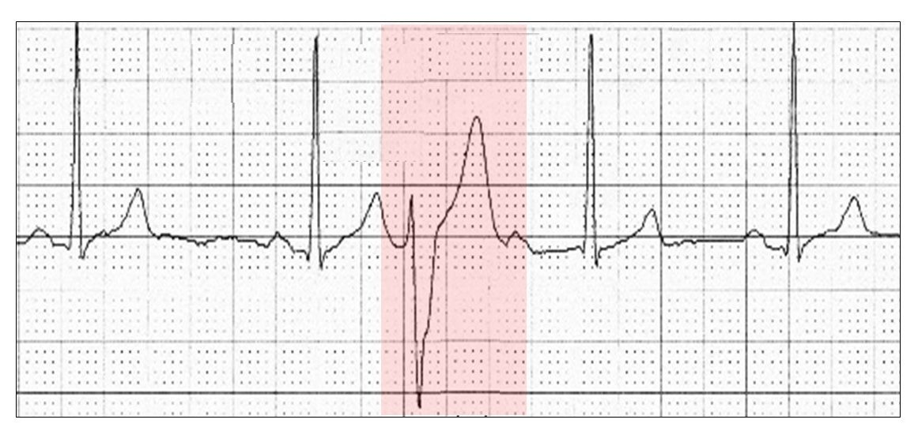
Interpolated extrasystole
A premature contraction that occurs between two normal heartbeats.

Slide 30
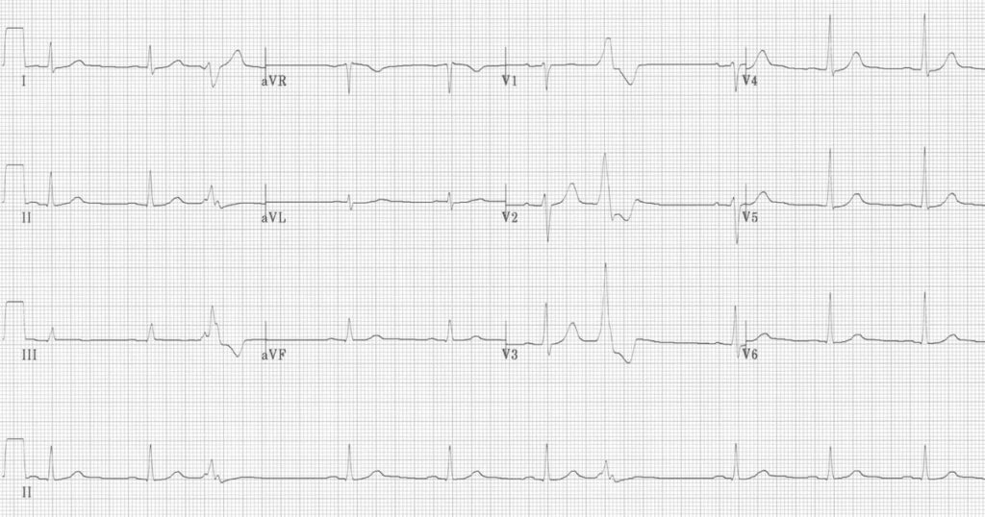

Ventricular quadrigeminy

Slide 31
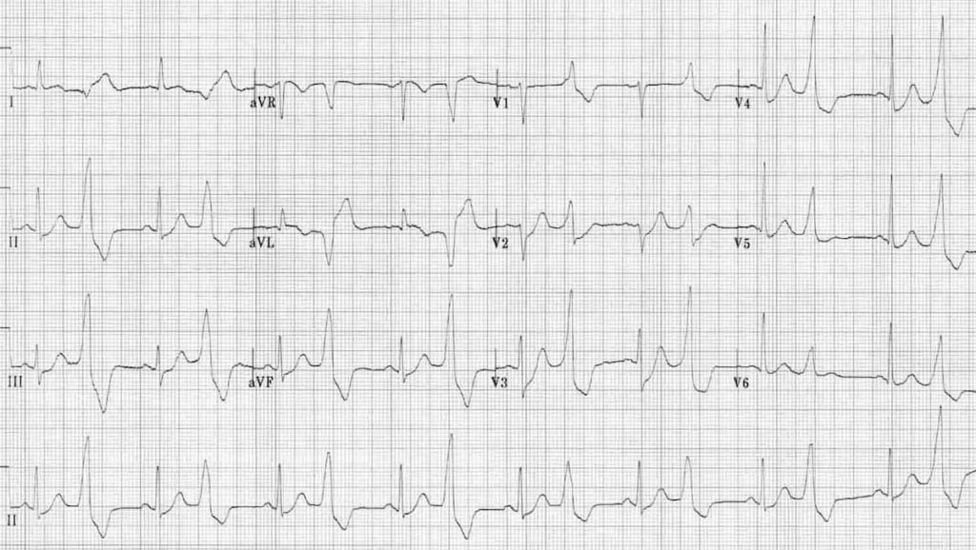
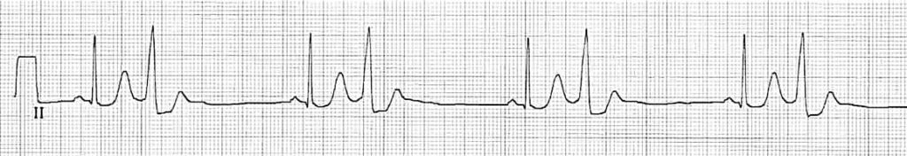
Ventricular bigeminy

Slide 32
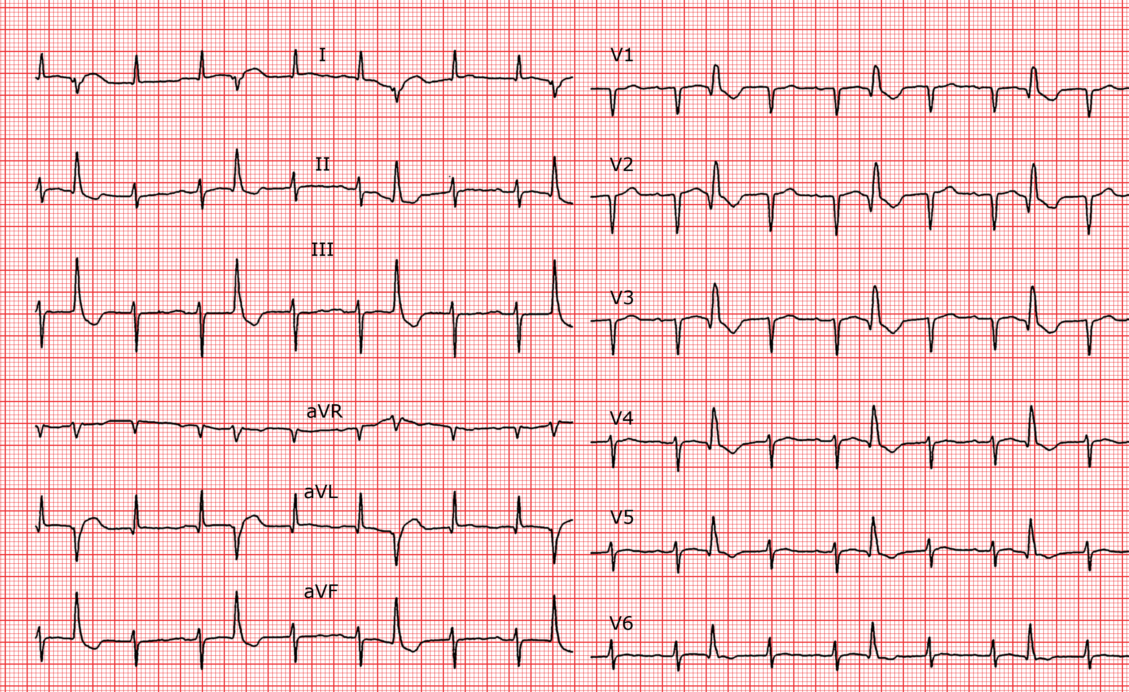

Slide 33
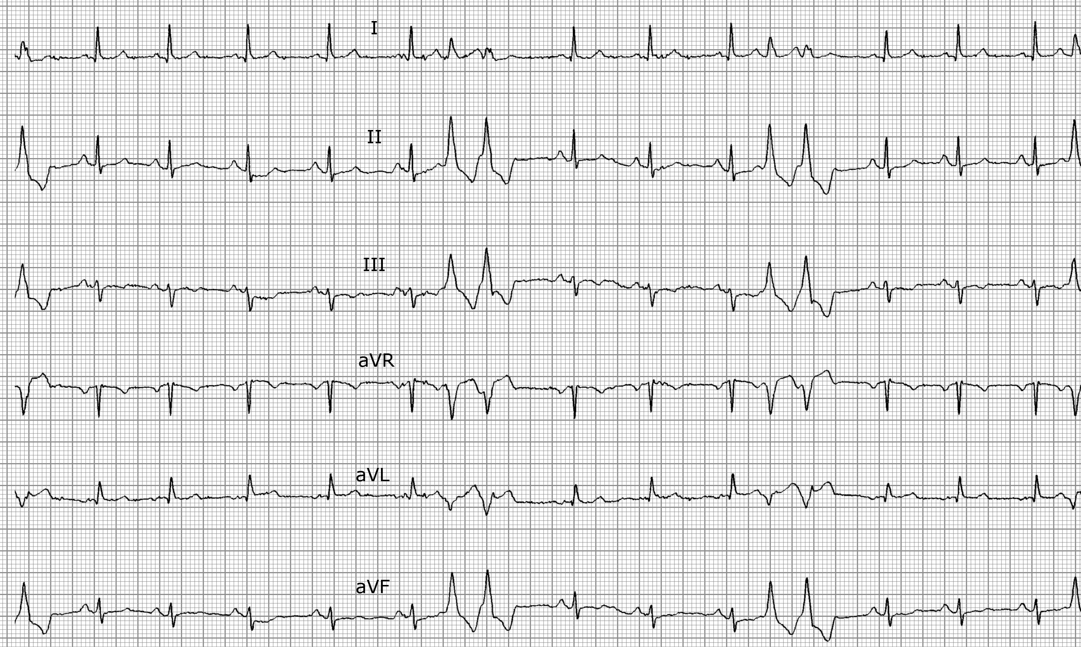
PVC pairs (couplets)

Slide 34

Non-sustained VT (NSVT)
When is a PVC not a PVC?
Definitions vary regarding 3 or more PVCs
Some authors define three PVCs as a triplet of PVCs; whilst others describe this as a ‘short burst of VT’; but more commonly as NSVT
A consensus definition would be: 3-30 consecutive PVCs with a rate >100bpm described as non-sustained VT (ventricular rhythm if rate <100bpm)
ECG PVC Triplets

Slide 35

Focal Atrial Tachycardia (FAT)
Definition
Focal atrial tachycardia (FAT) is a form of supraventricular tachycardia (SVT) originating from a single ectopic focus within the atria but outside of the sinus node
Focal atrial tachycardia (FAT): Consistent, abnormal P wave morphology indicating an ectopic focus

Slide 36
The term FAT is commonly used synonymously with atrial tachycardia, a broader term referring to any form of SVT originating within the atria but outside of the sinus node
FAT, atrial flutter and multifocal atrial tachycardia (MAT) are all forms of atrial tachycardia
Management of the three types varies and thus distinguishing between them is clinically important

Slide 37
Pathophysiology of FAT
Due to a single ectopic focus
The underlying mechanism can involve increased automaticity, triggered activity or reentry
May be paroxysmal or sustained
Multiple causes including:
Digoxin toxicity
Atrial scarring due to ischaemic heart disease
Catecholamine excess
Stimulants including cocaine, caffeine
Alcohol
Congenital abnormalities
Idiopathic
Sustained atrial tachycardia may rarely be seen and can progress to tachycardia-induced cardiomyopathy

Slide 38
ECG Features of Atrial Tachycardia
Atrial rate > 100 bpm
Abnormal P wave morphology and axis (e.g. inverted in inferior leads) due to ectopic origin
Unifocal, identical P waves
Isoelectric baseline (unlike atrial flutter)
Normal QRS morphology (unless pre-existing bundle branch block, accessory pathway, or rate-related aberrant conduction)
AV block may be present — this is generally a physiological response to the rapid atrial rate, except in digoxin toxicity where there is AV nodal suppression due to vagotonic effects of digoxin, resulting in a slow ventricular rate (“PAT with block”).

Slide 39
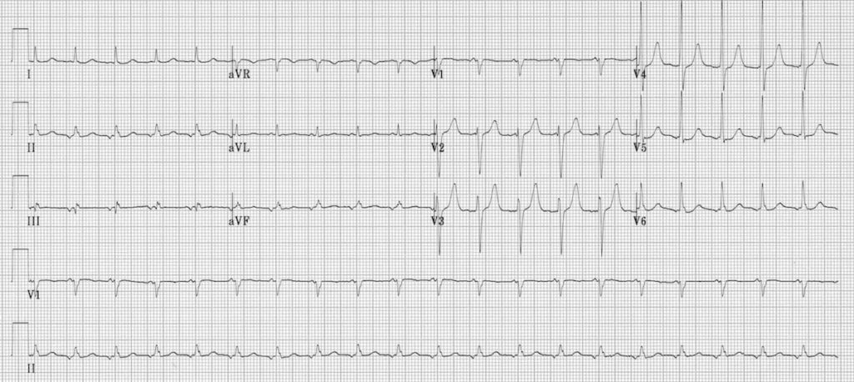
Focal atrial tachycardia:
There is a narrow complex tachycardia at 120 bpm
Each QRS complex is preceded by an abnormal P wave — upright in V1, inverted in the inferior leads II, III and aVF
P wave morphology is consistent throughout

Slide 40
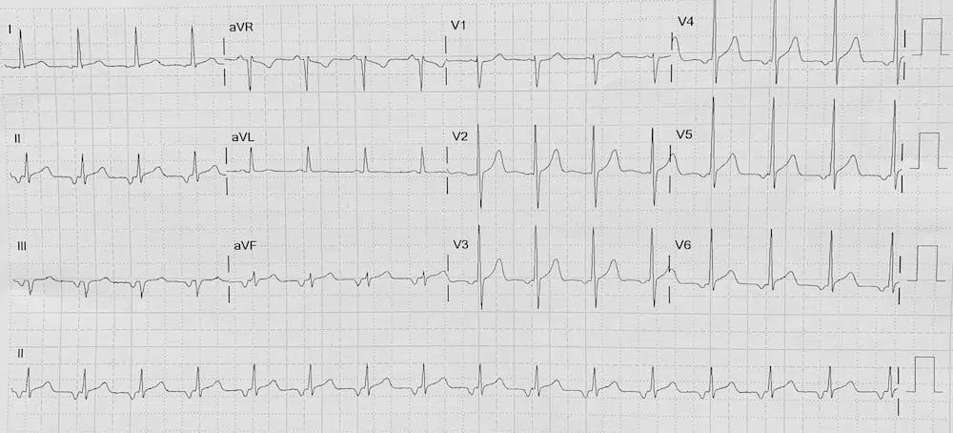
Focal atrial tachycardia:
There is a narrow complex tachycardia at 95 bpm
Each QRS complex is preceded by an abnormal P wave — biphasic in V1; inverted in the inferior leads II, III and aVF; and inverted V3-V6
P wave morphology is consistent throughout

Slide 41

Thank you for your attention

