Slide 1
Odesa National Medical University
Department of Family Medicine and Polyclinic Therapy
Elective course “ECG in General Practice”
Content module 3
Electrocardiography in the diagnosis of diseases of the cardiovascular system and extracardiac pathology

Slide 2
Theme 6
ECG signs in case of inadequate blood supply to the heart

Slide 3

Acute Coronary Syndromes
OVERVIEW
Coronary artery disease accounts for > 30% of death in West and presents acutely as acute coronary syndromes
Acute coronary syndrome (ACS) is a catch all term that refers to ischemic symptoms resulting from acute coronary occlusion
All patients who present with a suspected acute coronary syndrome must be assessed in the ED on an urgent (category 2) basis and have an ECG performed within 10 minutes of first acute clinical contact
A clinician with ECG expertise should review the ECG
A “CODE STEMI” activation system should be in place in any hospital that has an acute percutaneous coronary intervention service

Slide 4
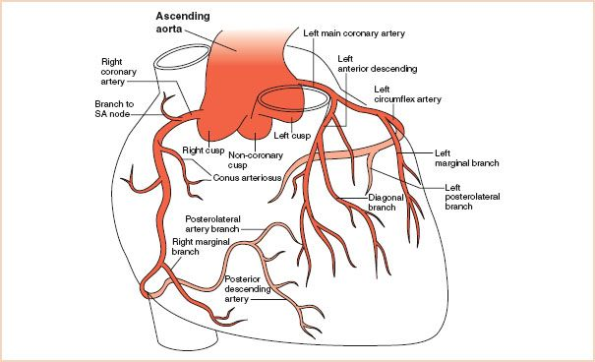

Slide 5
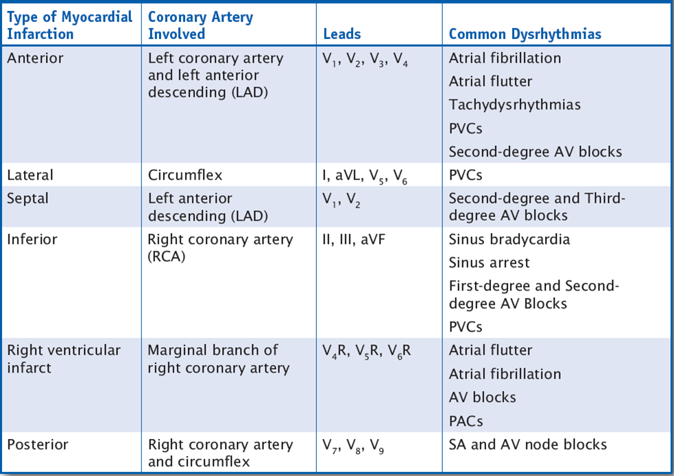

Slide 6
DEFINITIONS
STEMI (S-T Segment Elevation Myocardial Infarction)
presentation with clinical symptoms consistent with an acute coronary syndrome together with S-T segment elevation on ECG
New LBBB may be included in this sub-heading as the treatment approach is similar to STEMI
NSTE-ACS (non S-T Segment elevation acute coronary syndrome)
NSTE-ACS refers to any acute coronary syndrome which does not show S-T segment elevation
The ECG may show S-T segment depression or transient S-T segment elevation, but often will be normal
Non-STEMI (Non S-T Segment Elevation Myocardial Infarction)
By definition this will be shown by an elevation of serum troponin levels in the absence of S-T segment elevation

Slide 7
DEFINITIONS
Unstable Angina
A small but still significant proportion (< 4 %) of patients presenting with possible cardiac chest pain in whom biomarkers and ECGs are normal will have unstable angina due to underlying coronary artery disease
Note that “unstable angina” is measured against a patient’s usual pattern of “stable angina” which is most commonly classified according to the New York Heart Association’s Functional Classification of Angina
New onset angina should be considered unstable in the first instance

Slide 8

ECG
All patients who present with a suspected ACS must have an ECG within 10 minutes of first acute clinical contact
A clinician with ECG expertise should review the ECG
The immediate decision pathway then involves the ECG stratification of STEMI, from NSTEACS

Slide 9
Non-ST-elevation acute coronary syndrome (NSTEACS) encompasses two main entities:
Non-ST-elevation myocardial infarction (NSTEMI).
Unstable angina pectoris (UAP).
The differentiation between these two conditions is usually retrospective, based on the presence/absence of raised cardiac enzymes at 8-12 hours after the onset of chest pain.
Both produce the same spectrum of ECG changes and symptoms and are managed identically in the Emergency Department.

Slide 10
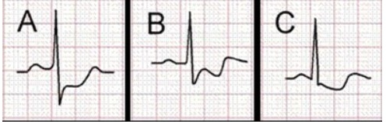
Patterns of Myocardial ischemia
Two main ECG patterns associated with NSTEACS:
ST segment depression
T wave flattening or inversion
While there are numerous conditions that may simulate myocardial ischemia (e.g. left ventricular hypertrophy, digoxin effect), dynamic ST segment and T wave changes (i.e. different from baseline ECG or changing over time) are strongly suggestive of myocardial ischemia.

Slide 11
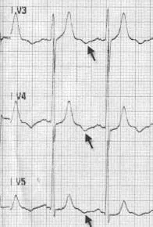
Other ECG patterns of ischemia
Hyperacute (peaked) T waves or pseudonormalization of previously inverted T waves (i.e. becoming upright) suggest hyperacute STEMI.
Another, less well-known ECG feature of myocardial ischemia is U-wave inversion.

Slide 12
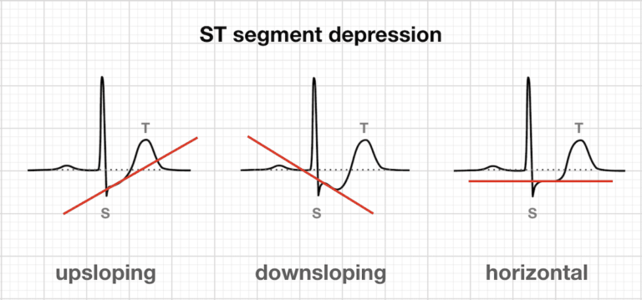
Morphology of ST Depression
ST depression can be either upsloping, downsloping, or horizontal (see diagram below).
Horizontal or downsloping ST depression ≥ 0.5 mm at the J-point in ≥ 2 contiguous leads indicates myocardial ischemia (according to the 2007 Task Force Criteria).
ST depression ≥ 1 mm is more specific and conveys a worse prognosis.
ST depression ≥ 2 mm in ≥ 3 leads is associated with a high probability of NSTEMI and predicts significant mortality (35% mortality at 30 days).
Upsloping ST depression is non-specific for myocardial ischemia.

Slide 13
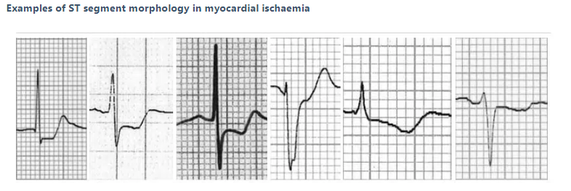

Slide 14
Distribution of ST segment depression
ST depression due to myocardial ischemia may be present in a variable number of leads and with variable morphology:
ST depression due to subendocardial ischemia is usually widespread — typically present in leads I, II, V4-6 and a variable number of additional leads.
A pattern of widespread ST depression plus ST elevation in aVR > 1 mm is suggestive of left main coronary artery occlusion.
ST depression localized to a particular territory (esp. inferior or high lateral leads only) is more likely to represent reciprocal change due to STEMI. The corresponding ST elevation may be subtle and difficult to see, but should be sought.

Slide 15
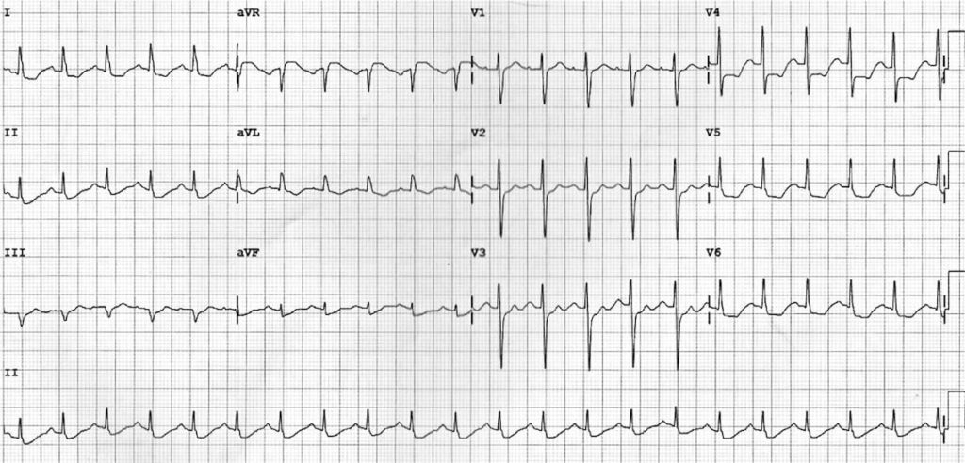
Widespread subendocardial ischemia due to Left main coronary artery (LMCA) occlusion

Slide 16
T wave inversion
T wave inversion may be considered to be evidence of myocardial ischemia if:
At least 1 mm deep
Present in ≥ 2 continuous leads that have dominant R waves (R/S ratio > 1)
Dynamic — not present on old ECG or changing over time
NB. T wave inversion is only significant if seen in leads with upright QRS complexes (dominant R waves). T wave inversion is a normal variant in leads III, aVR and V1.

Slide 17
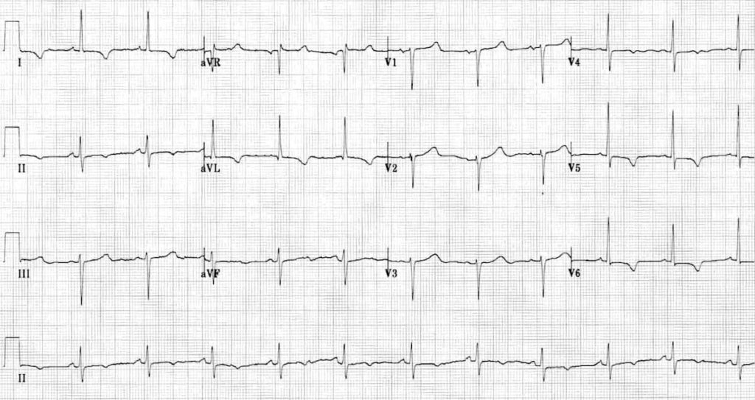
Widespread T wave inversion due to myocardial ischemia (most prominent in the lateral leads)

Slide 18
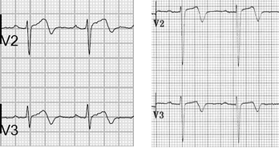
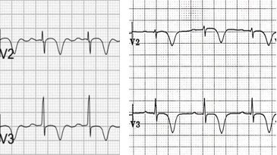
Wellens Syndrome
Wellens syndrome is a pattern of inverted or biphasic T waves in V2-4 (in patients presenting with ischemic chest pain) that is highly specific for critical stenosis of the left anterior descending artery.
Patients may be pain free by the time the ECG is taken and have normally or minimally elevated cardiac enzymes; however, they are at extremely high risk for extensive anterior wall MI within the next 2-3 weeks.
There are two patterns of T-wave abnormality in Wellens syndrome:
Type A – Biphasic, with initial positivity and terminal negativity (25% of cases)
Type B – Deeply and symmetrically inverted (75% of cases)
Type A
Type B

Slide 19
Non-specific ST segment and T wave changes
The following changes may occur with myocardial ischemia but are relatively non-specific:
ST depression < 0.5 mm
T wave inversion < 1 mm
T wave flattening
Upsloping ST depression

Slide 20
Minimal ST changes can be difficult to interpret, especially in those with pre-existing CAD or other significant CVS disease. In such cases:
Comparison with old ECGs will be useful
Smith-Modified Sgarbossa Criteria can help if LBBB or paced:
≥ 1 lead with ≥1 mm of concordant ST elevation
≥ 1 lead of V1-V3 with ≥ 1 mm of concordant ST depression
≥ 1 lead anywhere with ≥ 1 mm STE and proportionally excessive discordant STE, as defined by ≥ 25% of the depth of the preceding S-wave.
In cases of LBBB urgent echocardiography may be useful, if readily available, to detect wall motion abnormalities (suggesting myocardial ischemia) and hence assist in decision making

Slide 21

Findings in ACS
may be normal
Classic changes in acute myocardial infarction
peaked T waves with ST elevation
gradual loss of R wave
development of pathological Q wave and T wave inversion

Slide 22
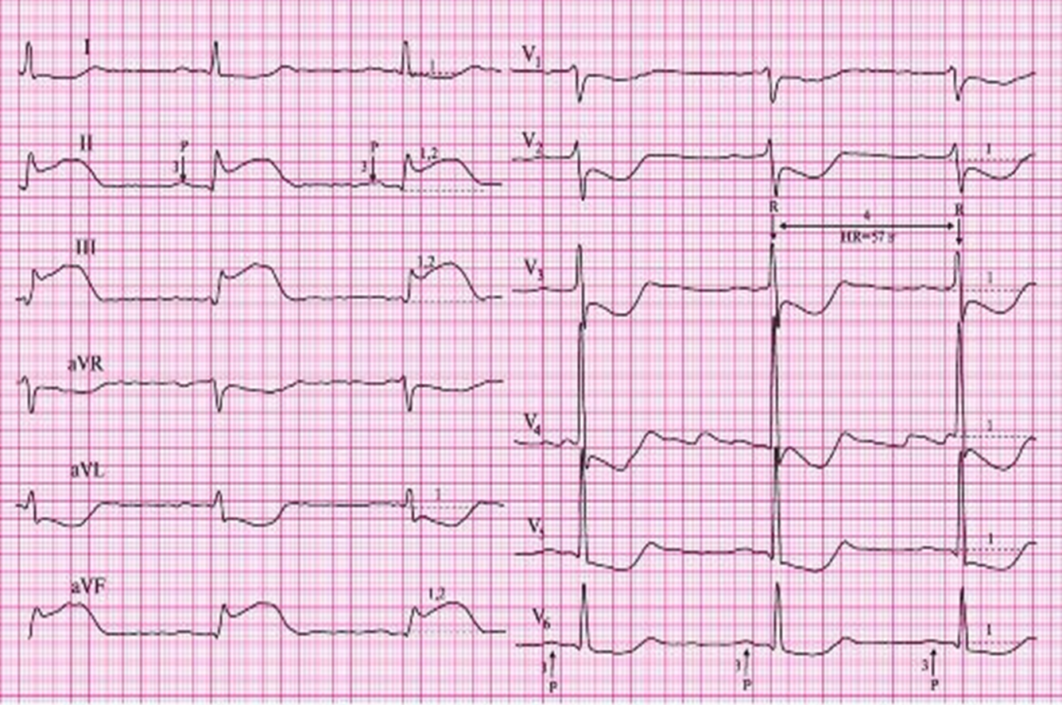
STEMI minimum criteria:
STEMI is defined as presentation with clinical symptoms consistent with ACS (generally of ≥ 20 minutes duration) with persistent (> 20 minutes) ECG features in ≥ 2 contiguous leads of:
≥ 2.5 mm (i.e. ≥ 2.5 small squares) ST elevation in leads V2-3 in men under 40 years, or ≥ 2.0 mm (i.e. ≥ 2 small squares) ST elevation in leads V2-3 in men over 40 years
≥ 1.5 mm ST elevation in V2-3 in women
≥ 1 mm ST elevation in other leads
New LBBB (LBBB should be considered new unless there is evidence otherwise)

Slide 23
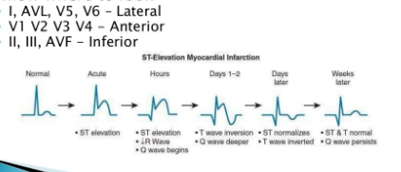

Slide 24
ECG Features of Anterior STEMI
ST segment elevation with subsequent Q wave formation in precordial leads (V1-6) +/- high lateral leads. These changes are often preceded by hyperacute T waves
Reciprocal ST depression in inferior leads (mainly III and aVF)
NB: The magnitude of reciprocal change in inferior leads is determined by the magnitude of ST elevation in I and aVL (as these leads are electrically opposite III and aVF), and hence may be minimal or absent in anterior STEMIs that do not involve high lateral leads.

Slide 25
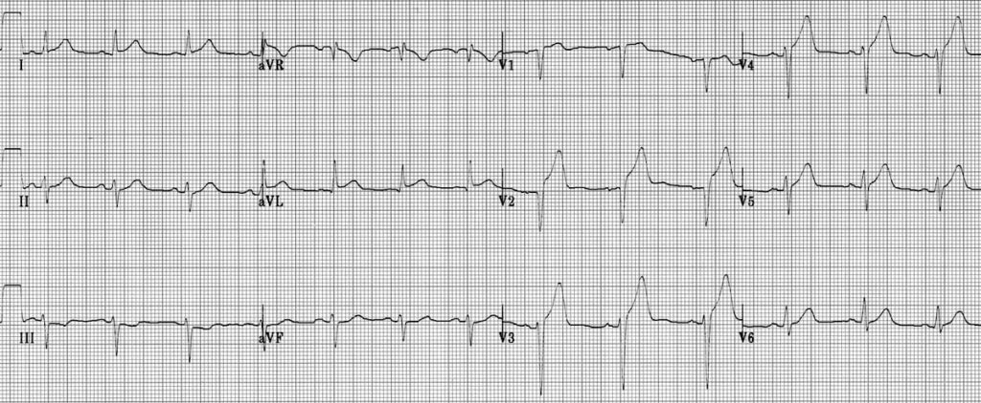
Hyperacute Anteroseptal STEMI:
ST elevation and hyperacute T waves in V2-4
ST elevation in I and aVL with reciprocal ST depression in lead III
Q waves are present in the septal leads V1-2
These features indicate a hyperacute anteroseptal STEMI

Slide 26
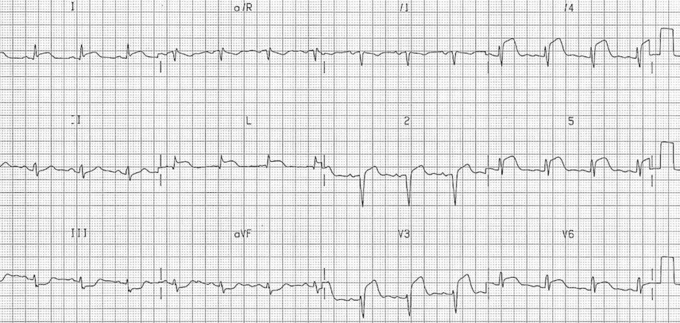
Extensive Anterolateral STEMI (acute):
ST elevation in V2-6, I and aVL.
Reciprocal ST depression in III and AVF.

Slide 27
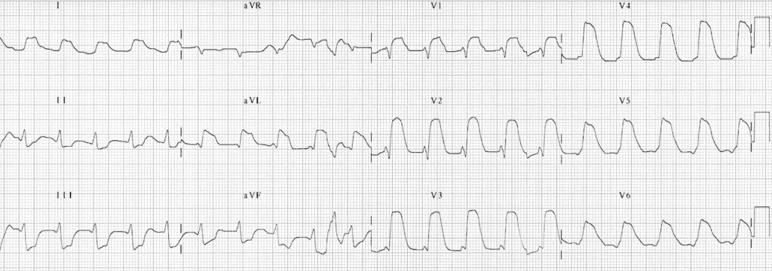
Extensive anterior MI (“tombstoning” pattern)
Massive ST elevation with “tombstone” morphology is present throughout the precordial (V1-6) and high lateral leads (I, aVL)
This pattern is seen in proximal LAD occlusion and indicates a large territory infarction with a poor LV ejection fraction and high likelihood of cardiogenic shock and death

Slide 28
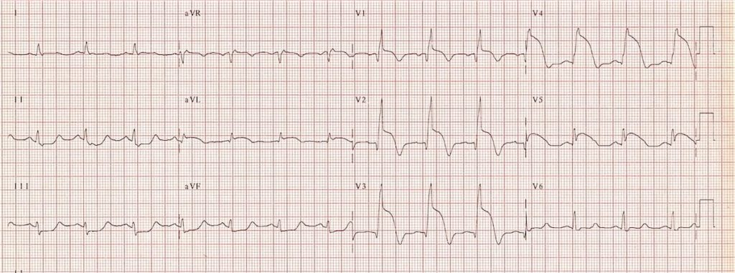
Acute anteroseptal STEMI with STE maximal in V1-4. The following signs of proximal LAD occlusion are present:
RBBB
STE in aVR
STE in aVL
> 1 mm ST depression in the inferior leads

Slide 29
Inferior STEMI
ECG diagnostic criteria
ST elevation in leads II, III, aVF
Hyperacute T waves may precede these changes
Reciprocal ST depression in aVL
Progressive development of Q waves in II, III, aVF
Associated features, all of which confer a worse prognosis, include:
Concomitant right ventricular infarction (40% of patients); these patients may develop severe hypotension in response to nitrates
Significant bradycardia due to second or third-degree AV block (20%)
Posterior infarction due to extension of infarct area

Slide 30
Don’t neglect aVL
aVL is the only lead truly reciprocal to the inferior wall, as it is the only lead facing the superior part of the ventricle. It is thus a sensitive marker for inferior infarction
In patient cohorts with inferior occlusion myocardial infarction (OMI), ST depression in aVL has been shown to be more prevalent than STE in inferior leads
91% of “subtle” inferior STEMIs that do not meet STEMI criteria but show occlusion on PCI demonstrate ST depression in aVL

Slide 31
RCA occlusion is suggested by:
ST elevation in lead III > lead II
Presence of reciprocal ST depression in lead I
Signs of right ventricular infarction: STE in V1 and V4R
Circumflex occlusion is suggested by:
ST elevation in lead II = lead III
Absence of reciprocal ST depression in lead I
Signs of lateral infarction: ST elevation in the lateral leads I and aVL or V5-6

Slide 32
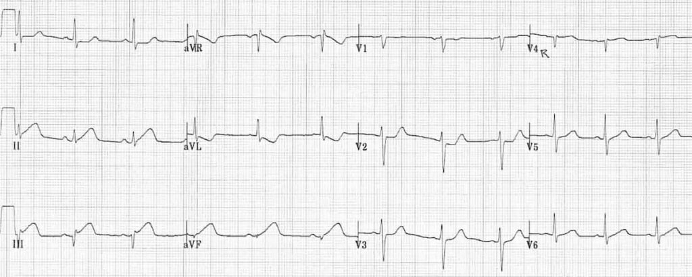
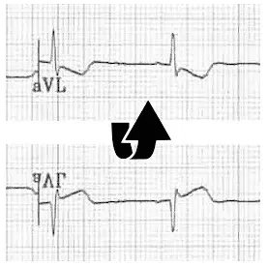
Note how the ST segment morphology in aVL is an exact mirror image of lead III. The concept of reciprocal change can be further highlighted by taking lead aVL and inverting it. Notice how the ST morphology now looks identical to lead III
Early inferior STEMI:
Hyperacute (peaked) T waves in II, III and aVF with relative loss of R wave height
Early ST elevation and Q-wave formation in lead III
Reciprocal ST depression and T wave inversion in aVL
ST elevation in lead III > lead II suggests an RCA occlusion; the subtle ST elevation in V4R would be consistent with this.

Slide 33
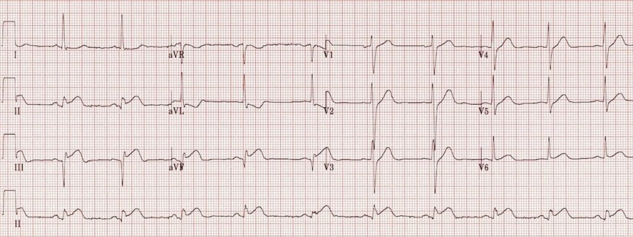
Inferior STEMI:
ST elevation in II, III and aVF.
Q-wave formation in III and aVF.
Reciprocal ST depression and T wave inversion in aVL
ST elevation in lead II = lead III and absent reciprocal change in lead I (isoelectric ST segment) suggests a left circumflex artery occlusion

Slide 34
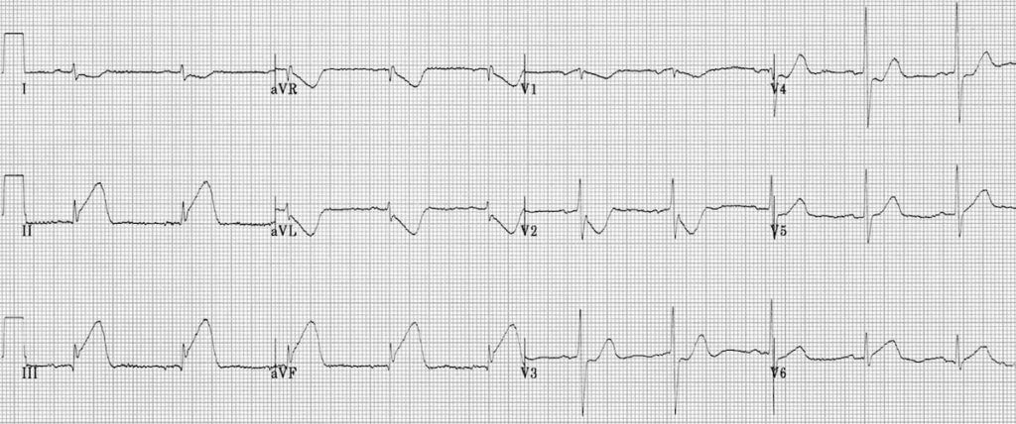
Hyperacute inferior STEMI:
Hyperacute T waves in II, III and aVF.
Early ST elevation and loss of R wave height in II, III and aVF.
Reciprocal change in aVL and lead I.

Slide 35
Lateral STEMI
How to recognize a lateral STEMI
ST elevation in the lateral leads (I, aVL, V5-6).
Reciprocal ST depression in the inferior leads (III and aVF).
ST elevation primarily localized to leads I and aVL is referred to as a high lateral STEMI.
NB. Reciprocal change in the inferior leads is only seen when there is ST elevation in leads I and aVL. This reciprocal change may be obliterated when there is concomitant inferior ST elevation (i.e. an inferolateral STEMI)

Slide 36
Patterns of lateral infarction
Three broad categories of lateral infarction:
Anterolateral STEMI due to LAD occlusion.
Inferior-posterior-lateral STEMI due to LCx occlusion.
Isolated lateral infarction due to occlusion of smaller branch arteries such as the D1, OM or ramus intermedius.

Slide 37
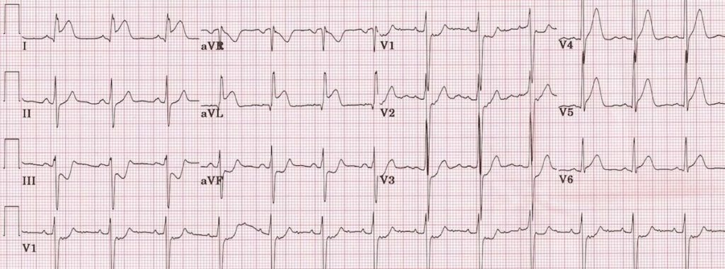
High Lateral STEMI
ST elevation is present in the high lateral leads (I and aVL).
There is also subtle ST elevation with hyperacute T waves in V5-6.
There is reciprocal ST depression in the inferior leads (III and aVF) with associated ST depression in V1-3 (which could represent anterior ischemia or reciprocal change).
This pattern is consistent with an acute infarction localized to the superior portion of the lateral wall of the left ventricle (high lateral STEMI).
The culprit vessel in this case was an occluded first diagonal branch of the LAD.

Slide 38
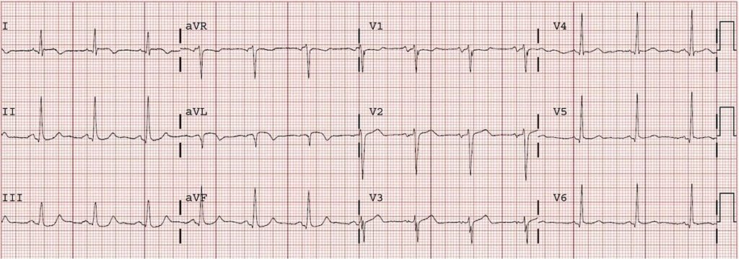
Recent High Lateral MI:
There is subtle ST elevation in the high lateral leads (I and aVL).
There is a pathological Q wave in aVL plus inverted T waves in both I and aVL.
This pattern is diagnostic of a recent (“completed”) high lateral MI.
The patient in this case had a 90% occlusion of his obtuse marginal artery (= a branch of the LCx supplying the lateral wall of the LV).

Slide 39
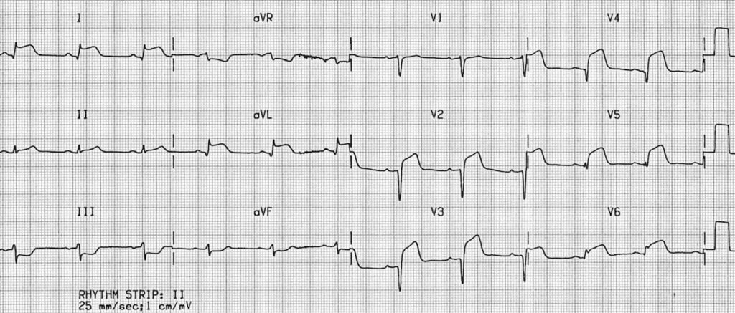
Anterolateral STEMI:
ST elevation is present in the anterior (V2-4) and lateral leads (I, aVL, V5-6).
Q waves are present in both the anterior and lateral leads, most prominently in V2-4.
There is reciprocal ST depression in the inferior leads (III and aVF).
This pattern indicates an extensive infarction involving the anterior and lateral walls of the left ventricle
ST elevation in the precordial leads plus the high lateral leads (I and aVL) is strongly suggestive of an acute proximal LAD occlusion (this combination predicts a proximal LAD lesion 87% of the time).

Slide 40
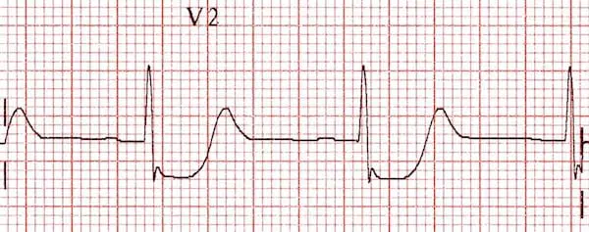
How to spot posterior infarction
As the posterior myocardium is not directly visualized by the standard 12-lead ECG, reciprocal changes of STEMI are sought in the anteroseptal leads V1-3.
Posterior MI is suggested by the following changes in V1-3:
  Horizontal ST depression
  Tall, broad R waves (>30ms)
  Upright T waves
  Dominant R wave (R/S ratio > 1) in V2
In patients presenting with ischemic symptoms, horizontal ST depression in the anteroseptal leads (V1-3) should raise the suspicion of posterior MI.
Posterior infarction is confirmed by the presence of ST elevation and Q waves in the posterior leads (V7-9).
The degree of ST elevation seen in V7-9 is typically modest – note that only 0.5 mm of ST elevation is required to make the diagnosis of posterior MI!

Slide 41
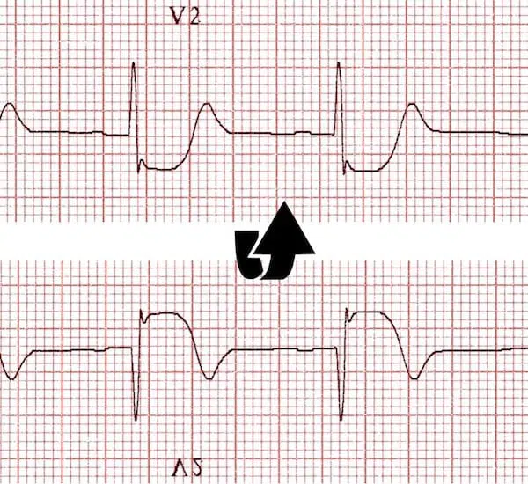
The progressive development of pathological R waves in posterior infarction (the “Q wave equivalent”) mirrors the development of Q waves in anteroseptal STEMI.
This picture illustrates the reciprocal relationship between the ECG changes seen in STEMI and those seen with posterior infarction. The previous image (depicting posterior infarction in V2) has been inverted. See how the ECG now resembles a typical STEMI!

Slide 42
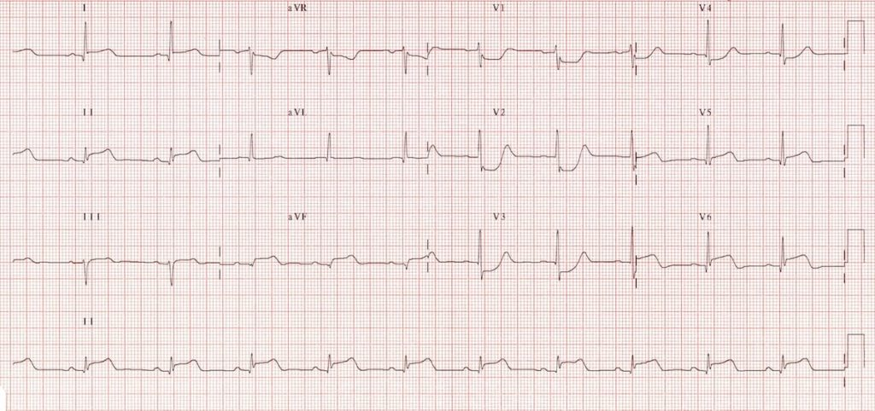
1a
Inferolateral STEMI. Posterior extension is suggested by:
Horizontal ST depression in V1-3
Tall, broad R waves (> 30ms) in V2-3
Dominant R wave (R/S ratio > 1) in V2
Upright T waves in V2-3

Slide 43
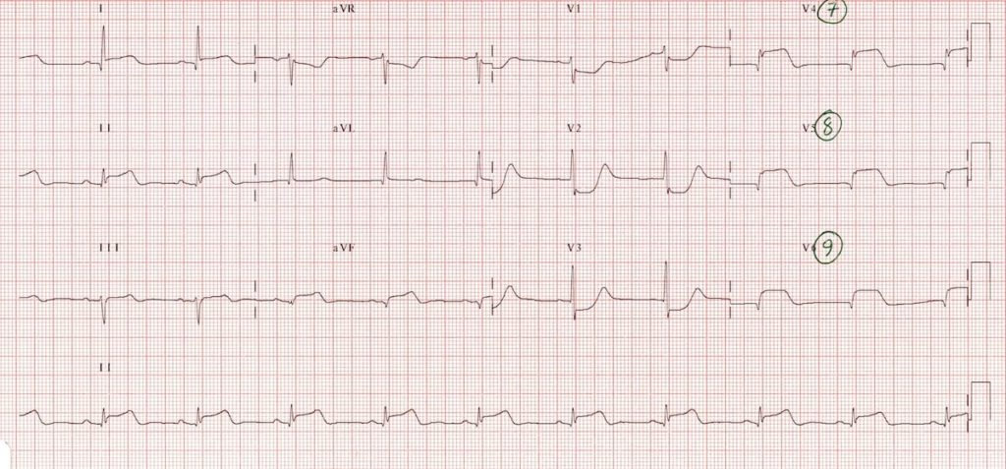
1b
The same patient, with posterior leads recorded: marked ST elevation in V7-9 with Q-wave formation confirms involvement of the posterior wall, making this an inferior-lateral-posterior STEMI (= big territory infarct!).

Slide 44
Right Ventricular Infarction
Diagnostic criteria
In patients with inferior STEMI, right ventricular infarction is suggested by:
ST elevation in V1
ST elevation in V1 and ST depression in V2 (highly specific for RV infarction)
Isoelectric ST segment in V1 with marked ST depression in V2
ST elevation in III > II
Diagnosis is confirmed by the presence of ST elevation in the right-sided leads (V3R-V6R)
NB. ST elevation in the right-sided leads is a transient phenomenon, lasting less than 10 hours in 50% of patients with RV infarction.
V1 is the only standard ECG lead that looks directly at the right ventricle
Lead III is more rightward facing than lead II and hence more sensitive to the injury current produced by the right ventricle

Slide 45
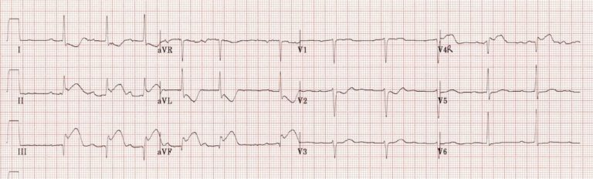
Example of right ventricular infarction in the context of inferior STEMI:
ST elevation in lead III > lead II
Isoelectric ST segment in V1 with marked ST depression in V2
There is ST elevation in V4R.

Slide 46
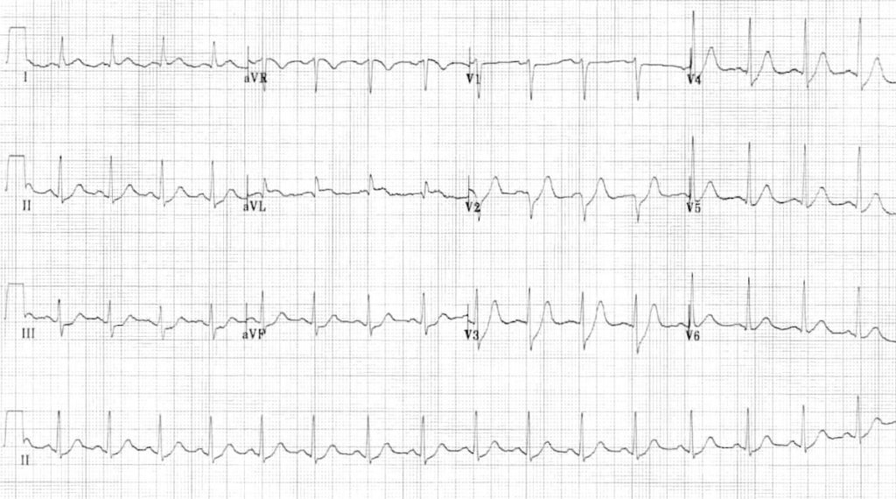
The most obvious abnormality is the horizontal ST depression in III and aVF.
This could be misinterpreted as “inferior ischemia” — however, subendocardial ischemia does not localize.
Regional ST depression should prompt you to scrutinize the ECG for signs of reciprocal ST elevation… In this case there is subtle ST elevation in aVL.
This is a high lateral STEMI!

Slide 47
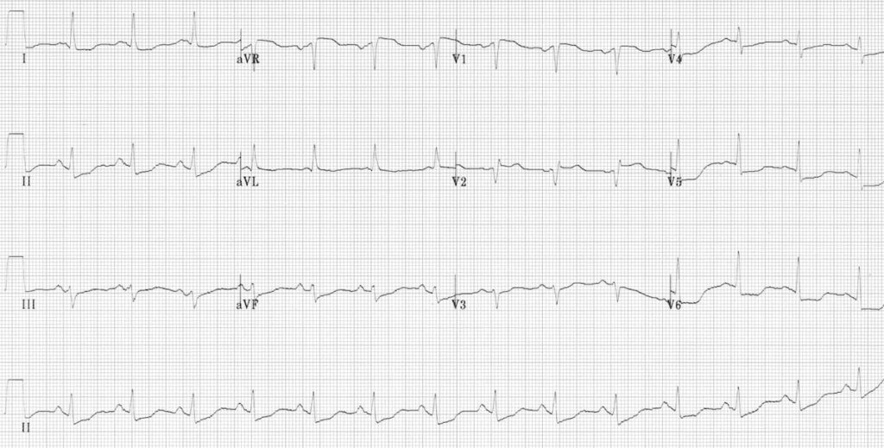
Subendocardial ischemia:
The most striking abnormality is the widespread ST depression, seen in leads I, II and V5-6. This is consistent with widespread subendocardial ischemia.
There is also some subtle ST elevation in V1-2 and aVR with small Q waves in V1-2, suggesting that the cause of the widespread ischemia is a proximal LAD occlusion.

Slide 48
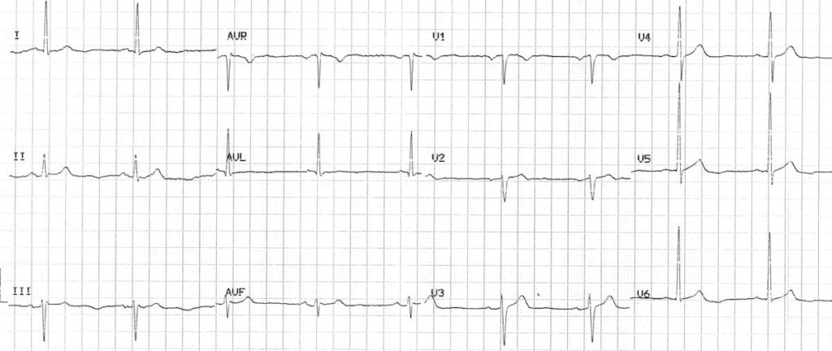
NSTEMI presenting with isolated U wave inversion:
There are inverted U waves, most prominent in leads V5-6.
This is an infrequently recognized but very specific sign of myocardial ischemia — this patient had a 12-hour troponin of 4.0 ng/mL.

Slide 49
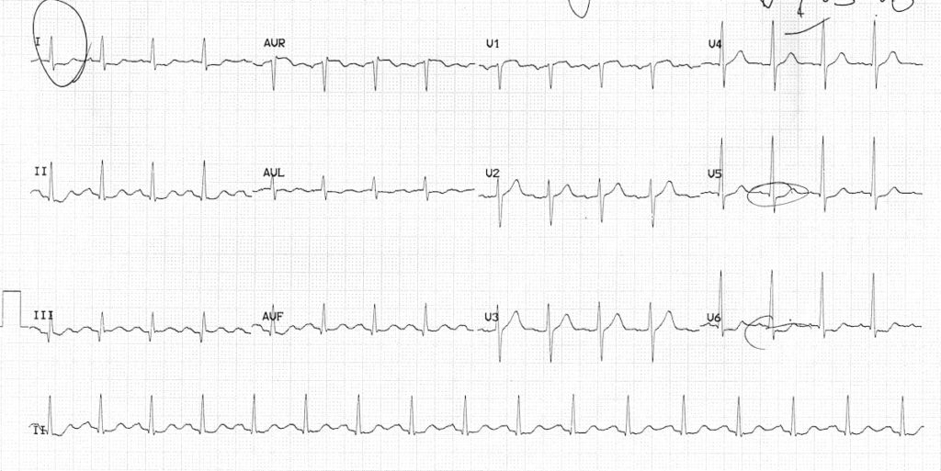
Dynamic ST depression in a patient with chest pain:
Widespread ST depression (leads I, II, V5-6) indicates subendocardial ischemia.
Q wave in lead III with slightly elevated ST segment suggests the possibility of early inferior STEMI.

Slide 50
Other important ECG patterns to be aware of:
Anterior-inferior STEMI due to occlusion of a “wraparound” LAD. This presents with simultaneous ST elevation in the precordial and inferior leads, due to occlusion of a variant (“type III”) LAD that wraps around the cardiac apex to supply both the anterior and inferior walls of the left ventricle
Left main coronary artery stenosis: widespread ST depression with ST elevation in aVR ≥ V1
Wellens syndrome: deep precordial T wave inversions or biphasic T waves in V2-3, indicating critical proximal LAD stenosis (a warning sign of imminent anterior infarction)
De Winter T waves: upsloping ST depression with symmetrically peaked T waves in the precordial leads; a “STEMI equivalent” indicating acute LAD occlusion.

Slide 51

Thank you for your attention!

