Slide 1

Discipline “Biopharmacy ”
Pharmaceutical factors and their impact on therapeutic efficacy of drugs. Influence of adjuvants nature on the process of releasing an active pharmaceutical ingredients from drugs.

Slide 2











PLAN OF THE LECTURE
1 Pharmaceutical factors
2
3
Classification of pharmaceutical factors
Simple chemical modification of drugs
4
Auxiliary substances
5
Type of medicinal form and the way of its administration
6
Technological process

Slide 3







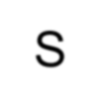







PHARMACEUTICAL FACTORS
Pharmaceutical factors - any factors that has influence on the drug during the manufacturing of the drug and has affect on its therapeutic efficiency
Pharmaceutical factors
Substance
DRUG
Obtaining BAS, adding auxiliary Substances, cycle manufacturing operations, etc.
The influence of pharmaceutical factors should be taken into account at all stages of the drug preparation - from getting the effect of biologically active substances to the packaging of finished products

Slide 4









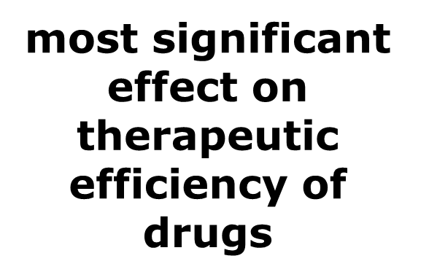

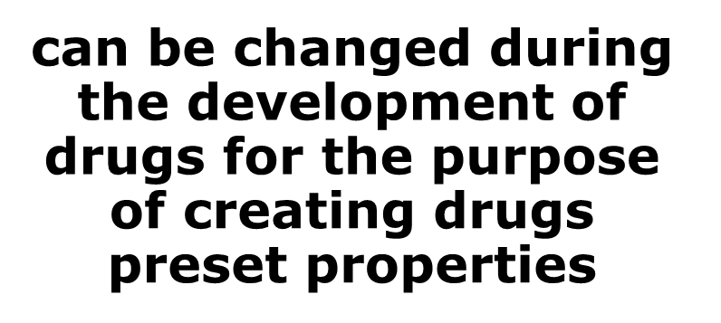





PHARMACEUTICAL FACTORS
Pharmaceutical factors
could cause therapeutic drugs inequivalence
most significant effect on therapeutic efficiency of drugs
can be changed during the development of drugs for the purpose of creating drugs preset properties
Rational choice of pharmaceutical factors in the manufacture drugs can provide maximum therapeutic efficiency of the active ingredient at a minimum possible side effects

Slide 5















CLASSIFICATION OF PHARMACEUTICAL FACTORS
Physical state of drugs
(on the next lecture)
1
2
Simple chemical modification of drugs
Classification of pharmaceutical factors
(their types)
Auxiliary substances (nature, the physical condition
and number)
3
Type of medicinal form
and the way of its administration
4
5
Technological process

Slide 6








SIMPLE CHEMICAL MODIFICATION OF DRUGS
The same active ingredient can be
incorporated into the drug in the form of various chemicals (salt, base, acid,
A simple chemical modification
ester, complex compound, etc.), that
are fully retains responsibility for the
pharmacological effect of the molecule substance (pharmacophore)
novocaine - base and novocaine hydrochloride - salt; codeine - base and codeine phosphate - salt; Caffeine - base and caffeinesodium benzoate - salt;
Phenobarbital - base and phenobarbital sodium - salt; norsulfazol - base and norsulfazol sodium - salt

Slide 7









SIMPLE CHEMICAL MODIFICATION OF DRUGS
 | A simple chemical modification of drugs commonly used in the creation of drugs: uses the chemical modification of the drug, which provides the best therapeutic effect.
 |  | Advantages:
increase the effectiveness of drug therapy reduce the dose of drug increase the stability of many drug substances and their preparations
Using different drug types in pharmacotherapy is done by converting the molecular mass or units of action
codeine phosphate (salt) 1.0
Example:
=
codeine (base) 0.75

Slide 8















AUXILIARY SUBSTANCES
Auxiliary substances -
any component of the drug, with the exception of active substances
Nature
Classification of auxiliary substances
Synthetic
Semisynthetic

Slide 9






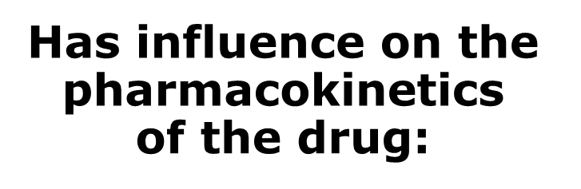









AUXILIARY SUBSTANCES
Auxiliary substances in drug
Provide retrieve certain drug form.
Function as:
Has influence on the pharmacokinetics
of the drug:
Release
Solvents Thickening agents Fillers
Emulsifiers
Stabilizers
Bases for ointments and suppositories Antioxidants Preservatives
Flavoring agents Dyes etc.
Absorption Distribution Metabolism Excretion

Slide 10













AUXILIARY SUBSTANCES
Biopharmaceutical research has shown that auxiliary substances significantly affects on therapeutic efficiency of drugs
Auxiliary substances can:
Increase Reduce Modify
the pharmacological effects of drugs

Slide 11







AUXILIARY SUBSTANCES
Separation of the drug components to active and auxiliary substances greatly arbitrary.
With a certain composition auxiliary substances become active and active become auxiliaries
Filler
in the tablets
Laxative in liquid dosage forms
Mannitol
Urethane Antipyrine Quinine chloride Tocopherol acetate
Active substances
Auxiliary substances using for solubilization, stabilization and
taste masking of drugs

Slide 12


















AUXILIARY SUBSTANCES
The choice of auxiliary substances
should be based primarily biopharmaceutical, and then the
technological, economic and other indicators
Auxiliary substances
should provide for drugs
Obtaining the required drug form suitable
for application, storage,
transport, etc.
Maximum therapeutic effect with minimal side effects

Slide 13



TYPE OF MEDICINAL FORM
AND THE WAY OF ITS ADMINISTRATION
The same drug can be administered to the patient in various dosage forms and in different ways:
per os - in the form of powders, capsules, pills, potions;
external - in the form of ointments;
parenterally - in the form of injection solutions;
sublingual, etc.
It is rational in terms of pharmacotherapy, easy to use and storage form used
for drug delivery to the patient
Dosage form

Slide 14










Liquid
TYPE OF MEDICINAL FORM
AND THE WAY OF ITS ADMINISTRATION
Solid
Dosage forms in technology
Gaseous
Soft

Slide 15


























TYPE OF MEDICINAL FORM
AND THE WAY OF ITS ADMINISTRATION
Establishing a significant impact of drug forms on therapeutic
efficiency and the development of pharmaceutical science contributed to the
emergence in the late XX century, a variety of new drug forms
Inhalation aerosols, foam, film
forming, etc.
Therapeutic Systems
Tablets
Multilayer
Sustained release
Ocular drug film
Retard
Controlled release
Skeletal
Suppositories
multilayer
Sublingual
With targeted delivery
For implantation
Rektiols
For dissolve
Eye drops
tube-feed
Effervescent

Slide 16










TYPE OF MEDICINAL FORM
AND THE WAY OF ITS ADMINISTRATION
The choice of medicinal form at the same time determines the route of administration of the drug in the body
Ways of drug administration
Enteral
Parenteral
Oral
Sublingual
Rectal
Buccal etc.
INJECTION
OTHER
Intravenous
Intra-arterial
Intramuscular
Subdermal, etc.
Inhalation
Transdermal
Instillyatsionny
Intranasal etc.

Slide 17



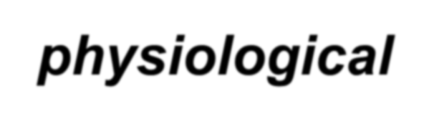









TYPE OF MEDICINAL FORM
AND THE WAY OF ITS ADMINISTRATION
The most common, most physiological and most convenient route of administration way is oral
70-80% of the drugs that are available are intended for oral administration
In general practice the most popular tablets - 50%
In pediatric practice up to 70% are liquid medicines

Slide 18








TYPE OF MEDICINAL FORM
AND THE WAY OF ITS ADMINISTRATION
According to the degree of release and, accordingly, the bioavailability of oral drugs can be arranged in the following series:
Solutions
Emulsion Suspensions Powders Capsules
Tablets
When choosing the type of medicinal form for oral administration consider the physicochemical properties of the drug, bioavailability and wishes of patients
In many cases for oral administration
several different drug forms of the same drug are produced
(tablets, capsules, syrups, granules, etc.)

Slide 19





TYPE OF MEDICINAL FORM
AND THE WAY OF ITS ADMINISTRATION
When introducing drug into the body in different ways and in different formulations the pharmacological action direction is preserved, but the speed of the therapeutic effect, the time and the strength of the therapeutic effect may differ significantly
Dosage form and the
way of its administration into the body must be clearly substantiated in each case:
be comfortable to use, provide maximum therapeutic effect
and minimum possible side effects

Slide 20




TECHNOLOGICAL PROCESS
complex sequence of
technological operations for handling active substances and excipients in the manufacture of the drug
Technological (manufacturing) process
The technological process of medicinal form preparation, consists of several sequential stages of production (granulation, packaging),
each includes a number ofsuccessive technological operations (weighing, grinding, mixing, etc.)

Slide 21




















TECHNOLOGICAL PROCESS
Depending on the physical, chemical, mechanical and other characteristics of the medicinal forms and the properties
of drugs and auxiliary substances in the preparation of
drugs employ different manufacturing operations and equipment
For example:
Preparation of suppositories
Preparation of tablets
grinding AS preparation of the base
AS mixing with the base pouring suppositories packing
grinding mixing granulation
pressing packing
Equipment: Ovens, crushers, mills, screens, reactors, tablet machines, mortars, packaging machinery and other.

Slide 22










TECHNOLOGICAL PROCESS
Conditions of the implementation of any technological operation can affect therapeutic effectiveness of drugs that must be considered in the development of their technology
Changes in conditions or equipment during grinding can cause
to change dispersion drug degree
Biological availability of medicinal substance depends:
Carrying out moist granulation can cause crystallization and formation another polymorph modification of the drug

Slide 23



TECHNOLOGICAL PROCESS
While drugs are produced all technological operations shall be
conducted in full accordance with the approved technology
NB! Changes in the drug, which can occur with non-adherence to process operations, often can not be
established byconventional methods of analysis.
The drug can fully meet current requirements,
but do not provide the necessary therapeutic effect
Strict compliance with the approved modes of technological operations require the GMP principles

Slide 24

TECHNOLOGICAL PROCESS
"The quality of drugs should be predetermined
the principles of GMP"(excerpt from the EU 89/341/EES).
In Ukraine there is guide 42-01-2001 "Drugs.
Good manufacturing practice"
GMP – Good Manufacturing Practice
Good manufacturing practices: a set of rules for the organization of production and quality control

Slide 25


TECHNOLOGICAL PROCESS
GMP includes a detailed description of all the requirements of the conditions of production of drugs, provides accurate performance of these requirements and establishes the order of strict control over production.
In GMP maximum account and clearly defined the factors that affect the drug quality: buildings and facilities, staff, equipment, organization and implementation process, documentation, control of the production process, quality control of finished products, etc.

Slide 26









TECHNOLOGICAL PROCESS
GPP – Good Pharmaceutical Practice
Special attention is required observance of technology in the manufacture of of drugs in pharmacies on individual prescriptions, when an important role is played by the subjective factors
Qualification and specialist knowledge
Selection technological operations and methods
in pharmacy
depends on :
Experience of the person
Analytical mind
Equipment, etc.

Slide 27

PHARMACEUTICAL FACTORS
Physical state of drugs
Simple chemical modification of drugs
Auxiliary substances
Type of medicinal form and the way of its administration
Technological process
Pharmaceutical factors -
it is a tool in the hands of a professional, through which he provides manufacturing
of high quality and effective drug: easy to use, with high therapeutic effectiveness
and minimal side effects

Slide 28

Conclusions:
Factors - forces acting simultaneously, states or other circumstances that affect the final result of the investigated processes, data or parameters.
All pharmaceutical factors, which influence on biological effects of drugs, can be divided on 5 groups:
Physical state of the medicinal substance.
Chemical nature of the medicinal substance
Auxiliary substances.
Type of the medicinal form and the ways of introduction it in the organism.
Technological operations, which take place in getting a drug.
Pharmaceutical factors play an important role in working out the composition and the technology of new drugs and improving already existed.
In practice of pharmacist-technologist the most important factors are: physical state of the medicinal substance, availability of helping compounds and their nature. Consequently, right choices of the technology of drugs, mechanization of technological process's levels are needed. Pharmacist in drug- store chooses neither medicinal substances nor medicinal forms, because determined form of prescription already exists. There a doctor gives instructions about what medicinal substance must be used and what medicinal form must be prepared.

Slide 29
Questions for individual work
Types of chemical bonds that arise between active substances and excipients.
Factors affecting the rate of resorption of
active substances.

Slide 30
THANK YOU FOR YOUR ATTENTION!

