Slide 1
Market economy and its regulation
Discipline Fundamentals of Economics

Slide 2
Definition
A market economy is an economic system in which economic decisions and the pricing of goods and services are guided solely by the aggregate interactions of a country's individual citizens and businesses.
Market economy is defined as a system where the production of goods and services are set according to the changing desires and abilities of the market players. This allows the market to operate freely in accordance with the law of supply and demand, set by individuals and corporations, as opposed to governments.
There is little government intervention or central planning. This is the opposite of a centrally planned economy, in which government decisions drive most aspects of a country's economic activity.

Slide 3
History
The theoretical basis for market economies was developed by classical economists, such as Adam Smith, David Ricardo and Jean-Baptiste Say in the late 19th and early 20th centuries.
These classically liberal free market advocates believed that protectionism and government intervention tended to lead to economic inefficiencies that actually made people worse off.

Slide 4
Characteristics of a Market Economy
Individuals have the right to profit from private ownership of business and property. That is, right to own is not only for the government, as is in a command economy.
Market players are free to produce, sell and purchase as they please, subject to government regulations on illegal products.
The market is motivated by individuals trying to sell their offerings to the highest offeror, while simultaneously attempting to pay the least for goods and services that they need.
Competition is present among producers, which keeps prices fair and ensures efficient production and supply.
Players have equal access to the same information on which to base their decisions.
Government plays a limited role in this economic system but has a regulatory function to ensure fair play and less monopoly.

Slide 6
Advantages of a Market Economy
Increased efficiency in production of goods and services due to business competition
Encourages innovation, which keeps the market evolving
People work harder to maintain their livelihood and prevent losing their jobs
Growing markets attract foreign investors
Wider variety of consumer goods available
Encourages entrepreneurship and new ventures
Decrease state bureaucracy as some public sector activities can be taken over by private entities

Slide 7
Disadvantages of a Market Economy
Inevitable periods of economic crisis due to the usual business cycle ebb and flow
Possible unemployment increase as compared to command economies
Wider economic and social gap
Possible exploitation of labor
Basic necessities may be harder to provide, as they are affected by demand and supply
Profiteering is favored over social welfare

Slide 8
What are the Laws of Supply and Demand?
The laws of supply and demand are microeconomic concepts that state that in efficient markets, the quantity supplied of a good and quantity demanded of that good are equal to each other.
The price of that good is also determined by the point at which supply and demand are equal to each other. Supply and demand are usually expressed in a line graph format, with Quantity (the independent variable) on the y-axis and Price (the dependent variable) on the x-axis.

Slide 9
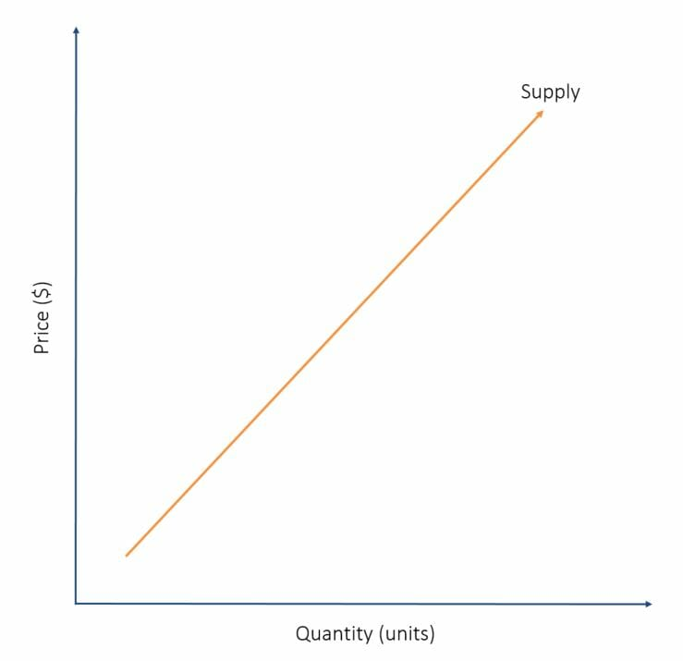
Understanding Supply
As price increases, the supply of that good also increases – as demonstrated by the chart below:
The supply line is seen from a seller’s perspective. The higher the price of a good, the more of that good a seller will want to sell since doing so will be profitable. Conversely, a low price will not attract many sellers to the market, thus the quantity supplied will be lower. Thus, we get a linear relationship.

Slide 10
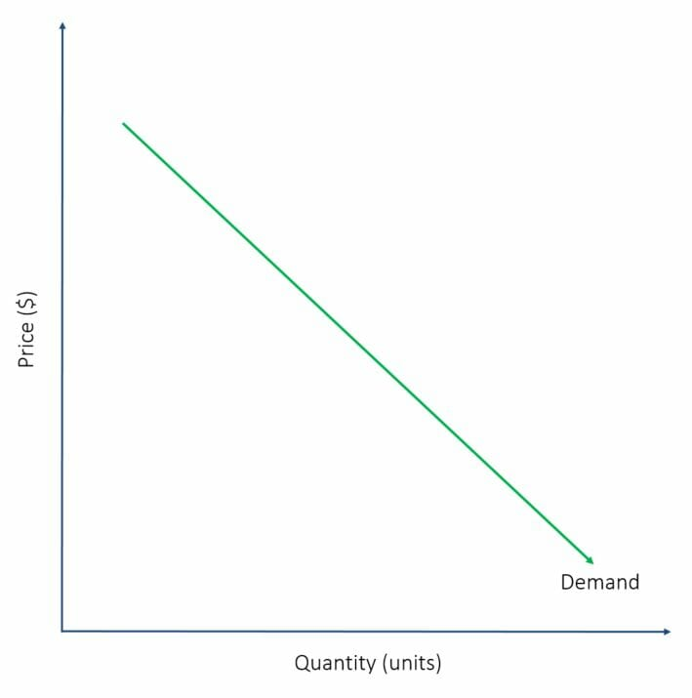
Understanding Demand
Demand works in the opposite way that supply does, and is inversely proportional to price. In other words, as price increases, the demand for that good will decrease – as demonstrated by the chart below:
The demand line is seen from a buyer’s perspective. The higher the price of a good, the lower the number of interested buyers since buyers want to save as much money as possible. Conversely, a low price will attract many buyers to the market, therefore the quantity demanded will be higher. Thus, we see an inverse relationship.

Slide 11
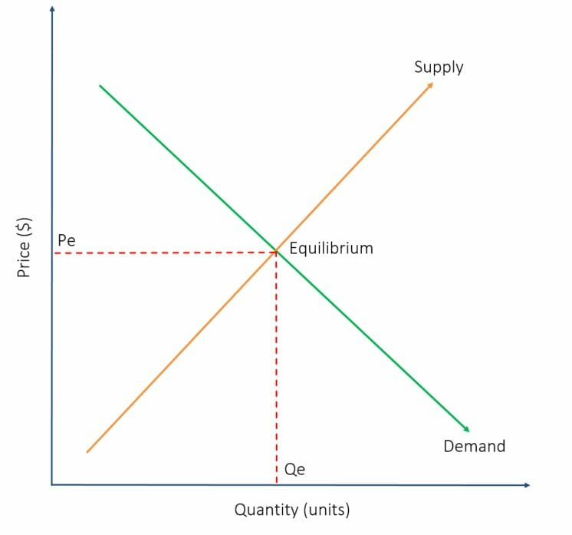
Supply and Demand Graph
By combining the two graphs, we can observe the point of equilibrium, where the supply and demand lines intersect. Tracing lines directly from the equilibrium point to the x- and y-axes will reveal the Price at Equilibrium (Pe) and Quantity at Equilibrium (Qe), respectively.
It is impossible to calculate Pe and Qe in real life since every individual buyer shows a different willingness to payfor goods, and every seller demonstrates a different willingness to accept prices.

Slide 12
a host of other real-life factors that interfere with the supply and demand model
Monopolies. Since buyers are unable to find another place to purchase the good, they are forced to accept whatever price the seller decides to set. This has been the case for goods with inelastic demand (i.e., essential goods) such as oil, medication
Price floors are price minimums put in place by the government to protect vulnerable sellers.
Subsidies can be thought of as an alternative to price floors.
Taxes. Government-imposed taxes are sometimes put in place to boost government revenue.

Slide 13
The five major market system types
Perfect Competition
Perfect competition is a market system characterized by many different buyers and sellers.
In the classic theoretical definition of perfect competition, there are an infinite number of buyers and sellers.
With so many market players, it is impossible for any one participant to alter the prevailing price in the market. If they attempt to do so, buyers and sellers have infinite alternatives to pursue.
Monopoly
A monopoly is the exact opposite form of market system as perfect competition. In a pure monopoly, there is only one producer of a particular good or service, and generally no reasonable substitute.
In such a market system, the monopolist is able to charge whatever price they wish due to the absence of competition, but their overall revenue will be limited by the ability or willingness of customers to pay their price.

Slide 14
The five major market system types
Oligopoly is similar in many ways to a monopoly.
The primary difference is that rather than having only one producer of a good or service, there are a handful of producers, or at least a handful of producers that make up a dominant majority of the production in the market system.
While oligopolists do not have the same pricing power as monopolists, it is possible, without diligent government regulation, that oligopolists will collude with one another to set prices in the same way a monopolist would.
Monopolistic competition is a type of market system combining elements of a monopoly and perfect competition.
Like a perfectly competitive market system, there are numerous competitors in the market. The difference is that each competitor is sufficiently differentiated from the others that some can charge greater prices than a perfectly competitive firm. An example of monopolistic competition is the market for music. While there are many artists, each artist is different and is not perfectly substitutible with another artist.
Monopsony. Whereas a perfectly competitive market theoretically has an infinite number of buyers and sellers, a monopsony has only one buyer for a particular good or service, giving that buyer significant power in determining the price of the products produced.

